Slide 1
Chapter 5 Induction and Recursion
5.1 Mathematical Induction
5.2 Strong Induction and Well-Ordering
5.3 Recursive Definitions and Structural Induction
5.4 Recursive Algorithms

Slide 2
5.1 Mathematical Induction
1. Introduction
Mathematical induction is used to prove propositions of the form ∀nP(n), where the domain of discourse is the set of positive integers.
In this section we will discuss:
How can mathematical induction be used?
Why is mathematical induction valid?

Slide 3
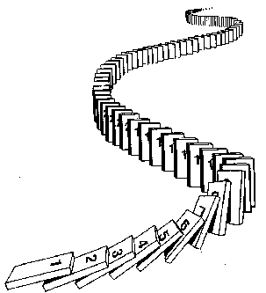
5.1 Mathematical Induction
Prove ∀ n P(n) by mathematical induction:
Basis step： Establish P(1)
Inductive step： Prove that P(k) → P(k+1) for k≥ 1
Conclusion: ∀ n P(n) , where the domain
is the set of positive integers

Slide 4
5.1 Mathematical Induction
2. Mathematical Induction
The (first) principle of Mathematical Induction
(P(1) ∧∀ k(P(k) → P(k+1))) →∀ n P(n)
The principle has the following form.
        P(1)
        ∀ k P(k)→ P(k +1)
        ∴∀nP(n)

Slide 5
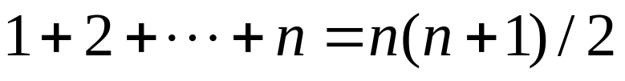
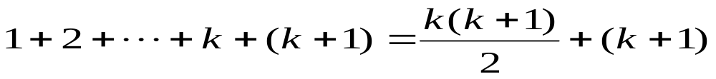
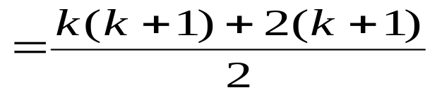
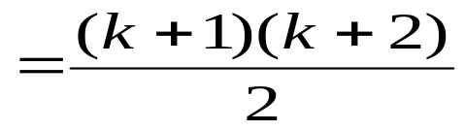
5.1 Mathematical Induction
〖Example 1〗 , where n is a positive integer
Proof:
Let P(n):
Basis step: P(1) is true because 1=1(1+1)/2
Inductive step: Assume P(k) holds for an arbitrary positive
Integer k. That is,
then
Therefore ∀ k P(k) → P(k+1) is true
By mathematical induction, ∀ n P(n) is true for all positive integers n

Slide 6
5.1 Mathematical Induction
〖Example 2〗Use mathematical induction to prove that
n < 2^{n} for all positive integers n.
Proof:
Let P(n): n < 2^{n}.
Basis step: P(1) is true because 1 < 2¹ = 2.
Inductive step: Assume P(k) holds for an arbitrary positive
  Integer k, i.e., k < 2^{k}.
  Since by the inductive hypothesis, k < 2^{k}, it follows that:
  k + 1 < 2^{k} + 1 ≤ 2^{k} + 2^{k} = 2 ∙ 2^{k} = 2^{k+1}
Therefore ∀ k P(k) → P(k+1) is true
By mathematical induction, n < 2^{n} holds for all positive integers n.

Slide 7



〖Example 3〗Tiling Checkerboards. Show that every 2^{n} ×2^{n} checkerboard with one square removed can be tiled using right triominoes.
A right triomino is an L-shaped tile which covers three squares at a time.
Proof:
Let P(n) be the proposition that every 2^{n} ×2^{n} checkerboard with one
square removed can be tiled using right triominoes. Use mathematical
induction to prove that P(n) is true for all positive integers n.
BASIS STEP: P(1) is true, because each of the four 2 ×2
checkerboards with one square removed can be tiled using one
right triomino.
  INDUCTIVE STEP: Assume that P(k) is true for every 2^{k} ×2^{k}
  checkerboard, for some positive integer k.

Slide 8
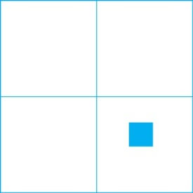
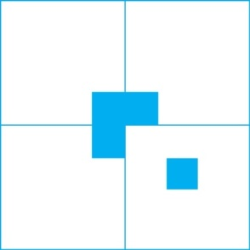
Proof:
Consider a 2^{k+1} ×2^{k+1} checkerboard with one square removed.
Split this checkerboard into four checkerboards of size 2^{k} ×2^{k},
by dividing it in half in both directions.
Remove a square from one of the four 2^{k} ×2^{k} checkerboards.
By the inductive hypothesis, this board can be tiled. Also by the
inductive hypothesis, the other three boards can be tiled with
the square from the corner of the center of the original board removed.
We can then cover the three adjacent squares with a triomino.
Hence, the entire 2^{k+1} ×2^{k+1} checkerboard with one square
removed can be tiled using right triominoes.
.

Slide 9
5.1 Mathematical Induction
The validity of mathematical induction follows from the well-ordering property for the set of positive integers.
A set S is well ordered if every nonempty subset of S has a least element.
For example,
N is well ordered
Z is not well ordered under the ≤ relation (Z has no smallest element).
(0, 1) is not well ordered since (0,1) does not have a least element.

Slide 10
5.1 Mathematical Induction
The well-ordering property
Every nonempty set of nonnegative integers has a
least element.

Slide 11
5.1 Mathematical Induction
P(1)
∀ k(P(k)→ P(k+1))
Why mathematical induction is valid?
∀nP(n)
Proof:
Assume that there is at least one positive integer for which P(n) is false.
S: the set of positive integer for which P(n) is false.
Then S is nonempty.
By the well-ordering property, S has a least element, which will be denoted by m.
Then m≠1, m-1 is a positive integer. m-1 is not in S. So P(m -1) is true.
Since the implication P(m-1)→ P(m ) is also true, P(m) must be true.
By contradiction, ∀nP(n)

Slide 12
5.1 Mathematical Induction
More general form
∀n ≥ b (P(n))
The procedure :
Basis step: Establish P(b)
Inductive step: Prove that P(k) → P(k+1) for k≥ b
Conclusion: The basis step and the inductive step
together imply ∀n ≥ b (P(n)) .

Slide 13
5.1 Mathematical Induction
〖Example 4〗Prove that if a set S has |S| = n, then |P(S)| = 2^{n}
Proof:
Let P(n): If |S| = n, then |P(S)| = 2^{n}
Basis step: P(0) is true because
S=ø, P(S) = {ø} and |P(S)| = 1 = 2⁰
Inductive step: Assume P(k): If |S| = k, then |P(S)| = 2^{k}
Prove that if |T| = k+1, then |P(T)| = 2^{k+1}
T= S U {a} for some S ⊂ T with |S| = k, and a ∈ T.
P(T) = {X | a ∈ X∧X-{a}⊆S } U {X | X ⊆S }
Equivalently, P(T) = {X | a ∈ X∧X-{a}⊆S } U P(S)
|P(T)| = |P(S)| + |P(S)| = 2 |P(S)| =2⋅2^{k} = 2^{k+1}
By mathematical induction, ∀ n P(n) is true for all nonnegative integers n

Slide 14
Homework (Due on March 30)
Sec. 5.1 46， 47， 48

Slide 15
Chapter 5 Induction and Recursion
5.1 Mathematical Induction
5.2 Strong Induction and Well-Ordering
5.3 Recursive Definitions and Structural Induction
5.4 Recursive Algorithms

Slide 16
5.2 Strong Induction and Well-ordering
1. Strong Induction
Strong Induction
(second principle of mathematical induction, complete induction)
(P(n₀)∧∀ k>=n₀(P(n₀)∧P(n₀+1)∧…∧P(k) → P(k+1)))→ ∀n>=n₀ (P(n))
The procedure :
Basis step: Establish P(n₀)
Inductive step: Prove P(n₀)∧P(n₀+1)∧ . . . ∧P(k) → P(k+1)
Conclusion: The basis step and the inductive step allow
one to conclude that ∀n≥n₀ P(n)

Slide 17
5.2 Strong Induction and Well-ordering
〖Example 1〗 Show that if n is an integer greater than 1, then n can be written as a prime or the product of primes.
Solution:
Let P(n) be “n can be written as a prime or the product of two or more primes”
(1) Basis step P(2) is true.
(2) Inductive step
Assume that P(j) is true for all positive integers j with j ≤ k. Show that P(k+1) is true under the assumption.
Proof by cases.
k+1 is prime P(k+1) is true.
k+1 is composite k+1=a×b, with 2≤ a ≤ b< k+1.
By the inductive hypothesis, k+1 is the product of primes, namely, those primes in the factorizations of a and b.
Therefore, ∀nP(n) by strong induction.

Slide 18
5.2 Strong Induction and Well-ordering
〖Example 2〗 Prove that every amount of postage of 12 cents or more can be formed using just 4-cent and 5-cent stamps.
Solution:
Let P(n) be “postage of n cents can be formed using 4-cent and 5-cent stamps.”
(1) Basis step P(12), P(13), P(14), and P(15) hold.
(2) Inductive step
  Assume that P(j) is true for all positive integers j with 12 ≤ j ≤ k, where k ≥ 15. Show that P(k+1) is true under the assumption.
  Using the inductive hypothesis, P(k − 3) holds since k − 3 ≥ 12. To form postage of k + 1 cents, add a 4-cent stamp to the postage for k − 3 cents.
Therefore, ∀n ≥ 12 P(n) by strong induction.

Slide 19
5.2 Strong Induction and Well-ordering
〖Example 2〗 Prove that every amount of postage of 12 cents or more can be formed using just 4-cent and 5-cent stamps.
Solution:
Let P(n) be “postage of n cents can be formed using 4-cent and 5-cent stamps.”
  (1) Basis step: P(12) is true because postage of 12 cents can be formed using three 4-cent stamps.
(2) Inductive step: The inductive hypothesis P(k) for any positive integer k is that postage of k cents can be formed using 4-cent and 5-cent stamps. To show P(k + 1) where k ≥ 12 , we consider two cases:
If at least one 4-cent stamp has been used, then a 4-cent stamp can be replaced with a 5-cent stamp to yield a total of k + 1 cents.
Otherwise, no 4-cent stamp have been used and at least three 5-cent stamps were used. Three 5-cent stamps can be replaced by four 4-cent stamps to yield a total of k + 1 cents.
Therefore, ∀n ≥ 12 P(n) by mathematical induction.

Slide 20
5.2 Strong Induction and Well-ordering
Note:
The validities of both mathematical induction and strong induction follow from the well-ordering property.
In fact, mathematical induction, strong induction, and well-ordering are all equivalent principles.

Slide 21
5.2 Strong Induction and Well-ordering
2. Using Strong Induction in Computational Geometry
Some terms:
  polygon
  side, vertex
  a polygon is simple
  Every simple polygon divides the plane into two regions: its interior, its exterior.
  convex, nonconvex
  diagonal, interior diagonal
  triangulation

Slide 22
5.2 Strong Induction and Well-ordering
2. Using Strong Induction in Computational Geometry
【LEMMA 1】Every simple polygon has an interior
diagonal.

Slide 23
5.2 Strong Induction and Well-ordering
【Theorem 1】The simple polygon with n sides, where
n is an integer with n≥3, can be triangulated into n-2 triangles.
Proof:
Let T(n) be the statement that simple polygon with n sides can be
triangulated into n-2 triangles
(1) Basis step T(3) is true.
(2) Inductive step
Assume that T(j) is true for all integers j with 3≤j ≤k. We must
show T(k+1) is true, that is that every simple polygon with k+1 sides
can be triangulated into k-1 triangles.
Suppose that we have a simple polygon P with k+1 sides.
By Lemma 1, P has an interior diagonal ab. ab splits P into two
simple polygon Q, with s (3≤s ≤k) sides, and R, with t (3≤t ≤k) sides.
(detail omitted.)
By strong induction, every simple polygon with n sides, where n ≥ 3, can be
Triangulated into n-2 triangles.

Slide 24
5.2 Strong Induction and Well-ordering
3. Proofs Using the Well-ordering property
〖Example 3〗 Use the well-ordering property to prove the division algorithm. The division algorithm states that if a is an integer and d is a positive integer, then there are unique integers q and r, with 0≤r<d such that a = dq + r.
Solution:
Let S be the set of nonnegative integers of the form a-dq, where q is an integer. This set is nonempty.
By the well-ordering property, S has a least element r=a-dq₀.
The integer r is nonnegative. It is also the case that r<d. If it were not, then there would be a smaller nonnegative element in S, namely, s=a-d(q₀.+1).
Consequently, there exist integers q and r with 0≤r<d.

Slide 25
5.2 Strong Induction and Well-ordering
〖Example 4〗 In a round-robin tournament every player plays every other player exactly once and each match has a winner and loser. We say that the players p1, p2, …, p_{m} form a cycle if p1 beats p2, p2 beats p3, …, p_{m}-1 beats p_{m}, and p_{m} beats p1. Using the well-ordering principle to show that if there is a cycle of length m (m≥3) among the players in a round-robin tournament, there must be a cycle of three of these player.

Slide 26
5.2 Strong Induction and Well-ordering
Solution:
Assume that there is no cycle of three players. Since there is at least one cycle in the round-robin tournament, the set of all positive integers n for which there is a cycle of length n is nonempty.
By the well-ordering property, this set of positive integers has a least element k, which by assumption must be greater than three. Consequently, there exists a cycle of players p1, p2, p3, …, p_{k} and no shorter cycle exists.
Consider the first three elements of this cycle, p1, p2, p3. There are two possible outcomes of the match between p1 and p3.
Case I: p3 beats p1
Case II: p1 beats p3
Either case forms a contradiction. Therefore there must be a cycle of length three.

Slide 27
Homework (Due on March 30)
Sec. 5.2 8, 18, , 39

Slide 28
Chapter 5 Induction and Recursion
5.1 Mathematical Induction
5.2 Strong Induction and Well-Ordering
5.3 Recursive Definitions and Structural Induction
5.4 Recursive Algorithms

Slide 29
5.3 Recursive Definition and Structural Induction
1. Introduction
Recursion is a principle closely related to mathematical induction.
In a recursive definition, an object is defined in terms of itself.
We can recursively define sequences, functions and sets.

Slide 30
5.3 Recursive Definition and Structural Induction
2. Recursively defined functions
Recursively defined functions, with the set of nonnegative integers as its domain:
    Basis Step: Specify the value of the function at zero.
    Recursive Step: Give a rule for finding its value at an integer from its values at smaller integers.
〖Example 1〗Factorial function
f(n) = n!=1 × 2 ×… ×(n-1) × n
Recursive (inductive) definition:
f(0) = 1
    f(n+1) =(n+1)f(n)

Slide 31
5.3 Recursive Definition and Structural Induction
Recursively defined functions are well-defined.
Why?
  Let P(n) be the statement “f is well-defined at n . ”
  (1) P(0) is true.
  Assume that P(n) is true. Then f is well-defined at n +1, since f(n+1) is given in terms of f(n).
  Therefore, by mathematical induction, P(n) is true for all n.

Slide 32
5.3 Recursive Definition and Structural Induction
Recursively defined functions ( a more general version)
Recursively defined functions, with the set of nonnegative integers as its domain:
    Basis Step: Specify the values of the function at the first k nonnegative integers.
    Recursive Step: Give a rule for finding its value at an integer from its values at some or all of the preceding k integers.

Slide 33
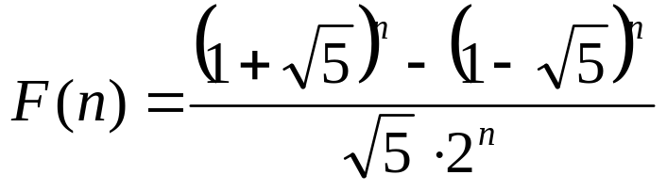
5.3 Recursive Definition and Structural Induction
〖Example 2〗The Fibonacci numbers
{f_{n} } = 0,1,1,2,3,5,8,13,21,34,55,…
The Fibonacci numbers can be defined
f ₀ = 0
        f ₁ = 1
        f _{n} = f _{n-1} + f _{n-2} for n=2,3,4,…
Non-recursive

Slide 34
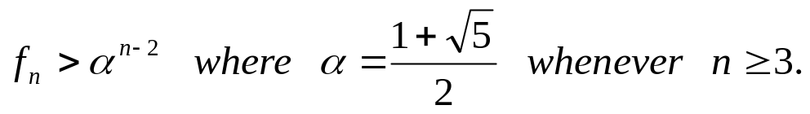
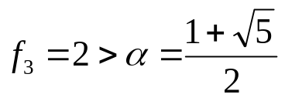
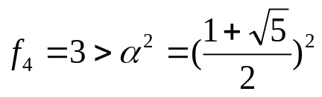








5.3 Recursive Definition and Structural Induction
〖Example 3〗 Show that
Proof:
(1) Basis step
(2) Inductive step
Assume that P(k) is true, namely, that for all integers k with .
We must show that P(n+1) is true, that is .
Since is the solution of , it follows that
Therefore,
By the inductive hypothesis, if , it follows that
Therefore, and P(n+1) is true
This completes the proof.

Slide 35
5.3 Recursive Definition and Structural Induction
3. Recursively defined sets
Sets can be defined recursively.
Basis Step: specifies an initial collection of elements.
Recursive Step: gives rules for forming new elements of the set from those elements already known to be in the set.
Sets described in this way are well-defined.

Slide 36
5.3 Recursive Definition and Structural Induction
〖Example 4〗 Consider the subset of the set of integers defined by
Basis Step: 3 ∈ S
Recursive Step: if x ∈S and y ∈S , then x+y ∈S

Slide 37
5.3 Recursive Definition and Structural Induction
〖Example 5〗 Well-formed formulae for compound propositions.
Solution:
Basis Step: T, F, and s, where s is a propositional variable, are well-formed formulae.
Recursive Step: ( ¬ E), (E ∨ F), (E ∧ F), (E → F), (E ↔ F) are well-formed formulae if E and F are well-formed formulae.

Slide 38
5.3 Recursive Definition and Structural Induction
4. Structural Induction
To prove results about recursively defined sets, we can use
- Mathematical induction
- Structural induction
Basis Step: Show that the result holds for all elements specified in the basis step of the recursive definition to be in the set.
Recursive Step: Show that if the statement is true for each of the elements used to construct new elements in the recursive step of the definition, the result holds for these new elements.

Slide 39
5.3 Recursive Definition and Structural Induction
The validity of structural induction follows from the principle of mathematical induction for the nonnegative integers.
p(n): the result is true for all elements of the set that are generated by n or fewer applications of the rules in the recursive step of a recursive definition.
Basis Step: Show that p(0) is true.
Recursive Step: if we assume p(k) is true, it follows that p(k+1) is true.

Slide 40
5.3 Recursive Definition and Structural Induction
〖Example 7〗Show that every well-formed formula for compound propositions, as defined in Example 5, contains an equal number of left and right parentheses.
Proof:
Basis Step: Show that the result is true for T, F, and s, whenever s is a propositional variable.
Recursive Step: Show that if the result is true for the compound propositions p and q , it is also true for ( ¬ p), (p ∨ q), (p ∧ q), (p→q), (p↔q).
This completes the proof by structural induction.

Slide 41
 | Weak mathematical | Strong Mathematical | Structural
Used for | Usuall formulae | Usual formulae not provable via mathematical induction | Only things defined via recursion
Assumption | Assume P(k) | Assume P(1), P(2), …, P(k) | Assume statement is true for some "old" elements
What to prove | True for P(k+1) | True for P(k+1) | Statement is true for some "new" elements created with "old" elements
Step 1 called | Base case | Base case | Basis step
Step 2 called | Inductive step | Inductive step | Recursive step

Slide 42
Homework: (Due on April 6)
Sec. 5.3 6(a,d), 14, 29(a)

Slide 43
Chapter 5 Induction and Recursion
5.1 Mathematical Induction
5.2 Strong Induction and Well-ordering
5.3 Recursive Definition and Structural Induction
5.4 Recursive Algorithms

Slide 44
4.4 Recursive Algorithms
An algorithm is called recursive if it solves a problem by reducing it to an instance of the same problem with smaller input.

Slide 45
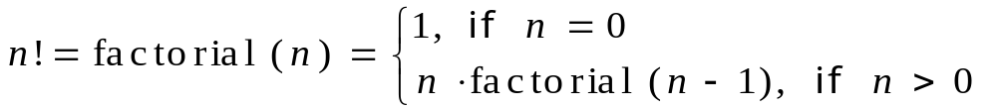
4.4 Recursive Algorithms
〖Example 1〗 Give a recursive algorithm for computing the factorial function n! .
Algorithm 1 A Recursive Procedure for Factorials.
procedure factorial(n: positive integer)
{
  if n=0 then
  factorial(n):=1
  else
  factorial(n) := n×factorial(n-1)
}

Slide 46
4.4 Recursive Algorithms
〖Example 2〗 Express the linear search algorithm as a recursive procedure.
Algorithm 3 A Recursive Linear Search Algorithm).
procedure search(i, j, x: i, j, x integers, 1≤ i, j ≤ n)
{
  if a_{i}=x then
  location:=i
  else if i=j then
  location:=0
  else
  search(i+1, j, x)
}

Slide 47
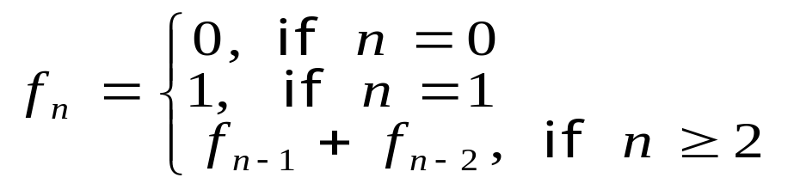
4.4 Recursive Algorithms
〖Example 3〗 Give a recursive algorithm for Fibonacci Numbers
Algorithm 4 A Recursive Procedure for Fibonacci Numbers.
procedure fibonacci(n: nonnegative integer)
{
if n = 0 then fibonacci(0) :=0
else if n = 1 then fibonacci(1) :=1
else fibonacci(n) := fibonacci(n-1) + fibonacci(n-2)
}

Slide 48
4.4 Recursive Algorithms
Algorithm 5 An Iterative Procedure for Computing Fibonacci Numbers.
procedure iterative fibonacci(n: nonnegative integer)
if n = 0 then y:= 0
else
begin
x:=0
y:=1
for i:=1 to n-1
begin
z:=x+y
x:=y
y:=z
end
end
{y is the nth Fibonacci number}

Slide 49
4.3 Recursive Definition and Structural Induction
Recursive algorithm vs. iterative algorithm
For every recursive algorithm, there is an equivalent iterative algorithm.
Recursive algorithms are often shorter, more elegant, and easier to understand than their iterative counterparts.
However, iterative algorithms are usually more efficient in their use of space and time.

Slide 50
Homework: (Due on April 6)
Sec. 5.4 29

