Slide 1
Chapter 6 Counting
6.1 The Basic of Counting
6.2 The Pigeonhole Principle
6.3 Permutations and Combinations
6.4 Binomial Coefficients
6.5 Generalized Permutations and Combinations
6.6 Generating Permutations and Combinations

Slide 2
6.3 Permutations and Combinations
1. Permutations
【Definition】A permutation of a set of distinct objects is an ordered arrangement of these objects.
An r-permutation is an ordered arrangement of r elements of a set.
Notation: P(n, r)
For example,
In how many ways can we select three students from a group of five students to stand in line for a picture?
P（5，3）

Slide 3
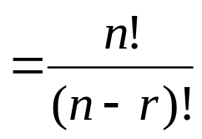
5.3 Permutations and Combinations
【Theorem 1】 The number of r-permutations of a set with
n distinct elements is
P(n, r)=n(n-1)(n-2)…(n-r+1)
Proof: Using the product rule.
In particular， P(n, n) = n!
P(n, 0) = 1

Slide 4




5.3 Permutations and Combinations
Phrased in terms of functions:
f: B→A
1) f is an injection from B to A ⇔ an r-permutation of the set A
2) the number of injections from B to A ⇔ P(n, r)
Why?
We order the elements of B
There are n ways to choose the image of ,
n - 1 ways to choose the image of ,
and so forth.

Slide 5
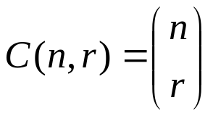
5.3 Permutations and Combinations
2. Combinations
【Definition】An r-combination of elements of a set is an unordered selection of r elements from the set.
Note: An r-combination is simply a subset of the set with r elements.
Notation:
Binomial coefficient

Slide 6
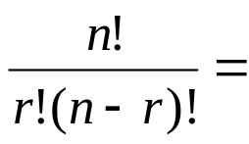
5.3 Permutations and Combinations
【 Theorem 2】 The number of r-combination of a set with
n elements, where n is a positive integer and r is an integer
with 0≤r≤n, equals
n(n-1)(n-2)…(n-r+1)/r!

Slide 7
5.3 Permutations and Combinations
Phrased in terms of functions:
, B={0，1}，f: A→B
f is the function from A to B such that the image of r elements in A is 1 ⇔ An r-combination of A.
C(n, r) = | { f | f: A→B ∧ r=|{a | a ∈A ∧f(a)=1}|}|

Slide 8
5.3 Permutations and Combinations
〖Example 1〗 A soccer club has 8 female and 7 male members. For today’s match, how many possible configurations are there?
The coach wants to have 6 female and 5 male players on the grass.
The coach wants to have 11 players with at most 5 male players on the grass.
Solution:
C(8, 6) • C(7, 5)
= 8!/(6!⋅2!) • 7!/(5!⋅2!)
= 28 • 21
= 588
(2) C(8，6)C(7，5)+C(8，7)C(7，4)+C(8，8) C(7，3)

Slide 9
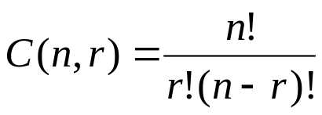
5.3 Permutations and Combinations
【 Corollary 1 】 combination corollary
Let n and r be nonnegative integers with r ≤ n. Then
C（n，r）= C（n，n-r）
Proof:
(1) Using theorem 2
(2) Using combinatorial proof

Slide 10
3. Combinatorial Proofs
【Definition】 A combinatorial proof of an identity is a proof that uses one of the following methods.
A double counting proof uses counting arguments to prove that both sides of an identity count the same objects, but in different ways.
A bijective proof shows that there is a bijection between the sets of objects counted by the two sides of the identity.

Slide 11

【 Corollary 1 】 combination corollary
Let n and r be nonnegative integers with r ≤ n. Then
C（n，r）= C（n，n-r）
  Bijective Proof: Suppose that S is a set with n elements. The function that maps a subset A of S to is a bijection between the subsets of S with r elements and the subsets with n − r elements. Since there is a bijection between the two sets, they must have the same number of elements.
  Double Counting Proof: By definition the number of subsets of S with r elements is C(n, r). Each subset A of S can also be described by specifying which elements are not in A, i.e., those which are in . Since the complement of a subset of S with r elements has n − r elements, there are also C(n, n − r) subsets of S with r elements.

Slide 12
Homework: (Due on April 6)
Sec 6.3: 20, 42, 44

Slide 13
Chapter 6 Counting
6.1 The Basic of Counting
6.2 The Pigeonhole Principle
6.3 Permutations and Combinations
6.4 Binomial Coefficients
6.5 Generalized Permutations and Combinations
6.6 Generating Permutations and Combinations

Slide 14
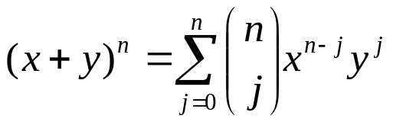

5.4 Binomial Coefficients
【 Theorem 1 】 The Binomial Theorem
Let x and y be varaibles, and let n be a nonnegative
integer. Then
Proof:
To count the number of terms of the form x^{n-j}y^{j}, note that to obtain such a term it is necessary to choose j ys from the n sums. Therefore the coefficient of x^{n-j}y^{j} is

Slide 15
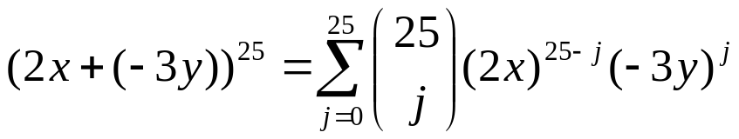
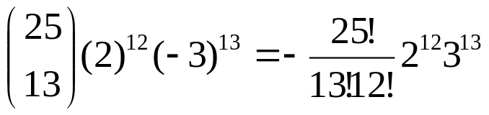
5.4 Binomial Coefficients
〖Example 1〗 What is the coefficient of x¹²y¹³ in the expansion of (2x-3y)²⁵?
Solution:

Slide 16
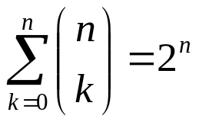
5.4 Binomial Coefficients
【 Corollary 1 】Let n be a nonnegative integer. Then
Proof:
Using the Binomial Theorem with x=1 and y=1.
Using combinatorial proof

Slide 17
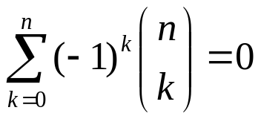
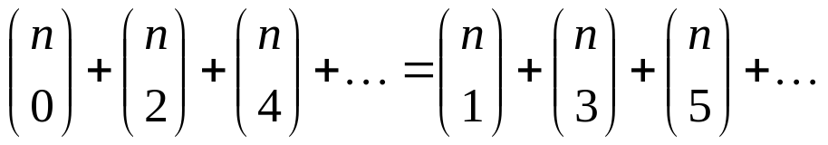
5.4 Binomial Coefficients
【 Corollary 2 】Let n be a positive integer. Then
Proof:
Using the Binomial Theorem with x = 1 and y = -1.
Remark:

Slide 18
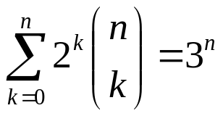
5.4 Binomial Coefficients
【 Corollary 3 】Let n be a nonnegative integer. Then
Proof:
Using the Binomial Theorem with x=1 and y=2.

Slide 19
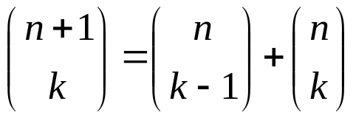

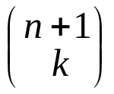

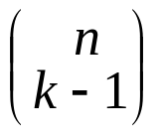
5.4 Binomial Coefficients
【 Theorem 2 】 PASCAL’S Identity
Let n and k be positive integers with k ≤ n. Then
Proof:
the number of subsets of size k from set A.
The total will include
the number of subsets of size k that do not contain the element x
plus
the number of subsets of size k containing element x

Slide 20
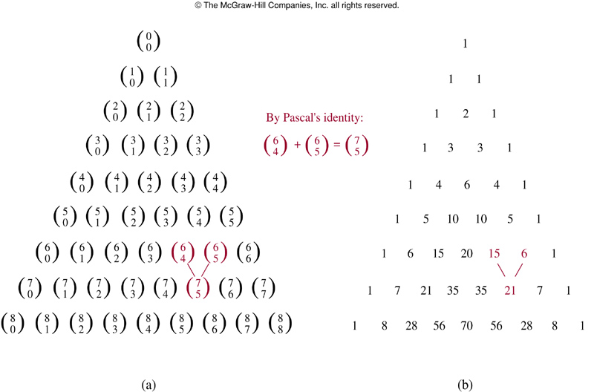
5.4 Binomial Coefficients
It produces Pascal's triangle
C(0, 0)
        C(1, 0) C(1, 1)
C(2, 0) C(2, 1) C(2, 2)
C(3, 0) C(3, 1) C(3, 2) C(3, 3)
……

Slide 21
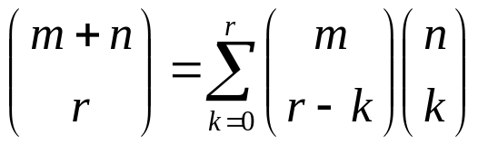
5.4 Binomial Coefficients
【 Theorem 3 】 Vandermonde’s Identity
Let m, n and r be nonnegative integer with r not exceeding
either m or n. Then
Proof:
A and B are two disjoint sets. |A|=m , |B|=n,
C(m + n，r) ---- the number of ways to pick r elements from A∪ B
Another way to pick r element from A∪B is to pick r-k elements from A and then k elements from B, where 0≤ k≤ r, which can be done in C(m，r-k) C(n，r)

Slide 22
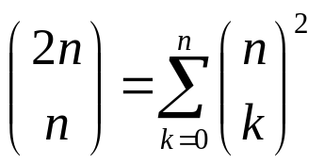
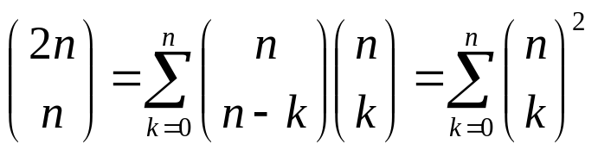
5.4 Binomial Coefficients
【 Corollary 4 】If n is a nonnegative integer. Then
Proof:
We use Vandermonde’s Identity with m = r = n to obtain

Slide 23
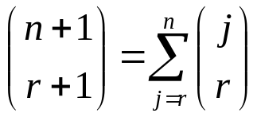
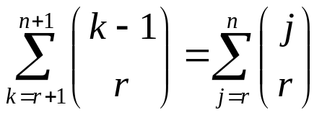
5.4 Binomial Coefficients
【 Theorem 4 】Let n and r be nonnegative integer with r≤n.
Then
Proof:
The left-hand side counts the bit strings of length n+1 containing r+1 1s.
We show that the right-hand side counts the same objects by considering the cases corresponding to the possible locations of the final 1 in a string with r+1 ones.

Slide 24
Homework: (Due on April 6)
Sec.6.4: 14, 22, 26, 30

