Slide 1
Chapter 9 Relations
9.1 Relations and Their Properties
9.2 n-ary Relations and Their Applications
9.3 Representing Relations
9.4 Closures of Relations
9.5 Equivalence Relations
9.6 Partial Orderings

Slide 2




【Definition】A binary relation R from a set A to a set B is a subset of A×B.
  Note:
  A binary relation R is a set.
  R ⊆ A×B
〖Example 1〗
(1)
(2) Let R be the set of integer numbers,

Slide 3



1. Functions As Relations
The graph of function f from set A to set B is a relation from A to B.
〖Example 2〗
Suppose that .
f: A→B, f(1)=f(3)=1,f(2)=f(4)=0
Conversely, if R is a relation from A to B, is it the graph of a function?
〖Example 3〗

Slide 4
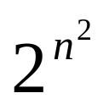
2. Relations on a Set
【Definition】A relation on the set A is a relation from A to A.
  Note:
  R ⊆ A×A
〖Example 4〗
Let
Question:
How many binary relations are there on a set A with n elements?

Slide 5
3. Representing Relations
The methods of representing a relation:
    list its all ordered pairs
    using a set build notation/specification by predicates
    2D table
    Connection matrix /zero-one matrix
    Directed graph/Digraph

Slide 6

〖Example 5〗
 | 2 | 3 | 4 | 5 | 6
2 | × |  | × |  | ×
3 |  | × |  |  | ×
4 |  |  | ×

Slide 7


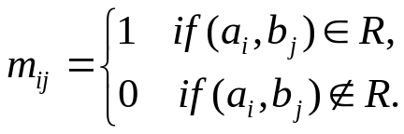
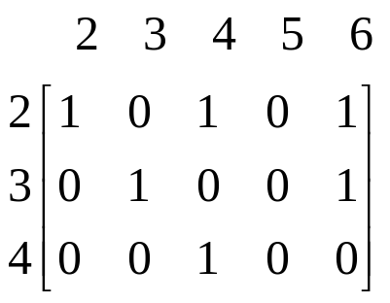
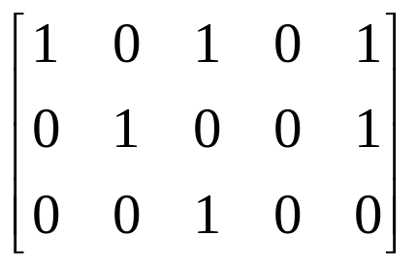
4. Connection Matrices
【Definition】Let R be a relation from
An connection matrix for R is defined by
For example,

Slide 8
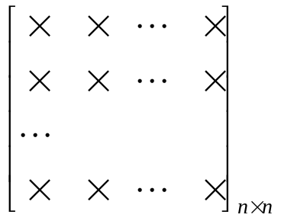
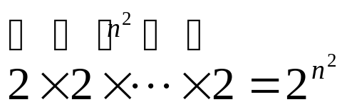
Question:
How many binary relations are there on a set A with n elements?
0,1
By the product rule,

Slide 9
5. Directed graph/Digraph
【Definition】A directed graph or a digraph, consists of a set V of vertices together with a set E of ordered pairs of elements of V called edges(or arcs).
The vertices a,b is called the initial and terminal vertices of the edge (a,b), respectively.
For example,
2
2
3
4
3
5
4
6

Slide 10
〖Example 6〗A = {0, 1, 2,3}
0
1
3
2
R = {(0,0), (0,3), (2,0),(2,1),(2,3),(3,2)}.

Slide 11
6. Special Properties of Binary Relations
    Reflexive
    Irreflexive
    Symmetric
    Antisymmetric
    Transitive

Slide 12
6. Special Properties of Binary Relations
    Reflexive
    Irreflexive
    Symmetric
    Antisymmetric
    Transitive

Slide 13

【Definition】A relation R on a set A is reflexive if

Slide 14

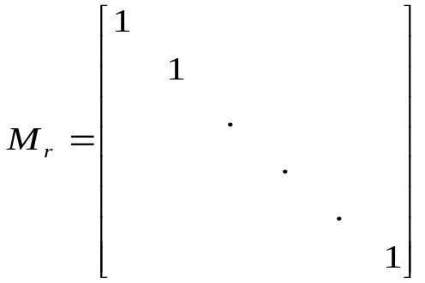
  Questions:
  (1) What do we know about matrices representing reflexive relations?
All the elements on the main diagonal of must
be 1s.
  (2) What do we know about digraphs representing reflexive relations?
  There is a loop at every vertex of the directed graph.

Slide 15
6. Special Properties of Binary Relations
    Reflexive
    Irreflexive
    Symmetric
    Antisymmetric
    Transitive

Slide 16

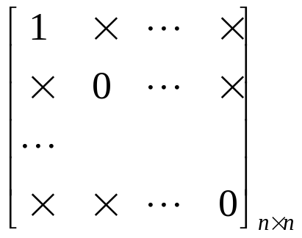
【Definition】A relation R on a set A is irreflexive if
  Questions:
  The connection matrix of an irreflexive relations?
  Digraph?
  Can a relation on a set be neither reflexive nor irreflexive?
  Yes.

Slide 17
6. Special Properties of Binary Relations
    Reflexive
    Irreflexive
    Symmetric
    Antisymmetric
    Transitive

Slide 18

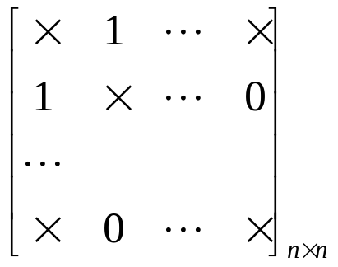
【Definition】A relation R on a set A is symmetric if
  Questions:
  The connection matrix of a symmetric relations?
  Digraph?
  If there is an arc (x, y) there must be an arc (y, x).

Slide 19
6. Special Properties of Binary Relations
    Reflexive
    Irreflexive
    Symmetric
    Antisymmetric
    Transitive

Slide 20
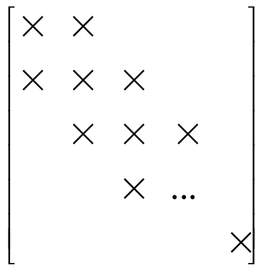
【Definition】A relation R on a set A is antisymmetric if
  Note:
  (1)
  (2)
1
0
0
0,1

Slide 21
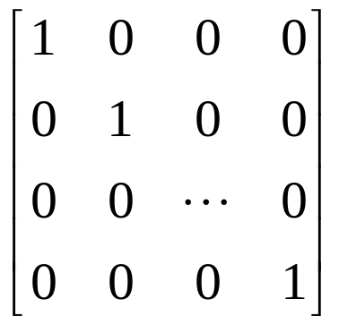
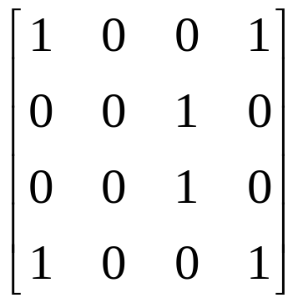
  (3) If there is an arc from x to y there cannot be one from y to x if x≠ y.
  (4) The symmetric and antisymmetric relations are not opposites.
  For example,

Slide 22
6. Special Properties of Binary Relations
    Reflexive
    Irreflexive
    Symmetric
    Antisymmetric
    Transitive

Slide 23
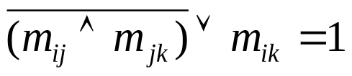
【Definition】A relation R on a set A is transitive if whenever
  Note:
  (1)
  Why?
  (2) If there is an arc from x to y and one from y to z then there must be one from x to z.

Slide 24
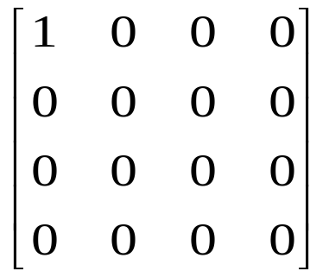
〖Example 7〗Determine whether the following relations are reflexive, irreflexive, symmetric, antisymmetric and/or transitive.
  (1)
reflexive, symmetric, antisymmetric, transitive
a
  (2)
b
d
c
symmetric, antisymmetric, transitive

Slide 25

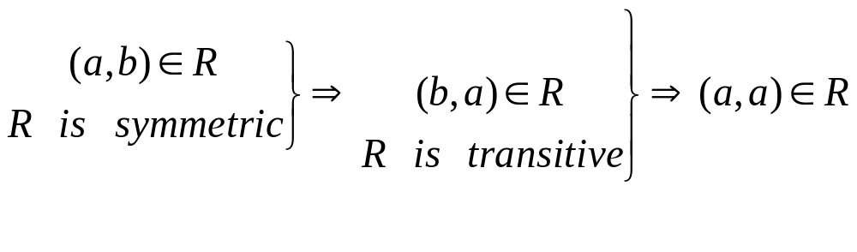

  (3)
reflexive, antisymmetric, transitive
  (4)
reflexive, symmetric, transitive
  Question:
  Symmetric, transitive ⇒ reflexive ?
This argument makes an assumption that
Therefore, symmetry and transitivity are not enough to infer reflexivity

Slide 26
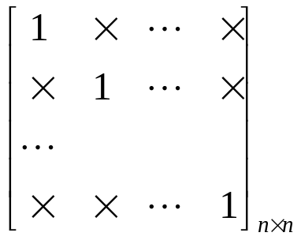
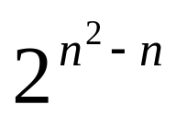
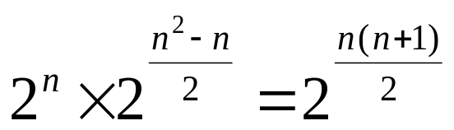
〖Example 8〗How many relations are there on a set with n
elements that are
(1) reflexive ?
  (2) symmetric ?
  (3) antisymmetric ?
Solution:
(1)
0,1
(2)

Slide 27
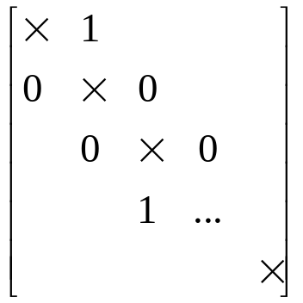
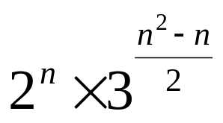
Solution:
(3)
Questions:
  reflexive and symmetric?
  transitive?

Slide 28
7. Combining Relations
Since relations from A to B are subsets of A×B, two relations from A to B can be combined in any way two sets can be combined.
    Set operation
    Composition
    Inverse relation

Slide 29
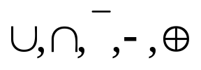




1)
〖Example 9〗 Let is the set of integers,
what are the relations ?
Solution:
(1) Set operations
Boolean operations/logical operations
The Boolean Or
The Boolean And
The Complement

Slide 30




The logical operations of matrices：
Let , the set
operations of two relations are defined by

Slide 31

2) Composition
The composite of R and S:
Question:
How to computer SoR?
    (1) Using the definition directly
    (2) Using the connection matrix

Slide 32




〖Example 10〗
Solution:
(1) Using the definition directly
Note:

Slide 33

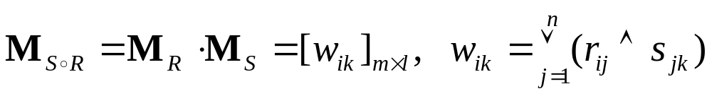
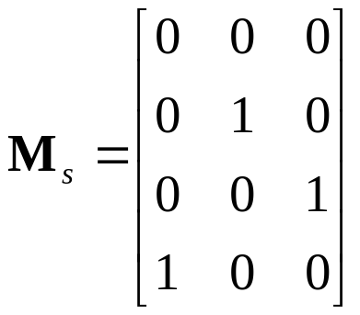
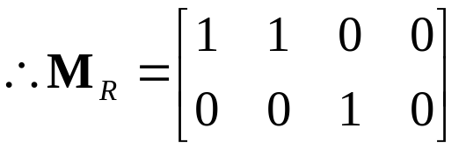
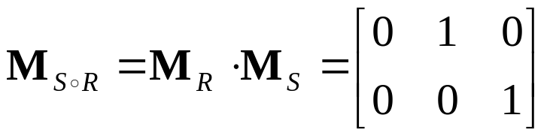

Solution:
(2) Using the connection matrix

Slide 34


【Definition】Let R be a relation on the set A. The powers
,are defined recursively by

Slide 35
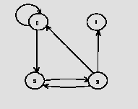
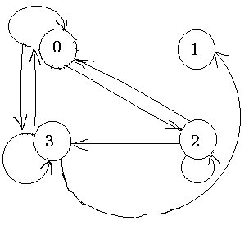
〖Example 11〗Let A={0,1,2,3}. R is the relation on the set A.
R ={(0,0),(0,3),(2,3),(3,2),(2,1),(2,0)}. R²=?
Solution:
  Using the definition
    R²={(0,0),(0,3),(0,2),(2,2),(3,3),(2,3),(2,0),(3,1),(3,0)}
  Using the digraph

Slide 36

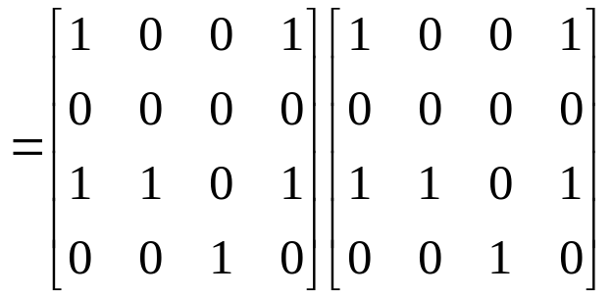
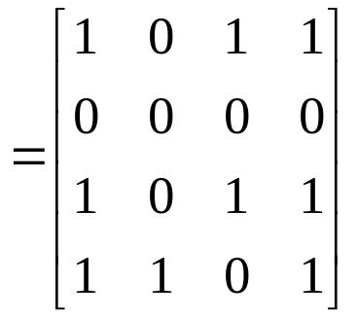
Using the matrix

Slide 37










【 Theorem 】 The relation R on a set A is transitive if and
only if
Proof:
(1)
⇒ R is transitive
(2) R is transitive ⇒
Inductive base
Inductive step
R is transitive

Slide 38





〖Example 12〗 Let R be a symmetric relation on the set A.
Show that R^{n} is symmetric for all positive integers n.
Proof:
Inductive base
n=1, R be a symmetric
Inductive step
R^{n} is symmetric ⇒ R^{n+1} is symmetric

Slide 39






3) Inverse relation
The inverse relation from B to A:
Question:
How to get ?
  Using the definition directly
  For example,
(2) Reverse all the arcs in the digraph representation of R
(3) Take the transpose M_{R} ^{T} of the connection matrix M_{R} of R.

Slide 40






4) The properties of relation operations
Suppose that R, S are the relations from A to B, T is the relation from B to C, P is the relation from C to D, then
(1)
Proof:

Slide 41







4) The properties of relation operations
Suppose that R, S are the relations from A to B, T is the relation from B to C, P is the relation from C to D, then
(1)
Proof:
(2)
(3)
(4)
(5)

Slide 42




4) The properties of relation operations
Suppose that R, S are the relations from A to B, T is the relation from B to C, P is the relation from C to D, then
(1)
(2)
(3)
(4)
(5)
(6)
(7)
(8)
(9)

Slide 43
Homework: (Due on May 4)
Sec. 9.1 7(a,c,h), 26, 32, 47, 51
Sec. 9.3 13,14,31

