Slide 1
Extra Exercises on Chapter 10
Ex. 1 A tournament is a simple directed graph such that if u and v are distinct vertices in the graph, exactly one of (u, v) and (v, u) is an edge of the graph. Assume all vertices are labeled, how many different tournaments with n vertices are there?

Slide 2
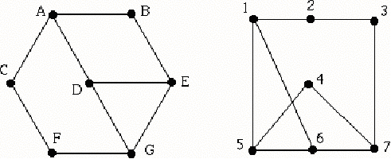
Extra Exercises on Chapter 10
Ex. 2 What is the length of the longest simple circuit in K5?
Ex. 3 Determine whether these two graphs are isomorphic, and justify your answer.
A–7, B–4, C–3, D–6, E–5, F–2, G–1

Slide 3
Extra Exercises on Chapter 10
Ex. 4 The Math Department has 6 committees that meet once a month. How many different meeting times must be used to guarantee that no one is scheduled to be at meetings at the same time, if committees and their members are: C1={Allen, Brooks, Marg}, C2={Brooks, Jones, Morton}, C3 ={Allen, Marg, Morton}, C4 ={Jones, Marg, Morton}, C5={Allen, Brooks}, C6 ={Brooks, Marg, Morton}.
5. Only C₄ and C₅ can meet at the same time.

Slide 4
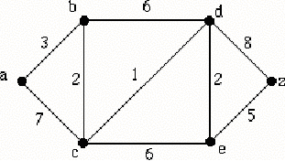
Extra Exercises on Chapter 10
Ex. 5 Use Dijkstra's Algorithm to find the shortest path length between the vertices a and z in this weighted graph.

Slide 5
Extra Exercises on Chapter 11
Ex. 1 How many full binary trees with six vertices?
Ex. 2 How many vertices does a full binary tree with 50 leaves have?
Ex. 3 If T is a full binary tree with 50 leaves, what is its minimum height?
Ex. 4 Evaluate the arithmetic expression whose prefix representation is − 5 / • 6 2 − 5 3
Ex. 5 How many spanning trees does C5 have?
Ex. 6 How many nonisomorphic spanning trees does K4 have?

Slide 6
Extra Exercises on Chapter 11
Ex. 7 The string 2 3 a · x + 4 ↑ + 7 ↑ is postfix notation for an algebraic expression. Write the expression in prefix notation.

Slide 7
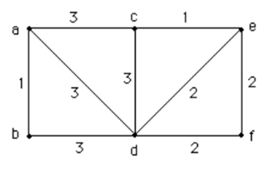
Extra Exercises on Chapter 11
Ex. 8 Use Prim’s algorithm to find a minimal spanning tree for this weighted graph. Use alphabetical order to break ties.

