Slide 1
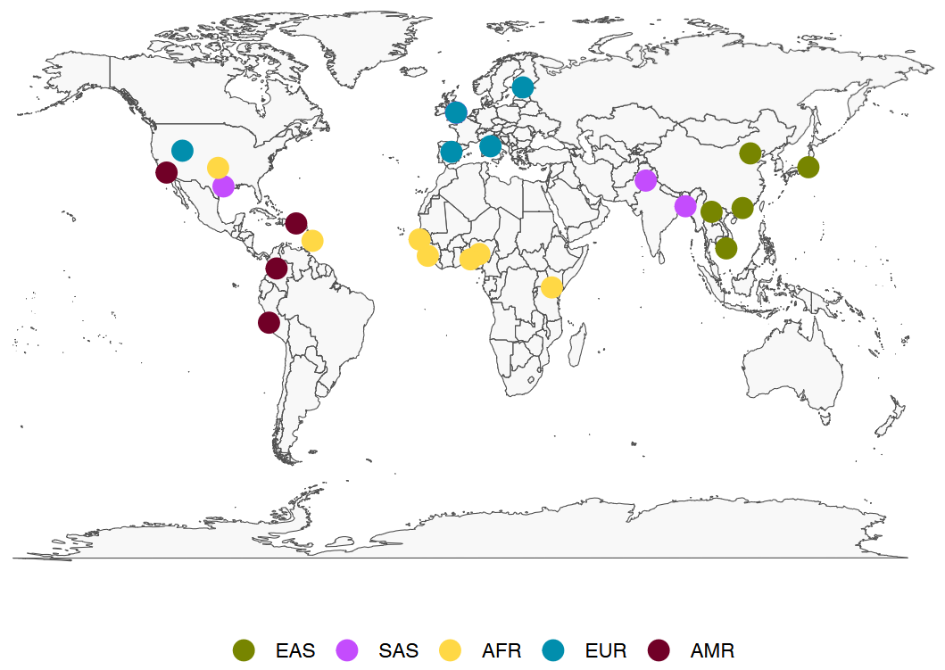
Population structure analysis using STRs
BIO392 Project Presentation by
Basil Burri &
Megumi Mizoguchi
Notes:
We present our project titled “Population structure analysis using STRs.” We explored whether STR profiles — typically used in forensics — can also reveal ancestry information and population structure.

Slide 2
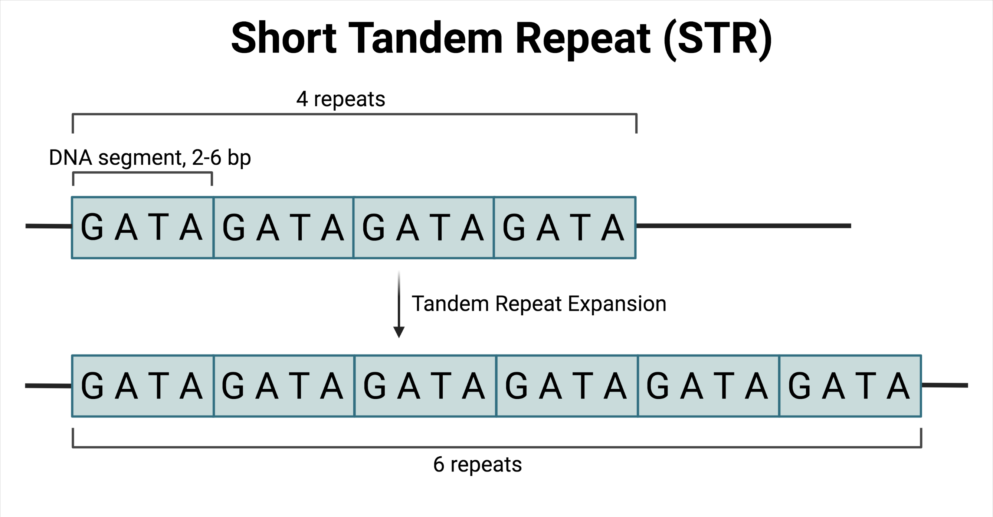
What are STRs?
Short Tandem Repeats (STRs)
Repeating sequences of 1-6 base pairs
Insertion/deletions of repeat units
Multi-allelic (many allele lengths)
5 to 100+ base pairs in length
Tandem repeat expansion of STR (bcgsc.ca, 2021)
Notes:
STRs, or Short Tandem Repeats, are repeating DNA sequences of 1 to 6 base pairs. They’re highly variable, multi-allelic, and found throughout the genome. Because of their variability, they’re widely used in forensics and paternity testing.

Slide 3
Why using STRs for Population Analysis
High variability in repeat number between individuals
STRs mutate quickly (~10⁻³ per generation), much faster than SNPs (~10⁻⁸ per generation)
STRs offer much more genotypic variation than SNPs
Rich variation across individuals
Distributed across the genome
STRs are found in all chromosomes
We can use any chromosome for population analysis in theory
Informative about ancestry and relatedness
Different populations may show different STR allele distributions due to genetic drift, founder effects, or selection
Population-specific variation allows clustering and classification
STRs remain underutilized in population classification, despite their informative potential.
Notes:
Compared to SNPs, STRs mutate much more rapidly — about 10⁻³ per generation — and offer greater genotypic variation. They’re distributed across the genome, and allele frequencies vary across populations. That makes them potentially useful for studying population structure — though they’re still underutilized in this area.
Most studies of population genetics use SNPs, but STRs offer several advantages: they mutate more rapidly and carry more individual-specific information. Despite this, they are underutilized in population prediction. Given their high variability and population-specific patterns, we asked: Can STR profiles be used to accurately predict population background?

Slide 4
Our Project: STR-based Population Inference
Research Question
Can we use STRs alone to predict the population background of individuals?
Aim
Analyze STR data from the 1000 Genomes Project (chr1)
Explore population structure using unsupervised methods (PCA, K-means, UMAP)
Train and evaluate a supervised model (Random Forest) for population prediction
We investigate whether STRs, without using SNPs, are sufficient for accurate population classification.
Notes:
So, we asked: Can we predict the population background of individuals using STR profiles alone, without using SNPs?
Our aim was to analyze STR data from chromosome 1 in the 1000 Genomes Project, use unsupervised methods to visualize structure, and then train a machine learning model to predict population background.
In this project, we explored how far we can go using STRs alone, without SNPs, to classify population background using machine learning.

Slide 5
Our Data: STRs from the 1000 Genomes Project
Data Source
1000 Genomes Project (Ziaei Jam, 2023)
Samples
Total number of individuals: 3552
Populations: 26
Superpopulations: 5
Chromosome
Only Chromosome 1 was used
(We chose chr1 because it's the largest and should therefore contain many STRs)
Geographic distribution of sampled populations (Map from Turner, 2022)
Notes:
We used STR genotypes from Ziaei Jam's 2023 dataset, based on the 1000 Genomes Project. We focused on chromosome 1 — the largest chromosome, with the most STRs. The dataset includes over 3,500 individuals from 26 populations, grouped into five superpopulations.
We used STR genotype data from the 1000 Genomes Project, specifically from chromosome 1, which is the largest and provides a high number of STR loci. The dataset includes over 3,500 individuals across 26 populations, grouped into five superpopulations. This diversity allows us to test how well STRs capture population structure.

Slide 6
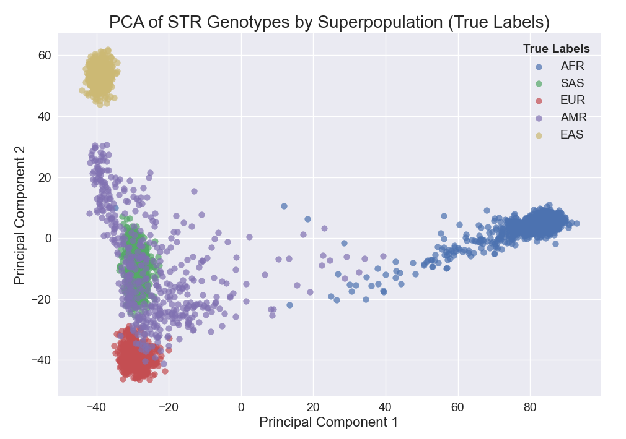
PCA Analysis: "Do STRs reflect population structure?"
PCA projection colored by true superpopulation
Purpose: We visualized the genetic structure in the STR data using PCA.
Result
Individuals with the same superpopulation cluster mostly together
This suggests STRs contain population-level structure!
Notes:
First, we used PCA to visualize structure. Here, each dot is an individual, and they’re colored by true superpopulation.
We see that individuals with the same superpopulation mostly cluster together — suggesting that STRs do reflect population structure.
While PCA shows structure visually, it doesn’t assign individuals to clusters. To test whether we could group individuals based on STR data alone, we applied K-means clustering.

Slide 7
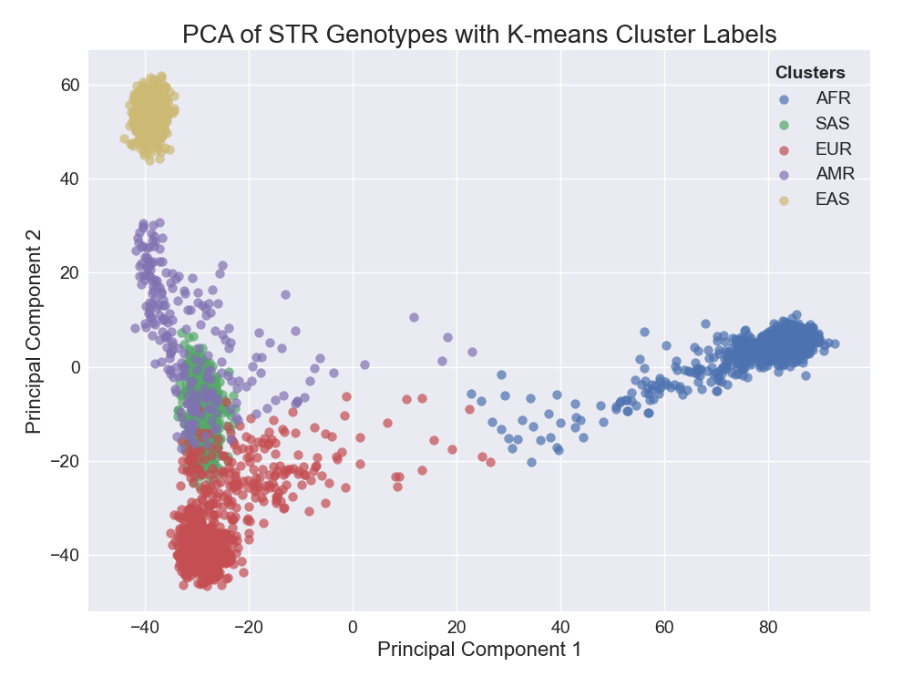
K-means Clustering : "Can we group individuals unsupervised?"
PCA projection colored by unsupervised clustering
Purpose: We applied unsupervised clustering to see if genetic structure alone could recover known groups.
Results
Clusters are formed based on genotypes
Cluster annotation was done manually
Notes:
We then applied K-means clustering — an unsupervised algorithm — to see if we could group individuals without any labels.
Here, clusters are based only on genetic patterns, not on population labels.

Slide 8
Missmatch between AMR True and Cluster Labels
True Labels based on individuals’ report
K-means Clusters based on STRs
Results
Most superpopulations matched well
Mismatch occurred mostly in American (AMR) samples
This mismatch may reflect European ancestry within American individuals!
Notes:
When comparing K-means clusters to true labels, most groups matched well. However, we noticed mismatches particularly in the admixed American (AMR) group — likely due to European ancestry in some individuals.

Slide 9
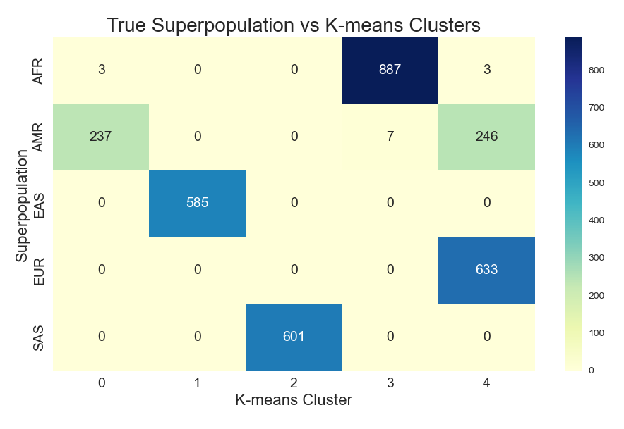
True Superpopulations vs K-means clustering
Confusion Matrix shows allocation structure
How well does the unsupervised K-means clustering correspond to the known superpopulation labels?
Method
Normalized Mutual Information (NMI) to assess similarity.
NMI 1: perfect information overlap
Results
NMI: 0.899
Notes:
We quantified the match using ARI and NMI. The adjusted Rand index was 0.867 and the normalized mutual information was 0.899 — indicating strong correspondence between our clusters and the true superpopulations.

Slide 10
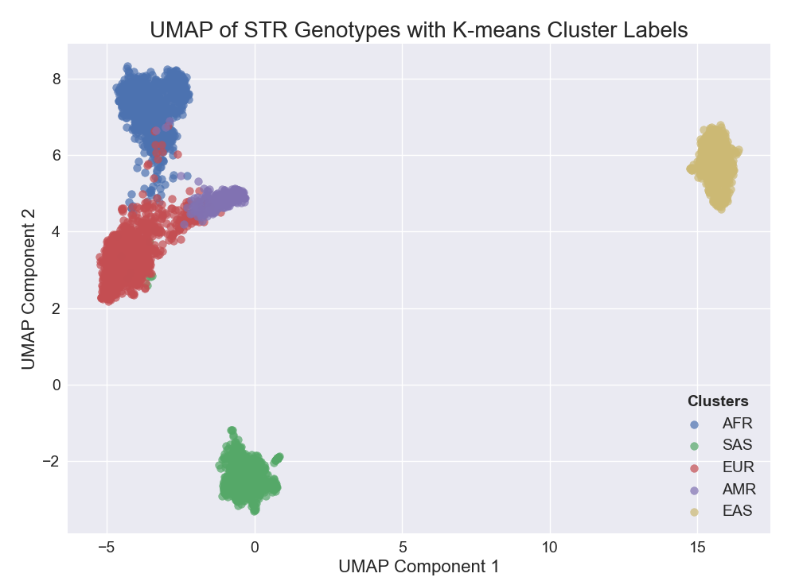
UMAP Visualization: "Does nonlinear projection improve separation?"
UMAP colored by true superpopulation
Purpose: UMAP preserves local and global structures, offering a more nuanced view.
Results
Individuals with the same superpopulation background cluster mostly together
It separates the populations better than PCA!
Especially for AMR vs EUR
Notes:
We also used UMAP — a nonlinear dimensionality reduction method. This showed even clearer separation of superpopulations, especially for admixed individuals like AMR. So we confirmed that STR data contains enough structure for unsupervised analysis.

Slide 11
Summary: Part 1
Unsupervised methods confirm that STRs contain meaningful population structure!
Notes:
To summarize so far: STRs carry strong population signals that can be detected visually and through clustering, even without labels.

Slide 12
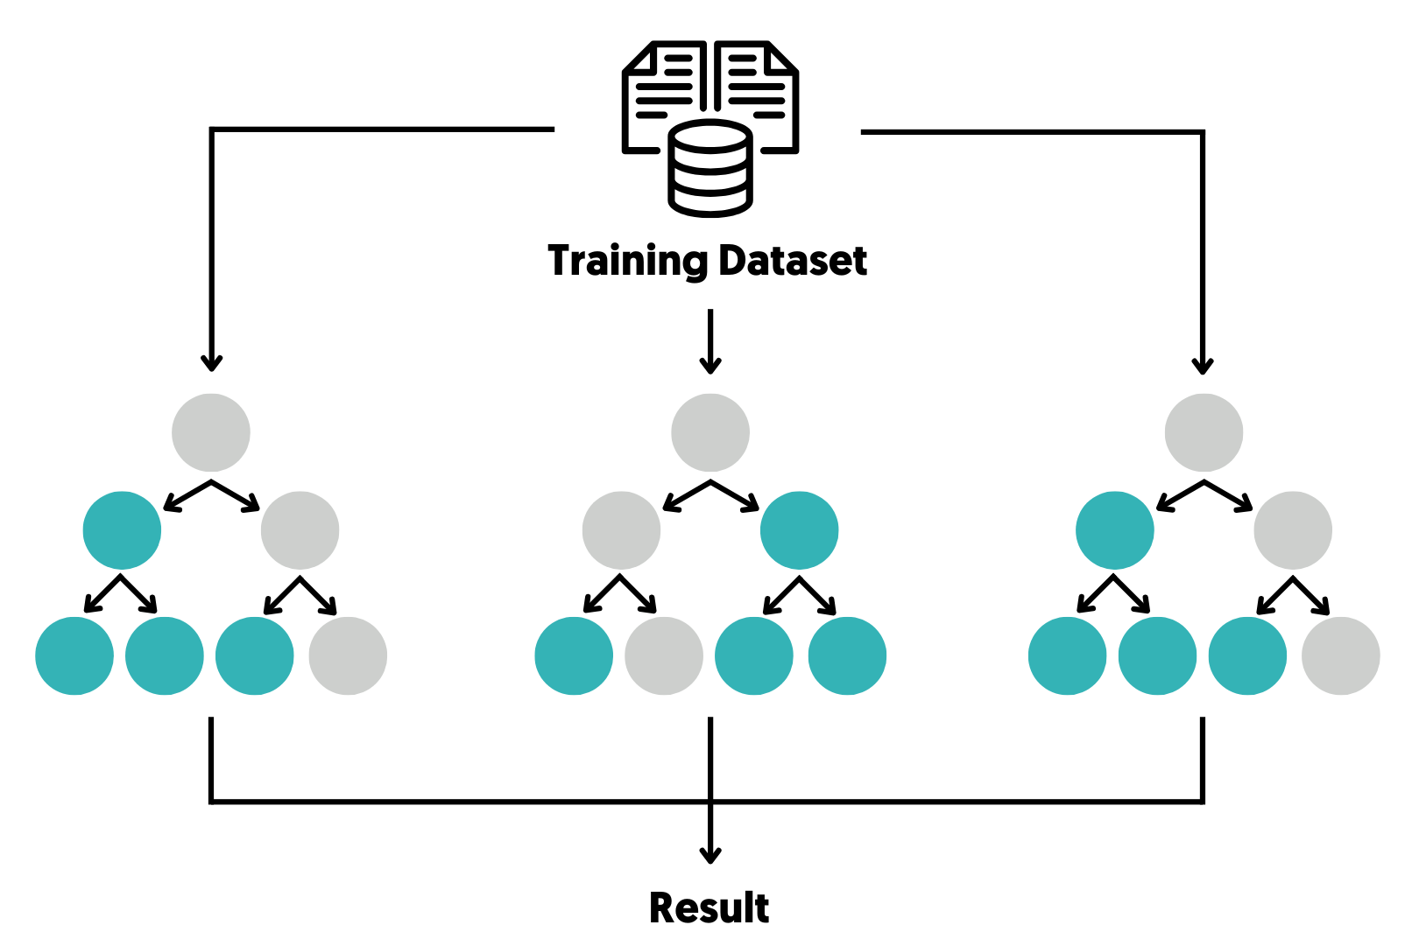
Random Forest Classification: “Can we predict population background from STRs?”
Purpose:
To test if population background could be accurately predicted from STRs, we trained a Random Forest classifier.
What is Random Forest?
Supervised machine learning algorithm that uses decision trees to predict outcomes, reducing overfitting by averaging predictions
Workflow
Train algorithm to predict populations using a 70-30 train-test split
70% for training, 30% for testing
Evaluate model accuracy and precision
Built Population Background Predictor
Notes:
Next, we used supervised learning to see if we could predict an individual’s population background from STRs. We trained a Random Forest classifier using a 70-30 train-test split.
Purpose: Now that we confirmed that STRs contain population structure, we asked: Can a supervised machine learning model learn to predict population identity from STRs?

Slide 13
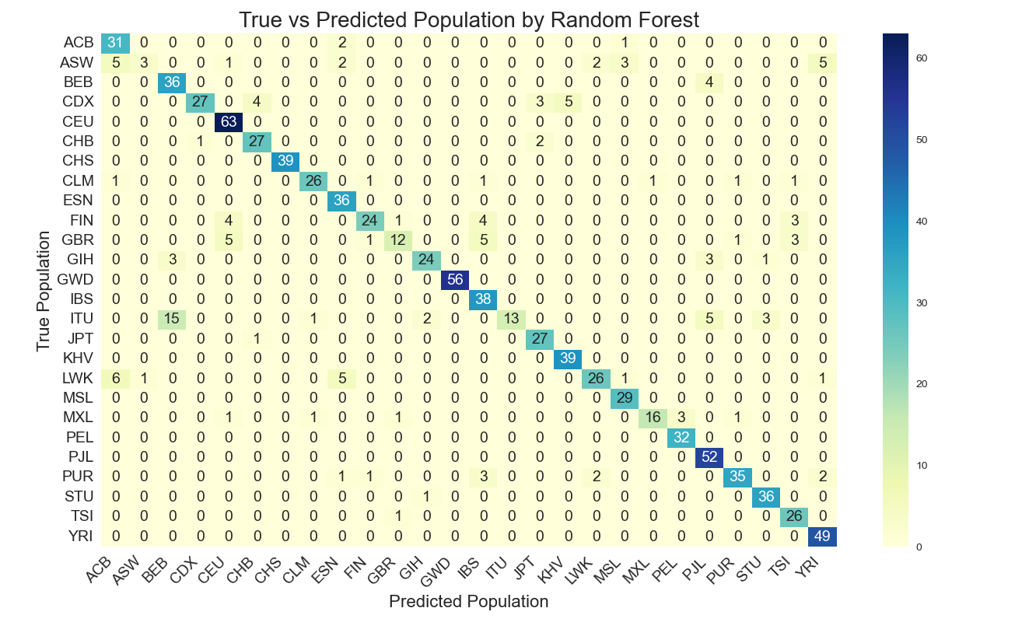
How good is the Predictor on pop. level?
Confusion Matrix shows allocation structure
Results
Most individuals were assigned correctly to their true population
Overall accuracy was good!
NMI: 0.855
Notes:
At the population level, most individuals were correctly classified. The adjusted Rand index was 0.765 and NMI was 0.855 — not perfect, but reasonably strong given the number of classes.

Slide 14
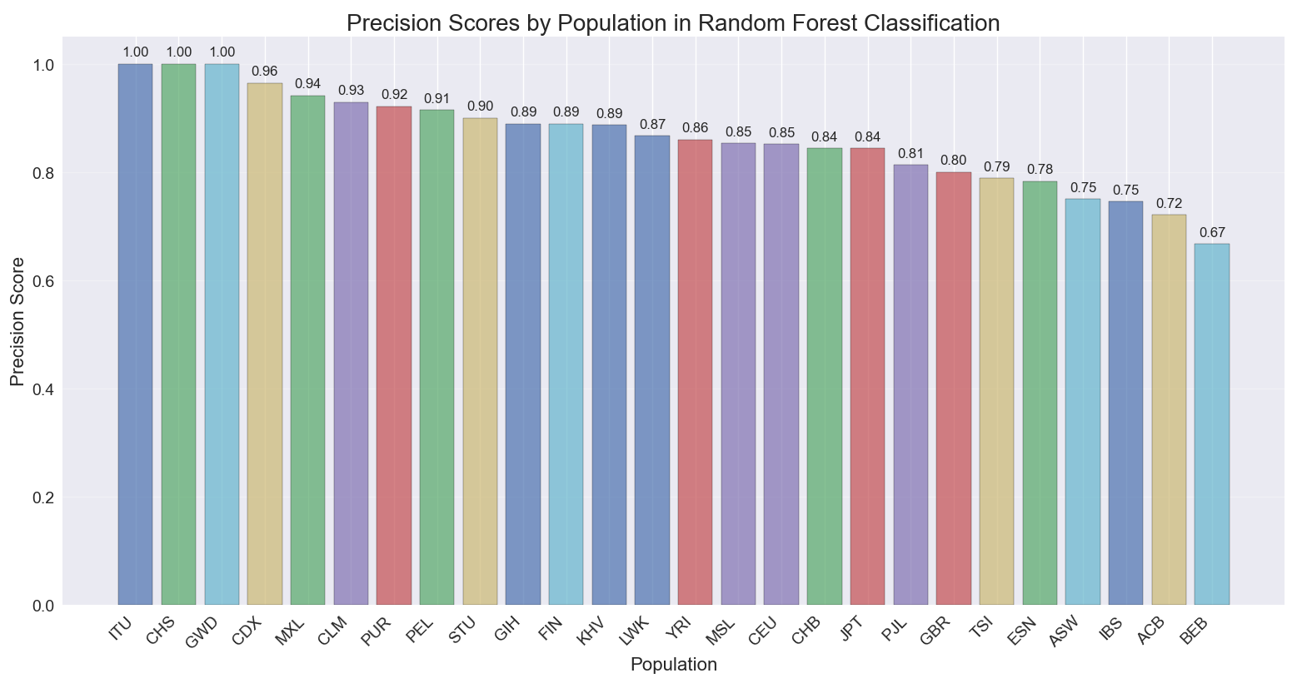
Precision scores per population
Precision = 1 means all individuals predicted to be in a group were truly from that group.
Notes:
Here are precision scores for selected populations.
Precision tells us how often individuals predicted to be in a group actually belong to that group.

Slide 15
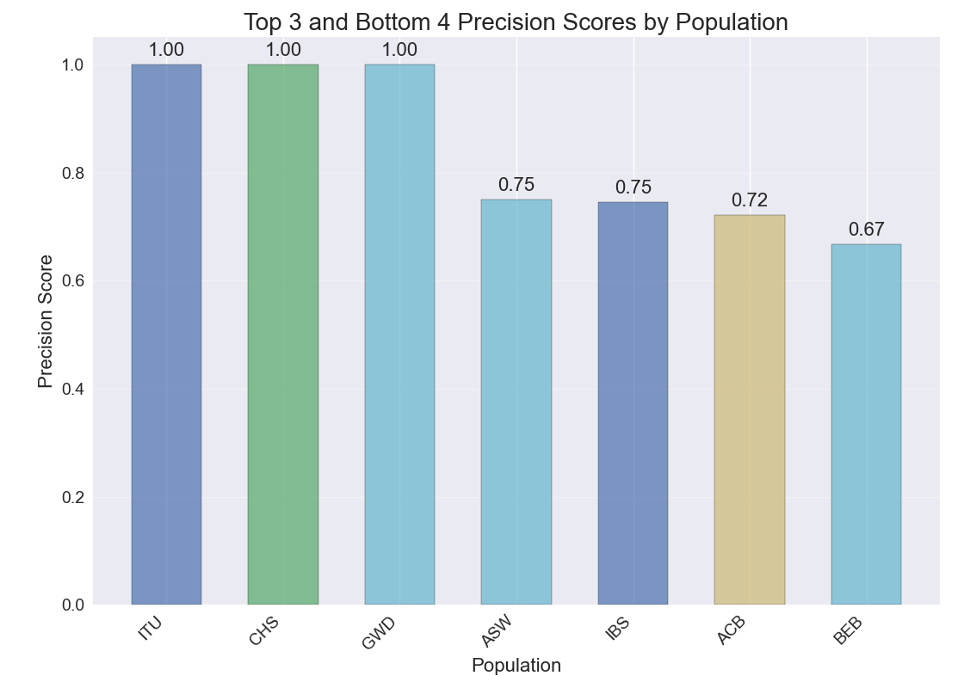
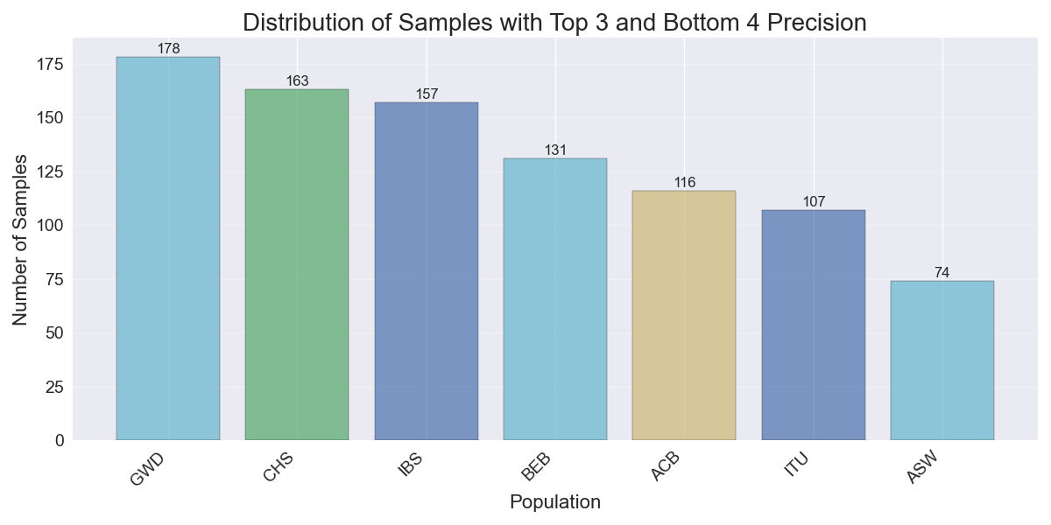
Precision scores per population
ITU: Indian Telugu from UK
CHS: Southern Han Chinese
GWD: Gambian in Western Division
ASW: African Americans in SW USA
IBS: Iberian Population in Spain
ACB: African Caribbean in Barbados
BEB: Bengali from Bangladesh
Notes:
Some groups, like CHS and IBS, had very high precision. Others, especially admixed groups like ASW and MXL, had lower precision — likely due to their mixed ancestry.

Slide 16
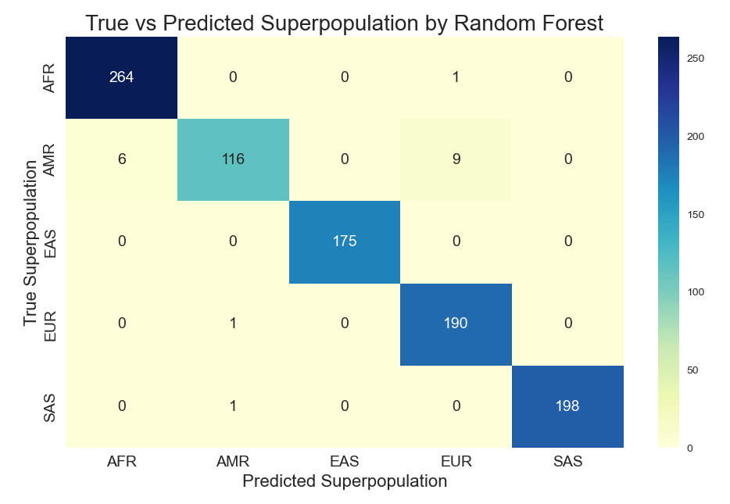
How good is the Predictor on superpop. level?
Confusion Matrix shows allocation structure
Results
Most individuals were assigned to their true superpopulation with very high accuracy
No struggle with AMR and EUR anymore unlike in K-means
Overall accuracy was high!
NMI: 0.948
Notes:
At the superpopulation level, performance improved significantly. The classifier reached ARI of 0.96 and NMI of 0.95 — and this time, AMR was no longer a problem. This shows that Random Forest can extract more subtle structure than K-means.
We then looked at the broader classification level — superpopulations.
This shows that supervised learning can capture patterns that unsupervised clustering struggles with — especially for admixed individuals.

Slide 17
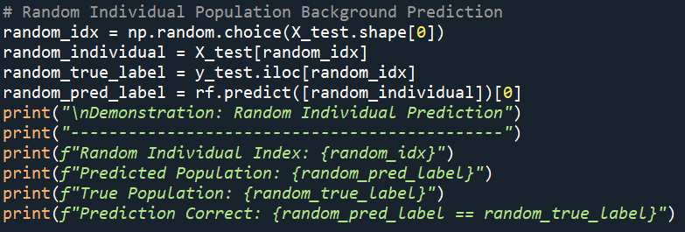
Population Background Predictor
Potential use in forensic?
Our final piece of code
Can we use STR profiles to predict the population background of individuals correctly?
Yes, we can!
Notes:
This is our final model, which we used to predict population background from STRs.
So, can we predict ancestry from STRs?
Yes, we can.
We implemented the final model in Python to predict population background from STRs.

Slide 18
Summary: Part 2
STRs provided enough information for our classifier to distinguish most populations
Superpopulation level prediction at high accuracy
Results support their potential use for ancestry prediction
Notes:
Overall, STRs provided enough signal for supervised classification, especially at the superpopulation level. This supports their potential use in ancestry inference.

Slide 19
Conclusion
STR profiles carry sufficient information to distinguish population background without SNPs
PCA and UMAP revealed population structure visually; K-means clustering largely recovered superpopulation labels
Random Forest classification achieved high accuracy at the superpopulation level (NMI = 0.95)
Prediction was less accurate for populations with complex ancestry
Our findings highlight the potential of STRs to provide useful ancestry information.
Notes:
To conclude: STR profiles alone — even without SNPs — can distinguish population backgrounds. PCA and UMAP revealed structure visually. K-means clustering reflected superpopulation groups. Random Forest achieved very high classification accuracy, particularly for major groups. We did observe lower precision for admixed individuals, highlighting limitations. But overall, STRs show strong potential for ancestry inference.
To conclude, we found that STR profiles carry sufficient signal to distinguish population background without relying on SNPs.
PCA and UMAP helped us visualize meaningful population structure, and K-means clustering largely recovered the correct superpopulation labels.
Our supervised learning model — Random Forest — achieved high classification accuracy at the superpopulation level, with an ARI of 0.96 and an NMI of 0.95.
However, prediction was less accurate for admixed populations, such as AMR, likely because of their complex ancestry backgrounds.
Overall, our findings highlight the potential of STRs to provide useful ancestry information.

Slide 20
Limitations and Outlook
Limitations
We only used chromosome 1
No comparison to using SNPs
No other clustering and machine learning tried
Outlook
Include more chromosomes (server needed)
Compare to classifier that uses SNPs
Notes:
To conclude: STR profiles alone — even without SNPs — can distinguish population backgrounds. PCA and UMAP revealed structure visually. K-means clustering reflected superpopulation groups. Random Forest achieved very high classification accuracy, particularly for major groups. We did observe lower precision for admixed individuals, highlighting limitations. But overall, STRs show strong potential for ancestry inference.
To conclude, we found that STR profiles carry sufficient signal to distinguish population background without relying on SNPs.
PCA and UMAP helped us visualize meaningful population structure, and K-means clustering largely recovered the correct superpopulation labels.
Our supervised learning model — Random Forest — achieved high classification accuracy at the superpopulation level, with an ARI of 0.96 and an NMI of 0.95.
However, prediction was less accurate for admixed populations, such as AMR, likely because of their complex ancestry backgrounds.
Overall, our findings highlight the potential of STRs to provide useful ancestry information.

Slide 21
Acknowledgement
Prof. Dr. Michael Baudis
Jiahui Yu
Ziying Yang
Hangjia Zhao
Fei Fei Xia
Thank you!
Notes:
Thank you, Michael, Jiahui, Ziying, Hangjia, and Fei fei for teaching us!, and to Fei fei for providing the STR dataset.
Thank you for your attention.

Slide 22
Data Wrangling
1. Load Data
Import STR genotype matrix and sample metadata (for population and superpopulation annotation)
2. Data Filtering
Remove loci/individuals with >10% missing data
Exclude loci with low variability (std < 0.5)
Transpose data for analysis (individuals as rows)

Slide 23
3. PCA Analysis
What is Principal Component Analysis (PCA) ?
Linear dimensionality reduction that transforms high-dimensional data into a lower-dimensional space by finding new axes (principal components) that maximize variance.
Workflow
Standardize data and apply PCA (2 components)
Merge PCA results with metadata for population annotation
PCA colored by true population
PCA colored by true superpopulation
Notes:
Principal Component Analysis (PCA) is a dimensionality reduction technique that transforms high-dimensional data into a lower-dimensional space by finding new axes (principal components) that maximize variance. It projects data onto these axes, preserving as much information as possible.

Slide 24
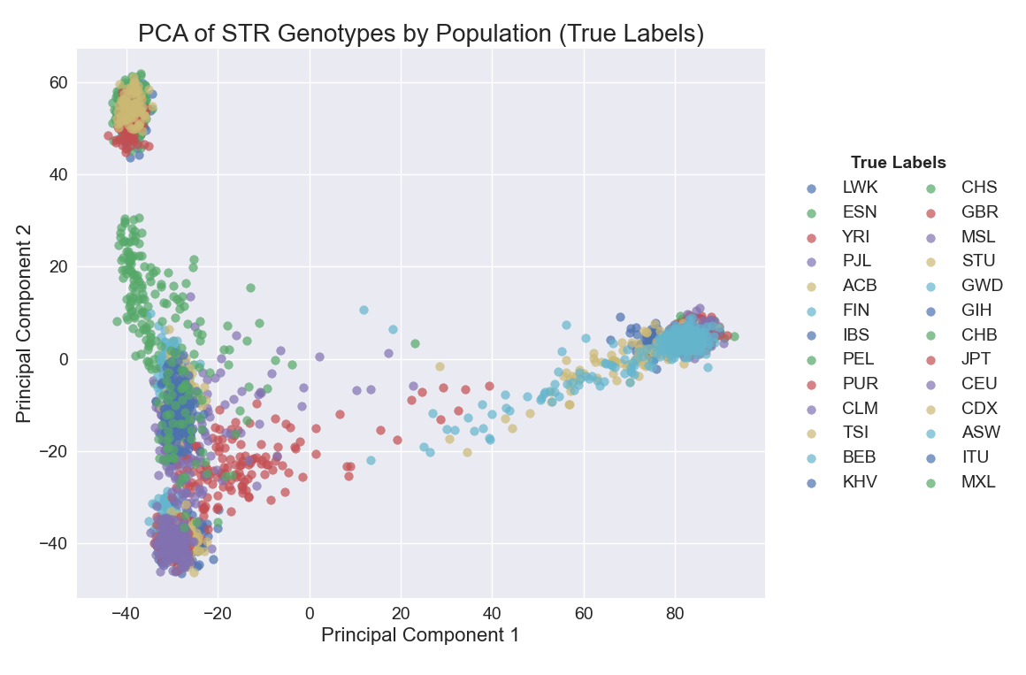
PCA colored by true population
What does the PCA show?
Individuals with the same population background cluster mostly together

Slide 25
4. K-means Clustering
What is K-means Clustering
An unsupervised algorithm that partitions data into K clusters by minimizing the variance within each cluster, assigning points to the nearest cluster centroid
Workflow
Cluster individuals into 5 cluster using K-means
Label clusters manually by comparing to true label PCA
PCA projection with K-means Cluster Labels
Notes:
Before applying machine learning, we first explored how STR variation reflects population structure.

Slide 26
5. UMAP Visualization
What is Uniform Manifold Approximation and Projection (UMAP)?
Nonlinear dimensionality reduction technique that preserves local and global data structure by modeling the data's manifold topology
Workflow
UMAP for nonlinear dimensionality reduction
Merge UMAP results with metadata for population annotation
UMAP projection with True Labels
Notes:
PCA is linear and might not capture complex patterns. To explore whether nonlinear structure improves separation, we next used UMAP.

