Slide 1
Bladder Urothelial Carcinoma & Ductal Breast Carcinoma

Slide 2
Tumor suppression genes:
TP53 = p53 "the guardian of the genome”
CDKN2A cyclin-dependent kinase inhibitor 2A

Slide 3
Urothelial Carcinoma
Urothelial carcinoma of the bladder (UCB) is the fifth most common cancer in the USA.
The direct economic cost of bladder cancer was US$ 3.7 billion in 2001, making it the most expensive of all cancers in terms of cost per patient, and the fifth most expensive in terms of total health care expenditure.
UCB has two main clinical manifestations that affect prognosis: noninvasive lesions that usually recur but rarely progress, and aggressive muscle-invasive lesions that progress and are associated with poor long-term survival.
Notes:
Lips, E.H., Kumar, T., Megalios, A. et al. Genomic analysis defines clonal relationships of ductal carcinoma in situ and recurrent invasive breast cancer. Nat Genet 54, 850–860 (2022). https://doi.org/10.1038/s41588-022-01082-3

Slide 4
Ductal Breast Carcinoma
a breast carcinoma arising from the ducts
Ductal carcinomas account for about two thirds of all breast cancers
Two types of ductal carcinomas have been described: ductal carcinoma in situ (DCIS) and invasive breast carcinoma
Notes:
URL:https://ncit.nci.nih.gov/ncitbrowser/ConceptReport.jsp?dictionary=NCI_Thesaurus&ns=ncit&code=C4017

Slide 5
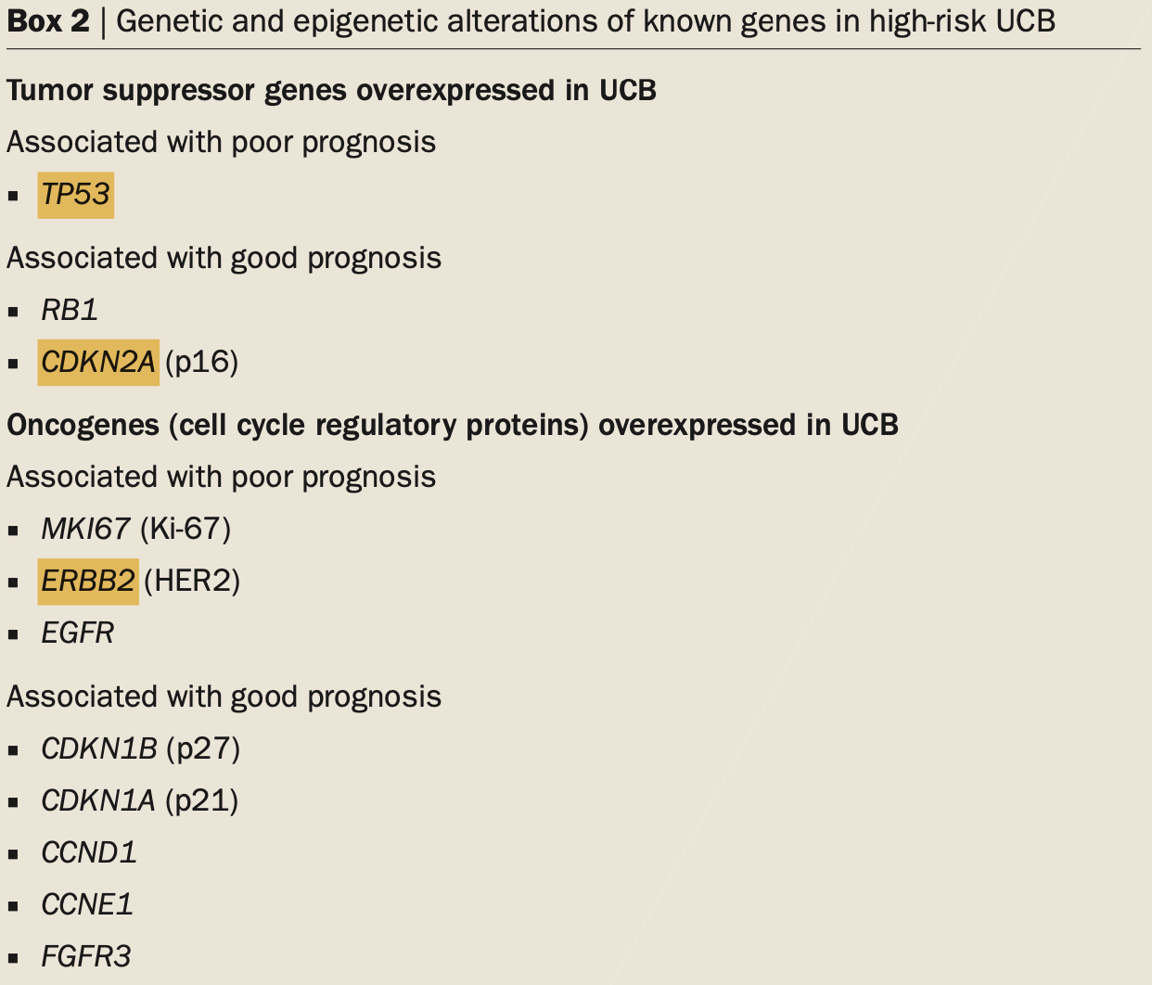
Genotype Comparison
Notes:
Bild: Prasad, S., DeCastro, G. & Steinberg, G. Urothelial carcinoma of the bladder: definition, treatment and future efforts. Nat Rev Urol 8, 631–642 (2011). https://doi.org/10.1038/nrurol.2011.144

Slide 6
Kaplan-Meier Plots
Bladder Urothelial Carcinoma
Ductal Breast Carcinoma
Survival fraction
Notes:
Duplications of Oncogenes generally lead to worse outcomes

Slide 7
CNV counts across cancer types
Bladder Urothelial Carcinoma
Ductal Breast Carcinoma

Slide 8
Duplication/deletion of gene per mutation type
Oncogenes
Tumor suppressor genes

Slide 9
CNV frequencies across cancer types
Bladder Urothelial Carcinoma
Ductal Breast Carcinoma
CNV fraction

Slide 10
Summary/Conclusions
Aftab, A., Shahzad, S., Hussain, H.M.J. et al. CDKN2A/P16INK4A variants association with breast cancer and their in-silico analysis. Breast Cancer 26, 11–28 (2019). https://doi.org/10.1007/s12282-018-0894-0 --> CDKN2A
Miligy, I.M., Toss, M.S., Gorringe, K.L. et al. The clinical and biological significance of HER2 over-expression in breast ductal carcinoma in situ: a large study from a single institution. Br J Cancer 120, 1075–1082 (2019). https://doi.org/10.1038/s41416-019-0436-3 --> ERBB2
p53 Loss in Breast Cancer Leads to Myc Activation, Increased Cell Plasticity, and Expression of a Mitotic Signature with Prognostic Value → MYC
Morrissey, R.L., Thompson, A.M. & Lozano, G. Is loss of p53 a driver of ductal carcinoma in situ progression?. Br J Cancer (2022). https://doi.org/10.1038/s41416-022-01885-5 --> TP53

