Slide 1




Survival Analysis of Bladder Cancer
Sarah Oppolzer & Marieluisa Buchegger
BIO 392: Bioinformatics of Molecular Sequence Variations
02.05.2025, University of Zurich
Notes:
9th most common cancer in the world

Slide 2
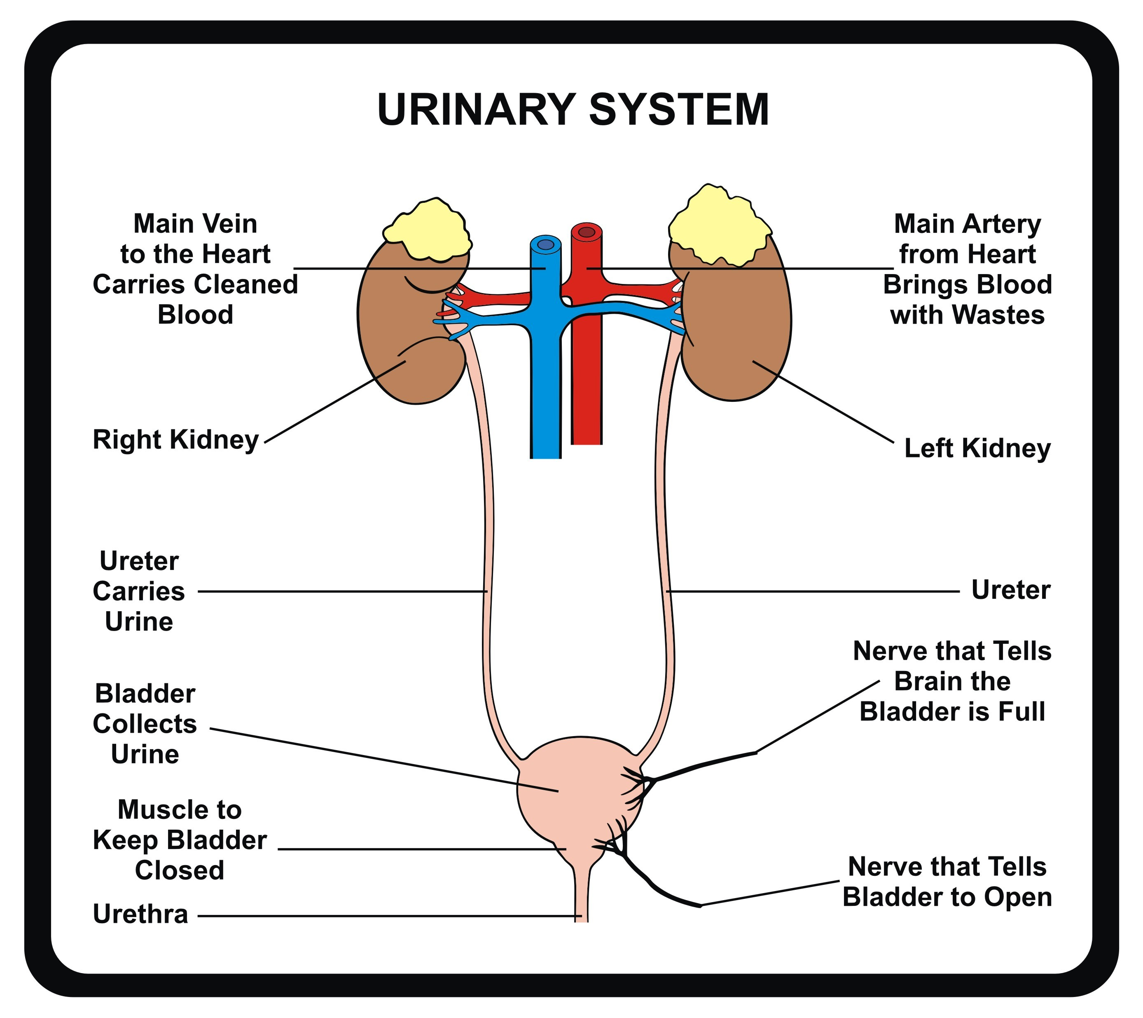
Bladder Urothelial Carcinoma
most common cancer in the bladder
Often begins in the urothelial cells inside of bladder
Usually diagnosed at an early stage, but recurrence after treatment is common
Can be aggressive and life-threatening
main risk factor: smoking
Most common symptom: blood in the urine
Source: Urine Infection? Causes, Treatment & Prevention - Welcome to Baliga Diagnostics
Sources: Mayoclinic, Cleveland Clinic, World Cancer Research Fund
Notes:
There are many risk factors

Slide 3
Survival Analysis
Survival analysis: deals with time duration until an event of interest occurs
Goal: explore different survival analysis methods in the context of bladder cancer
Dataset: cBioPortal: Bladder Urothelial Carcinoma (TCGA, GDC)
Source: Wikipedia, Survival Anaylsis (Definition)
Notes:
(in this case death)
TCGA: cancer genomics program

Slide 4
Survival Analysis Methods
Kaplan-Meier | Cox Proportional Hazards Regression
Non-parametric | Semi-parametric
Survival function, provides empirical survival probabilities over time | Hazard function, assumes proportional hazards yields a hazard ratio (HR) HR <1 : reduced hazard of death HR >1: increased hazard of death
Does not handle covariates | Can include multiple covariates (eg. Age, Stage etc), allows for variable adjustment
Both focus on time until an event occurs
Both deal with conditional probability
Source: BIO 392 Lecture Survival , Andrade (2023), Github Tutorial
Notes:
Non parametric: make no assumptions about the shape or distribution of survival time
Hazard function: instantaneous risk of the event, or the probability that if a person survives to t, they will experience the event in the next instant.
Proportional hazards: the ratio of hazards between groups is constant over time.
Hazard ratio (relative risk of an event occurring at any given point in time)
HR values below 1 indicate a lower risk of occurrence of the event relative to the comparison group, values above 1 indicate a higher risk,
Cox can estimate the effect of covariates on the survival time
(Semi parametric: Key trait: Flexibility in handling unknown survival distributions while still modeling predictors.)

Slide 5
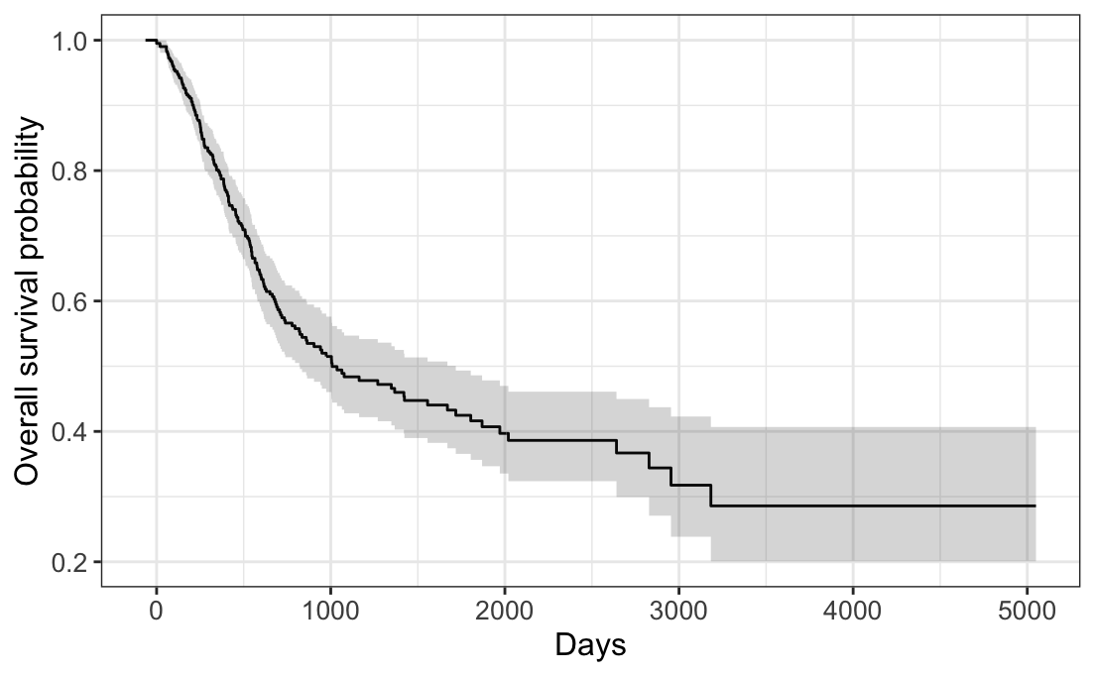
Kaplan Meier Survival Curve
Notes:
X axis shows the amount of days, and y axis shows the overall survival probability,
the grey area showing the confidence interval
As you can see the survival probability drops to 50% at around 1000 days

Slide 6
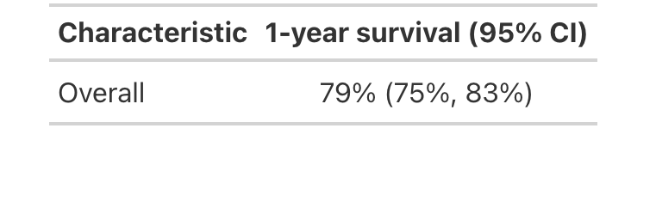
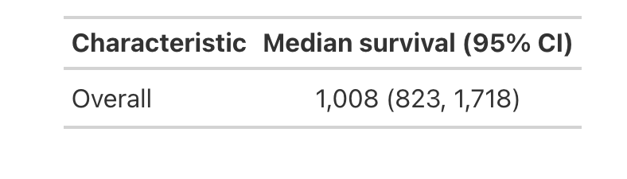
Estimating x- year Survival
Estimating Median Survival Time
Notes:
We were also able estimate the x-year survival and median survival time
So 79% of the patients within the first year
And the median survival time is 1000 days which is about 2.7 years

Slide 7
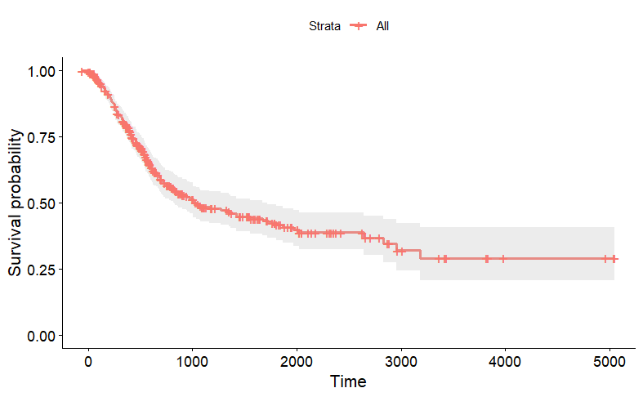
Cox Regression

Slide 8
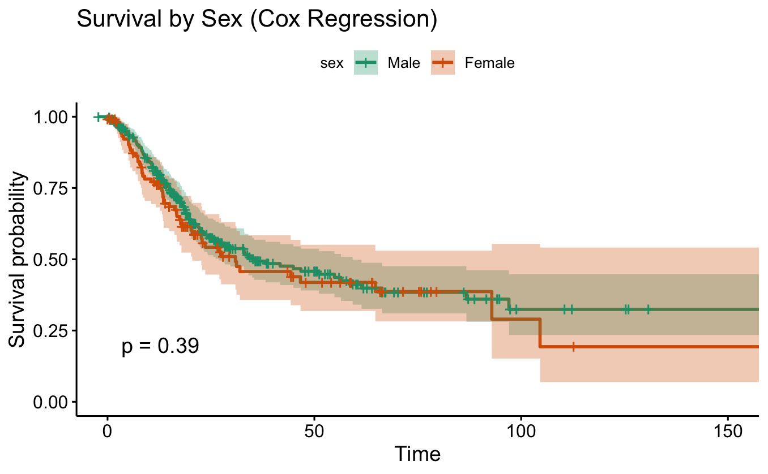
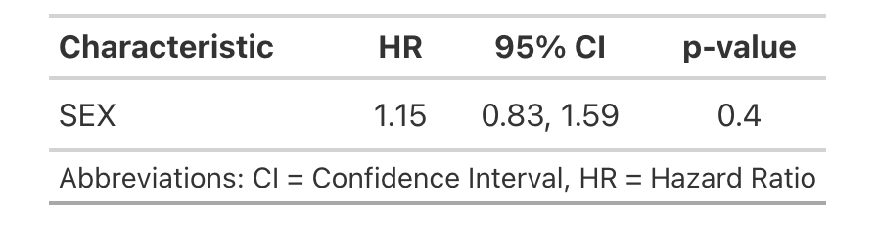
Cox Regression for Sexes

Slide 9
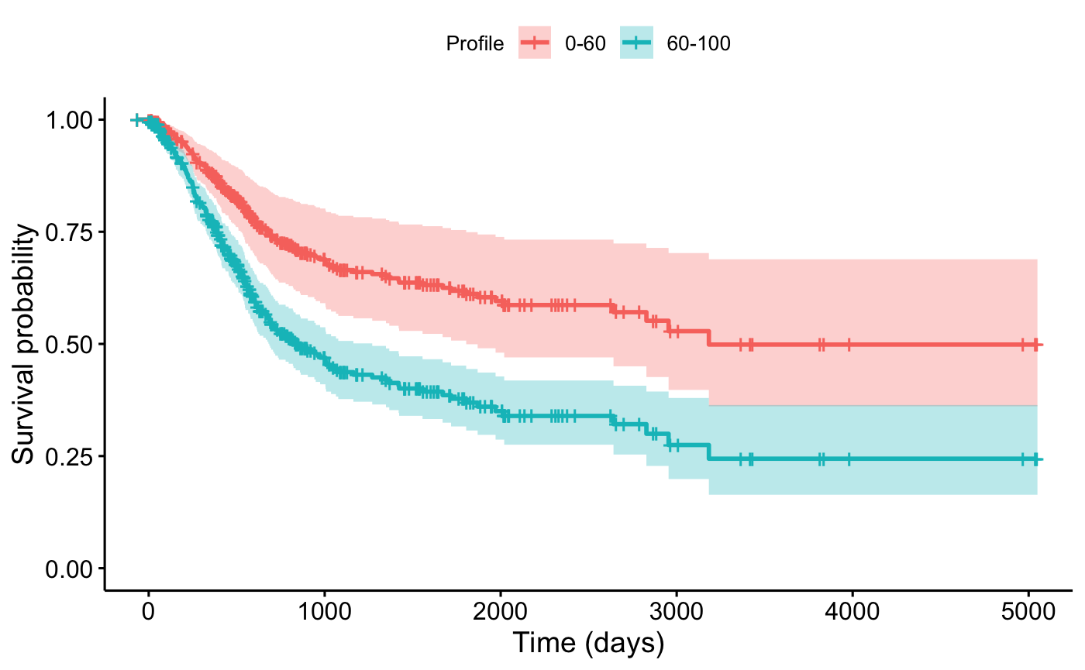
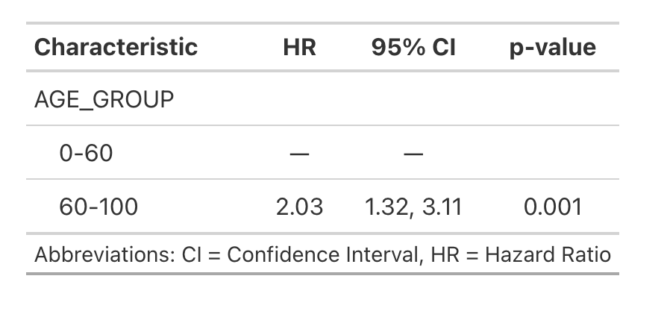
Cox Regression for Age Groups

Slide 10
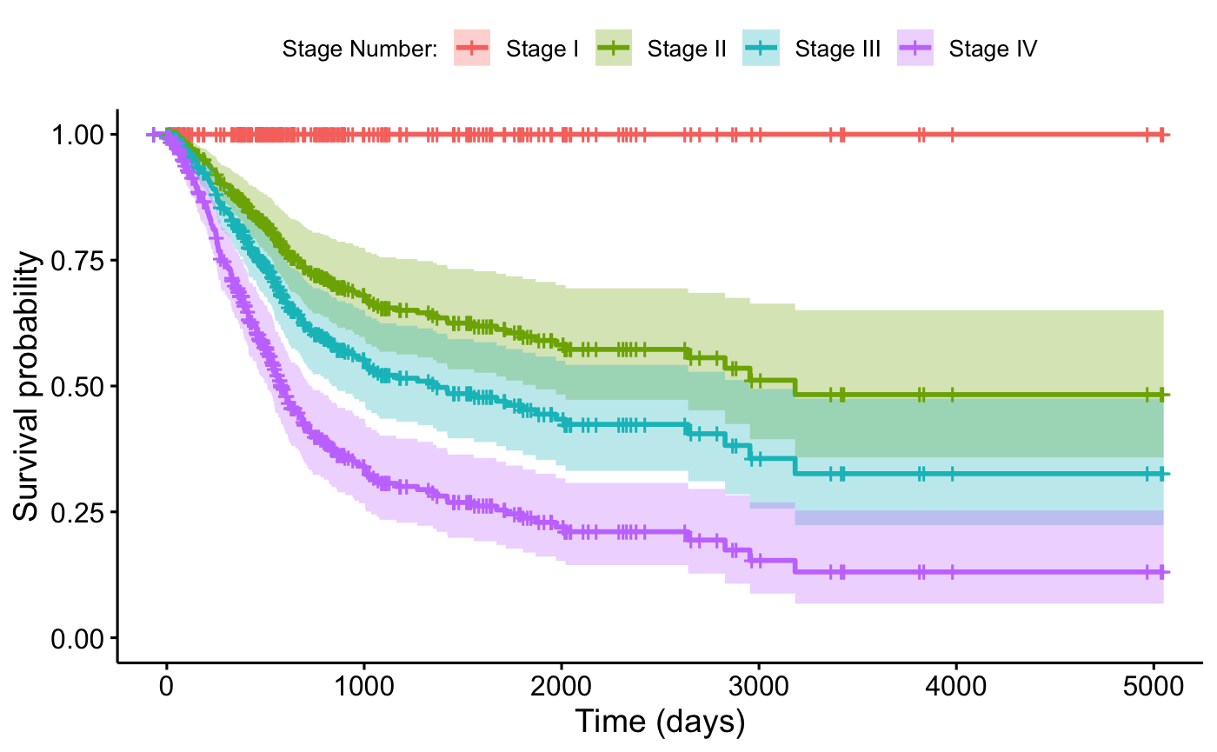
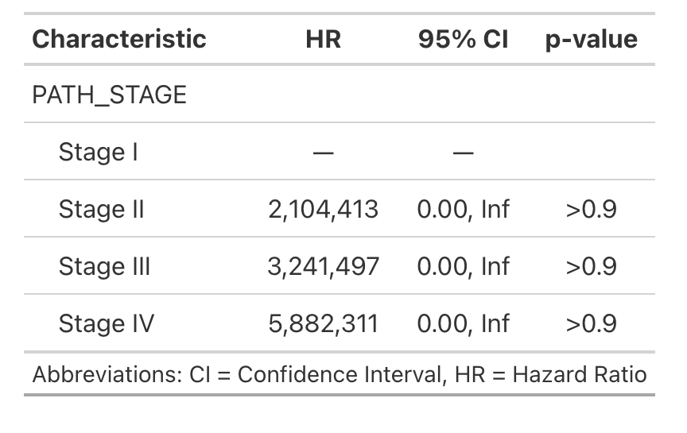
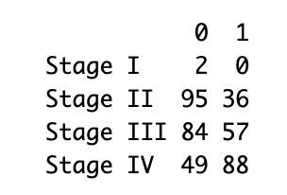
Cox Regression for Stages

Slide 11
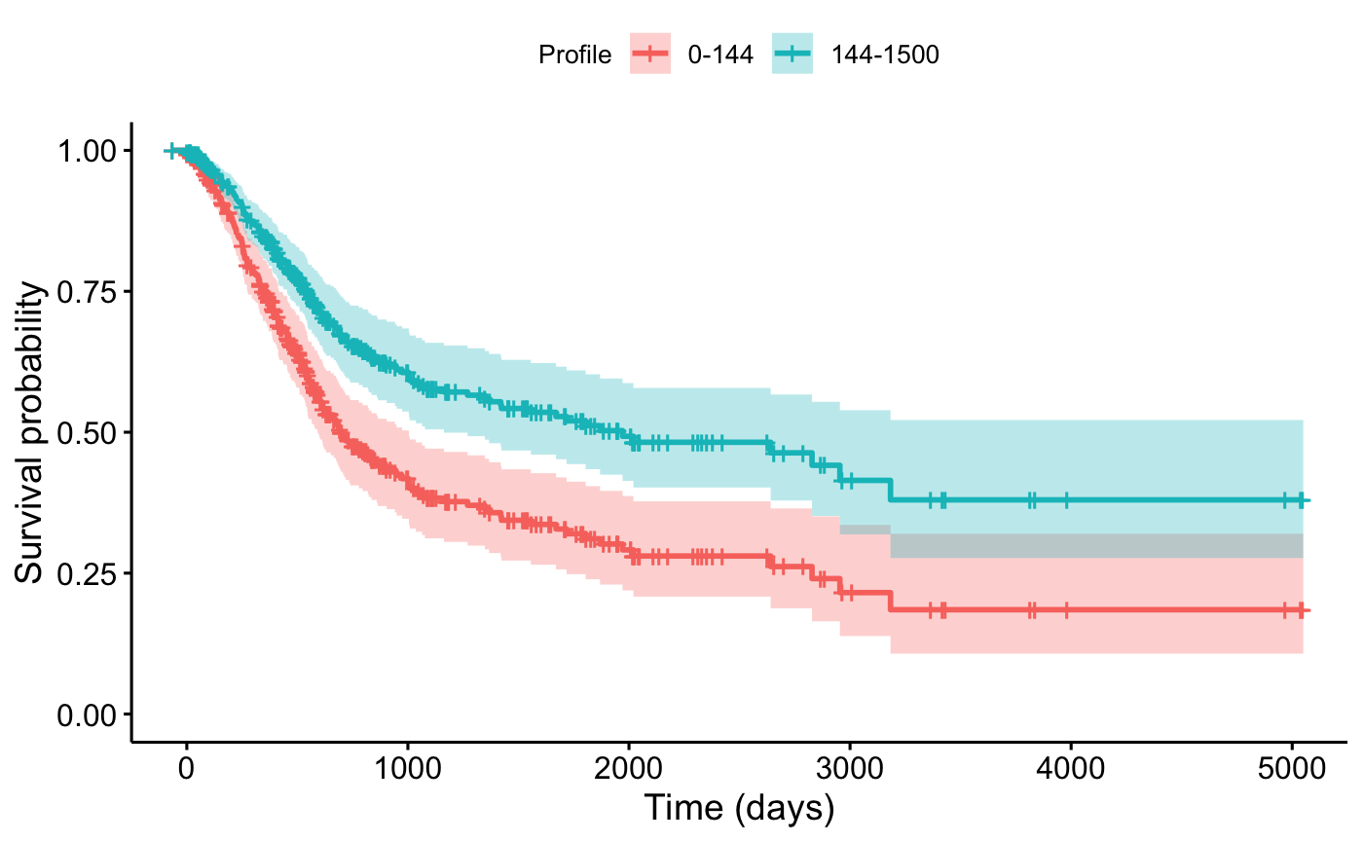
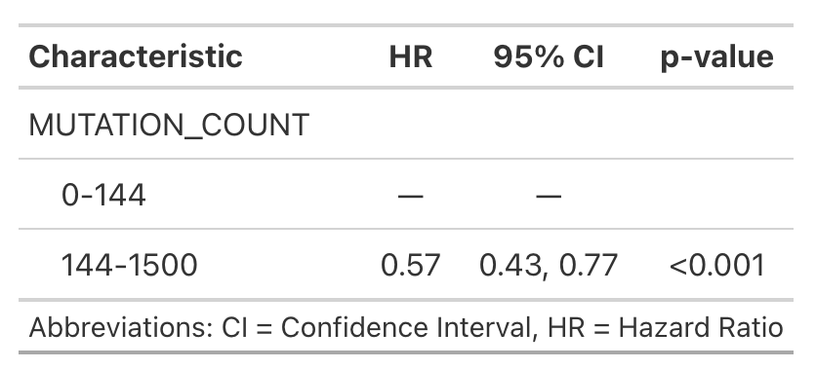
Cox Regression for Mutational Load
Notes:
More neoantigens -> higher immune surveillance
-> better response to immune therapy (immune checkpoint inhibitors)

Slide 12
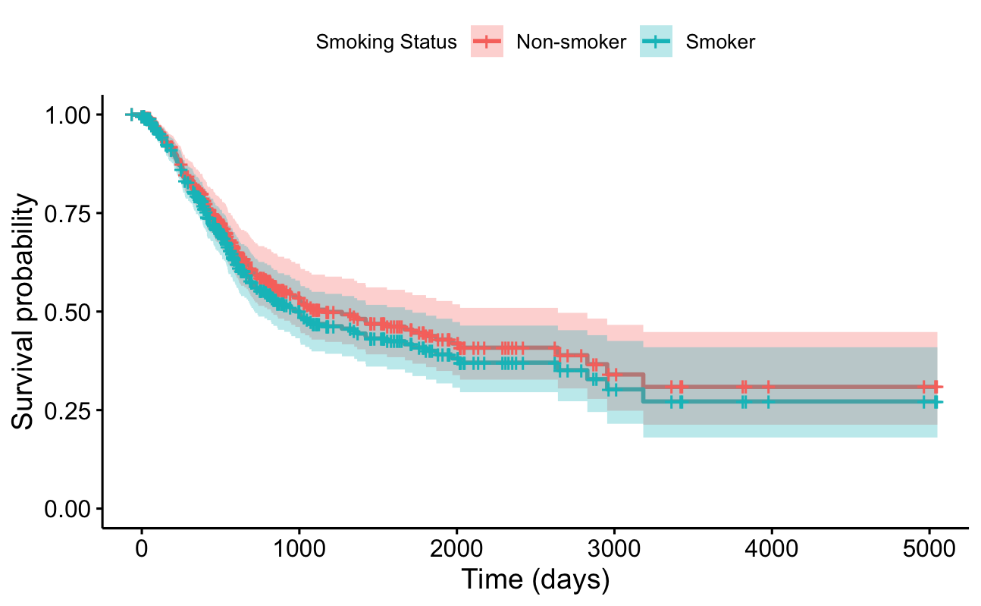
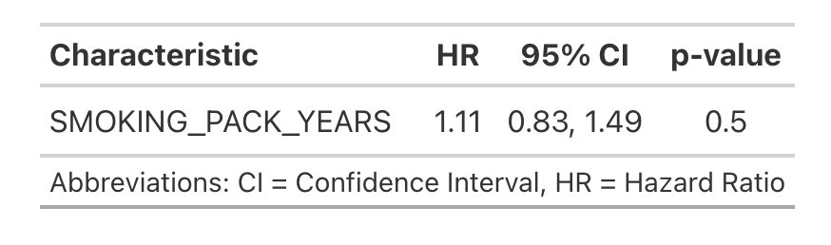
Smokers vs. Non-Smokers

Slide 13
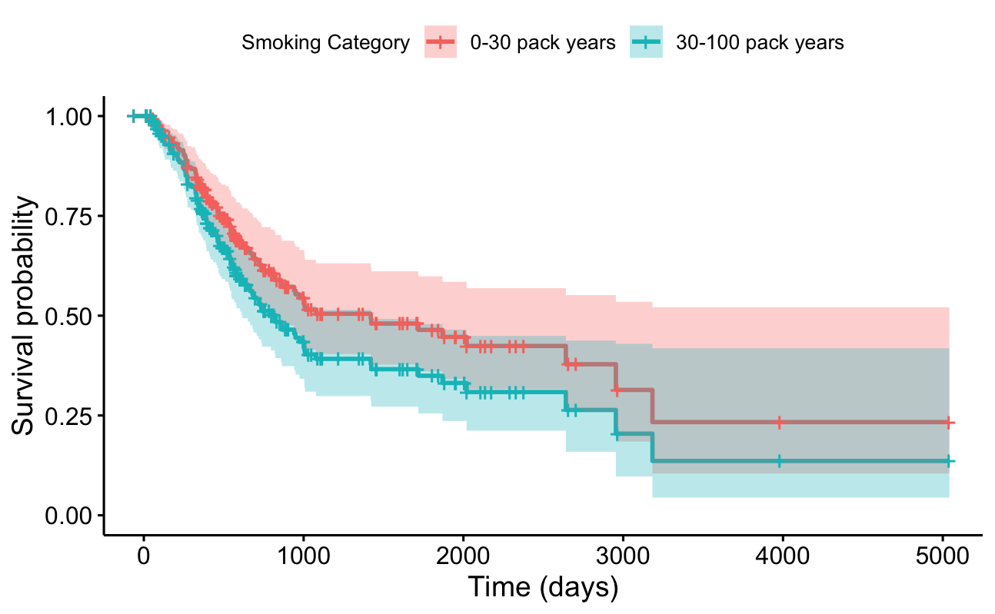
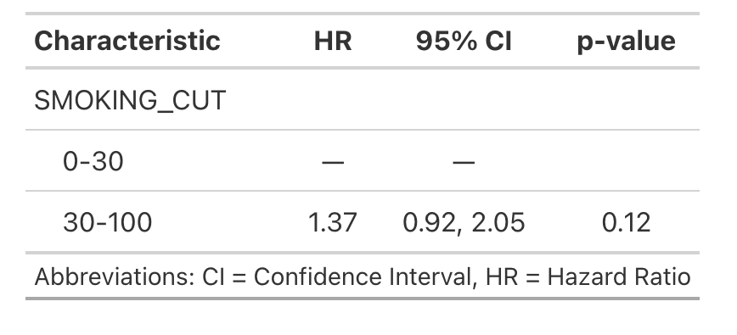
Light vs. Heavy Smokers

Slide 14
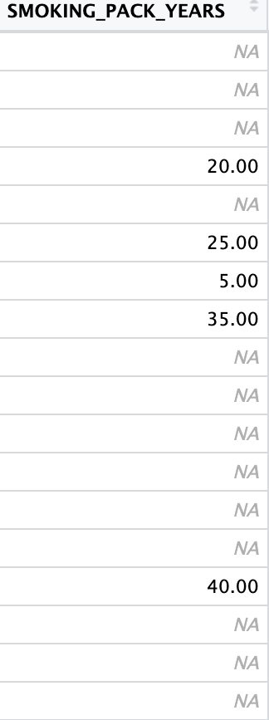

Slide 15
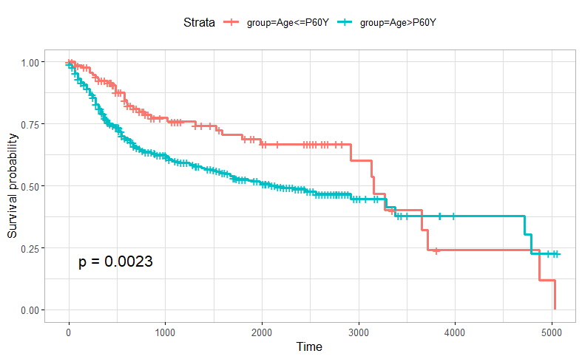
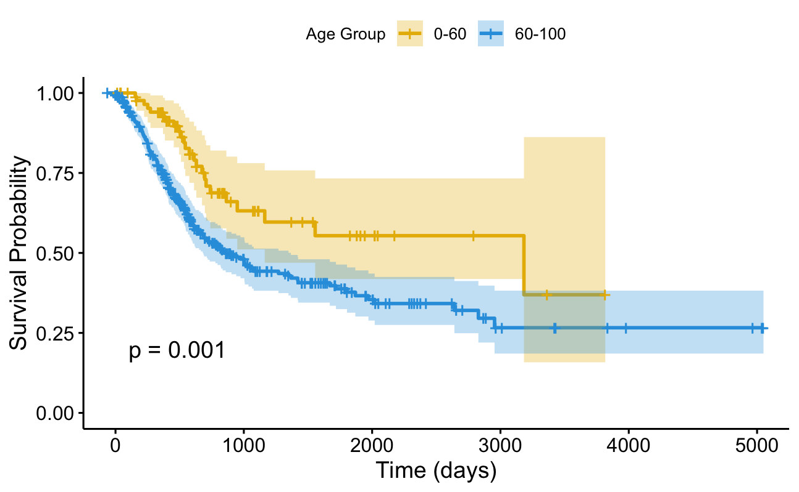
Using the Progenetix Database
Notes:
In addition, we created a Kaplan meier survival plot using the Progenetix database and Hangjia’s library in R for Urothelial Bladder Carcinoma.
Here the data is stratified so we could compare the two age groups
Comparing it the the Kaplan meier curve from our database, there is a slight similar trend, however the younger age group reaches a lower probability after 10 years than the older age group. This isn’t something we would expect but this could be because of all the censoring in the first 10 years, the number of individuals still at risk becomes very small in both groups.
But it would be interesting to further investigate.

Slide 16
Thank you for listening!

Slide 17
References
Mayoclinic, «Bladder Cancer», Bladder cancer - Symptoms and causes - Mayo Clinic
Cleveland Clinic, «Urothelial Carcinoma», What Is Urothelial Carcinoma?
World Cancer Research Fund, «Bladder Cancer», Bladder cancer | What causes bladder cancer? | World Cancer Research Fund
Survival Analysis Definition: Survival analysis - Wikipedia
Dataset: cBioPortal for Cancer Genomics
BIO 392 Lecture Survival, Michael Baudis
Github Tutorial: Survival Analysis of Breast Cancer Data from the TCGA Dataset
Andrade (2023), Survival Analysis, Kaplan-Meier Curves, and Cox Regression: Basic Concepts – PMC

