Slide 1
Survival Analysis of Head and Neck Squamous Cell Carcinoma
Bio 392 – Project 3
Sandrin Hunkeler
Lea Scherr

Slide 2
Structure
Motivation
Background
Objectives
Dataset
Methods
Results
Discussion
Conclusion

Slide 3
1) Motivation
Survival Analysis in General
Helps to estimate how long patients live after the diagnosis or treatment
Valuable for comparing treatments
Detecting associations with risk factors
Head and Neck Carcinoma
A relatively common type of cancer
Notable difference in risk between sexes
Risk strongly associated with lifestyle

Slide 4
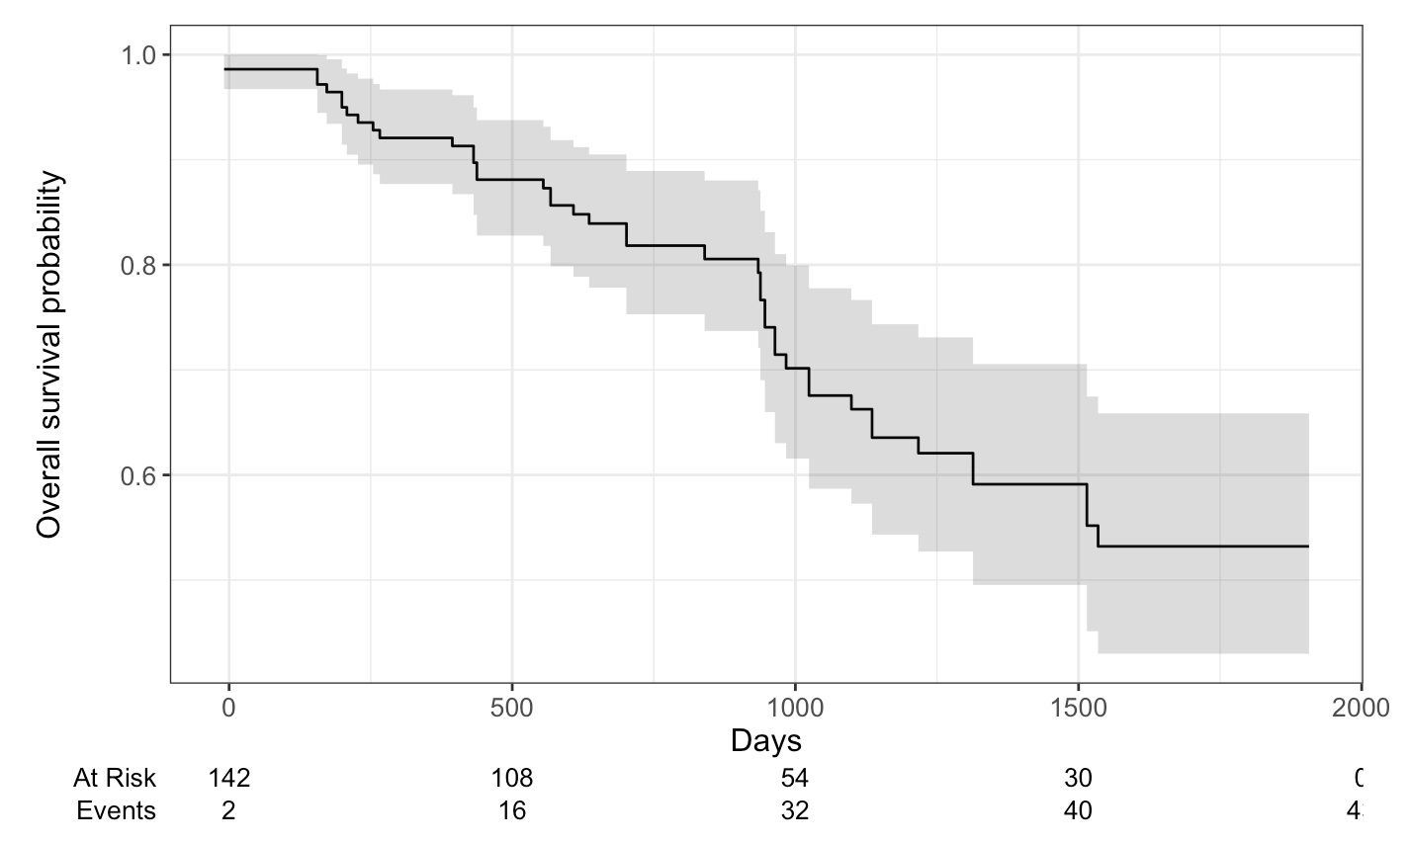
2.1) Background – Survival Analysis
Survival Analysis Methods
Kaplan-Meier method for probability of survival over time [3]
Cox regression model for assessing variables which affect survival time [4]
[3] https://www.emilyzabor.com/survival-analysis-in-r.html#kaplan-meier-plots
[4] https://www.emilyzabor.com/survival-analysis-in-r.html#the-cox-regression-model

Slide 5
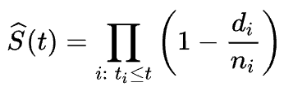
2.2) Background – Kaplan Meier
Kaplan-Meier Method [3]
Estimates the probability of survival over time
Creates a step-shaped survival curve showing the fraction of patients still alive at each time point
Accounts for patients who are still alive or lost to follow-up
Mathematical Model
Survival is a conditional probability
Surviving beyond a time, given survival before that time
d is number of events at time t
​n number of patients at risk just before t
[3] https://www.emilyzabor.com/survival-analysis-in-r.html#kaplan-meier-plots

Slide 6
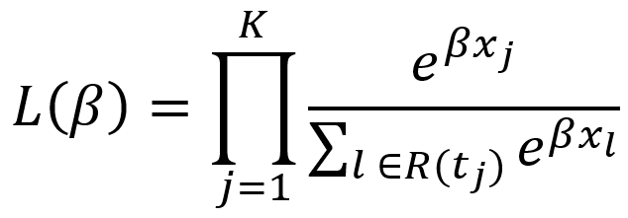
2.3) Background – Cox Regression Model
Cox Regression Model [4]
Identifies which factors influence survival time
Estimates a hazard ratio for each risk factor
Can handle multiple variables at once, adjusting for their effects
Assumes that hazard ratios stay constant over time
Mathematical Model
Risk of factors (smoking) is assumed to be constant
Estimates the chance of the events happening (risk) sooner or later for each risk factor
Product over all events K, all factors x of a patient, at time t_i, for all still observed patients R(t_j)
[4] https://www.emilyzabor.com/survival-analysis-in-r.html#the-cox-regression-model

Slide 7
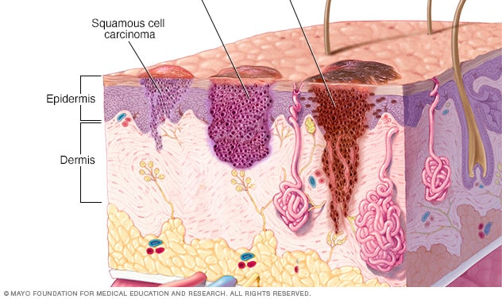
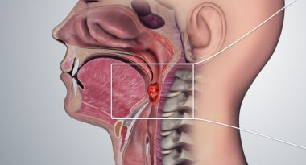
2.4) Background
Head and Neck Squamous Cell Cancer [0]
Collection of cancers usually developing in the mucosal surfaces of the head and neck
The combination of alcohol and tobacco use is the most important risk factor
Nearly 4% of all cancers in the United States
Males account for over two-thirds of cases, indicating a strong sex-based difference in risk
Most head and neck tumours are squamous cell cancers
[0] https://www.cancer.gov/types/head-and-neck/head-neck-fact-sheet

Slide 8
3) Objectives
Explore survival rates of Head and Neck Carcinoma over time
Explore influence of alcohol, tobacco consumption and sex on survival rate
Apply Kaplan-Meier method and Cox regression model to clinical data on cBioPortal
Compare our results to Progenetix

Slide 9
4.1) Dataset
cBioPortal [1]
An open-access, open-source resource for interactive exploration of cancer data sets
Head and Neck Squamous Cell Carcinoma [2]
NCIT:C34447
150 samples
Properties [2]
Patient ID
Overall Survival Months
Overall Survival Status
Sex
Alcohol Intensity
Smoking Status
[1] https://sciwiki.fredhutch.org/datascience/cbioportal
[2] https://www.cbioportal.org/study/clinicalData?id=ohnca_cptac_gdc

Slide 10
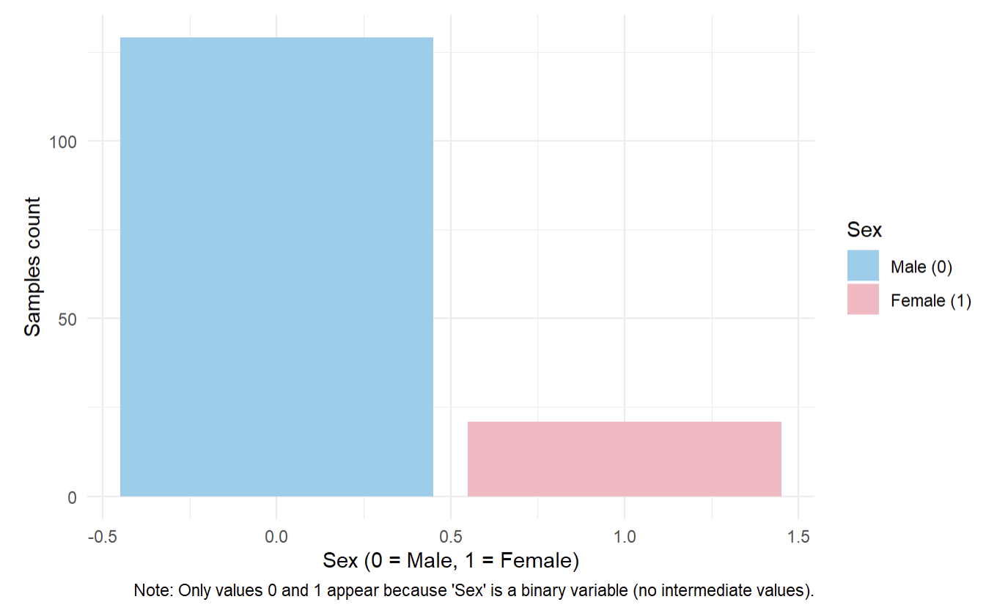
4.2) Dataset

Slide 11
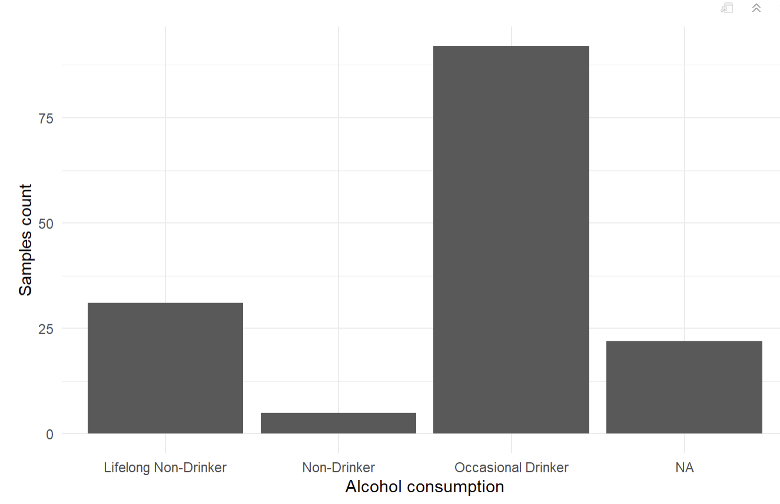
4.3) Dataset

Slide 12
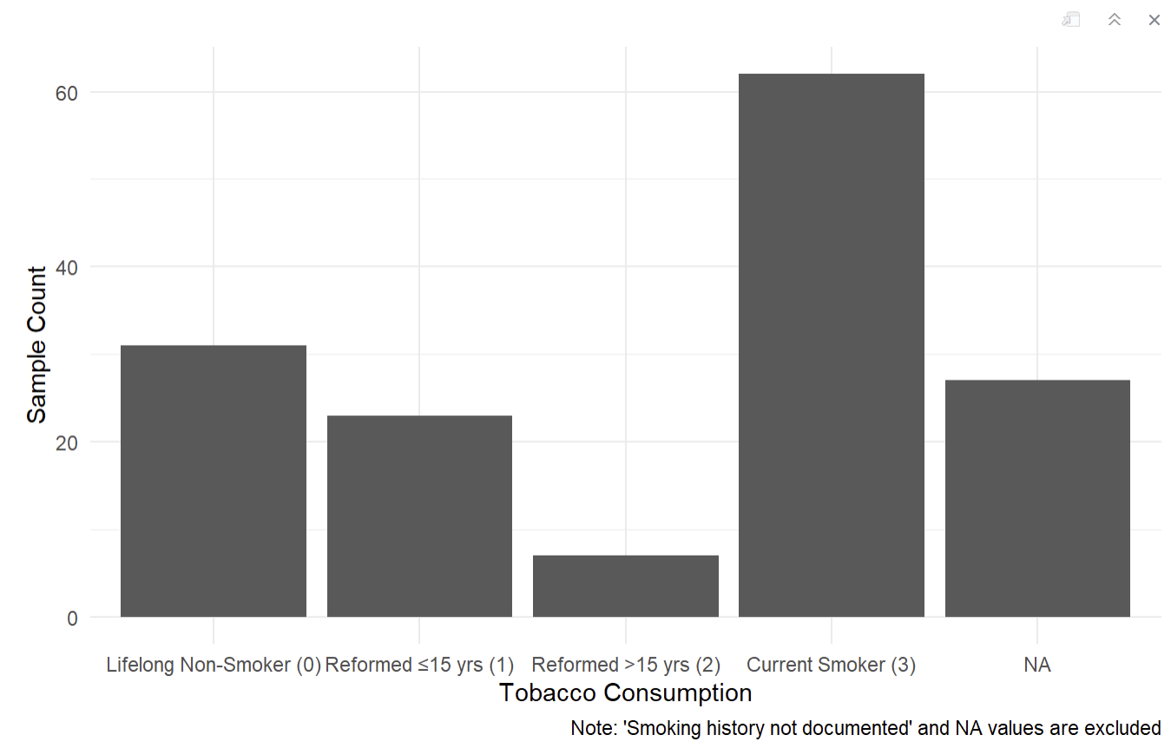
4.4) Dataset

Slide 13
5) Methods
Clinical survival data analysed using R
Variables conversions into binary representation for the use with libraries
Assessed both Kaplan-Meier and Cox models
Compared survival across groups and factors
Compared our results visually to Progenetix

Slide 14
6.1) Results - Kaplan-Meier Method
Year | Survival Rate (%) | 95% CI
1 | 92.1 | 87.7 – 96.7
2 | 81.8 | 75.3 – 88.9
3 | 67.6 | 58.7 – 77.8
4 | 59.1 | 49.5 – 70.6
Median Survival
1’314 days ~ 3.4 years (95% CI)

Slide 15
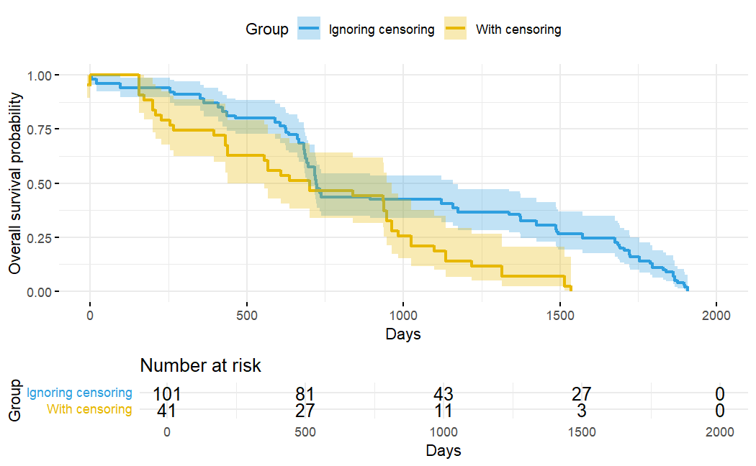
6.2) Results - Kaplan-Meier Method
Censoring in Survival Analysis
Censoring occurs when patients are still alive at the end of the study or missing follow-up
Ignoring censoring leads to a higher overall survival probability

Slide 16
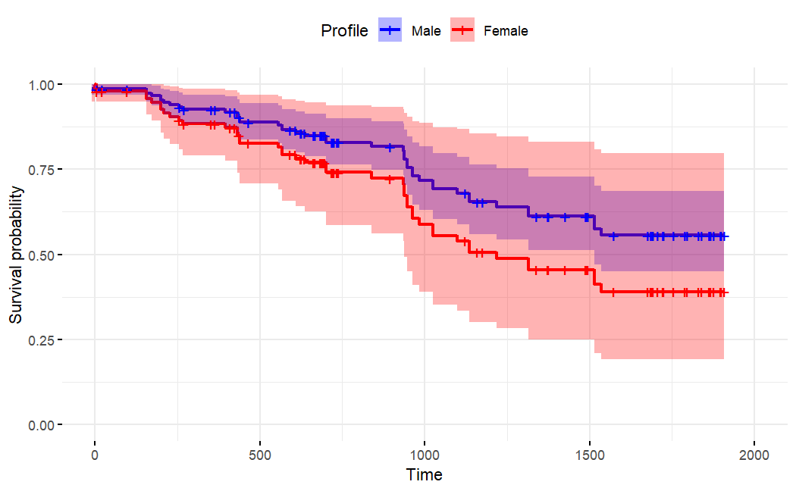
6.3) Results – Cox Regression Model
Sex and Survival
Only 21 female samples compared to 129 male samples
Lower survival probability for female patients but with large confidence interval
p = 0.2791

Slide 17
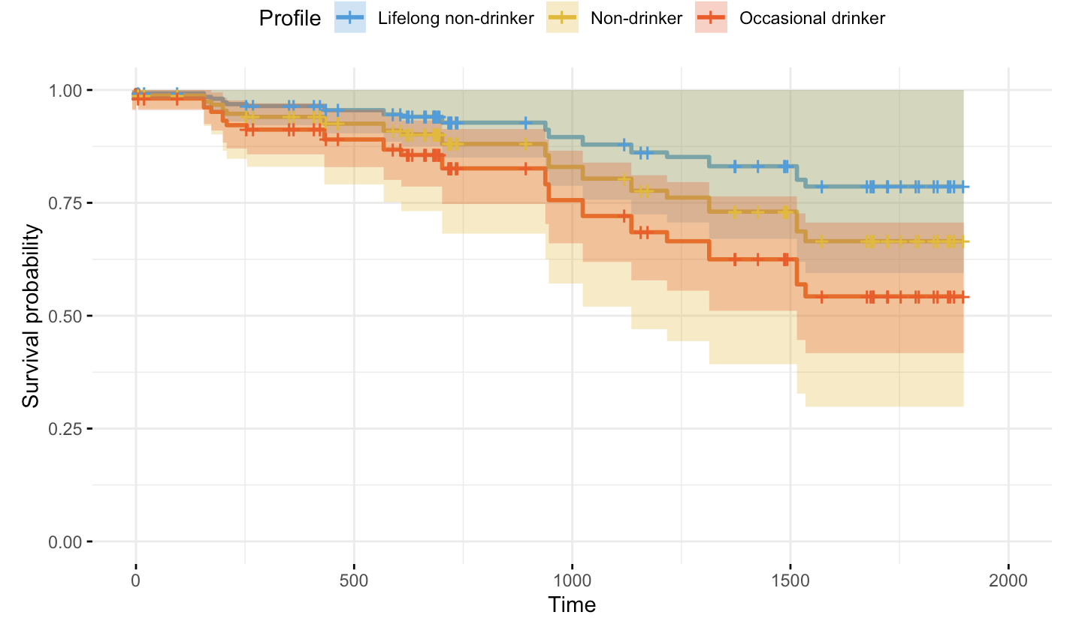
6.4) Results – Cox Regression Model
Alcohol Consumption
Measuring association of Alcohol Intensity with survival probability
Large confidence intervals
Notes:
The plot indicates -> occasional drinker has highest mortality rate. Lifelong non-drinker and non-drinker have high confidence intervals, since they are limited in number (especially non-drinkers) -> lifelong non and occasional can be compared better

Slide 18
6.5) Results – Cox Regression Model
Alcohol Abuse Level | Hazard Ratio (HR) | 95% CI | p-value | Interpretation
0 (Reference) | — | — | — | Baseline (no abuse)
1 (Moderate) | 1.70 | 0.18 – 16.4 | 0.60 | No significant effect
2 (Heavy) | 2.54 | 0.77 – 8.43 | 0.13 | Higher risk, but not statistically significant
Notes:
Result not significant though using the Cox regression model
HR = A measure of how often a particular event happens in one group compared to how often it happens in another group, over time

Slide 19
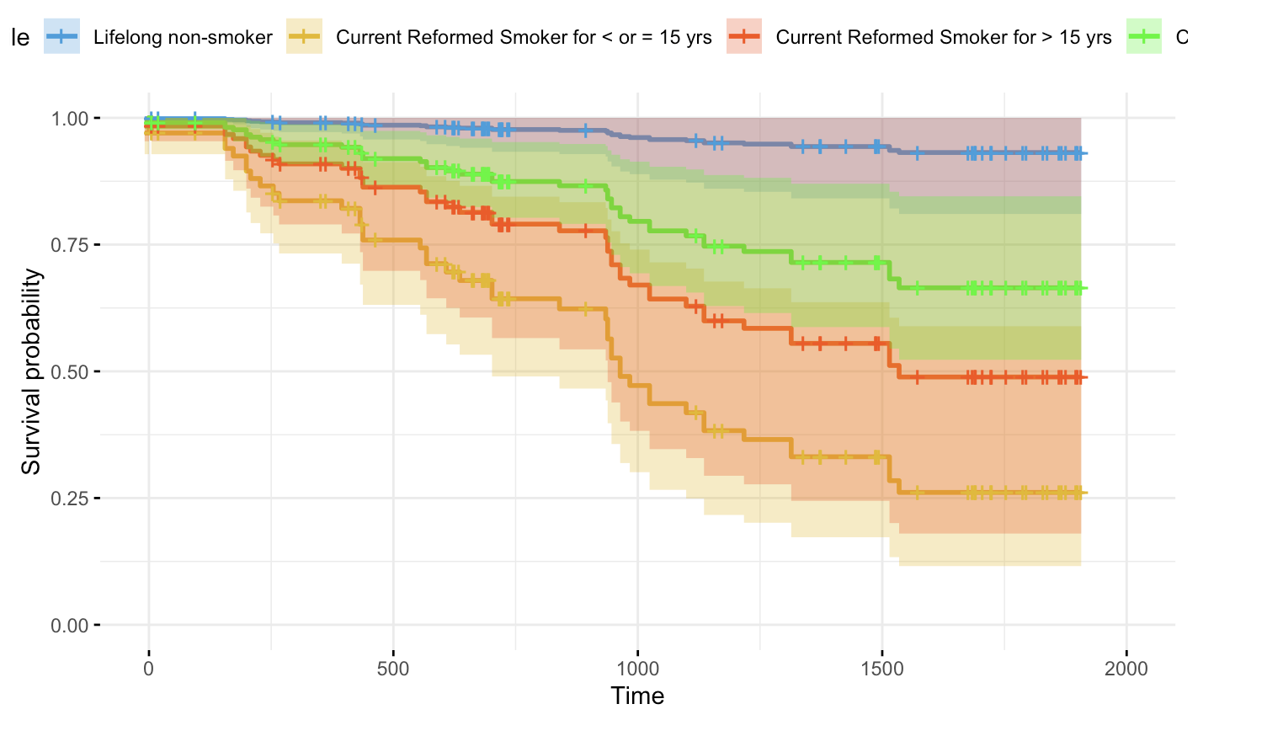
6.6) Results – Cox Regression Model
Smoking and Survival
Lifelong non-smokers (blue) show the highest survival probability across all time points
Long-term reformed smokers (yellow & red)
Current or recent smokers (green)
 | P - value
Smoking | 0.001
Notes:
More than 15 years very underrepresented -> very large confidence interval -> hardly be trusted
Althoug less data for lifelong non smoker -> small confidence interval -> better survival -> at least better than current smoker/reformed smoker
Lifelong and current have biggest sample size

Slide 20
6.7) Results – Cox Regression Model
 | P - value
Smoking and Alcohol | 0.01
Notes:
Interaction
Plot uninformative due to 12 combinations and small sample size for each combination -> plot that couldn't be interpreted

Slide 21
6.8) Results - Cox Regression Model
Variable | p-value | Significant?
Sex | 0.28 | No
Alcohol Abuse | 0.30 | No
Smoking | 0.001 | Yes
Smoking and Alcohol | 0.01 | Yes
Notes:
Here a plot would have 12 combinations, which would be
Summary table

Slide 22

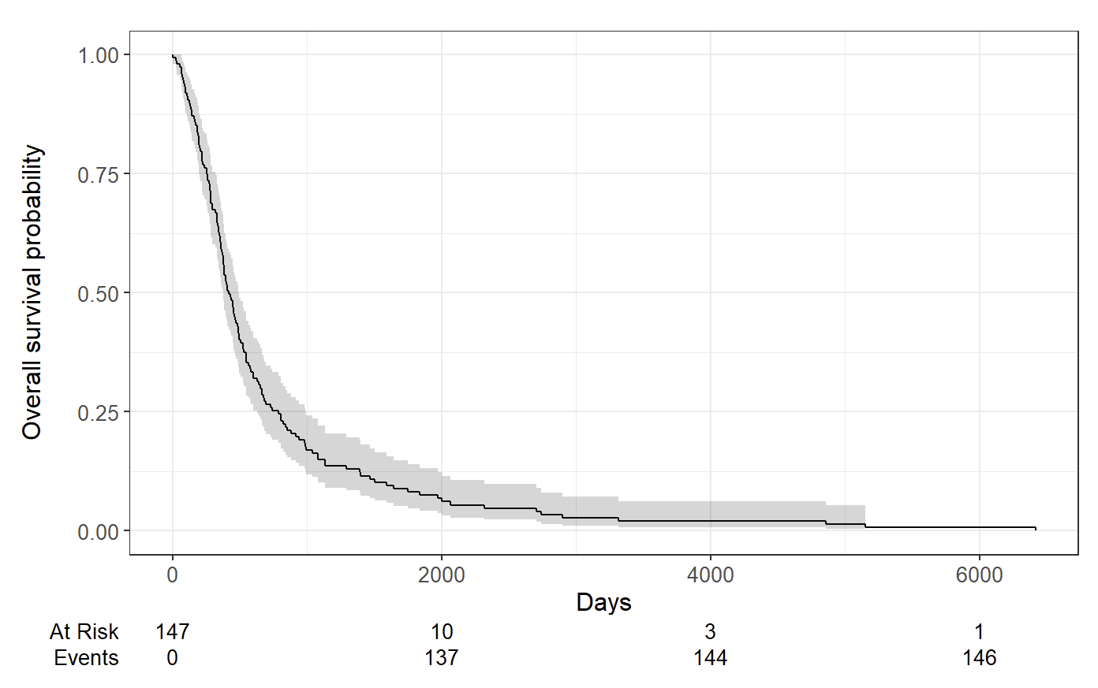
7.1) Discussion - Progenetix
Our Results
150 samples
Progenetix
2053 samples
Notes:
Progenetix has more data, and goes to 0. we have only limited data (150 vs 2053 samples)
Has median survival 415 days compared to ours of 1'314 days.
Progenetix has more tumours

Slide 23
7.2) Discussion - Progenetix
 | Our Results | Progenetix
Median Survival (95% CI) | 1’314 d | 415 d
Notes:
Progenetix has more data, and goes to 0. we have only limited data (150 vs 2053 samples)
Has median survival 415 days

Slide 24
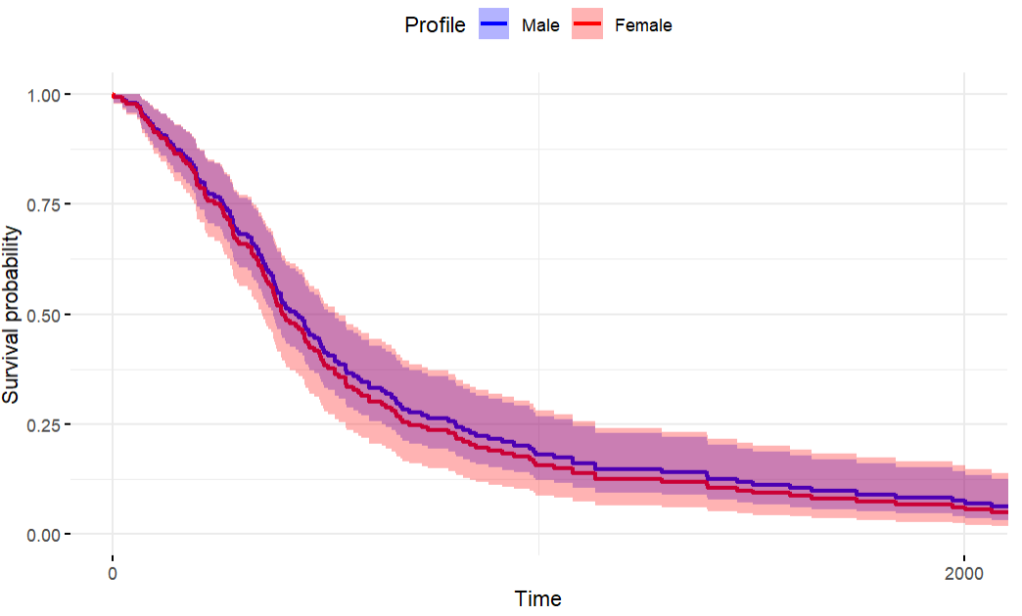
7.3) Discussion - Progenetix
Our Results
p-value = 0.28
Progenetix
p-value = 0.66
Notes:
p=0.6559 is the cox p-value for sexes, so also not statistically significant, even with more data.
Only one that we could compare, progenetix is missing clinical data

Slide 25
8) Conclusion
Compared to Progenetix, our results indicate a much longer median survival time
Association between sex and survival rate was not significant by our results and Progenetix
Results show no significant association between alcohol consumption and survival
Results show significant association between smoking and survival
Results show significant association between combination of smoking and alcohol consumption and survival
Big difference in datasets from cBioPortal and Progenetix
Notes:
Kaplan meier shows very long survival compared to progenetix
Alcohol consumption -> non significant
Smoking consumption -> significant
Interaction between Alcohol and smoking (progenetix doesn't have those) -> significant interaction
Differences between sex -> not significant in both progenetix and our analyses
Difference in sample size and length of study (2000 days vs 6000 days), and progenetix is missing the clinical information of alcohol and tobacco consumption

Slide 26
Thank you for listening

