Slide 1
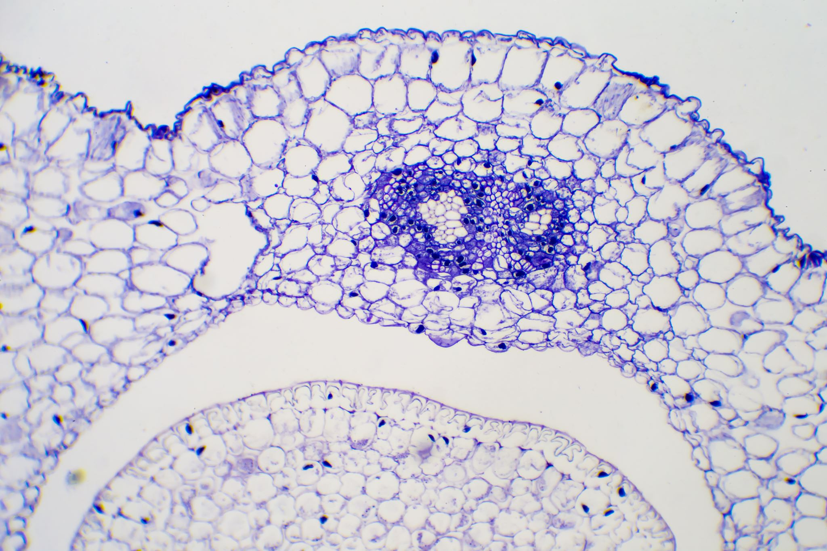
Respiratory System Neoplasm
Copy number variation of four genes of interest and their impact on lung cancer development

Slide 2
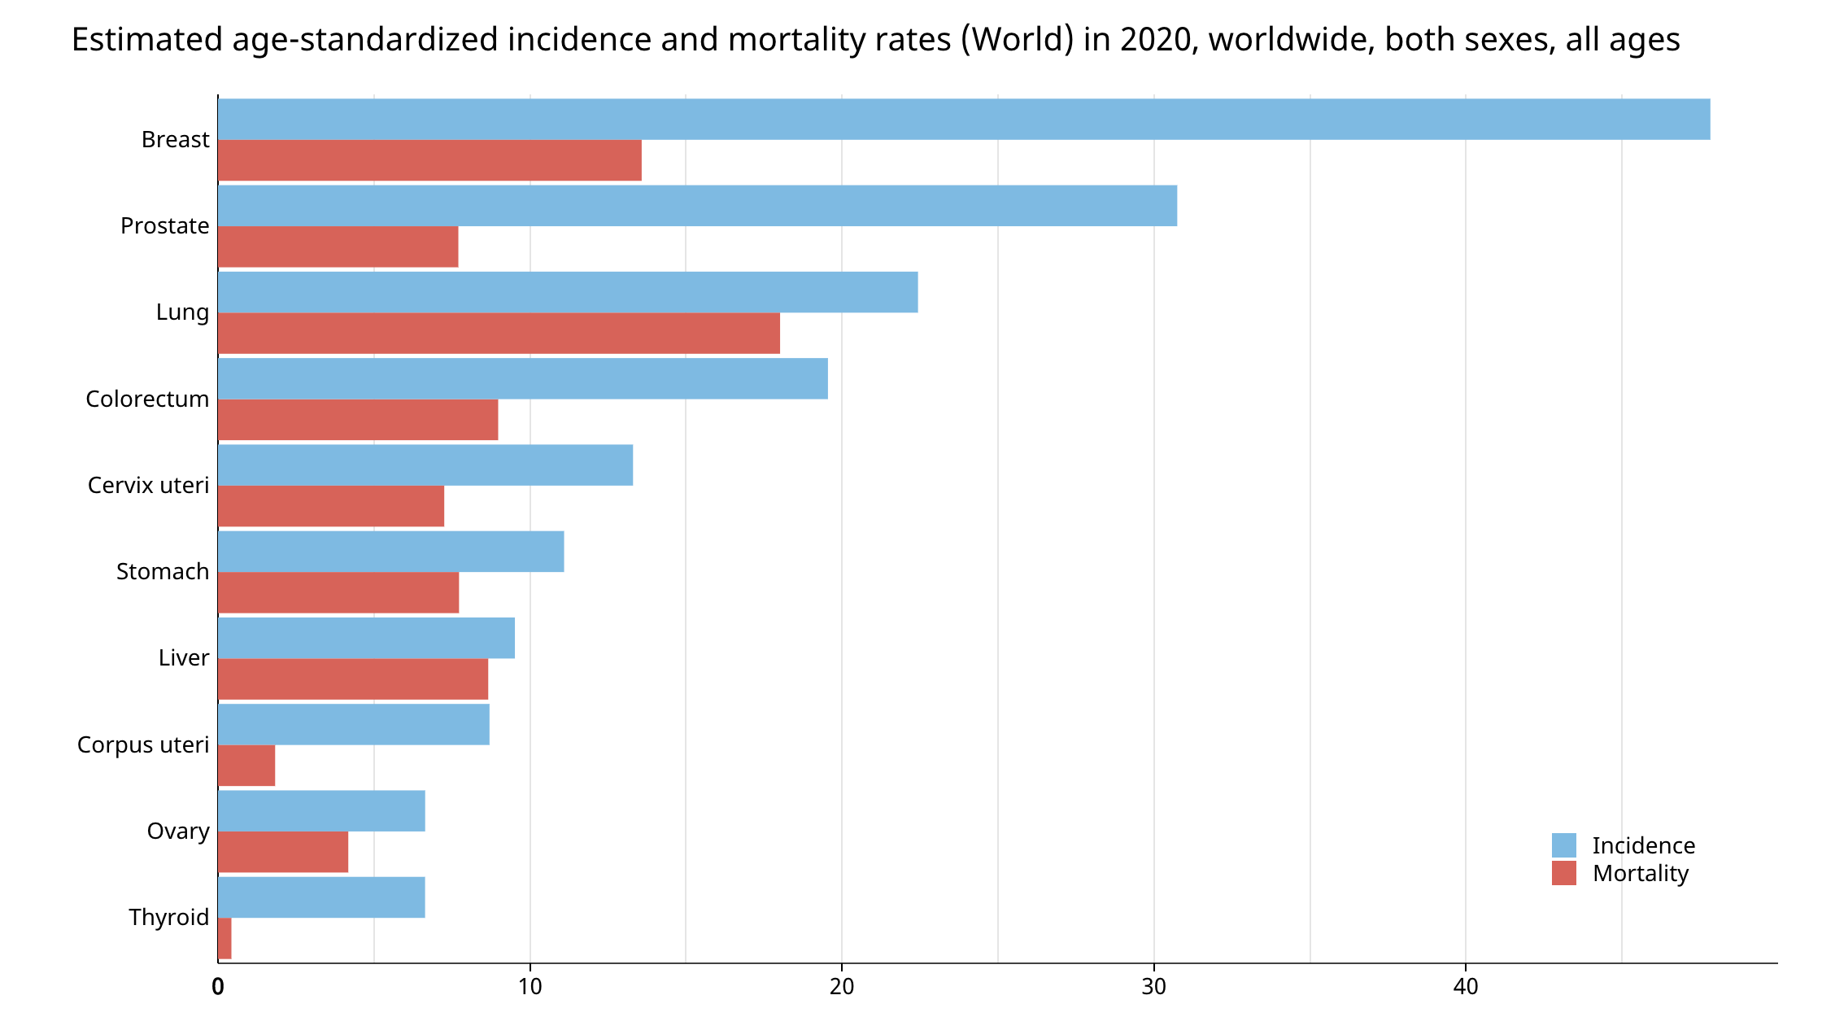
General stats
Source: Global Cancer Observatory

Slide 3
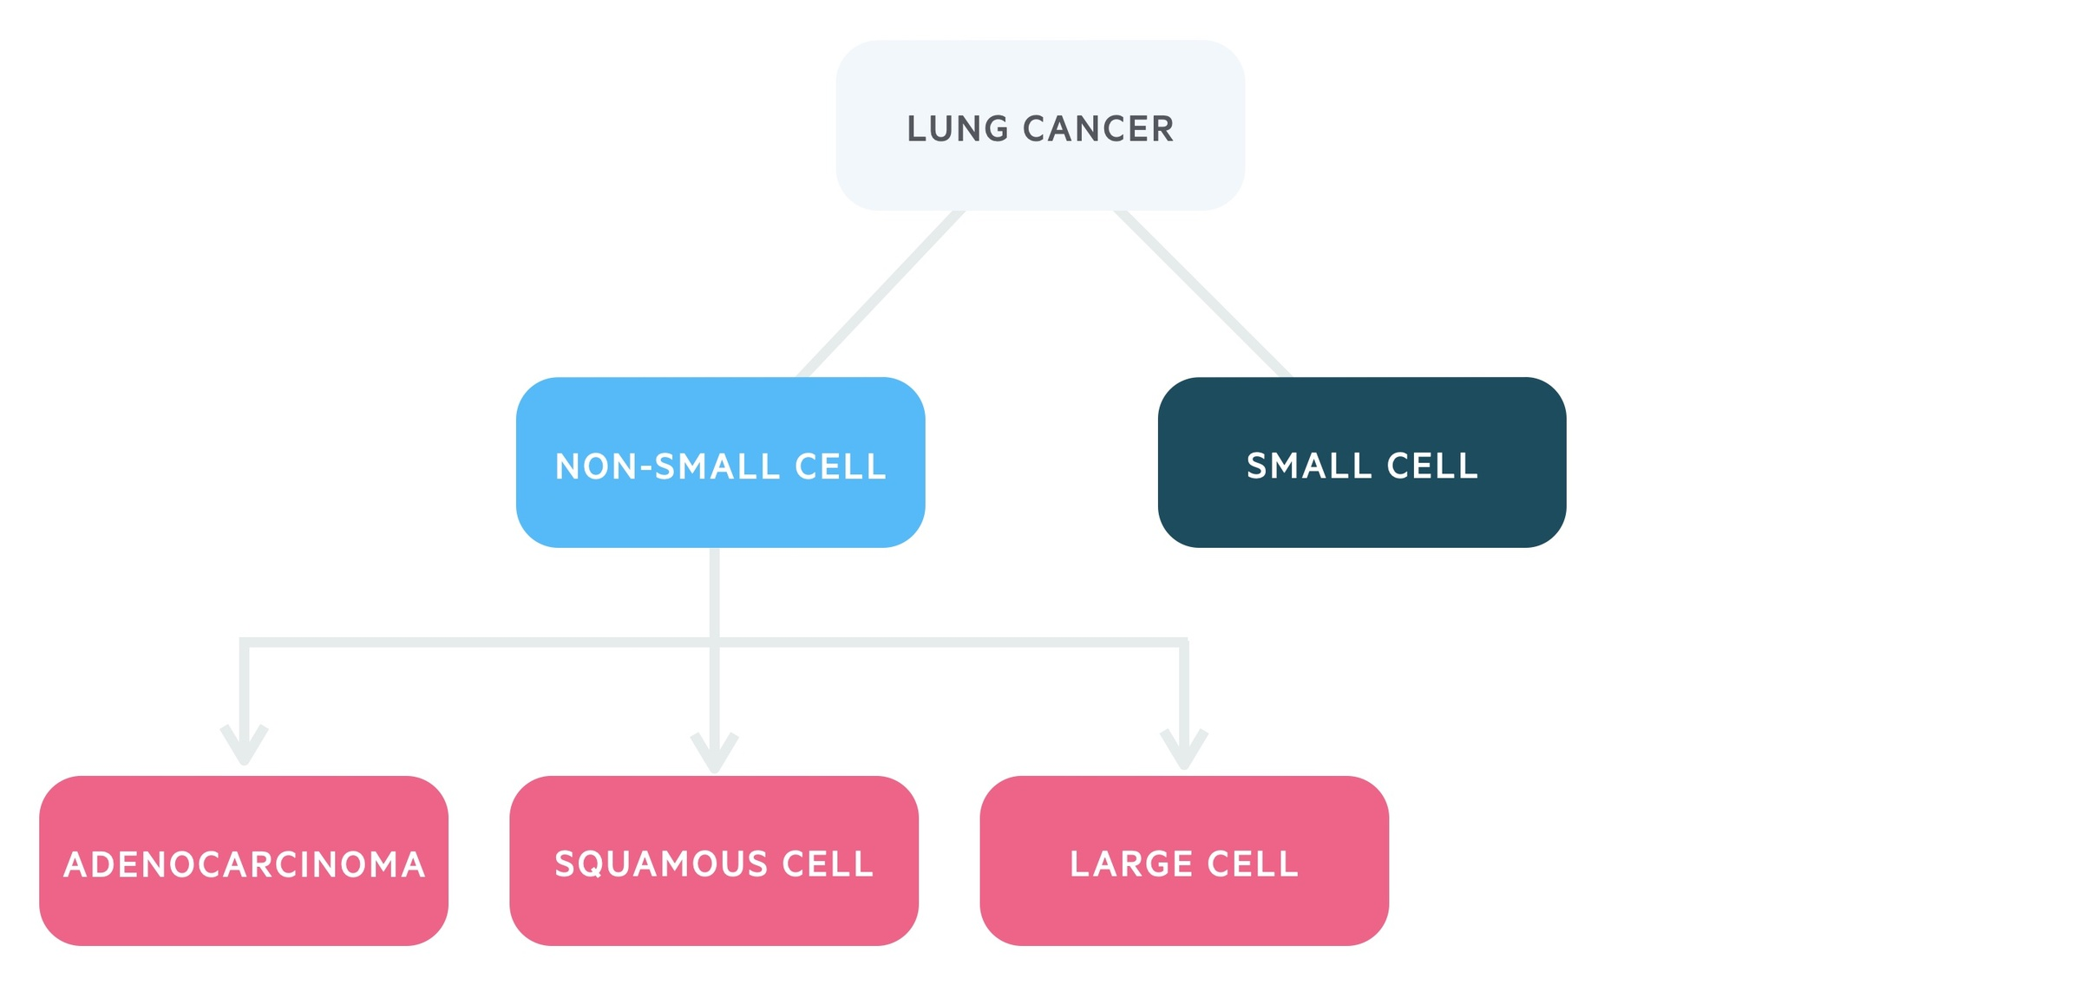
Main types
Notes:
Types of respiratory system neoplasms: broadly categorized into two main types: Non-Small-Cell Lung Cancer (NSCLC) and Small-Cell Lung Cancer
Adenocarcinoma and Squamous Cell Carcinoma both are NSCLC and most frequent Lung cancer types
small cell lung cancer spreads more aggressively than non small cell lung cancer
neuroendocrine carcinomas, carcinoid tumors

Slide 4
Aim of our project
How do CNVs in genes ERBB2, MYC, TP53, CDKN2A affect lung cancer survival?
Procedure:
Understand data set
Survival rate: cancer subtypes, mutations in genes of interest
CNV fractions in different cancer subtypes to understand if deletions or duplications were more prevalent

Slide 5
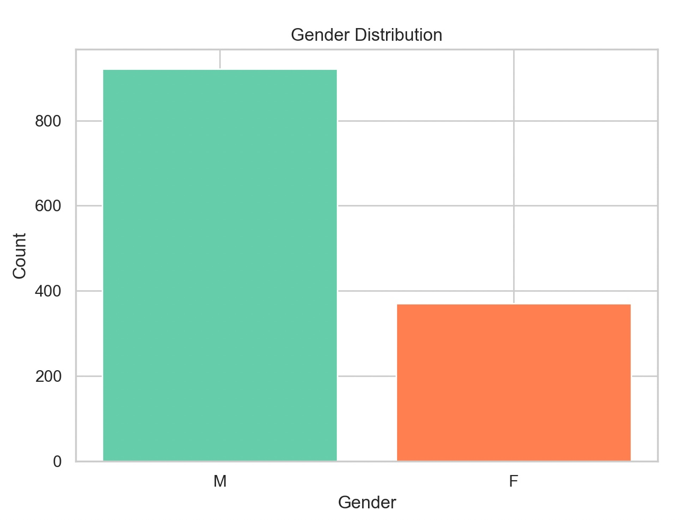
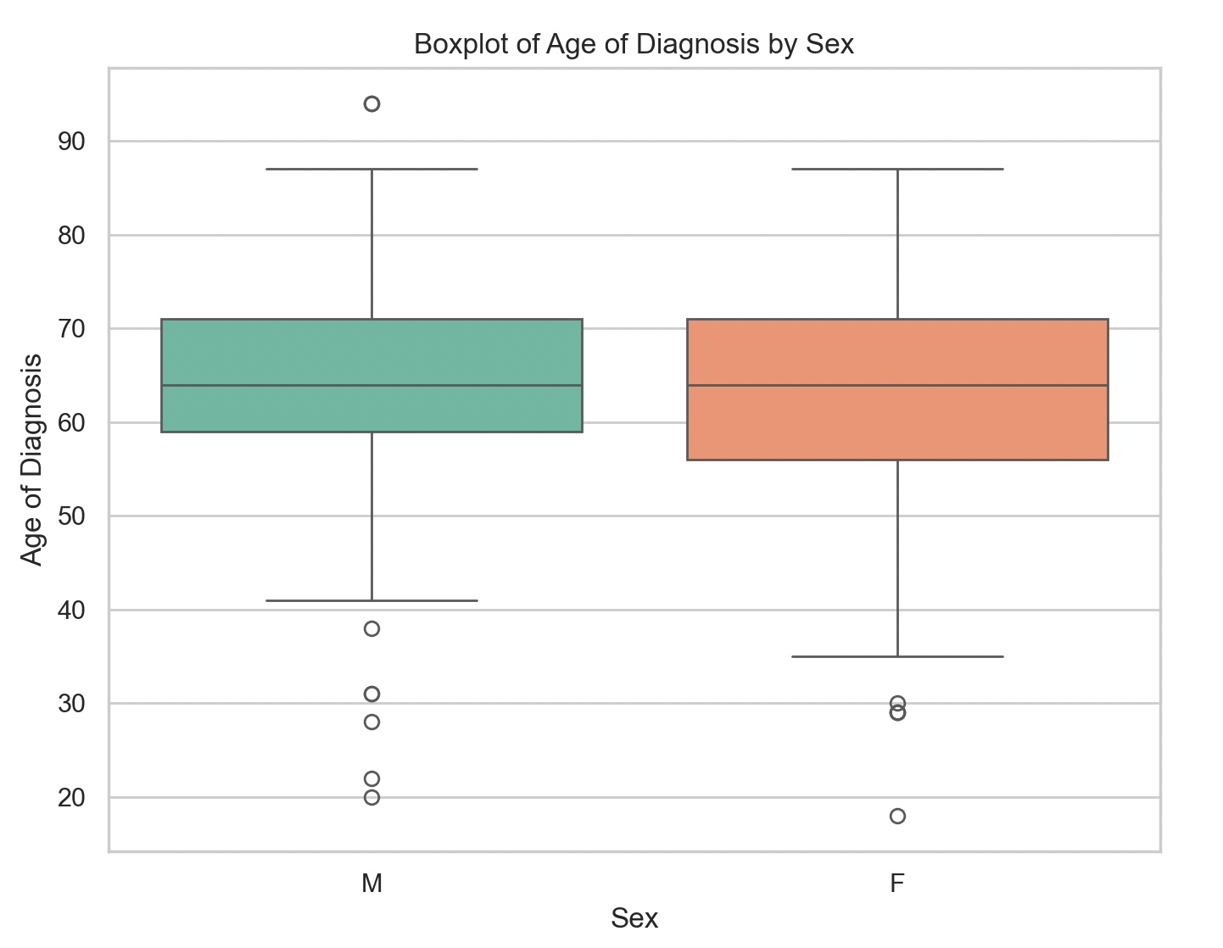
Results
Sex
Sex
Notes:
- in the plot you can see that age of onset of disease is similar in women and men
- males have higher incidence of lung cancer
- our results also correspond with papers we‘ve found online

Slide 6
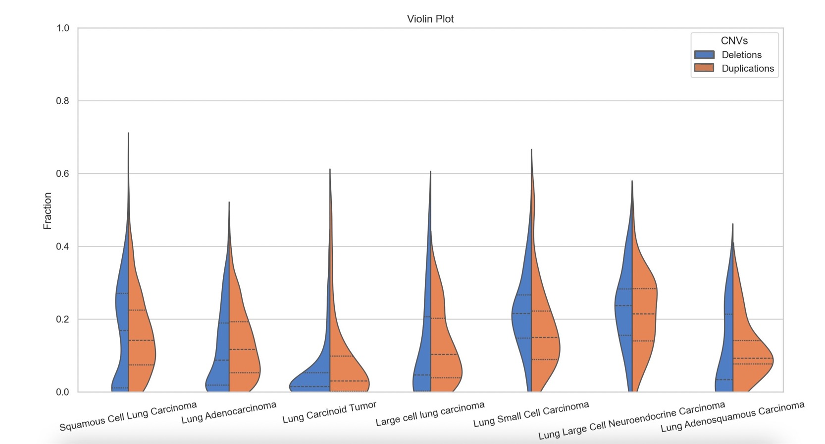
CNV fractions in lung cancer subtypes
Notes:
- most copy number variation: large cell neuroendocrine carcinoma
- carcinoid tumor shows the least copy number variation
- CNVs contribute to tumour progression
- large cell neuroendocrine is very aggressive
- generally we observe more duplications

Slide 7
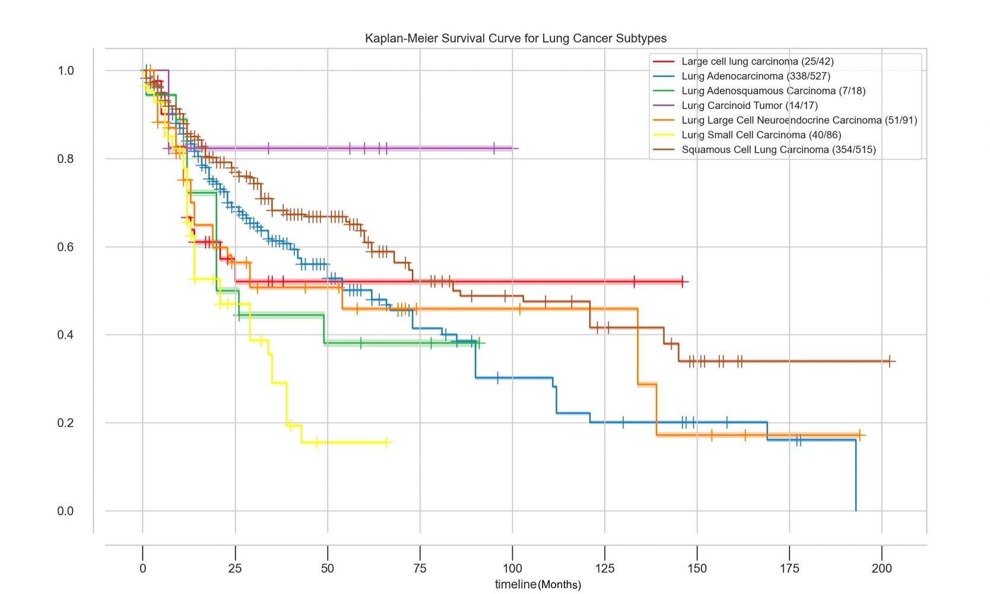
Notes:
- poorest survival for small cell carcinoma
-

Slide 8
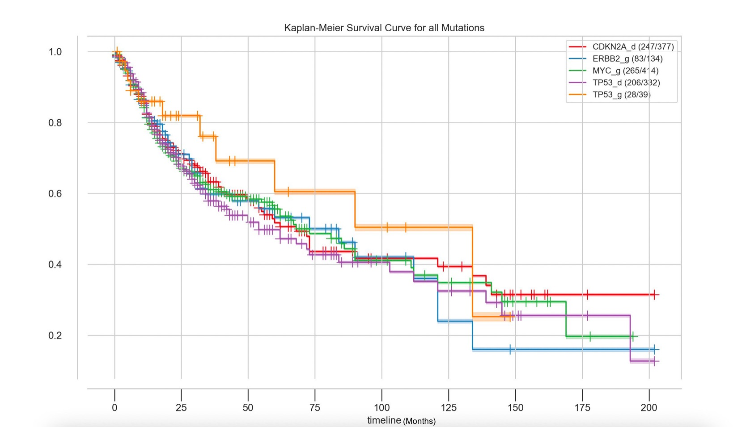
Notes:
- ERBB2 gain mutation have poorest survival after about 10 years
- tp53 gain occurs in lung cancer but less frequent and better survival outcome than tp53 deletion

Slide 9
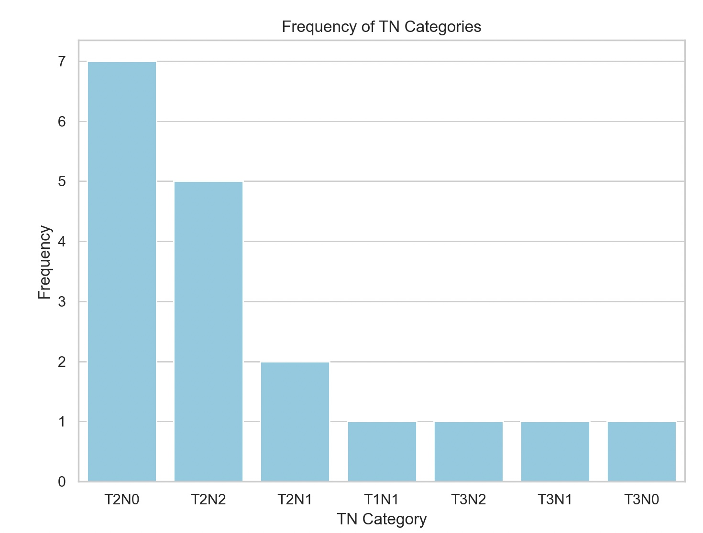
Notes:
- TNM: tumor size, n: lymph node, m: metastasis
- T2: 3-5 cm big, has invaded nearby structures of the lung
- N0: lymph nodes do not contain cancer cells
- N2: lymph nodes next to lung are affected by cancer cells

Slide 10
Conclusion
Males are more affected than females
Small lung cancer is most aggressive lung cancer type
Unexpected impact of ERBB2 on survival prognosis

