Slide 1
The Privacy Externality Game
Strategic budget choices in sampling-based individual differential privacy
Silos declare ε_{i}; the mechanism solves one σ and rates p_{i} (every budget binds, Σ|G_{i}|p_{i} = B); each silo maximises u_{i} = V(σ) − λ_{i} A_{PLD,i}.
Canonical instance: 2 silos × 5000 records, B = 128, T = 390, δ = 10⁻¹², ε ∈ [0.5, 64], λ = 1.
IN PLAIN WORDS
With individual differential privacy, each data owner picks how private their data should be. In the popular sampling-based version, all choices are tied together through one shared batch and one shared noise level, so your privacy depends on what everyone else picks. We ask what happens when everyone picks rationally.
EVERY SLIDE: ONE FINDING, WITH A TRUST LEVEL
A · proved / exact
analytic proof or exact accounting (closed form / certified)
B · solid numerics
post-fix deployed-accountant numerics, K = 200 grid
C · provisional
pre-fix, coarse, or single-configuration evidence

Slide 2
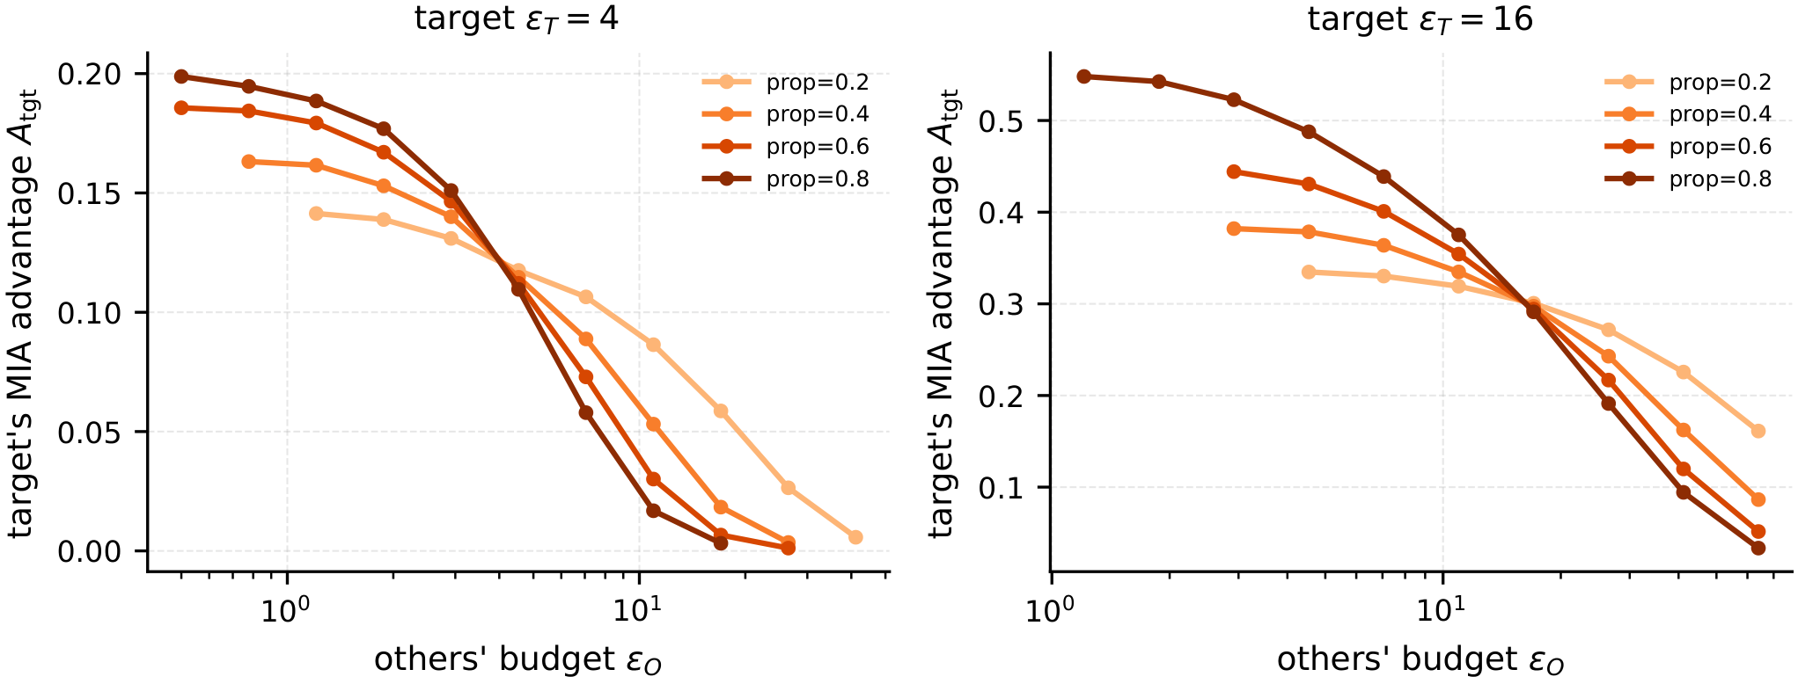
FINDING 1 · THE EXTERNALITY
Your risk is set by the others' budgets, not by your contract
WHAT WE LOOKED AT
• Target budget fixed (ε_{T} = 4, 16); other group's budget ε_{O} and data share (0.2–0.8) swept; A_{PLD} by exact PLD accounting.
WHAT WE FOUND
• Same contract: A_{PLD} falls 0.20 → ≈0 (ε_{T}=4) and 0.55 → 0.03 (ε_{T}=16) as the others loosen.
• Curves cross at ε_{O} ≈ ε_{T}: a large foreign share amplifies the effect below, damps it above.
• Tightening any budget raises everyone else's A_{PLD}.
Paper Fig. 15. Canonical instance, deployed RDP accountant.
HOW MUCH TO TRUST IT
IN PLAIN WORDS
A · proved / exact
B · solid numerics
Each training batch has a fixed number of seats. If the other group asks for more privacy, it takes fewer seats, so your records are drawn more often to fill the batch, and more noise is added. The extra sampling outweighs the extra noise: your data leaks more, although your own setting never changed.
• Sign proved for small p. Full K = 200 grid: 0 violations in 25,612 unit differences (321 ties). No analytic proof beyond small p.
The Privacy Externality Game · strategic budgets in sampling-based iDP
2
Notes:
Files: run_continuous.py (C5) → _cache_v2/C5.pkl; tasks_findings/20, 11; FINDINGS_MAP T1

Slide 3
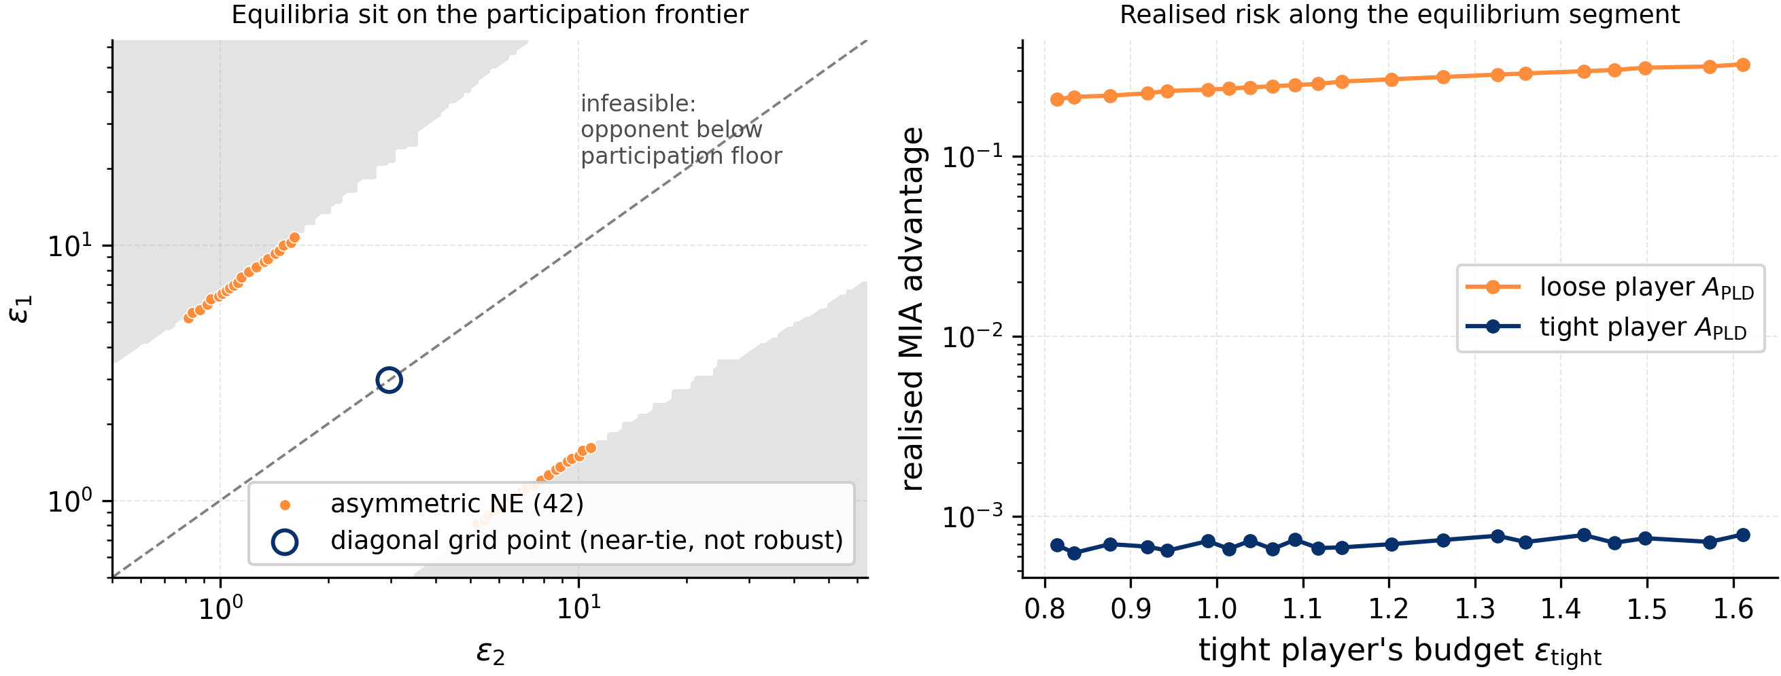
FINDING 2 · EQUILIBRIUM STRUCTURE
Identical players mostly split into a hiding and a carrying role
WHAT WE LOOKED AT
• Symmetric 2-player game, λ = 1: all pure NE on the K = 200 deployed grid; exact first-order conditions at the equilibria.
WHAT WE FOUND
• 42 of 43 grid NE sit on the participation frontier: tight player at the floor rate, loose player 6.4–6.7× looser.
• Risk ≈7·10^{−4} vs 0.21–0.32; the hiding seat earns more (0.43–0.59 vs 0.23–0.27): Hawk–Dove.
• Corner equilibria (two one-sided conditions): the grid samples one continuum. The 43rd point is the symmetric equilibrium (next slide).
HOW MUCH TO TRUST IT
IN PLAIN WORDS
A · proved / exact
B · solid numerics
Two identical groups do not end up behaving alike. One sets a strict budget and is almost never sampled (it hides at the floor); the other fills nearly all batch seats. The hider gets the good model almost for free. As in Hawk–Dove, both prefer the hiding role, but only one can have it.
• Corner conditions exact (loose player pushes into the wall, +9.7·10⁻³); the asymmetric family survives every grid, V and accountant tested.
The Privacy Externality Game · strategic budgets in sampling-based iDP
3
Notes:
Files: run_locus.py (C6) → C6_K200.pkl; exact_foc.py; slides/make_figs.py; FINDINGS_MAP T2

Slide 4
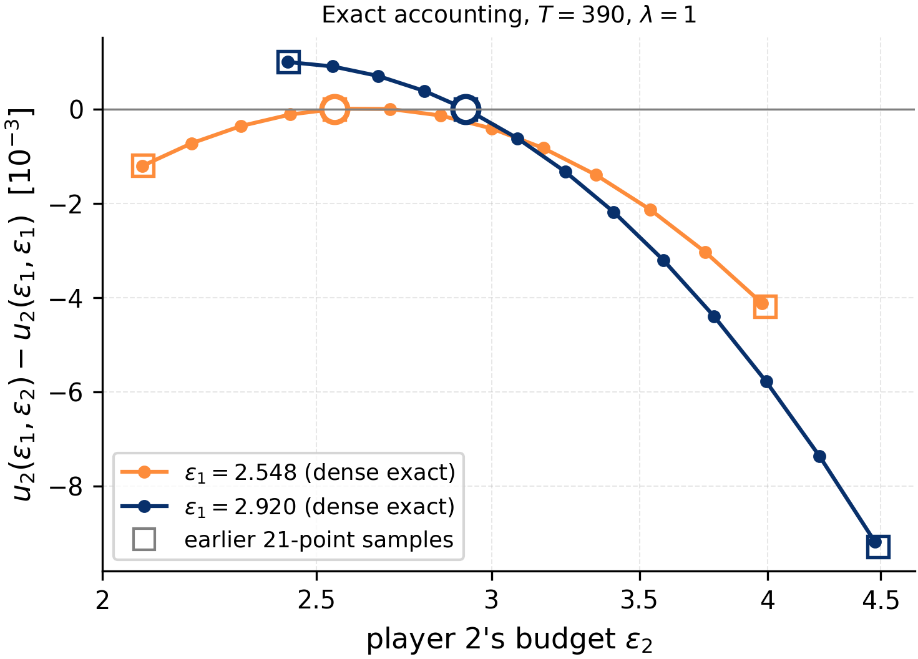
FINDING 3 · SYMMETRIC MODERATION
There is one symmetric equilibrium, and it needs composition
WHAT WE LOOKED AT
• Exact composition (no accountant), T = 390, λ = 1: player 2's utility on 14 dense budgets around the diagonal for ε₁ = 2.548 and 2.92 (Slurm 292170).
WHAT WE FOUND
• The own slice is a peak, not a trough: BR(2.548) ≈ 2.62, BR(2.92) ≈ 2.38.
• Symmetric NE at ε* ≈ 2.59 (σ ≈ 1.16 < √3); BR slope ≈ −0.65, so best-response play is locally stable.
• T ≤ 2: no interior symmetric NE at any λ. The deployed RDP grid shows this point at 2.96, as a 10⁻⁴ near-tie.
HOW MUCH TO TRUST IT
IN PLAIN WORDS
A · proved / exact
B · solid numerics
There is one exception: if both pick a moderate budget of about 2.6, neither gains by moving. It exists only because training repeats the noisy step many times; with 1–2 steps it does not. The peak is very flat, so a coarse search can easily miss it or invent it.
• Exact profiles, dense near the diagonal. ε* is bracketed (2.55, 2.92) by two columns; stability from a two-point slope. The earlier 21-point columns had no deviation within ±40% of the diagonal.
The Privacy Externality Game · strategic budgets in sampling-based iDP
4
Notes:
Files: game_experiments/t390_local_slice.py → _scripts/83_t390_local_slice.pkl; multi_step_game.py; FINDINGS_MAP T4

Slide 5
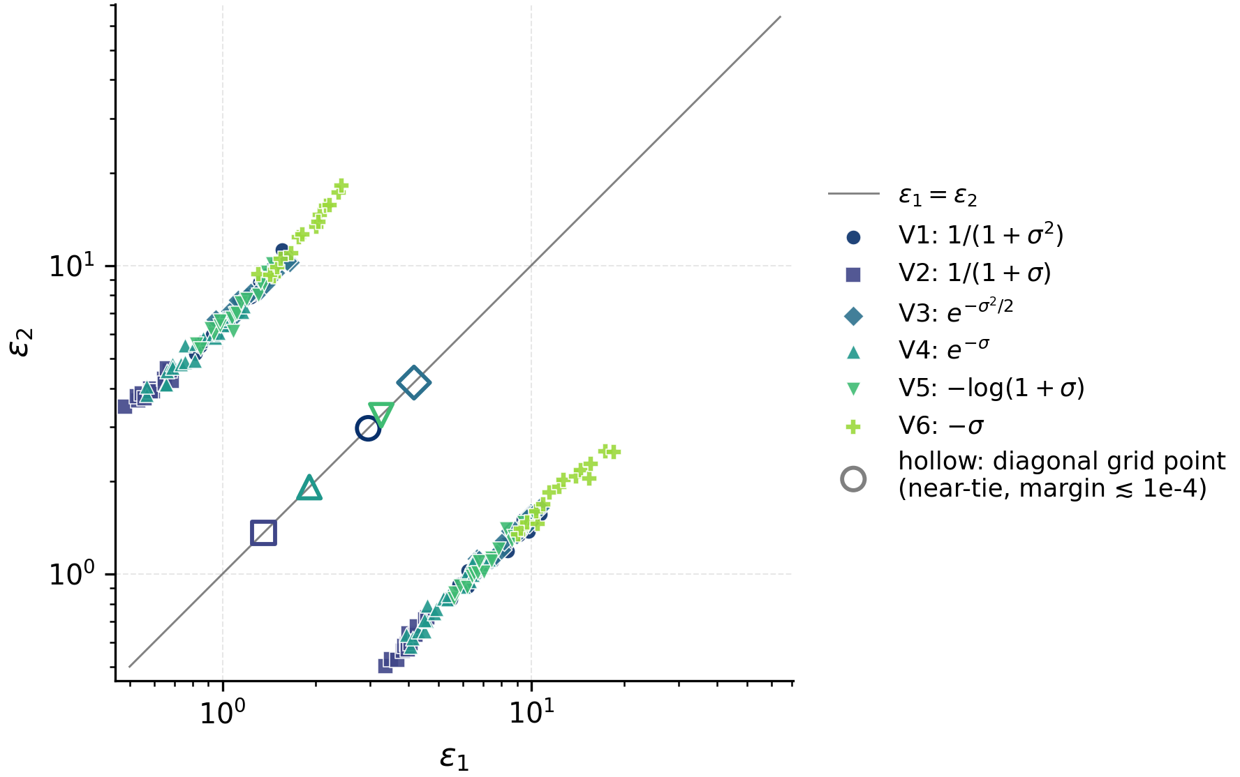
FINDING 4 · UTILITY MODEL
Utility shape moves the symmetric point, never the asymmetric family
WHAT WE LOOKED AT
• Six admissible V(σ): 1/(1+σ²), 1/(1+σ), e^{−σ²/2}, e^{−σ}, −log(1+σ), −σ; pure NE re-enumerated on the same K = 200 mechanism grid (V-free).
WHAT WE FOUND
• All asymmetric NE lie on the same participation frontier; V only slides their extent (27–45 NE).
• Five of six V show one symmetric point, at a V-dependent budget (1.4–4.2); linear V = −σ shows none.
• So the symmetric point is a property of V's shape; the asymmetric family is a property of the mechanism.
Paper Fig. 14, recomputed on the post-fix grid. Hollow: symmetric grid points.
HOW MUCH TO TRUST IT
IN PLAIN WORDS
B · solid numerics
C · provisional
We don't know exactly how model quality depends on noise, so we tried six plausible curves. The 'one hides, one carries' outcomes barely move: they come from how seats are allocated, not from the curve. Only the moderate equal-budget point depends on it, and a straight-line curve removes it.
• Frontier family: solid. Symmetric points: deployed-grid near-ties (margins ≲ 10⁻⁴), exact check done only for V₁.
The Privacy Externality Game · strategic budgets in sampling-based iDP
5
Notes:
Files: tasks_findings/_scripts/15_v_shape.py, 82_paper_audit.py; slides/make_figs.py; FINDINGS_MAP T15

Slide 6
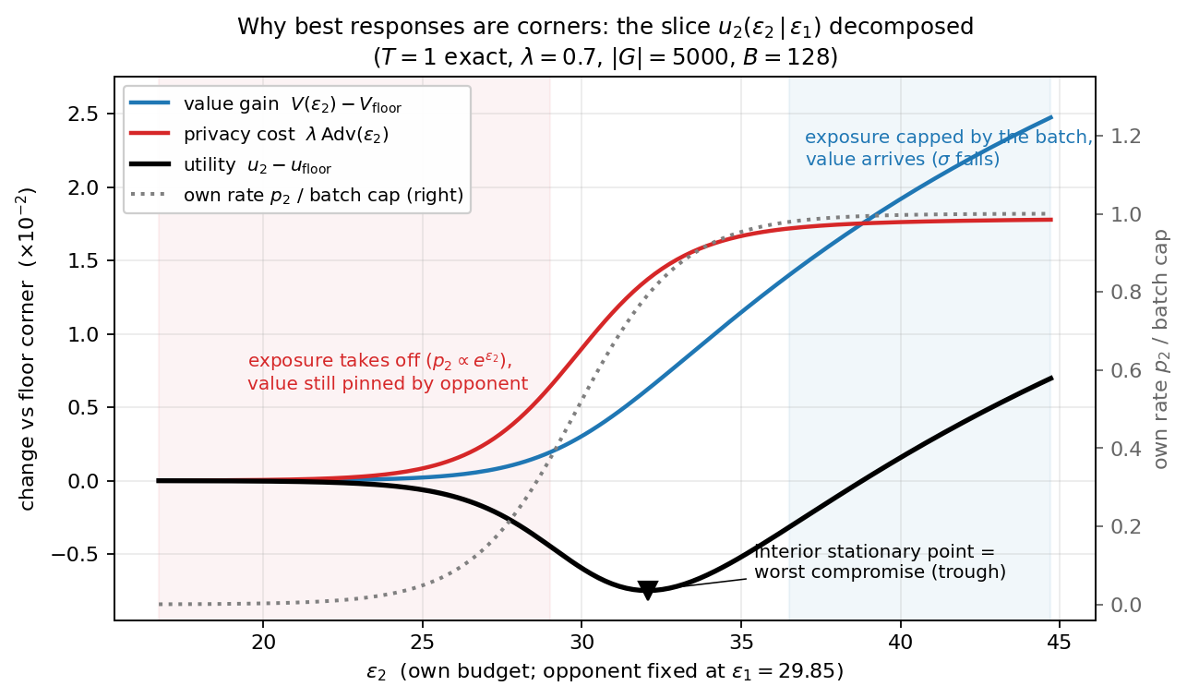
FINDING 5 · WHY
A budget buys participation before it buys model quality
WHAT WE LOOKED AT
• Exact T = 1 game (closed form): own-budget slice split into value gain and privacy cost; λ swept over 10⁻³–80; group size 500–50,000.
WHAT WE FOUND
• Rate phase: exposure takes off ~e^{ε} while σ is still pinned by the opponent → a trough. Moderate participation is the worst reply.
• Noise phase: rate capped; extra budget lowers σ.
• Best replies: floor, frontier, or noise phase, hence the corner equilibria.
T = 1, λ = 0.7, |G| = 5000, B = 128; opponent fixed at ε₁ = 29.85.
HOW MUCH TO TRUST IT
IN PLAIN WORDS
A · proved / exact
B · solid numerics
Raising your budget first mainly gets you sampled more, so your exposure jumps while the other group still controls the noise and the model hardly improves. Only once you hold most of the batch does extra budget make the model cleaner. The middle is the worst spot: stay strict or go all in.
• Machine precision at T = 1, certified at T = 2. Across 191 robustness worlds corner play holds in 107/110 linear-cost ones; convex cost breaks it.
The Privacy Externality Game · strategic budgets in sampling-based iDP
6
Notes:
Files: single_step_*.py, two_step_*.py, _scripts/46, 66; nummeric_eval §7–15; FINDINGS_MAP T3

Slide 7
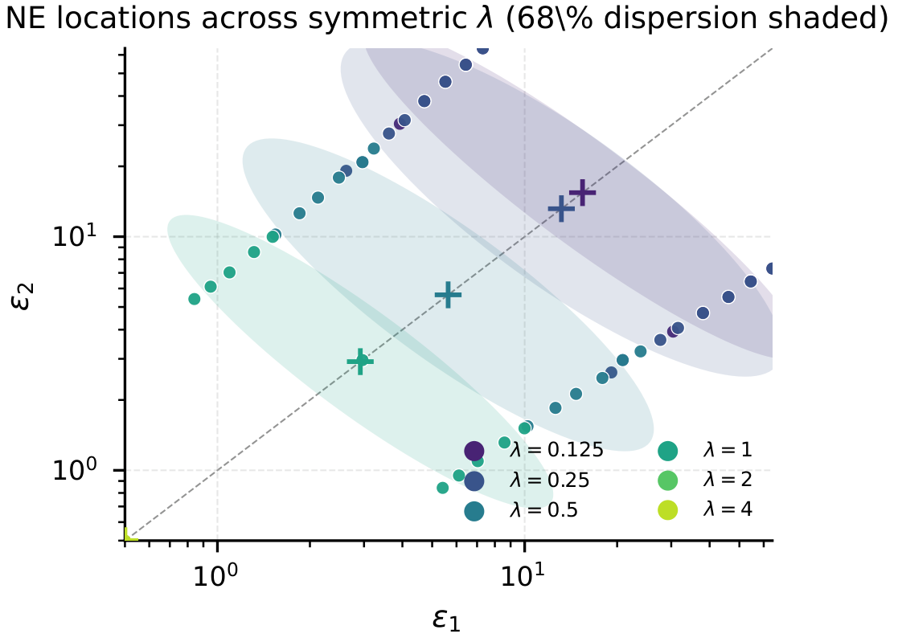
FINDING 6 · SHARED PRIVACY PREFERENCE
Caring more about privacy shifts the asymmetric family down
WHAT WE LOOKED AT
• Common weight λ ∈ {0.125, …, 4} for both players; all pure NE on the K = 200 deployed grid.
WHAT WE FOUND
• λ ≤ 0.5: 34–62 NE, all asymmetric; λ = 1 adds the symmetric point.
• Higher λ pulls the whole family to lower budgets.
• λ = 2: no pure NE on this grid; λ = 4: single corner (0.5, 0.5).
Paper Fig. 16. Crosses: centroids; ellipses: 68% dispersion.
HOW MUCH TO TRUST IT
IN PLAIN WORDS
B · solid numerics
C · provisional
If both groups care more about privacy, both choose stricter budgets, but the split into one hider and one carrier remains. Turning up how much everyone values privacy does not make the groups behave the same way.
• Asymmetric family: solid. The λ = 2 gap is accountant-conditional: with 761 Rényi orders the cycle collapses onto pure NE.
The Privacy Externality Game · strategic budgets in sampling-based iDP
7
Notes:
Files: run_locus.py (C7) → C7_K200.pkl; run_cycle_zoom.py; FINDINGS_MAP T6

Slide 8
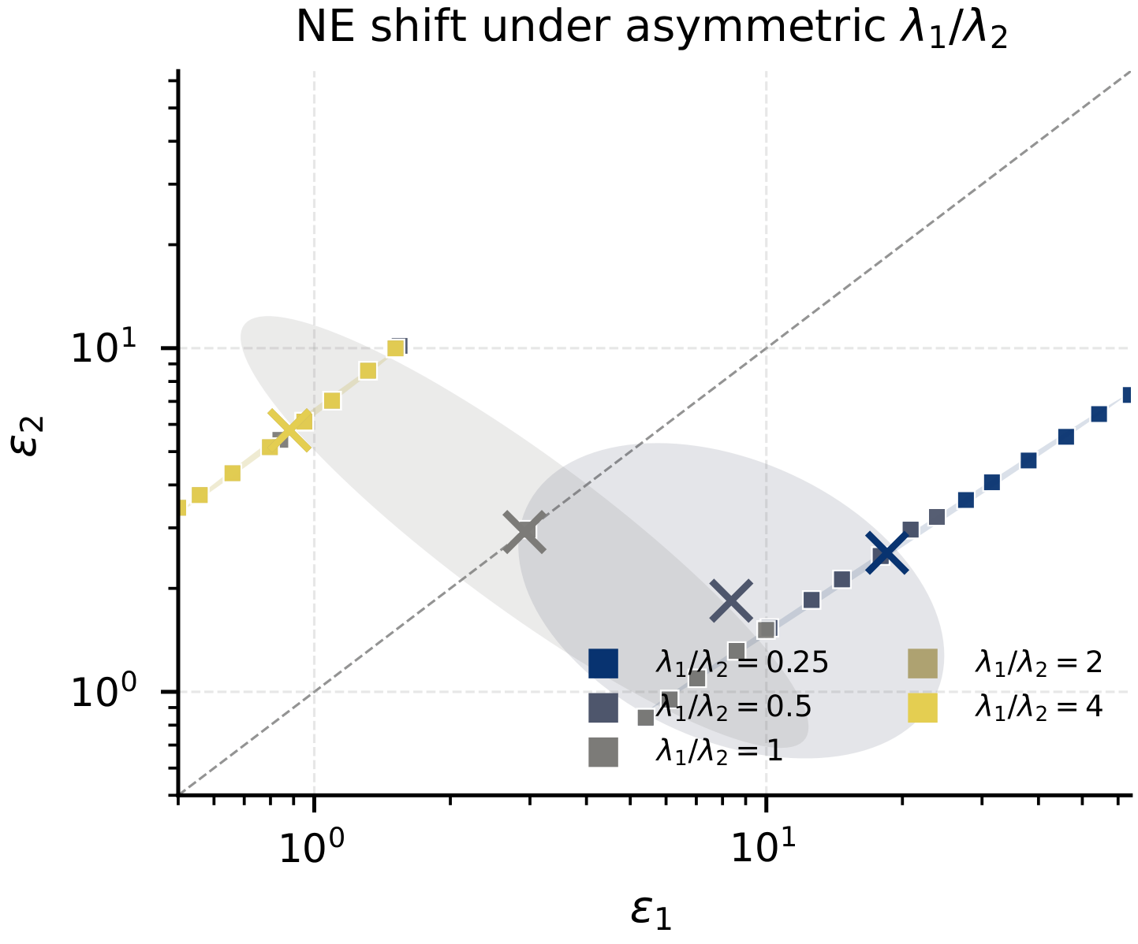
FINDING 7 · HETEROGENEITY
Preferences decide who is exposed: whoever values privacy least
WHAT WE LOOKED AT
• λ₁/λ₂ ∈ {0.25, 0.5, 1, 2, 4}, K = 200; group-size ratios 0.1–10; n = 3–10 players with λ_{i} ∈ geomspace(0.25, 4).
WHAT WE FOUND
• 170/174 heterogeneous NE give the lower budget to the more sensitive player; the cloud jumps sides at λ₁ = λ₂.
• Group size does not sort: smaller groups appear in both roles.
• n = 3–10: budget order is the exact reverse of λ order in every NE.
HOW MUCH TO TRUST IT
IN PLAIN WORDS
A · proved / exact
B · solid numerics
When the groups value privacy differently, the outcome is predictable: the group that cares least ends up carrying the batch and the exposure. Who gets exposed is set by preferences, not chance. Being the smaller group, on its own, does not protect you.
• Proved under an exchange condition; λ sweep post-fix. n-player: 100% sorting up to n = 10 (coarse 7-action grid).
The Privacy Externality Game · strategic budgets in sampling-based iDP
8
Notes:
Files: run_locus.py (C8), run_continuous.py (C2), run_nplayer.py; tasks_findings/07, 19; FINDINGS_MAP T7, T10

Slide 9
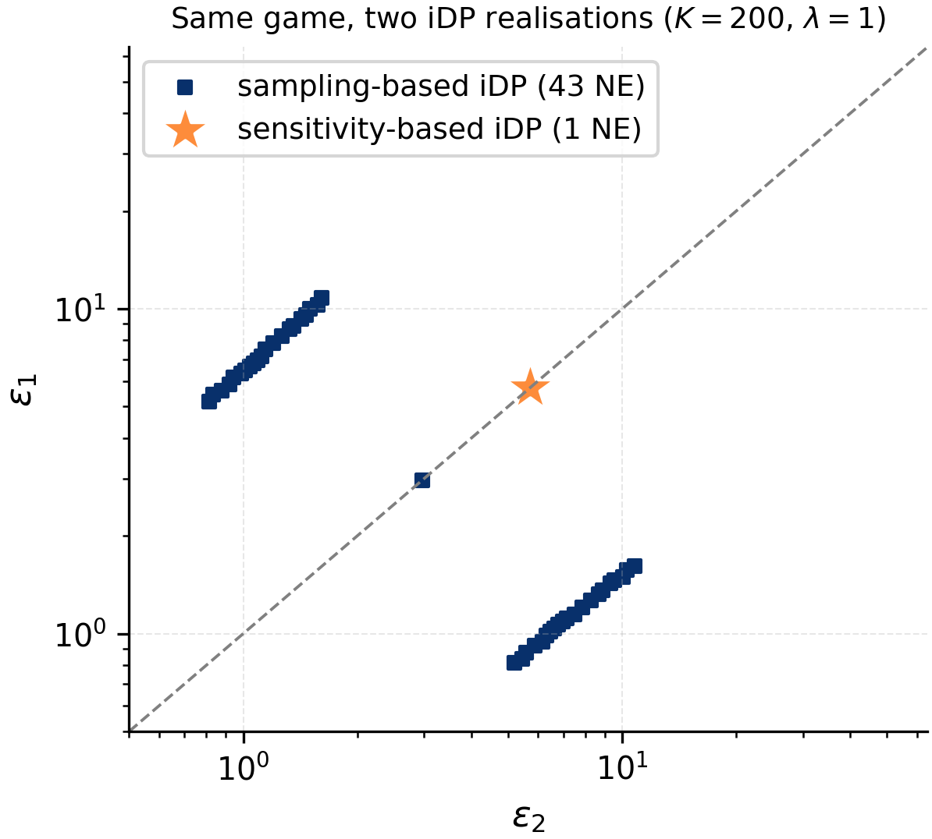
FINDING 8 · MECHANISM, NOT PARADIGM
Individual budgets don't cause it; the shared sampling solve does
WHAT WE LOOKED AT
• Same game, same grid, same V and λ, replayed through sensitivity-based iDP (per-group clipping under shared σ): A_{i} depends on ε_{i} only.
WHAT WE FOUND
• Sensitivity-based: exactly one pure NE, symmetric at (5.73, 5.73).
• Same holds for λ ∈ {0.25, 0.5, 1}.
• Sampling-based: 43 NE, 42 asymmetric.
HOW MUCH TO TRUST IT
IN PLAIN WORDS
B · solid numerics
The other common way to give personal budgets changes each group's gradient clipping instead of its sampling rate. There your risk depends only on your own choice, and both groups simply pick the same budget. So the trouble comes from how sampling-based iDP fills the batch, not from personal budgets.
• Post-fix K = 200 caches for both mechanisms. It acts as a control: remove the coupling and the Hawk–Dove structure disappears.
The Privacy Externality Game · strategic budgets in sampling-based iDP
9
Notes:
Files: game/mechanism_scale.py, run_scale.py → _cache_scale/; tasks_findings/18; FINDINGS_MAP T11

Slide 10
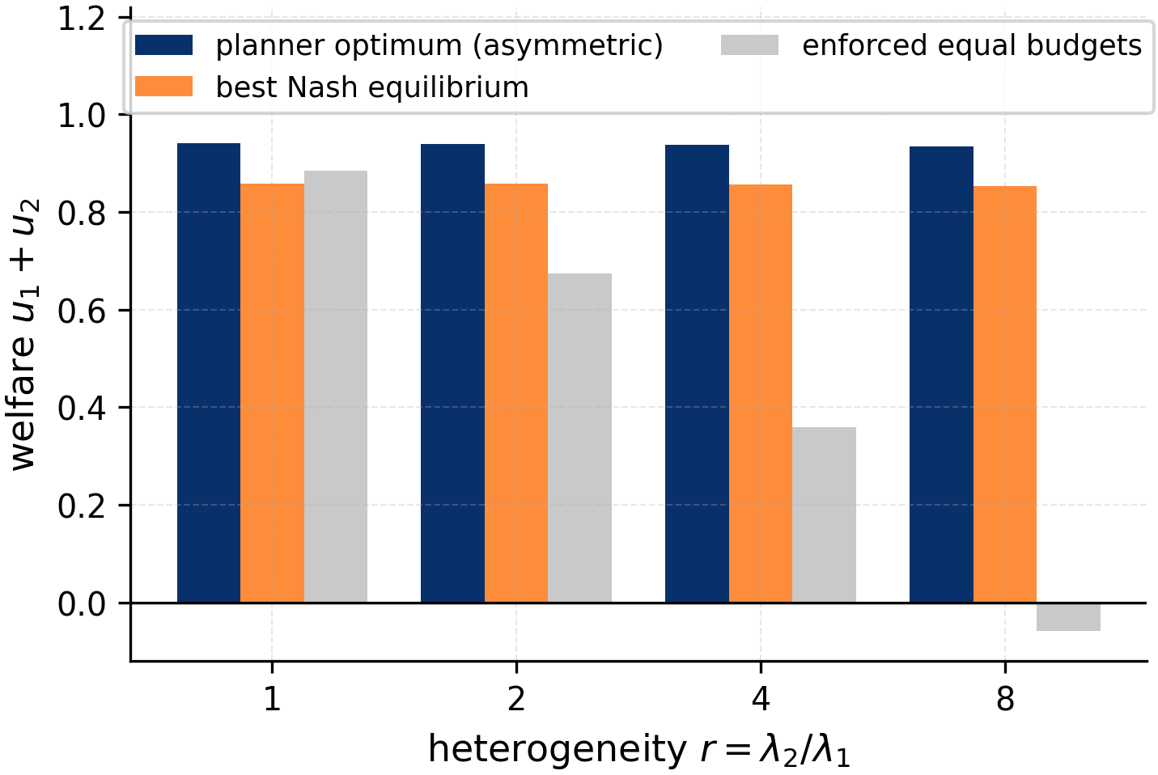
FINDING 9 · WELFARE
Selfish play assigns the roles efficiently, but never pays the carrier
WHAT WE LOOKED AT
• Welfare u₁+u₂ on the K = 200 cache: planner optimum, best pure NE, enforced equal budgets; r = λ₂/λ₁ ∈ {1, 2, 4, 8}.
WHAT WE FOUND
• The planner optimum is itself asymmetric (3.35, 24.13): composed exposure is concave in the rate.
• Best NE sits ~9% below the planner at every r.
• Enforced equal budgets: 6% below the planner at r = 1, below zero at r = 8.
HOW MUCH TO TRUST IT
IN PLAIN WORDS
B · solid numerics
Even a fair-minded planner would let one group carry the batch, because concentrating exposure costs less overall. Selfish play gets fairly close (about 9% worse), but nobody pays the carrier back. Forcing equal budgets on groups that care differently is the worst option.
• Cache-only computations on the post-fix grid; NE welfare is grid-resolved. No equilibrium transfers utility to the carrier, so fairness needs a transfer.
The Privacy Externality Game · strategic budgets in sampling-based iDP
10
Notes:
Files: _scripts/59_alt_plays.py → 59_alt_plays_summary.txt; nummeric_eval §22; FINDINGS_MAP T9

Slide 11
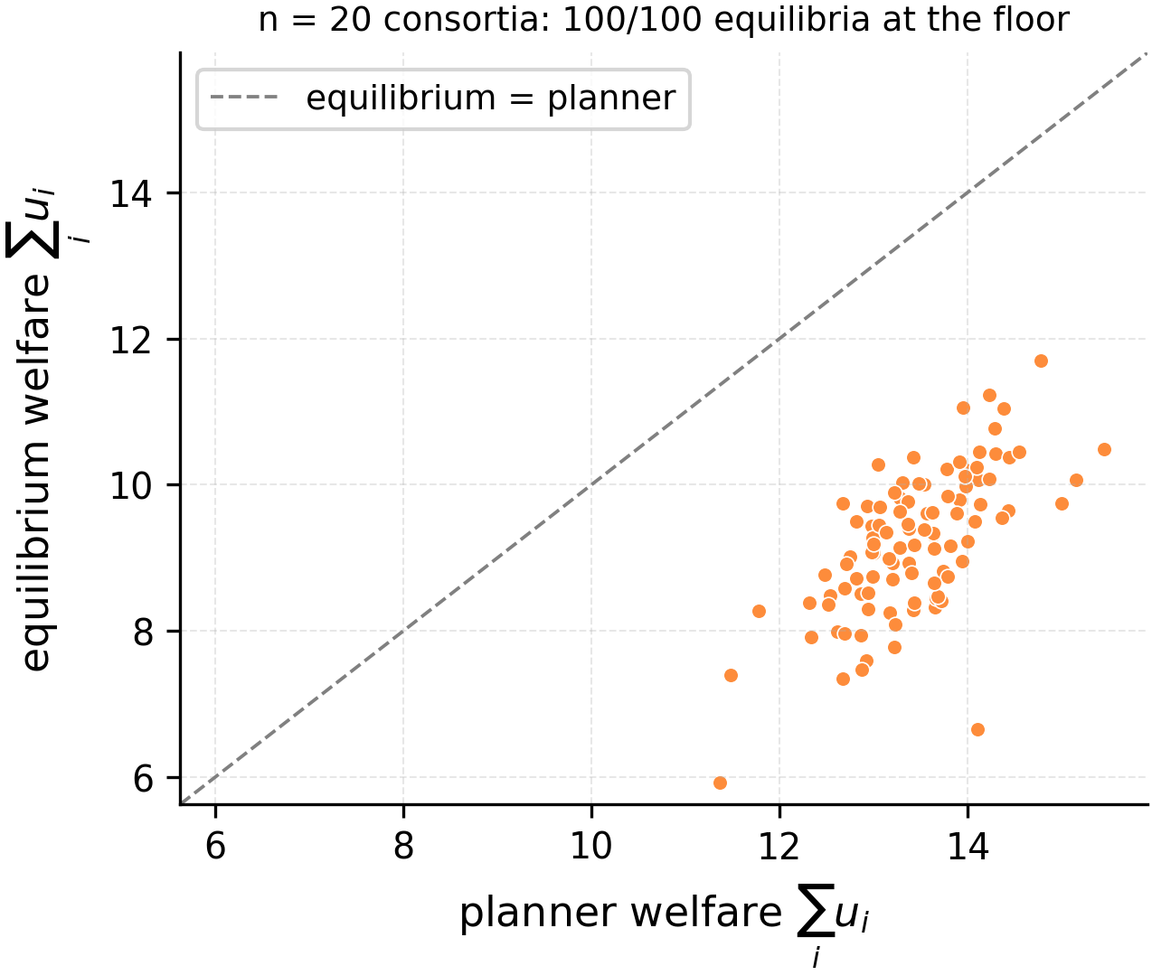
FINDING 10 · MANY PLAYERS
In a 20-silo consortium, everyone free-rides at the strictest budget
WHAT WE LOOKED AT
• 100 sampled FL consortia: n = 20, |G_{i}| ~ U{2000…12000}, λ_{i} ~ LogNormal(0, 0.7), B = 256, actions {10, …, 50}; sequential BR.
WHAT WE FOUND
• 100/100 converge to the uniform floor (10, …, 10).
• One silo moves σ by ~1/20, so the free-riding threshold is λ* ≈ 0.02–0.04.
• Welfare 31% below a sorted planner (planner Gini 0.58).
HOW MUCH TO TRUST IT
IN PLAIN WORDS
C · provisional
With 20 groups, each one barely affects the shared noise, so no group has a reason to loosen its budget for the common good. Everyone picks the strictest option and hopes others carry the batch: classic free-riding, about 30% worse than a coordinated plan. Preliminary result.
• Pre-solver-fix run, approximate planner, 6-point grid. The run at the critical weight scale was never analysed.
The Privacy Externality Game · strategic budgets in sampling-based iDP
11
Notes:
Files: game_experiments/run_flpop_e1.py, flpop_common.py → _cache_flpop/E1_pop*.json; tasks_findings/28; FINDINGS_MAP T10

Slide 12
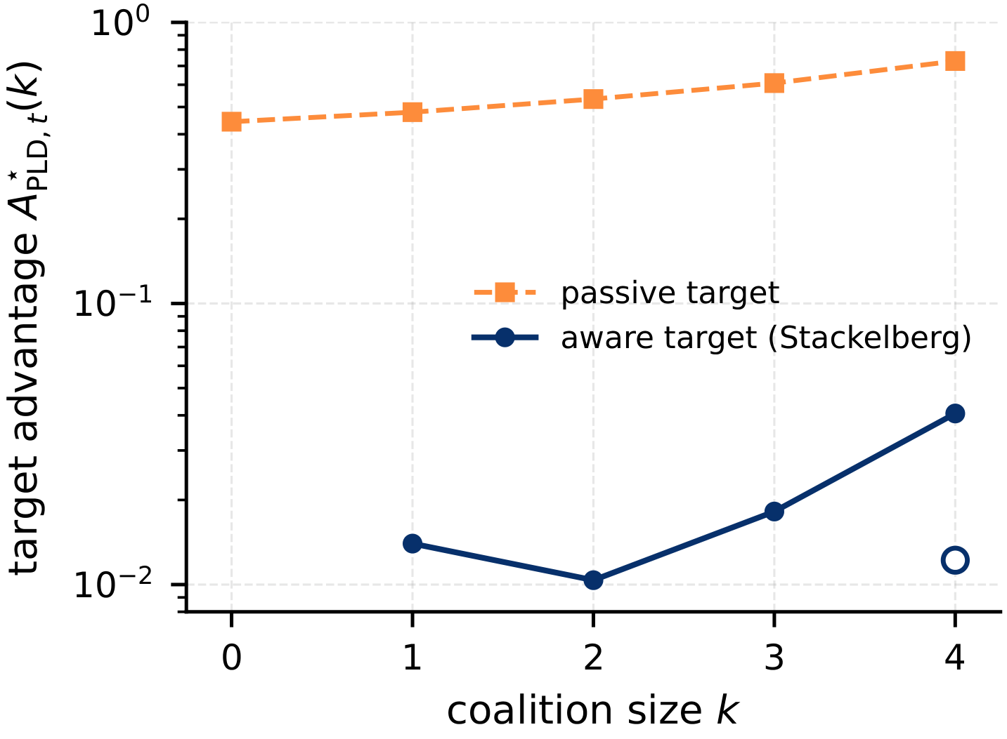
FINDING 11 · ATTACKS
The attack is coalition play, and fails against an aware target
WHAT WE LOOKED AT
• n = 5, others at ε = 32; a k-coalition commits to one budget maximising A_{PLD,t} (κ → ∞); target passive or best-responding (14-point grids).
WHAT WE FOUND
• Passive: A_{PLD,t} 0.44 → 0.73 at k = 4; the coalition plays the participation-preserving minimum, as predicted.
• Aware: 0.010–0.041, 18–51× lower, below the no-coalition baseline.
Hollow marker: interior optimum at k = 4 (filled: poisoning corner, ε_{C} = 0.5).
HOW MUCH TO TRUST IT
IN PLAIN WORDS
A · proved / exact
B · solid numerics
In the known attack, some groups pick strict budgets on purpose to push a target into more exposure. In our model that is simply what colluding players would do. But it only works on a target that stays put; a target that reacts by tightening its own budget escapes almost entirely.
• Corollary proved. Post-fix caches. Coarse 14-point action grids, so ratios are approximate.
The Privacy Externality Game · strategic budgets in sampling-based iDP
12
Notes:
Files: run_continuous.py (C4), run_h4.py → C4.pkl, H4.pkl; tasks_findings/13; FINDINGS_MAP T12

Slide 13
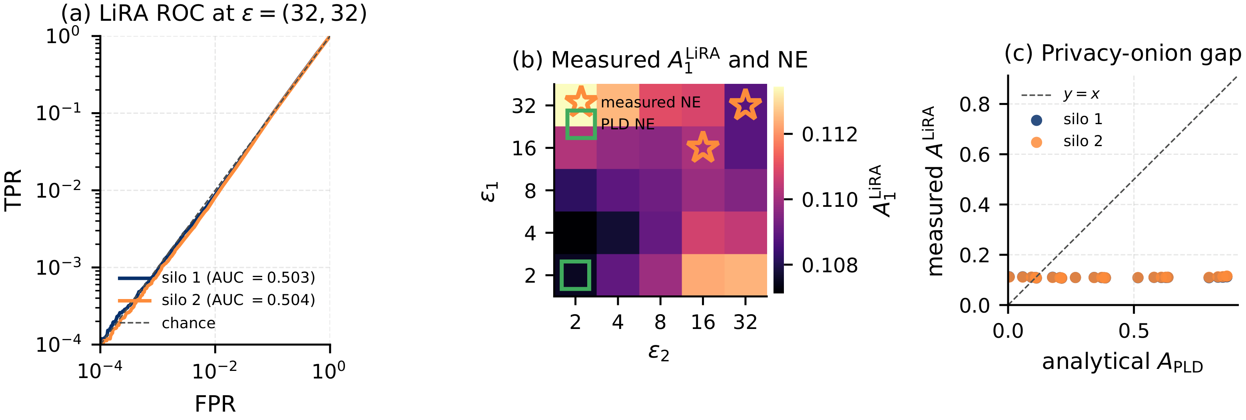
FINDING 12 · MEASURED ADVERSARY
At the attack's noise floor, the strategic pressure vanishes
WHAT WE LOOKED AT
• Adult, MLP, 5000 records/silo, 5×5 grid ε ∈ {2, …, 32}; 128 DP-SGD shadow models per profile; payoffs from measured LiRA + accuracy.
WHAT WE FOUND
• A_{LiRA} ∈ [0.107, 0.115] (AUC ≤ 0.506) vs A_{PLD} ∈ [0.004, 0.870].
• Externality term flat → measured NE at the accuracy corner (16,16)/(32,32); analytic NE at (2,2).
HOW MUCH TO TRUST IT
IN PLAIN WORDS
C · provisional
Our risk numbers assume the strongest possible attacker. With real trained models and a real attack (LiRA), the attack could barely tell members from non-members here. Then everyone's risk looks the same, the game disappears, and groups simply maximise accuracy.
• Pre-fix mechanism (audit: σ ≤ 2.6%, rates ≤ 18.5% off); one dataset. The above-floor instance is the main missing experiment.
The Privacy Externality Game · strategic budgets in sampling-based iDP
13
Notes:
Files: experiment_scripts/mia/04_mia_pergroup.py, _scripts/24_*; _cache_H1; audit_h1_sigma.py; FINDINGS_MAP T13

Slide 14
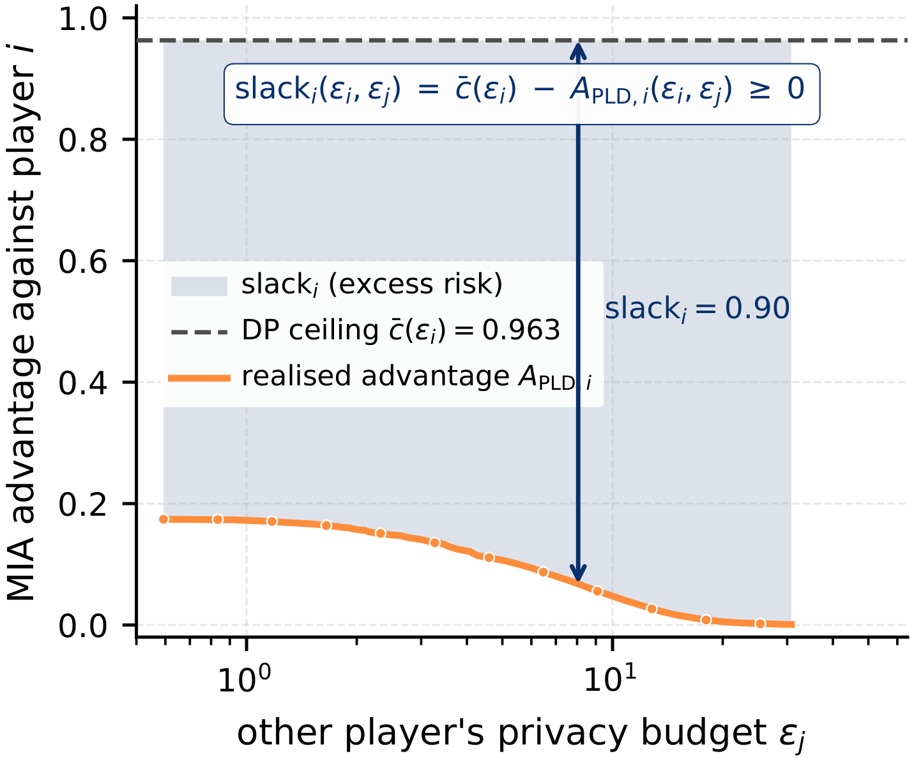
FINDING 13 · MITIGATION
Fix the contract, not the players: cap the slack
WHAT WE LOOKED AT
• Slack decomposition A_{PLD,i} = A_{εᵢ,δ} − slack_{i}; budget declaration as a direct mechanism; linear vs convex exposure pricing.
WHAT WE FOUND
• Δ-iDP: slack_{i} ≤ Δ ⇒ no coalition moves A_{PLD,i} by more than Δ at fixed ε_{i}.
• Budget reports are not DSIC: the best report depends on the others.
• Linear prices only rescale the game; convex pricing gives symmetric interior NE already at T = 1.
The shaded slack is the movable part of the risk that the Δ-clause caps.
HOW MUCH TO TRUST IT
IN PLAIN WORDS
A · proved / exact
C · provisional
The problem is that others can move your risk without breaking your contract. The fix is to cap how far they can move it: promise a maximum excess Δ on top of ε. Asking for honest budget reports cannot fix it, and a flat price per unit of risk doesn't help; only a price that grows with the risk does.
• Δ bound and non-DSIC proved. Convex-pricing result at sample resolution. Whether the Δ-restricted game is unique/symmetric, and its cost, is open.
The Privacy Externality Game · strategic budgets in sampling-based iDP
14
Notes:
Files: tasks_findings/04, 08; nummeric_eval §16; paper/tex/07_mitigation.tex; FINDINGS_MAP T14

Slide 15
AUDIT · PAPER VS. DATA
Where the paper disagrees with the data
Paper claim | Current data | Verdict
One symmetric NE (text) vs. none (Figs. 3, 14) | one symmetric NE exists: exact ε* ≈ 2.59; grid shows it at 2.96 | captions wrong
Symmetric NE confirmed by 25-point refinement at 2.96 | deployed grid: 10⁻⁴ near-tie, dissolves at 16× | scoped
Fig. 14 counts 44–60 NE | 27–45 NE post-fix | stale
Minority group plays the lower budget | both orientations for |G₁| < |G₂| | falsified
Symmetric NE is the welfare-best | least ΣA, but W = 0.64 vs 0.86 (frontier) | falsified
Exposed player compensated / loose player indifferent | u = 0.25 vs 0.50; strictly wall-blocked | falsified
Ordinal-potential 4-cycle (K = 22) | gone; 6-cycle on K = 200 replaces it | falsified → fixable
n-player: 83% sorting at n = 10, A ratio 480 → 75 | 100% at all n; ratios 44–330 | falsified
Sensitivity appendix, non-DSIC example (2.92 / 1.21) | 7 → 43 NE; 1.82 / 3.43 (direction flips) | falsified
λ = 2: no pure NE | 761 Rényi orders → pure-NE cluster | scoped
BR-PEG regret, H1 measured instance | pre-fix runs, not re-run | unverified
IN PLAIN WORDS
The paper grew over many drafts, and a solver bug fixed in July shifted several numbers. The core story survives: others set your risk, equal groups split into a hider and a carrier, and the least privacy-minded group is exposed. These rows must be fixed. Full list with line references: PAPER_AUDIT.md.
The Privacy Externality Game · strategic budgets in sampling-based iDP
15
Notes:
Holds: externality sign, 43-NE frontier structure, ratio band, Hawk–Dove numbers, λ-ratio sorting 170/174, PoEV sweep, sensitivity-based control, H4 values.

