Slide 1


Jake
the tale of ase team 04
january 2008
Notes:
so... gleich gehts los!

Slide 2

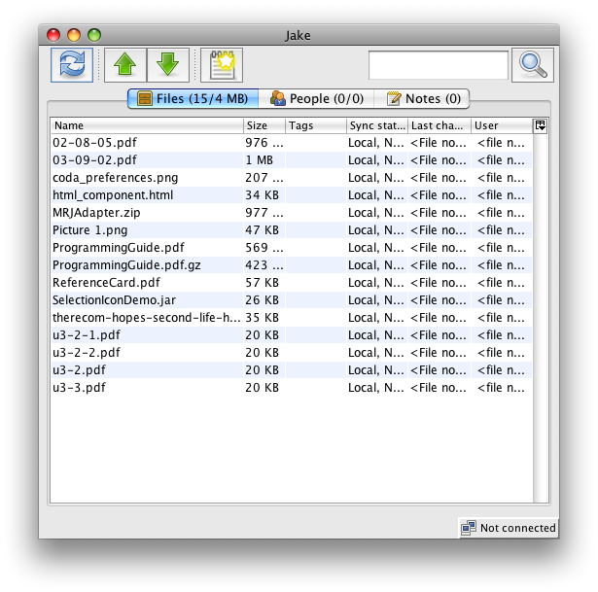
THE PAST
Notes:
yeah... that’s pretty much it.

Slide 3
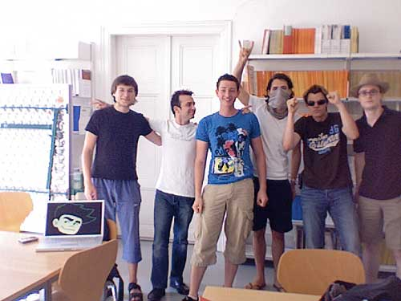
success!
Notes:
ein erfolg wars, 1er abgeräumt :)

Slide 4
but...
it was just a mock...
and the gui sucked, badly!

Slide 5
The PRESENT
“PROJECT ASSIGNMENT”
phase 2 of our collaboration client
replace mock with xmpp-implementation
replace gui
system integration with mac, linux and windows

Slide 6
The PRESENT
ADDITIONAL REQUIREMENTS
(nobody asked for)
replace plain-jdbc with hibernate
do not reuse current daos
triggered redesign of all internal components
r&d daos: > 100h!

Slide 7
The PRESENT
ADDITIONAL REQUIREMENTS
& their ramifications
delay and problems documented since mr2 & status quo
why?
    hibernate unsuitable for dynamic loading of linked data
    complex domain

Slide 8
The PRESENT
ADDITIONAL REQUIREMENTS
& the FALLOUT
finished daos on january, 17th
recoding of sync module could not be finished
but:
    the project will be continued!
    200-300 h until feature complete
    beta Q1 2009

Slide 9
OTHER obstacles
did we mention hibernate already?
too long evaluation (coding-start: late november)
problems with multithreading
gold-plating
(or: we just wanted to get it right from the beginning)

Slide 10
Architecture
frontend
core
fss
ics

Slide 11
CORE
highly extensible architecture
multi-user
multi-protocol
multi-project
multi-frontend

Slide 12
gui development, reloaded
evaluation of our users
development of demo ui
massive usability tests “on first hand”
look native & gorgeous
(= do not look like java)

Slide 13
gui development
evaluation of our users
development of demo ui
massive usability tests “on first hand”
look native & gorgeous
(= do not look like java)

Slide 14
personas
“stefanie” uses msn messenger, word, has an iPod, only knows windows - wants to share her holiday photos, “it should just work”
“alex” student @ tu vienna. very experienced using software. uses linux or mac os. likes open-source stuff. wants an easier workflow than sending emails for sharing files in group work situations. wants full control over his files; service should be free, fast and reliable.
“frank” architect. usually works on files that are way to large to send via email. finds it cumbersome to send those files to his boss every day. cares about security and does not want to use servers in the cloud to store his work.

Slide 15
gui development, reloaded
became #1 contributor of macwidgets
massive use of modern libs
do it like iTunes
look native & gorgeous (= do not look like java)
Notes:
swingx, jxlayer, miglayout, quaqua, jna,
everybody knows iTunes!
don’t show the user that we are java!

Slide 16
details, its all about THE details
“why does the menu look so weird?”
why i can’t just drag my files into the application?
what’s xmpp? is it expensive? do i have to get that?
what does red mean in the file table?
i want to see when someone accepts my invitation!
What to do next? (Status Bar info)

Slide 17
SHOWTIME

Slide 18
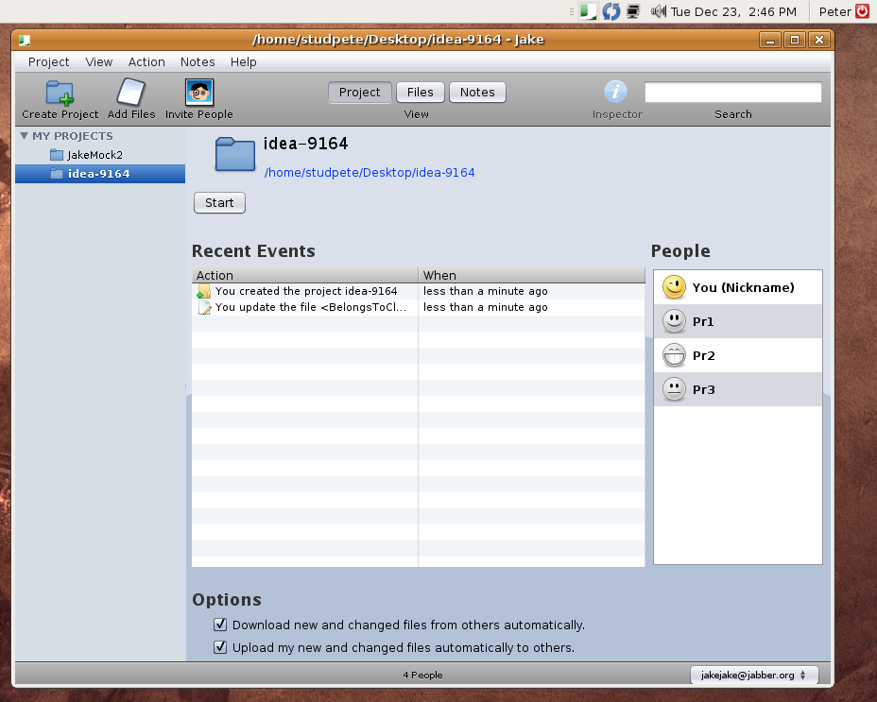

Slide 19
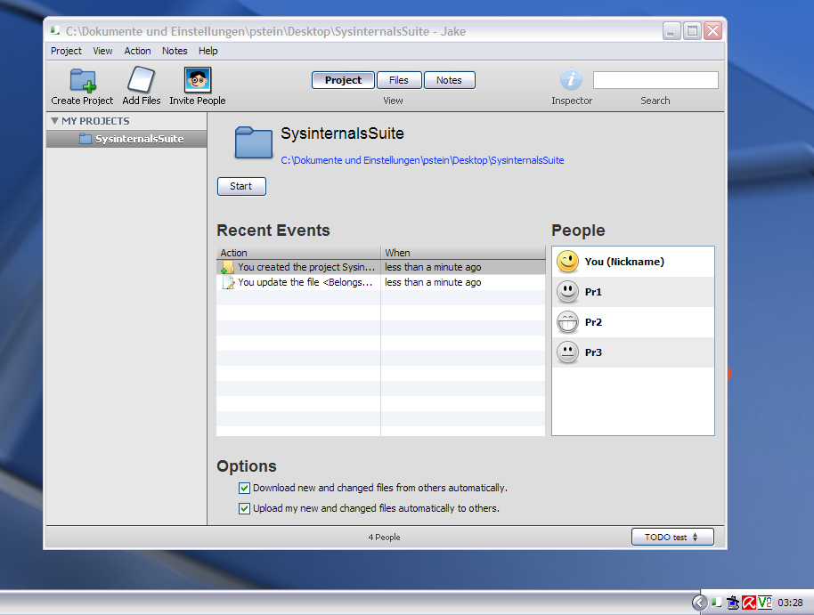

Slide 20
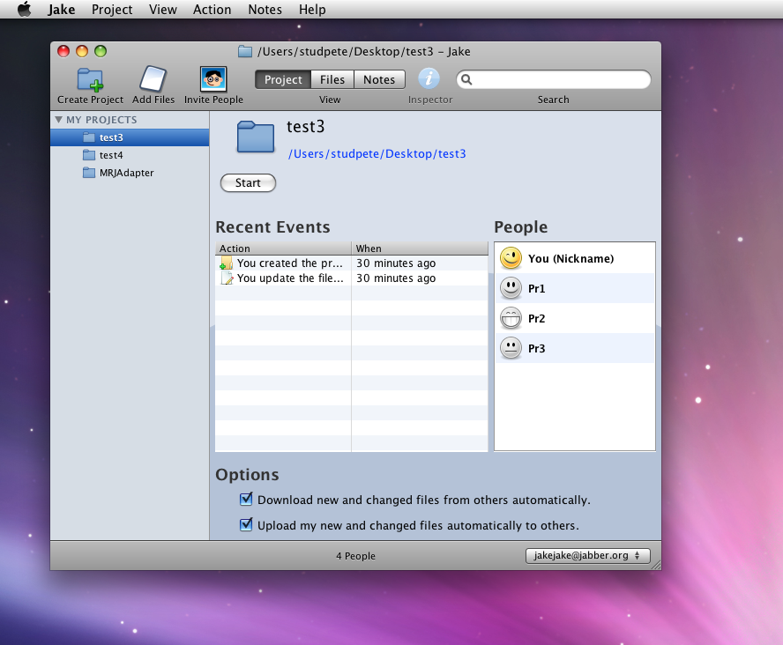

Slide 21
LIVE DEMO

Slide 22
XMPP / ICS
Ersetzbare Komponentenarchitektur des ICS
ICS bietet:
Login/Logout
Verwenden einer Nutzergruppe
Onlinestatus anzeigen
Nachrichten verschicken
Große Inhalte übertragen (z.B. Files)
Registrieren von Benachrichtigungscallbacks (kein Polling)

Slide 23
XMPP / ICS
Die XMPP-Implementierung bietet darüberhinaus
  Login an beliebigen XMPP-Servern
    Auch Google Talk, GMX, etc (tw. Unterschiede in Authentifizierung)
Benutzergruppe wird in Roster abgelegt
Dateitransfers per XEP-0047 (In-band)

Slide 24
ADditional ICS features
In-Band oft langsam (Bandbreitenbegrenzung)
Fallback-Architektur für Datentransfers
  Socketadressen austauschen → P2P
      Schnell, z.B. in Firmennetzen
  Inband
    Angedacht ist dazwischen:
      ICE, mittels uPNP durch NATs

Slide 25
SHOWTIME II

Slide 26
Statistics
core/ 13757
fss/ 2547
gui/ 22271
ics/ 3655
ics-xmpp/ 3108
sum / 45338 lines of code
revision 1333+

Slide 27
The Future
finish development
go private beta
release
get on slashdot
get rich & famous ;)

Slide 28
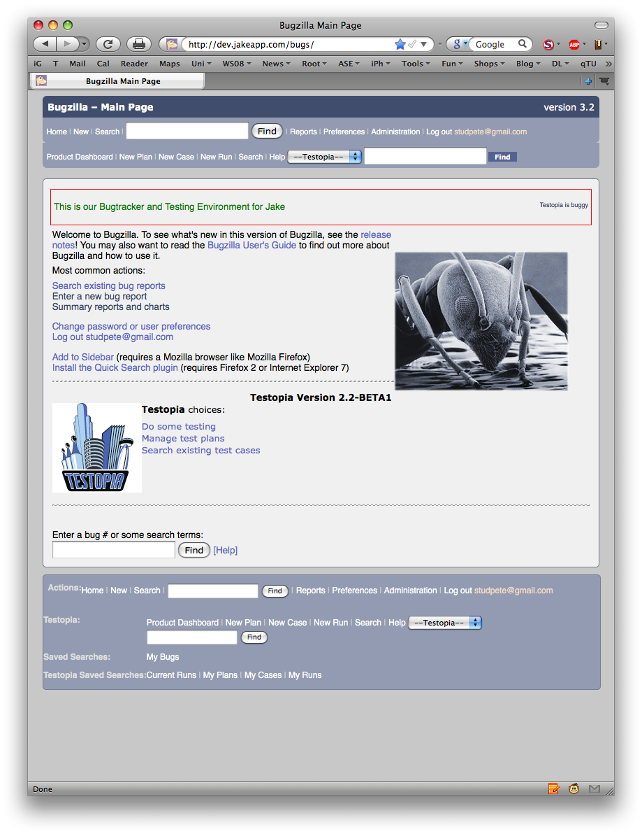
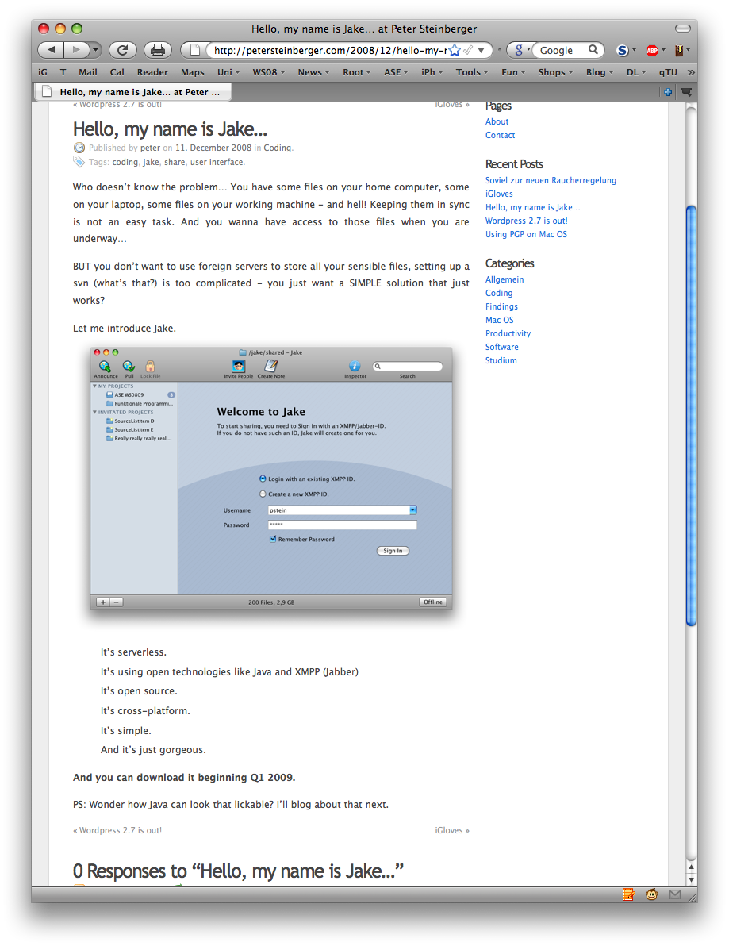
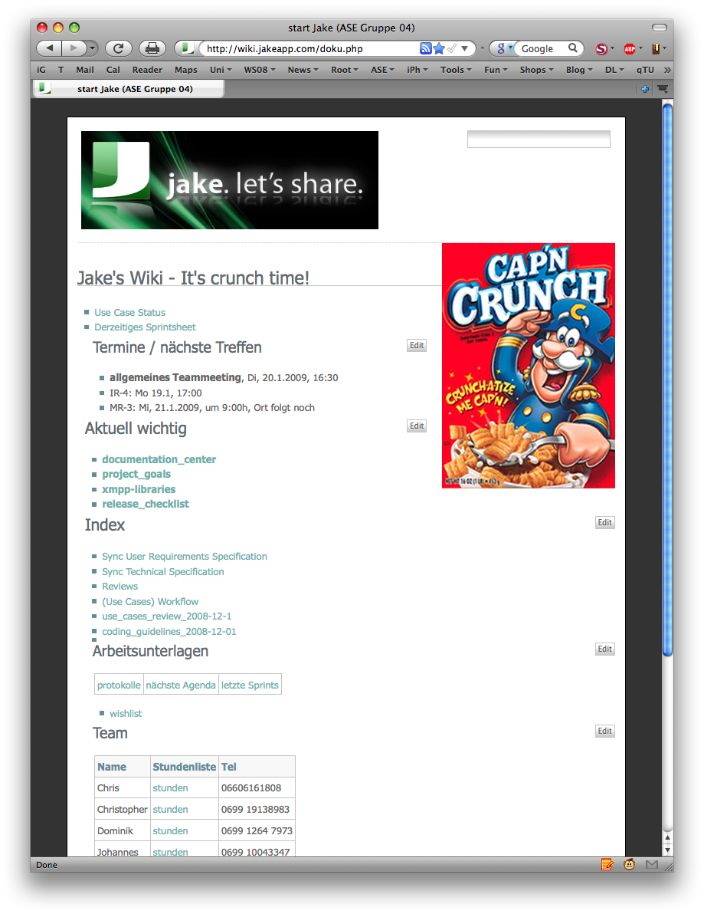
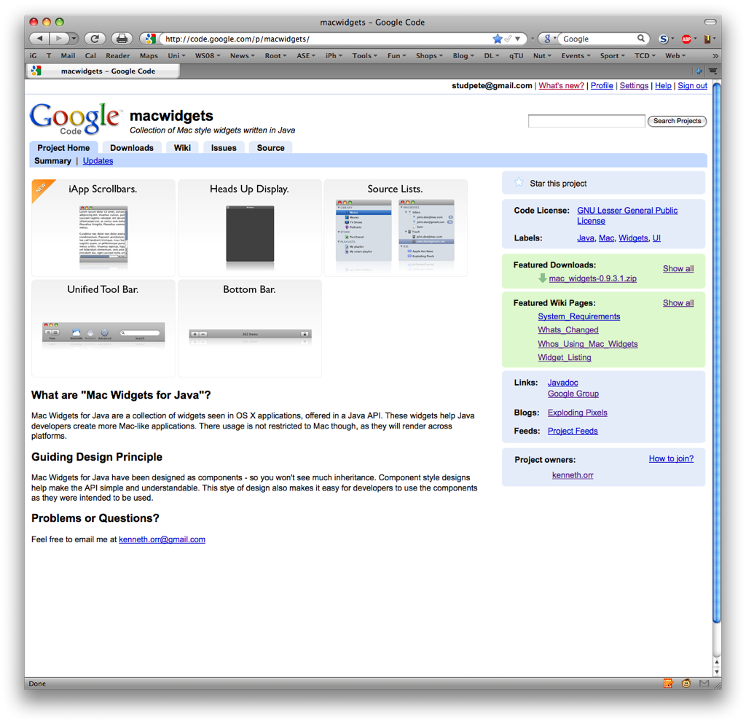
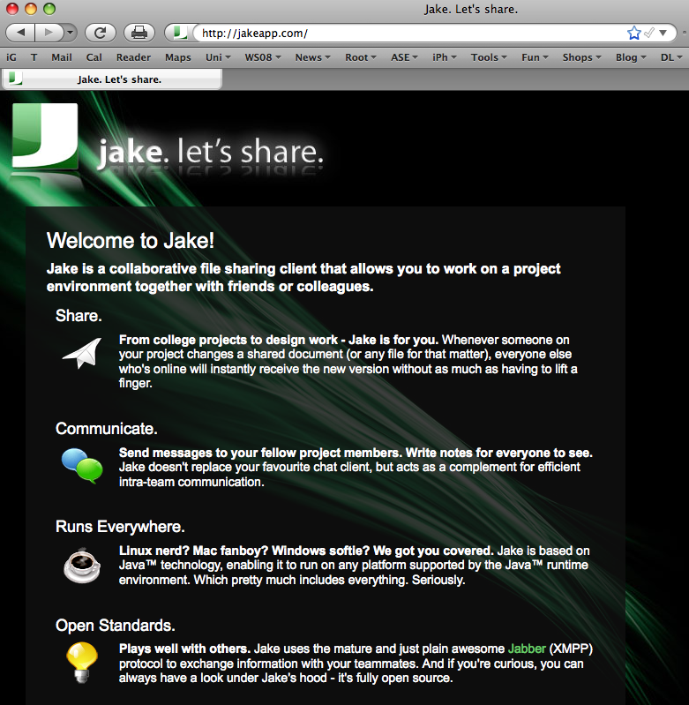

Slide 29
thank you!
we had a great time
.... and this is just the beginning!

