Slide 1
XLF
eROSITA
&
the AGN X-ray Luminosity Function
Johannes Buchner, MPE 2013

Slide 2
Introduction
LF = comoving space density
p(L, z, …)
Sensitivity of eROSITA
Methods
Predictions for eROSITA
Notes:
Comoving volume
p(spawning an AGN) with certain properties

Slide 3
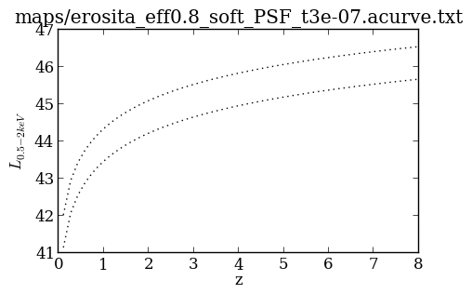
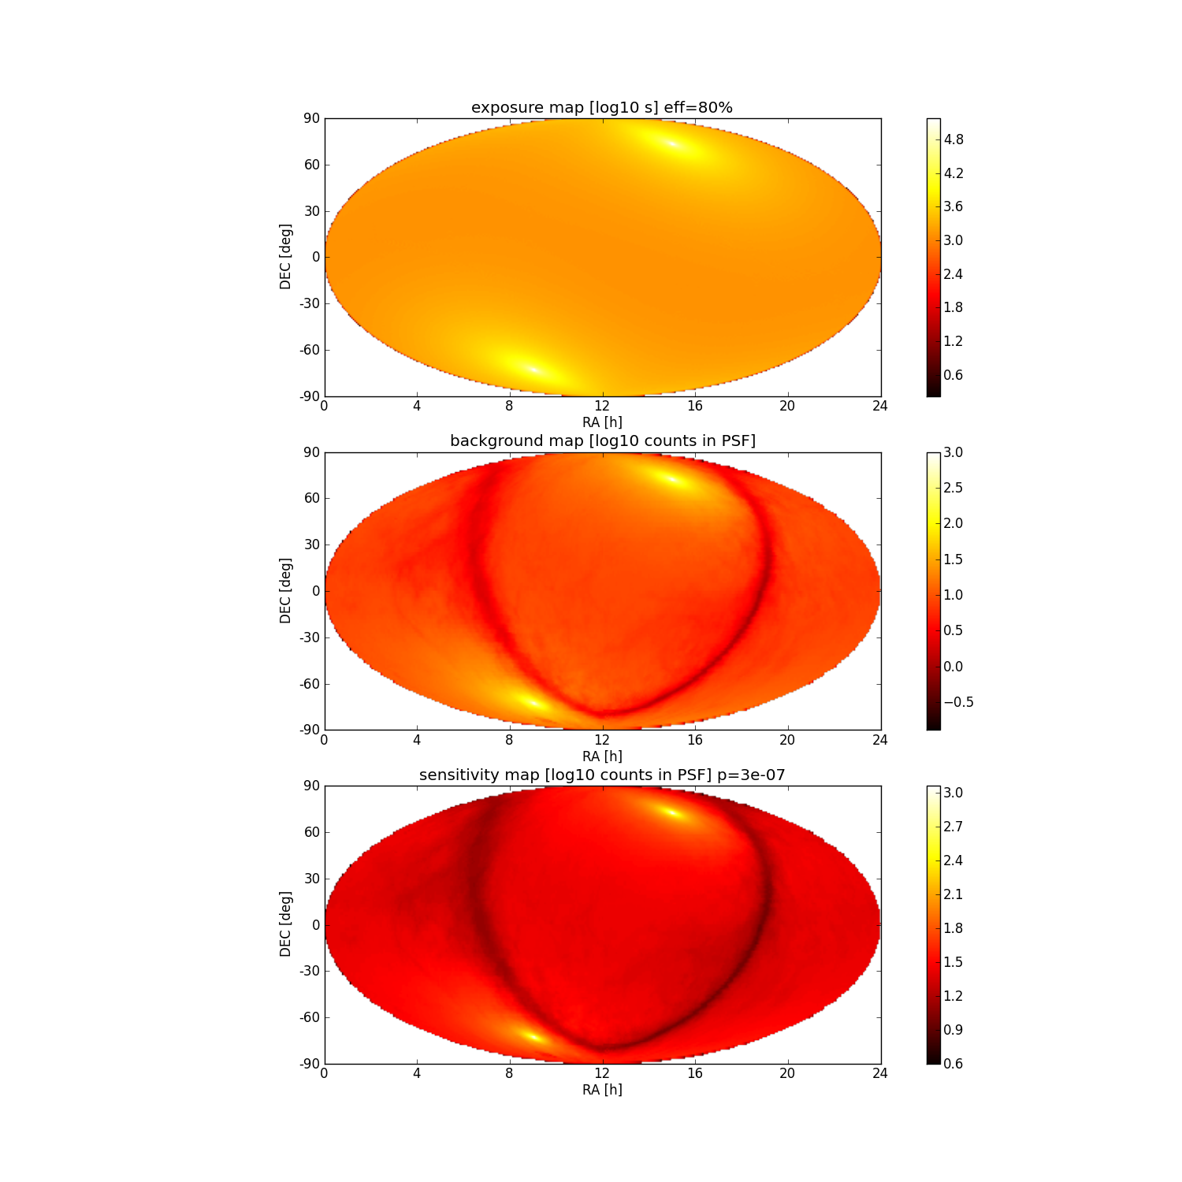
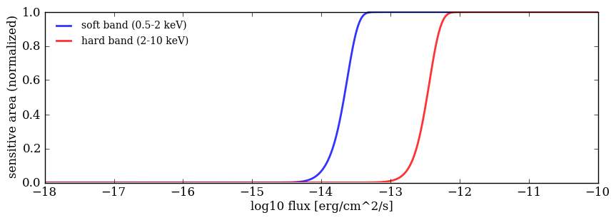
eRosita Sensitivity
complete
undetectable
→ make predictions
https://wiki.mpe.mpg.de/
eRosita/ScienceRelatedStuff/BackgroundMaps
Notes:
Exposure Map Jan Robrade
Based on NH map
Sensitivity: when is a flux “unusual” – how many counts are needed to claim a detection
Area/sensitivity curve: probability of detecting an object with flux x
* total collecting area

Slide 4
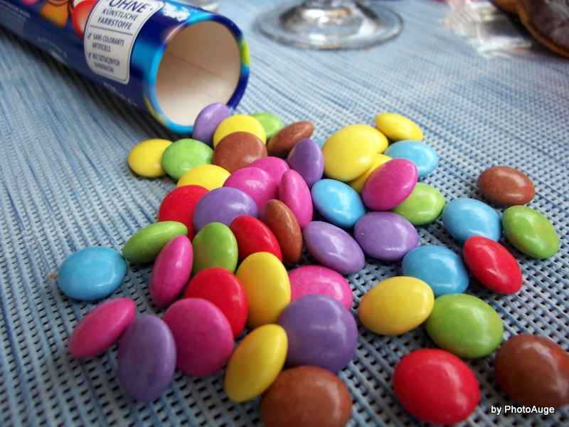
LF methods
Infer mixture, fractions, numbers of red, yellow, green in box
http://augenblickmal.blog.de/2009/06/29/viele-viele-bunte-smarties-6418345/

Slide 5
LF methods
Infer mixture, fractions, numbers of red, yellow, green in box
From sample statistics to population demographics
Combinatorics problem (k out of n successes) – Poisson/Binomial
Observable-
independent
# expected
Observable-
dependent
k hits
http://augenblickmal.blog.de/2009/06/29/viele-viele-bunte-smarties-6418345/

Slide 6
LF methods
Uncertainty in properties
of detected objects
Observable-
dependent
k hits
Observable-
independent
# expected
Sensitivity to objects of
certain properties
Marshall+83 – ML estimator
Loredo+04 – Why λ ≠ λ
Kelly+08 – Binomial
“Model-dependent methods”
  Data-motivated: PLE, LDDE, LADE (Aird+08/10 model comparison)
  Physical: Semi-analytic: Hirschmann+12, Hütsi+13
“Model-independent methods” (Vmax) – binned, constant

Slide 7
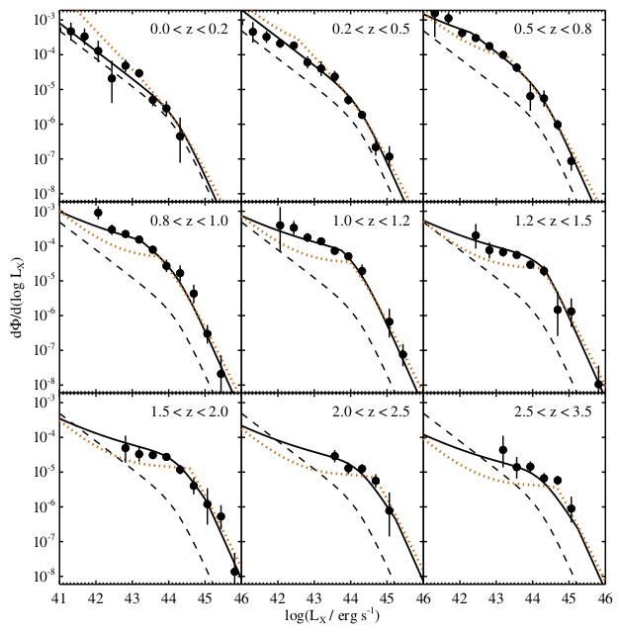
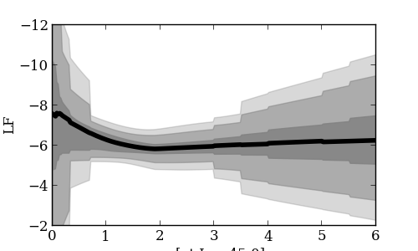
LF models
“Model-dependent methods”
  Data-motivated: PLE, LDDE, LADE (Aird+08/10 model comparison)
  Physical: Semi-analytic: Hirschmann+12, Hütsi+13
“Model-independent methods” (Vmax) – binned, constant
z; L=10⁴⁵ erg/s

Slide 8
eRosita predictions

Slide 9
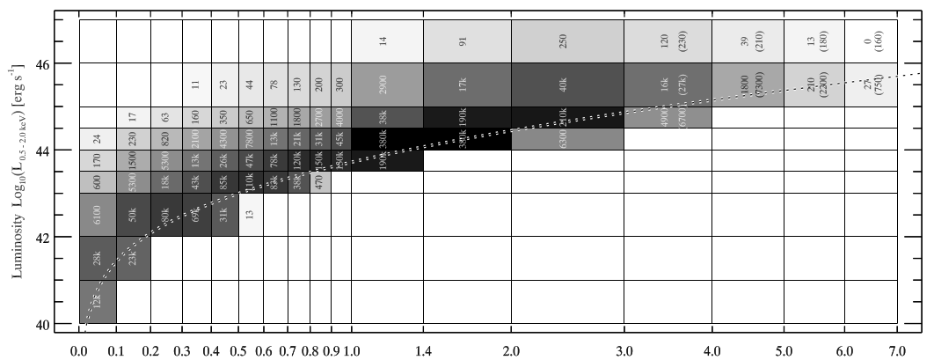
eRosita predictions
3.000.000 AGN (Kolodzig+12)
RASS: ~120.000 (Voges+99/00)
(systematic) uncertainty in LF:
2 dex at z < 0.2, L = 10⁴⁴ (Fotopoulou+ in prep.)

