Slide 1
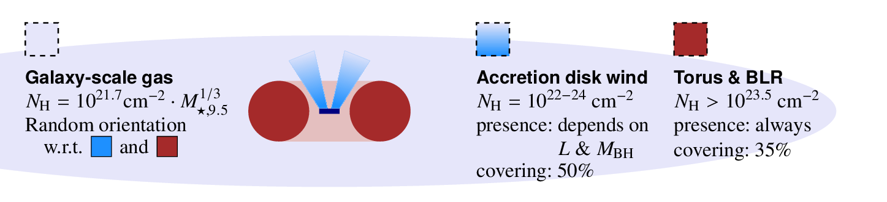

Separating the nuclear and galaxy-scale obscuration of AGN
Johannes Buchner
CONICYT fellow
astrost.at/istics
Collaborators: @PUC: Steve Schulze, Franz Bauer
Previously: @MPE HEG: A. Georgakakis, K. Nandra,
M. Salvato, L-T. Hsu, J. Aird, M-L. Menzel, Z. Liu

Slide 2
Observations
Obscured fraction
77% ± 5%
Compton-thick fraction
38% ± 8%
Buchner+15 HEG MPE
  Better associations
  Better redshifts
  Uncertainty propagation
  Full spectral information
  Fewer assumptions about evolution, shape
  Largest sample of CTK
Averaged over cosmic time, log L>42

Slide 3
Research question
Obscuration by host galaxy
Subtract from observations
Describe nuclear obscurer
New paradigm: “radiation-lifted torus”

Slide 4
The obscurer
Accretion Disk
“Torus” Obscurer
Galactic Center gas
Star forming regions
e.g. in spiral arms
UV, Opt, X-ray, ...
<0.1pc
10pc
1 kpc
10 kpc
Nuclear obscuration
Galaxy-scale obscuration
How is it stable and extended?
Density? Substructure?
Feeding of AGN?
First constraint:
- Column density
- Covering fraction

Slide 5
Column density N_{H}
N_{H} … number of H atoms along line-of-sight
N_{H} = few atoms / cm³ x few kpc = 10²²/cm²
Compton-thick: ~ 10²⁴ cm²
O, Fe, H
  absorb soft X-rays
  Measure N_{H} assuming local abundances from X-ray spectrum

Slide 6
GRBs x-raying Galaxies
Long (>2s) Gamma Ray Bursts:
  Collapse of massive stars
  Produce γ-ray
    Detected through any obscuration
    Detected at z=0-10
  X-ray, Opt, … Radio
  Follow blue light, general SF
    But: avoid high-Z galaxies
    SF, low-mass galaxies
Idea:
  X-ray tomography
  Can we reconstruct the galaxy from LOS densities

Slide 7

Host Mass – Obscuration
SHOALS
  Perley+15
  Deep follow-up
  ~90% redshift complete
  Spitzer masses
“Galaxy gas as obscurer: I.”
Buchner, Schulze & Bauer (submitted)

Slide 8

Expected Scatter
~0.5 dex from geometry
“Galaxy gas as obscurer: I.”
Buchner, Schulze & Bauer (submitted)

Slide 9

Local Galaxies
1% densest column from HI maps
Gas metallicity-corrected
“Galaxy gas as obscurer: I.”
Buchner, Schulze & Bauer (submitted)

Slide 10
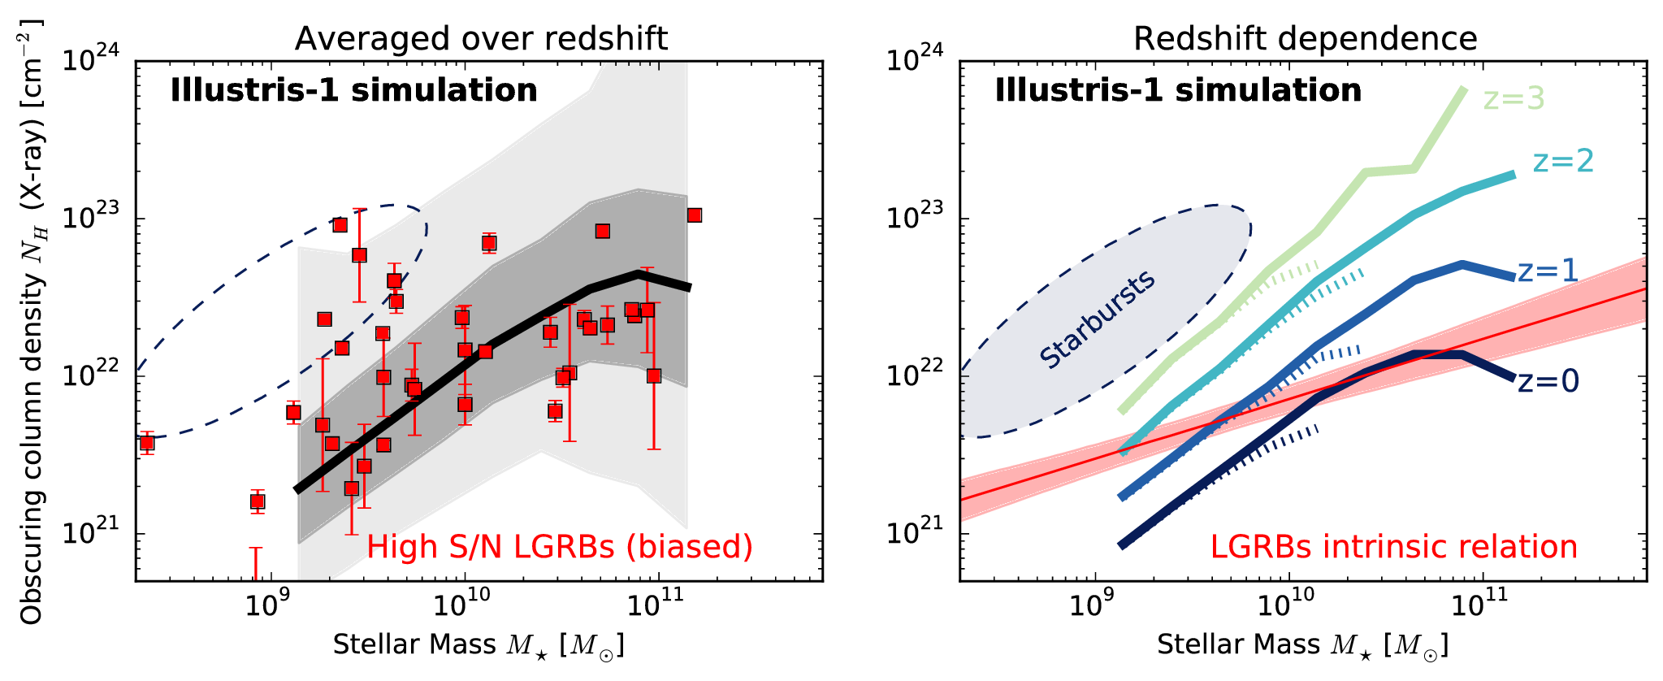
Predictions by simulations
“Galaxy gas as obscurer: I.”
Buchner, Schulze & Bauer (submitted)

Slide 11




Host Mass – Obscuration
SHOALS
  Perley+15
  Deep follow-up
  ~90% redshift complete
Hosts?
  Actively star-forming, AGN not necessarily
  Metallicity bias
N_{H} – M* relation
Obscurer is host galaxy
Understand normalisation
Understand slope
Understand scatter
“Galaxy gas as obscurer: I.”
Buchner, Schulze & Bauer (submitted)

Slide 12
Caveats
Stellar mass
Redshift evolution
SFR
  Lower in AGN
Metallicity
  Overlapping
  Stellar metallicity vs. gas metallicity
Vantage point

Slide 13
From GRBs to AGN
New Relation from GRBs
AGN fraction
Aird+12, Bongiorno+12
Stellar Mass Function
Ilbert+13, Muzzin+13
Marginalisation
“Galaxy gas as obscurer: II.”
Buchner & Bauer (submitted)

Slide 14

Predictions for AGN
No CT AGN
Substantial % C-thin obscured
Slight overprediction:
  GRB-SF?
  Ellipticals?
“Galaxy gas as obscurer: II.”
Buchner & Bauer (submitted)

Slide 15
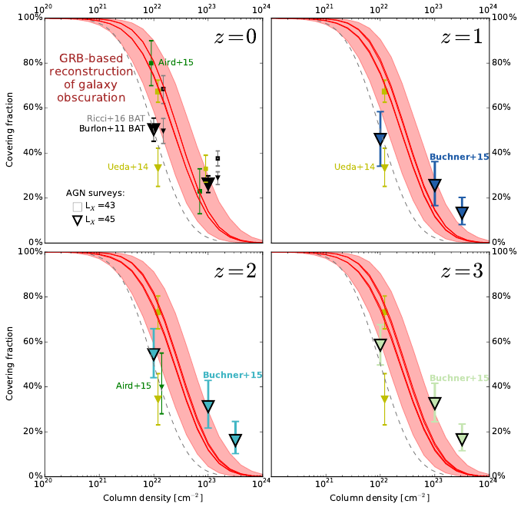

Slide 16
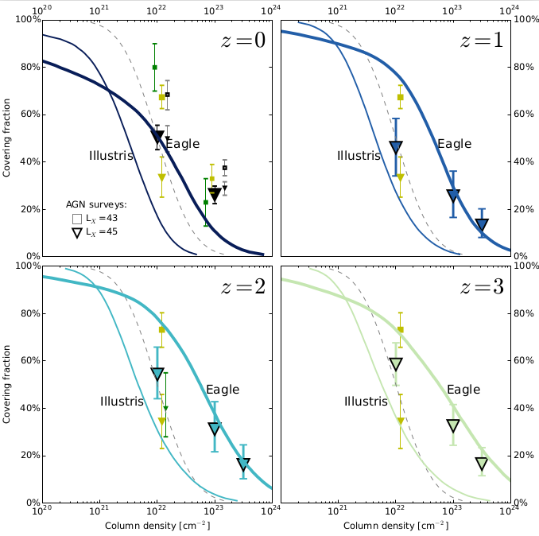

Slide 17
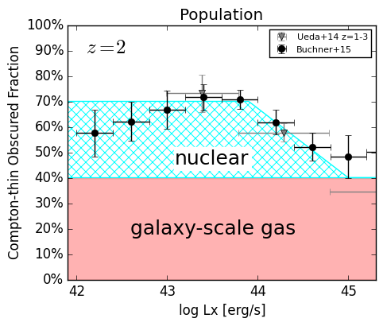
The Nuclear Obscurer
Host galaxy
CTK obscurer
CTN obscurer
disappears at bright end
describe nuclear obscurer alone
“Galaxy gas as obscurer: II.”
Buchner & Bauer (submitted)

Slide 18
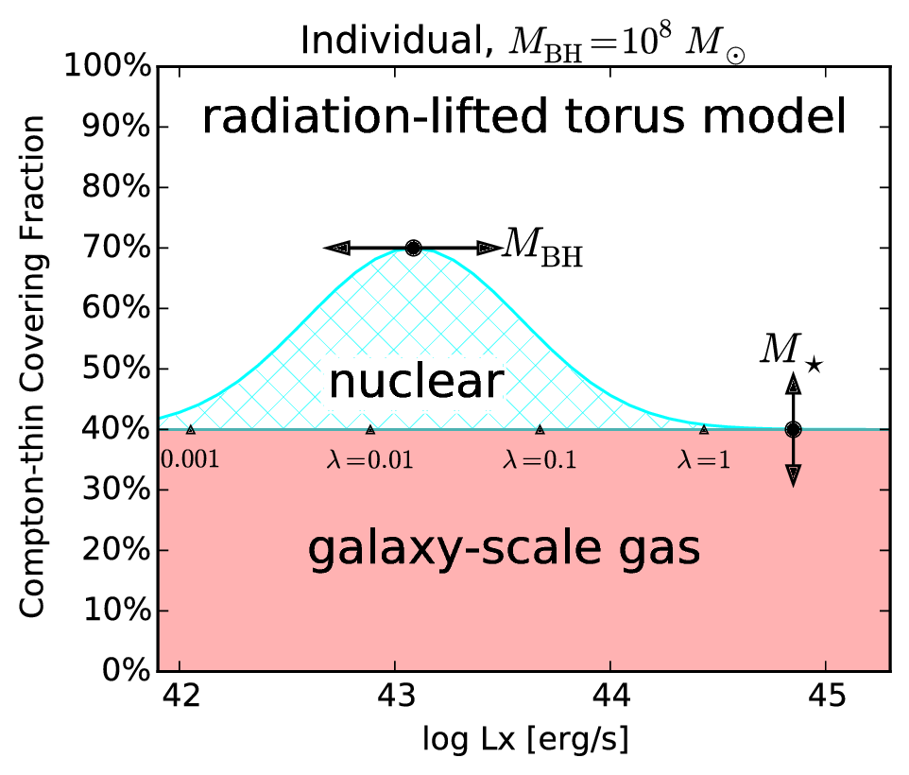
“Radiation-lifted torus”
Predict covering factor
f(L_{X}, M_{BH})
  Redshift evolution Buchner+15
  L_{X}/(M_{BH}^{2/3}) rad. pressure Elitzur+15, Wada15
  Opt./SDSS Oh+15
replace receding torus
  Unphysical for X-rays
“Galaxy gas as obscurer: II.”
Buchner & Bauer (submitted)

Slide 19
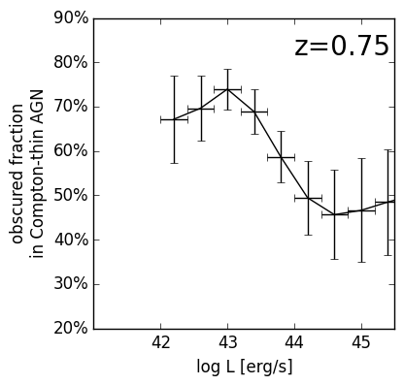
“Radiation-lifted torus”
Predict covering factor
f(L_{X}, M_{BH})
  Redshift evolution Buchner+15
  L_{X}/(M_{BH}^{2/3}) rad. pressure Elitzur+15, Wada15
  Opt./SDSS Oh+15
replace receding torus
  Unphysical for X-rays
“Galaxy gas as obscurer: II.”
Buchner & Bauer (submitted)

Slide 20
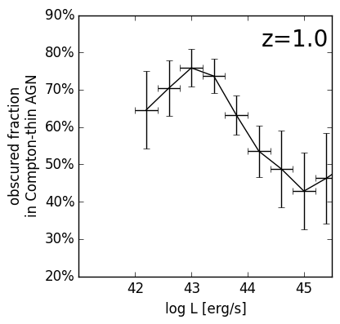
“Radiation-lifted torus”
Predict covering factor
f(L_{X}, M_{BH})
  Redshift evolution Buchner+15
  L_{X}/(M_{BH}^{2/3}) rad. pressure Elitzur+15, Wada15
  Opt./SDSS Oh+15
replace receding torus
  Unphysical for X-rays
“Galaxy gas as obscurer: II.”
Buchner & Bauer (submitted)

Slide 21
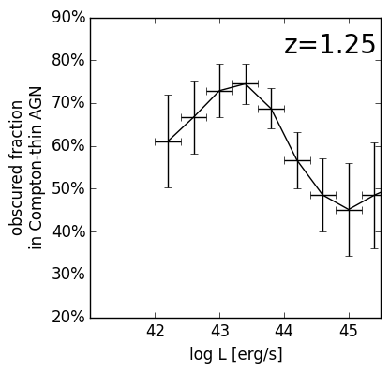
“Radiation-lifted torus”
Predict covering factor
f(L_{X}, M_{BH})
  Redshift evolution Buchner+15
  L_{X}/(M_{BH}^{2/3}) rad. pressure Elitzur+15, Wada15
  Opt./SDSS Oh+15
replace receding torus
  Unphysical for X-rays
“Galaxy gas as obscurer: II.”
Buchner & Bauer (submitted)

Slide 22
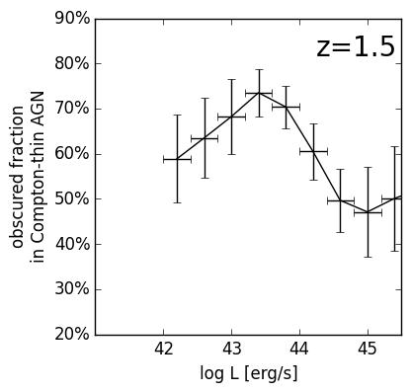
“Radiation-lifted torus”
Predict covering factor
f(L_{X}, M_{BH})
  Redshift evolution Buchner+15
  L_{X}/(M_{BH}^{2/3}) rad. pressure Elitzur+15, Wada15
  Opt./SDSS Oh+15
replace receding torus
  Unphysical for X-rays
“Galaxy gas as obscurer: II.”
Buchner & Bauer (submitted)

Slide 23
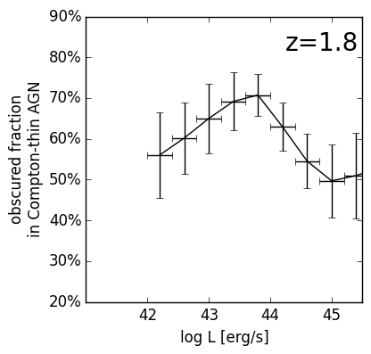
“Radiation-lifted torus”
Predict covering factor
f(L_{X}, M_{BH})
  Redshift evolution Buchner+15
  L_{X}/(M_{BH}^{2/3}) rad. pressure Elitzur+15, Wada15
  Opt./SDSS Oh+15
replace receding torus
  Unphysical for X-rays
“Galaxy gas as obscurer: II.”
Buchner & Bauer (submitted)

Slide 24
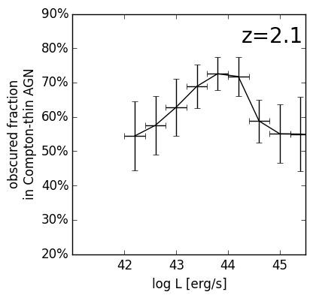
“Radiation-lifted torus”
Predict covering factor
f(L_{X}, M_{BH})
  Redshift evolution Buchner+15
  L_{X}/(M_{BH}^{2/3}) rad. pressure Elitzur+15, Wada15
  Opt./SDSS Oh+15
replace receding torus
  Unphysical for X-rays
“Galaxy gas as obscurer: II.”
Buchner & Bauer (submitted)

Slide 25
“Radiation-lifted torus”
Predict covering factor
f(L_{X}, M_{BH})
  Redshift evolution Buchner+15
  L_{X}/(M_{BH}^{2/3}) rad. pressure Elitzur+15, Wada15
  Opt./SDSS Oh+15
replace receding torus
  Unphysical for X-rays
“Galaxy gas as obscurer: II.”
Buchner & Bauer (submitted)

Slide 26
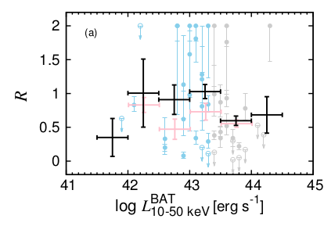
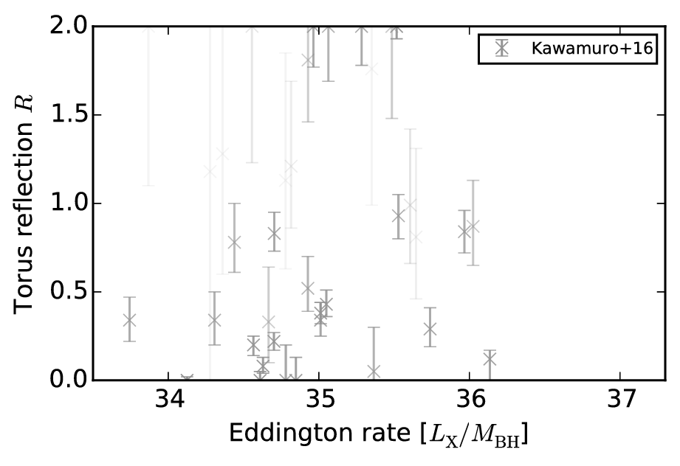
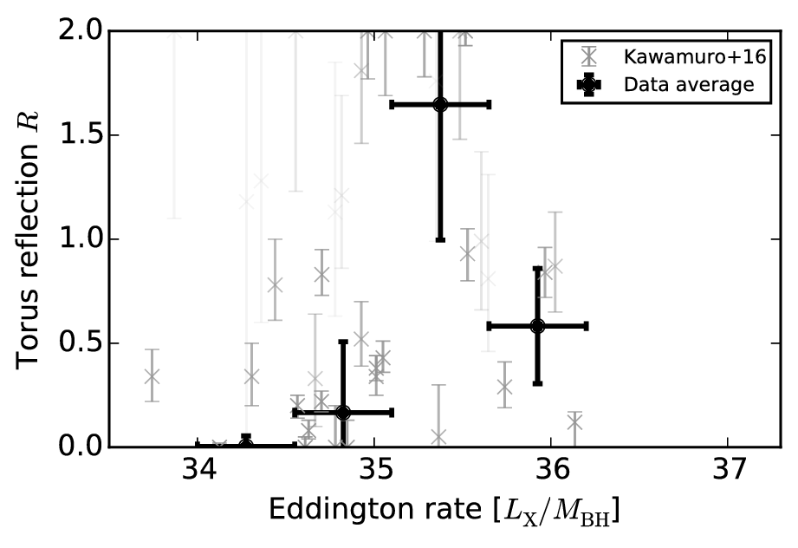
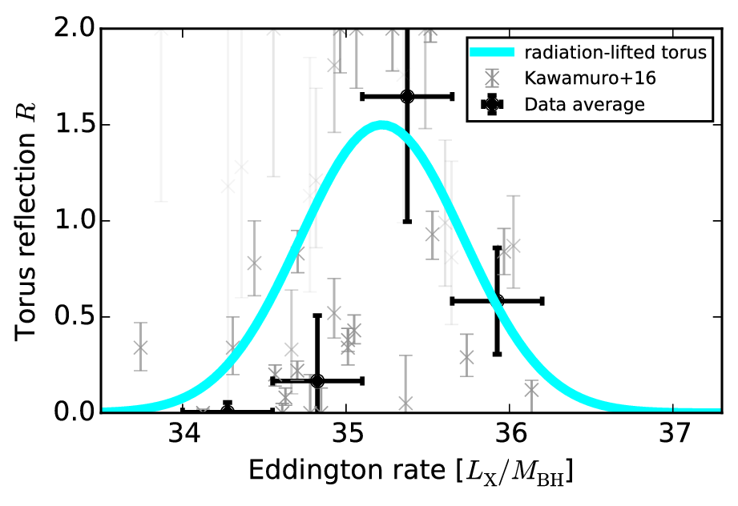
“Radiation-lifted torus”
Kawamuro+16
Swift/BAT sample
Covering factor

Slide 27
Physical mechanisms
Unified model
  Wind + Torus
  Radiation-pressure causes large covering
Evolution
  Off 89%
  Gas nearby +
  faint AGN 10%
  Bright AGN,
  blow-out of gas 1%
Wada15, Elitzur+15
see Poster by Kawakatu

Slide 28
Conclusions
The host galaxy as obscurer
  0% CTK LOS
  ~40% CTN obscured fraction
Nuclear obscurer - radiation-lifted torus
  CTK component
  CTN component
    Disappears at bright end
    M_{BH} + L_{X} dependent
“Galaxy gas as obscurer: II.”
Buchner & Bauer (submitted)

Slide 29
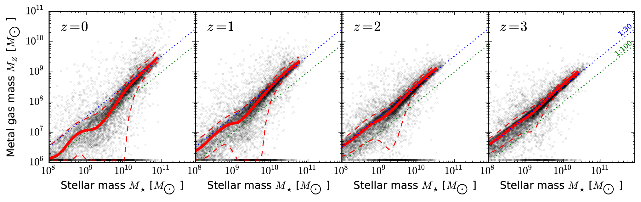
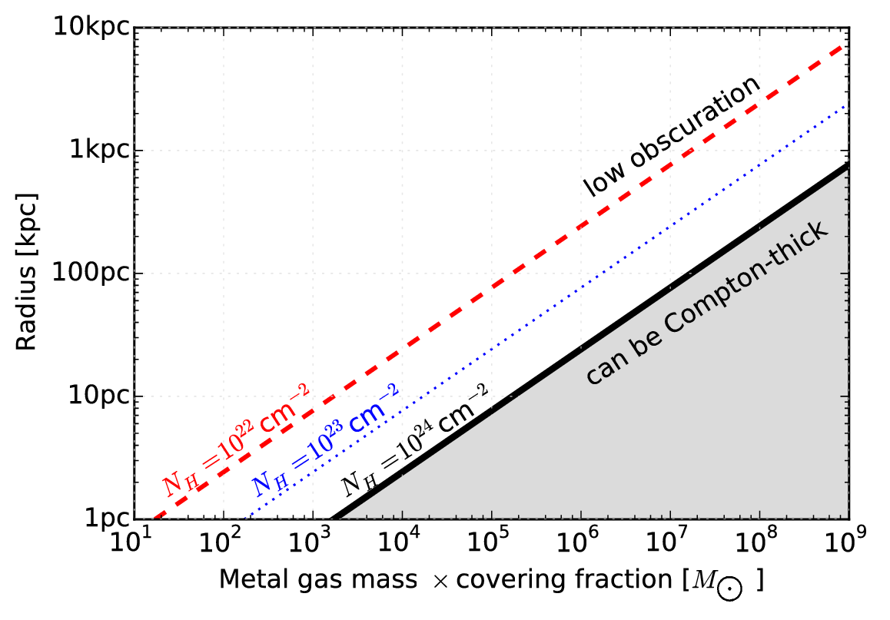
Metal gas
in galaxies

