Slide 1
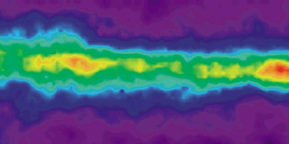
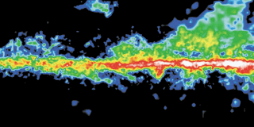
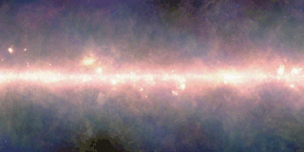
Galaxy gas probed by
X-ray sources (AGN, GRB)
Milky Way plane:
Atomic HI
Molecular Hydrogen
Infrared (dust)
NASA GSFC
Johannes Buchner
PUC
Collaborators: @PUC: Steve Schulze, Franz Bauer
@MPE: A. Georgakakis, K. Nandra, M. Brightman, ML. Menzel, Z. Liu, L-T. Hsu, M. Salvato, C. Rangel, J. Aird, A. Merloni

Slide 2
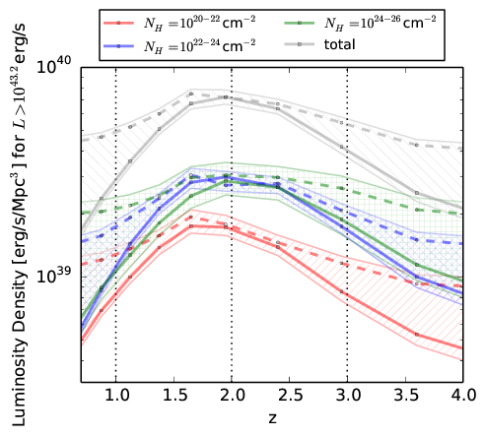
Galaxies from Gas
Gas collapse
SF & accretion
Emission
Absorption
most activity at z=0.5-3 e.g. AGN, SF
Buchner+15

Slide 3
AGN: Accretion onto SMBH
Accretion Disk
“Torus” Obscurer
Galactic Center gas
Star forming regions
e.g. in spiral arms
UV, Opt, X-ray, ...
<0.1pc
10pc
1 kpc
10 kpc
Nuclear obscuration
Galaxy-scale obscuration
How is it stable and extended?
Density? Substructure?
Feeding of AGN?
First constraint:
- Column density
- Covering fraction

Slide 4
Column density N_{H}
N_{H} … number of H atoms along line-of-sight
N_{H} = few atoms / cm³ x few kpc = 10²²/cm²
Compton-thick: ~ 10²⁴ cm² – Circinus, NGC1068
  Nuclear regions with high density
  Mergers – major accretion events for SMBH
H, O, Fe
  absorb everything except hard X-ray, re-radiate thermally in IR
  Measure N_{H} assuming local abundances from X-ray spectrum

Slide 5
Covering fraction
Unobscured sky
Obscured sky
Measure: % of obscured AGN
via surveys

Slide 6
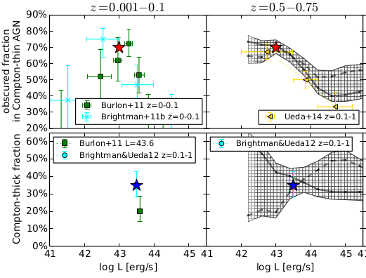

Fraction of Obscured AGN
Nuclear?
Galactic?
Can not be answered from a single central point source
Buchner+15

Slide 7
GRBs x-raying Galaxies
Long (>2s) Gamma Ray Bursts:
  Collapse of massive stars
  Produce γ-ray
    Detected through any obscuration
    Detected at z=0-10
  X-ray, Opt, … Radio
  Follow blue light, general SF
    But: avoid high-Z galaxies
    SF, low-mass galaxies
Idea:
  X-ray tomography
  Can we reconstruct the galaxy from LOS densities

Slide 8
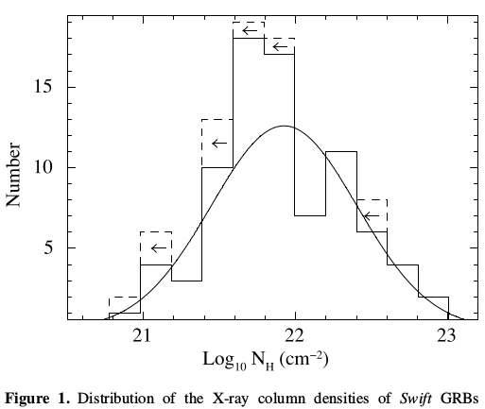
GRB column densities
Campana+10
Scatter:
  ~0.5 dex Geometry
  and Galaxy diversity
    Mass
    Gas content
    ...
No Compton-thick GRBs
Swift: ~900 GRBs
Long >2s GRB
X-ray afterglow
Flares removed

Slide 9
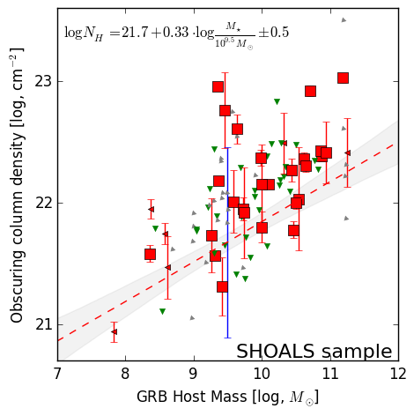
Host Mass – Obscuration
SHOALS
  Perley+15
  Deep follow-up
  ~90% redshift complete
  Spitzer masses

Slide 10




Host Mass – Obscuration
SHOALS
  Perley+15
  Deep follow-up
  ~90% redshift complete
LMC
M87
SMC
MW

Slide 11
Caveats
Relation from actively star-forming galaxies
  AGN have typical/lower SFR, also red&dead ell.
Metallicity lower in GRB than AGN hosts
  but overlap
AGN feedback may alter galaxies
  outflows, radiation pressure
Massive AGN host galaxies with N_{H}<10²² cm⁻² exist
  e.g. BCG; – ionisation; rare
Geometric effects from different POV
  but <x1.5 for ellipsoidal geometries

Slide 12
From GRBs to AGN
New Relation from GRBs
AGN fraction
Aird+12, Bongiorno+12
Stellar Mass Function
Ilbert+13, Muzzin+13
Multiplication, Marginalisation

Slide 13
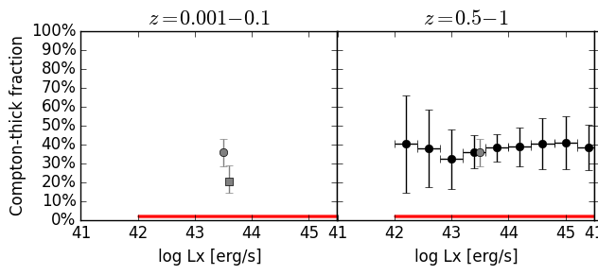
Predictions for
Compton-thick AGN
GRB-based model:
  No Compton-thick AGN expected from galaxy gas
  Compton-thick obscurer is nuclear

Slide 14

Predictions for AGN
Predicts no CT AGN
  nuclear
Slight overprediction:
  GRB-SF?
  Ellipticals?

Slide 15
Fraction of Obscured AGN
Nuclear: Disappears for luminous AGN: feedback on nucleus?
Galactic
Nuclear.
Galactic

Slide 16
Fraction of Obscured AGN
Nuclear
Disappears for luminous AGN
Galactic
Nuclear.
Galactic
Galactic

Slide 17
Conclusions
GRB show mass-dependent obscuration
Relation can predict LOS distribution for individual galaxies
For AGN population:
  Caveats: SF distribution, metallicity
  Galaxy gas+dust can explain much of the AGN obscuration at N_{H} = 10²² – 10²³ cm⁻²
For Torus models:
  Covering factors is … (see Buchner et al. in prep)
  Diminished in luminous AGN

Slide 18
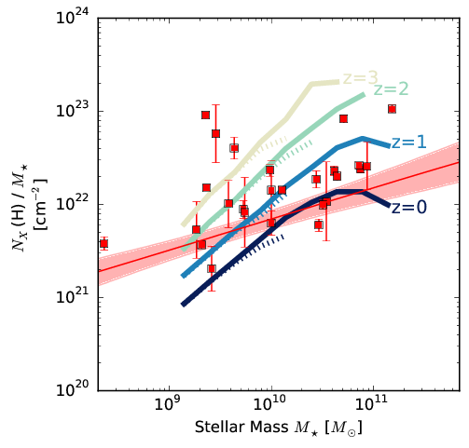
Cosmological simulations: GRB
EAGLE + Illustris
Match SMF
Predict gas mass in galaxies
  Morphology
  Colors
  Sizes
Illustris

Slide 19
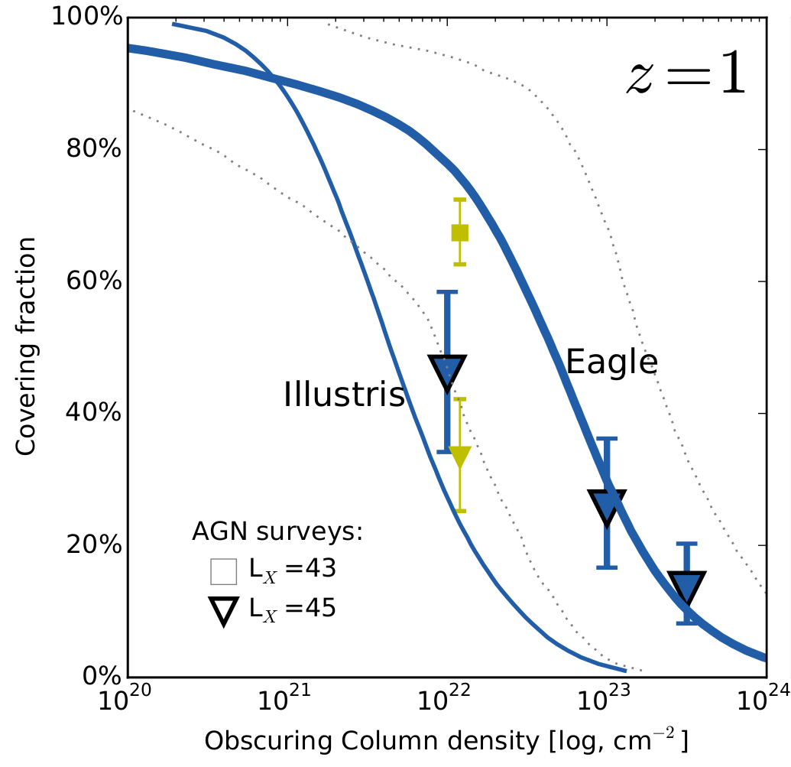
Cosmological simulations: AGN
In agreement depending on assumed feedback

Slide 20
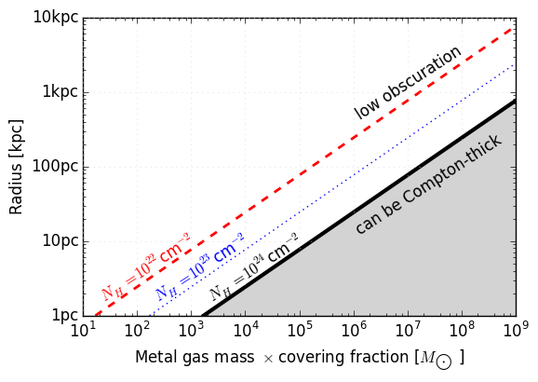
Mass required by CT obscurers
Modulo covering fraction
M_{Z} = 1% of stellar mass

Slide 21

Expected Shape
Scatter:
  ~0.5 dex Geometry
  and Galaxy diversity
    Mass
    Gas content
    Clumpiness
    ...

