Slide 1

Host Galaxies as Obscurers
The Nuclear and Galaxy-Scale Obscuration of AGN & LGRB
Johannes Buchner
FONDECYT fellow
http://astrost.at/istics/
Collaborators: @PUC: Steve Schulze, Franz Bauer
@MPE: A. Georgakakis, K. Nandra, M. Brightman, ML. Menzel, Z. Liu, L-T. Hsu, M. Salvato, C. Rangel, J. Aird, A. Merloni

Slide 2
Topics
Total Obscuration of AGN
Total accretion over cosmic time, incl. CTK
Behaviour of the obscurer with L,z vs models
How important are galaxies as obscurers?
Total Obscuration of LGRB
Importance of host-galaxy scale gas
Separating the nuclear and galaxy-scale obscurer of AGN

Slide 3
AGN: Accretion onto SMBH
Accretion Disk
“Torus” Obscurer
Galactic Center gas
Star forming regions
e.g. in spiral arms
UV, Opt, X-ray, ...
<0.1pc
10pc
1 kpc
10 kpc
Nuclear obscuration
Galaxy-scale obscuration

Slide 4
AGN: Accretion onto SMBH
Accretion Disk
“Torus” Obscurer
Galactic Center gas
Star forming regions
e.g. in spiral arms
Total growth over cosmic time? (z=0.5-3)
Self-regulation?
AGN-galaxy connection?
…
How is it stable and extended?
Density? Substructure?
Feeding of SMBH?
First observational constraint:
- Intrinsic accretion history
- Luminosity function
First observational constraint:
- Column density
- Covering fraction

Slide 5
Column density N_{H}
N_{H} … number of H atoms along line-of-sight
N_{H} = few atoms / cm³ x few kpc = 10²²/cm²
Compton-thick: ~ 10²⁴ cm² – Circinus, NGC1068
  Nuclear regions with high density
  Mergers – major accretion events for SMBH
Fe, O, He, H absorption:
  Intrinsic powerlaw from corona near accretion disk
  absorb soft but not hard X-ray, re-radiate thermally in IR
  Measure N_{H} assuming local abundances from X-ray spectrum

Slide 6
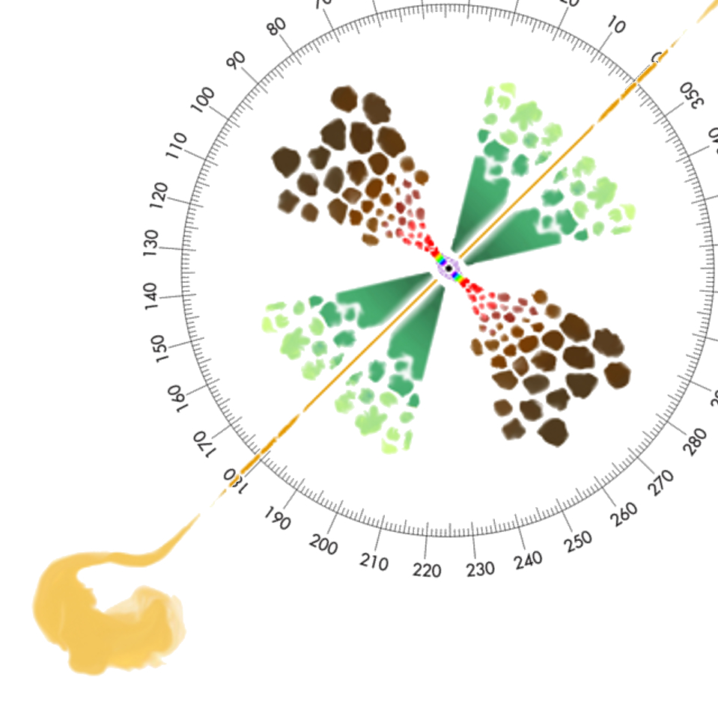
Covering fraction
Unobscured sky
assuming random views
% of obscured AGN =
% of obscured sky =
covering fraction
need sample of AGN
+ selection function
+L, z, N_{H} range coverage
Obscured sky: Nuclear? Galaxy?
Matt2000
Compton-thick sky
Torus, Nuclear (?) Goulding&Alexander+09
Marin+16

Slide 7
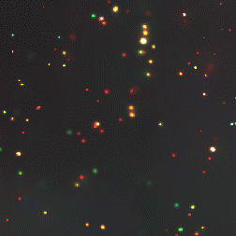
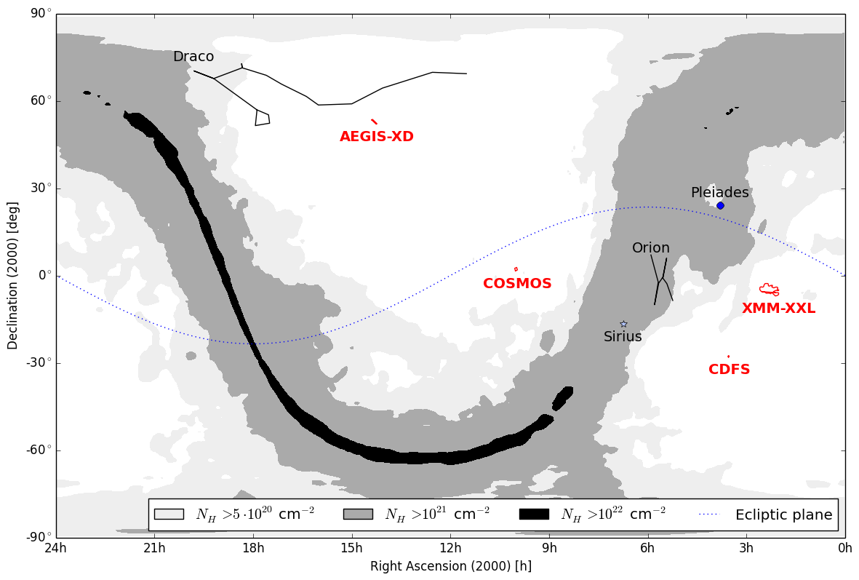
Selection of AGN
Deep + shallow fields

Slide 8



Surveys
2-10 keV Chandra detection
Wedding-cake
~2000 objects
>100 CT (Brightman+14)

Slide 9


2-10keV X-ray Selection
Gilli+07
+ Chandra positioning
for associations and
redshift computations
Li-Ting Hsu, Mara Salvato,
Marie-Luise Menzel, James Aird
ROSAT
Chandra z=2
NuSTAR z=0
Chandra z=0

Slide 10
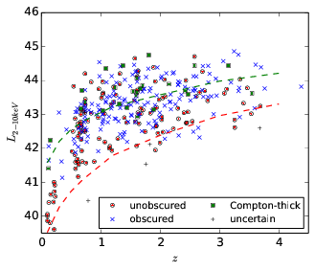
Selection function
Selection function of Chandra is sensitive to CTK AGN at z=2
Good PSF accuracy for association
Chandra is sensitive to Compton-thick AGN at z=1-3
Brightman+14 detected 100 CTK in CDFS, AEGIS-XD, COSMOS fields
Largest sample of CTK AGN!

Slide 11
Selection of AGN
X-rays:
  Efficient
  Little host contamination
  Selection function understood
  Multi-λ: association, redshifts
  Measure N_{H}, intrinsic luminosity simultaneously
  Proxy for bolometric accretion luminosity
Other options: IR, Radio
ultimately need N_{H} and intrinsic luminosities

Slide 12
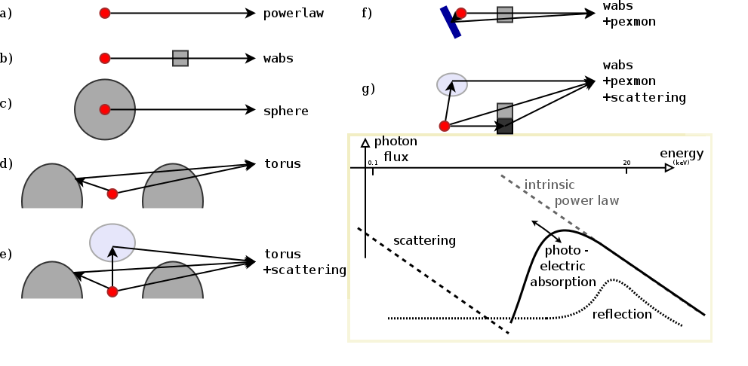
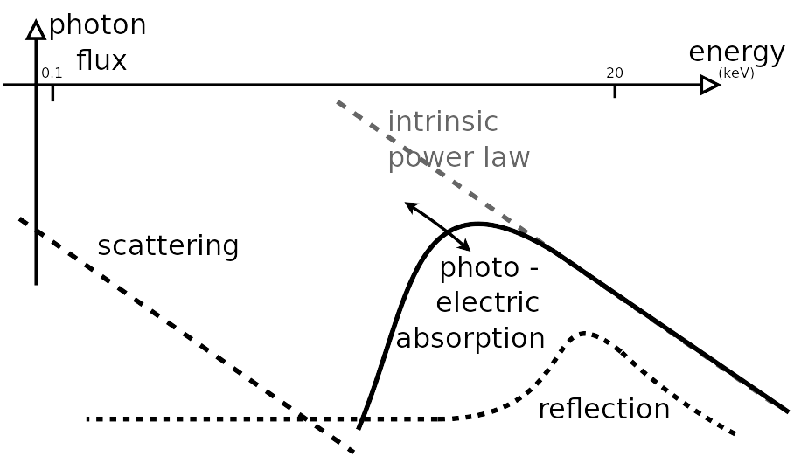
X-ray spectra
2
1
3
We know the obscured X-ray spectra at z=0.5-3
We find warm scattering and cold scattering escaping
- if those are mirrors of the intrinsic radiation – not completely covered

Slide 13
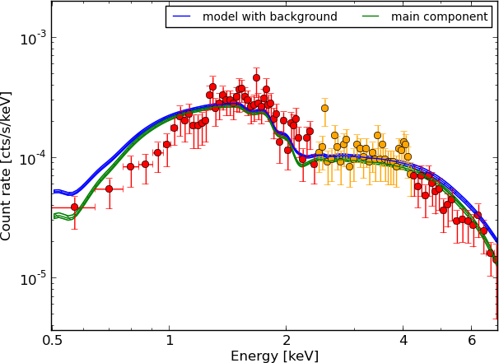
X-ray spectra

Slide 14
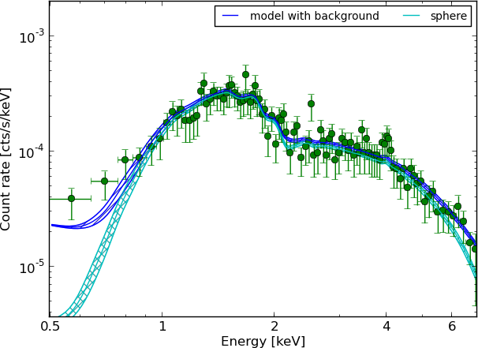
X-ray spectra

Slide 15
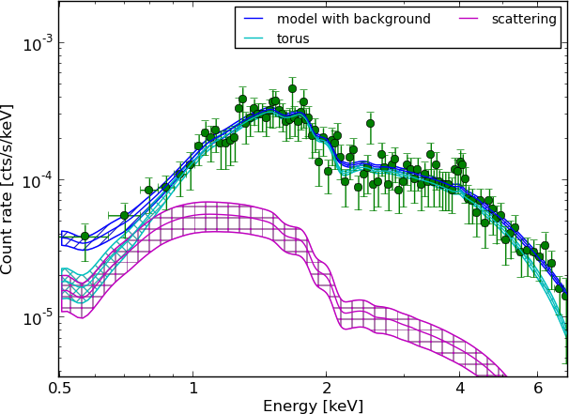
X-ray spectra

Slide 16
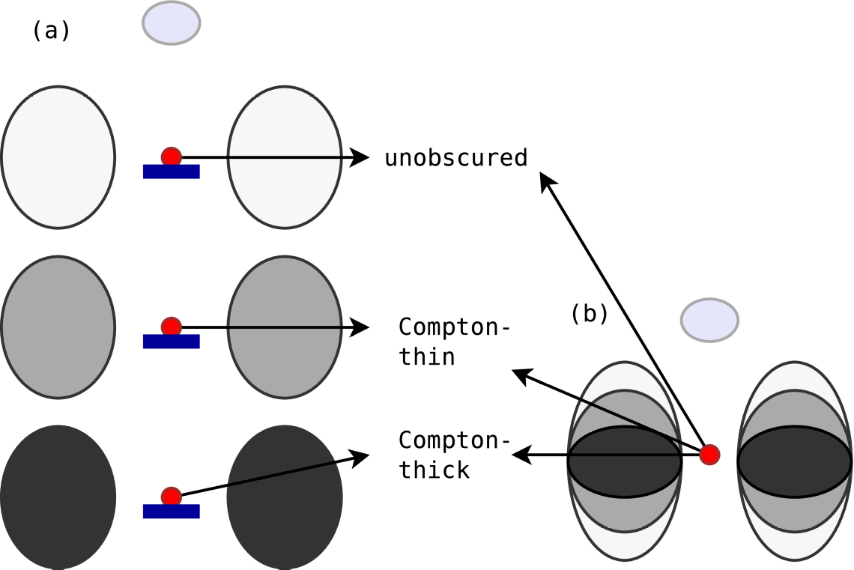
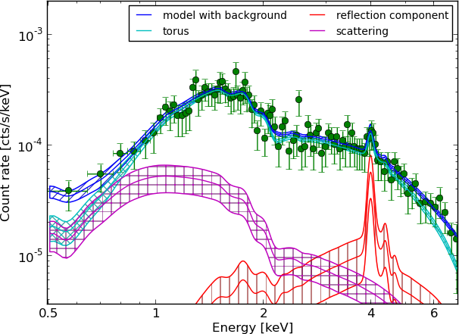
X-ray spectra
X-ray model comparison
prefers this model
BXA – MultiNest for xspec/sherpa
systematically – bootstrapping
also for CTK AGN
2-10 keV Chandra detection
Wedding-cake
~2000 objects
>100 CT (Brightman+14)

Slide 17

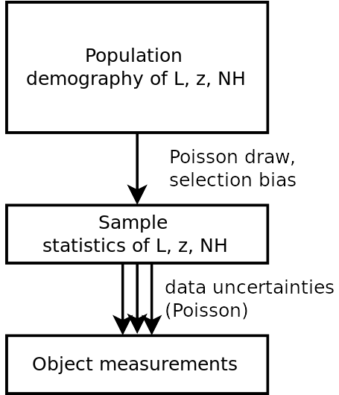
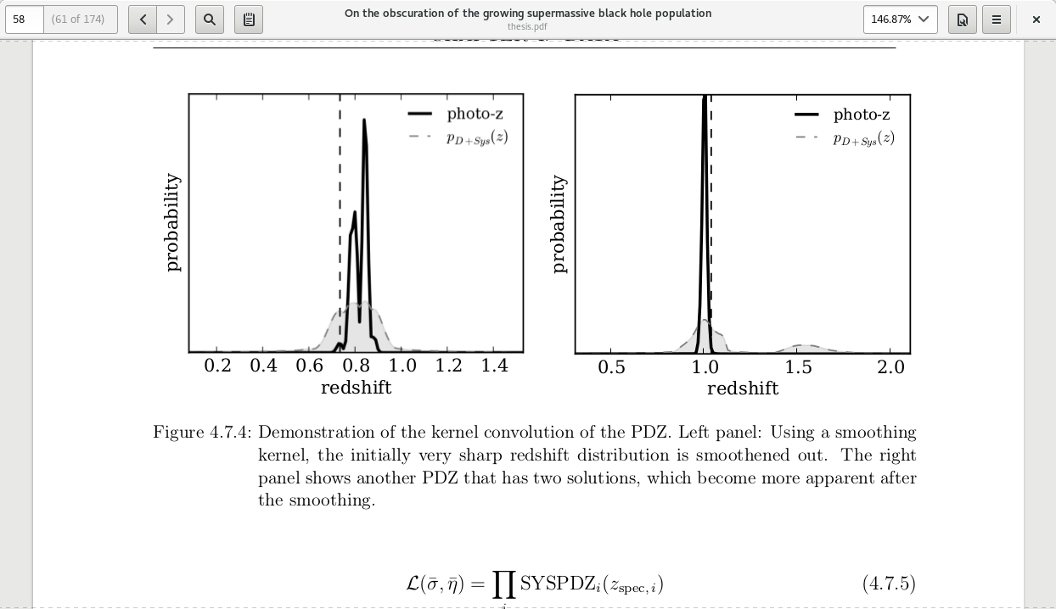
Survey analysis
Marshall 1983
C=(L,z,N_{H})
Incorporates
Uncertainties in z, L, N_{H} from spectra
Sensitivity
Is hierarchical inference with Censorship (Loredo04, Kelly+08)

Slide 18
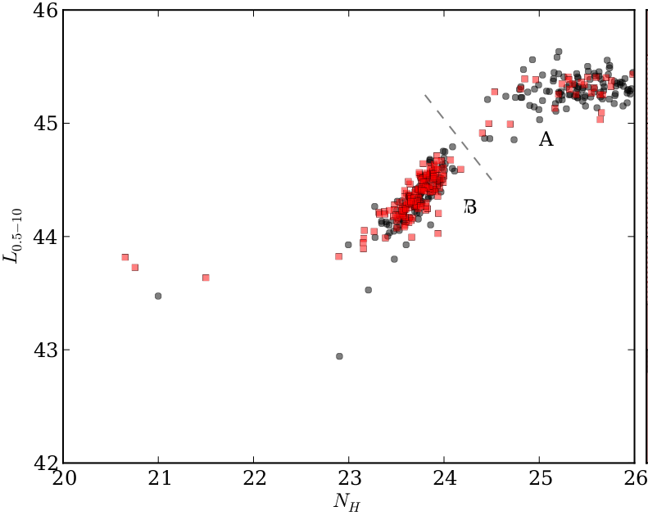
Consistent Bayesian Analysis
Advanced matching to opt/IR (Hsu+14, M. Brusa)
Deep multi-wavelength coverage
  High redshift completeness
  Precise & accurate photo-z (M. Salvato, Hsu+14)
Include sources without counterparts consistently
Uncertainty in photometric redshift, multiple solutions
Systematic errors of photometric redshift
Full spectral analysis of unbinned spectrum
  Uncertainty clouds in L, z, NH
Propagated into luminosity function analysis
  Recover a smooth field ϕ(L, z, NH) / d...
  Non-parametric, model-independent
Luminosity
Column density NH
Buchner+14
Robust Results – Realistic Uncertainties

Slide 19
Survey analysis
Spec-z, ignore others +photo-z Photo-z + systematics
Total counts two bands full spectra
ad-hoc fit statistic sample as poisson draw
parametric LF flexible LF non-parametric
(+sensitivity calculations, +association methods)
Notes:
Full spectral information
Incorporate redshift uncertainties, including systematic uncertainties
Incorporate sources w/o counterparts
Show how methods improved over the years

Slide 20
Function Φ(L, z, N_{H})
Bending powerlaw, evolving parameters
  LDDE (Ueda+03, Ueda+14)
  LADE (Aird+10)
  FLDE (Aird+15)
New: Non-parametric approach
  Vmax estimators – binning is problematic
  Our approach: smooth 3D field Φ(L, z, N_{H})
    need smoothness prior:
    at each N_{H}, z: slope or flat. Across: flat

Slide 21
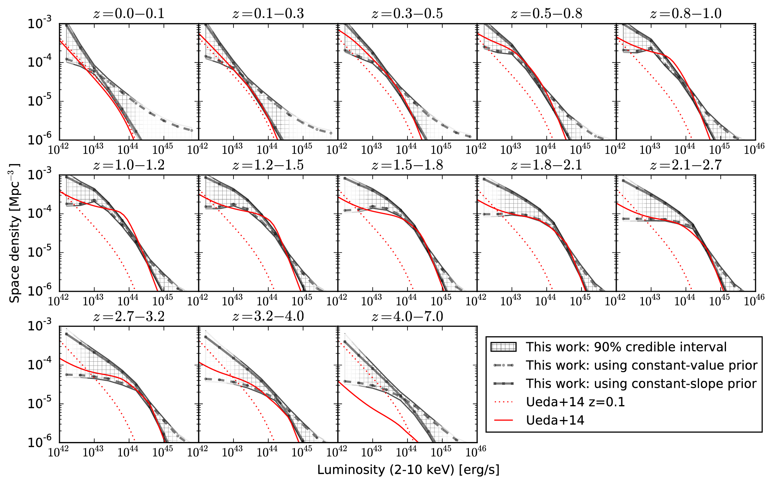
Intrinsic LF shape
Buchner+15

Slide 22


Compton-thick Luminosity Function
Reconstruction of a smooth field
  Results insensitive to chosen
  smoothing length
    0.5 mag between bins
  Consistent Cthin total LF with
  Ueda+14, Aird+10
Buchner+15

Slide 23

Obscured accretion history
Buchner+15
CTK
CTN obscured
unobscured

Slide 24

Black Hole Mass Accretion
ε=10%
Bol. Corr.:
Marconi+04
not Hopkins+07
Convert to mass flowing into BH Accretion consistent with local BHMD
in prep., see also Merloni15

Slide 25
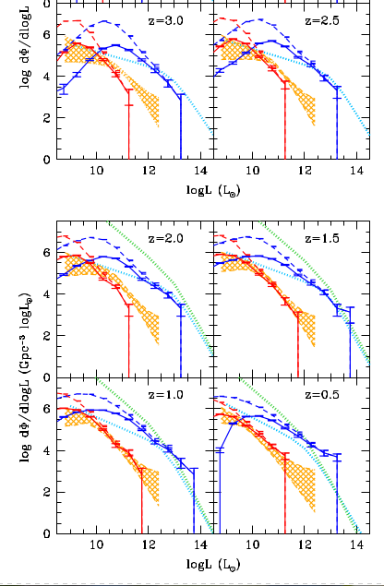

Simulations
Became a standard for testing
cosmological simulations
and their AGN feedback
Horizon-AGN Volonteri+16
Buchner+15

Slide 26

Simulations
EAGLE Rosas-Guevara+16
Buchner+15

Slide 27
Obscured fractions
Total number density
Obscured fraction:
Compton-thick fraction:
Ricci+16: Swift/BAT, z=0 lum-dep
Annuar in prep: NuSTAR z=0
Wilkes+13: Radio, z~2 CTK fraction < 40%
Buchner+15
77 ⁺⁴₋₅%
38 ⁺⁸₋₇%

Slide 28
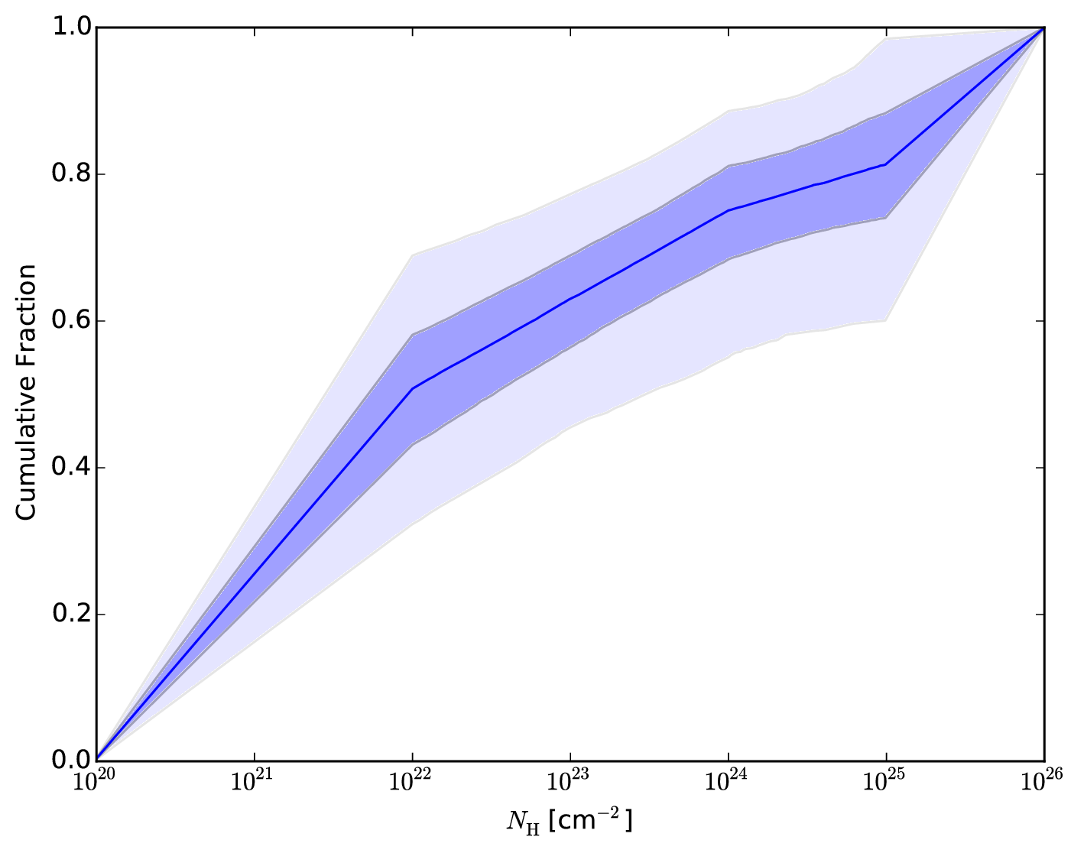
Radio results
radio-selected, high-L; 38 total, 9 CTK, 3 more?
z~2, complete
spectral analysis
Results confirm
Wikes+13
Unobscured
Compton-thin
obscured
Compton-thick

Slide 29
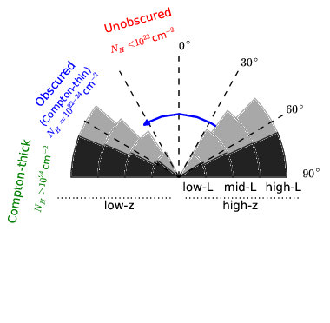
Total covering fractions

Slide 30

Obscuration – Luminosity – Redshift
Buchner+15

Slide 31
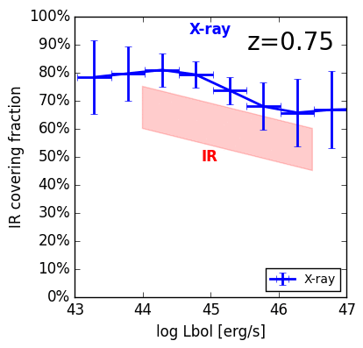
Comparison w/ IR covering fractions
IR: Stalevski+16,
z~1.5
Buchner+15
Buchner+17b
In parametric models (since 2003)
e.g. Ueda+03, Ueda+14, Aird+15
Does the obscured fraction
really increase with redshift?

Slide 32

Buchner+15

Slide 33
z evol
Buchner+15

Slide 34
z evol
Buchner+15

Slide 35
z evol
Buchner+15

Slide 36
z evol
Buchner+15

Slide 37
z evol
Buchner+15
With BHM downsizing

Slide 38
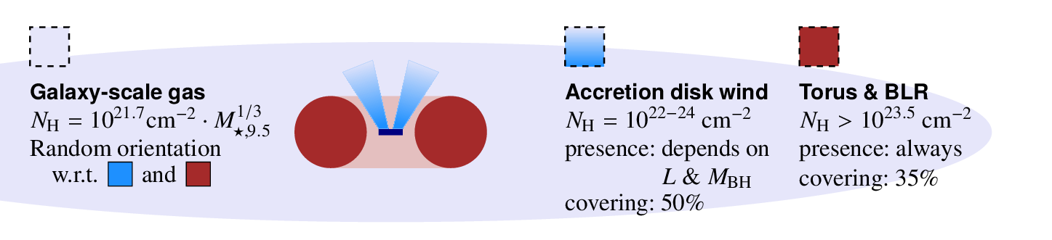
Physical mechanisms
Unified model
  Wind + Torus
  Radiation-pressure causes large covering
Evolution
  Off 89%
  Gas nearby +
  faint AGN 10%
  Bright AGN,
  blow-out of gas 1%
Wada15, Elitzur+15
Buchner+17b

Slide 39
Pretty video for patient listeners
Wada12, Wada15

Slide 40
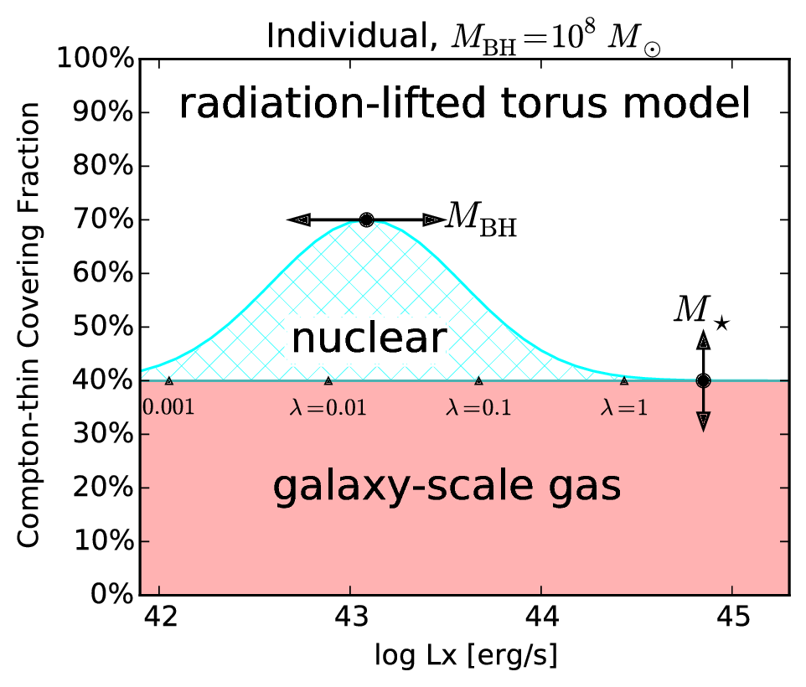
Radiation-lifted torus
Buchner+17b
Alternative to
“receding torus”
Mdot-dep

Slide 41
Summary I
Successfully constrained obscured accretion
Hidden accretion is the majority
Have covering fractions for various column densities
  For torus modellers & simulators
  L-dep is complex – Eddington-rate dependent?
  “radiation-lifted torus” paradigm
But how important is galaxy-scale obscuration?

Slide 42
Galaxy-scale obscuration
Need:
  Probe that is sensitive to high columns
  Not just a central point source
  Provides X-ray, for column densities
  z=0.5-3
Lets try to understand the obscurer of LGRBs

Slide 43
GRBs x-raying Galaxies
Long (>2s) Gamma Ray Bursts:
  Collapse of massive stars
  Produce γ-ray
    Detected through any obscuration
    Detected at z=0-10
  X-ray, Opt, … Radio
  Follow blue light, general SF
    But: avoid high-Z galaxies
    SF, low-mass galaxies
Idea:
  X-ray tomography
  Can we reconstruct the galaxy from LOS densities

Slide 44
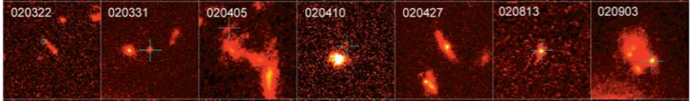
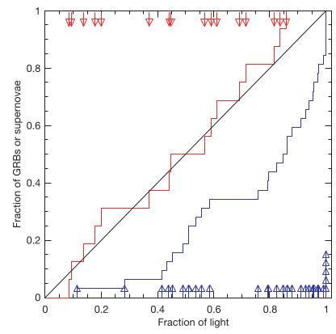
HST, blue or ultraviolet rest-frame images of GRB host galaxies
Massive O/B stars
Die early
In star-forming regions, molecular clouds
Need low metallicity gas
Follow blue light, general SF
But: avoid high-Z galaxies
SF, low-mass galaxies
Fruchter+06
SN: proportional
to blue light
GRB:
concentrated at bluest regions

Slide 45
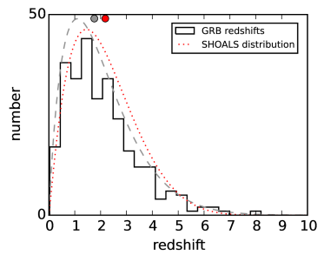
LGRB surveys
Swift: >900 sample of LGRBs, good positioning
Limited follow-up = redshift bias
Solutions:
  Include sources without redshift in analysis
  Use highly complete, unbiased samples
    SHOALS: defines criteria that do not depend on properties of the host galaxy

Slide 46
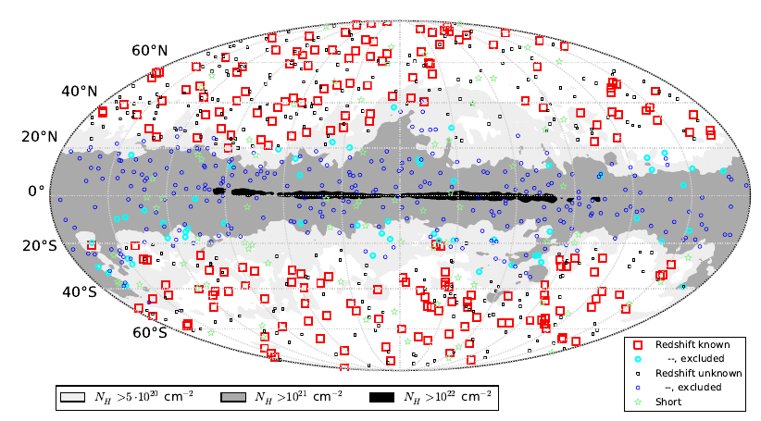
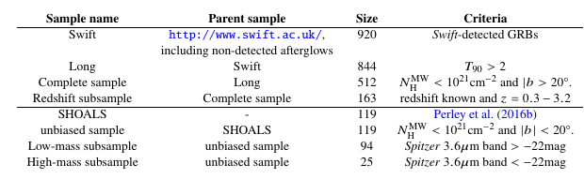
Data
Entire swift.ac.uk archive
Exclude flares & prompt emission
  Automated + visual inspection
Samples

Slide 47
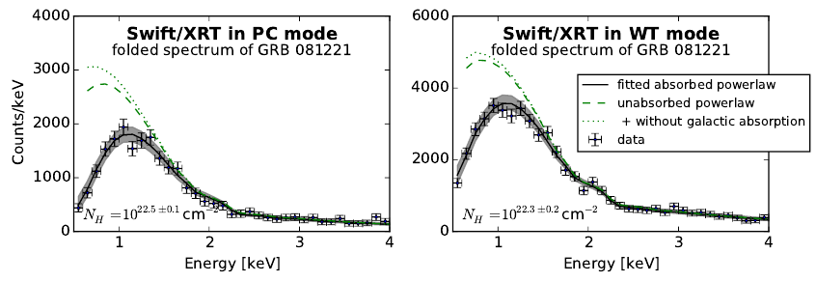
X-ray spectroscopy
Obscurer model:
  Intrinsic powerlaw
  a) tbabs
  b) SPHERE (Compton scattering)
Normalisation

Slide 48
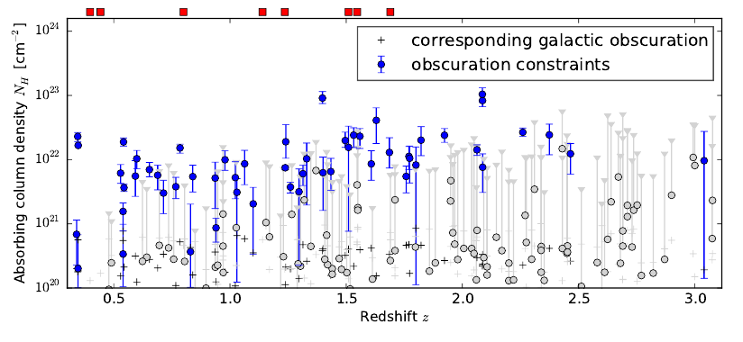
Column density distribution

Slide 49
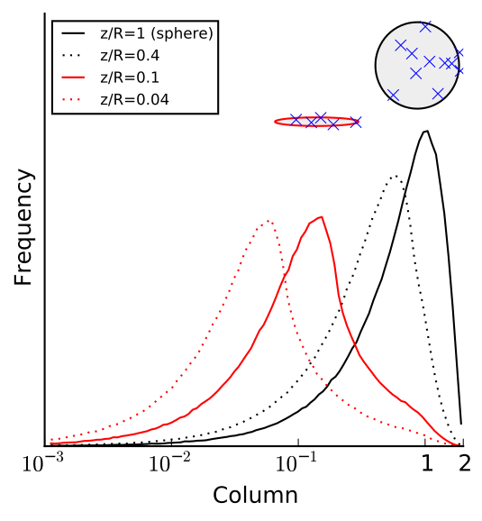
N_{H} distribution: Primer
~0.5 dex from geometry

Slide 50
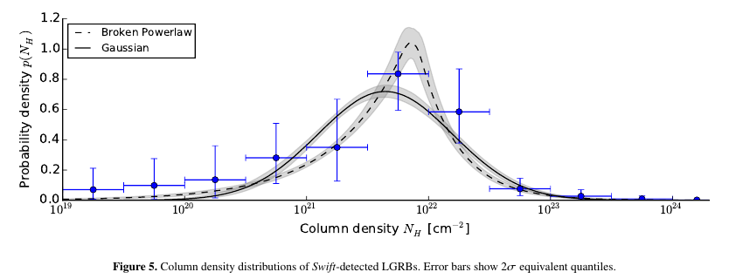
N_{H} distribution: observed
Model comparison (AIC): broken powerlaw is better

Slide 51
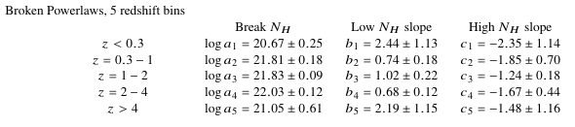
Redshift evolution
Not monotonic
Consistent within factor 2
KS test not valid
Splitting sample not valid

Slide 52
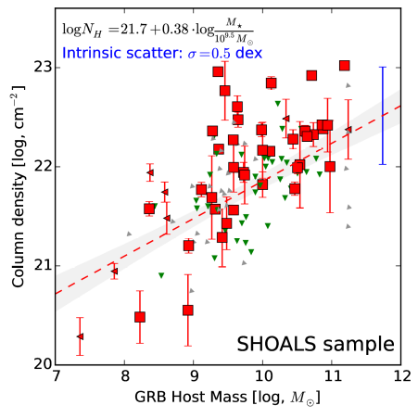
Host Mass - Obscuration
SHOALS
  Perley+15
  Deep follow-up
  ~90% redshift complete
  Spitzer masses
“Galaxy gas as obscurer: I.”
Buchner, Schulze & Bauer (2017)

Slide 53
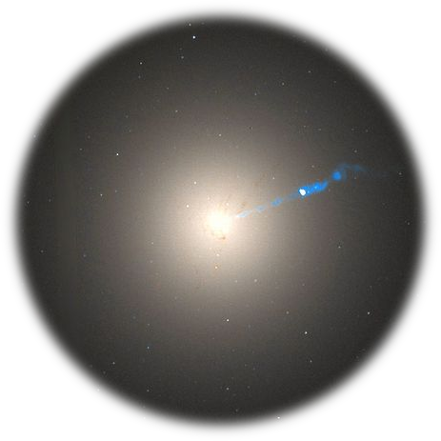
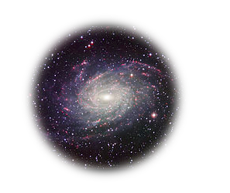
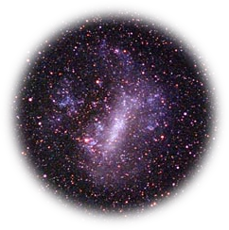
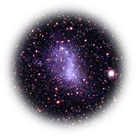
Host Mass – Obscuration
SHOALS
  Perley+15
  Deep follow-up
  ~90% redshift complete
“Galaxy gas as obscurer: I.”
Buchner, Schulze & Bauer (2017)

Slide 54
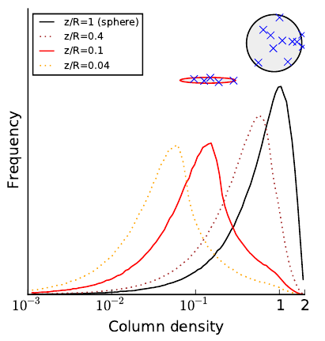
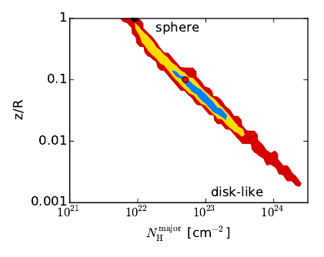
Toy model explains scatter
Ellipsoid gas is preferred model

Slide 55
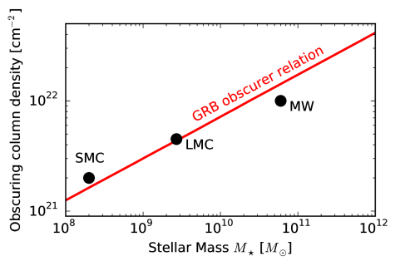
Local Galaxies
1% densest column from HI maps
Gas metallicity-corrected
“Galaxy gas as obscurer: I.”
Buchner, Schulze & Bauer (2017)

Slide 56
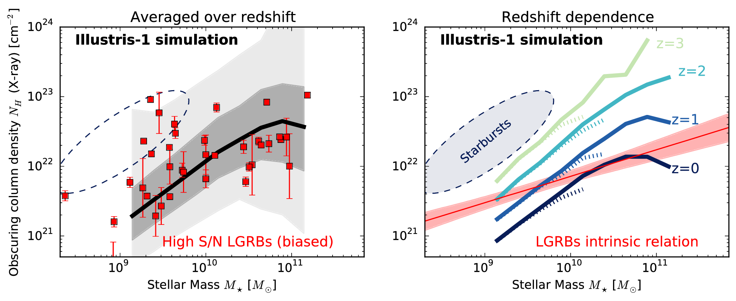
Predictions by simulations
“Galaxy gas as obscurer: I.”
Buchner, Schulze & Bauer (2017)
Notes:
Reproduce M* function
Reproduce observed HI, CO masses
Reproduce galaxy radii
They put the right amount of gas into galaxies
Resolution is problem, but averages out over long LOS

Slide 57

Host Mass – Obscuration
SHOALS
  Perley+15
  Deep follow-up
  ~90% redshift complete
Hosts?
  Actively star-forming, AGN not necessarily
  Metallicity bias
N_{H} – M* relation
Obscurer is host galaxy
Understand normalisation
Understand slope
Understand scatter
“Galaxy gas as obscurer: I.”
Buchner, Schulze & Bauer (2017)

Slide 58
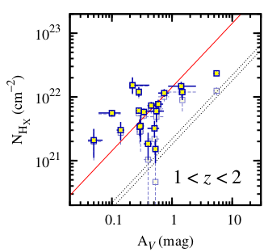
A_{V}/N_{H}
X-ray absorption (metals)
exceeds
Optical dust extinction
Watson+13

Slide 59
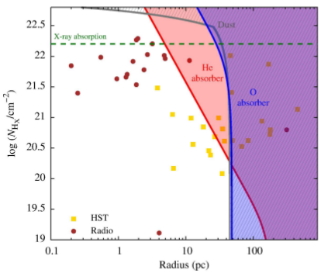
Non-local ISM abundances
Circum-burst, <30pc
Ionisation of H
Ionisation of O, Fe
(some) He left
  Original (He) column must have been 7 times higher
Predictions:
  No metals in LOS
  Energy dependence
  No stellar mass-dependence
    Larson’s laws
Watson+13

Slide 60
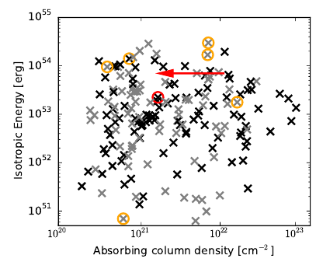
Energy-dependence
Expectation:
  For energetic bursts
  systematic decrease
  Most energetic ones: unobscured

Slide 61
Energy-dependence
SHOALS sample
Orange:
metals detected
More consistent with host galaxy as dominant obscurer
Perhaps sub-dominant nuclear ionised obscurer

Slide 62
Summary II
Host galaxy is the main obscurer of LGRBs
  Relation valid for local galaxies
  Slope understood
  Scatter understood
  Zero-point as expected from simulations
Constraints at z=0.5-3
  No redshift evolution there, at most a factor of 2

Slide 63
Generalising LGRB results
Stellar mass
Redshift evolution
SFR
  Lower in AGN
Metallicity
  Overlapping
  Stellar metallicity vs. gas metallicity
Vantage point
Same Observable

Slide 64
From GRBs to AGN
New Relation from GRBs
AGN fraction
Aird+12, Bongiorno+12
Stellar Mass Function
Ilbert+13, Muzzin+13
Marginalisation
“Galaxy gas as obscurer: II.”
Buchner & Bauer (2017)

Slide 65
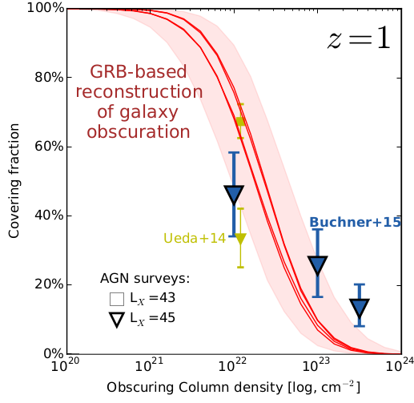
Predictions for AGN
No CTK AGN
Substantial % C-thin obscured
Slight overprediction:
  GRB-SF?
  Ellipticals?
“Galaxy gas as obscurer: II.”
Buchner & Bauer (2017)

Slide 66
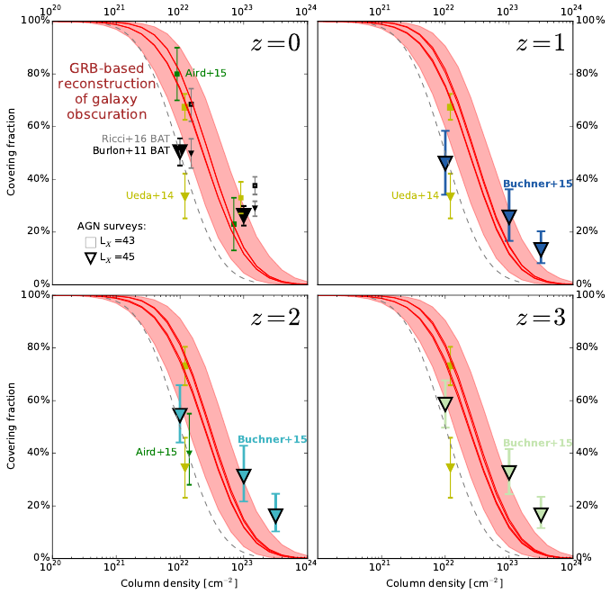
“Galaxy gas as obscurer: II.”
Buchner & Bauer (2017)

Slide 67
Simulations vs Observations
EAGLE (and Illustris)
Reproduce SMF
Reproduce observed HI, CO masses
Reproduce galaxy radii
They put the right amount of gas into galaxies
Resolution is problem
  but averages out over long LOS
But: Answer is feedback dependent

Slide 68
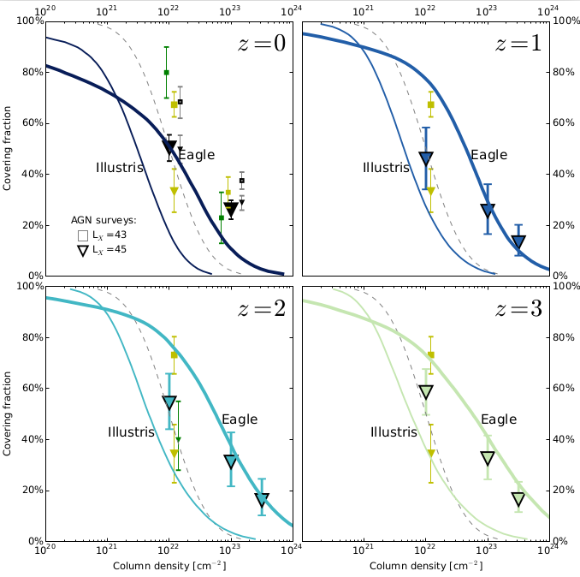

Slide 69
Interpretation
No CTK obscured AGN by galaxy-scale obscurer
Plausibly up to 40% of AGN are galaxy-scale obscured
  Even without any nuclear obscurer
  First separation of nuclear (<100pc) and galaxy-scale obscurer (>100pc)

Slide 70
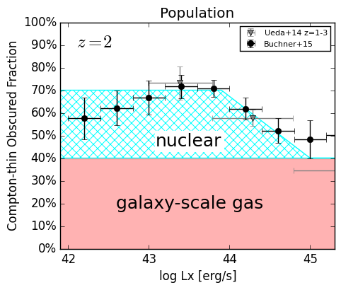
The Nuclear Obscurer
Host galaxy
CTK obscurer
CTN obscurer
disappears at bright end
describe nuclear obscurer alone
“Galaxy gas as obscurer: II.”
Buchner & Bauer (2017)

Slide 71
“Radiation-lifted torus”
Predict covering factor
f(L_{X}, M_{BH})
  Redshift evolution Buchner+15
  L_{X}/(M_{BH}^{2/3}) rad. pressure Elitzur+15, Wada15
  Opt./SDSS Oh+15
replace receding torus
  Unphysical for X-rays
“Galaxy gas as obscurer: II.”
Buchner & Bauer (2017)

Slide 72
Summary III
If AGN did not have a nuclear obscurer, 40% of them would still be obscured
  In fact, 3/4 obscured, 1/3 CTK (avg over z&L)
  obscurer may be Eddington-rate dependent
    to explain redshift evolution of L-dependence
    “radiation-lifted torus” – for modellers & simulators
host galaxy is an important CTN obscurer in AGN+LGRBs
LGRB are dominated by host galaxy obscuration, and show little evolution
  These observational results are supported by state-of-the-art cosmological simulations and may be used to calibrate AGN feedback strengths
  Probe of metal gas content in z=0.5-3 galaxies

Slide 73
References & Tools
Buchner+2014: Comparison of torus geometries of X-ray spectra in CDFS. Find high Compton scattering.
Buchner+2015: Intrinsic CT fractions, luminosity functions
Buchner, Schulze & Bauer 2017:
Galaxy gas as obscurer: I LGRBs x-ray their host galaxies
Buchner & Bauer 2017:
Galaxy gas as obscurer: II Separating the nuclear and host galaxy obscuration of AGN
PyMultiNest: Robust and fast model comparison and parameter estimation with Python
BXA: MultiNest for xspec&sherpa, for model comparison with X-ray spectral models
Website: astrost.at/istics

Slide 74
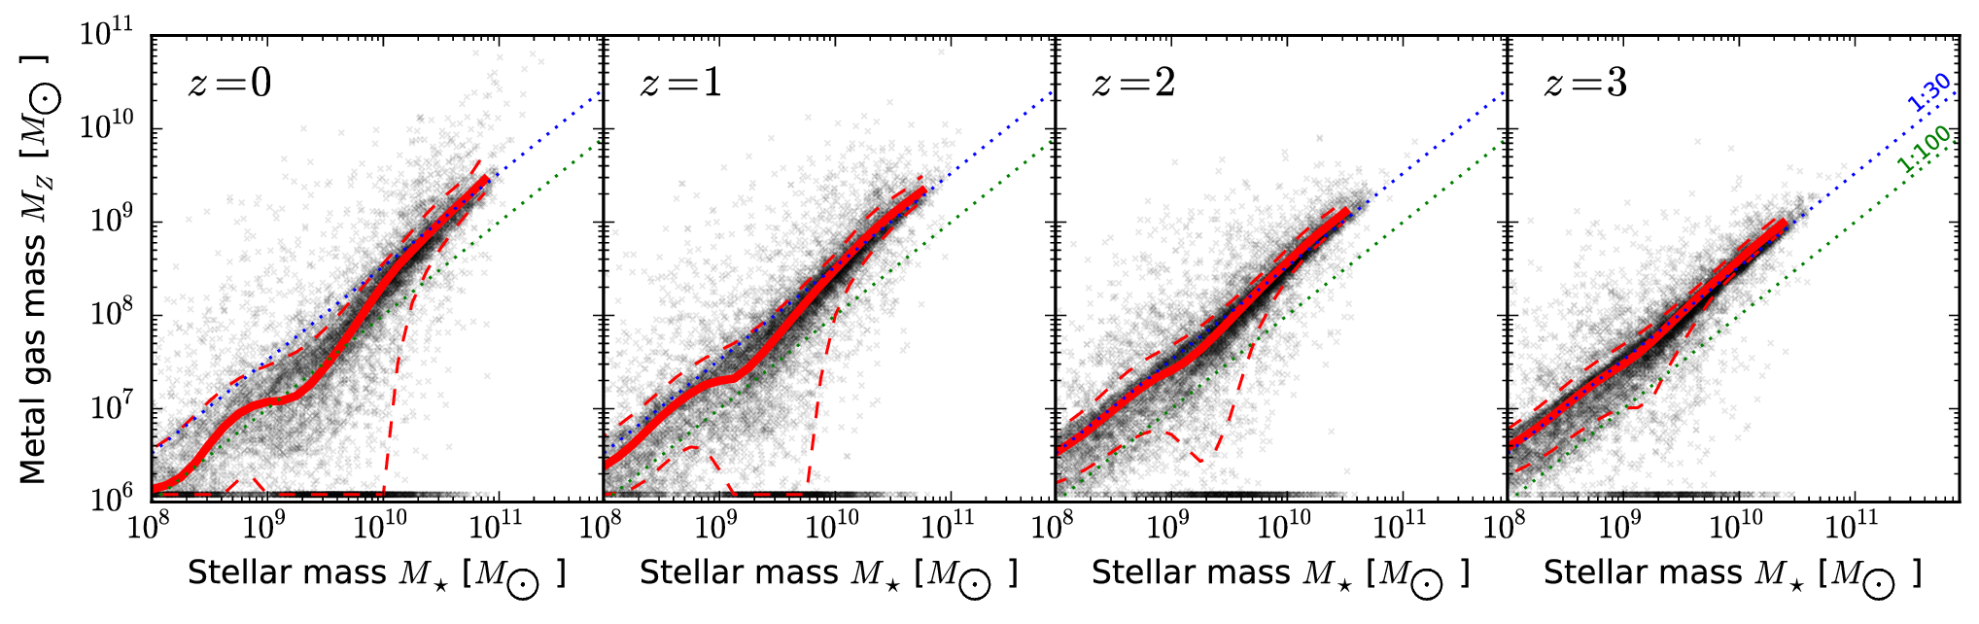
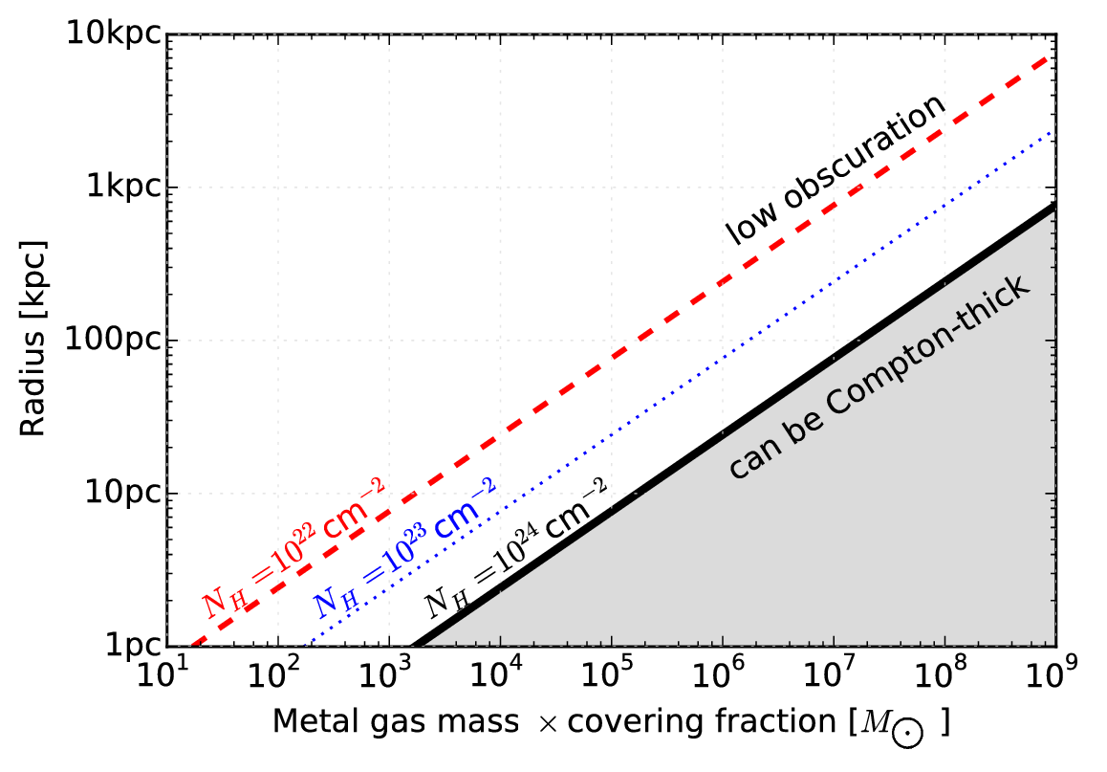
Metal gas
in galaxies
Mergers

Slide 75
Mergers
Disturbed/merger fractions similar LGRB-AGN
  (in the relevant luminosity regime)
Obscuration by merger at high-L should become more prevalent
  We see the opposite
  merger stages

