Slide 1

New CLUMPY models for the X-ray obscurer of AGN
Johannes Buchner
FONDECYT fellow
http://astrost.at/istics/
Collaborators: M. Brightman, K. Nandra, R. Nikutta, F. Bauer

Slide 2
AGN: Accretion onto SMBH
Accretion Disk
“Torus” Obscurer
Galactic Center gas
Star forming regions
e.g. in spiral arms
UV, Opt, X-ray, ...
<0.1pc
10pc
1 kpc
10 kpc
Nuclear obscuration
Galaxy-scale obscuration

Slide 3
AGN: Accretion onto SMBH
Accretion Disk
“Torus” Obscurer
Galactic Center gas
Star forming regions
e.g. in spiral arms
Total growth over cosmic time? (z=0.5-3)
Self-regulation?
AGN-galaxy connection?
…
How is it stable and extended?
Density? Substructure?
Feeding of SMBH?
First observational constraint:
- Intrinsic accretion history
- Luminosity function
First observational constraint:
- Column density
- Covering fraction

Slide 4
The “Torus”
Obscurer with substantial covering
  75% LOS are obscured, ~38% are CTK Buchner+15
  (corrected for selection-effect, i.e. intrinsic fractions)
  Subtracting the host galaxy,
  40% LOS are obscured, CTK unchanged, Buchner+17
  But depends on luminosity or Eddington rate (Buchner+15,17)
few pc scale – VLBI
Non-spherical – polarisation
  –> donut?
polar dust emissions – high-res IR
  –> wind/outflow?

Slide 5
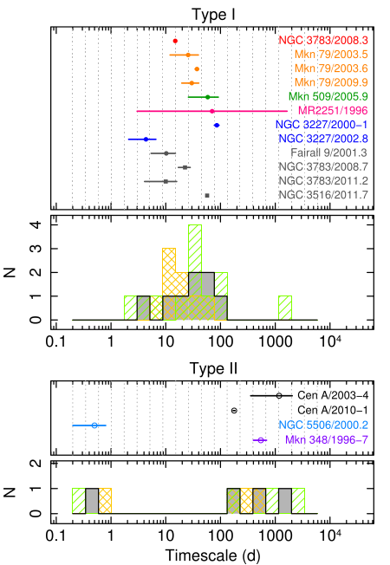
The Clumpy “Torus”?
Initially IR SEDs
X-ray eclipse events
Risaliti+02, Markowitz+14

Slide 6
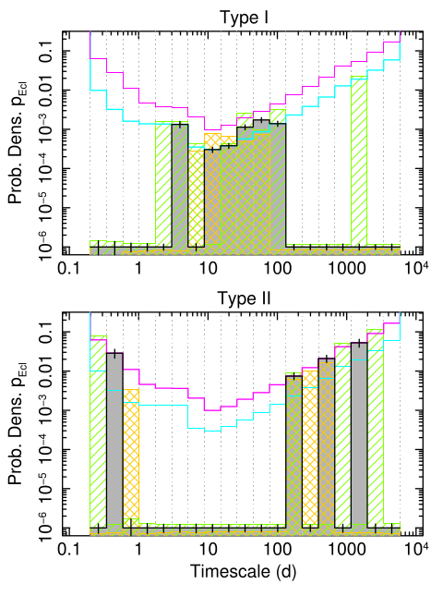

Slide 7
Idea
A Constrained model
Unification
  Realistic obscured fractions, CTK fractions
  “Opening angle” free parameter
Cloud eclipse events
  Realistic angular size of clouds
  Realistic distance (distribution)
Self-consistent IR and X-ray models
  Here: augment CLUMPY

Slide 8
XARS
X-ray photon propagation
  Photo-electric absorption
  Fluorescent lines
  Compton scattering
For arbitrary, user-specified geometries
Fast & open source

Slide 9
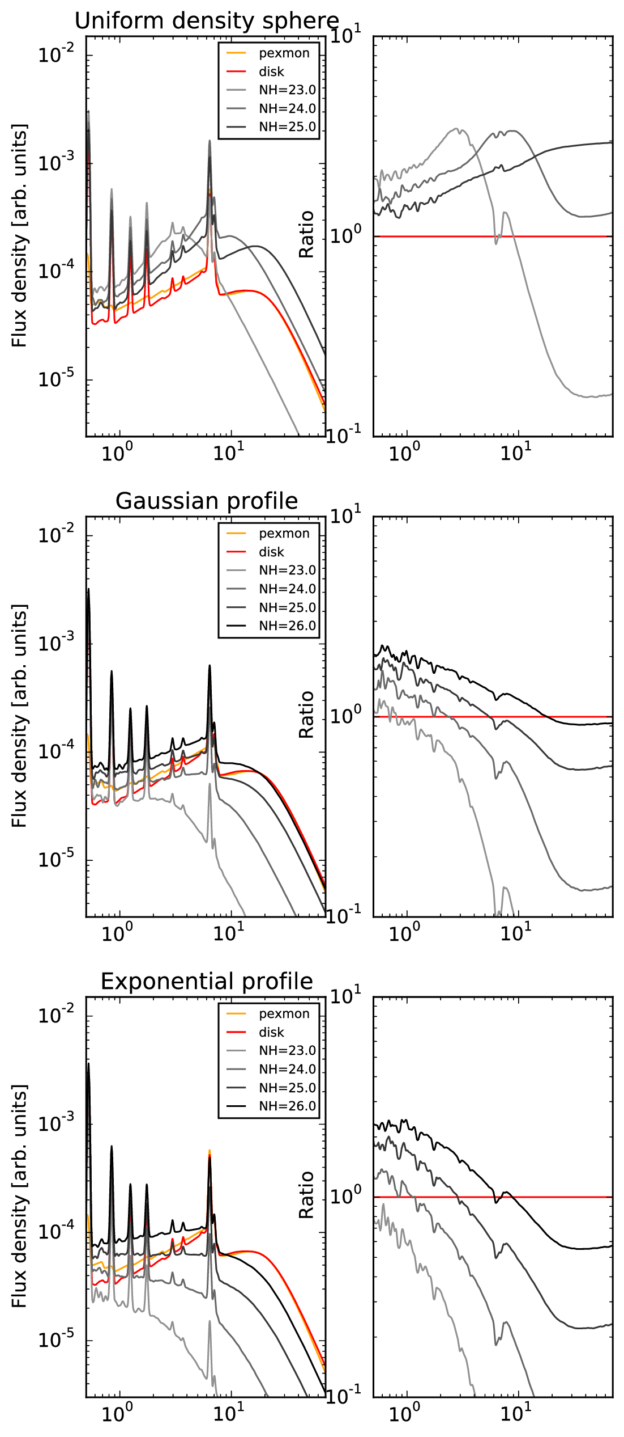
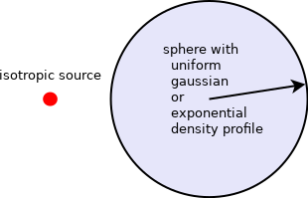

Slide 10
Model

