Slide 1

Learning about the torus geometry from X-ray surveys
Johannes Buchner
FONDECYT fellow
http://astrost.at/istics/
Collaborators: @PUC: Steve Schulze, Franz Bauer
@MPE: A. Georgakakis, K. Nandra, M. Brightman, ML. Menzel,
Z. Liu, L-T. Hsu, M. Salvato, C. Rangel, J. Aird, A. Merloni

Slide 2
Better X-ray Analysis
Poisson
statistics
Model
background
MultiNest
(global)
Profile
likelihood
MCMC
Counts
rebinning,
Gaussian
statistics
subtract
background
Simple
optimization
Energy
BXA connects xspec/sherpa with MultiNest
  Global parameter space exploration – PDFs – handles dual solutions easily
Automatic background fitting routines
– more information per photon
github.com/JohannesBuchner/BXA

Slide 3
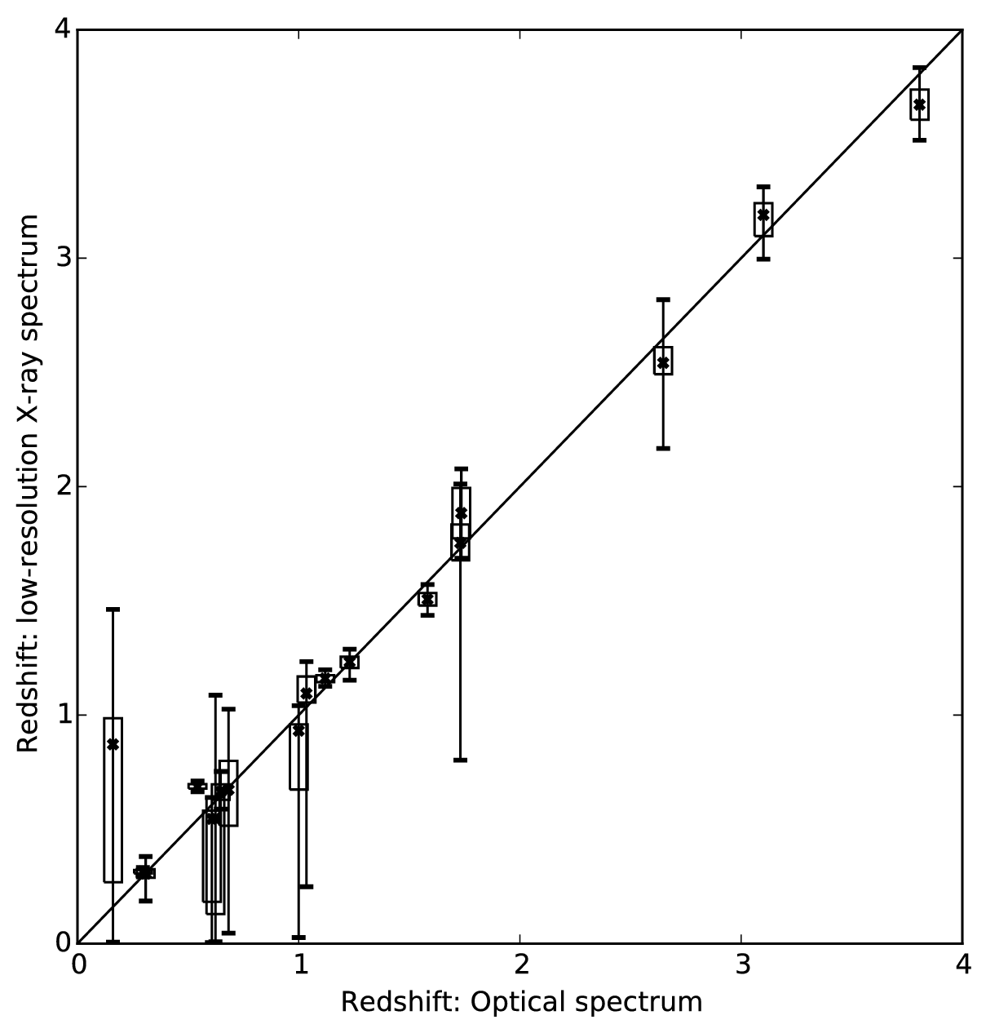

XZ – X-ray spectroscopic redshifts
Solve simultaneously for:
Column density
Photon Index
Redshift
Luminosity
Soft scattering
CDFS
Small redshift uncertainties for obscured sources

Slide 4
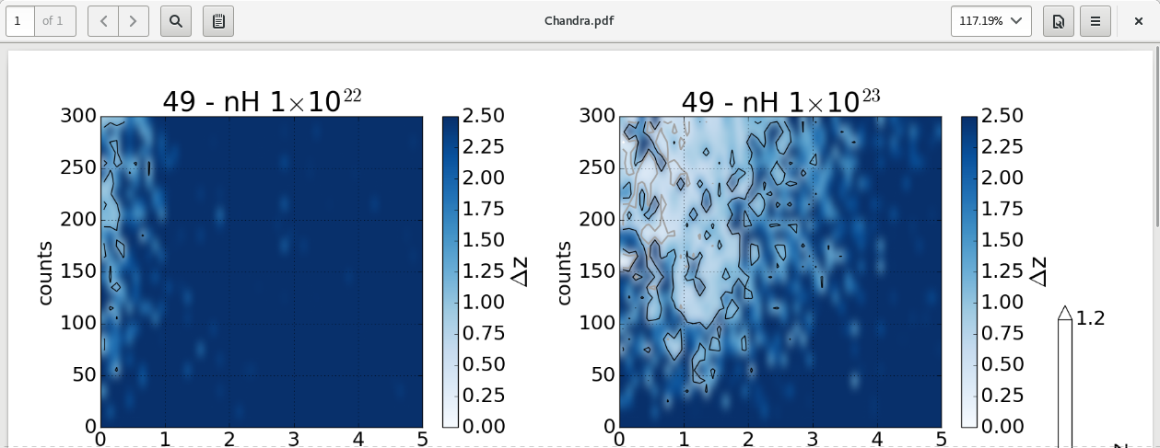
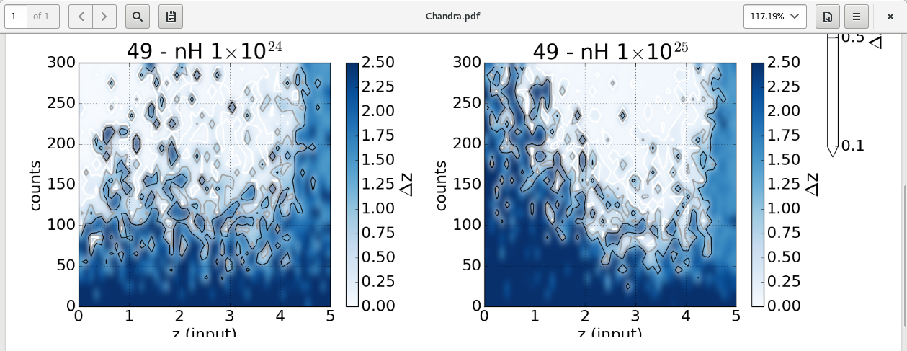
XZ – X-ray spectroscopic redshifts
Charlotte Simmonds – student @ PUC
Compton-thick – through FeKa line
Compton-thin – through edges
Similar to optical line spectroscopy
Similar to Lyman-dropout technique
Can be blindly applied, gives constraints for obscured AGN, low error fraction <1%

Slide 5
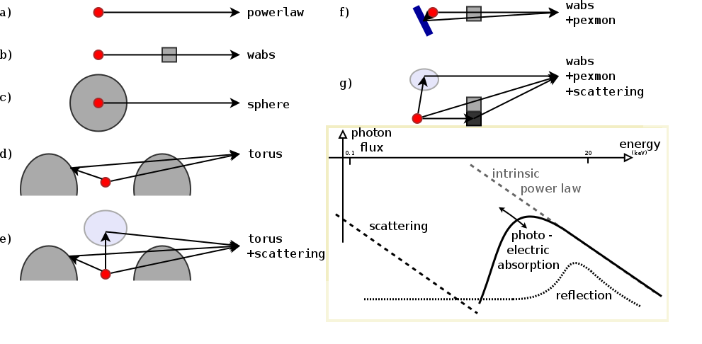
BXA – Bayesian model comparison
chi² test requirements:
  High-data regime
  Not at edge of parameter space
  Linear in parameters
Alternatives:
  simulations
  AIC
  Bayesian model comparison – Easy with BXA!
    Buchner+14: Compare AGN obscurer geometries

Slide 6

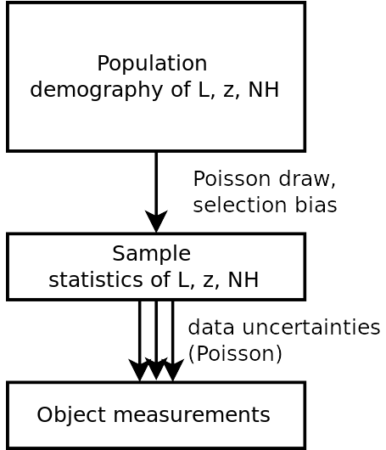
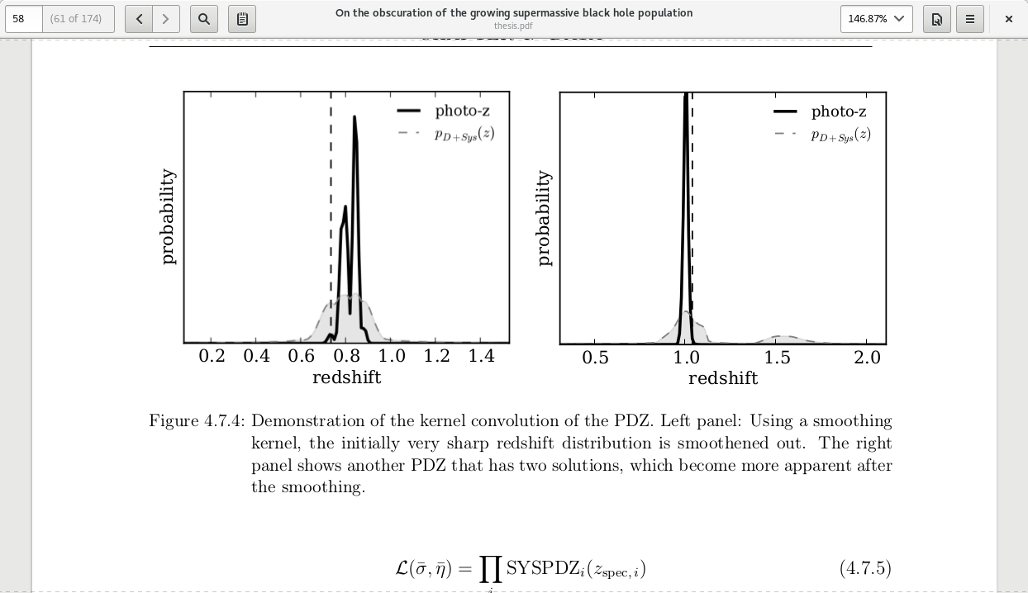
sample statistics population demographics
Marshall 1983
C=(L,z,N_{H})
Incorporates
Uncertainties in z, L, N_{H} from spectra
Sensitivity / Censorship
Is hierarchical inference with Censorship (Loredo04, Kelly+08)

Slide 7
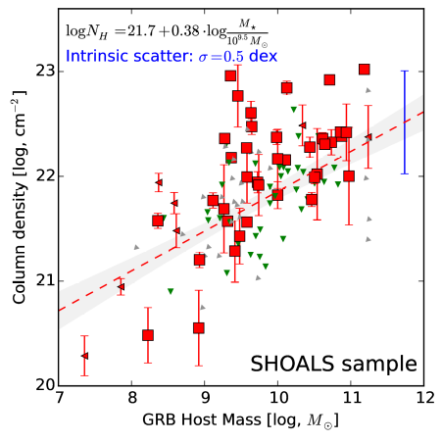
Host Mass – Obscuration
Swift GRB
X-ray afterglows
SHOALS
(Perley+15)
  Deep follow-up
  ~90% redshift complete
  Spitzer masses
“Galaxy gas as obscurer: I.”
Buchner, Schulze & Bauer (2017)

Slide 8
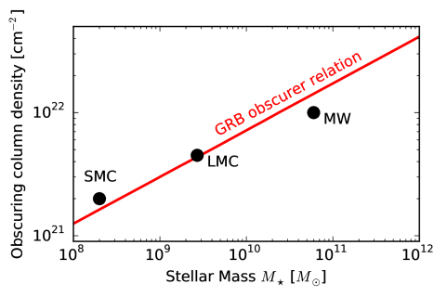
Local Galaxies
Metal galaxy gas at z=0.5-3!
Impact of galaxy gas on AGN obscuration?
see Buchner & Bauer (2017)
1% densest column from HI maps
Gas metallicity-corrected
“Galaxy gas as obscurer: I.”
Buchner, Schulze & Bauer (2017)

Slide 9



AGN Surveys
2-10 keV Chandra detection
Wedding-cake
~2000 objects
>100 CT (Brightman+14)
Bin Luo’s talk

Slide 10

2-10keV X-ray selection
Gilli+07
ROSAT
Chandra z=2
NuSTAR z=0
Chandra z=0

Slide 11
Consistent Bayesian Analysis
Advanced matching to opt/IR (Hsu+14, M. Brusa)
Deep multi-wavelength coverage
  High redshift completeness
  Precise & accurate photo-z (M. Salvato, Hsu+14)
Include sources without counterparts consistently
Uncertainty in photometric redshift, multiple solutions
Systematic errors of photometric redshift
Full spectral analysis of unbinned spectrum
  Uncertainty clouds in L, z, NH
Propagated into luminosity function analysis
  Recover a smooth field ϕ(L, z, NH) / d...
  Non-parametric, model-independent
Robust Results – Realistic Uncertainties

Slide 12
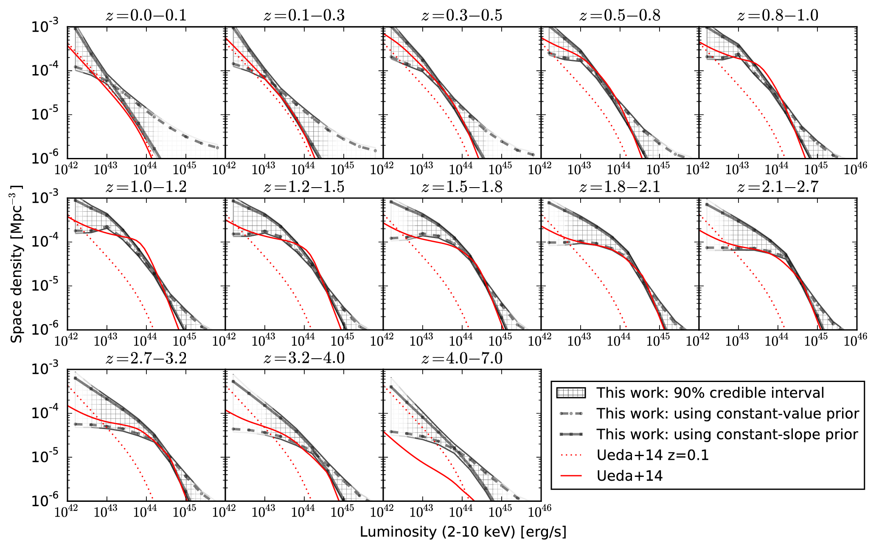
Intrinsic LF shape
Buchner+15

Slide 13


Compton-thick Luminosity Function
Reconstruction of a smooth field
  Results insensitive to chosen
  smoothing length
    0.5 mag between bins
  Consistent Cthin total LF with
  Ueda+14, Aird+10
Buchner+15

Slide 14

Obscured accretion history
Buchner+15
CTK
CTN obscured
unobscured

Slide 15

Black Hole Mass Accretion
ε=10%
Bol. Corr.:
Marconi+04
not Hopkins+07
Convert to mass flowing into BH Accretion consistent with local BHMD
Merloni15

Slide 16
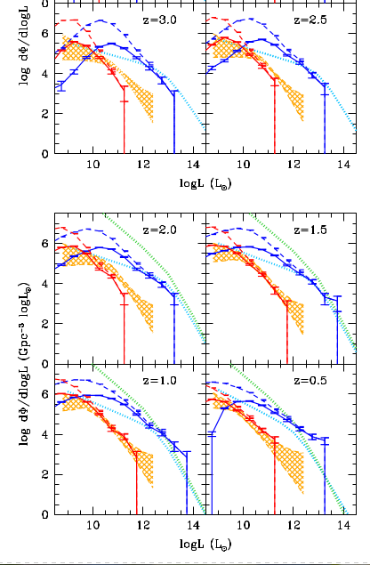

Simulations
Became a standard for testing
cosmological simulations
and their AGN feedback
Horizon-AGN Volonteri+16
Buchner+15

Slide 17

Simulations
EAGLE Rosas-Guevara+16
Buchner+15

Slide 18
Obscured fractions
Total number density
Obscured fraction:
Compton-thick fraction:
Ricci+16: Swift/BAT, z=0 lum-dep
Annuar in prep: NuSTAR z=0
Wilkes+13: Radio, z~2 CTK fraction < 40%
Buchner+15
77 ⁺⁴₋₅%
38 ⁺⁸₋₇%

Slide 19
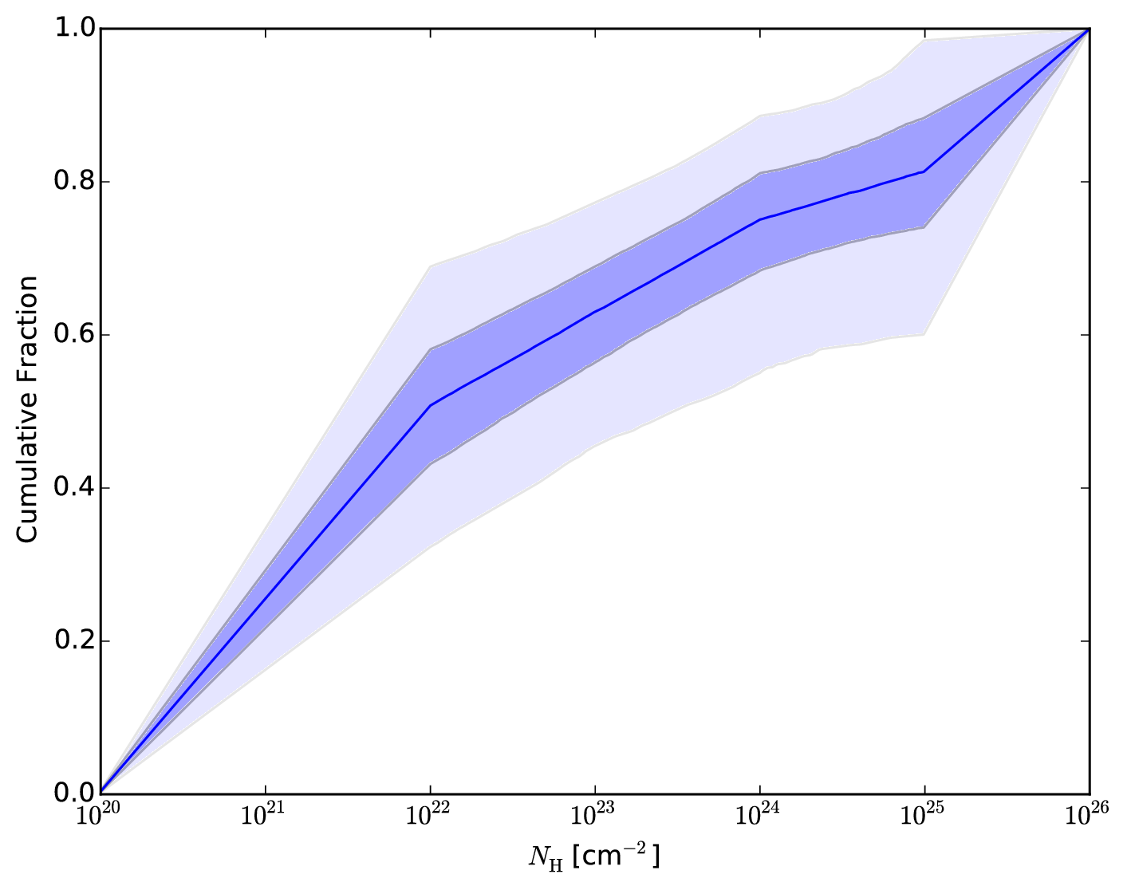
3CR high-z Radio results
radio-selected, high-L; 38 total, 9 CTK, 3 more?
z~2, complete
spectral analysis
Results confirm
Wikes+13
Unobscured
Compton-thin
obscured
Compton-thick

Slide 20
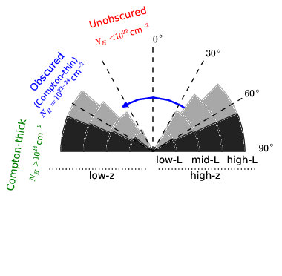
Total covering fractions

Slide 21

Obscuration – Luminosity – Redshift
Buchner+15

Slide 22

Buchner+15

Slide 23
z evol
Buchner+15

Slide 24
z evol
Buchner+15

Slide 25
z evol
Buchner+15
With BHM downsizing

Slide 26
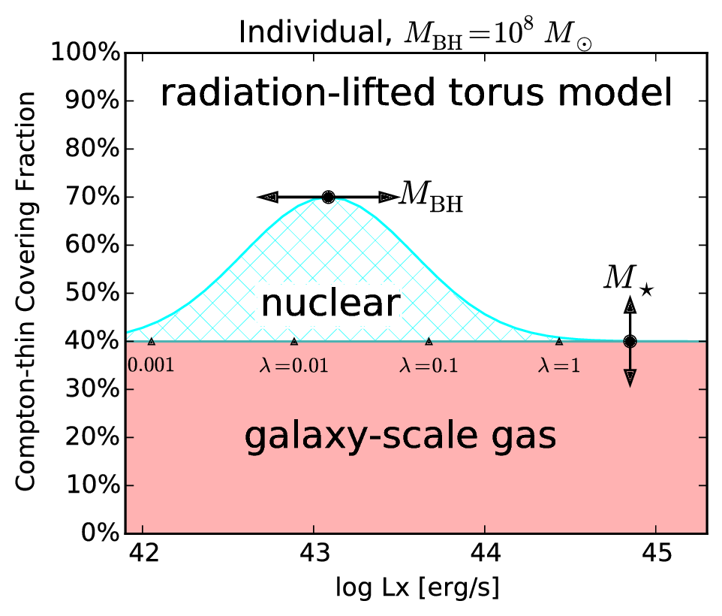
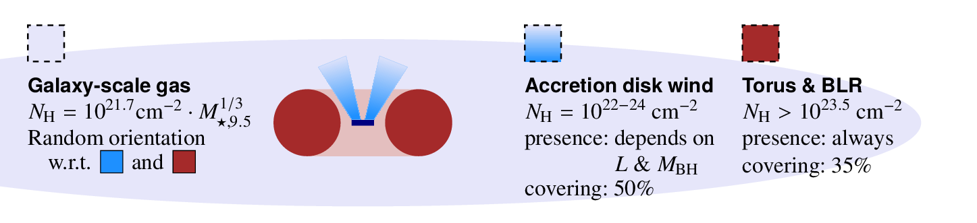
Radiation-lifted torus model
Buchner+17b
Alternative to
“receding torus”
Mdot-dep

Slide 27
Summary
Improving X-ray spectroscopy
  Model comparison
  Get more information out of observations
X-ray surveys: obscuration
  hidden growth revealed
  Luminosity-dependence evolves over cosmic time
  Possibly Eddington-rate dependent obscurer
  = radiation-lifted torus
http://astrost.at/istics – Johannes Buchner

