Slide 1

Astrostatistics toolkit of the 21st century astronomer
Johannes Buchner
FONDECYT fellow
http://astrost.at/istics/

Slide 2
Astrostatistics toolkit of the 21st century astronomer
Johannes Buchner
FONDECYT fellow
PUC, Chile
Formerly MPE
astrost.at/istics
Nested sampling
UltraNest
PyMultiNest
Obscured Black Holes
Bayesian X-ray spectroscopy
ArXiV
Minimal statistics checklist

Slide 3
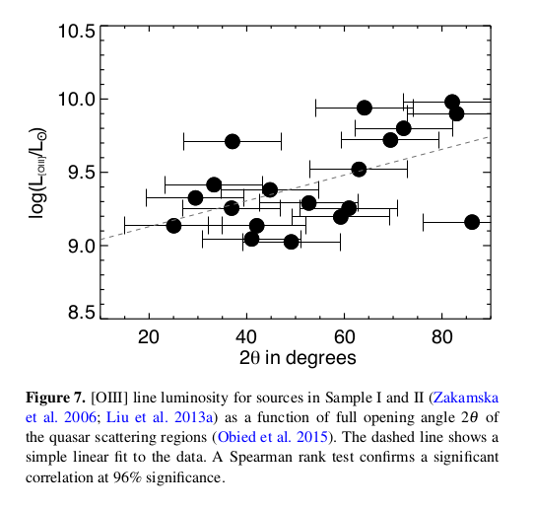
p=0.04

Slide 4
Intro: p-values
From: “The Null Ritual: What You Always Wanted to Know About Significance Testing but Were Afraid to Ask”
p<0.001 – from Pearson correlation, KS test, etc.
what can you infer:
  You have absolutely disproved the null hypothesis (e.g. "no correlation" is ruled out, the data are not sampled from this model, there is no difference between the samples).
  You have found the probability of the null hypothesis being true.
  You have absolutely proved your experimental hypothesis (e.g. that there is a correlation, there is a difference between two samples, the data are sampled from this model).
  You can deduce the probability of the experimental hypothesis being true.
  You know, if you decide to reject the null hypothesis, the probability that you are making the wrong decision.
  You have a reliable experimental finding in the sense that if, hypothetically, the experiment were repeated a great number of times, you would obtain a significant result on 99.9% of occasions.
Choose the right answer A - F

Slide 5
Intro: p-values
Originally: to indicate a problem with a model worth investigating. Not: p small therefore other model correct.
p-values are not probabilities
p-values are random variables between 0 and 1
  if the null hypothesis is true
So the p-values should rarely be at one extreme
  If try often enough, it will happen
The exact value of p-values below 1e-6 is unreliable
  don’t compare p=10⁻²⁰⁰ and p=10⁻¹⁰⁰
Effect size may be more interesting
http://astrost.at/istics/minimal-statistics-checklist.html

Slide 6
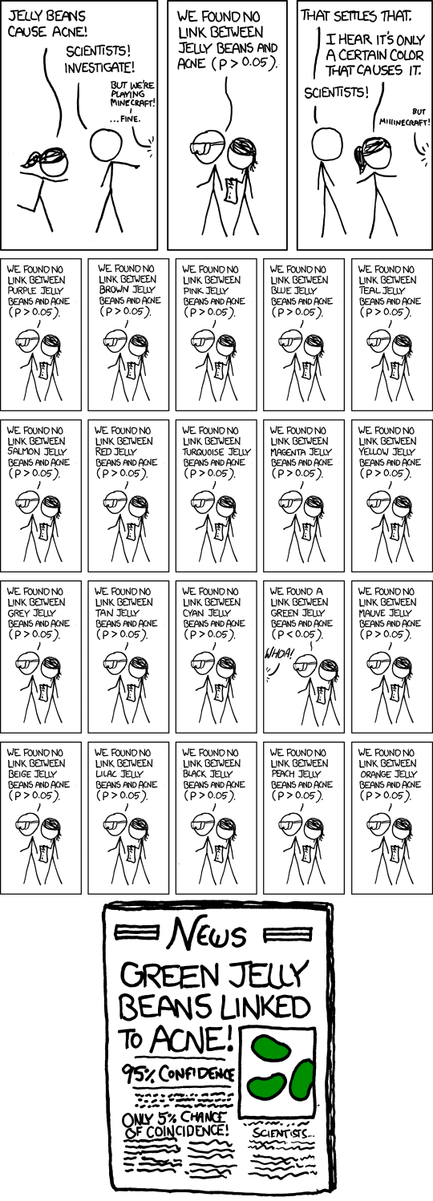
https://xkcd.com/882/

Slide 7
Intro: p-values
https://xkcd.com/882/

Slide 8
Intro: p-values
https://xkcd.com/882/

Slide 9
Also in single papers:
Multiple tests – Bonferri correction
Multiple variables, many possible correlations
Look for large sample longitudinal studies (nsubjects>>nparam)
Multiple ways to prepare the data
Publication bias
Don’t get your health information from internet news
https://xkcd.com/882/

Slide 10
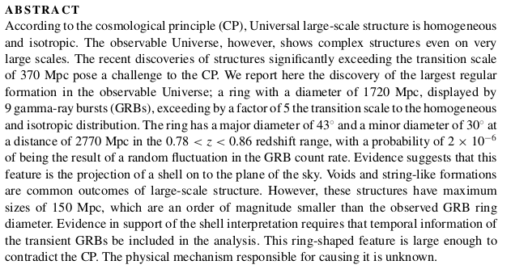
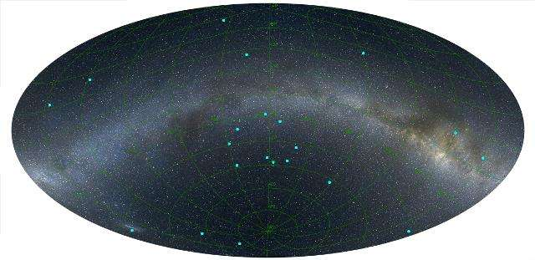
“You know, the most amazing thing happened to me tonight... I saw a car with the license plate ARW 357. Can you imagine? Of all the millions of license plates in the state, what was the chance that I would see that particular one tonight? Amazing!”
– R. Feynman

Slide 11
Era of large surveys
Beware of size of parent population
  Given 10⁹ stars (Gaia, etc), you will find plenty of 3,4,5 sigma outliers.

Slide 12
About me: Johannes Buchner
Astrophysics interests
  Supermassive black hole growth; X-ray surveys
  Obscuration of AGN: “torus”, galaxy-scale
  Obscuration of Gamma-ray burst afterglows
Astrostatistics interests
  nested sampling algorithms (Buchner 2014)
  Improving X-ray spectral analysis (BXA)
    Modern statistical tools for parameter estimation and spectral model comparison – invited talk HEAD meeting August 2017
  Consulting for papers, Astrostatistics group; astrost.at/istics

Slide 13
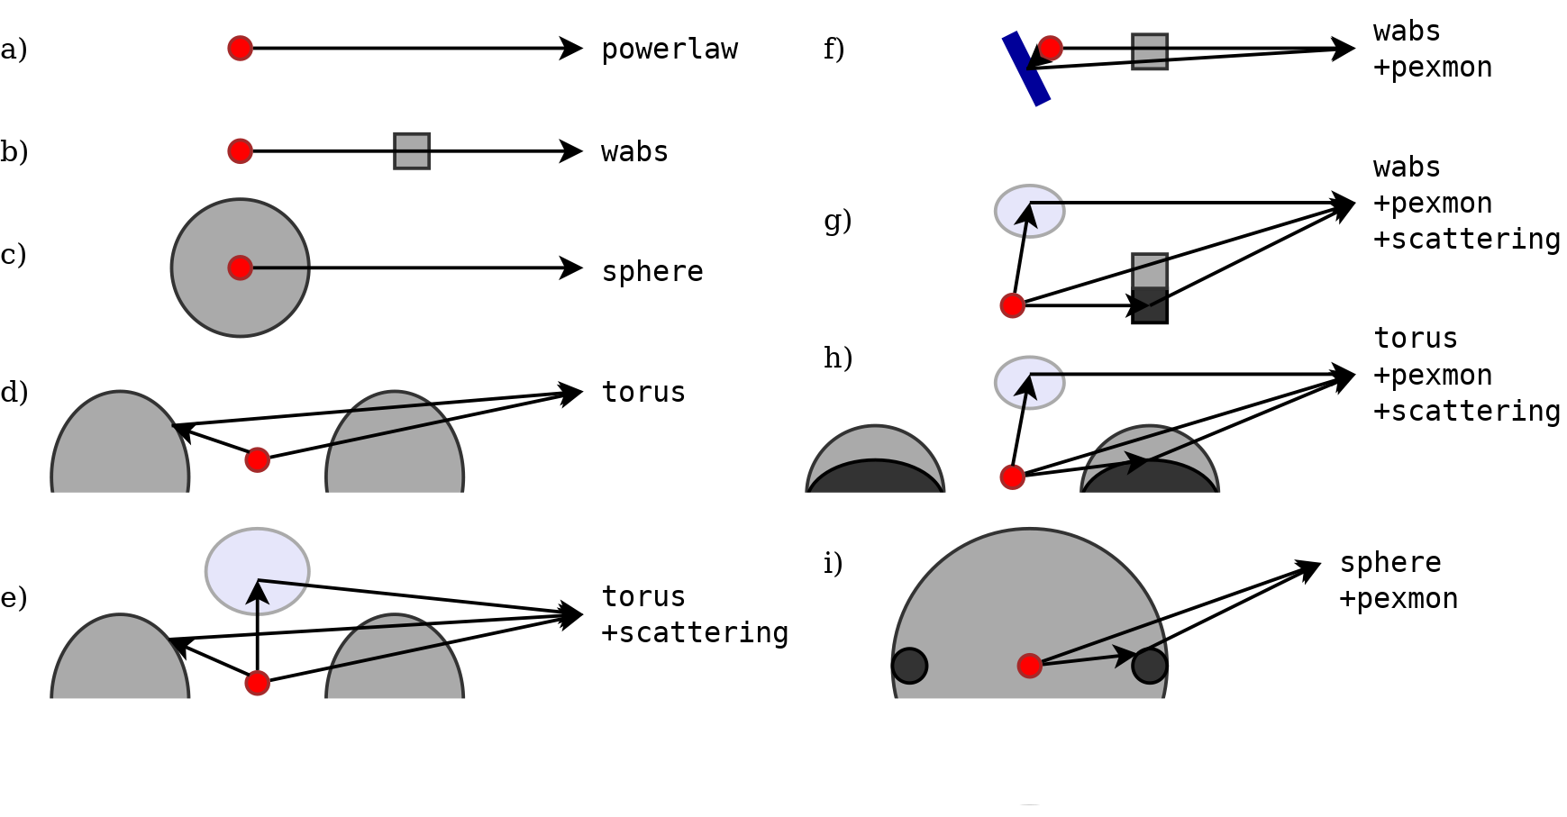
Research overview
“X-ray spectral modelling of the AGN obscuring region in the CDFS: Bayesian model selection and catalogue”
Buchner+14:
  Introduced model comparison for analysing X-ray spectra –> BXA, pymultinest
  Compare obscurer geometries

Slide 14
Research overview
Buchner+15:
  Population analysis from 2000 AGN
  Intrinsic luminosity function of AGN
  Density of Compton-thick AGN
  Total accretion onto SMBH over cosmic time
  New interpretation for luminosity-dependence of obscurer
“Obscuration-dependent Evolution of Active Galactic Nuclei”

Slide 15
Research overview
Galaxy gas as obscurer - I. GRBs x-ray galaxies
and find an N_{H}³ ~ M* relation
Buchner+17a:
  Population analysis from 700 Swift GRB
  Obscuration is stellar mass dependent
  Probably the host galaxy
Buchner+17b:
  Reweight with stellar mass function of AGN
  Prediction of AGN obscuration by host galaxies alone (non-nuclear)
  Comparison to cosmological hydro simulations
  Eddington-rate dependent nuclear obscurer model
Galaxy gas as obscurer - II. Separating the galaxy-scale and nuclear obscurers of active galactic nuclei

Slide 16
Research overview
“A statistical test for Nested Sampling algorithms”, Statistics & Computing
Buchner 2014:
  How to verify the correctness of
  nested sampling algorithms (such as MULTINEST)

Slide 17
Common problems in astrophysics
Characterising a source
  Spectral lines, pulsation frequencies
  Orbital parameters
  Learn physical parameters
Comparing physical effects
  Include a mechanism or not. 0, 1 or 2 planets?
  Is the distribution a log-normal, a powerlaw or a broken powerlaw?
Characterising a population of sources
  Intrinsic distribution behind measurements
  Luminosity functions
  Population demographic behind drawn sample

Slide 18
Example
flux
Period?
  e.g. Binaries, Exoplanets, rotating neutron star
Scatter beyond measurement errors?
  intrinsic variability
time

Slide 19
Approach 1: Estimators
Take data and compute back
Compare data scatter to measurement scatter
Fourier transform of values, find maximum power
  Measurement errors? – Monte Carlo simulations
  Missing data?
  Significance of peak?
Need to characterise estimators:
  Variance – is a property of the estimator
  Type 1 error – false positive
  Type 2 error – false negative

Slide 20
Approach 1: Estimators
Benefits:
  Fast & simple to compute
Drawbacks:
  characteristics describe estimator, not the probability of the system having property X
  Limitations of assumptions can not easily extended:
    Homogeneous measurement data
    Gaussian
    Regular sampling
    Specific model shape

Slide 21
Approach 2: Forward-modelling
Assume a model, assume parameters
Compute likelihood=frequency that data are produced
Vary parameters (+vary model)
Produces “allowed” parameter ranges

Slide 22
Approach 2: Forward-modelling
Drawbacks:
  Requires a model, can be complex
  Can be costly to compute
Benefit:
  can be as realistic as you want
  gives actual answer to probability of the system having property X
  transferable results/predictions for other experiments

Slide 23
Example
flux
mean and standard deviation of distribution
What if not exactly Gaussian? What if multiple Gaussians?
What if measurements are not Gaussian. Correlated noise?
time

Slide 24
Example
flux
Forward fitting with MCMC is popular.
How does it work?
time

Slide 25
Preliminaries
Likelihood function – tendency/propensity to produce such data:
Prediction function m(x|theta) = model
Explore possible a,b,c,d – likelihood function surface
Probable ranges of a,b,c,d – need a density

Slide 26
Likelihoods
Can construct a likelihood that produces always and only the observed data
But that process is not very probable
L is a function, not a probability density
Data: hear squeaking
Model:
Cat
  Meows
  Sleeps
  Walks around on squeaky stairs L=1/3
Ghost
  makes squeaky noise L=1

Slide 27

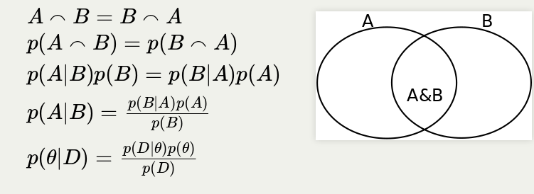
Bayes Theorem

Slide 28
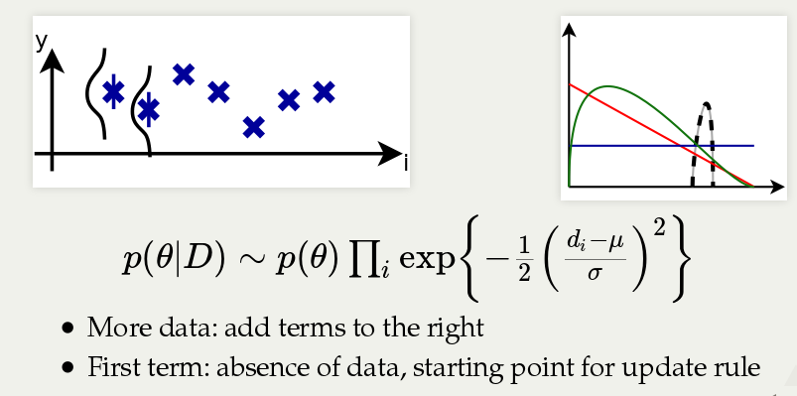
Bayes as density update rule

Slide 29
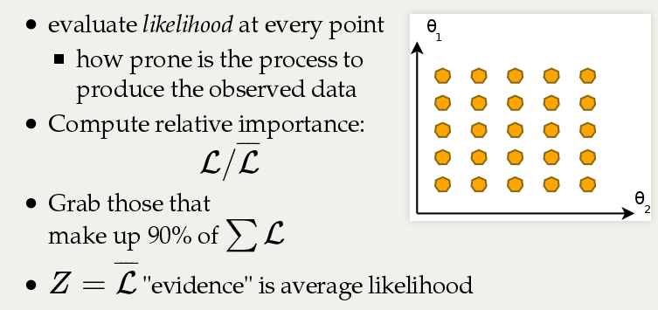
Discrete introduction to BI

Slide 30
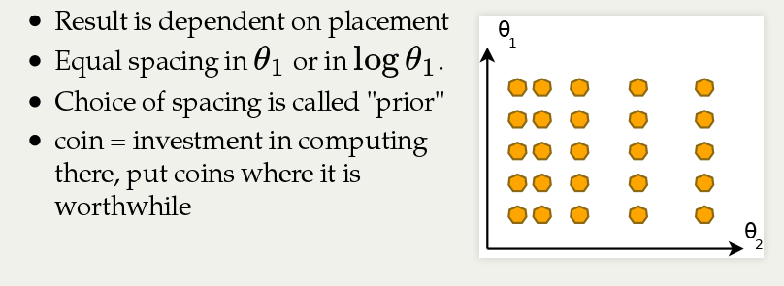
How to place grid points

Slide 31
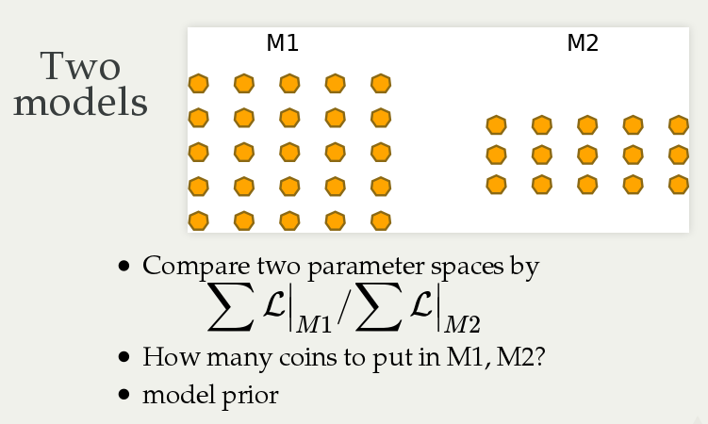

Slide 32
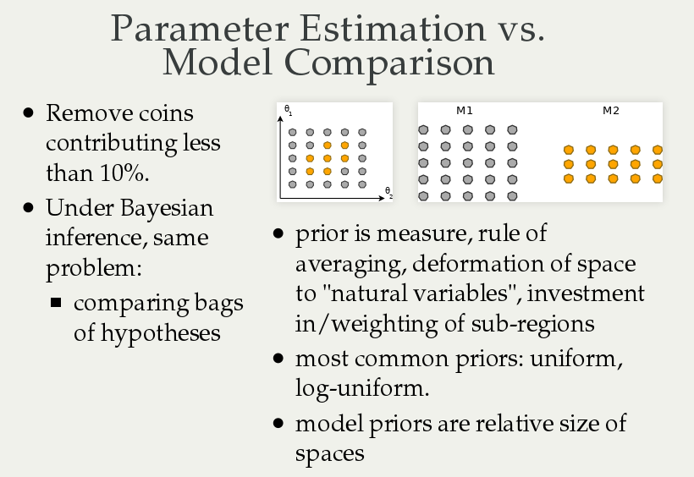

Slide 33
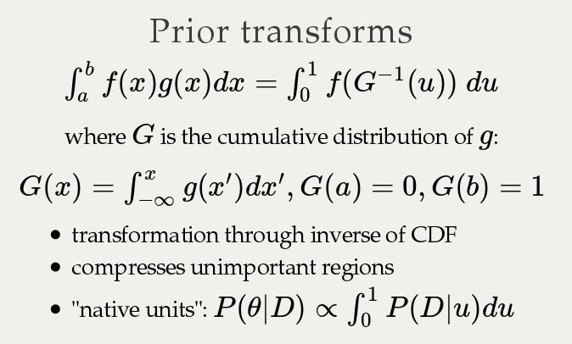

Slide 34
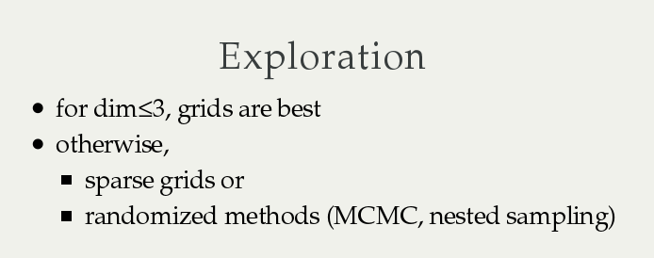
Exploration

Slide 35
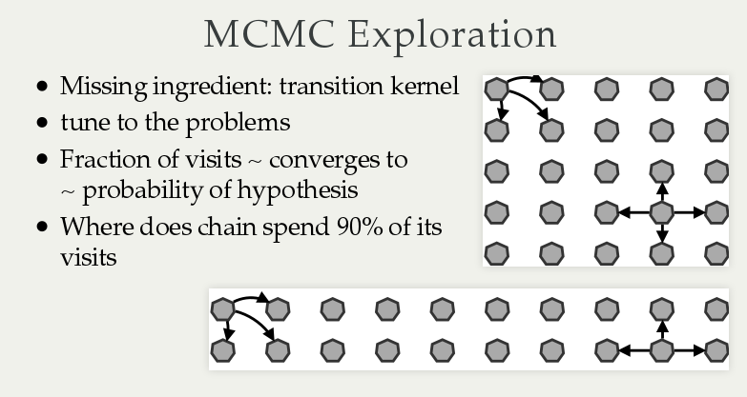

Slide 36
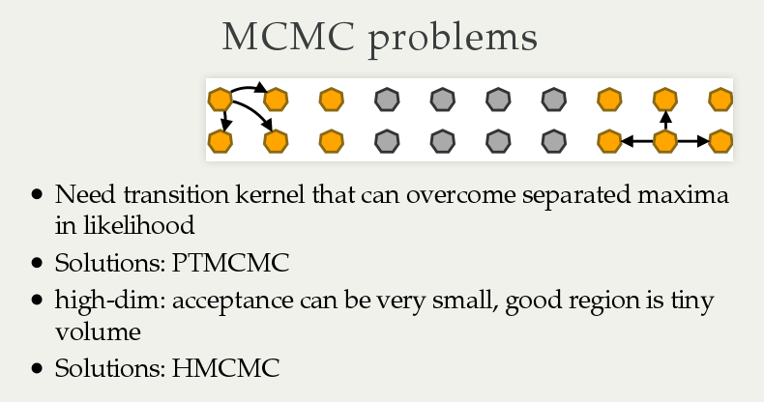

Slide 37
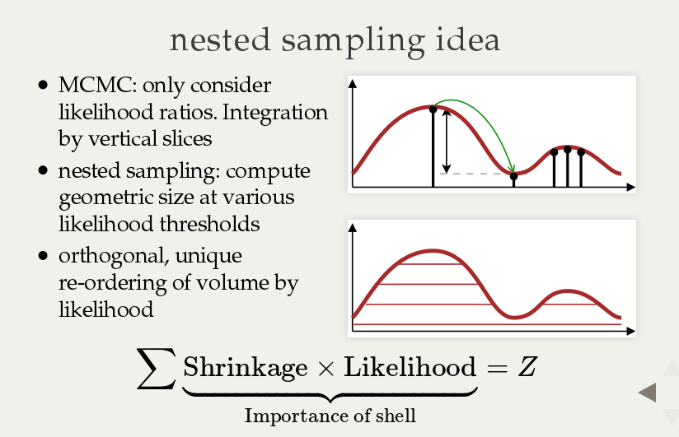

Slide 38
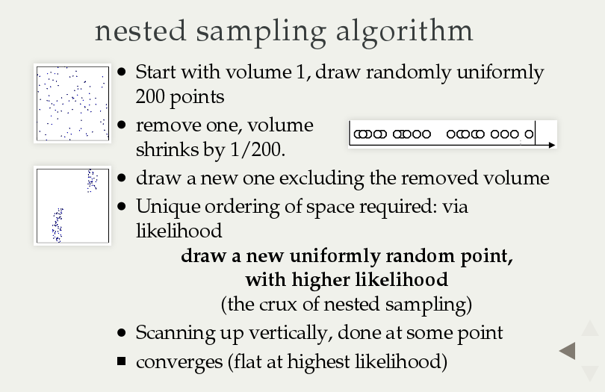

Slide 39
Missing ingredients
MCMC: Insert tuned transition kernel
NS: Insert constrained drawing algorithm
  General solutions: MultiNest, MCMC, HMCMC, Galilean, RadFriends, PolyChord

Slide 40
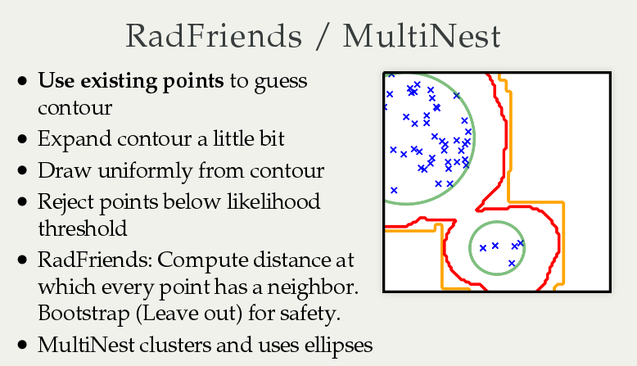

Slide 41
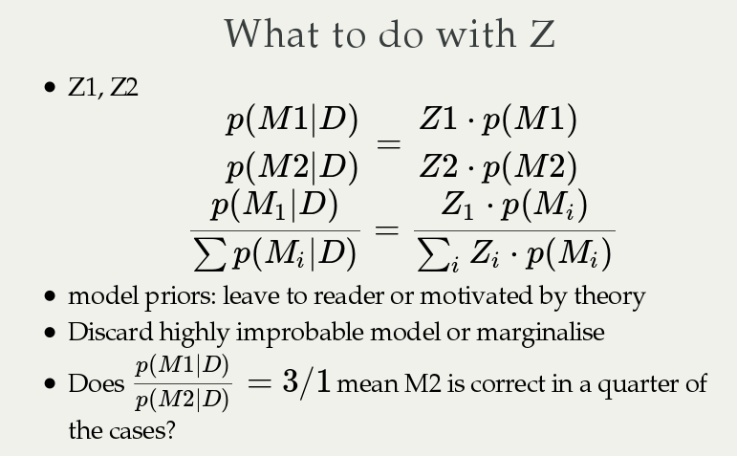

Slide 42
Methods summary
Parameter estimation
  Low-dim: Nested sampling - MultiNest
  High-dim: HMCMC with multiple chains - Stan
Model comparison
  Low-dim: Nested sampling - MultiNest
  High-dim: open research problem. NS+some MCMC variant. More research needed
To handle multiple maxima, low state of information, peculiar shapes in likelihood, numerical likelihood definitions

Slide 43
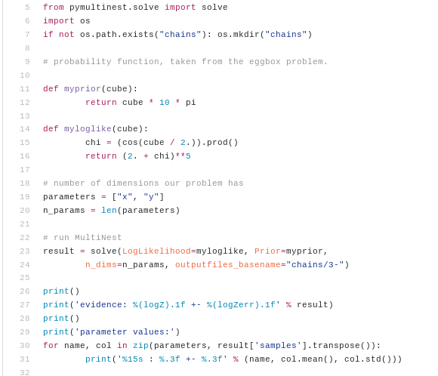
PyMultiNest
No starting points
Automatic convergence
Pythonic
Parameter estimation +
Model comparison

Slide 44
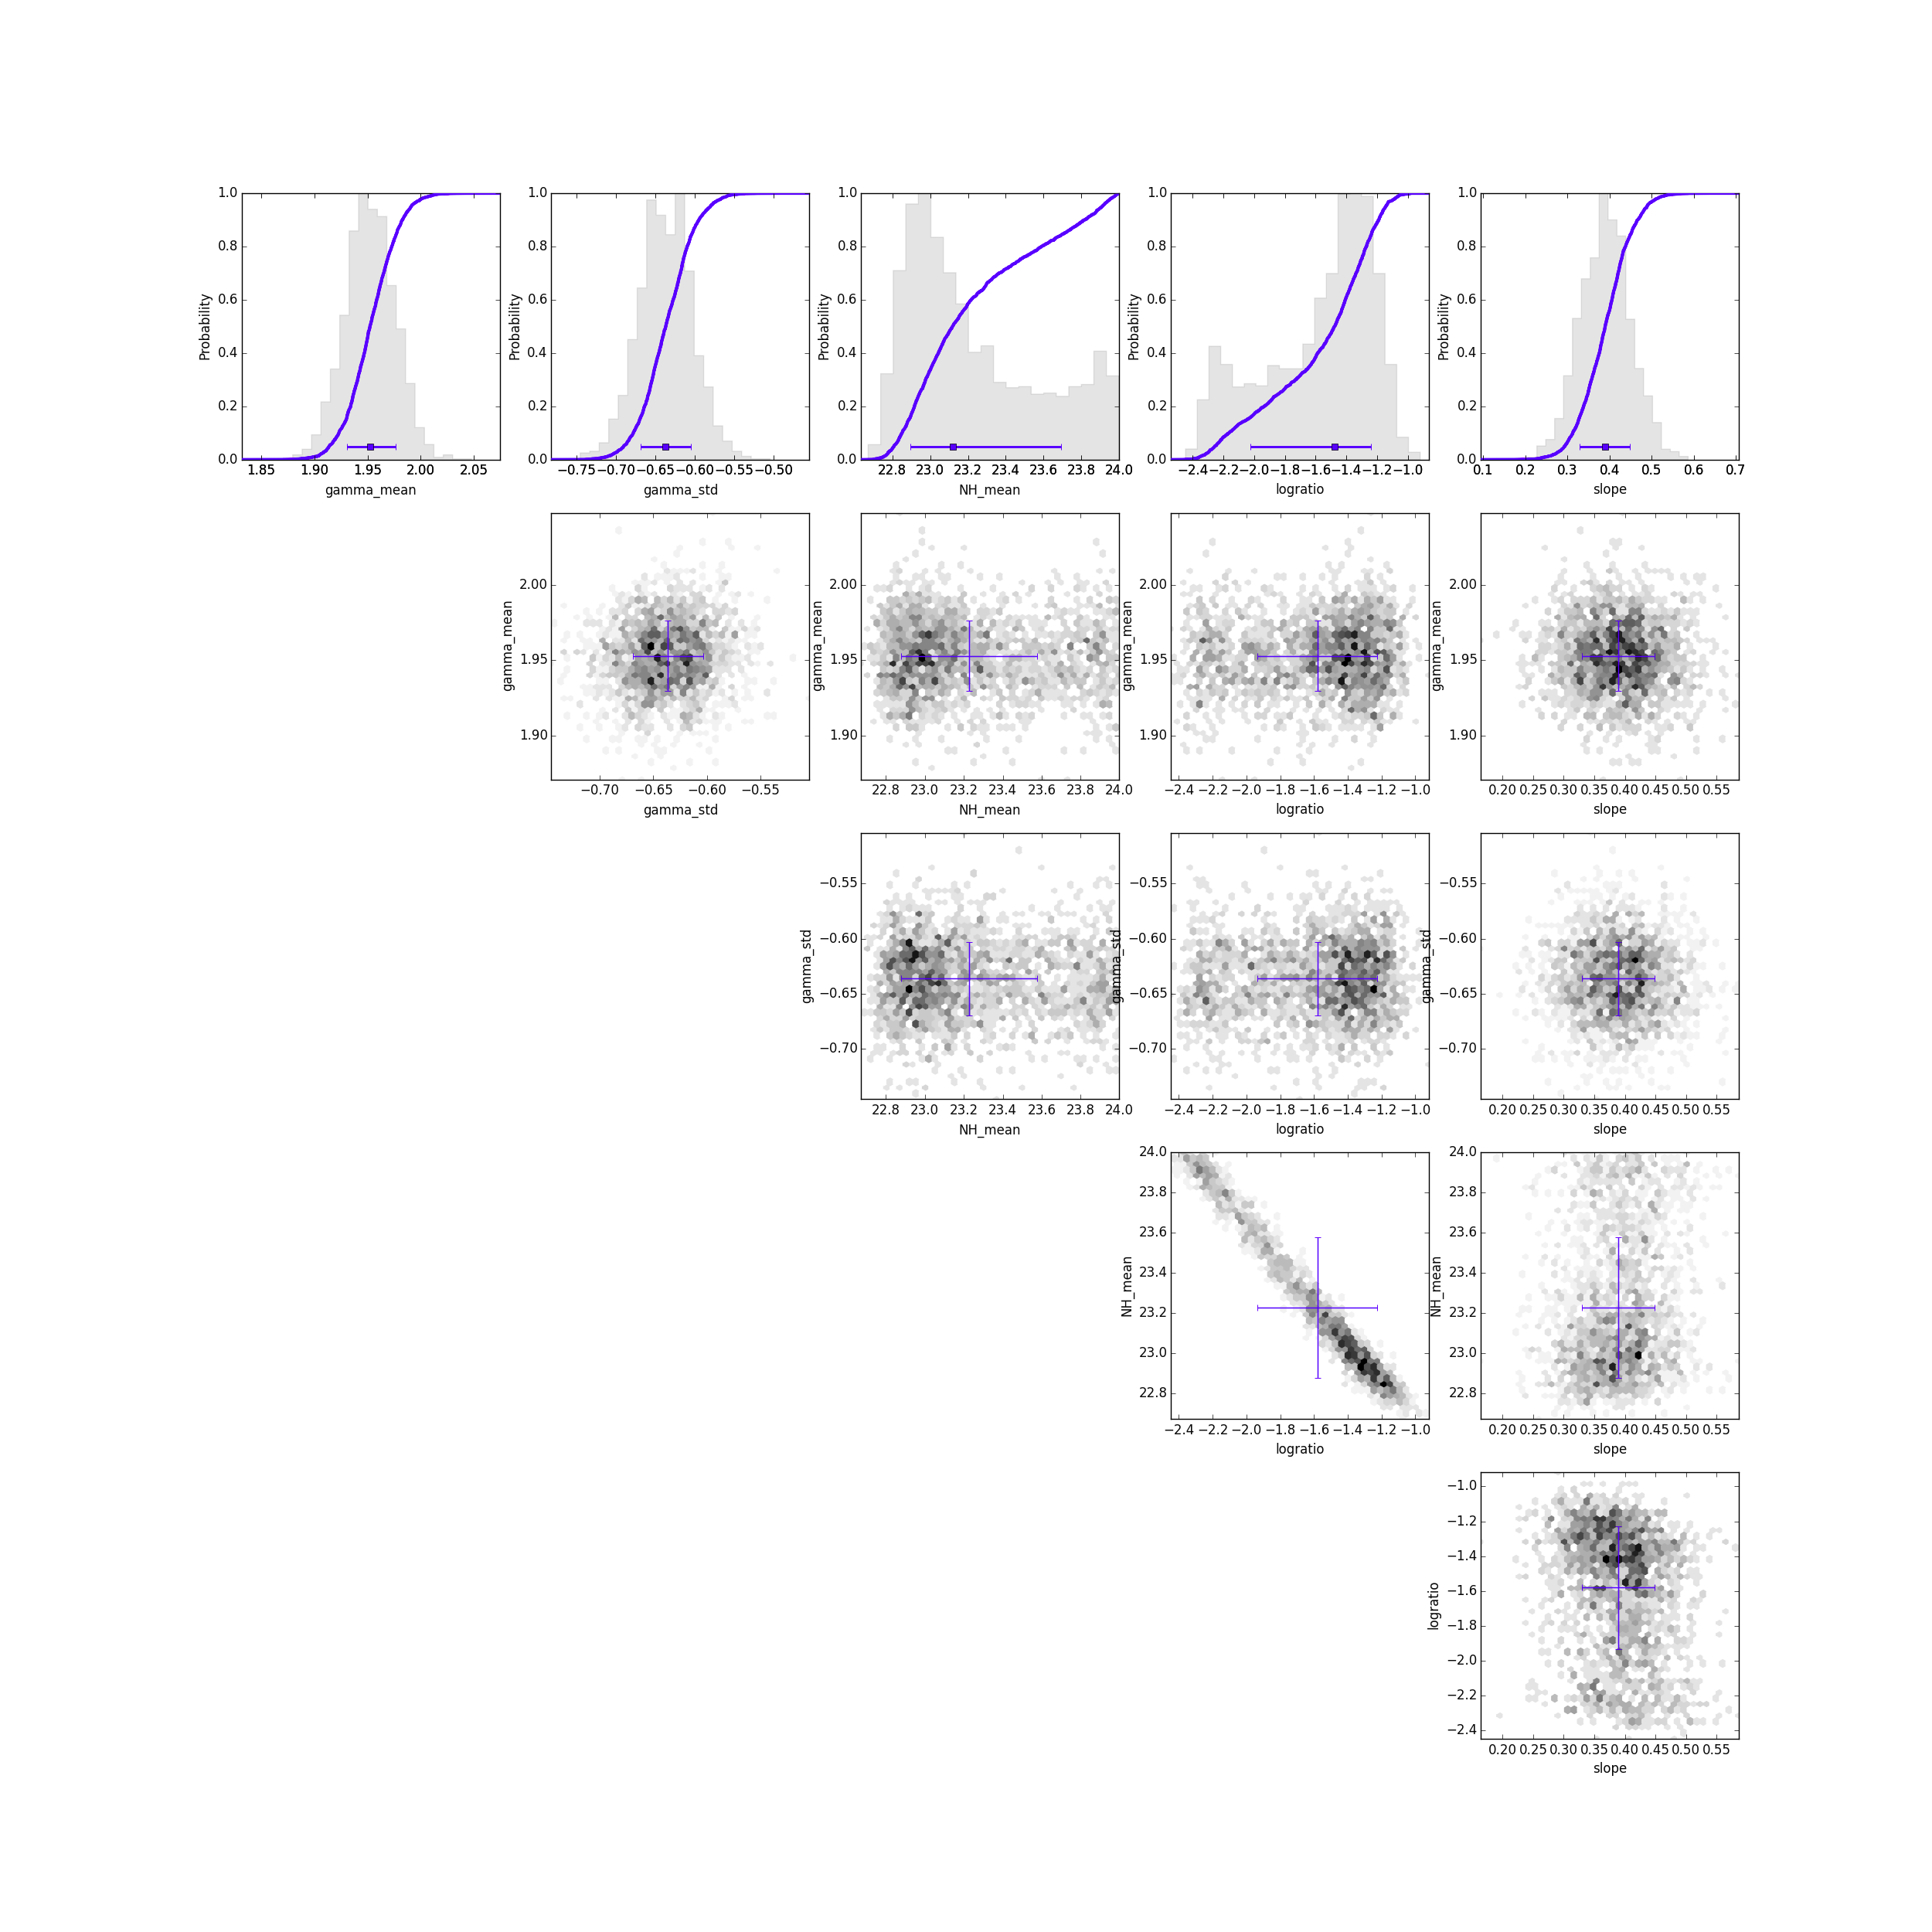
PyMultiNest
No starting points
Automatic convergence
Pythonic
Parameter estimation +
Model comparison
Posterior probability
distributions: 1d & 2d
“MCMC chains” in
post_equal_weights.dat file

Slide 45
Stan
data {
int<lower=0> N;
real[N] x;
real[N] y;
real[N] y_err;
}
parameters {
real a;
real b;
real c;
real d;
}
model {
for (i in 1:N) {
real m;
m <- a*sin(x[i]*b + c) + d;
y[i] ~ normal(m, y_err[i]);
}
}
http://mc-stan.org

Slide 46
Common problems in astrophysics
Define a generative data model – likelihood + parameter space definition
Find parameter ranges
Distinguish models with Z
Robustness:
Test sensitivity to different priors
Cross-validation – leave some data out
Characterising a source
  Spectral lines, pulsation frequencies
  Orbital parameters
  Learn physical parameters
Comparing physical effects
  Include a mechanism or not. 0, 1 or 2 planets?
  Is the distribution a log-normal, a powerlaw or a broken powerlaw?

Slide 47
Common problems in astrophysics
Characterising a source
  Spectral lines, pulsation frequencies
  Orbital parameters
  Learn physical parameters
Comparing physical effects
  Include a mechanism or not. 0, 1 or 2 planets?
  Is the distribution a log-normal, a powerlaw or a broken powerlaw?
Characterising a population of sources
  Intrinsic distribution behind measurements
  Luminosity functions
  Population demographic behind drawn sample

Slide 48
Literature
In luminosity functions:
  Marshall+83, likely earlier
In astrostatistics:
  Loredo04 : Samples drawn from Poisson
  Kelly+08 : Samples drawn from Bernoulli
  Buchner+15: Side-to-side comparison, give same formula unless selection bias is applied.
In statistics/cross-fields:
  Hierarchical models, multi-level models

Slide 49
A common problem
Detected a set of objects
  Galaxies, stars, asteroids
Measured some property
  Luminosity, Mass, Obscuration, Metallicity
With uncertainty, upper limits, missing data
Limited sample size
What is the distribution of that property in the underlying population

Slide 50
Uncertainties
P(x)
Upper limit
Measurement error
“Degeneracy”
Multiple solutions
Multiple modes
x
Related to our measuring instrument and observing conditions
One of these values inside the posterior is the true one (LOGICAL XOR)

Slide 51
Intrinsic Scatter
f(x)
Spectral slope, Photon Index distribution
Mass, Luminosity distributions: Powerlaw-like, truncated
Beta distribution = Schechter function
x
Width of the distribution of the underlying population
Intrinsic to the astrophysical population
The population produced all of the objects
(LOGICAL AND)

Slide 52
Different “distributions”
Frequency distribution
  Population
Uncertainty, probability distribution
  Observation
social sciences, ML, non-parametric methods: Use point estimator, look at total distribution
Physics: Separate out measurement uncertainty
Political opinions
Ad-hoc behavior models

Slide 53
How to do it wrong
Generate N random points from measurements, treat them as pseudo-objects (weight 1/N)
Stack posteriors
Mixes uncertainty with intrinsic scatter
Can under-estimate or over-estimate
Also difficult: splitting sample (histograms, Vmax)
x

Slide 54
Parametric Methods
Assume a model for the underlying population
e.g. Gaussian distribution with intrinsic scatter
For a individual object, the likelihood to have x is
convolve measurement uncertainty with model
LOGICAL OR
Must be true for all objects --> LOGICAL AND

Slide 55
Example
Measurement gave
x1 = 4+-1
x2 = 5+-0.1
Generate 100 samples for each
100xN matrix of x

Slide 56
Example
Evaluate model
F(x)
100xN matrix of x
100xN matrix of F

Slide 57
Example
Sum probabilities
Multiply probabilities
Then try out other model parameters
100xN matrix of F
N
vector
L

Slide 58
Graphic explanation
P(x)
Measurement error
x
F(x)
Population distribution

Slide 59
Graphic explanation
P(x)
Measurement error
x
F(x)
Population distribution

Slide 60
Graphic explanation
P(x)
Measurement error
x
F(x)
Population distribution

Slide 61
Graphic explanation
P(x)
Measurement error
x
F(x)
Population distribution

Slide 62
Behaviour
Generate from 6+-2 with measurement errors

Slide 63
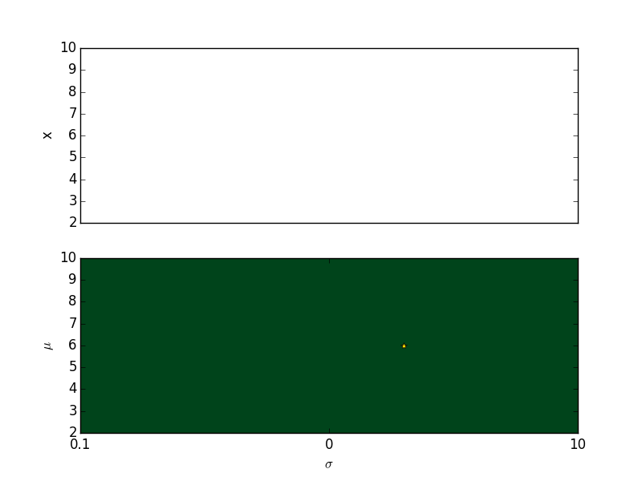
Behaviour

Slide 64
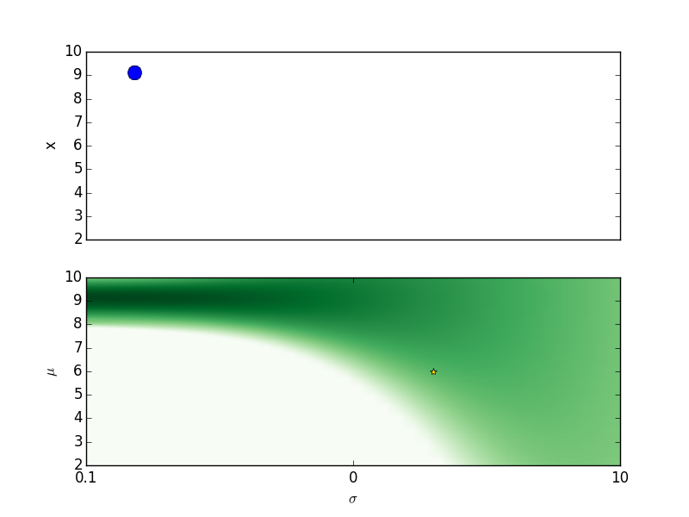
Behaviour

Slide 65
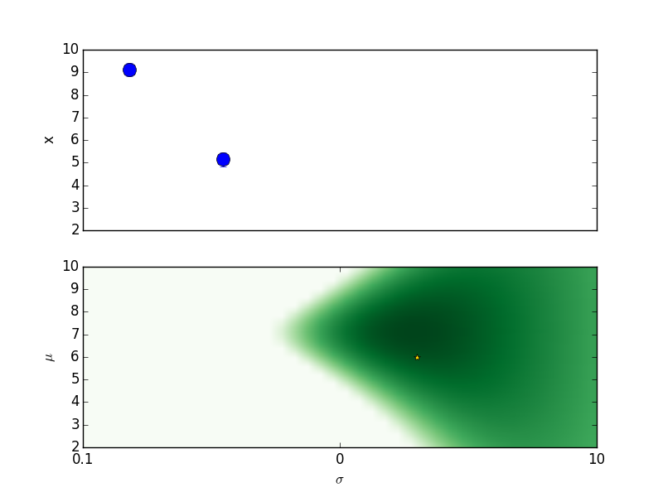
Behaviour

Slide 66
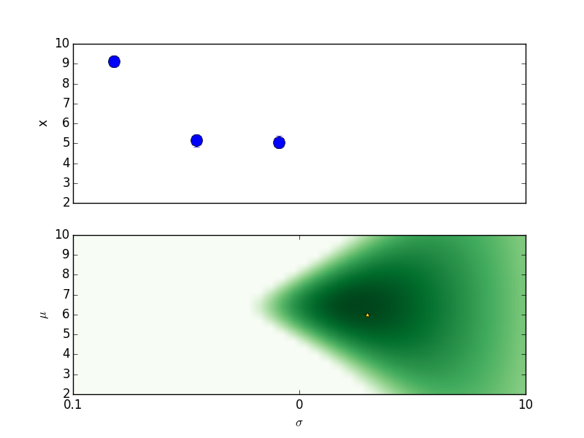
Behaviour

Slide 67
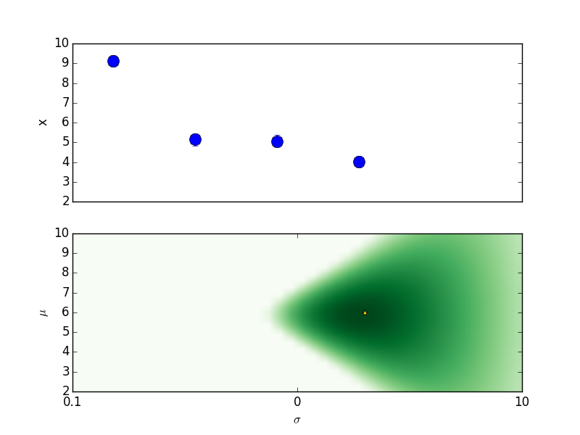
Behaviour

Slide 68
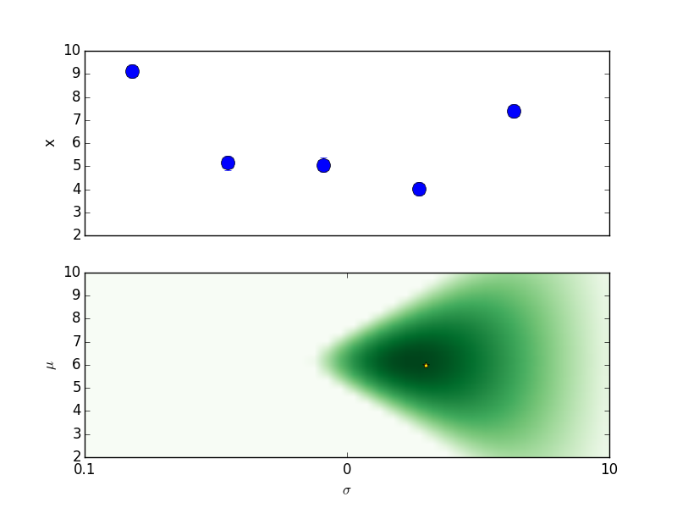
Behaviour

Slide 69
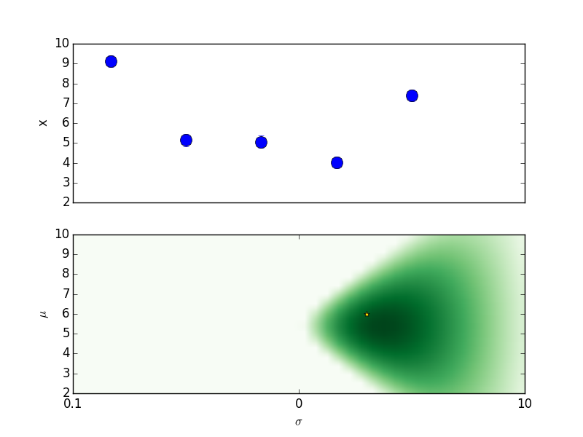
Behaviour

Slide 70
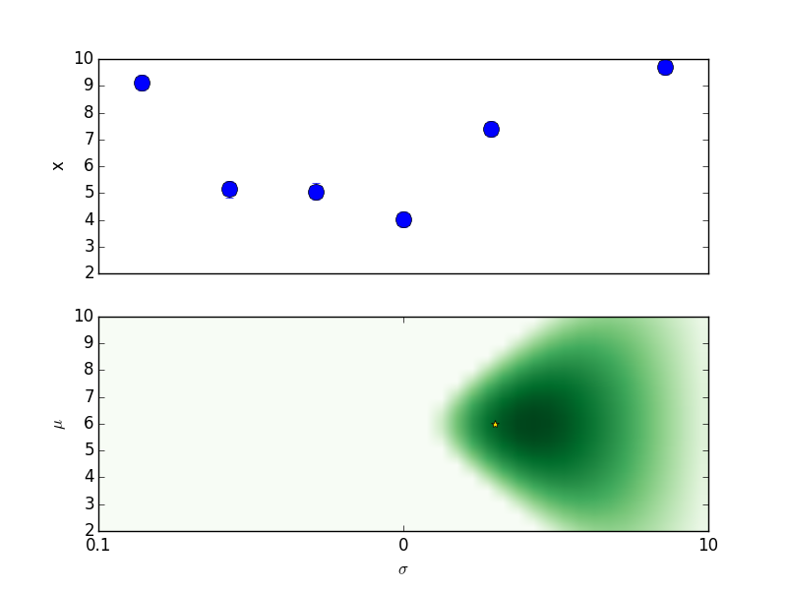
Behaviour

Slide 71
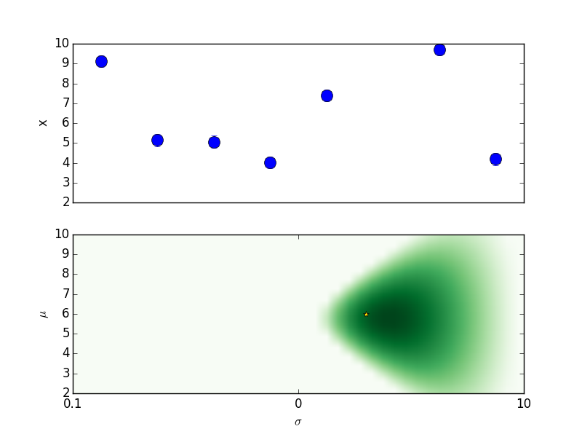
Behaviour

Slide 72
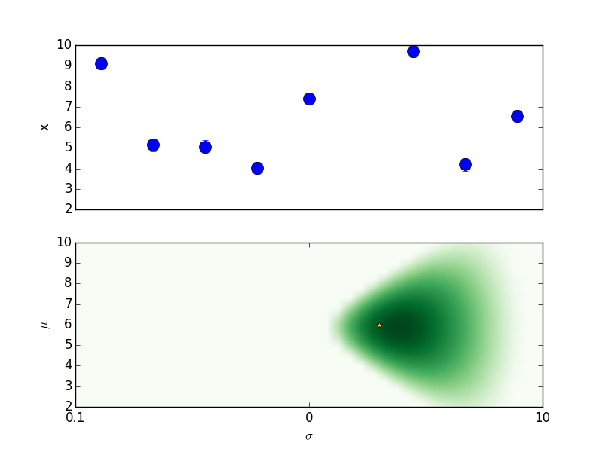
Behaviour

Slide 73
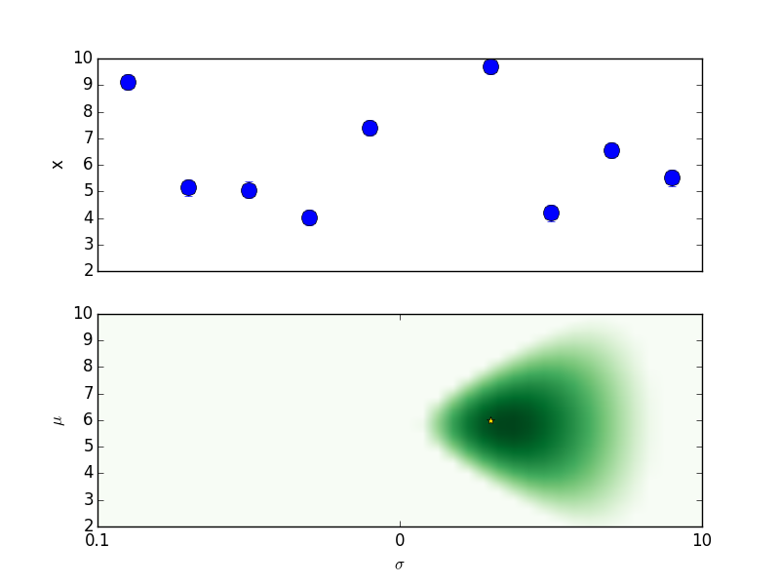
Behaviour

Slide 74

Behaviour

Slide 75

Behaviour

Slide 76
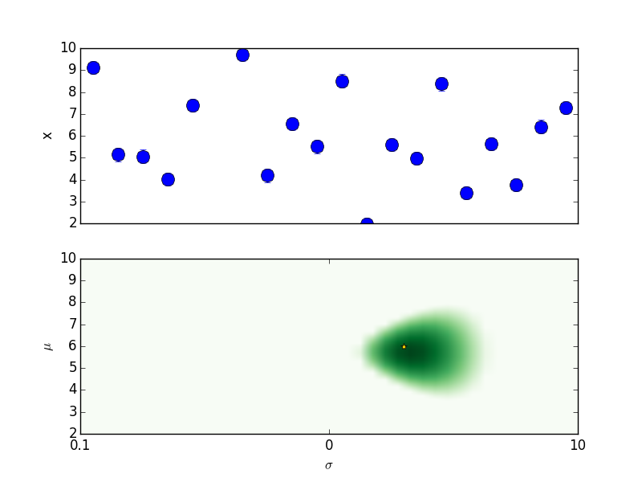
Behaviour

Slide 77
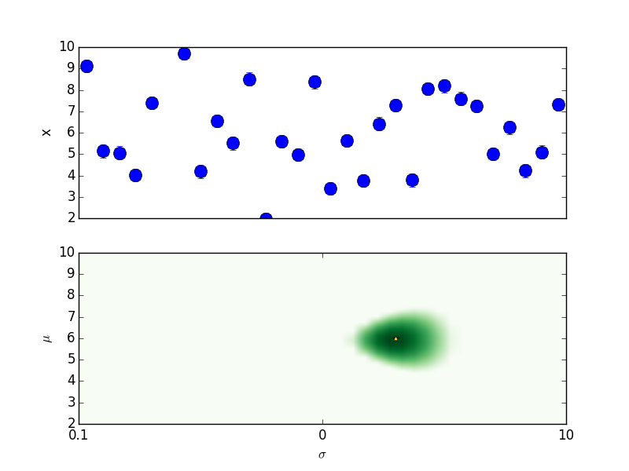
Behaviour

Slide 78
Behaviour

Slide 79
Behaviour

Slide 80
Behaviour

Slide 81

Behaviour

Slide 82

Behaviour

Slide 83
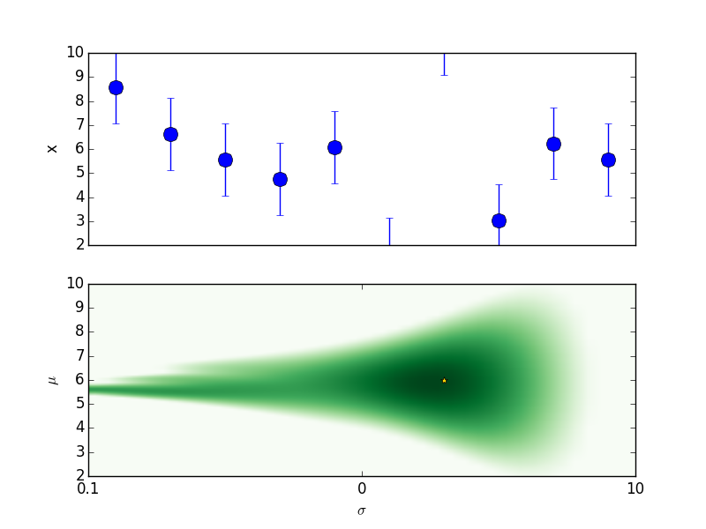
Behaviour

Slide 84
Behaviour

Slide 85
Behaviour

