Slide 1

Growth of super-massive black holes over cosmic time
Obscuration on all scales
Johannes Buchner
FONDECYT fellow
http://astrost.at/istics/
Collaborators: @PUC: Steve Schulze, Franz Bauer
@MPE: A. Georgakakis, K. Nandra, M. Brightman, ML. Menzel, Z. Liu, L-T. Hsu, M. Salvato, C. Rangel, J. Aird, A. Merloni

Slide 2
About me: Johannes Buchner
Astrophysics interests
  AGN; SMBH growth; X-ray surveys
  Obscurer of AGN; galaxy-scale obscuration
  Obscuration of Gamma-ray burst afterglows
  Simulations: X-ray illumination; cosmological simulations
Astrostatistics interests
  PyMultinest, nested sampling algorithms
  Improving X-ray spectral analysis (BXA)
    Modern statistical tools for parameter estimation and spectral model comparison – invited talk HEAD meeting August 2017
  Consulting for papers, Astrostatistics group; astrost.at/istics
Buchner15
Buchner16a
Buchner16b
Buchner16b + in prep
Buchner14
Buchner+14

Slide 3
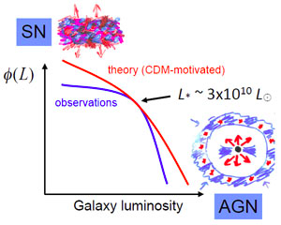
Motivation
Galaxy evolution
  “Feedback” from
  SMBH growth
  solves GMF, colors, …
Black hole growth
  How and when?
  0.2% of galaxy mass in compact objects
  AGN sometimes outshines the galaxy
  Extreme environments
Silk&Mamon12
Croton+06

Slide 4
Introduction
Flow into black hole
  Accretion disk
  Heating, secondary emissions
  AGN Luminosity output ~ 10%
  Across all wavelengths, primarily optical/UV
Reconstruction:
  Detect emission in a uncontaminated band
  Compute total luminosity at various z
  Correct for survey sensitivity
  flow at z
Accretion Disk

Slide 5
Problem
Surveys: >50% of found AGN are obscured
  Intrinsically: most accretion hidden
  behind layers of gas & dust
  Need selection which is
    not as affected by obscuration
    selection bias can be easily quantified
Our approach: X-ray selection
  Efficient: most point sources in deep fields are AGN
  Clean: Virtually no galaxy emission at z>0
  Less affected: Hard X-rays pass through obscurer
    Intrinsic luminosity and obscuration measurable from spectrum

Slide 6
AGN: Accretion onto SMBH
Accretion Disk
“Torus” Obscurer
Galactic Center gas
Star forming regions
e.g. in spiral arms
UV, Opt, X-ray, ...
<0.1pc
10pc
1 kpc
10 kpc
Nuclear obscuration
Galaxy-scale obscuration

Slide 7
AGN: Accretion onto SMBH
Accretion Disk
“Torus” Obscurer
Galactic Center gas
Star forming regions
e.g. in spiral arms
Total growth over cosmic time? (z=0.5-3)
Self-regulation?
AGN-galaxy connection?
…
How is it stable and extended?
Density? Substructure?
Feeding of SMBH?
First observational constraint:
- Intrinsic accretion history
- Luminosity function
First observational constraint:
- Column density
- Covering fraction

Slide 8
Column density N_{H}
N_{H} … number of H atoms along line-of-sight
N_{H} = few atoms / cm³ x few kpc = 10²²/cm²
Compton-thick: ~ 10²⁴ cm² – Circinus, NGC1068
  Nuclear regions with high density
  Mergers – major accretion events for SMBH
Fe, O, He, H absorption:
  Intrinsic powerlaw from corona near accretion disk
  absorb soft but not hard X-ray, re-radiate thermally in IR
  Measure N_{H} assuming local abundances from X-ray spectrum

Slide 9
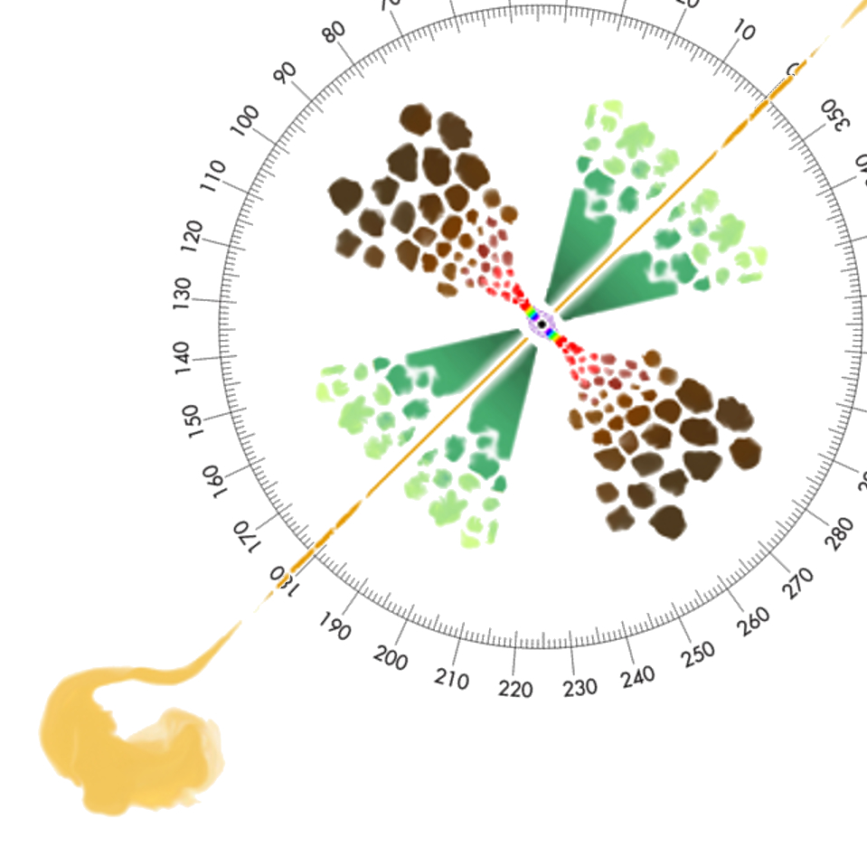
Covering fraction
Unobscured sky
assuming random views
% of obscured AGN =
% of obscured sky =
covering fraction
need selection function
+L, z, N_{H} range coverage
Obscured sky
Compton-thick sky
Marin+16

Slide 10
What IS the “Torus”
Obscurer with substantial covering
  How much covering? How thick? – this talk
few pc scale – VLBI,
Non-spherical – polarisation
  –> donut?
polar dust emissions – high-res IR
  –> wind/outflow?

Slide 11
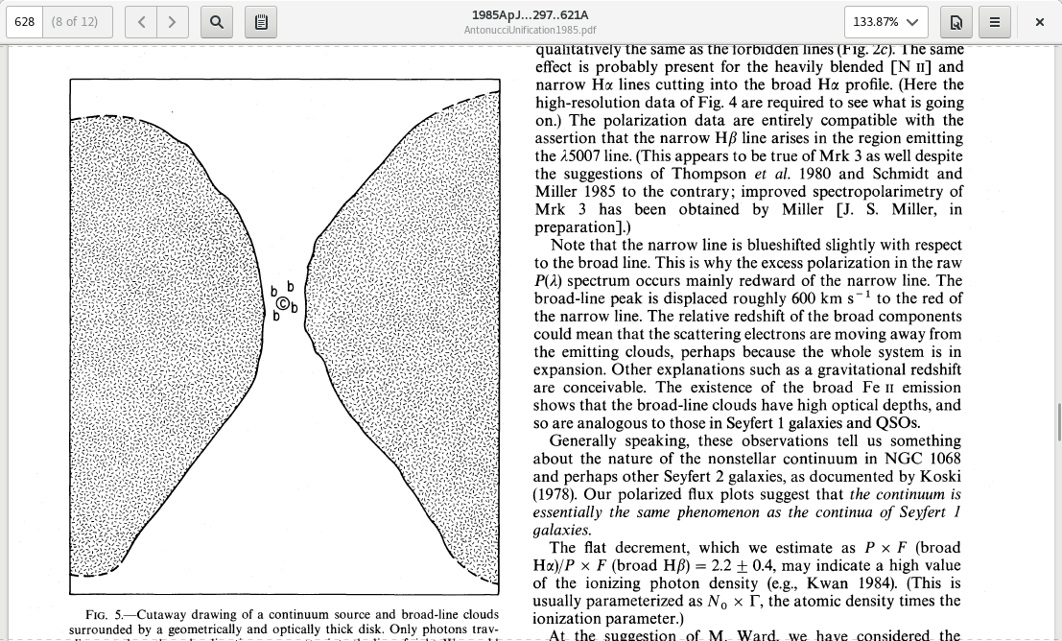
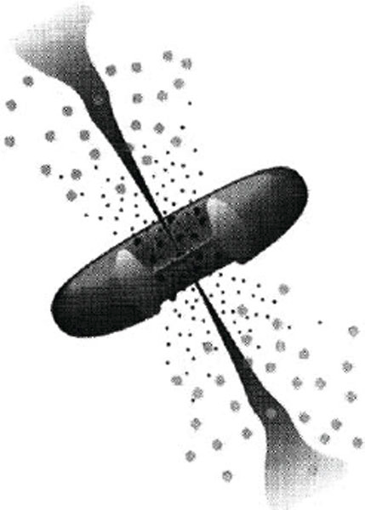
Old picture
Antonucci&Miller85
An actual torus/donut
  Evidence: non-spherical
  from polarisation direction

Slide 12
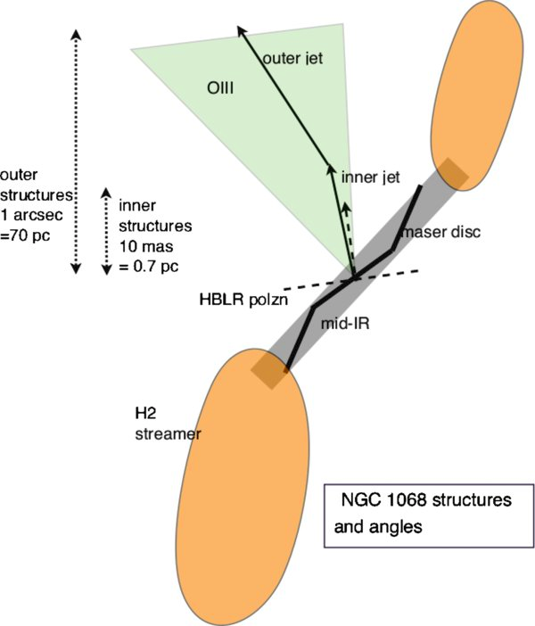
Warped disks
Warped, tilted, twisted disks
  Evidence: maser disks
  Evidence: misalignments
  on larger scales

Slide 13
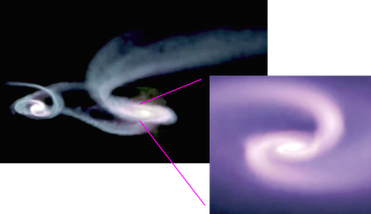
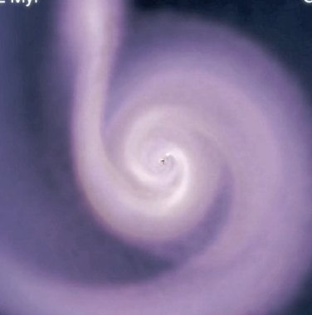
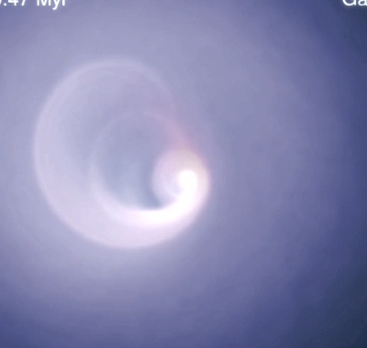
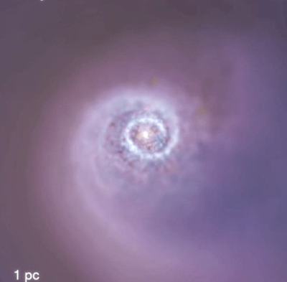
Hopkins+12
Torus is just torqued accretion flow from larger scales
Tilting & warping

Slide 14
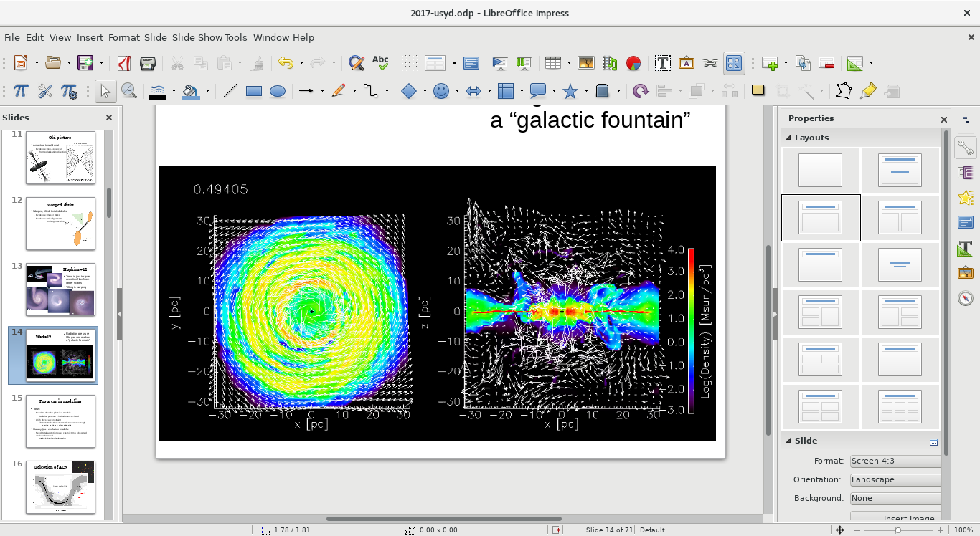
Wada12
Radiation pressure lifts gas and makes a “galactic fountain”

Slide 15
Wada12
Radiation pressure lifts gas and makes a “galactic fountain”

Slide 16
Progress in modeling
Torus:
  Need to develop physical models
    Radiation pressure + hydrodynamics = hard
  With physical constraint
    First constraint: Obscurer needs to obscure enough
      covering fractions & column densities
Galaxy (co-)evolution models:
  Need total accretion over cosmic time, obscured and unobscured
    Intrinsic luminosity function

Slide 17
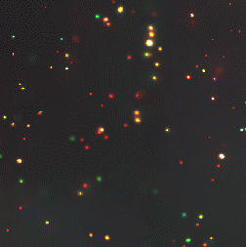
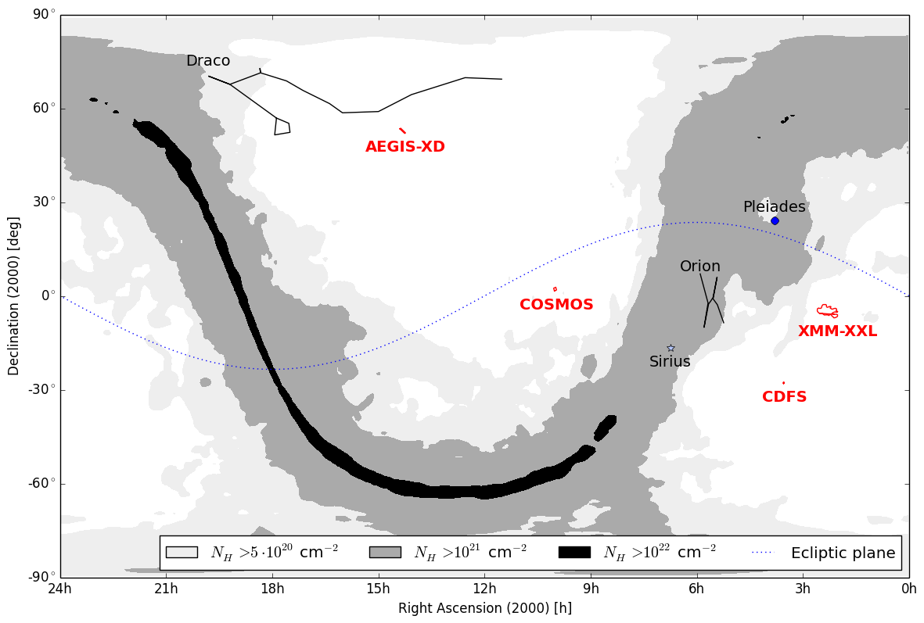
Selection of AGN
Deep + shallow fields

Slide 18



Surveys
2-10 keV Chandra detection
Wedding-cake
~2000 objects
>100 CT (Brightman+14)

Slide 19


2-10keV X-ray Selection
Gilli+07
+ Chandra positioning
for associations and
redshift computations
Li-Ting Hsu, Mara Salvato,
Marie-Luise Menzel, James Aird
ROSAT
Chandra z=2
NuSTAR z=0
Chandra z=0

Slide 20

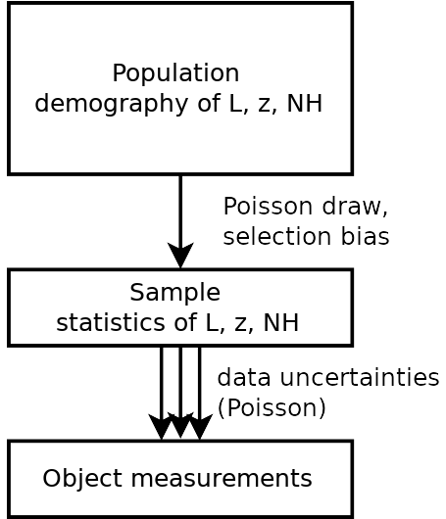
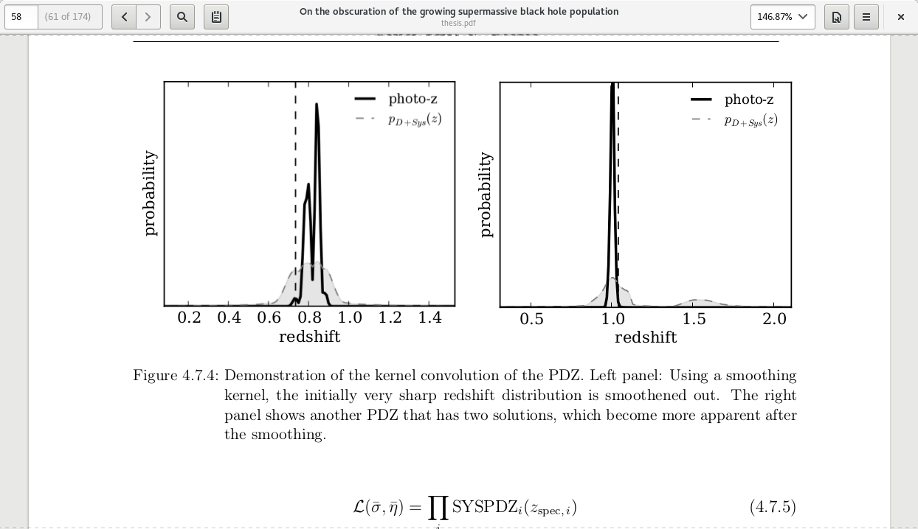
sample statistics population demographics
Marshall 1983
C=(L,z,N_{H})
Incorporates
Uncertainties in z, L, N_{H} from spectra
Sensitivity / Censorship
Is hierarchical inference with Censorship (Loredo04, Kelly+08)

Slide 21
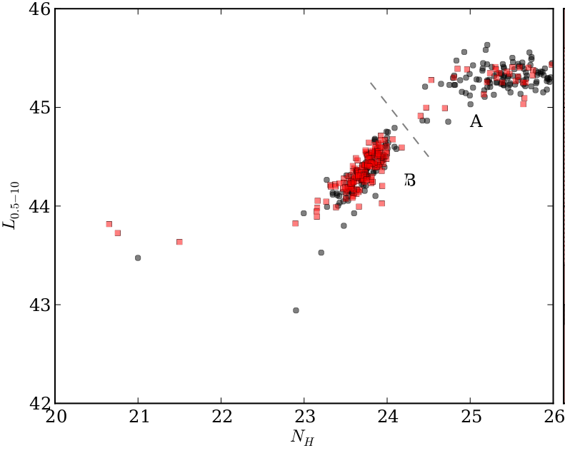
Consistent Bayesian Analysis
Advanced matching to opt/IR (Hsu+14, M. Brusa)
Deep multi-wavelength coverage
  High redshift completeness
  Precise & accurate photo-z (M. Salvato, Hsu+14)
Include sources without counterparts consistently
Uncertainty in photometric redshift, multiple solutions
Systematic errors of photometric redshift
Full spectral analysis of unbinned spectrum
  Uncertainty clouds in L, z, NH
Propagated into luminosity function analysis
  Recover a smooth field ϕ(L, z, NH) / d...
  Non-parametric, model-independent
Luminosity
Column density NH
Buchner+14
Robust Results – Realistic Uncertainties

Slide 22
Function Φ(L, z, N_{H})
Bending powerlaw, evolving parameters
  LDDE (Ueda+03, Ueda+14)
  LADE (Aird+10)
  FLDE (Aird+15)
New: Non-parametric approach
  Vmax estimators – binning is problematic
  Our approach: smooth 3D field Φ(L, z, N_{H})
    need smoothness prior:
    at each N_{H}, z: slope or flat. Across: flat

Slide 23
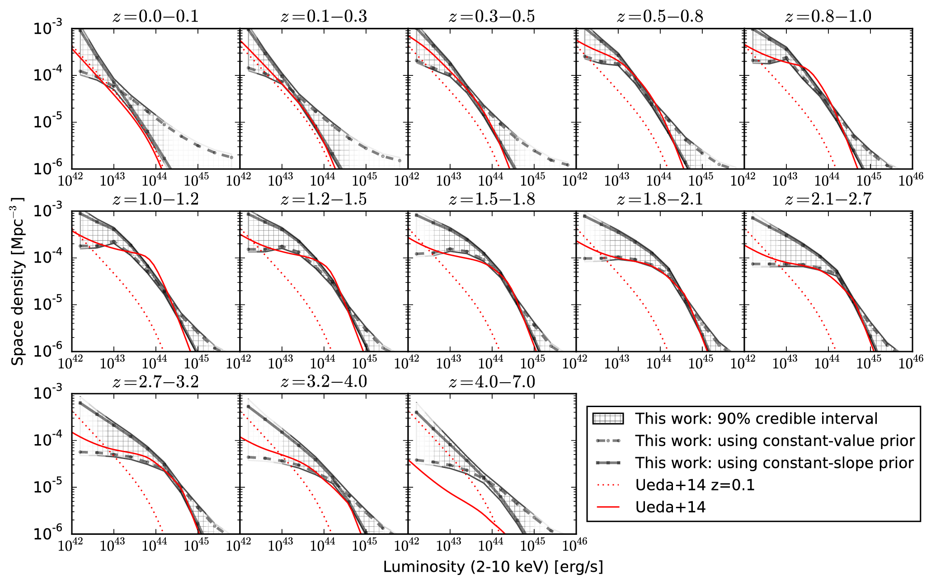
Intrinsic LF shape
Buchner+15

Slide 24


Compton-thick Luminosity Function
Reconstruction of a smooth field
  Results insensitive to chosen
  smoothing length
    0.5 mag between bins
  Consistent Cthin total LF with
  Ueda+14, Aird+10
Buchner+15

Slide 25

Obscured accretion history
Buchner+15
CTK
CTN obscured
unobscured

Slide 26

Black Hole Mass Accretion
ε=10%
Bol. Corr.:
Marconi+04
not Hopkins+07
Convert to mass flowing into BH Accretion consistent with local BHMD
in prep., see also Merloni15

Slide 27
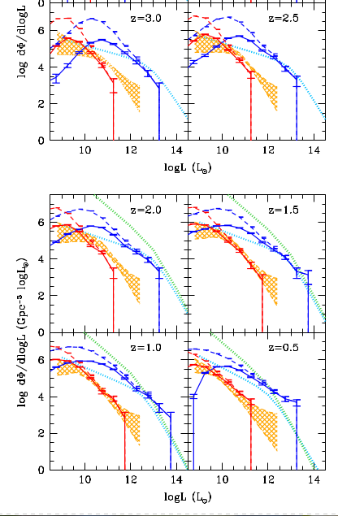

Simulations
Became a standard for testing
cosmological simulations
and their AGN feedback
Horizon-AGN Volonteri+16
Buchner+15

Slide 28

Simulations
EAGLE Rosas-Guevara+16
Buchner+15

Slide 29
Obscured fractions
Total number density
Obscured fraction:
Compton-thick fraction:
Ricci+16: Swift/BAT, z=0 lum-dep
Annuar in prep: NuSTAR z=0
Wilkes+13: Radio, z~2 CTK fraction < 40%
Buchner+15
77 ⁺⁴₋₅%
38 ⁺⁸₋₇%

Slide 30
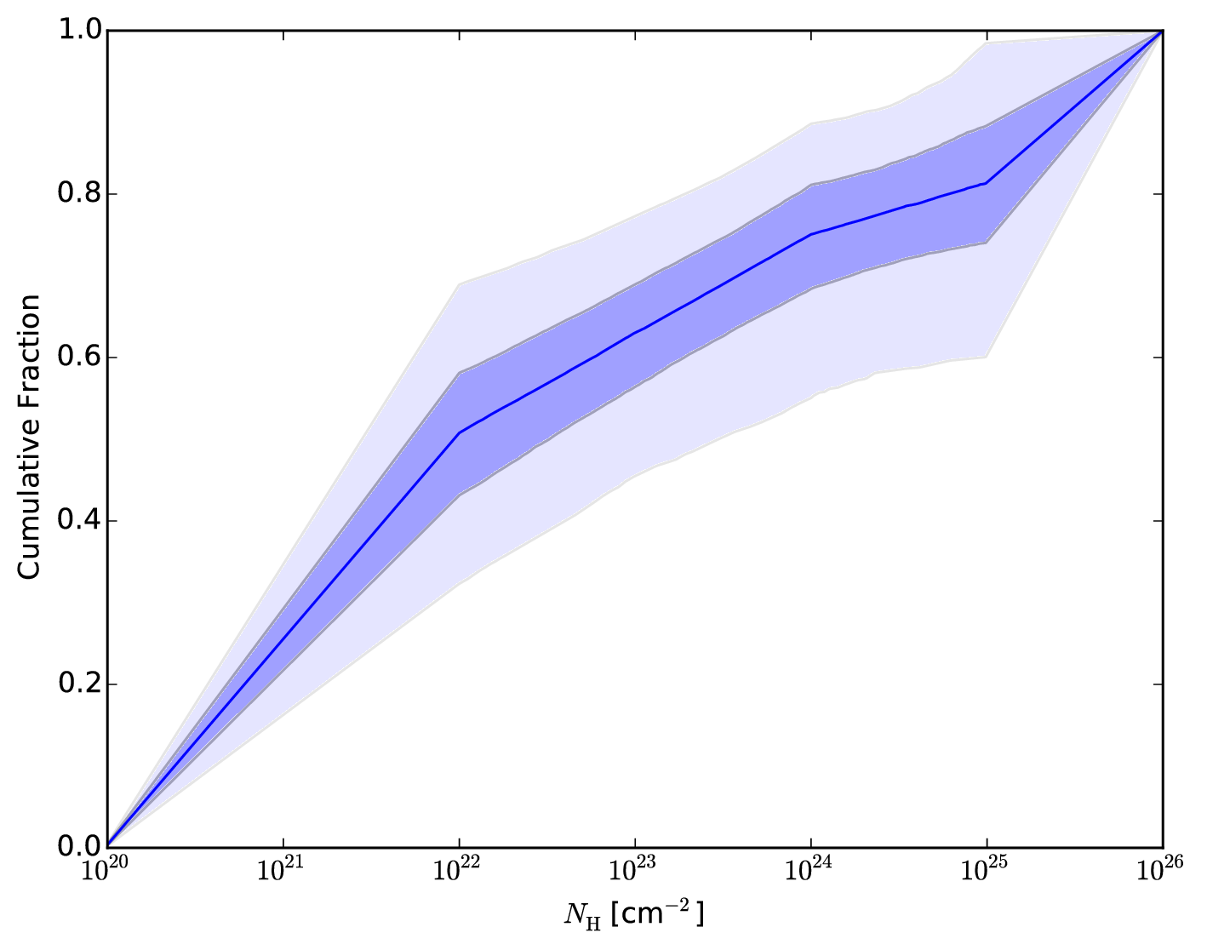
Radio results: 3CR
radio-selected, high-L; 38 total, 9 CTK, 3 more?
z~2, complete
spectral analysis
Results confirm
Wikes+13
Unobscured
Compton-thin
obscured
Compton-thick

Slide 31
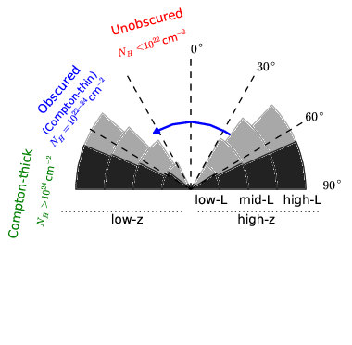
Total covering fractions

Slide 32

Obscuration – Luminosity – Redshift
Buchner+15

Slide 33
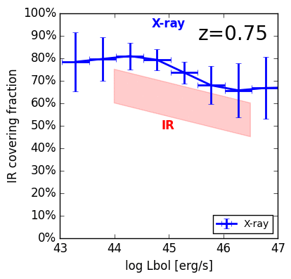
Comparison w/ IR covering fractions
IR: Stalevski+16,
z~1.5
Buchner+15
Buchner+17b
In parametric models (since 2003)
e.g. Ueda+03, Ueda+14, Aird+15
Does the obscured fraction
really increase with redshift?

Slide 34

Buchner+15

Slide 35
z evol
Buchner+15

Slide 36
z evol
Buchner+15

Slide 37
z evol
Buchner+15

Slide 38
z evol
Buchner+15

Slide 39
z evol
Buchner+15
With BHM downsizing

Slide 40
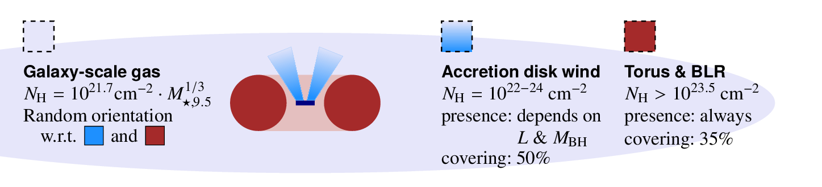
Physical mechanisms
Unified model
  Wind + Torus
  Radiation-pressure causes large covering
Evolution
  Off 89%
  Gas nearby +
  faint AGN 10%
  Bright AGN,
  blow-out of gas 1%
Wada15, Elitzur+15
Buchner+17b

Slide 41
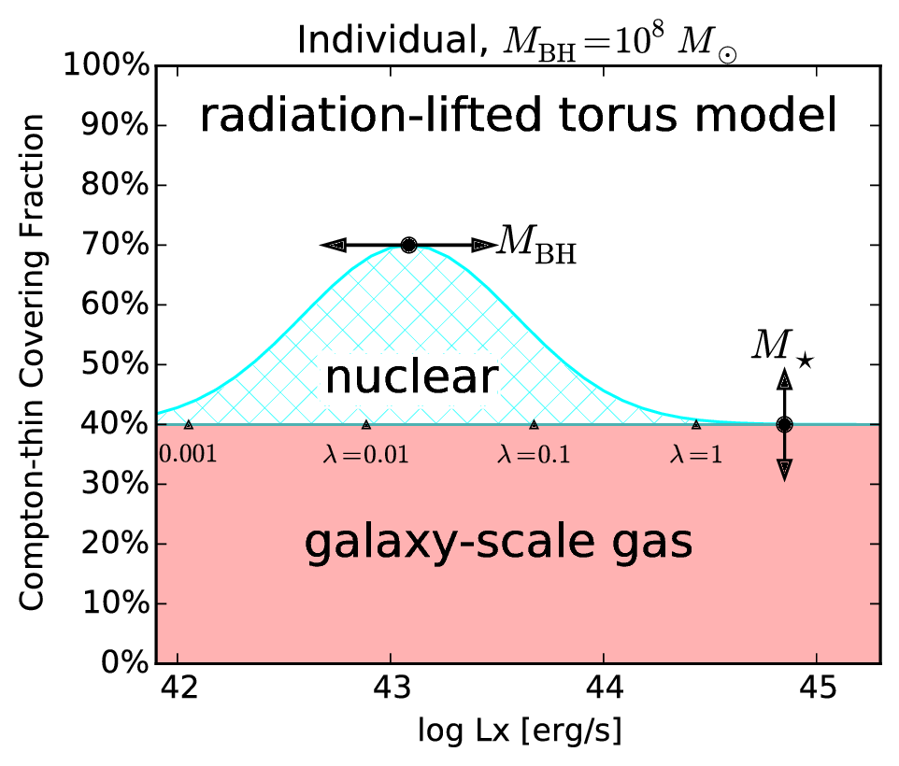
Radiation-lifted torus
Buchner+17b
Alternative to
“receding torus”
Mdot-dep

Slide 42
Summary
Successfully constrained obscured accretion
Hidden accretion is the majority
Have covering fractions for various column densities
  For torus modellers & simulators
  L-dep is complex – Eddington-rate dependent?
  “radiation-lifted torus” paradigm
But how important is galaxy-scale obscuration?

Slide 43
Galaxy-scale obscuration
Need:
  Probe that is sensitive to high columns
  Not just a central point source
  Provides X-ray, for column densities
  z=0.5-3
Lets try to understand the obscurer of LGRBs

Slide 44
GRBs x-raying Galaxies
Long (>2s) Gamma Ray Bursts:
  Collapse of massive stars
  Produce γ-ray
    Detected through any obscuration
    Detected at z=0-10
  X-ray, Opt, … Radio
  Follow blue light, general SF
    But: avoid high-Z galaxies
    SF, low-mass galaxies
Idea:
  X-ray tomography
  Can we reconstruct the galaxy from LOS densities

Slide 45
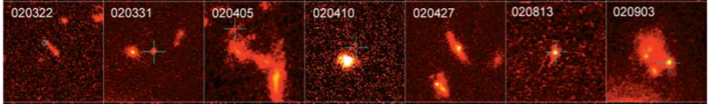
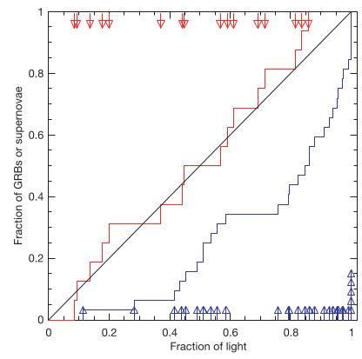
HST, blue or ultraviolet rest-frame images of GRB host galaxies
Massive O/B stars
Die early
In star-forming regions, molecular clouds
Need low metallicity gas
Follow blue light, general SF
But: avoid high-Z galaxies
SF, low-mass galaxies
Fruchter+06
SN: proportional
to blue light
GRB:
concentrated at bluest regions

Slide 46
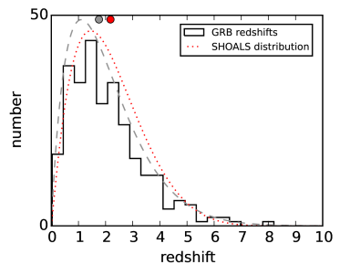
LGRB surveys
Swift: >900 sample of LGRBs, good positioning
Limited follow-up = redshift bias
Solutions:
  Include sources without redshift in analysis
  Use highly complete, unbiased samples
    SHOALS: defines criteria that do not depend on properties of the host galaxy

Slide 47
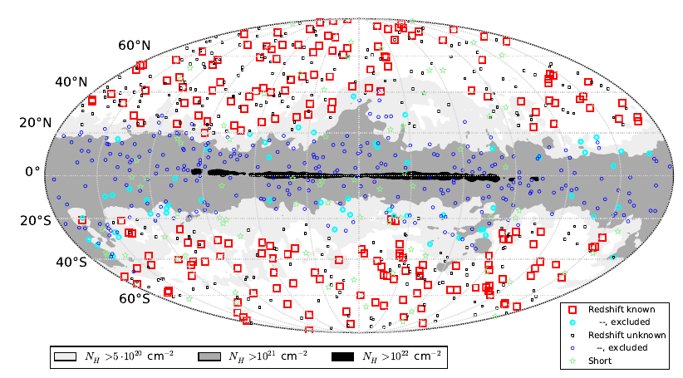
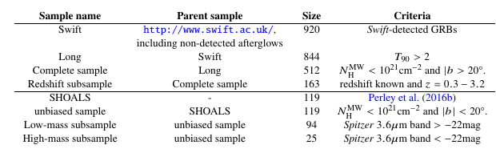
Data
Entire swift.ac.uk archive
Exclude flares & prompt emission
  Automated + visual inspection
Samples

Slide 48
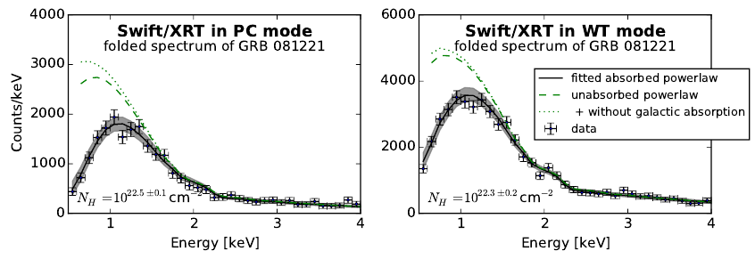
X-ray spectroscopy
Obscurer model:
  Intrinsic powerlaw
  a) tbabs
  b) SPHERE (Compton scattering)
Normalisation

Slide 49
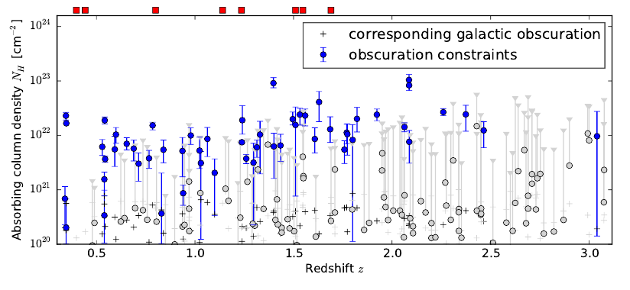
Column density distribution

Slide 50
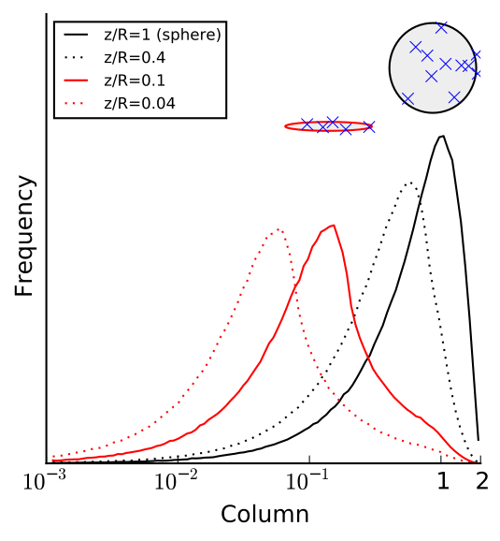
N_{H} distribution: Primer
~0.5 dex from geometry

Slide 51
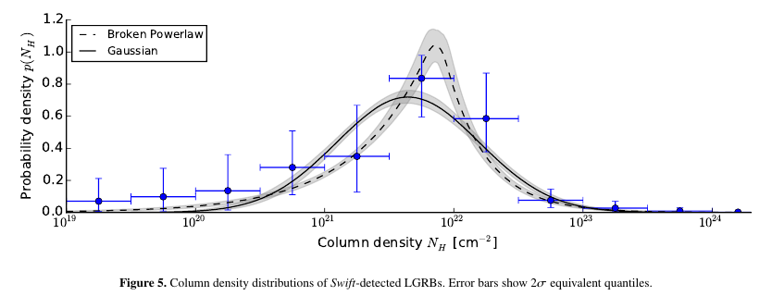
N_{H} distribution: observed
Model comparison (AIC): broken powerlaw is better

Slide 52
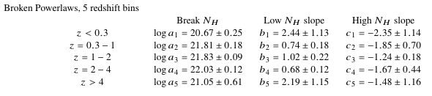
Redshift evolution
Not monotonic
Consistent within factor 2
KS test not valid
Splitting sample not valid

Slide 53
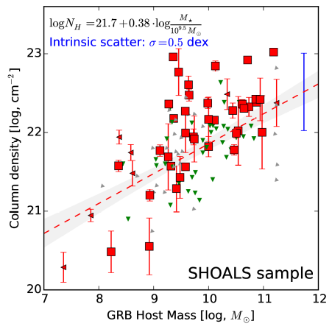
Host Mass - Obscuration
SHOALS
  Perley+15
  Deep follow-up
  ~90% redshift complete
  Spitzer masses
“Galaxy gas as obscurer: I.”
Buchner, Schulze & Bauer (2017)

Slide 54
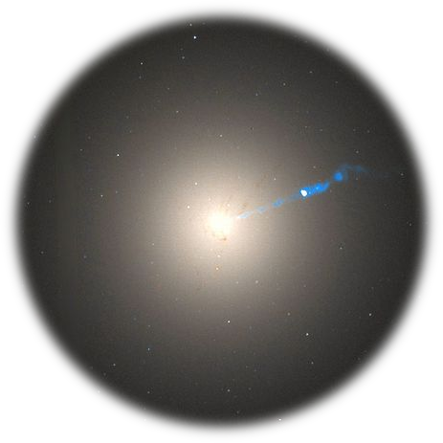
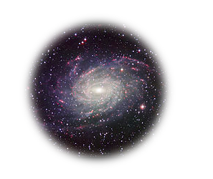
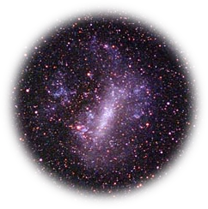
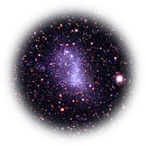
Host Mass – Obscuration
SHOALS
  Perley+15
  Deep follow-up
  ~90% redshift complete
“Galaxy gas as obscurer: I.”
Buchner, Schulze & Bauer (2017)

Slide 55
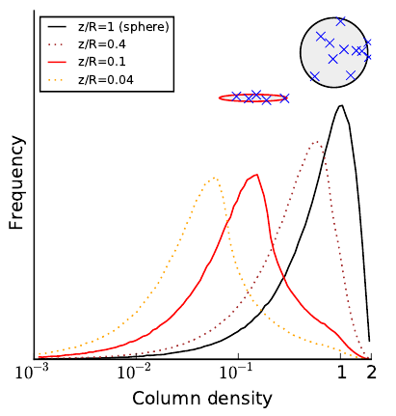
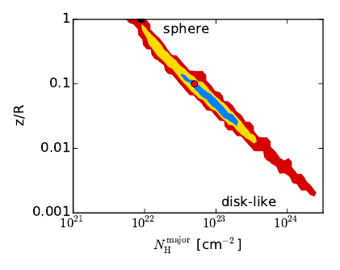
Toy model explains scatter
Ellipsoid gas is preferred model

Slide 56
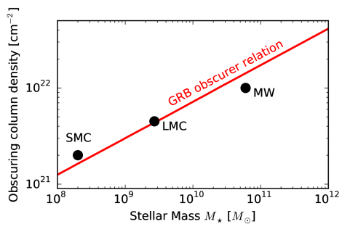
Local Galaxies
1% densest column from HI maps
Gas metallicity-corrected
“Galaxy gas as obscurer: I.”
Buchner, Schulze & Bauer (2017)

Slide 57
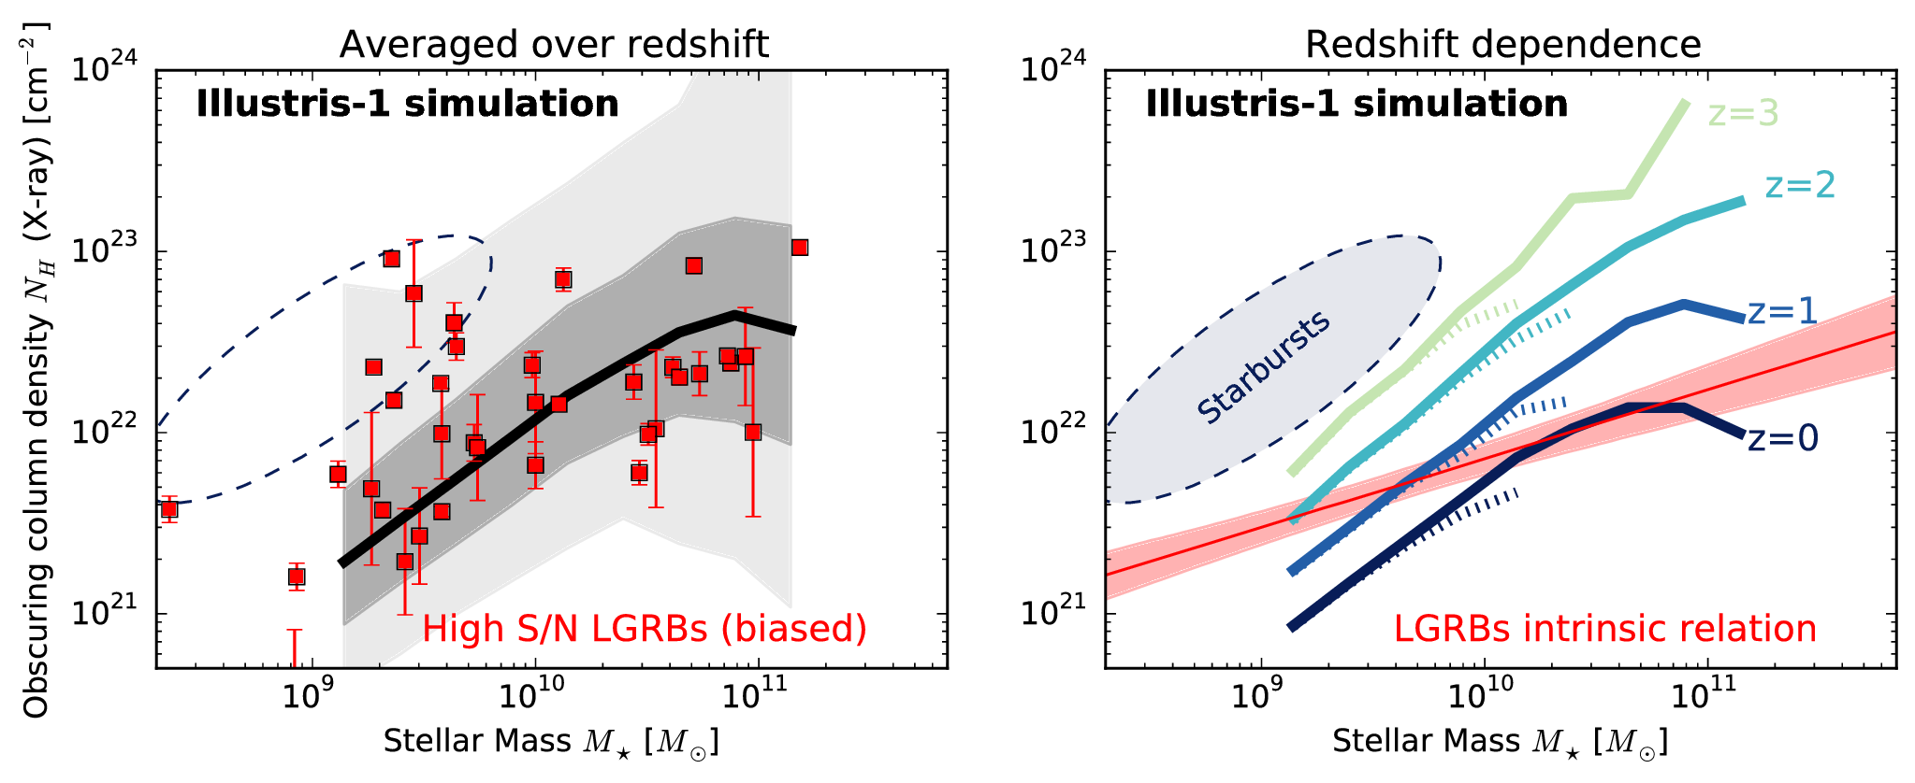
Predictions by simulations
“Galaxy gas as obscurer: I.”
Buchner, Schulze & Bauer (2017)
Notes:
Reproduce M* function
Reproduce observed HI, CO masses
Reproduce galaxy radii
They put the right amount of gas into galaxies
Resolution is problem, but averages out over long LOS

Slide 58

Host Mass – Obscuration
SHOALS
  Perley+15
  Deep follow-up
  ~90% redshift complete
Hosts?
  Actively star-forming, AGN not necessarily
  Metallicity bias
N_{H} – M* relation
Obscurer is host galaxy
Understand normalisation
Understand slope
Understand scatter
“Galaxy gas as obscurer: I.”
Buchner, Schulze & Bauer (2017)

Slide 59
Summary II
Host galaxy is the main obscurer of LGRBs
  Relation valid for local galaxies
  Slope understood
  Scatter understood
  Zero-point as expected from simulations
Constraints at z=0.5-3
  No redshift evolution there, at most a factor of 2

Slide 60
Generalising LGRB results
Stellar mass
Redshift evolution
SFR
  Lower in AGN
Metallicity
  Overlapping
  Stellar metallicity vs. gas metallicity
Vantage point
Same Observable

Slide 61
From GRBs to AGN
New Relation from GRBs
AGN fraction
Aird+12, Bongiorno+12
Stellar Mass Function
Ilbert+13, Muzzin+13
Marginalisation
“Galaxy gas as obscurer: II.”
Buchner & Bauer (2017)

Slide 62
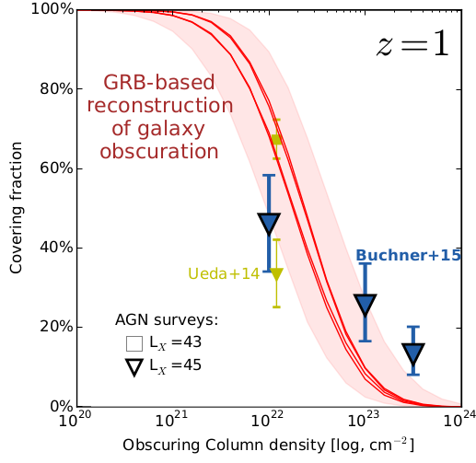
Predictions for AGN
No CTK AGN
Substantial % C-thin obscured
Slight overprediction:
  GRB-SF?
  Ellipticals?
“Galaxy gas as obscurer: II.”
Buchner & Bauer (2017)

Slide 63
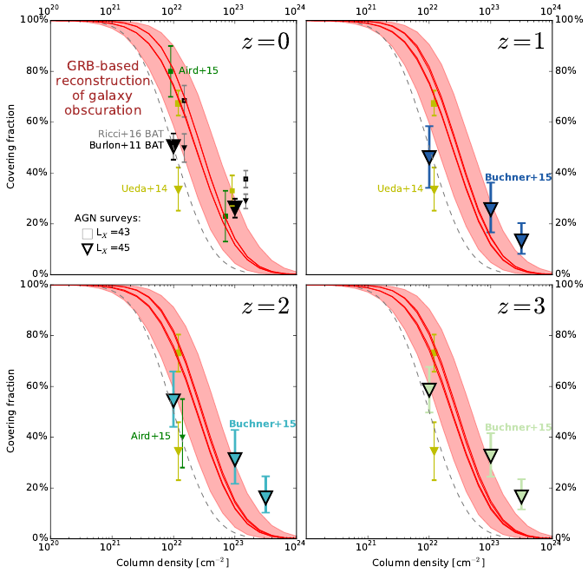
“Galaxy gas as obscurer: II.”
Buchner & Bauer (2017)

Slide 64
Simulations vs Observations
EAGLE (and Illustris)
Reproduce SMF
Reproduce observed HI, CO masses
Reproduce galaxy radii
They put the right amount of gas into galaxies
Resolution is problem
  but averages out over long LOS
But: Answer is feedback dependent

Slide 65
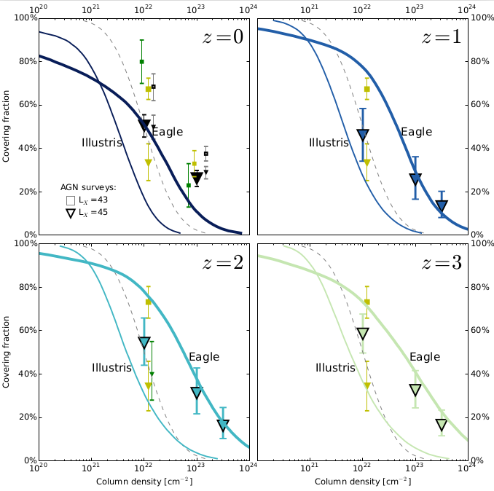

Slide 66
Interpretation
No CTK obscured AGN by galaxy-scale obscurer
Plausibly up to 40% of AGN are galaxy-scale obscured
  Even without any nuclear obscurer
  First separation of nuclear (<100pc) and galaxy-scale obscurer (>100pc)

Slide 67
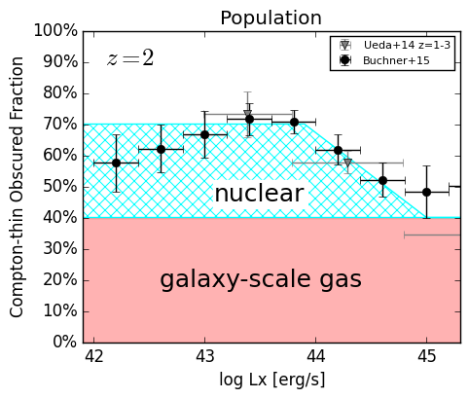
The Nuclear Obscurer
Host galaxy
CTK obscurer
CTN obscurer
disappears at bright end
describe nuclear obscurer alone
“Galaxy gas as obscurer: II.”
Buchner & Bauer (2017)

Slide 68
“Radiation-lifted torus”
Predict covering factor
f(L_{X}, M_{BH})
  Redshift evolution Buchner+15
  L_{X}/(M_{BH}^{2/3}) rad. pressure Elitzur+15, Wada15
  Opt./SDSS Oh+15
replace receding torus
  Unphysical for X-rays
“Galaxy gas as obscurer: II.”
Buchner & Bauer (2017)

Slide 69
Summary III
If AGN did not have a nuclear obscurer, 40% of them would still be obscured
  In fact, 3/4 obscured, 1/3 CTK (avg over z&L)
  obscurer may be Eddington-rate dependent
    to explain redshift evolution of L-dependence
    “radiation-lifted torus” – for modellers & simulators
host galaxy is an important CTN obscurer in AGN+LGRBs
LGRB are dominated by host galaxy obscuration, and show little evolution
  These observational results are supported by state-of-the-art cosmological simulations and may be used to calibrate AGN feedback strengths
  Probe of metal gas content in z=0.5-3 galaxies

Slide 70
References & Tools
Buchner+2014: Comparison of torus geometries of X-ray spectra in CDFS. Find high Compton scattering.
Buchner+2015: Intrinsic CT fractions, luminosity functions
Buchner, Schulze & Bauer 2017:
Galaxy gas as obscurer: I LGRBs x-ray their host galaxies
Buchner & Bauer 2017:
Galaxy gas as obscurer: II Separating the nuclear and host galaxy obscuration of AGN
PyMultiNest: Robust and fast model comparison and parameter estimation with Python
BXA: MultiNest for xspec&sherpa, for model comparison with X-ray spectral models
Website: astrost.at/istics

Slide 71
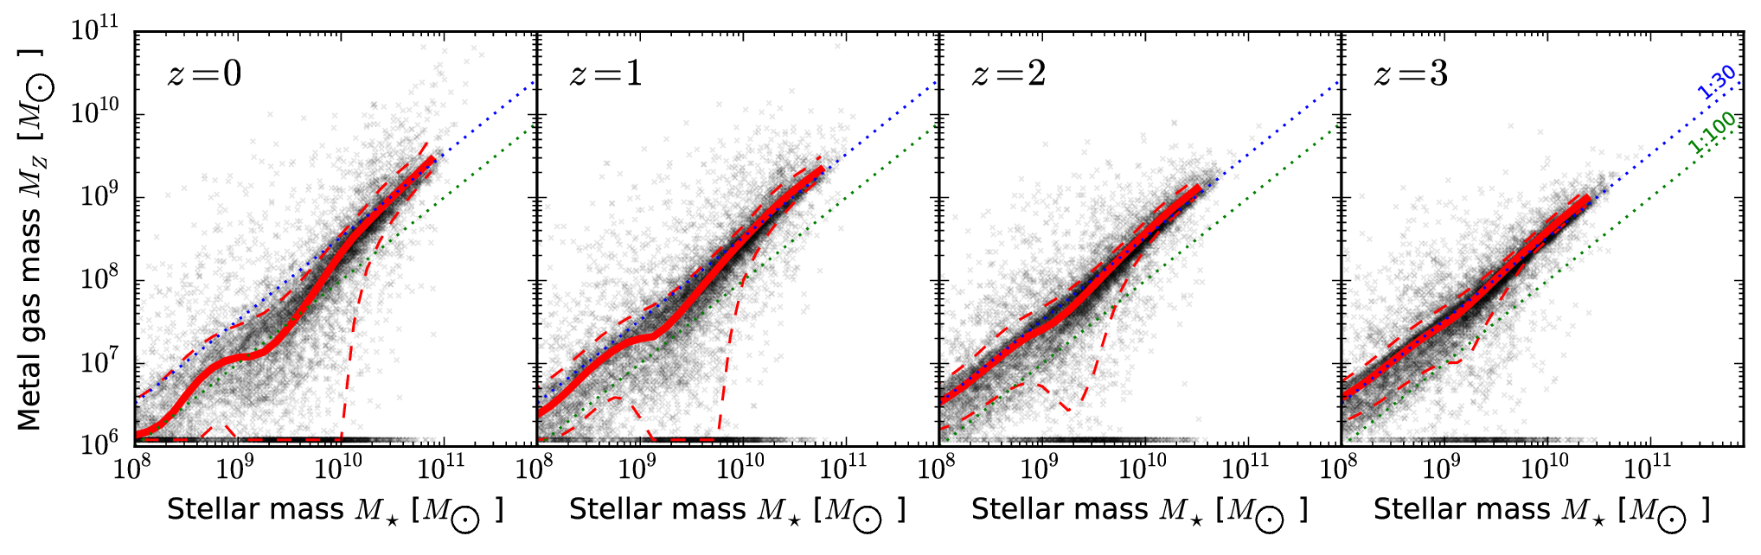
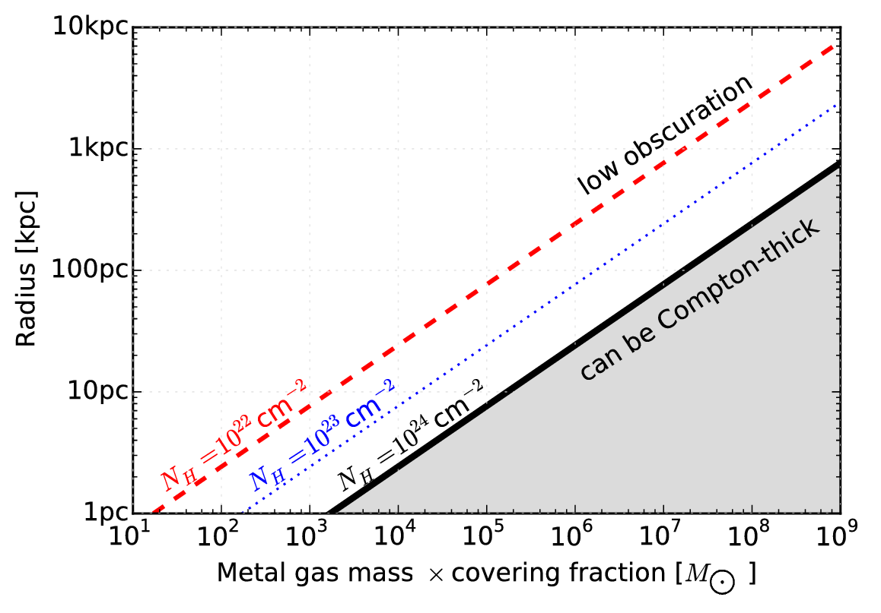
Metal gas
in galaxies
Mergers

Slide 72
Mergers
Disturbed/merger fractions similar LGRB-AGN
  (in the relevant luminosity regime)
Obscuration by merger at high-L should become more prevalent
  We see the opposite
  merger stages

