Slide 1

The
Compton-thick growth of
Supermassive Black Holes constrained
Johannes Buchner
FONDECYT fellow
http://astrost.at/istics/
Collaborators: @PUC: Steve Schulze, Franz Bauer
@MPE: A. Georgakakis, K. Nandra, M. Brightman, ML. Menzel, Z. Liu, L-T. Hsu, M. Salvato, C. Rangel, J. Aird, A. Merloni

Slide 2
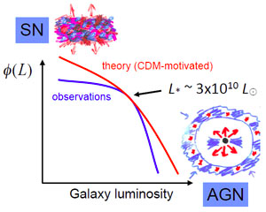
SMBH growth
Local Universe: 10⁶⁻¹⁰M* black holes
  How and when did they get there?
  Interaction with hosts? As gal-form tool
Growth mode: AGN
  Inflow, self-heating
  radiates as AGN, proportional
Silk&Mamon12
Croton+06

Slide 3
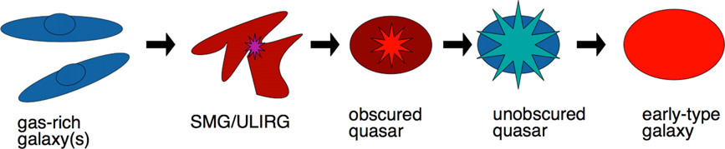
SMBH growth channels
How to get 0.5% of bulge mass
into <0.0001% of the volume?
  Angular momentum problem
  One efficient way: major mergers
  In any case:
  matter feeding can be matter obscuring
Alexander&Hickox12

Slide 4
Census of SMBH growth
Need census over cosmic time of AGN
unobscured N_{H}=10²⁰⁻²²/cm²
mildly obscured N_{H}=10²²⁻²⁴/cm²
heavily obscured N_{H}=10²⁴⁻²⁶/cm² (CTK)

Slide 5
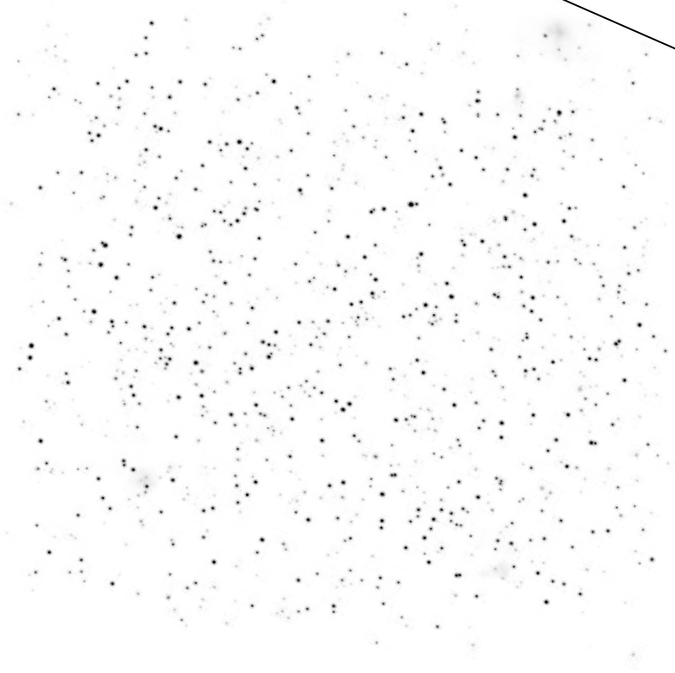
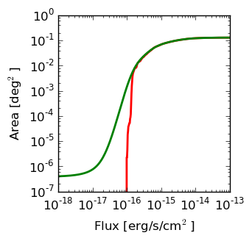
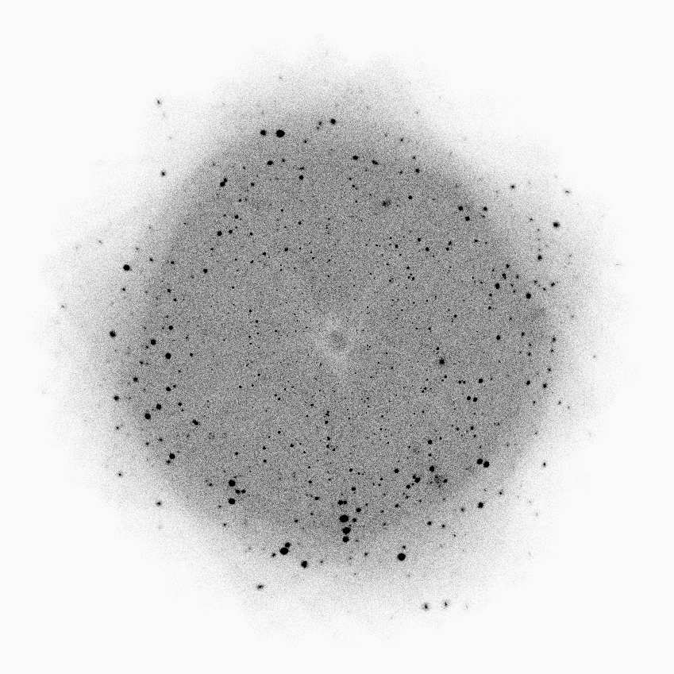
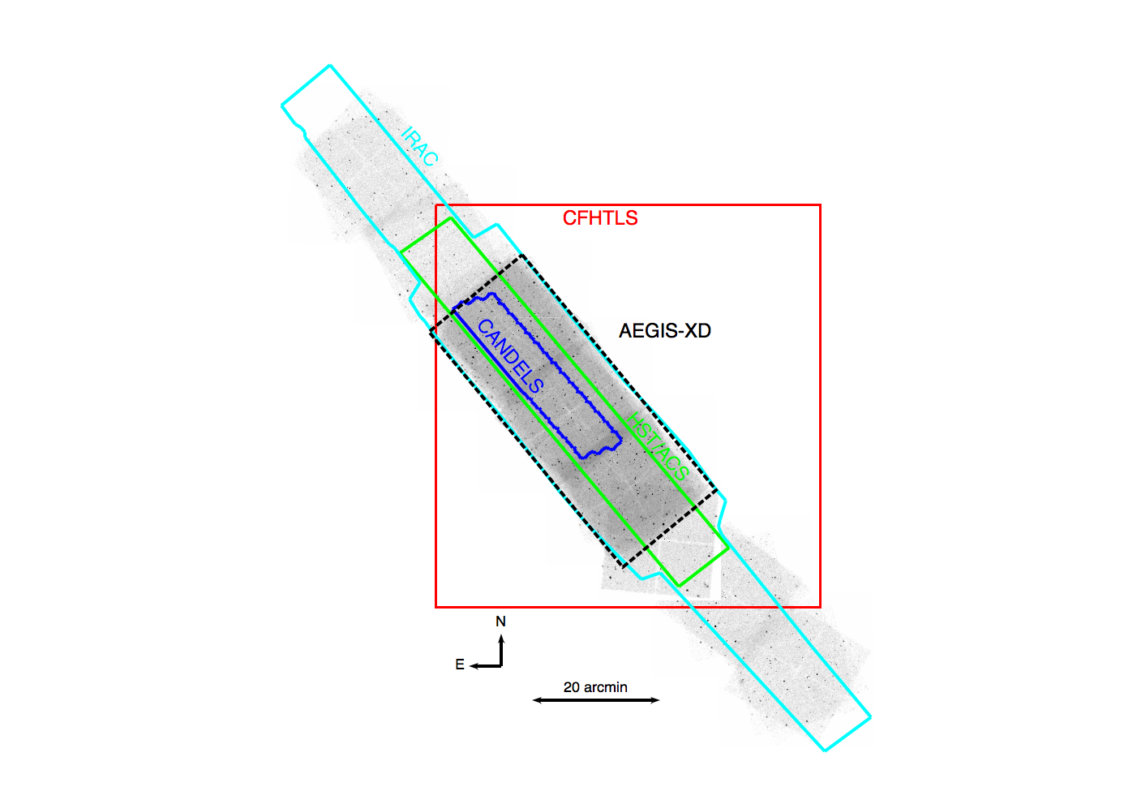
X-ray Selection
Why?
  Fewer objects, longer exposures, but:
  Selection function understood (photo-el. Abs.)
  Little contamination from non-AGN
COSMOS
160ks
0.9deg²
CDFS
800ks
1010 arcmin²
CDFS
4/7Ms
464 arcmin²

Slide 6


2-10keV Selection
Flux Fraction
Chandra z=2
NuSTAR z=0
Gilli+07
Chandra z=0
Column density N_{H}
at z=0: misses heavily obscured AGN
at z=1-3: use cosmic particle decelerator
largest (~100) sample of CTK AGN Brightman+14

Slide 7
Characterisation of AGN
inflow rate
inflow obscuration
inflow time
Accretion luminosity
intrinsic (abs.-corr.)
LOS column density
Redshift

Slide 8
Redshift
Not possible from X-ray alone
see XZ: C. Simmonds
Association with multi-λ: not trivial
see NWAY talk: M. Salvato
Redshift estimation
  spec-z: expensive
  photo-z: hard for AGN –> M. Salvato, LT. Hsu
How much to trust & when not to trust a z
  z with uncertainties, propagate
  include sources w/o redshift Aird+10

Slide 9
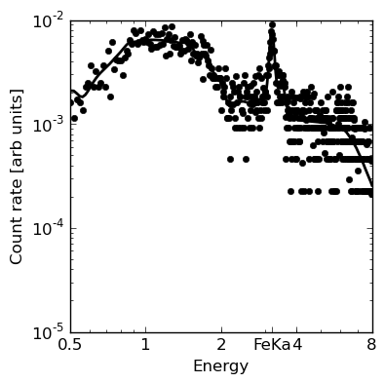
L, N_{H} from X-ray spectrum
Scattered Powerlaw component
CTK flat spectrum + FeK line

Slide 10

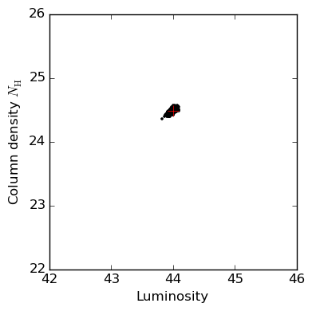
L, N_{H} from X-ray spectrum
Probability cloud

Slide 11
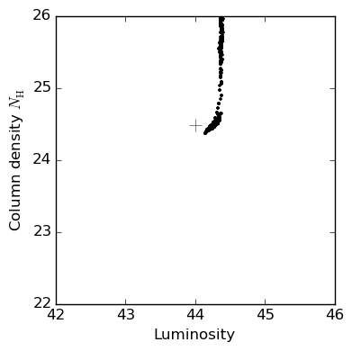
L, N_{H} from X-ray spectrum
MCMC (emcee/GW)
Nested Sampling (BXA/Multinest)

Slide 12
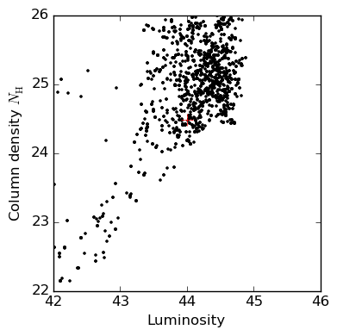
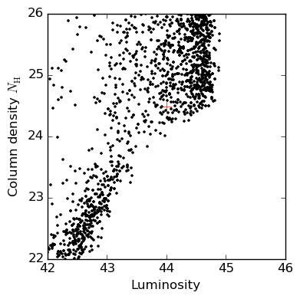
L, N_{H} from X-ray spectrum
MCMC (emcee/GW)
Nested Sampling (BXA/Multinest)
Simple fitting:
One minimum
MCMC:
One minimum
convergence tests
can be fooled

Slide 13
Population inference
L
z
z
z
X-ray point source spectra
L
z
z
z

Slide 14

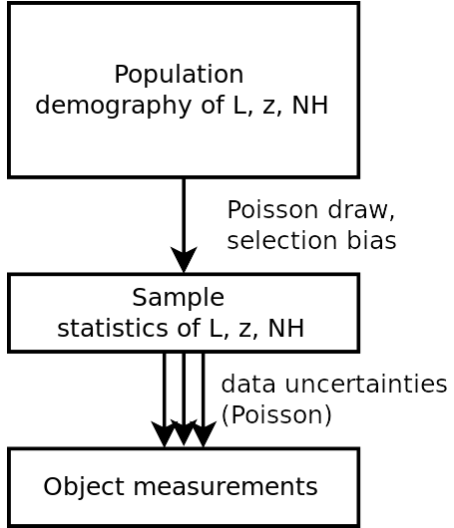
sample statistics population demographics
Obscured fraction in the sample
Marshall 1983
C=(L,z,N_{H})
Incorporates
Uncertainties in z, L, N_{H} from spectra
Sensitivity / Censorship
Is hierarchical inference with Censorship (Loredo04, Kelly+08)

Slide 15



Surveys
2-10 keV Chandra detection
Wedding-cake
~2000 objects
>100 CT (Brightman+14)

Slide 16
Assumptions on LF shape
Density φ(L_{X}, z, N_{H})
Shift in field to verify if
  assumed double-PL evolution is simple
  or complex (LDDE)
Miyaji+15 split sample, check LF in bins
Aird+10,+15 bending PL of obsc, unobsc
evolution via polynomials
Buchner+15 smooth fields
fewest assumptions, large uncertainties

Slide 17


Compton-thick Luminosity Function
Reconstruction of a smooth field
  Results insensitive to chosen
  smoothing length
    0.5 mag between bins
  Consistent Cthin total LF with
  Ueda+14, Aird+10
Buchner+15

Slide 18
Obscured fractions
Total number density
Obscured fraction:
Compton-thick fraction:
Ricci+16: Swift/BAT
Annuar in prep: NuSTAR z=0
Wilkes+13: Radio, z~2 CTK fraction < 40%
see talk Mateos+17 for upper limit z<1
Buchner+15
77 ⁺⁴₋₅%
38 ⁺⁸₋₇%

Slide 19

Obscuration–Luminosity evolves
Buchner+15
CTK L-dep in local Universe: Ricci+16
Consensus in works correcting for selection biases:
Evolution is
not
Obscurer is
not only L-dep
Edd-rate-dep?
see Buchner+17b

Slide 20

Total luminosity emitted
Buchner+15
CTK
CTN obscured
unobscured

Slide 21

Black Hole Mass Accretion
ε=10%
Bol. Corr.:
Marconi+04
not Hopkins+07
Convert to mass flowing into BH Accretion consistent with local BHMD
in prep., see also Merloni15

Slide 22
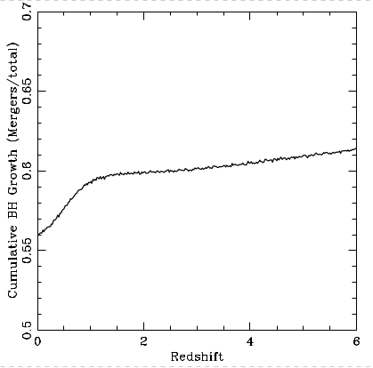
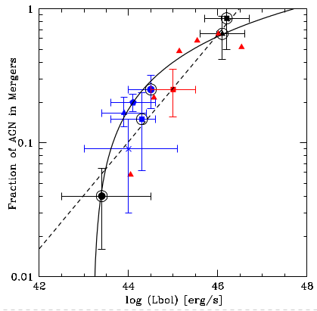
Mergers
Treister+12

Slide 23
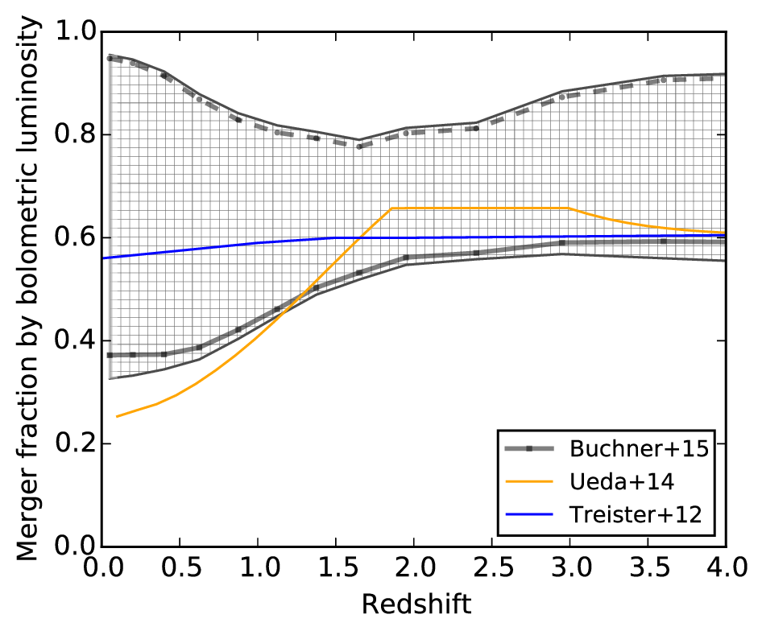
Mergers
Treister+12

Slide 24
Summary
CTK ~ 1/3 (in number and accretion)
Obscured ~ 3/4 (in number and accretion)
Mergers are majority growth mode
Beware of pitfalls of simple methods

Slide 25
Summary
CTK ~ 1/3 (in number and accretion)
Obscured ~ 3/4 (in number and accretion)
Mergers are majority growth mode
Beware of pitfalls of simple methods
Impact of galaxy-scale gas on obscuration?
  Poster, Buchner+17a,b
Poster: New CLUMPY X-ray spectral model

