Slide 1

How many Supermassive Black Holes are there?
Johannes Buchner
FONDECYT fellow
http://astrost.at/istics/
Collaborators (PUC & ETH): Ezequiel Treister, Franz Bauer,
Lia Sartori, Kevin Schawinski, Roberto Gonzalez, Nelson Padilla

Slide 2
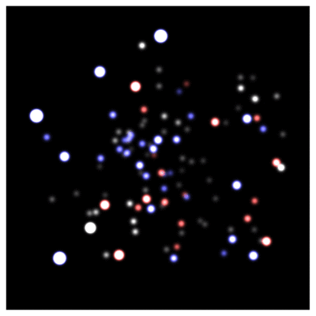
SMBH evidence: local Universe
Reconstruct orbits
Enclosed mass
4.31±0.38 10⁶M_{o}
GC / IR group at MPE
Schödel+02, Eisenhauer+05, Gillessen+09

Slide 3
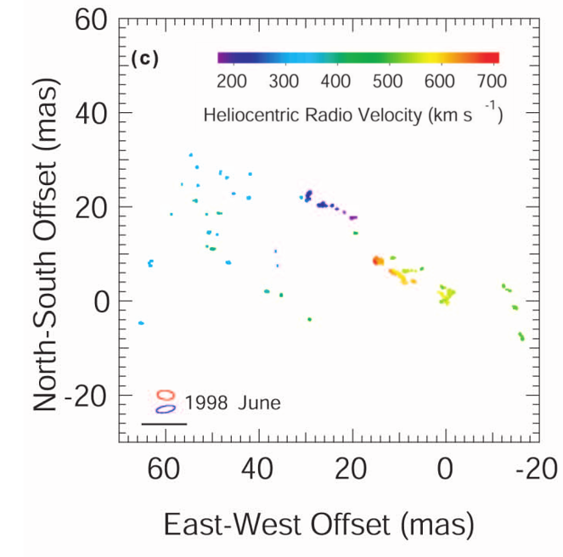
SMBH evidence: local Universe
Water maser clumps
Keplerian velocity profile
Enclosed mass
1.7±0.3 10⁶ M_{o}
Circinus
Greenhill+01

Slide 4
SMBH evidence: local Universe
Stellar dynamics
H2O megamasers (VLBI)
Gas dynamics (HST)
Reverberation mapping (spectroscopy)
10⁶⁻¹⁰ M_{o} in the centres of massive galaxies
Enclosed, dark mass

Slide 5
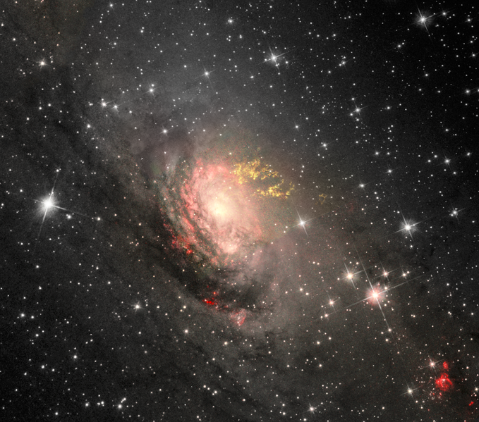
Growing SMBHs: AGN
Signatures of growing SMBH:
Hard UV ionisation field
Ionised line ratios (OIII)
Hard X-rays
Radio
Circinus CC Judy Schmidt

Slide 6
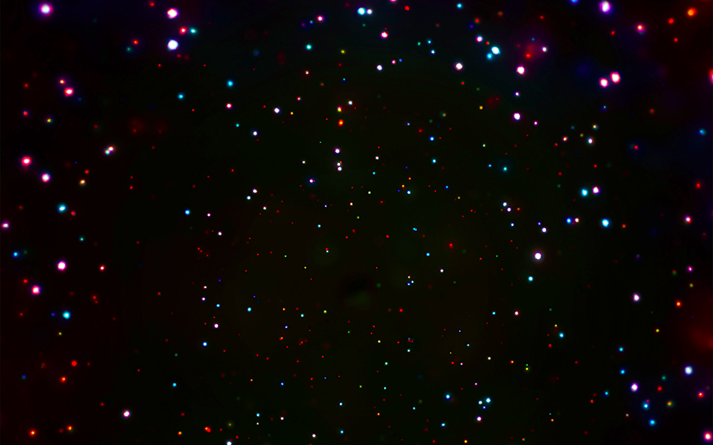
SMBH evidence z=0-4
CDFS: Luo+17

Slide 7
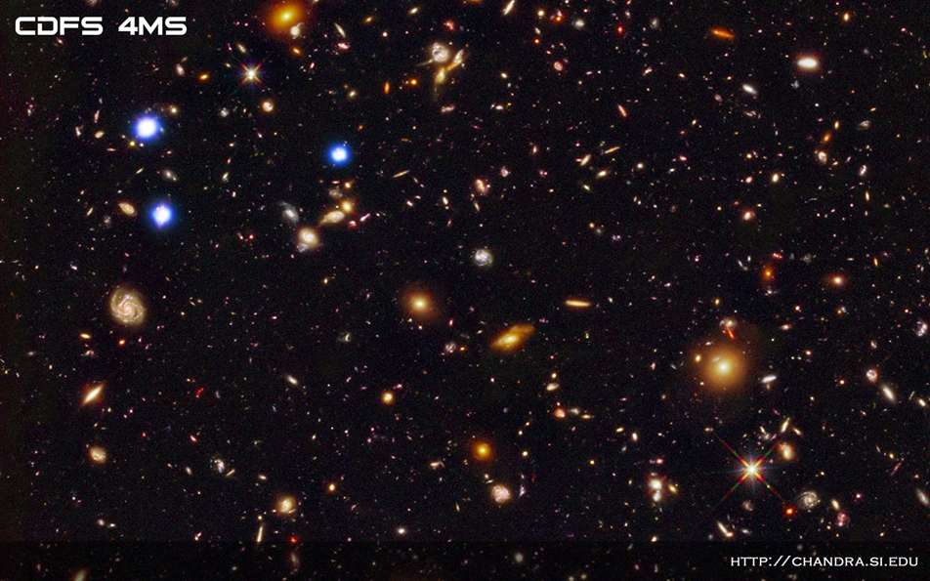
SMBH evidence z=0-4

Slide 8
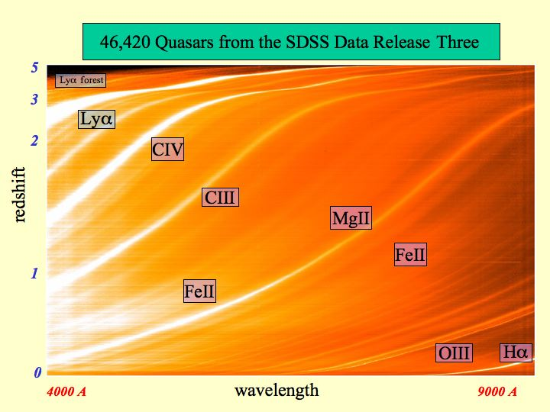
SMBH evidence z=6
Efficient z~6 detection with narrow filters around Lya
BHM measured with RM:
10⁶⁻¹⁰ M_{o}
X. Fan, SDSS

Slide 9
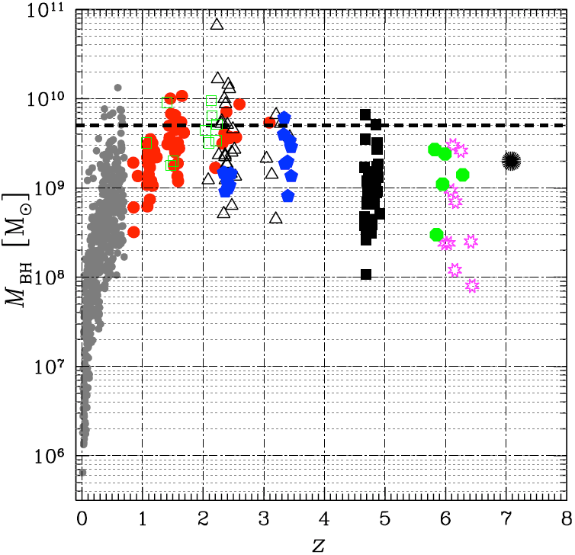
Black hole masses known
(Marziani & Sulentic, 2012)

Slide 10
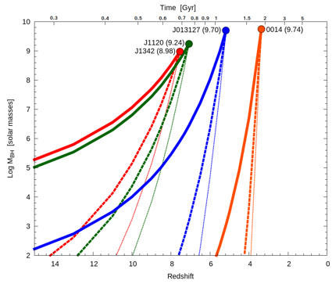
Timely growth
Eddington-rate limit
L_{edd}=10³⁸ M/M_{O} erg/s
exponential growth
Open questions:
  Is it a relevant limit?
  Is the gas supply there?
Campitiello+18

Slide 11
Open questions
How did they get here? (seed mechanism)
Can we find unevolved seeds?
  In merger-free dwarf galaxies? Difficult!
    Sphere of influence 10⁵M_{o} at 10 Mpc ~ 0.01’’ (<HST)
    Ha widths ~ SN
    Low X-ray emission give selection biases
How do they evolve? (accretion, mergers)
Co-evolution with galaxies? (feedback)

Slide 12
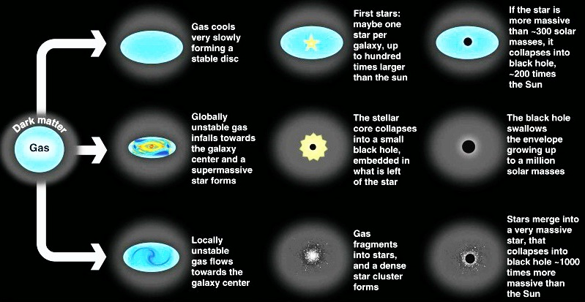
Theoretical models
Pop-III
DCBH
Cluster core collapse
Volonteri 2012, Rees 1978

Slide 13
Question here
How many SMBH are minimally required by observations?
How does the population evolve over time?
  Does the environment trigger AGN activity?
  What happens in galaxy mergers?

Slide 14
LCDM: Hierarchical collapse
EAGLE simulation

Slide 15
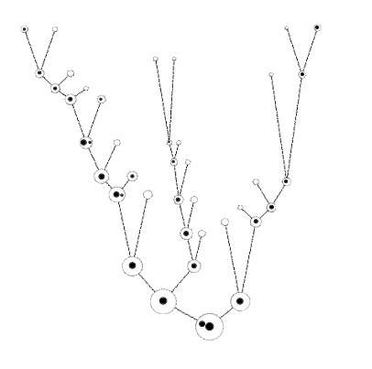
Motivation
Local galaxies host SMBHs
Built from many small halos
How does the seeding process need to behave?
Insights independent of specific seeding model
credit: M. Volonteri

Slide 16
Assumptions
Halos are born and grow
At some threshold mass M_{c}: chance p for seeding success
Can approximate physical seeding mechanisms
Does not need assumptions of
- seed black hole mass
- accretion
- feedback
see also Menou+01

Slide 17
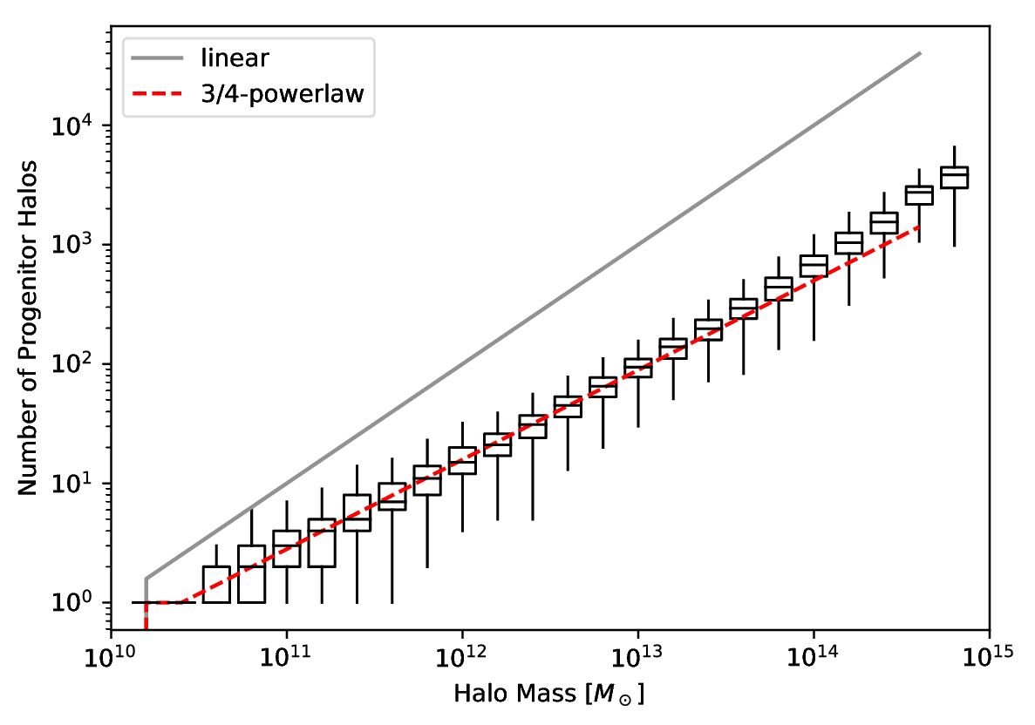
Building blocks
Count leaves of merger tree
z=0 halo building blocks
of size
SMDPL dark-matter simulation
Rockstar subhalos
Planck cosmology

Slide 18
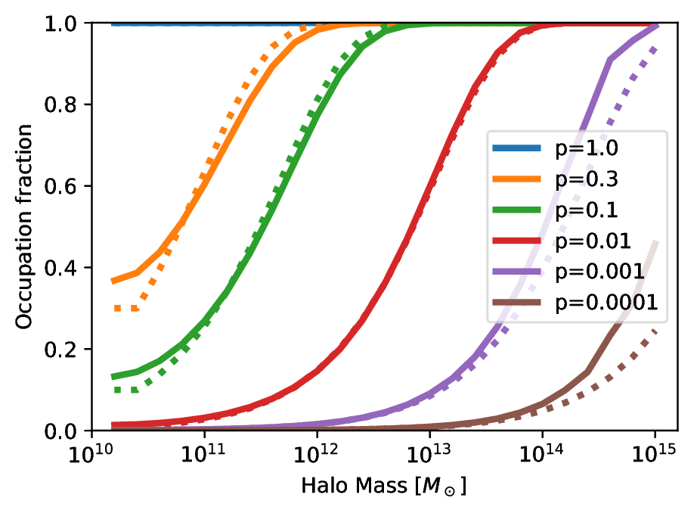
Occupation at z=0

Slide 19
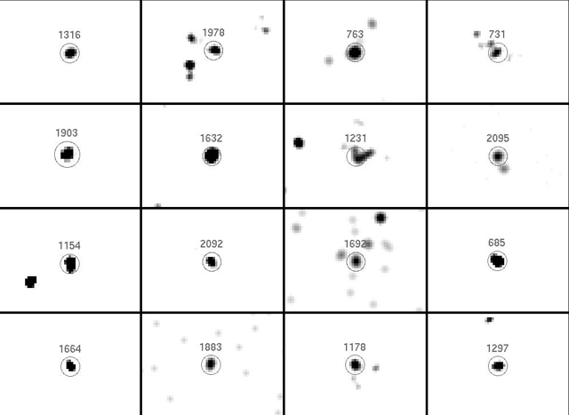
Occupation Observations
Gallo+10, Miller+15
AMUSE-Virgo

Slide 20
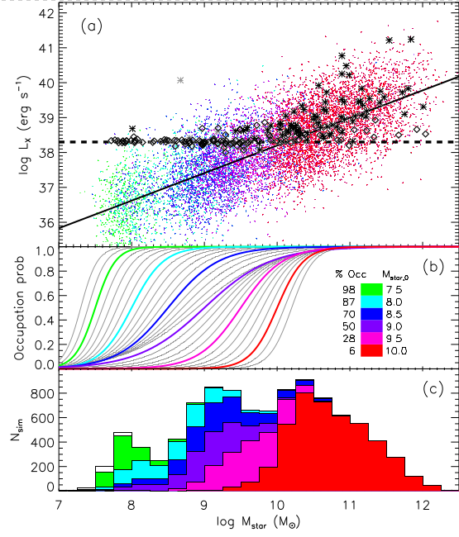
Occupation Observations
Gallo+10, Miller+15
AMUSE-Virgo

Slide 21
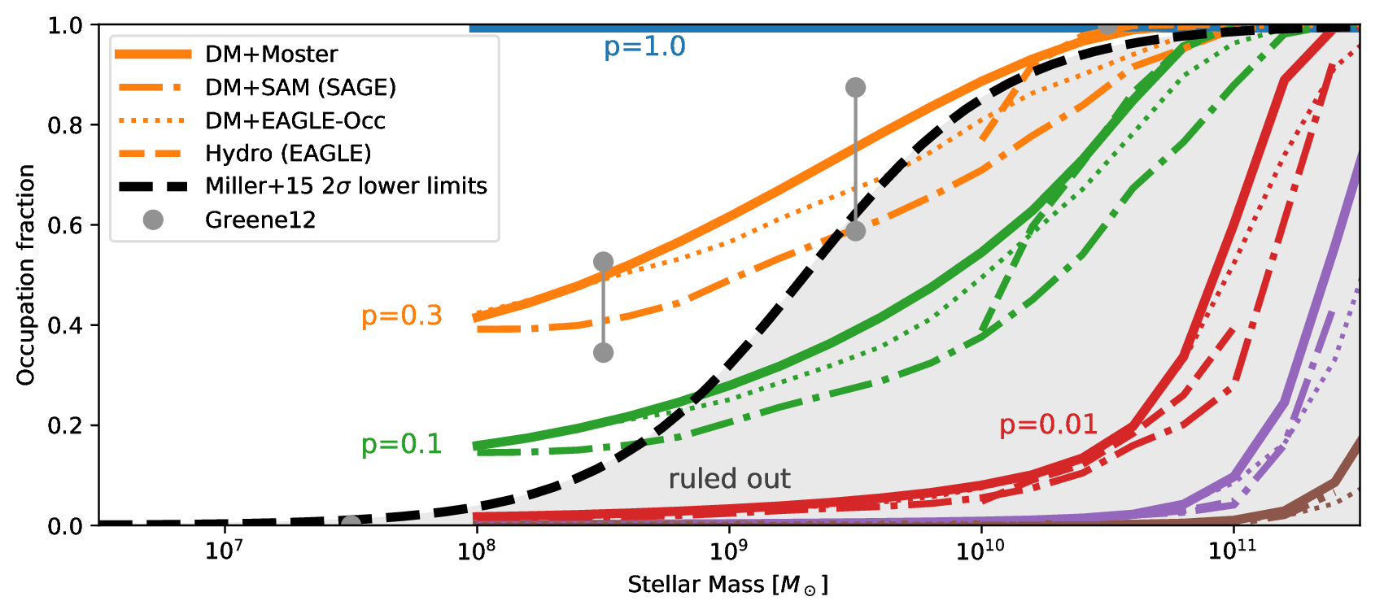
Occupation at z=0
Buchner et al. (in prep)

Slide 22
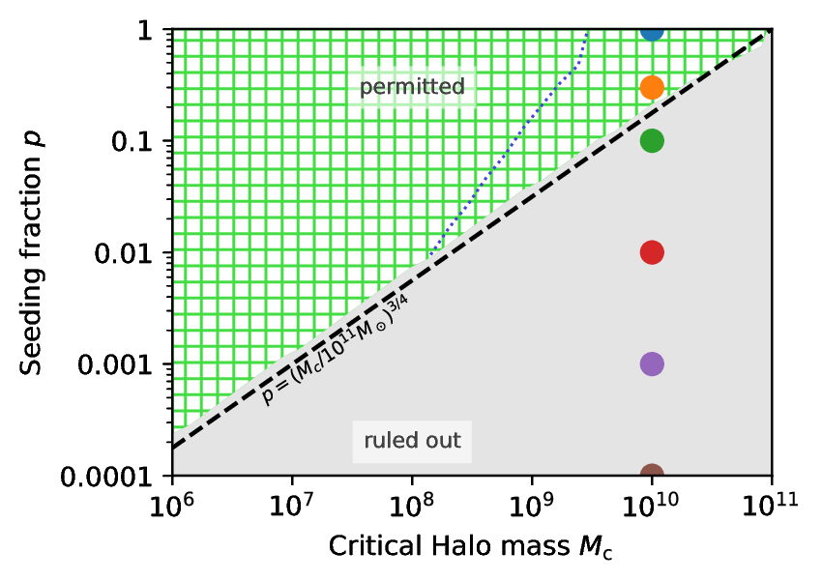
Required Seeding Efficiency
Buchner et al. (in prep)

Slide 23
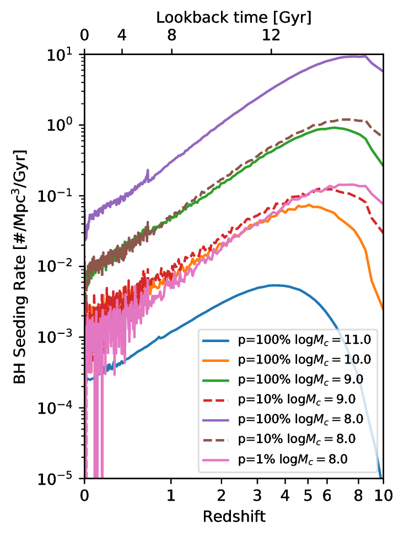
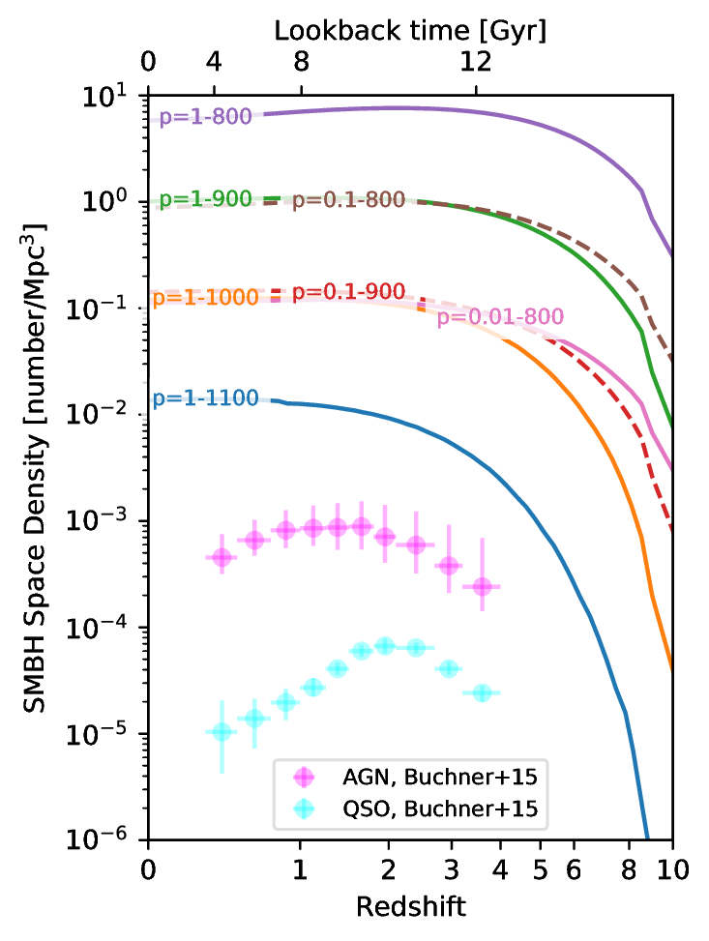
Population Evolution
BH births
Total number

Slide 24
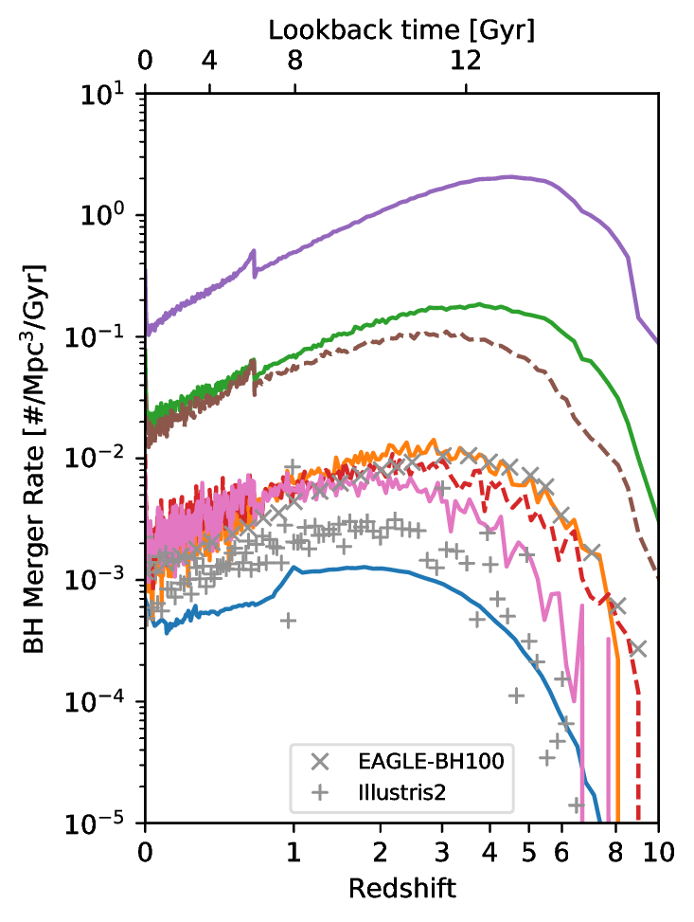
Population Evolution
BH births
BH host mergers

Slide 25
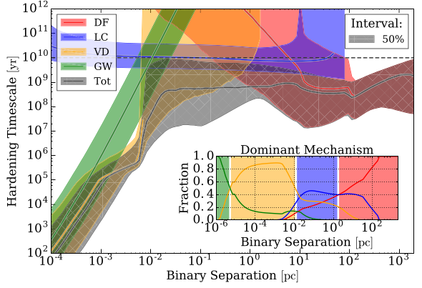
SMBH merger delays
Kelley+17
Dynamical friction, Light cone scattering, Viscous drag, Gravitational waves

Slide 26
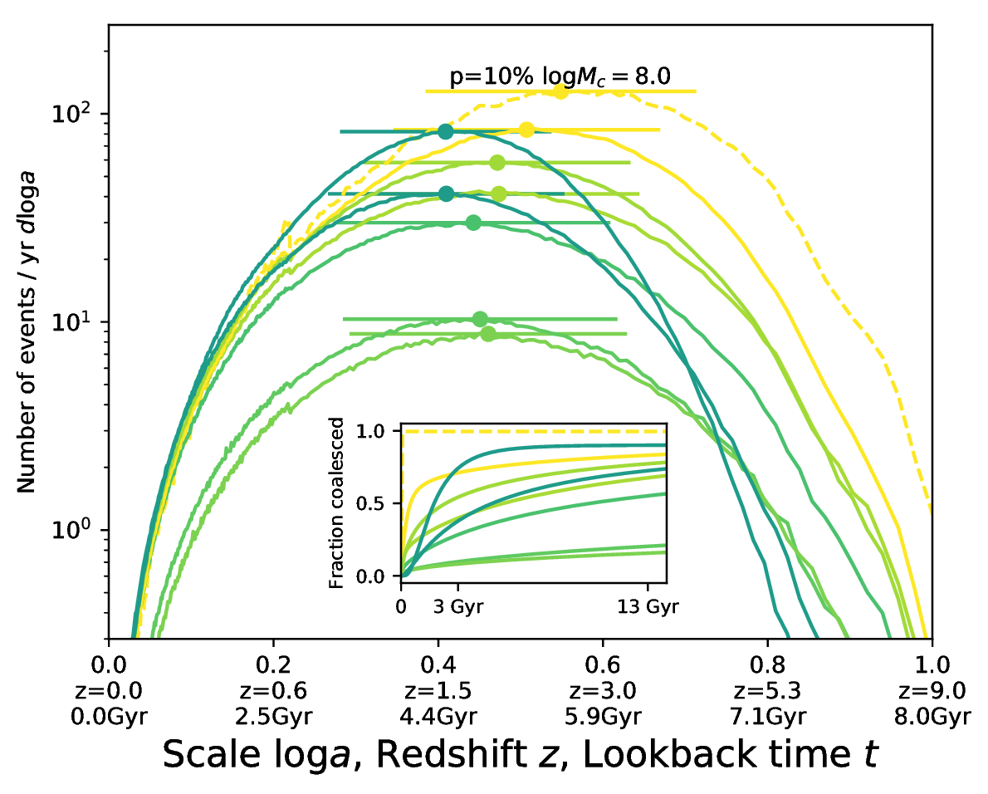
SMBH merger delays
Kelley+17

Slide 27
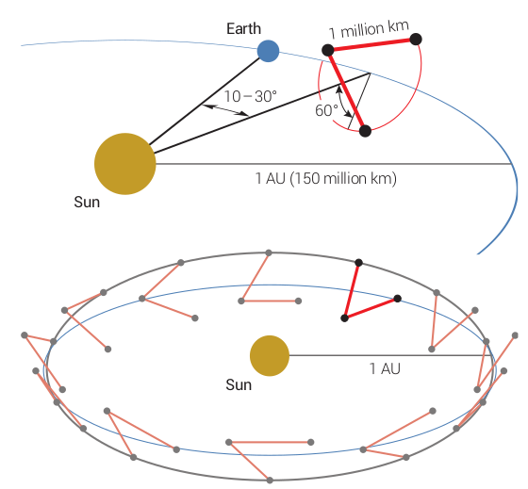
Gravitational Waves with eLISA
Interferometry with 2 arms
10⁴⁻⁸ M_{o}
z=0-13
Distance -> z
Signal duration -> Doppler shift localisation

Slide 28
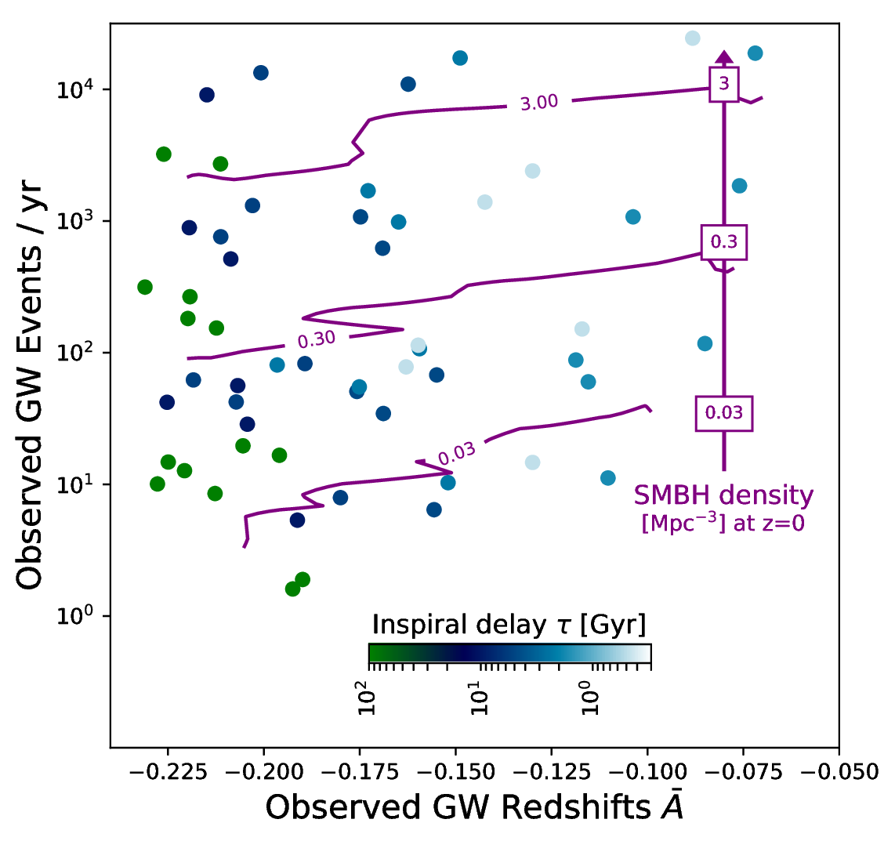
eLISA Gravitational Wave Events
Buchner et al. (in prep)
All SMBH mergers will be detected
(Salcido+16, EAGLE sim + waveshape modelling)
Combination of z mean and std

Slide 29
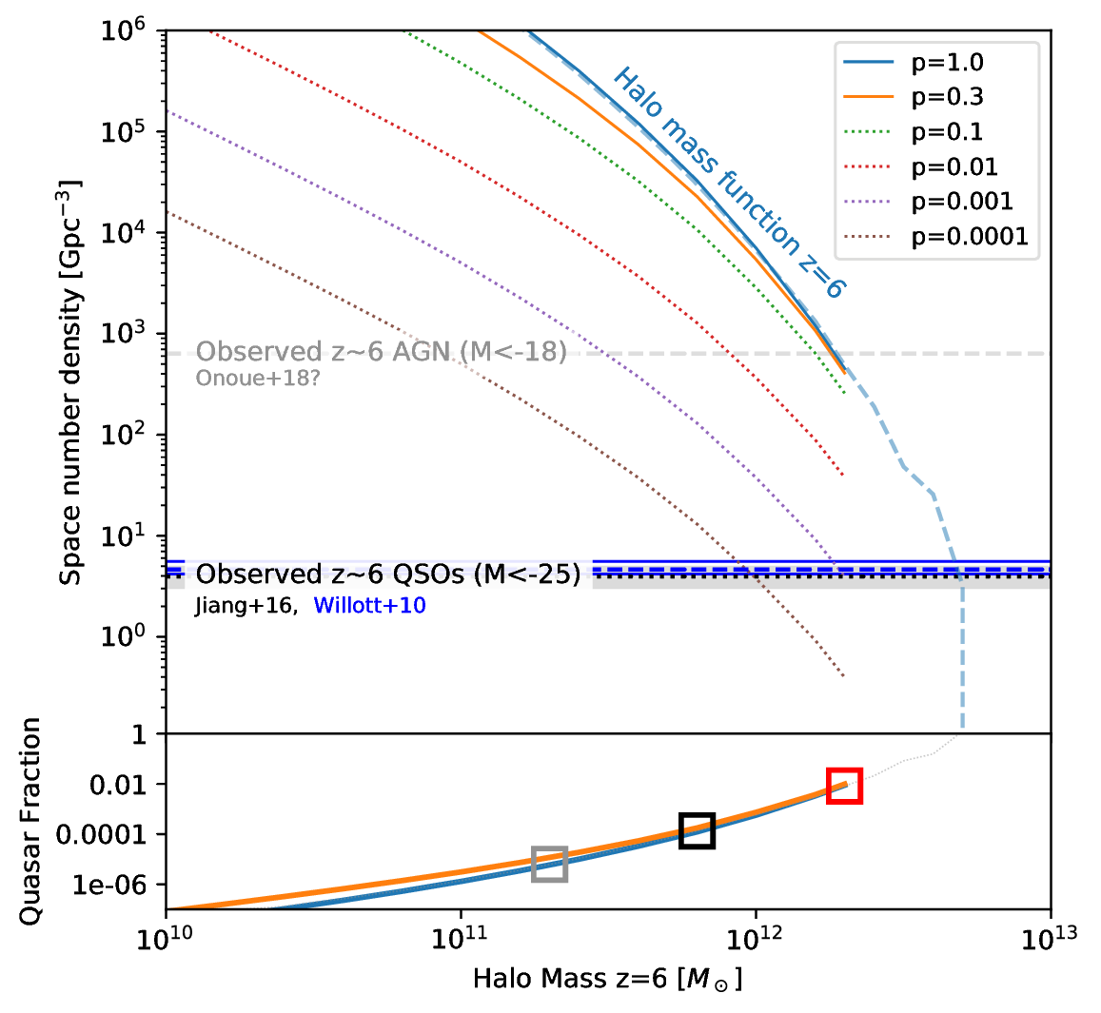
High-redshift quasars
z=6 QSO surveys (SDSS)
Earliest census of active SMBH population
There are more SMBHs
Live in massive halos?
Massive halos or duty cycle?

Slide 30
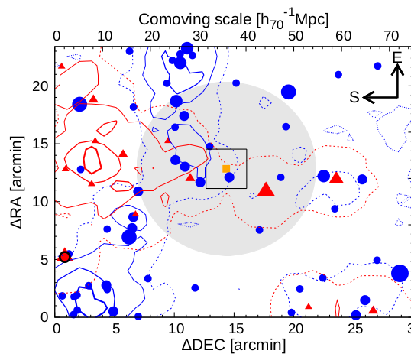
Overdensities near Quasars
LBG
Literature has conflicting results:
- Overdensities
- Equal
- Underdensities
compared to control fields
What is happening?
LAE
QSO
Ota+18

Slide 31
Overdensity predictions
QSO Hosts definition:
  Halo mass cut, e.g.:
  only >10^{12.3}M_{O}
Look at neighbourhood
Galaxies definition:
  LBG: Hatfield+17
  LAE: Kovač+07, Sobacchi&Mesinger+15
  selection as in observations (redshift window, magnitude)
Simply count galaxies within radial shells around quasar

Slide 32
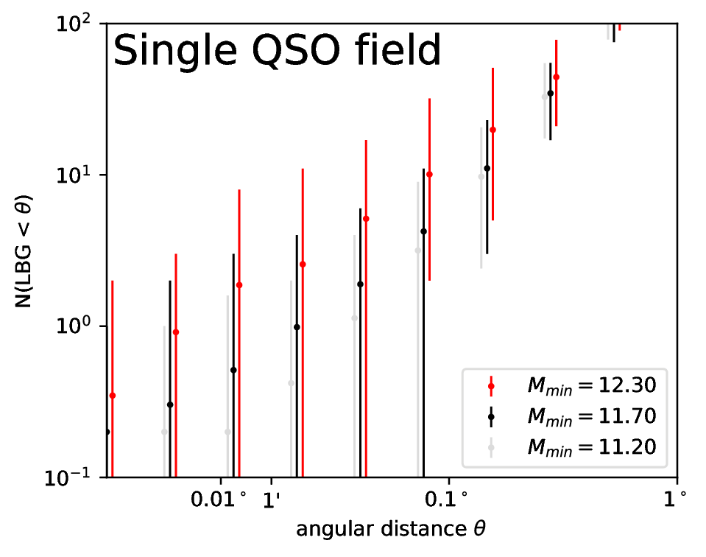
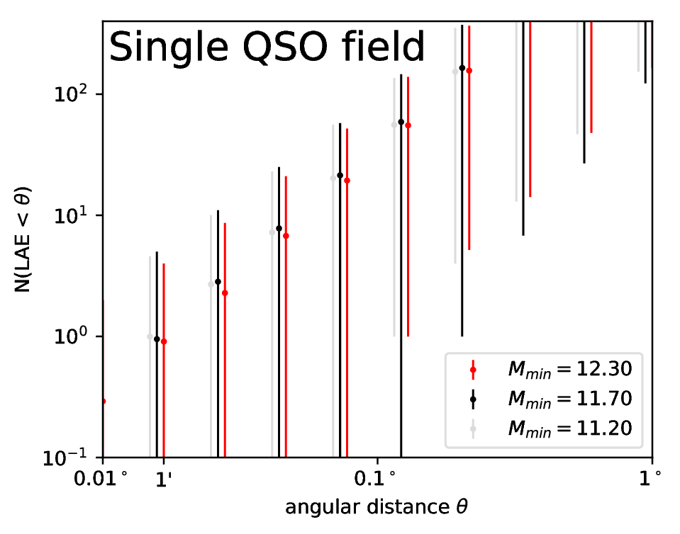
Understanding high-z quasars
LBG
LAE
Large diversity!
Large volume in z!
Large diversity!
Poisson noise!

Slide 33
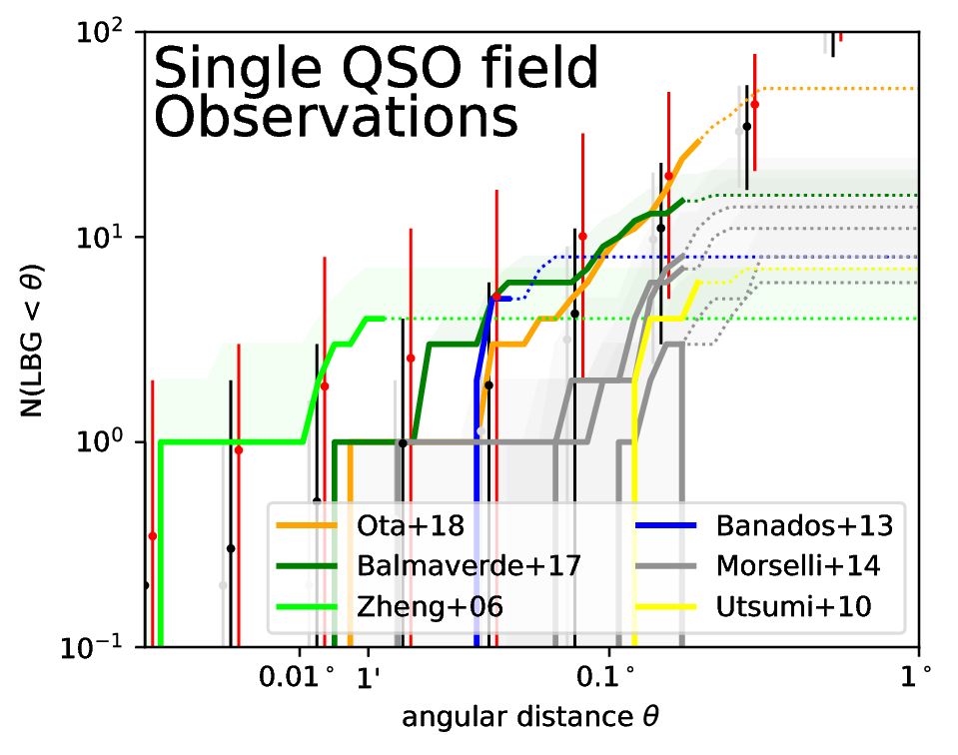
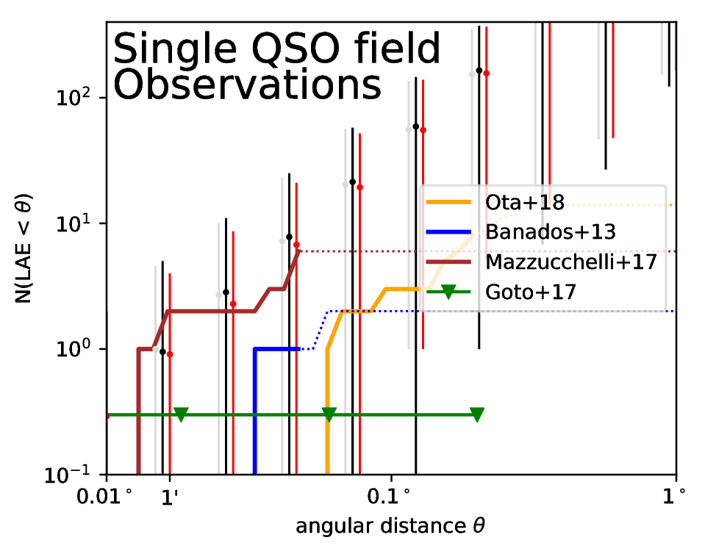
Understanding high-z quasars
LBG
LAE
Buchner et al. (in prep)

Slide 34
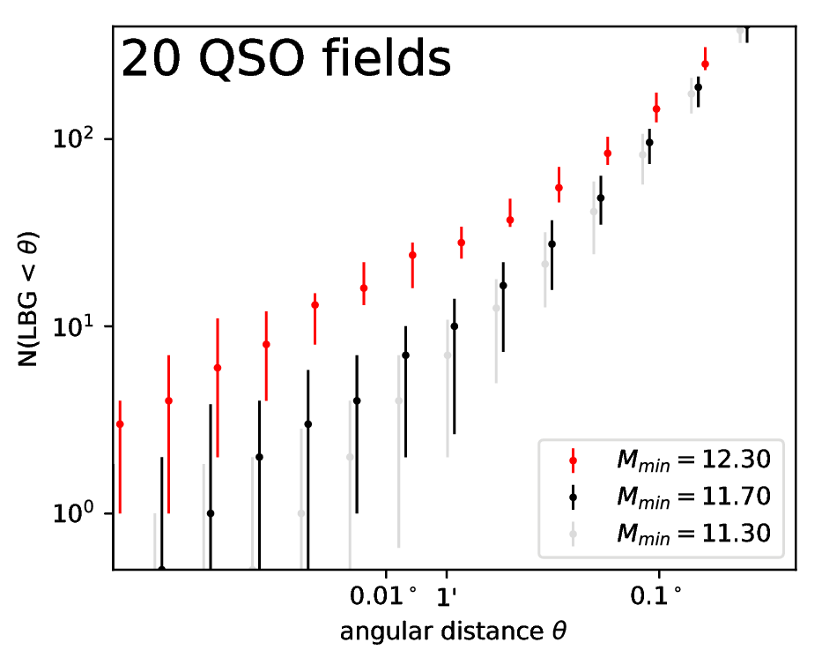
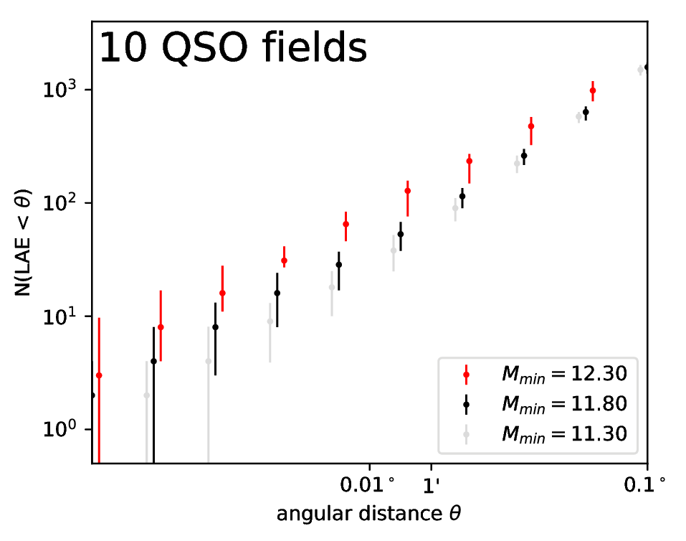
Understanding high-z quasars
LBG
LAE

Slide 35
Model-independent seeding
Seeding efficiency
eLISA will directly
  Detect >1 merger/year
  Measure the SMBH space density
  Measure the merger delay time
High-z Quasar host environments are diverse
  Observe many(ten) fields
see Buchner et al. (in prep)

