Slide 1

Exploring the AGN obscurer geometry with
NuSTAR Compton humps
Johannes Buchner
FONDECYT fellow
http://astrost.at/istics/
Collaborators:
M. Brightman, M. Baloković, F.E. Bauer, K. Nandra, K. Wada

Slide 2
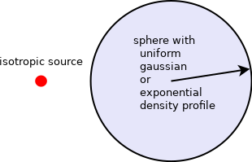
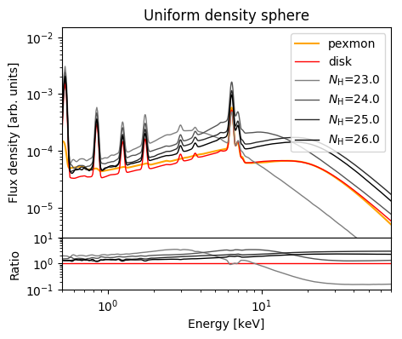
Compton Hump Primer
N_{H}
Compton-hump contains imprints of geometry and density of reflector
Also: Nandra&George (1994)

Slide 3
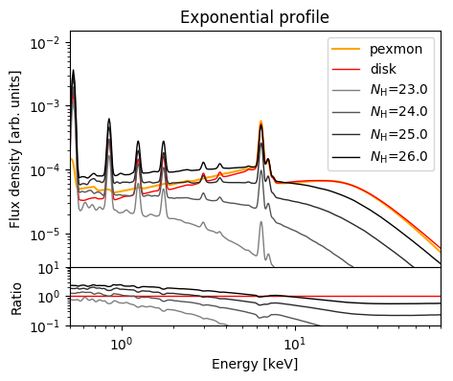
Compton Hump Primer

Slide 4
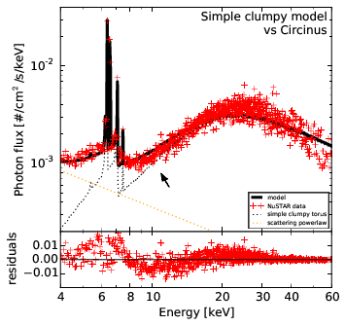
The problem

Slide 5
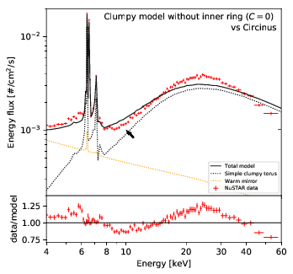
The problem

Slide 6
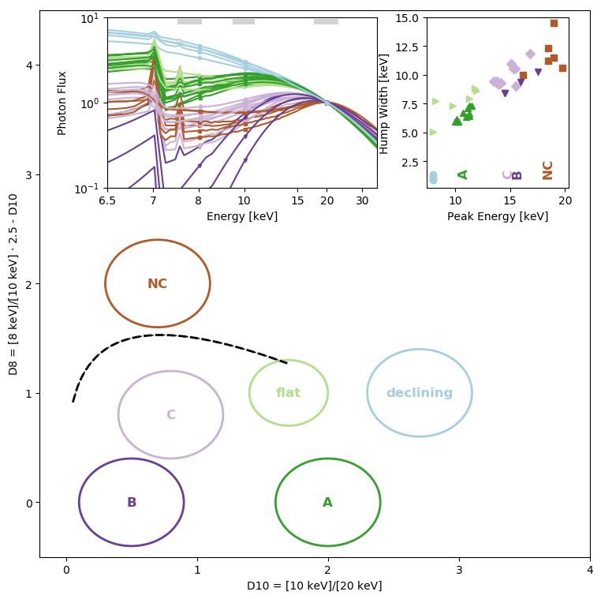
X-ray color-color diagram
Shape of the Compton hump
High-energy
Plane where
models and
observations
can meet
8/10keV
10/20
keV

Slide 7
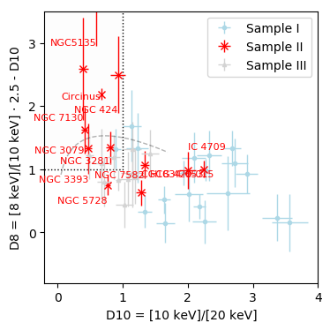
NuSTAR Observations
Below X-MIR correlation
Some interesting sources
Compton-thick candidates from previous studies
(Swift/BAT sample, Balokovic et al., in prep.)

Slide 8
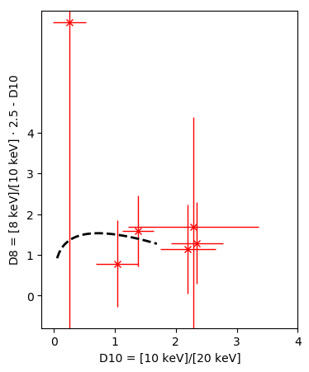
CDFS Observations

Slide 9
What is the point?
Can we find a model geometry for each?
Can a single geometry explain most? (Unification)
Any model space not used by nature?
Quick way to check new models
Model-independent characterisation of sources
3pts!

Slide 10
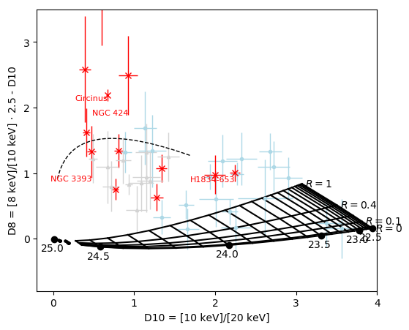
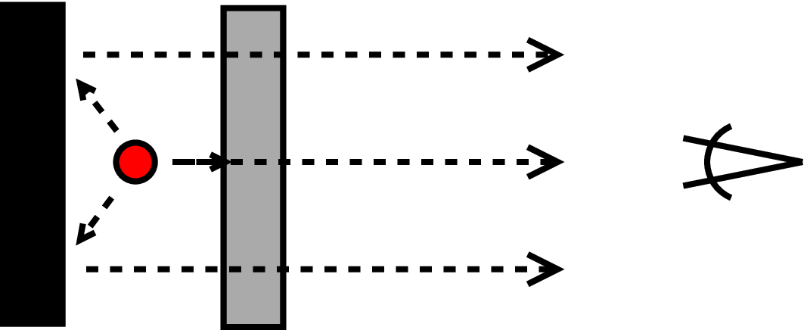
Absorbed system
Lessons learned:
No 4pi obscured sources?

Slide 11
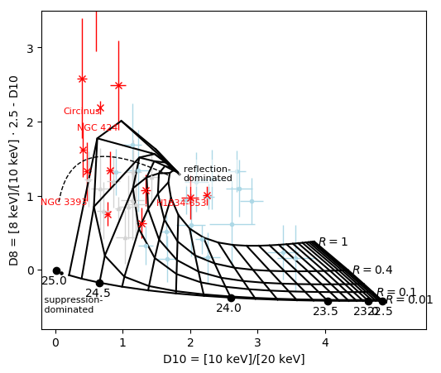
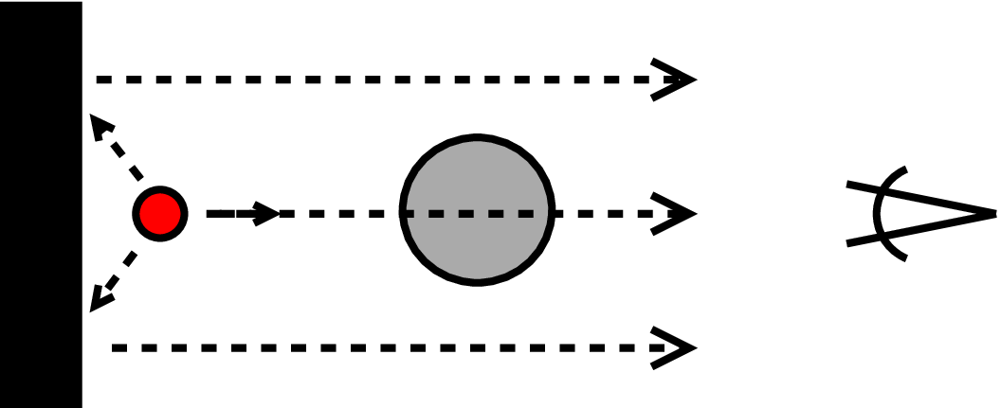
Unobstructed view to cold mirror
Lessons learned:
Reflection dominated sources
Fair overlap

Slide 12
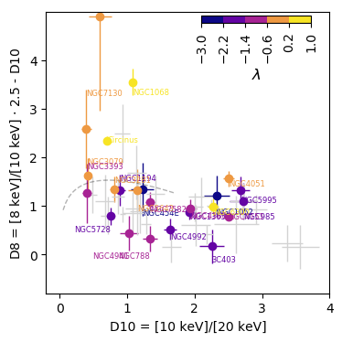
Eddington ratio
Lessons learned:

Slide 13
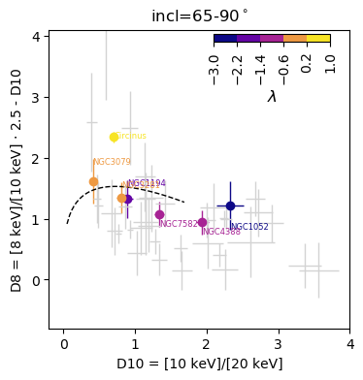
Edge-on
Lessons learned:

Slide 14
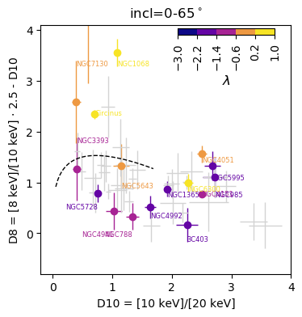
Face-on
Lessons learned:

Slide 15
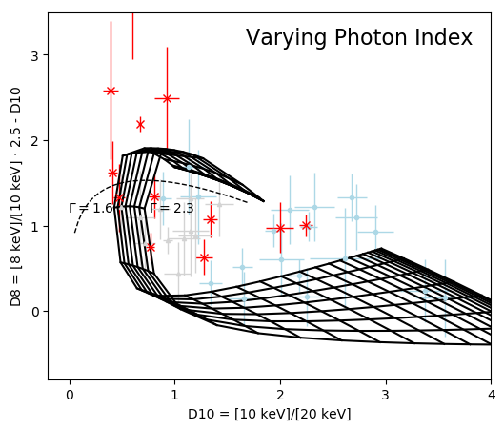
Impact of Photon Index
Lessons learned:
Small impact

Slide 16
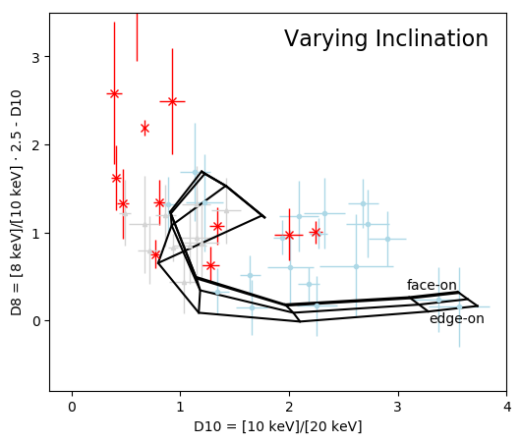
Impact of Inclination
Lessons learned:
Small impact

Slide 17
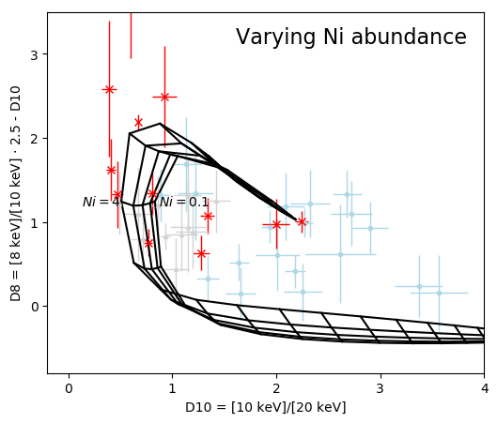
Impact of Ni/Fe ratio
Lessons learned:
Small impact

Slide 18
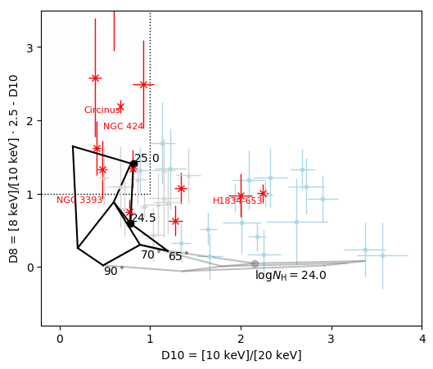
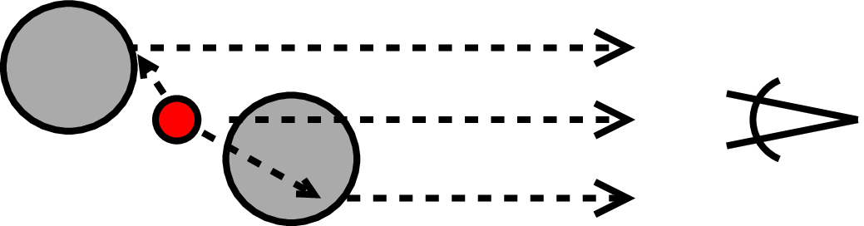
Smooth torus
Murphy & Yaqoob (2009)

Slide 19
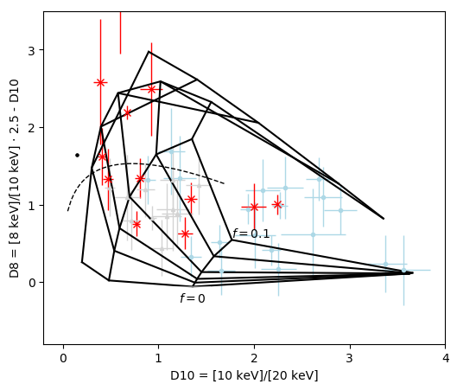
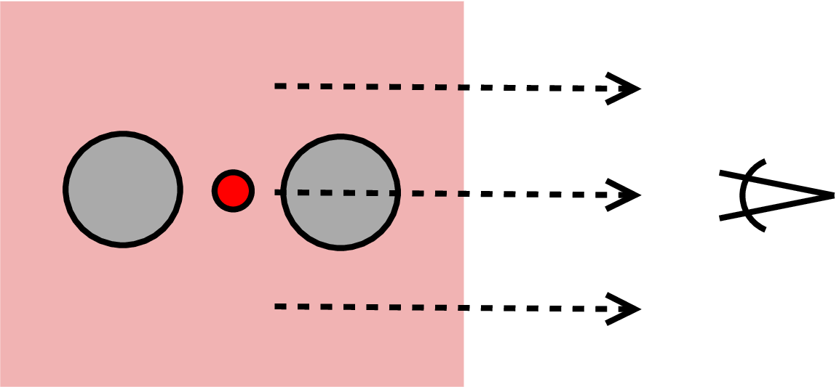
Smooth torus + warm mirror

Slide 20
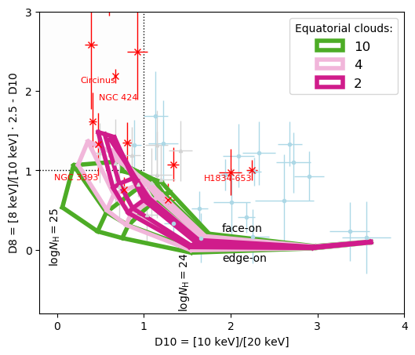
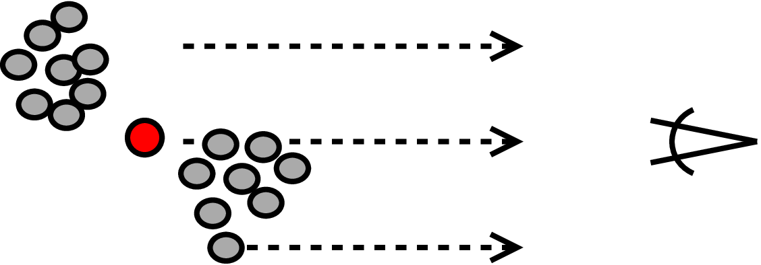
Clumpy torus
Liu&Li (2014)
Lessons learned:
Low number of clouds preferred
logN_{H}>25 reflectors needed (!)

Slide 21
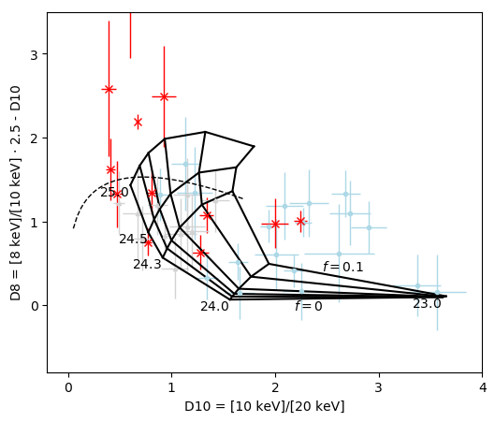
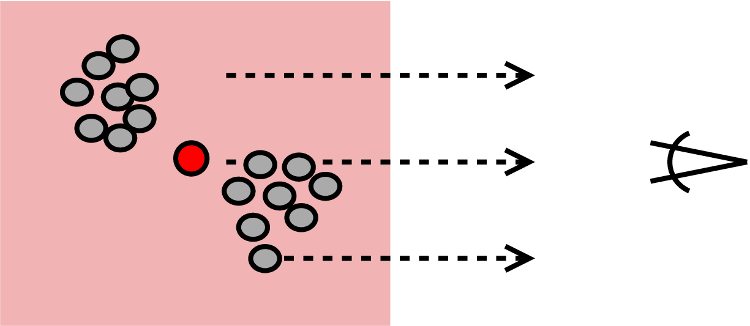
Clumpy torus
Liu&Li (2014)
Lessons learned:
Low number of clouds preferred
logN_{H}>25 reflectors needed (!)

Slide 22
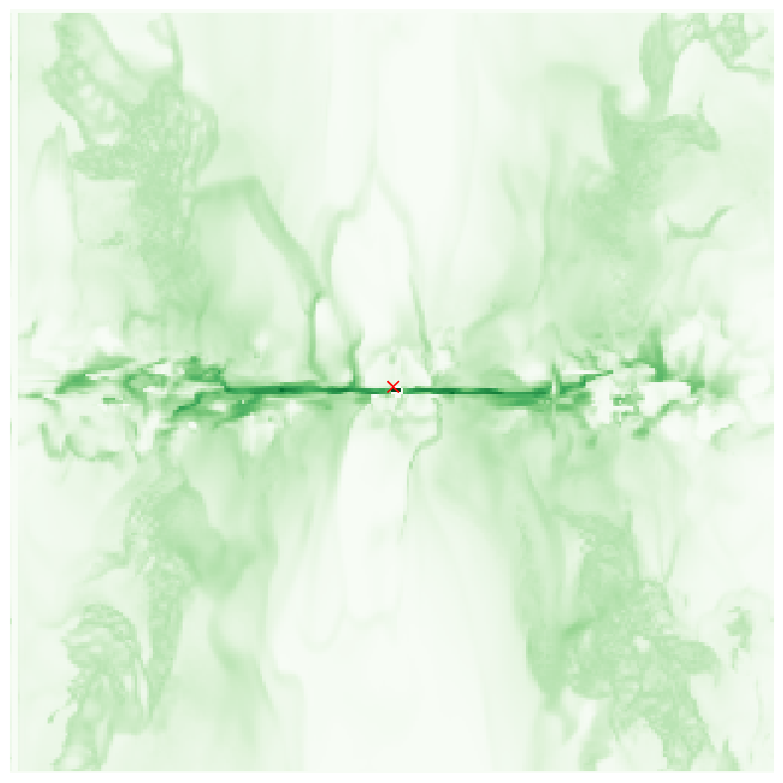
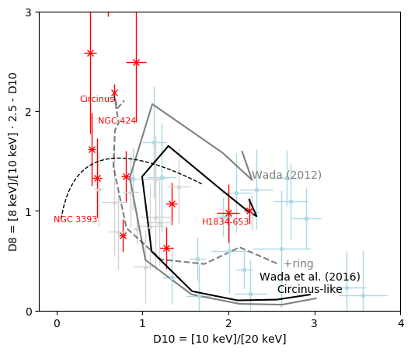
Radiative fountain
Lessons learned:
Physically motivated
Polar Compton-thin gas contaminates

Slide 23
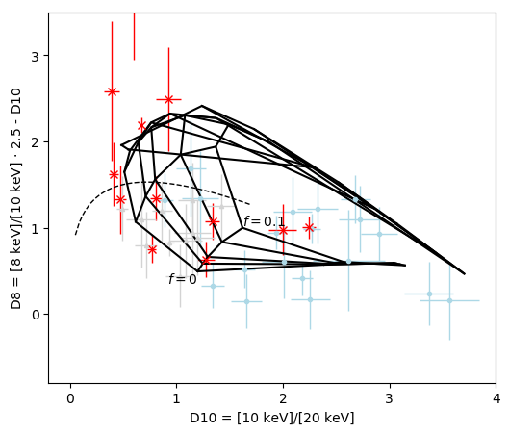
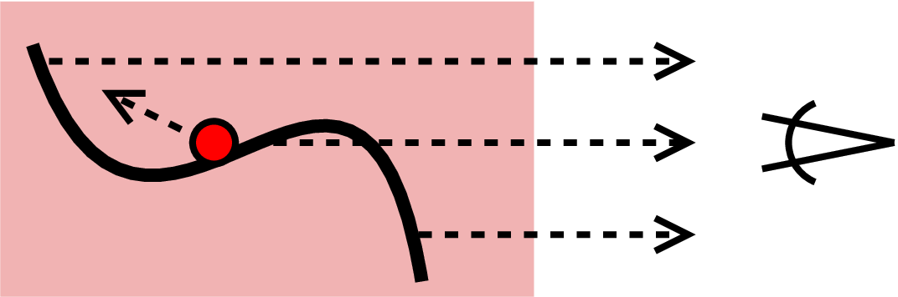
Warped disk + warm mirror
Lessons learned:
Reproduces left outline
Physically motivated
Best spectral fit to Circinus

Slide 24
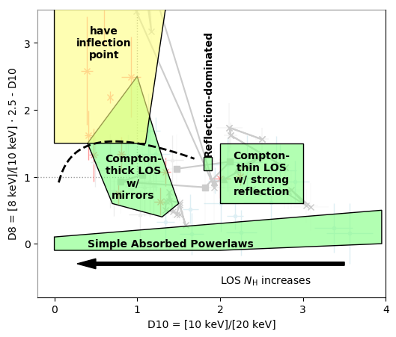
Properties of the diagram
X-ray color-color diagram
Observations:
  Mission-independent
  Model-independent
  classification
Geometries:
  Quick check if covers observations
Need more models at bottom right quarter

Slide 25
Directions for future models
In CTK sources, last scattering surface can be constrained:
  Large-covering
  Non-clumpy
  logN_{H}>25 (!)
  low-N_{H} reflectors absent
Physically motivated models:
  Radiative fountain
  Warped disk – good fits

Slide 26
Things to look forward to in 2018
XARS
  X-ray Absorption Re-emission Scattering
  Python, open-source
  Arbitrary user-defined geometries
  Uniform Spheres (100000)
  Arbitrary uniform density grid
New models:
  Radiative fountain model
  Warped disk
  UXCLUMPY

Slide 27
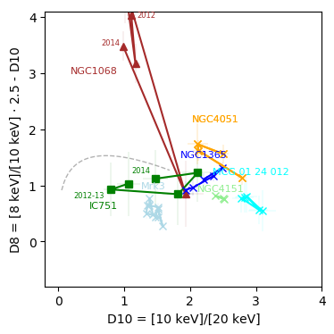
Changing Look sources
Models should reproduce these without grave changes in the geometry
NGC1068!

Slide 28
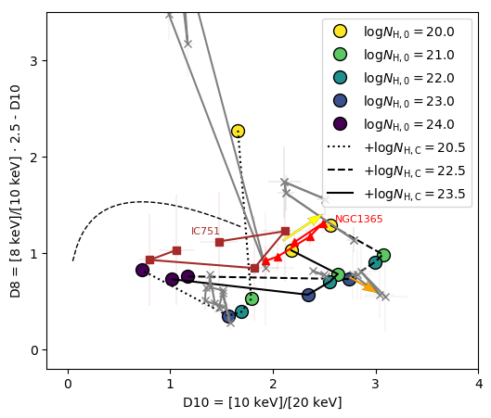
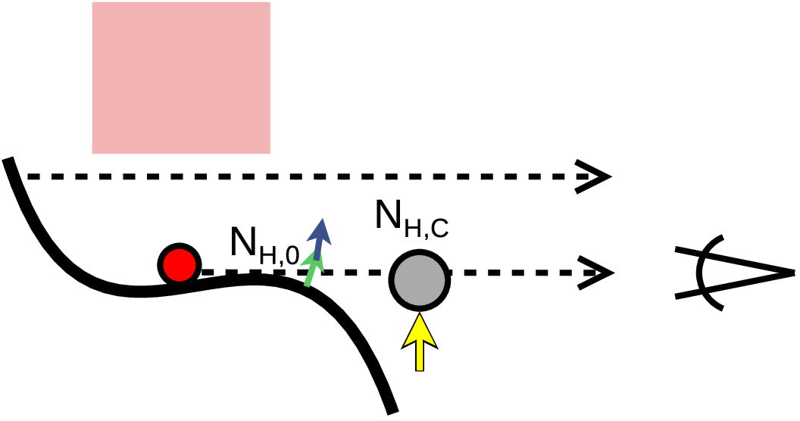
Changing looks at models

Slide 29
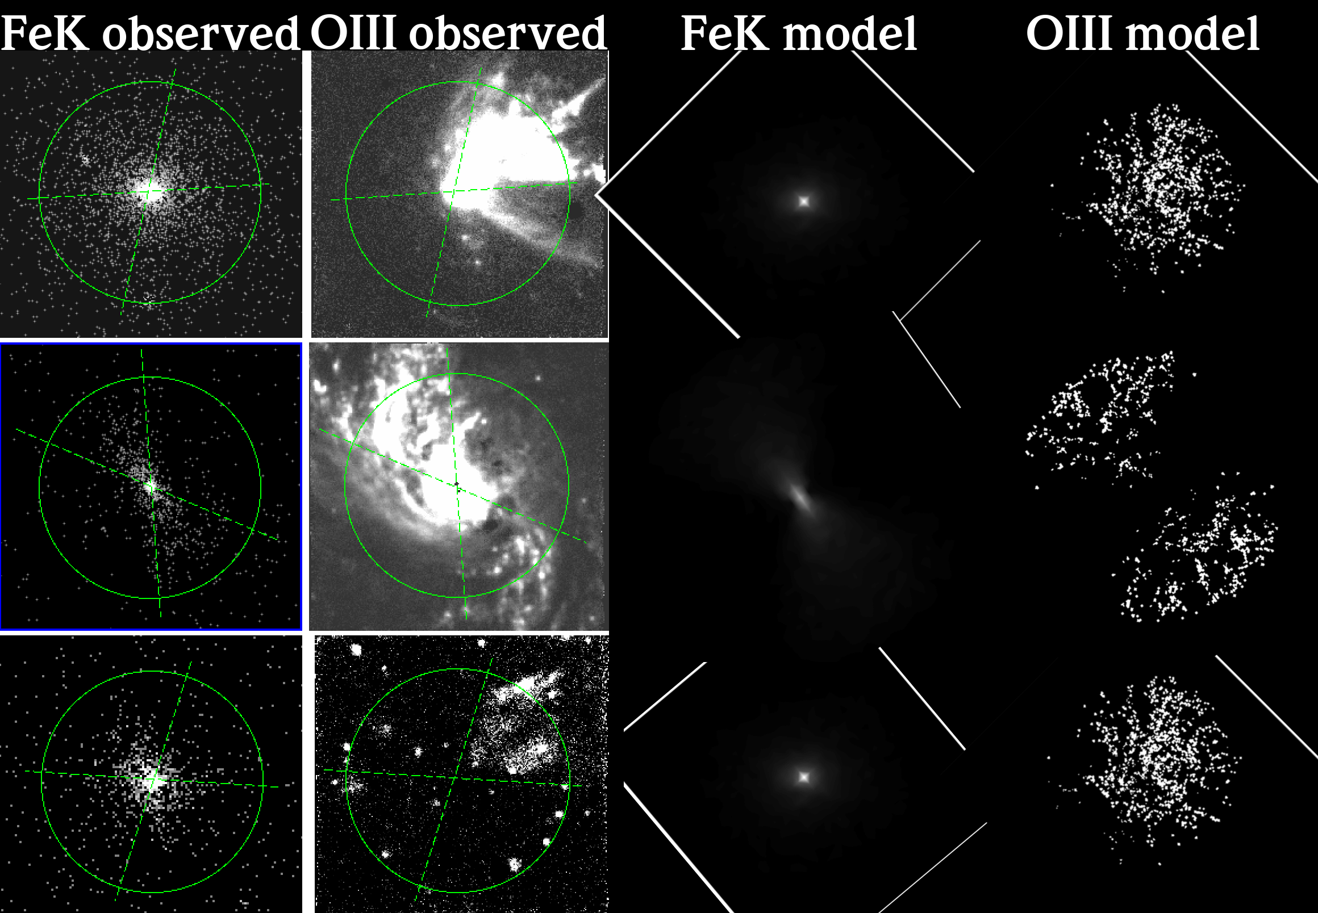
The need for new models
Eclipse events
Unification
UXCLUMPY

