Slide 1
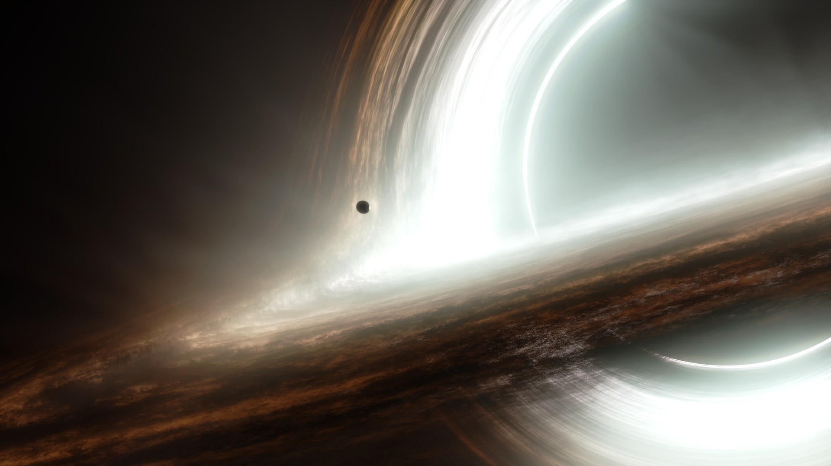

Spectral fitting methods & BXA
Johannes Buchner
astrost.at/istics
Max Planck Institute for extraterrestrial Physics

Slide 2
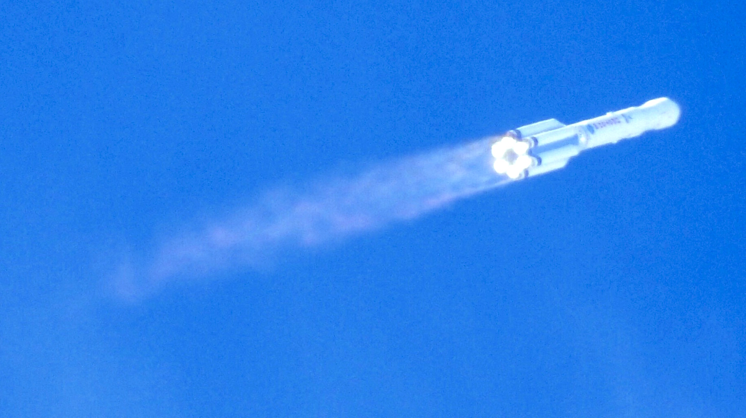
eROSITA on SRG
Launch 13.07.2019

Slide 3
eROSITA on SRG

Slide 4
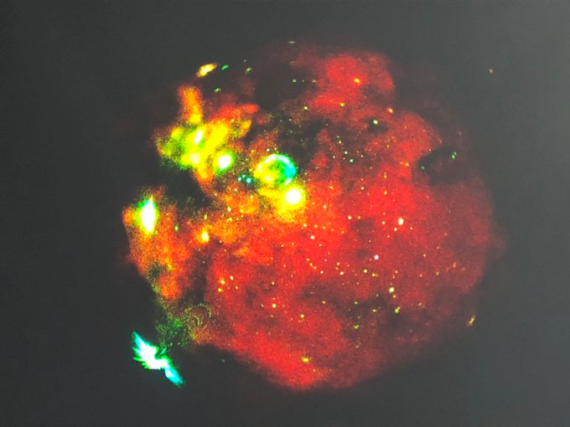

Slide 5
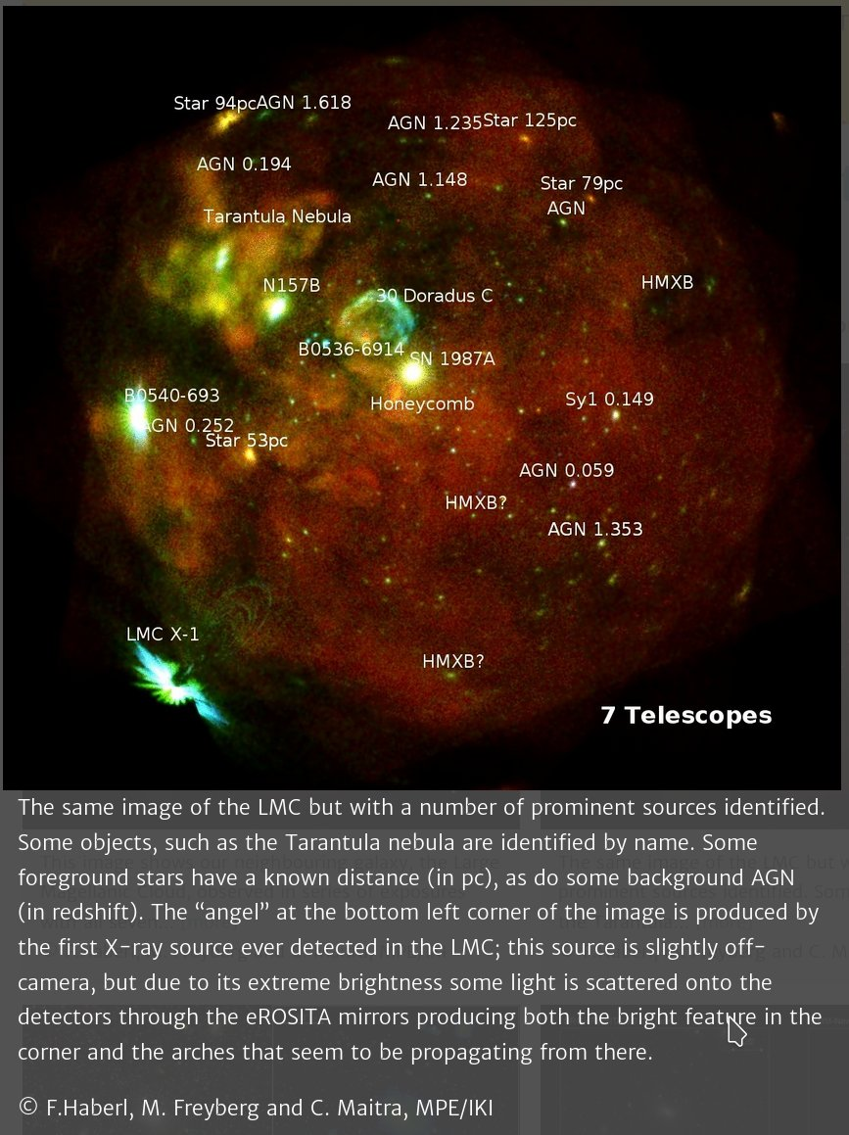
F. Haberl, M. Freyberg, C. Maitra MPE/IKI

Slide 6
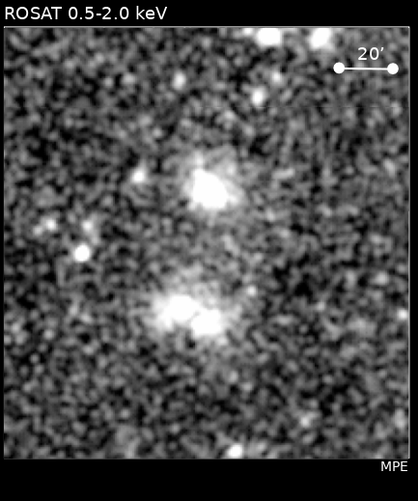
Energy range & resolution@6keV | 0.2-10keV 130eV
Angular resolution HEW@1.5keV | <15’’ on axis, 20’’ on average
Field of View All-sky scans | 0.833 deg² Every 6 months 8 times
Soft flux limit Hard flux limit | 1e-14 erg/s/cm² 1e-13 erg/s/cm²
Data access eROSITA_DE | 2y proprietary; ext. collaborator
https://arxiv.org/abs/1209.3114

Slide 7
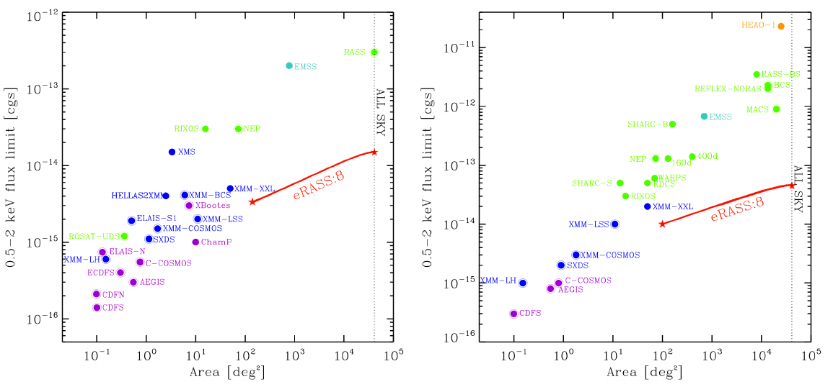
Survey grasp
https://arxiv.org/abs/1209.3114

Slide 8
Spectral fitting methods
Workshop at the
Max Planck Institute for extraterrestrial Physics
24-25.09.2019
organised by
Johannes Buchner, J Michael Burgess, Joern Wilms

Slide 9
Spectral fitting methods
Johannes Buchner, J Michael Burgess, Joern Wilms, Konrad Dennerl, Jeremy Sanders
Linear data model
Statistics – Poisson vs Gaussian
Background handling
Parameter space exploration methods
Model comparison methods
Information stacking
Imaging spectroscopy
Calibration
https://tinyurl.com/xrayspectra

Slide 10
Spectral fitting methods
Johannes Buchner, J Michael Burgess, Joern Wilms, Konrad Dennerl, Jeremy Sanders
Linear data model
Statistics – Poisson vs Gaussian
Background handling
Parameter space exploration methods
Model comparison methods
Information stacking
Imaging spectroscopy
Calibration
https://tinyurl.com/xrayspectra

Slide 11

Parameter space exploration

Slide 12
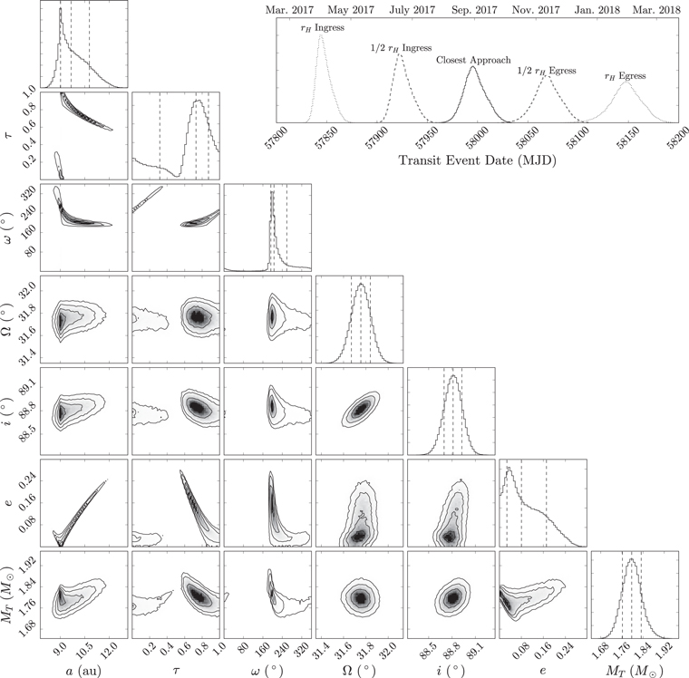
Parameter space exploration
Local optimization
  LM, simplex, … (many)
  Monte carlo optimization
Global optimization
  Genetic algorithms (DE)
Local sampling: MCMC
  Tempering
  Limitations
Global sampling
  Nested sampling

Slide 13
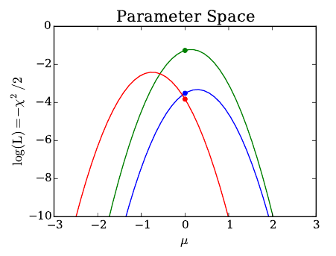
Best fit parameters
If away from boundary
If model is linear
If ndata → high
If θ is true parameter
→ then
(symmetric, single gauss)
If many data are created under θ
logL interval -1 below best fit
Contains true value 68% of realisations
Confidence interval
What was the question again?
Are conditions fulfilled?
What do unequal “errors” mean?

Slide 14
Best fit distributions
L
Convolution of
True parameter distribution +
Measurement error & analysis method
Confidence intervals
Histogram of best fits
Cumulative distribution
Clean solution:
Model population distribution (HBM)
θ
Meaning?
Upper limits?
Buchner+17a

Slide 15
Bayesian posterior
L
L
Find regions with high probability mass
Density
Volume
Probability mass
θ
Idea: Sample parameter solutions proportionally to their probability
For example with a grid

Slide 16
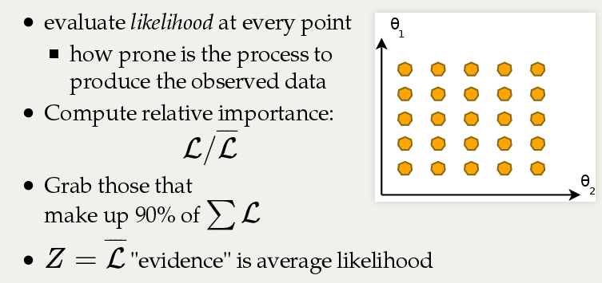
Posterior grid

Slide 17
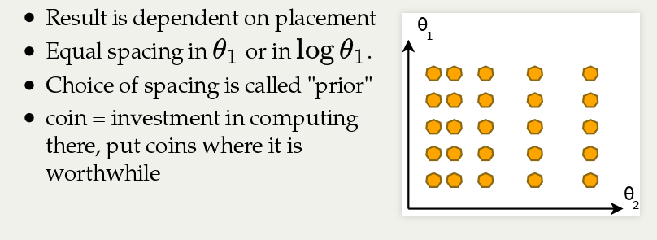
Posterior grid

Slide 18
Bayesian posterior
P
parameter solutions weighted by their probability
Credible intervals
Definitions:
Density → cumulative → quantiles
Highest Density Intervals
Borders (upper limits)
θ

Slide 19
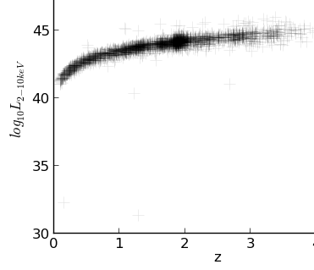
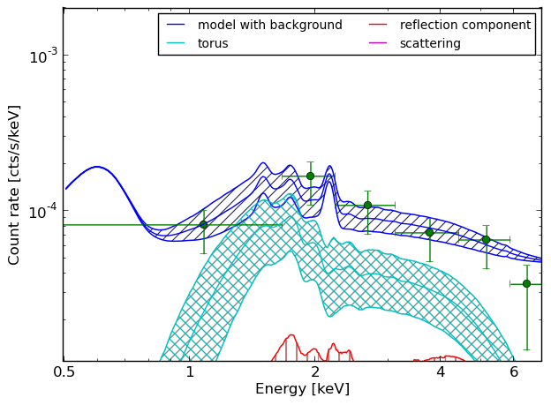
Using posterior chains
P
Posterior chain
  θ₁ θ₂ θ₃ ….
Find regions with high prob
Compute prob. of regions
Posterior predictions
Derived quantities
q₁₀ q₅₀ q₉₀
P
P(x>4)=
sample fraction
F, z → L, z

Slide 20

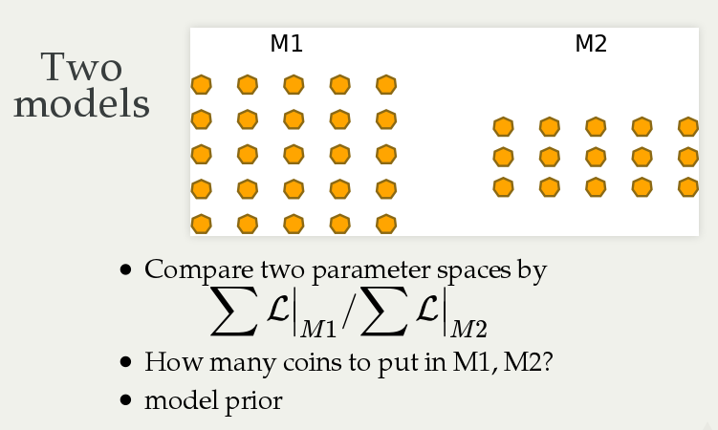

Slide 21
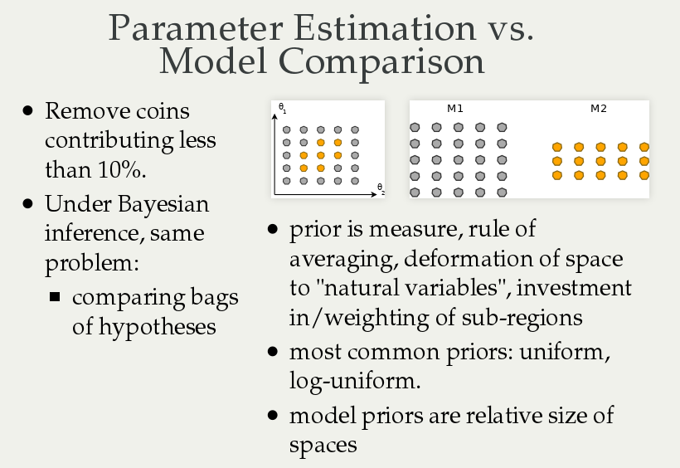

Slide 23
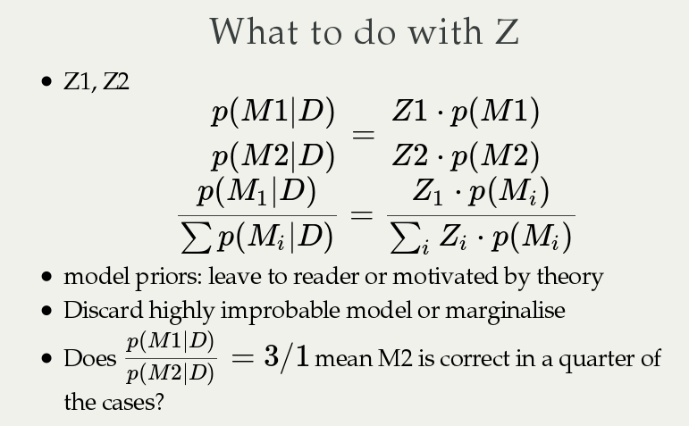
Posterior
odds ratio
Bayes
factor
Prior
odds ratio

Slide 24
Buchner+14

Slide 25
Punishing prediction diversity
(not number of parameters)
Flexible model
Inflexible model
Data
L high, V tiny
L medium, V medium

Slide 26
Model comparison
Buchner+14
Empirical models
  Information content
  Prediction quality
Component presence
  Regions of practical equivalence
Physical effects
  Bayesian model comparison
  Priors often well-justified
https://arxiv.org/abs/1506.02273
Betancourt (2015)

Slide 27
Information criteria
Akaike information criterion
Is more complex worth storing?
Akaike (1973)
AIC = 2 * d – 2 * L_{max}
AIC = 2 * d + CStat
Advantages:
- rooted in information theory
- independent of prior
Disadvantages:
- No uncertainties, thresholds unclear
- …

Slide 28
Nested sampling

Slide 29
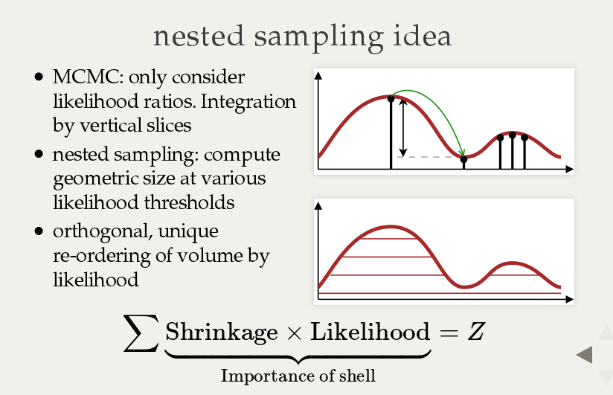

Slide 30
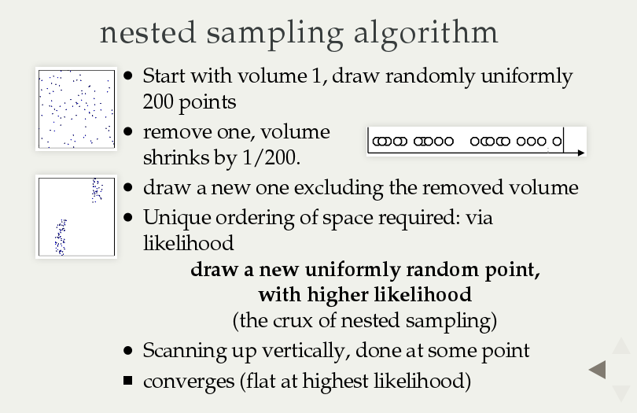

Slide 31
Missing ingredients
MCMC: Insert tuned transition kernel
NS: Insert constrained drawing algorithm
  General solutions: MultiNest, MCMC, HMCMC, Galilean, RadFriends, PolyChord

Slide 32
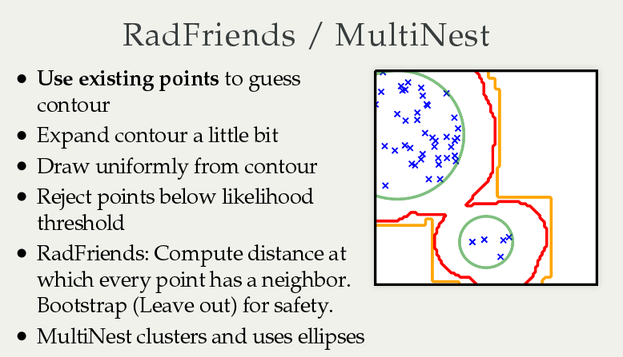
Animation:
https://johannesbuchner.github.io/mcmc-demo/app.html#RadFriends-NS,standard(via chi-feng.github.io)

Slide 34
Posterior
odds ratio
Bayes
factor
Prior
odds ratio

Slide 35
Buchner+14

Slide 36
Model comparison
Test model in isolation?
yes
PPC
Parametric bootstrap
no, relative
Compare physical models or
empirical descriptions?
empirical
Information content (AIC)
Prediction quality (Cross validation)
physical effects
Additive component
yes
Parameter estimation
Region of equivalence
Bayesian model comparison
no
Bayesian model comparison

Slide 37
Spectra with few counts

Slide 38
Spectra with few counts
Are nothing special
Poisson likelihood + good background handling
0 counts
Think in terms of allowed regions
N
T

Slide 39
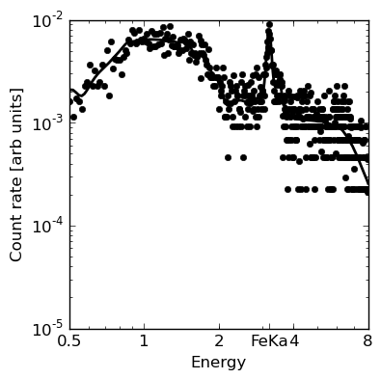
L, N_{H} from X-ray spectrum
Scattered Powerlaw component
CTK flat spectrum + FeK line

Slide 40

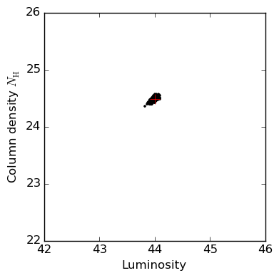
L, N_{H} from X-ray spectrum
Probability cloud

Slide 41
BXA in practice

Slide 42
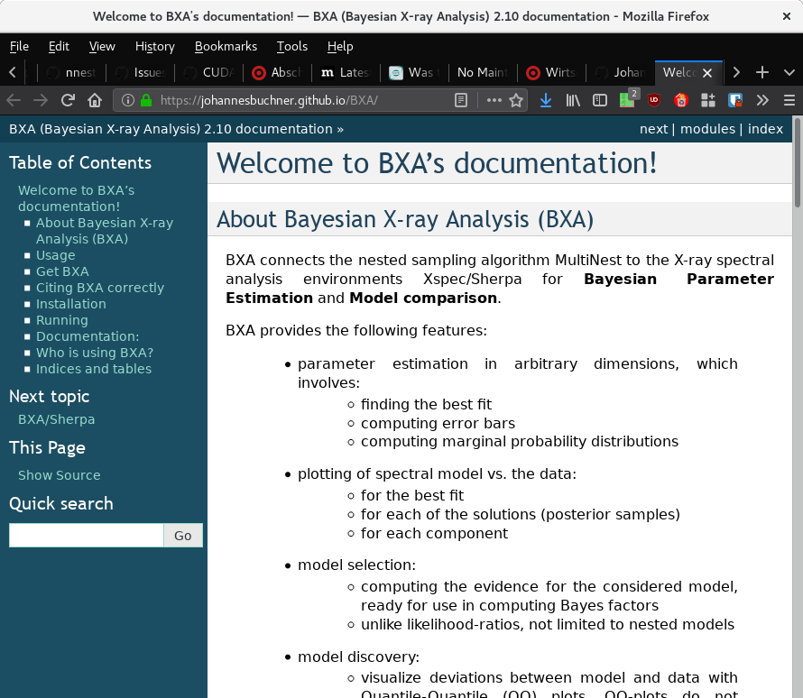
https://github.com/JohannesBuchner/BXA

Slide 43
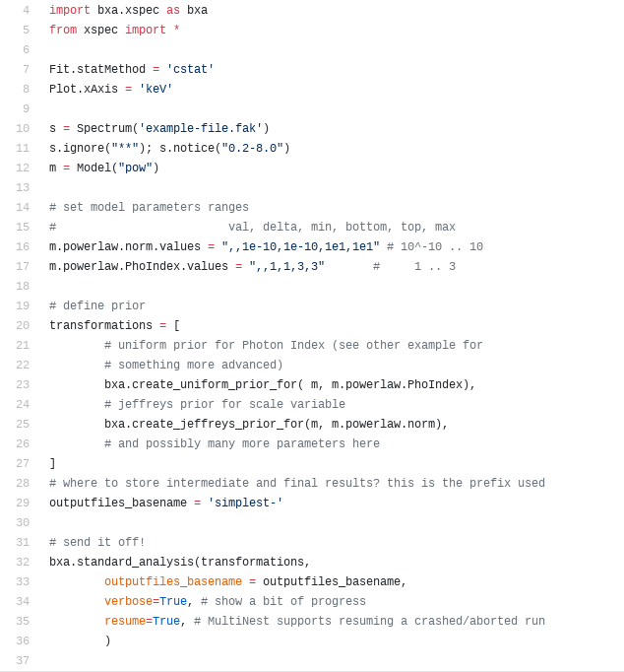
pyxspec
Specify priors
Where to store
Run!

Slide 44
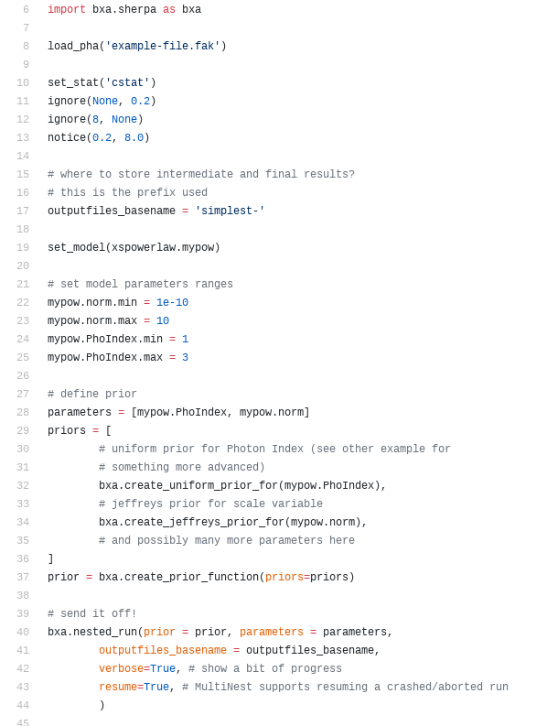
sherpa
Specify priors
Run!

Slide 45
Background

Slide 46
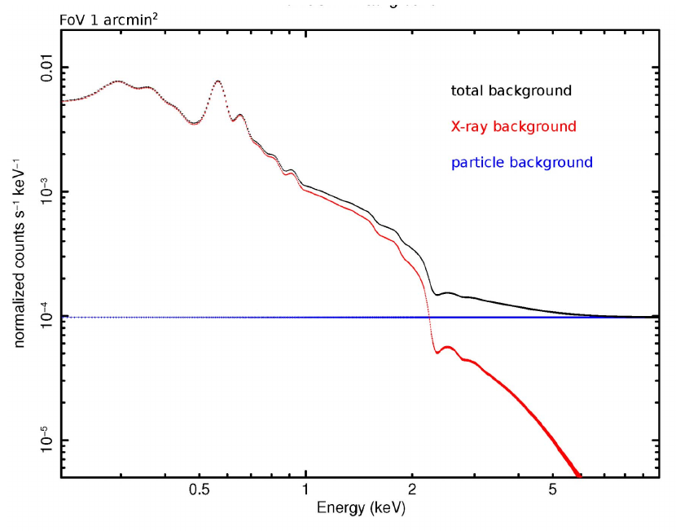
eROSITA background
Diffuse emission
  Local hot bubble
  Galactic disk
  Galactic halo
Cosmic background
  Unresolved AGN
High-energy particle background
https://wiki.mpe.mpg.de/eRosita/ScienceRelatedStuff/Background

Slide 47
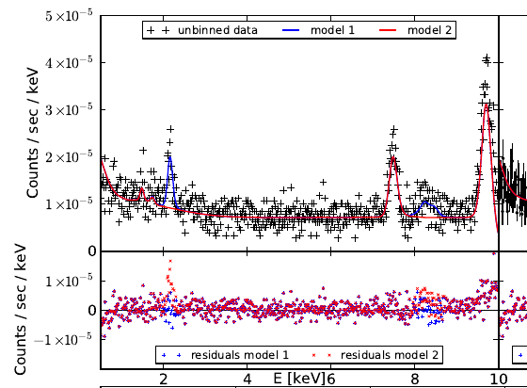
Empirical background models
Maximize poisson likelihood at all bins
→shape
Pros:
  Can contain physical knowledge & smoothness
  Small uncertainties
  0 bin counts ok
Cons:
  Need to specify model
  Fit can be poor
Chandra
(XMM, Chandra, Swift models in-house)

Slide 48
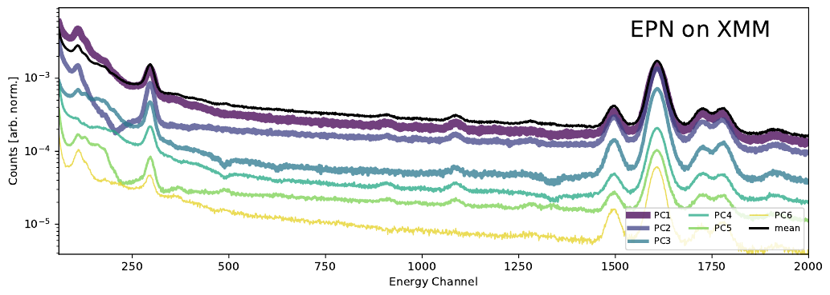
Empirical background models
Automated shape finding
Simmonds, Buchner et al. (2017)
XMM/PN,MOS, Chandra/ACIS, NuSTAR,
Suzaku, RXTE, Swift/XRT

Slide 49
Intrinsic parameter distributions

Slide 50
Example
Measurement gave
x1 = 4+-1
x2 = 5+-0.1
Generate 100 samples for each
100xN matrix of x

Slide 51
Example
Evaluate model
F(x)
100xN matrix of x
100xN matrix of F

Slide 52
Example
Sum probabilities
Multiply probabilities
Then try out other model parameters
100xN matrix of F
N
vector
L

Slide 53
Graphic explanation
P(x)
Measurement error
x
F(x)
Population distribution

Slide 54
Graphic explanation
P(x)
Measurement error
x
F(x)
Population distribution

Slide 55
Graphic explanation
P(x)
Measurement error
x
F(x)
Population distribution

Slide 56
Graphic explanation
P(x)
Measurement error
x
F(x)
Population distribution

Slide 57
Behaviour
Generate from 6+-2 with measurement errors

Slide 58
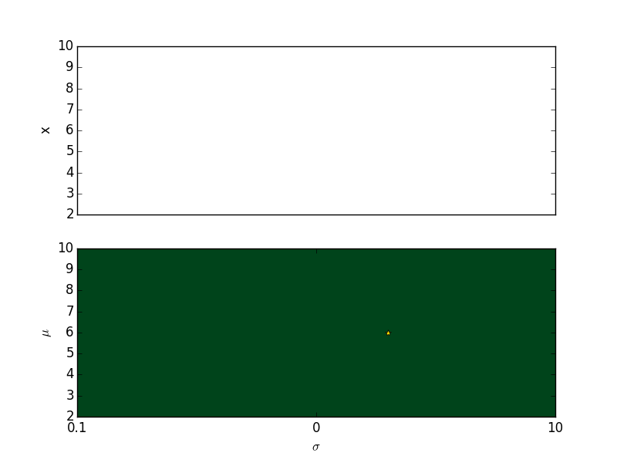
Behaviour

Slide 59
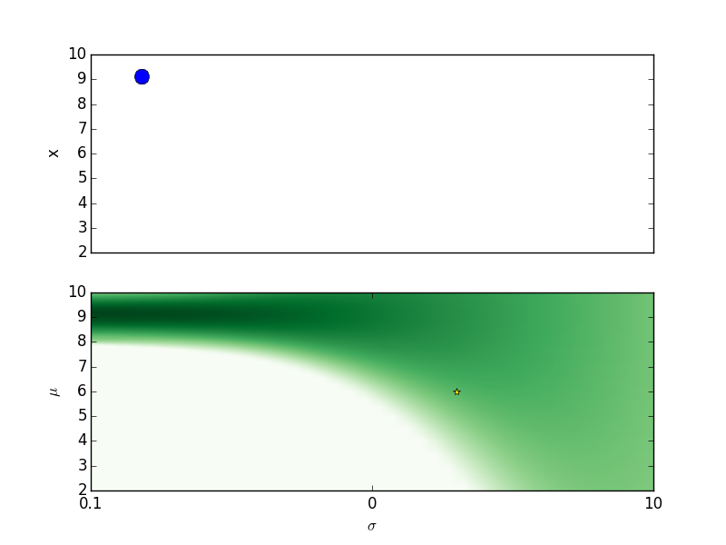
Behaviour

Slide 60
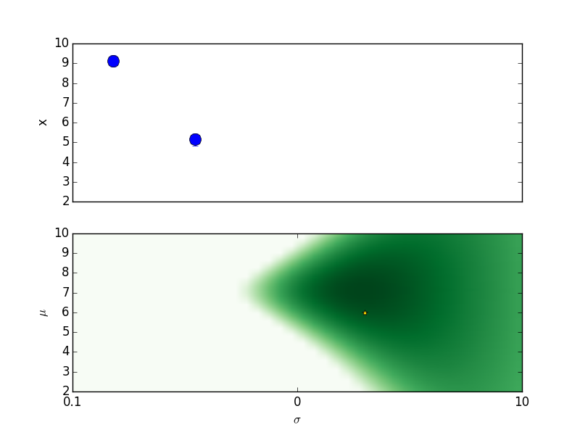
Behaviour

Slide 61
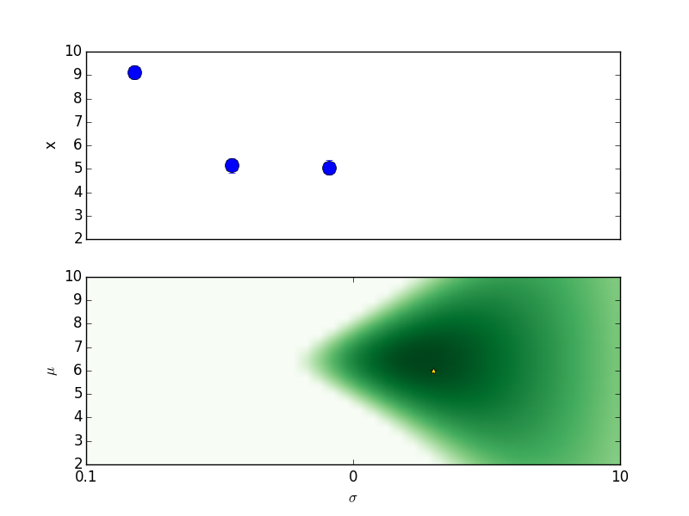
Behaviour

Slide 62
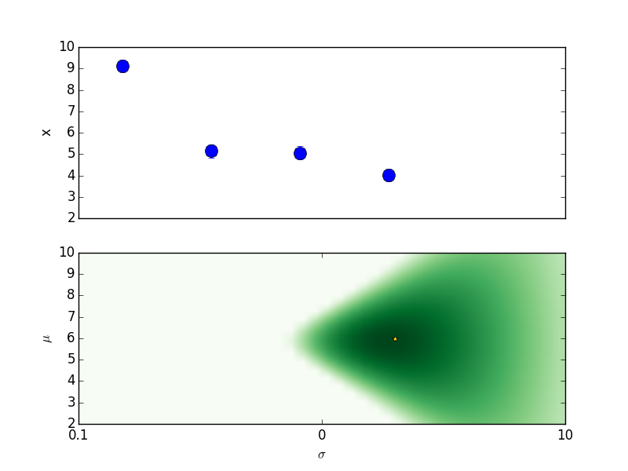
Behaviour

Slide 63
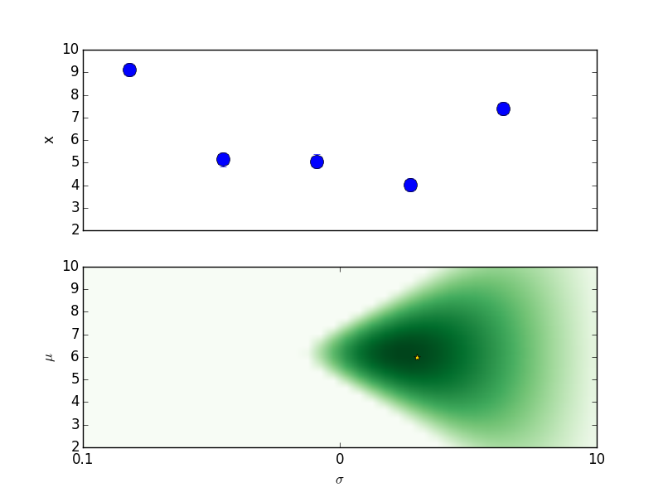
Behaviour

Slide 64
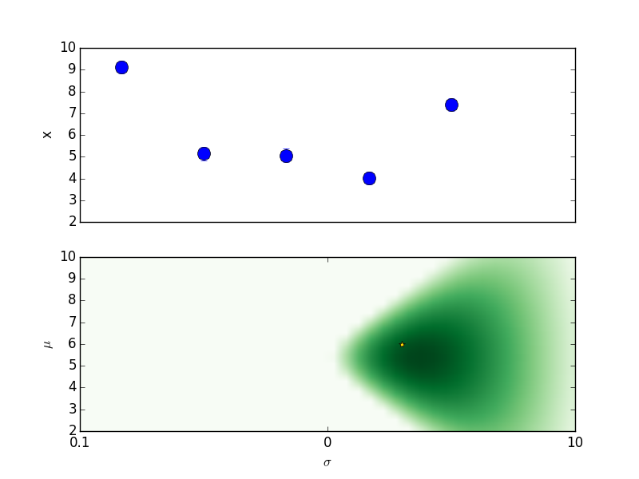
Behaviour

Slide 65
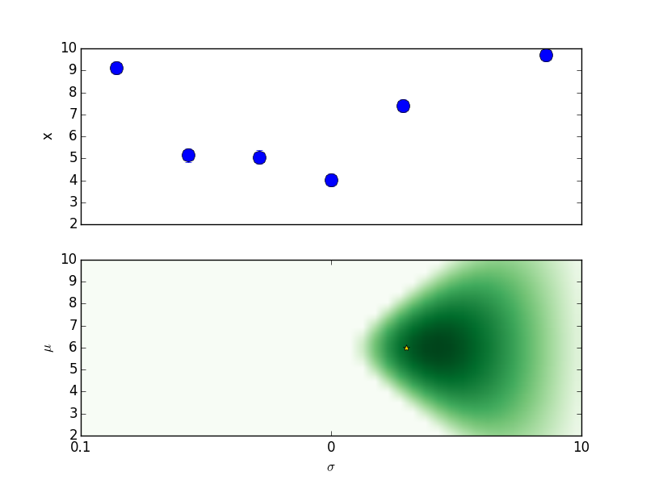
Behaviour

Slide 66
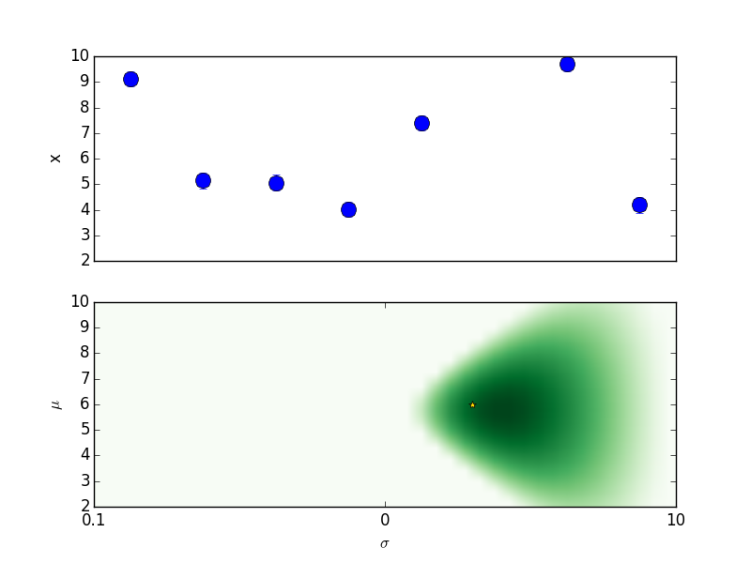
Behaviour

Slide 67
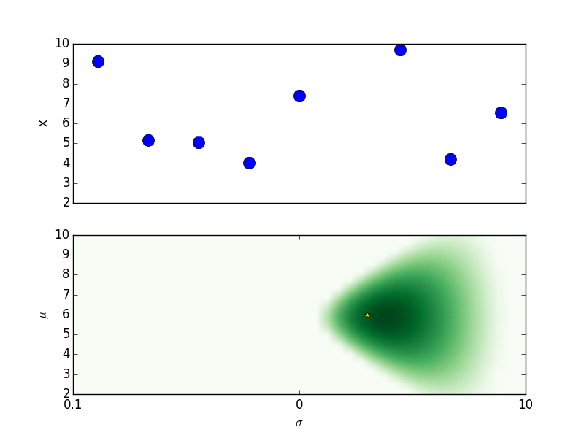
Behaviour

Slide 68
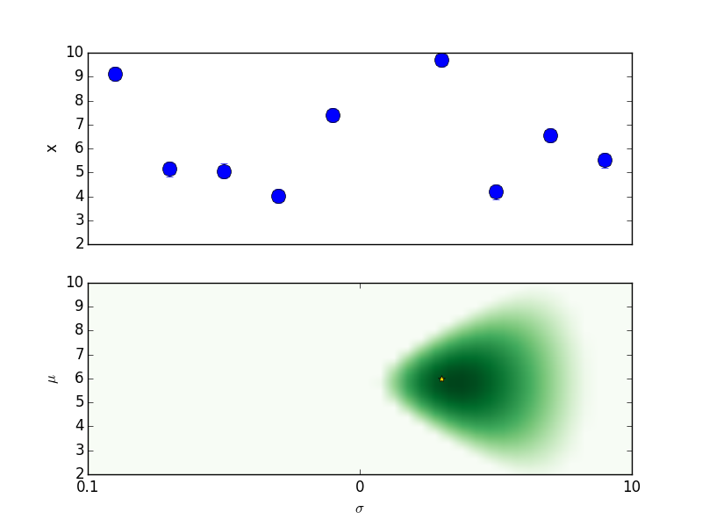
Behaviour

Slide 69

Behaviour

Slide 70

Behaviour

Slide 71
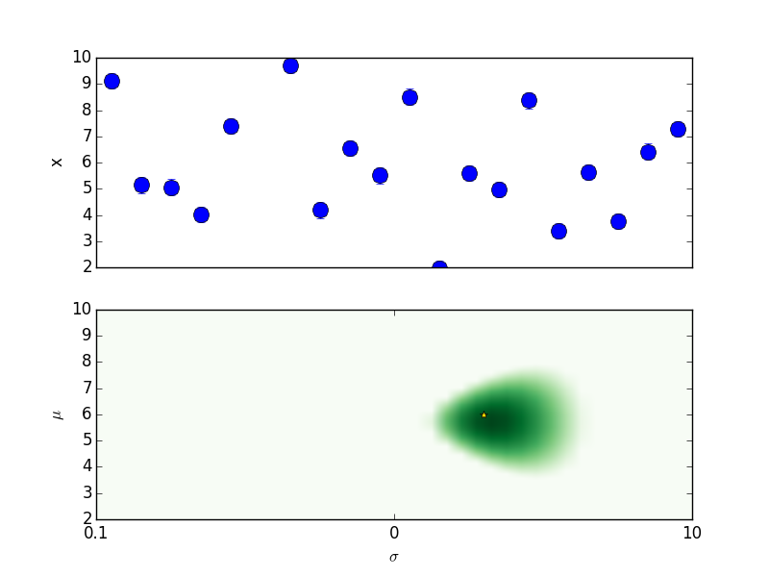
Behaviour

Slide 72
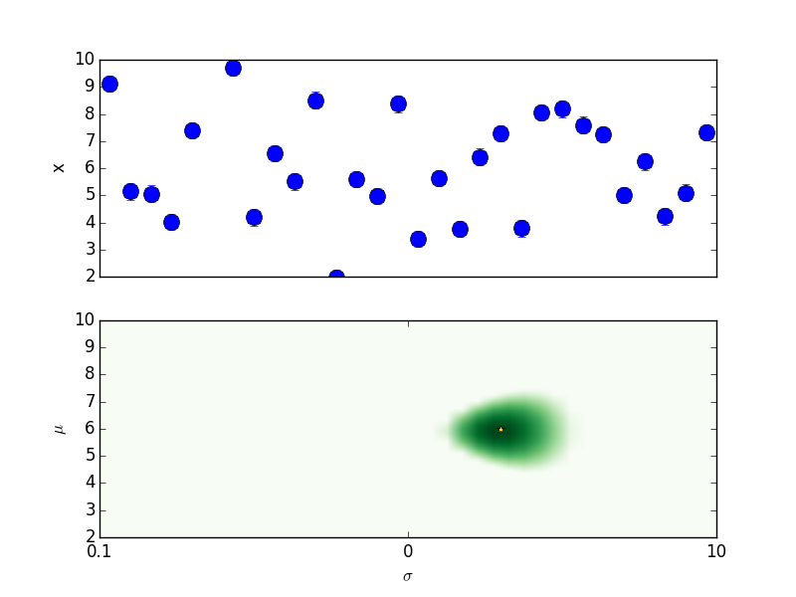
Behaviour

Slide 73
Behaviour

Slide 74
Behaviour

Slide 75
Behaviour

Slide 76

Behaviour

Slide 77

Behaviour

Slide 78
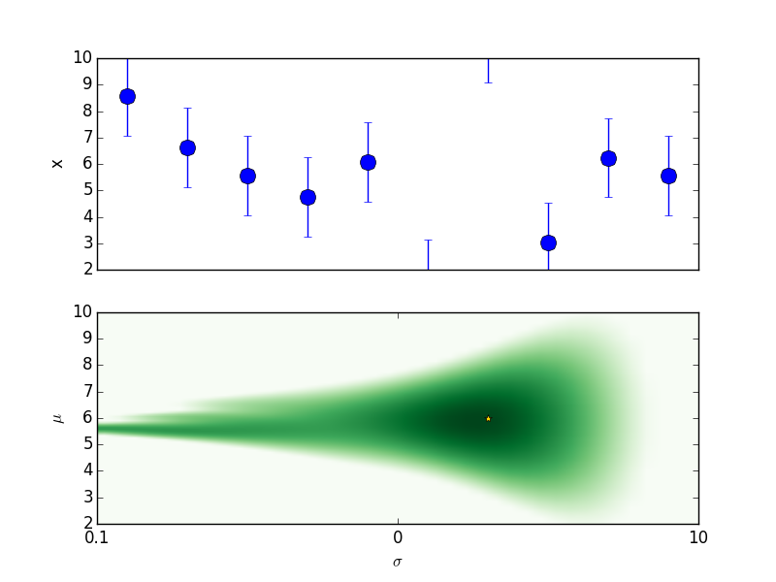
Behaviour

Slide 79
Behaviour

Slide 80
Behaviour

