Slide 1


Nested sampling & population inference
Johannes Buchner
astrost.at/istics
Max Planck Institute for extraterrestrial Physics

Slide 2
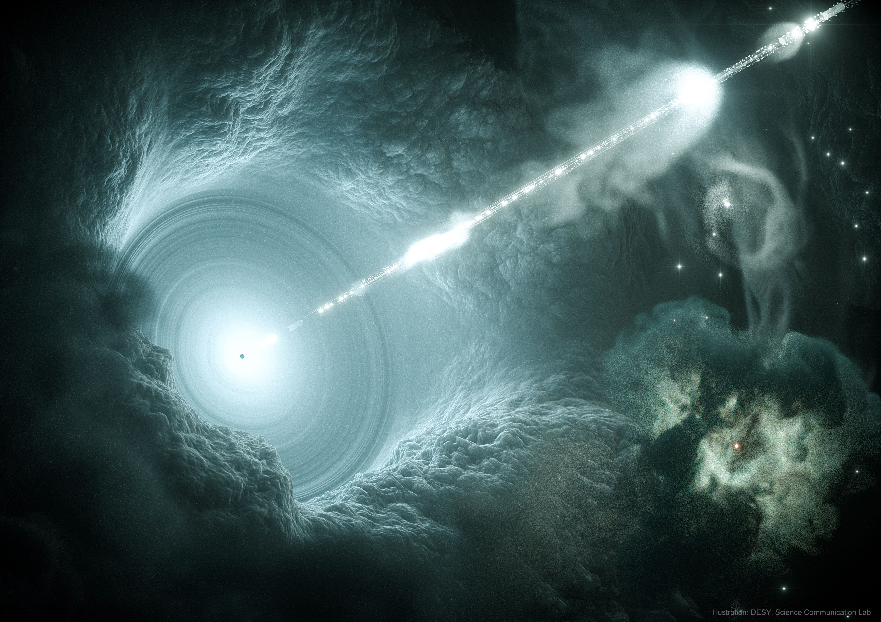

Slide 3
Bayesian inference is integral
What parameters are probable under a given model?
What models are probable?
“physical model prediction”
non-linear, complex, slow
statistical measurement process
data vs. model

Slide 4
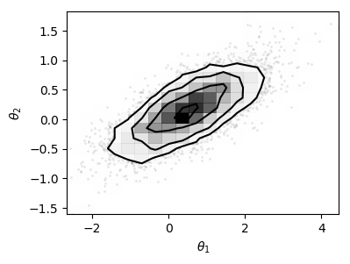
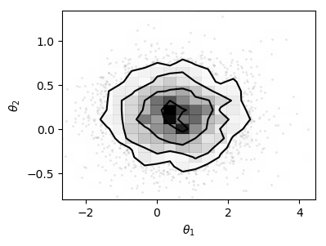
Bayesian inference is integral
dx
dx
dx
Function:
Likelihood
Integration measure:
Prior
Parameter estimation: Identify parameter space subset
Model comparison: identify model subset
containing 99% of probability mass

Slide 5
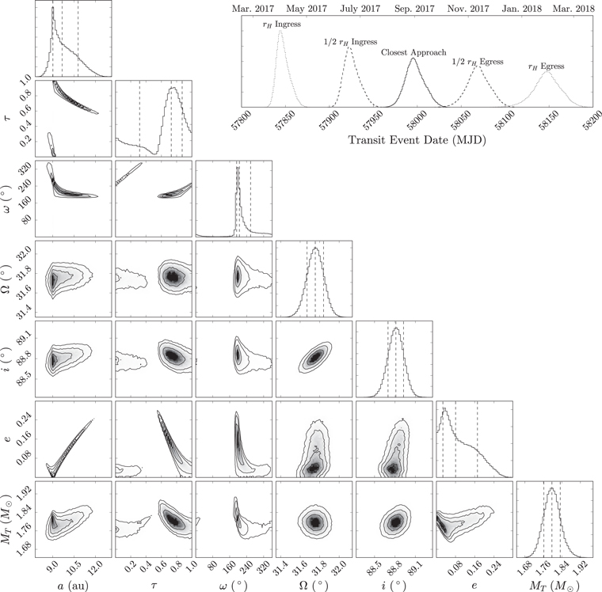
Integration algorithms
Parameter estimation
  HMCMC (Stan)
  emcee (?)
Model comparison
  Nested sampling
Challenges:
  In tails
  In missed modes
  In high-dimensions
  Reliability against assumptions
  Visualisation

Slide 6

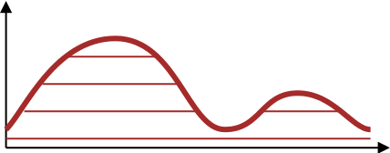
Nested sampling idea
Keeping track of volume
  Exponential shrinkage (~1/N)
Keeping track of height
To be replaced
Sorted live points
Skilling ‘04,06,09
Evans ‘07
Chopin&Robert ‘07,10
Walter ‘14

Slide 7
Nested sampling idea
L
Dead points’ L & V
Keeping track of volume
  Exponential shrinkage (~1/N)
Keeping track of height
V
Skilling ‘04,06,09
Evans ‘07
Chopin&Robert ‘07,10
Walter ‘14

Slide 8
Constrained sampling
Skilling ‘04,06,09
Evans ‘07
Chopin&Robert ‘07,10
Walter ‘14

Slide 9
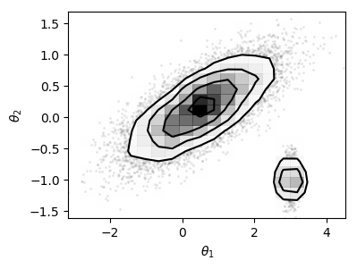
Multi-dimensional case
Ordering of samples well-defined by L
“Indep. of dim”
  depends primarily on constrained sampler!
no need for fixed dim, continuous spaces

Slide 10
Multi-dimensional case
Ellipsoidal sampling
  Mukherjee+06
Multi-ellipsoidal sampling
  Shaw+07, Feroz&Hobson08, Feroz+09
  MultiNest (pymultinest)
Very popular!
Wilks’ theorem
Elliptical distributions

Slide 11
Nested sampling
For efficiency:
Reconstruct a region
Sample uniformly
RadFriends: ellipsoid around each point
Circle size cross-validated to recover current points
Alternative: MCMC
https://chi-feng.github.io/mcmc-demo/app.html

Slide 12
Nested Sampling Extensions
Dynamic NS
No hard borders:
  Daemonic NS
  Diffusive NS
Using thrown-away points
  Importance NS
Higson+17
Habeck15
Brewer+11
Chopin & Roberts 07, 08,10

Slide 13
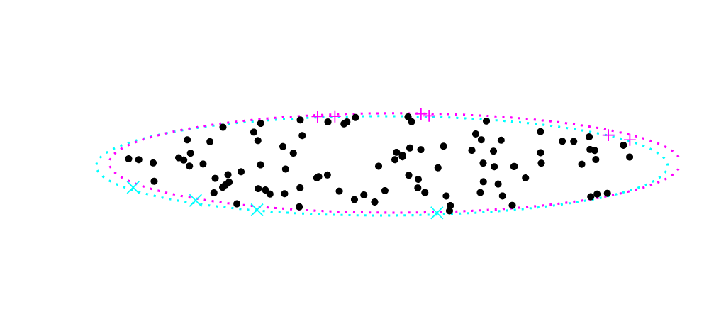
Similar datasets
Multi-likelihood
Model prediction
What happens if similar datasets run with same RNG?
Ordering of points same in beginning
–> can save model evaluations in beginning
then diverge
–> sample from superset
D1
D2
D3
D4
L
Dead points’ L & V
To be replaced
Sorted live points
V
Buchner (2018): collaborative nested sampling

Slide 14
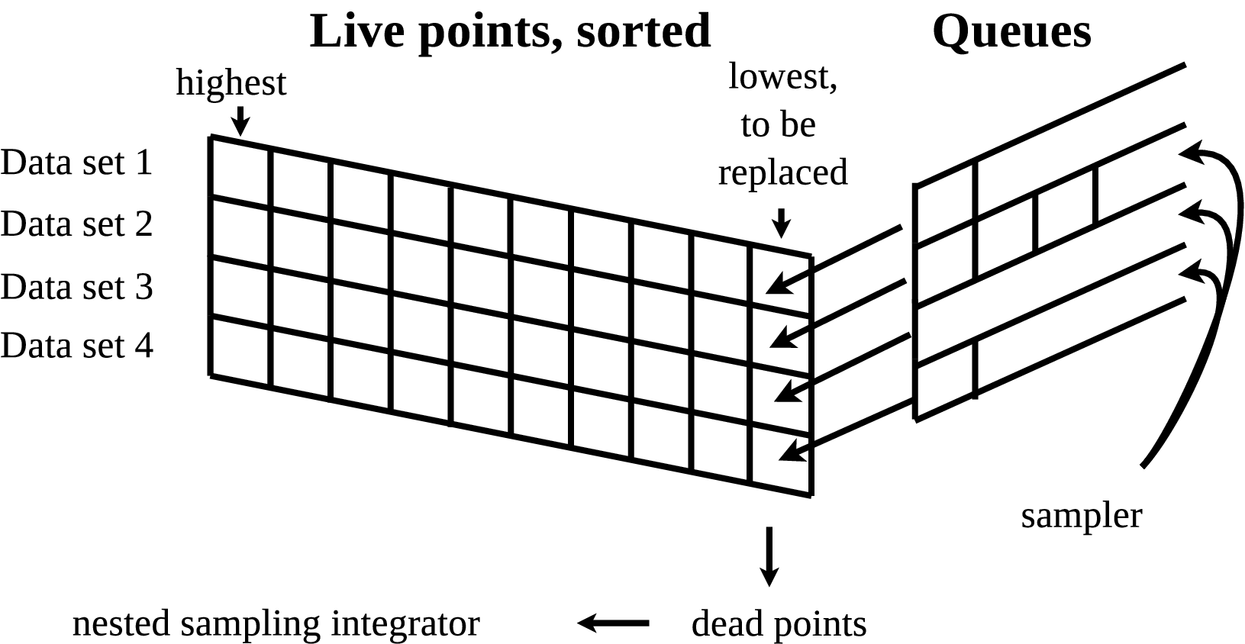
Sharing live points
L
Dead points’ L & V
V
Buchner (2018): collaborative nested sampling

Slide 15
Constructing super-regions
across all data
  “Superset draw”
across empty queues
  “Focussed draw”
Trade-off: sharing efficiency
Buchner (2018): collaborative nested sampling

Slide 16
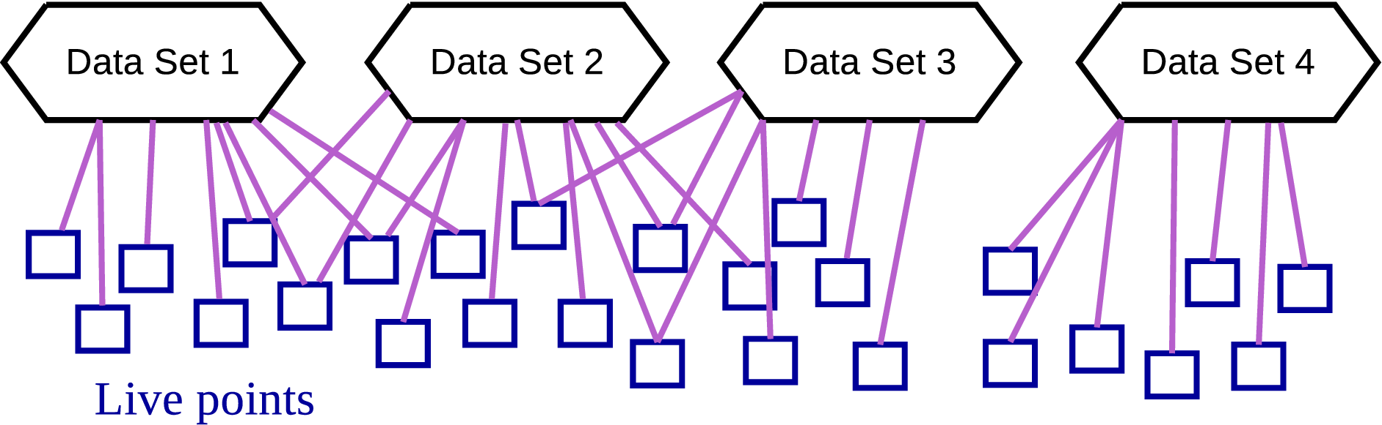
Sharing live points
Shared live points = acceleration
Diverging runs = independence
Find disjoint graph = overhead
Buchner (2018): collaborative nested sampling

Slide 17
When could this be useful?
(in contrast to
standard ML)
Large # of data sets
  Similarly structured & potentially similar parameters
  Optimal if uncertainties substantial
Complex models
  Physics slow, not analytical
  Arbitrarily complex statistical process
separate measurement process from physics!
  Get uncertainties on physical parameters
  Model comparison
Buchner (2018): collaborative nested sampling

Slide 18
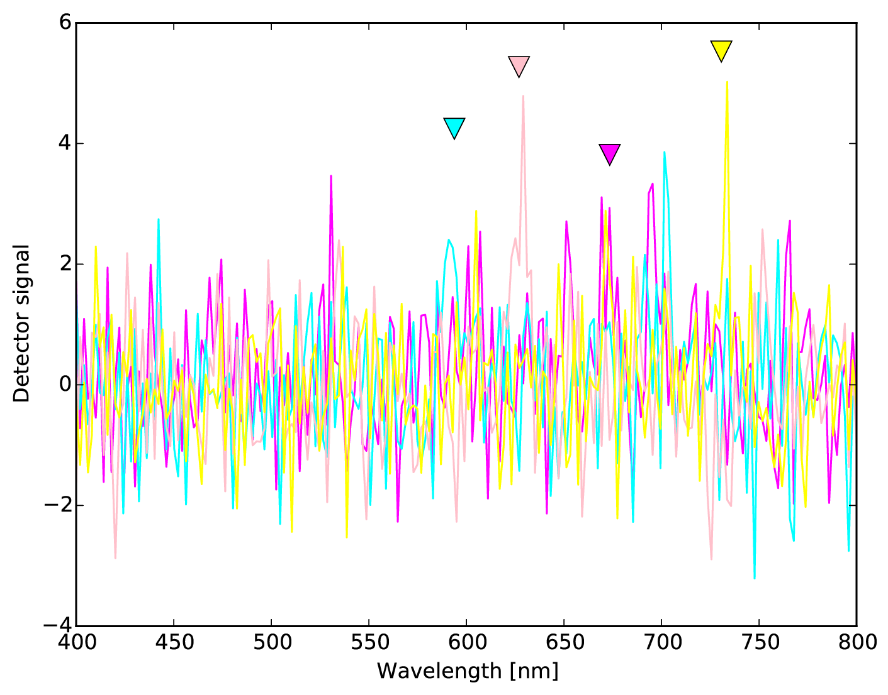
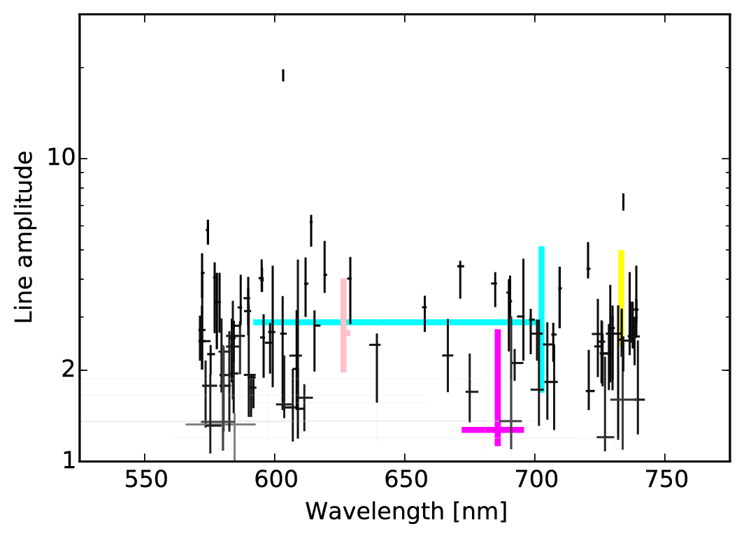
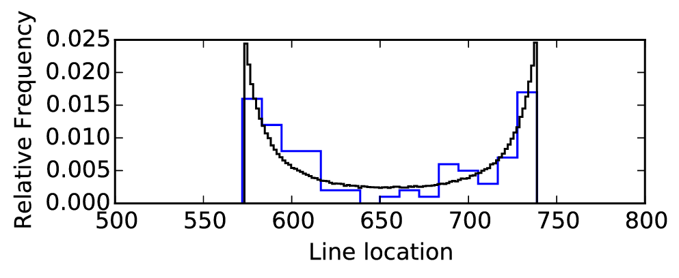
Toy demo: Fit a line
Simulated
Gaussian line = “slow model”
Gaussian noise = “fast likelihood”
Fitted with Collaborative NS + RadFriends
Buchner (2018): collaborative nested sampling

Slide 19
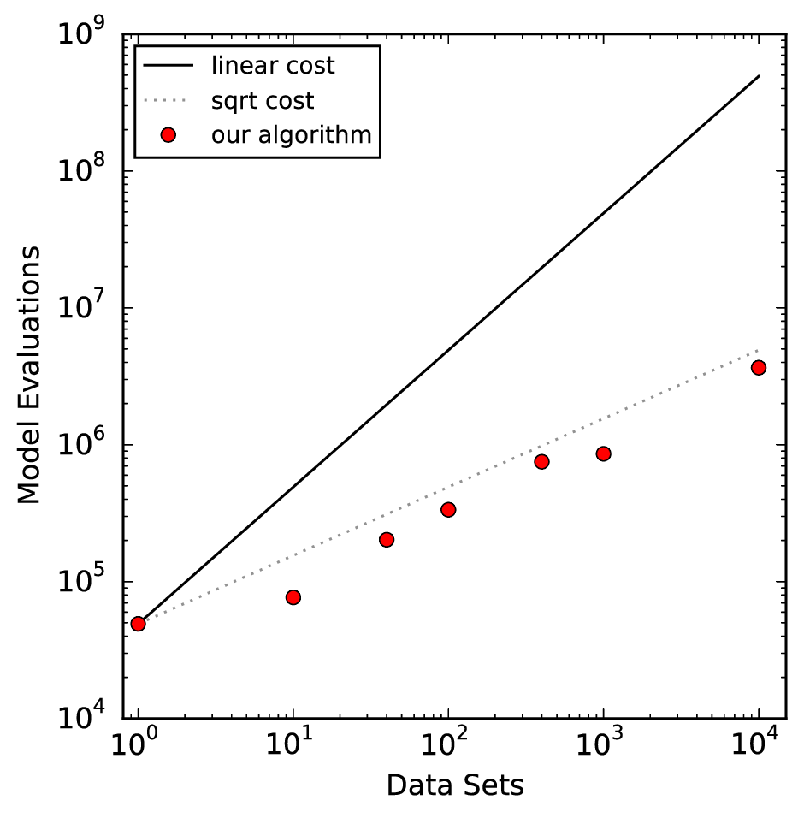
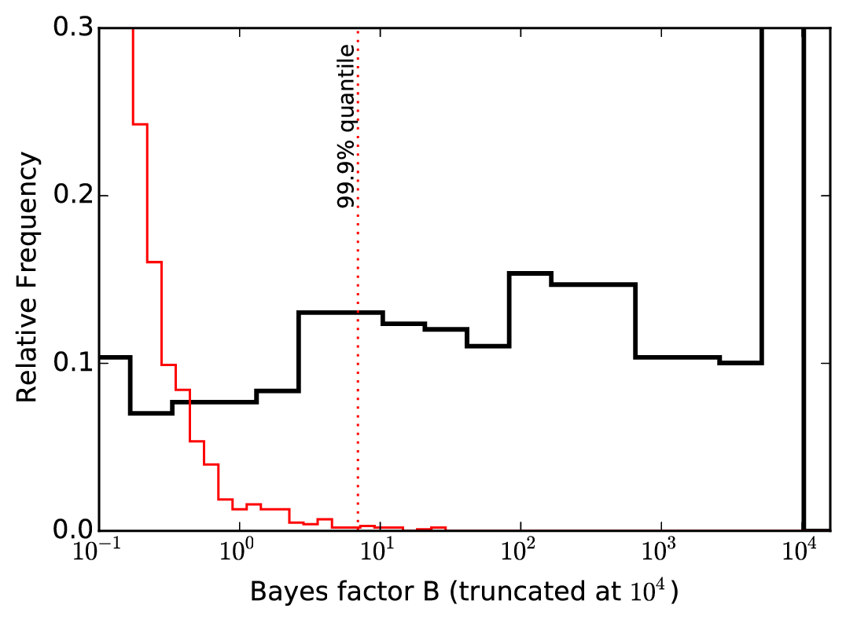
Toy demo: Fit a line
Sub-linear scaling
Monte Carlo simulations
Buchner (2018): collaborative nested sampling

Slide 20
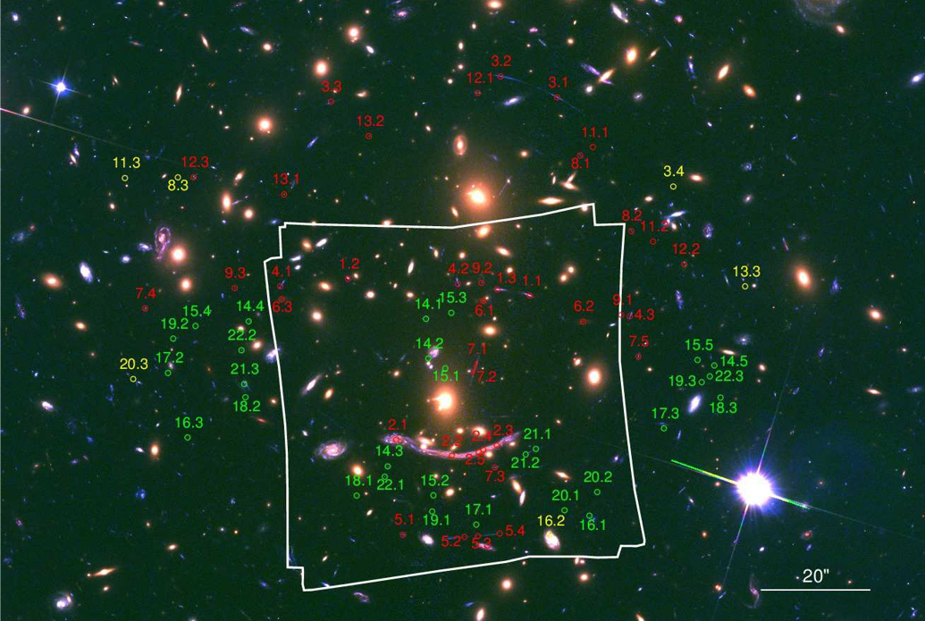
Demo: MUSE IFU
1arcmin² FOV,
480-930nm
Abell 370 galaxy cluster

Slide 21
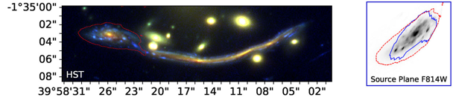
Demo: MUSE IFU
1arcmin² FOV,
480-930nm
Abell 370 galaxy cluster

Slide 22
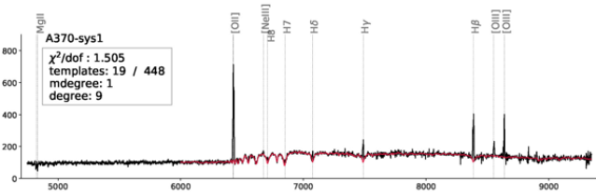
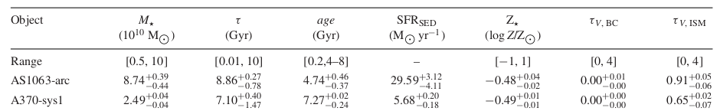
Demo: MUSE IFU
1arcmin² FOV,
480-930nm
Abell 370 galaxy cluster

Slide 23
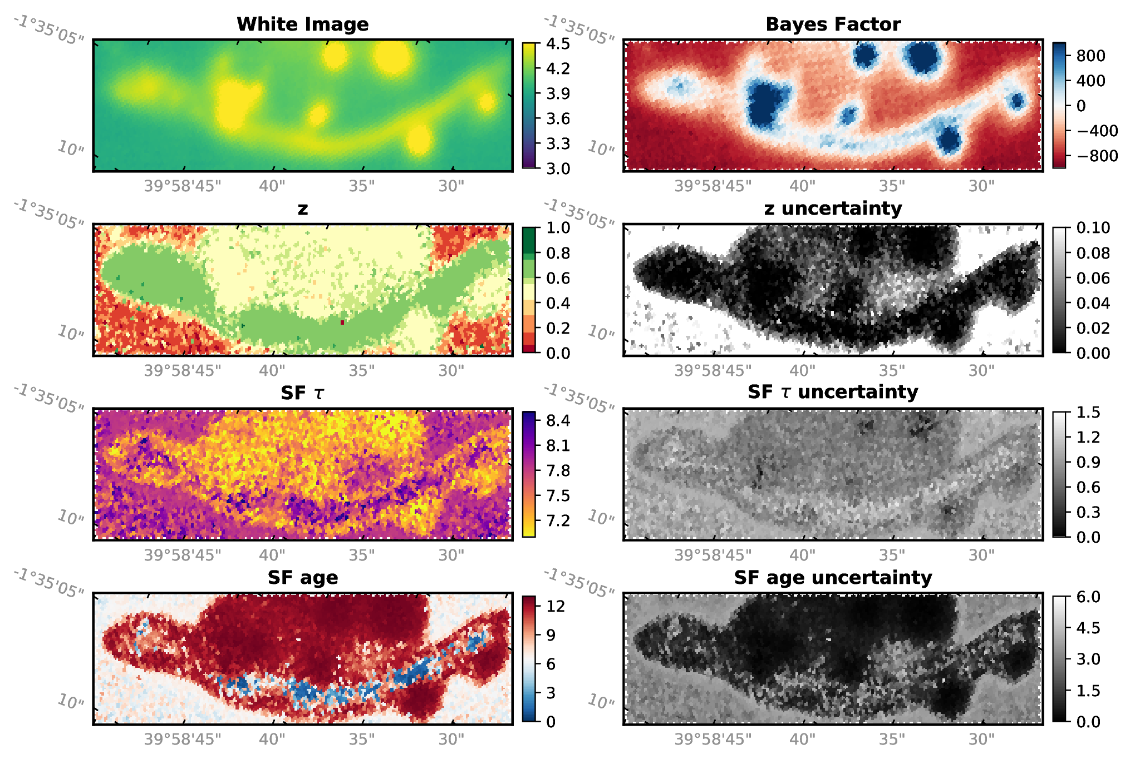
Buchner (2018): collaborative nested sampling

Slide 24
4223 fibers 140h 14.4e6 likelihood evaluations
100 fibers 14.9h 2.8e6 likelihood evaluations
speed-up: 4x
Buchner (2018): collaborative nested sampling

Slide 25
Limitations & Open problems
Multi-likelihood
Model prediction
M. slower than point bookkeeping
Complexity
  Python implementation @ https://github.com/JohannesBuchner/massivedatans/
Problem formulation
  Physical model uncertainties
How to do NS while accumulating data?
D1
D2
D3
D4
Buchner (2018): collaborative nested sampling

Slide 26
Intrinsic parameter distributions

Slide 27
Example
Measurement gave
x1 = 4+-1
x2 = 5+-0.1
Generate 100 samples for each
100xN matrix of x

Slide 28
Example
Evaluate model
F(x)
100xN matrix of x
100xN matrix of F

Slide 29
Example
Sum probabilities
Multiply probabilities
Then try out other model parameters
100xN matrix of F
N
vector
L

Slide 30
Graphic explanation
P(x)
Measurement error
x
F(x)
Population distribution

Slide 31
Graphic explanation
P(x)
Measurement error
x
F(x)
Population distribution

Slide 32
Graphic explanation
P(x)
Measurement error
x
F(x)
Population distribution

Slide 33
Graphic explanation
P(x)
Measurement error
x
F(x)
Population distribution

Slide 34
Behaviour
Generate from 6+-2 with measurement errors

Slide 35
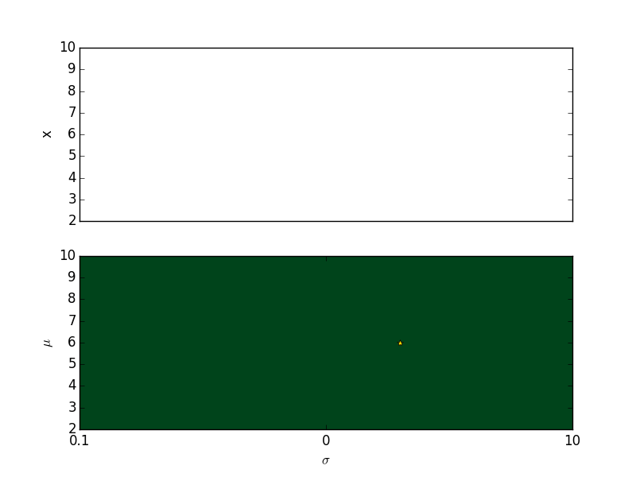
Behaviour

Slide 36
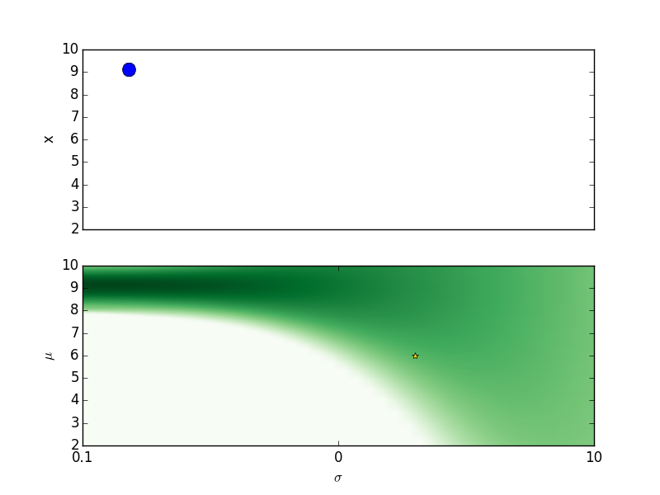
Behaviour

Slide 37
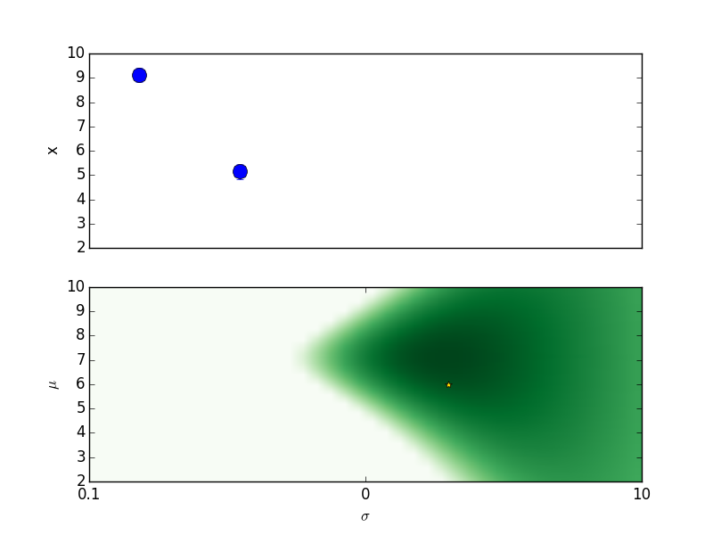
Behaviour

Slide 38
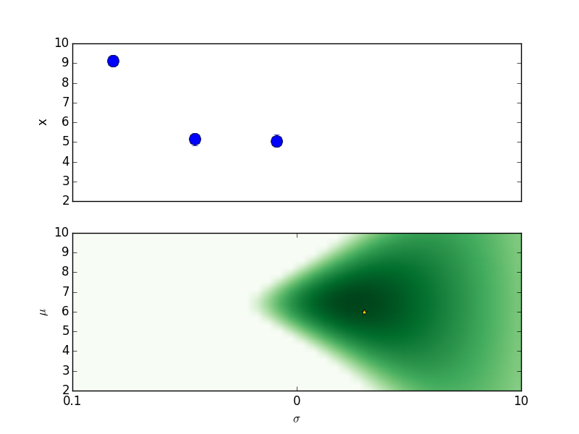
Behaviour

Slide 39
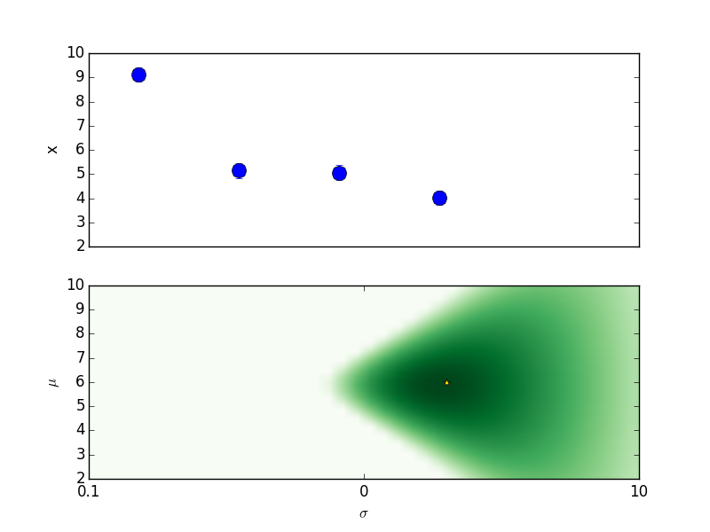
Behaviour

Slide 40
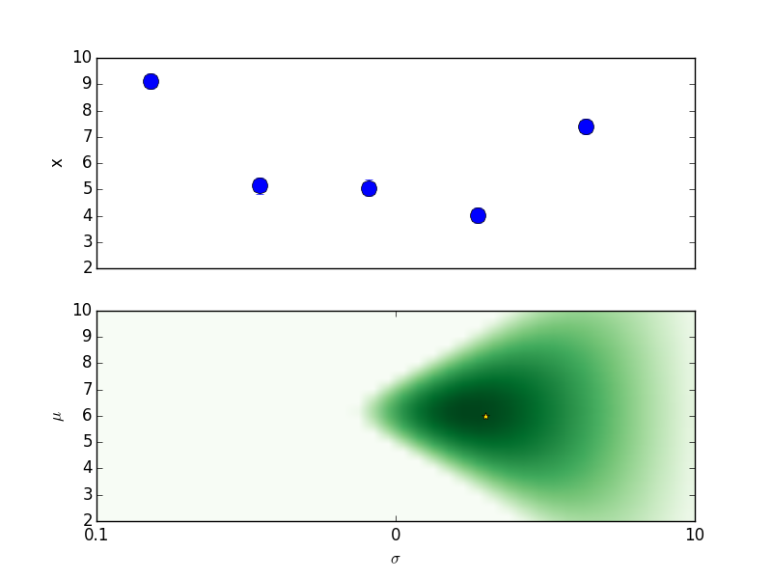
Behaviour

Slide 41
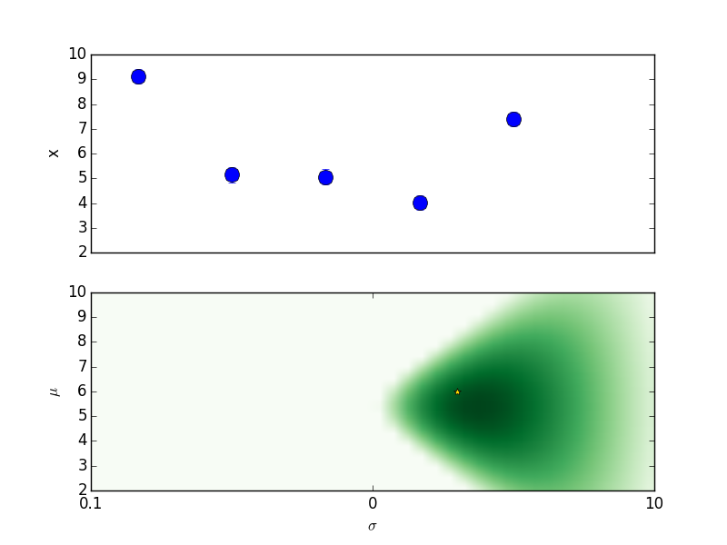
Behaviour

Slide 42
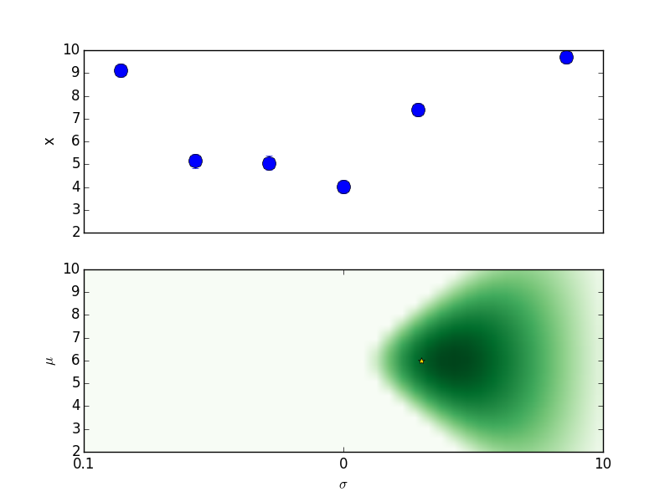
Behaviour

Slide 43
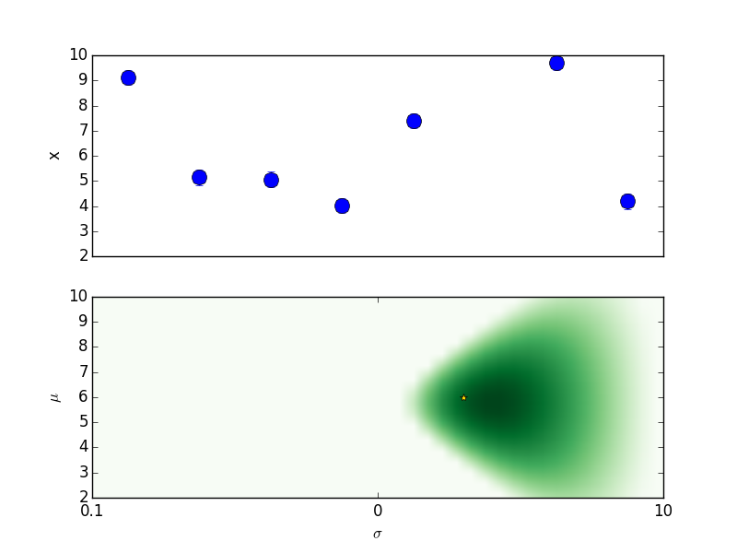
Behaviour

Slide 44
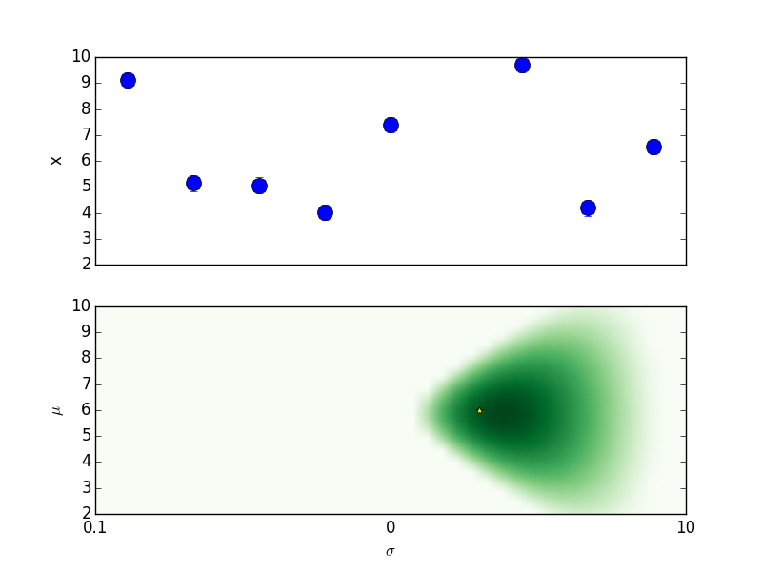
Behaviour

Slide 45
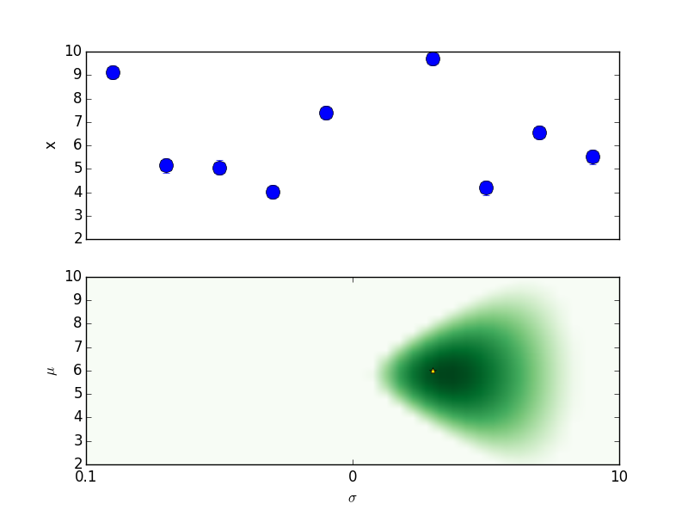
Behaviour

Slide 46

Behaviour

Slide 47

Behaviour

Slide 48
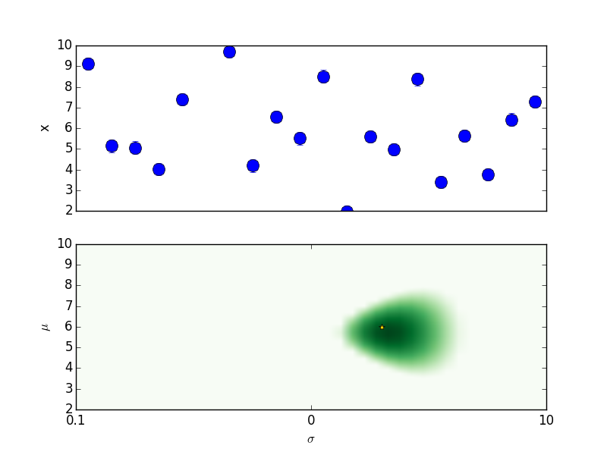
Behaviour

Slide 49
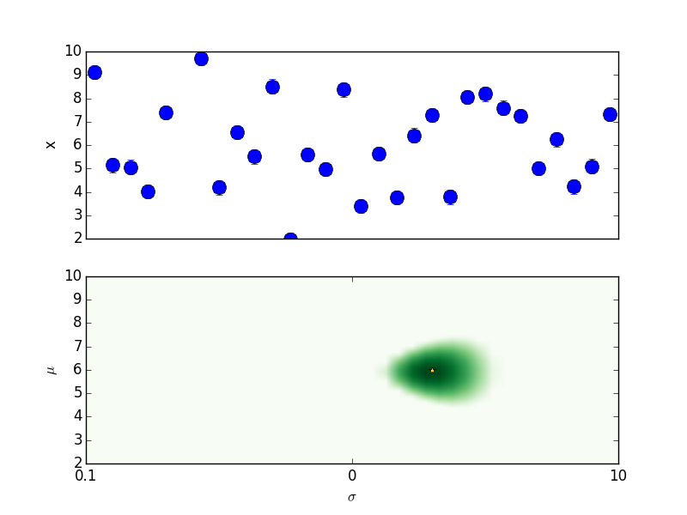
Behaviour

Slide 50
Behaviour

Slide 51
Behaviour

Slide 52
Behaviour

Slide 53

Behaviour

Slide 54

Behaviour

Slide 55
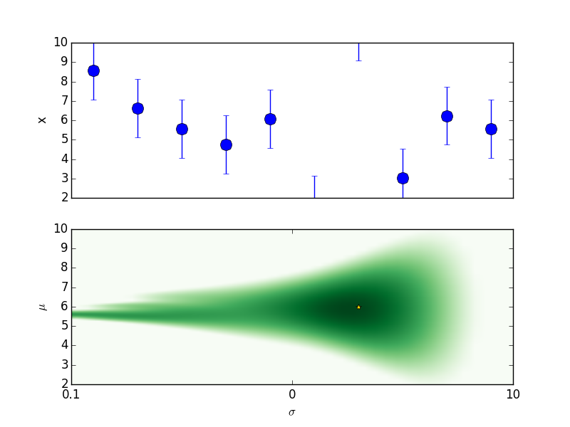
Behaviour

Slide 56
Behaviour

Slide 57
Behaviour

Slide 58



“Luminosity functions”
X-ray Survey analysis
Buchner+15, Kelley+10, Loredo02
Obscured, CTK fraction
f(L,z)
Obscured, CTK fraction
by galaxy gas f(M*,z)
Spectral fitting
with low counts (BXA)
Multi-wavelength
Association NWAY
Cosmological Sims
CDFS: Luo+17
COSMOS,
AEGIS-XD,
XMM-XXL
Buchner+15
Nested Sampling &
PyMultiNest
Hierarchical Bayesian
Models

Slide 59
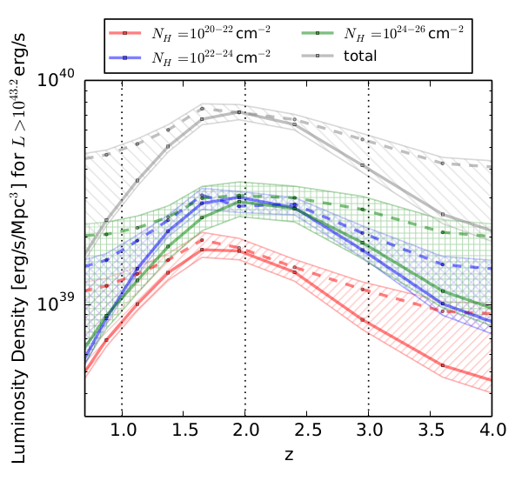
“Luminosity functions”
X-ray Survey analysis
Buchner+15, Kelley+10, Loredo02
Obscured, CTK fraction
f(L,z)
Obscured, CTK fraction
by galaxy gas f(M*,z)
Spectral fitting
with low counts (BXA)
Multi-wavelength
Association NWAY
Cosmological Sims
CDFS: Luo+17
COSMOS,
AEGIS-XD,
XMM-XXL
Buchner+15
Nested Sampling &
PyMultiNest
Hierarchical Bayesian
Models

