Slide 1

The hidden
SMBH population over cosmic time
Collaborators:
Franz Bauer, Ezequiel Treister,
Mara Salvato, Kirpal Nandra,
Antonis Georgakakis, Murray Brightman, Mislav Balokovic,
Keiichi Wada, Robert Nikutta,
Lia Sartori, et altera
Johannes Buchner
http://astrost.at/istics

Slide 2
Research interests
X-ray Survey analysis
Geometry of obscurer
from X-ray spectra
Luminosity function of
Heavily obscured AGN
SMBH occupation
f(M*,z)
Obscured, CTK fraction
f(L,z)
Obscured, CTK fraction
by galaxy gas f(M*,z)
Spectral fitting
with low counts (BXA)
Multi-wavelength
Association NWAY
Cosmological Sims
Nested Sampling &
PyMultiNest
Hierarchical Bayesian
Models

Slide 3
Research interests
X-ray Survey analysis
Geometry of obscurer
from X-ray spectra
Luminosity function of
Heavily obscured AGN
SMBH occupation
f(M*,z)
Obscured, CTK fraction
f(L,z)
Obscured, CTK fraction
by galaxy gas f(M*,z)
Spectral fitting
with low counts (BXA)
Multi-wavelength
Association NWAY
Cosmological Sims
Nested Sampling &
PyMultiNest
Hierarchical Bayesian
Models

Slide 4
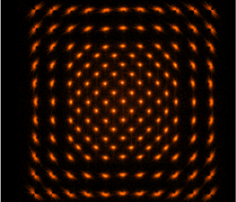

Research interests
X-ray Survey analysis
Chandra
XMM
ROSAT
eROSITA
Geometry of obscurer
from X-ray spectra
Luminosity function
Heavily obscured AGN
SMBH occupation
f(M*,z)
Obscured, CTK fraction
f(L,z)
Obscured, CTK fraction
by galaxy gas f(M*,z)
X-ray PSF can be large
in deep images: Multiple possible counterparts
Spectral fitting
with low counts (BXA)
Multi-wavelength
Association NWAY
Cosmological Sims
Nested Sampling &
PyMultiNest
Hierarchical Bayesian
Models

Slide 5


Research interests
X-ray Survey analysis
Geometry of obscurer
from X-ray spectra
Luminosity function
Heavily obscured AGN
SMBH occupation
f(M*,z)
Obscured, CTK fraction
f(L,z)
Obscured, CTK fraction
by galaxy gas f(M*,z)
Presence or absence of counterpart in catalog
Depends on imaging depth
Spectral fitting
with low counts (BXA)
Multi-wavelength
Association NWAY
Cosmological Sims
Nested Sampling &
PyMultiNest
Hierarchical Bayesian
Models

Slide 6
Our method in a nutshell: NWAY
Research interests
X-ray Survey analysis
Salvato, Buchner, Budavári et al. 2017
H1: chance alignment of unrelated srcs
H2: single source
depends on
counterpart sky number density ρ_{s}
and expected counterpart fraction η_{x}
Geometry of obscurer
from X-ray spectra
Luminosity function
Heavily obscured AGN
SMBH occupation
f(M*,z)
Bayes
factor
Angular separation
Obscured, CTK fraction
f(L,z)
Obscured, CTK fraction
by galaxy gas f(M*,z)
posterior probability for
match between X-ray source i
& a potential counterpart j
Weighting term
(mag, colors,etc)
Positional uncertainties
Spectral fitting
with low counts (BXA)
Multi-wavelength
Association NWAY
Cosmological Sims
Nested Sampling &
PyMultiNest
Hierarchical Bayesian
Models

Slide 7

Research interests
X-ray Survey analysis
Pineau+16
Geometry of obscurer
from X-ray spectra
Luminosity function
Heavily obscured AGN
SMBH occupation
f(M*,z)
Obscured, CTK fraction
f(L,z)
Obscured, CTK fraction
by galaxy gas f(M*,z)
Explore combinatorics
Find relative probabilities of matches
Spectral fitting
with low counts (BXA)
Multi-wavelength
Association NWAY
Cosmological Sims
Nested Sampling &
PyMultiNest
Hierarchical Bayesian
Models

Slide 8

Test 1: XMM-COSMOS
Research interests
Fast!
X-ray Survey analysis
ML: 1281 considered reliable, after careful visual inspection
Now with Chandra coverage:
NWAY: automatic, with single band, self-learning magnitude distribution:
NWAY with 1+3.6um catalogues
1281 total
139 were mis-associated
additional
49/139 sources right
Geometry of obscurer
from X-ray spectra
Luminosity function
Heavily obscured AGN
SMBH occupation
f(M*,z)
got 86/139 sources right
Obscured, CTK fraction
f(L,z)
Obscured, CTK fraction
by galaxy gas f(M*,z)
eROSITA: All-Sky priors
Spectral fitting
with low counts (BXA)
Multi-wavelength
Association NWAY
Cosmological Sims
Nested Sampling &
PyMultiNest
Hierarchical Bayesian
Models

Slide 9
Bayesian inference is integral
What parameters are probable under a given model?
What models are probable?
“physical model prediction”
non-linear, complex, slow
statistical measurement process
data vs. model

Slide 10
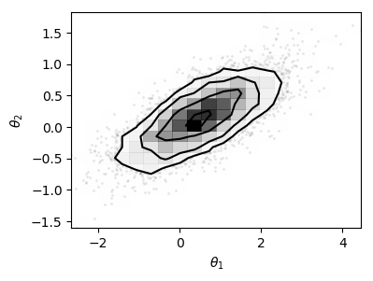
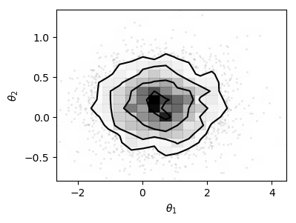
Bayesian inference is integral
dx
dx
dx
Function:
Likelihood
Integration measure:
Prior
Parameter estimation: Identify parameter space subset
Model comparison: identify model subset
containing 99% of probability mass

Slide 11
Integration algorithms
Parameter estimation
  HMCMC (Stan)
  emcee (?)
Model comparison
  Nested sampling
Challenges:
  In tails
  In missed modes
  In high-dimensions
  Reliability against assumptions
  Visualisation

Slide 12

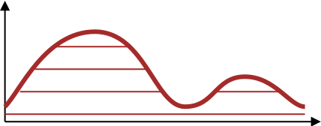
Nested sampling idea
Keeping track of volume
  Exponential shrinkage (~1/N)
Keeping track of height
To be replaced
Sorted live points
Skilling ‘04,06,09
Evans ‘07
Chopin&Robert ‘07,10
Walter ‘14

Slide 13
Nested sampling idea
L
Dead points’ L & V
Keeping track of volume
  Exponential shrinkage (~1/N)
Keeping track of height
V
Skilling ‘04,06,09
Evans ‘07
Chopin&Robert ‘07,10
Walter ‘14

Slide 14
Constrained sampling
Skilling ‘04,06,09
Evans ‘07
Chopin&Robert ‘07,10
Walter ‘14

Slide 15
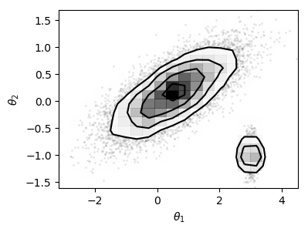
Multi-dimensional case
Ordering of samples well-defined by L
“Indep. of dim”
  depends primarily on constrained sampler!
no need for fixed dim, continuous spaces

Slide 16
Multi-dimensional case
Ellipsoidal sampling
  Mukherjee+06
Multi-ellipsoidal sampling
  Shaw+07, Feroz&Hobson08, Feroz+09
  MultiNest (pymultinest)
  nestle
Very popular!
Wilks’ theorem
Elliptical distributions

Slide 17
Nested sampling
For efficiency:
Reconstruct a region
Sample uniformly
RadFriends: ellipsoid around each point
Circle size cross-validated to recover current points
Alternative: MCMC
https://chi-feng.github.io/mcmc-demo/app.html

Slide 18
Nested Sampling Extensions
Dynamic NS
No hard borders:
  Daemonic NS
  Diffusive NS
Using thrown-away points
  Importance NS
Higson+17
Habeck15
Brewer+11
Chopin & Roberts 07, 08,10

Slide 19
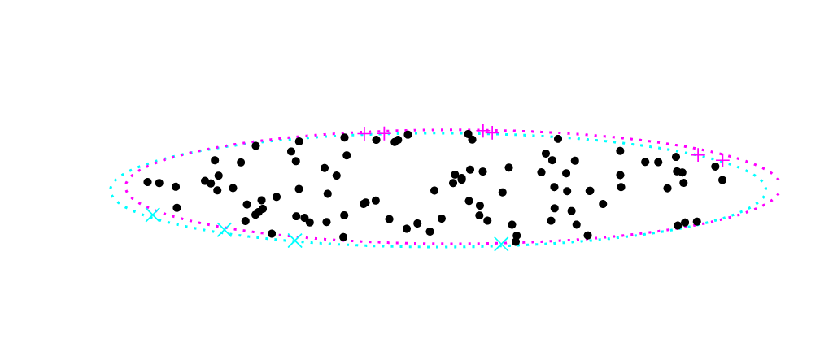
Similar datasets
Multi-likelihood
Model prediction
What happens if similar datasets run with same RNG?
Ordering of points same in beginning
–> can save model evaluations in beginning
then diverge
–> sample from superset
D1
D2
D3
D4
L
Dead points’ L & V
To be replaced
Sorted live points
V
Buchner (2018): collaborative nested sampling

Slide 20
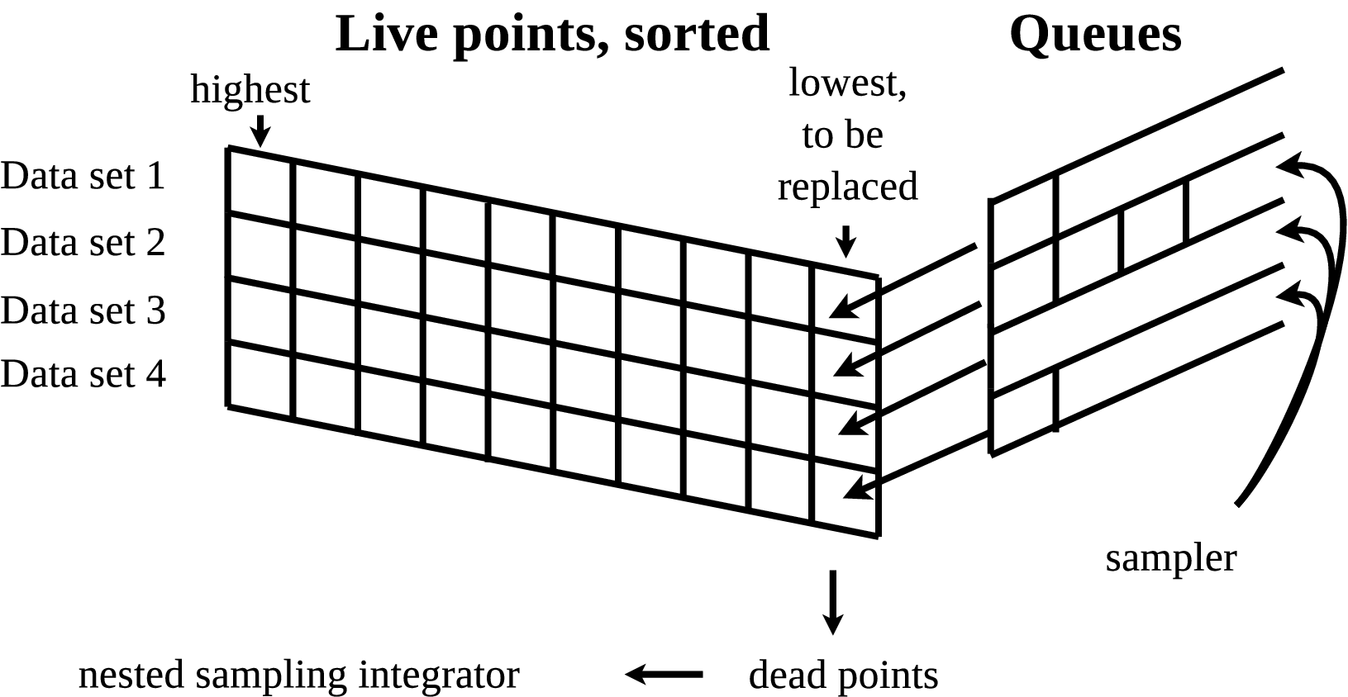
Sharing live points
L
Dead points’ L & V
V
Buchner (2018): collaborative nested sampling

Slide 21
Constructing super-regions
across all data
  “Superset draw”
across empty queues
  “Focussed draw”
Trade-off: sharing efficiency
Buchner (2018): collaborative nested sampling

Slide 22
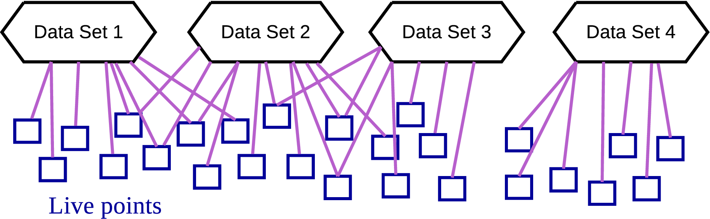
Sharing live points
Shared live points = acceleration
Diverging runs = independence
Find disjoint graph = overhead
Buchner (2018): collaborative nested sampling

Slide 23
When could this be useful?
(in contrast to
standard ML)
Large # of data sets
  Similarly structured & potentially similar parameters
  Optimal if uncertainties substantial
Complex models
  Physics slow, not analytical
  Arbitrarily complex statistical process
separate measurement process from physics!
  Get uncertainties on physical parameters
  Model comparison
Buchner (2018): collaborative nested sampling

Slide 24
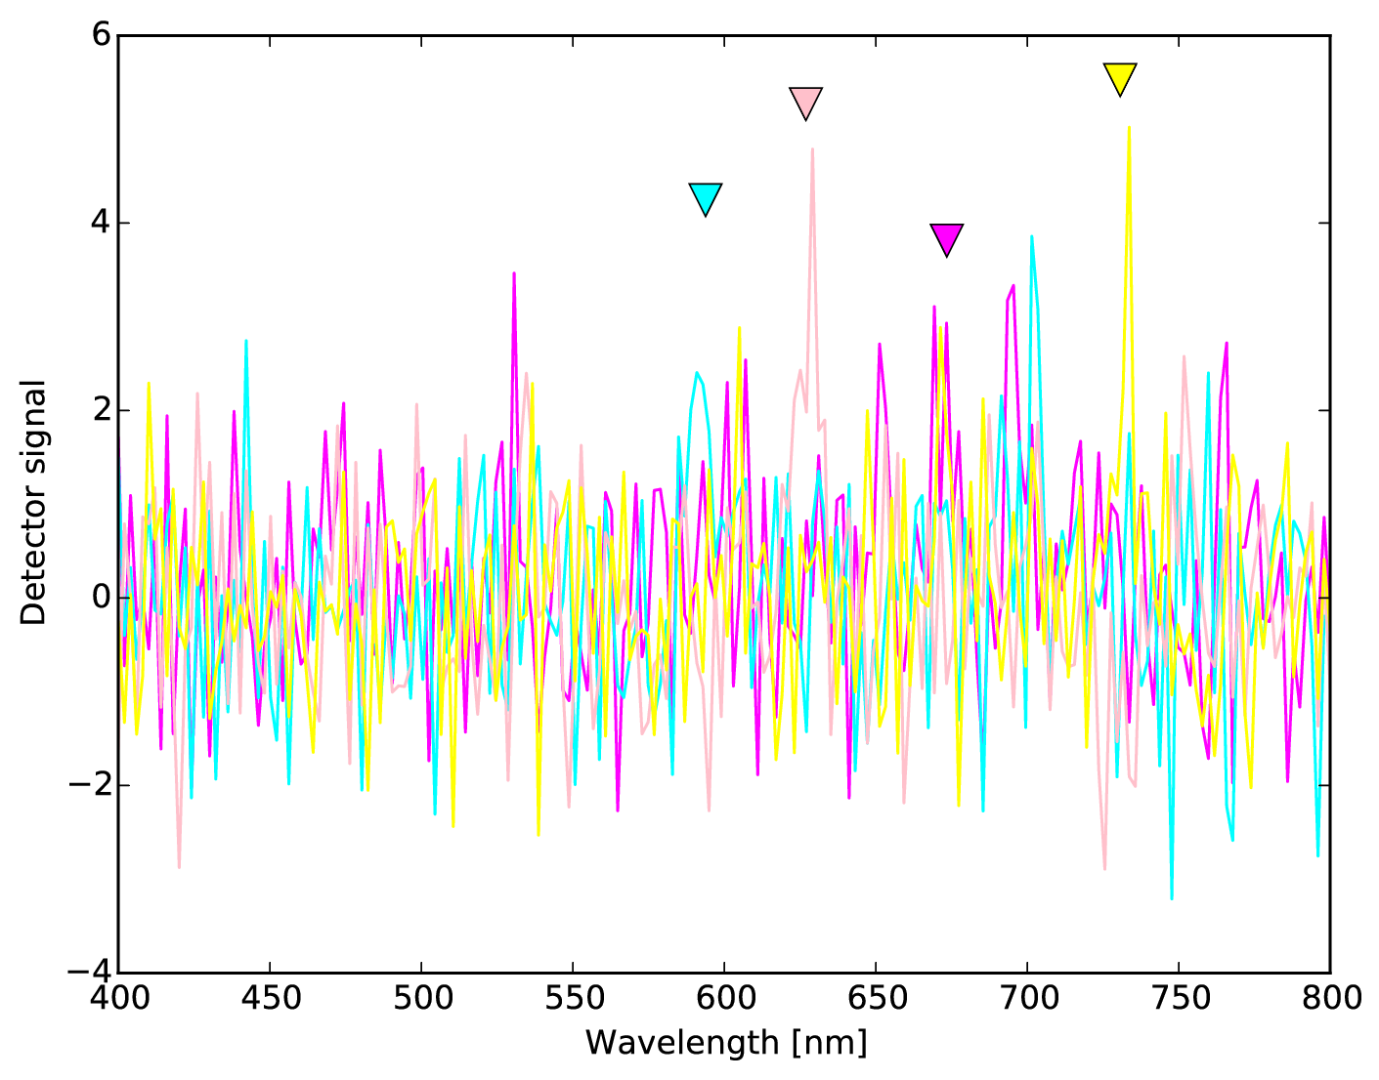
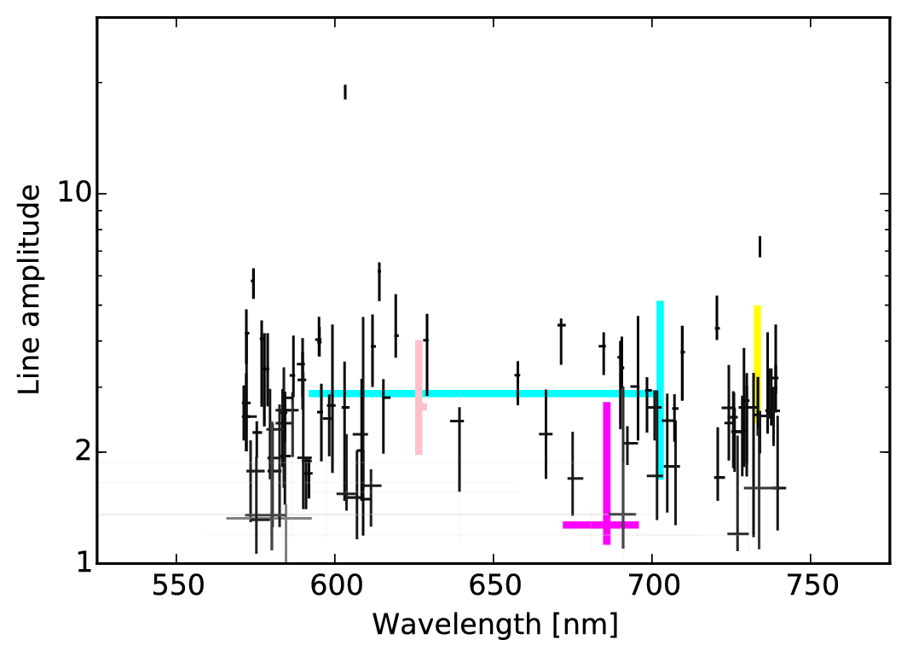
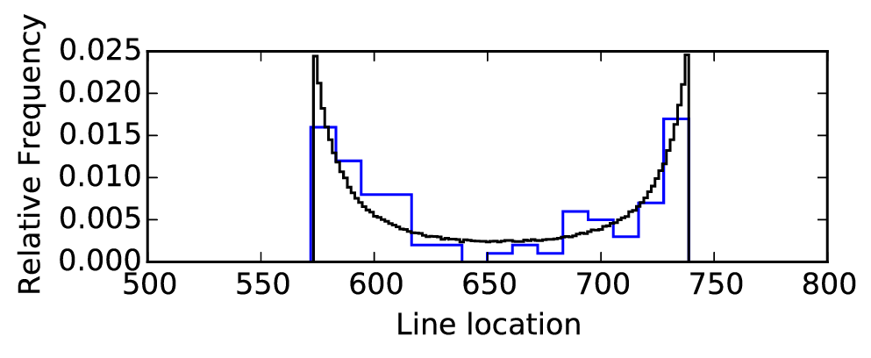
Toy demo: Fit a line
Simulated
Gaussian line = “slow model”
Gaussian noise = “fast likelihood”
Fitted with Collaborative NS + RadFriends
Buchner (2018): collaborative nested sampling

Slide 25
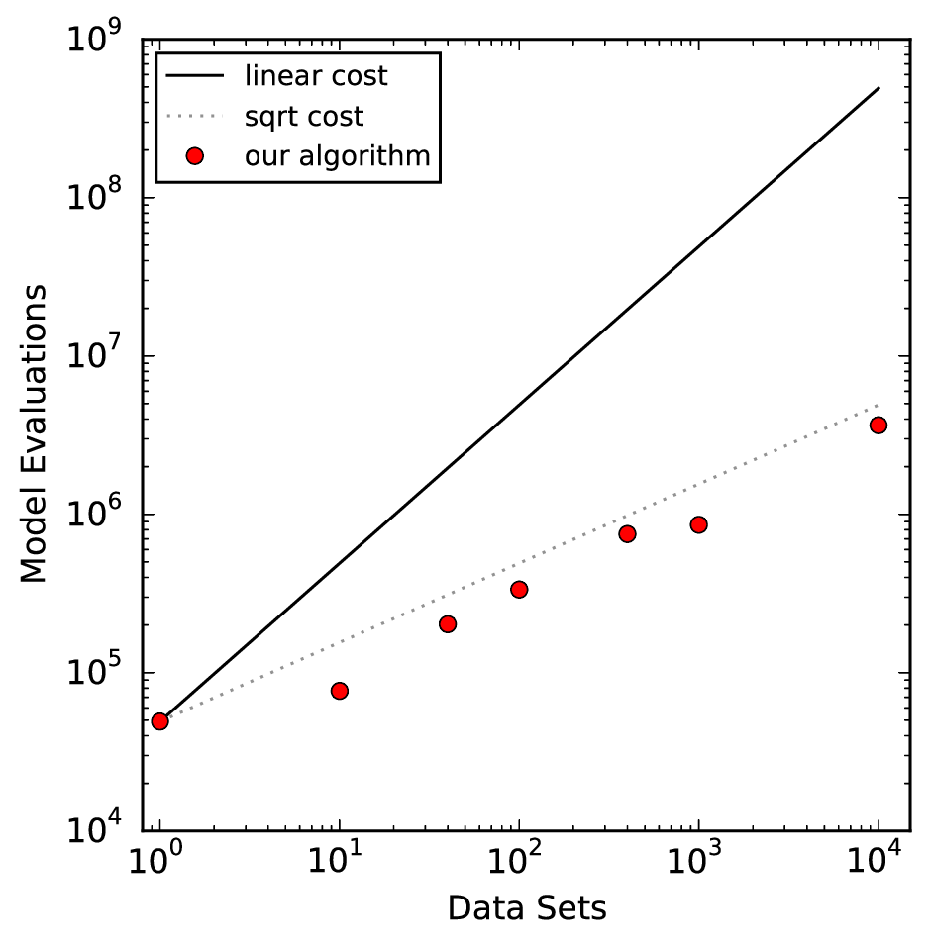
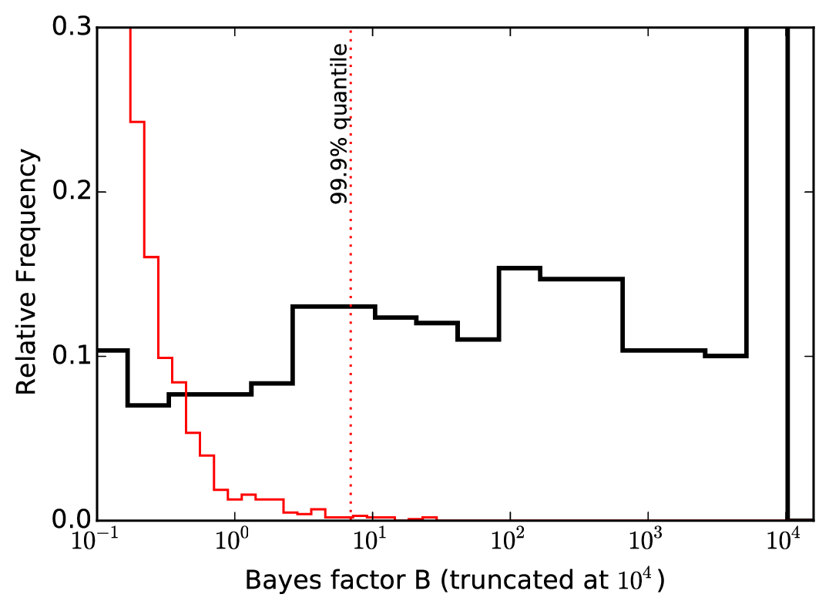
Toy demo: Fit a line
Sub-linear scaling
Monte Carlo simulations
Buchner (2018): collaborative nested sampling

Slide 26
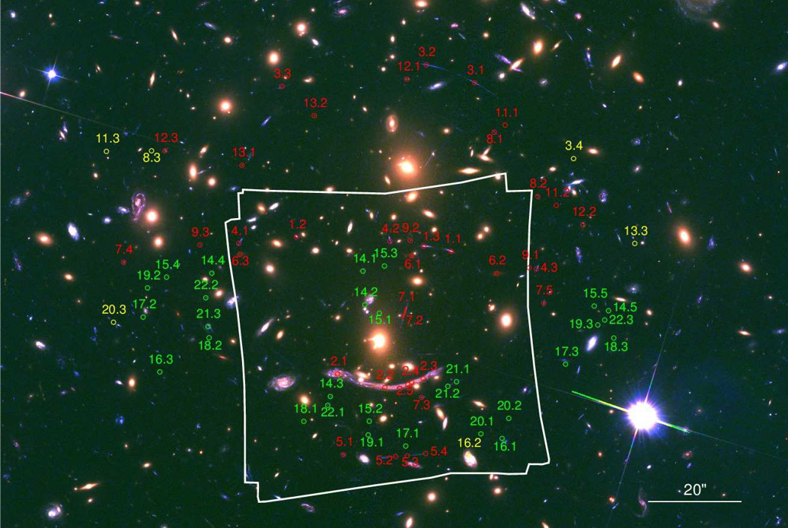
Demo: MUSE IFU
1arcmin² FOV,
480-930nm
Abell 370 galaxy cluster

Slide 27
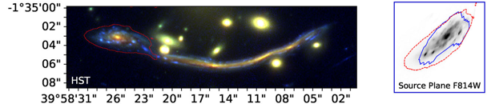
Demo: MUSE IFU
1arcmin² FOV,
480-930nm
Abell 370 galaxy cluster

Slide 28
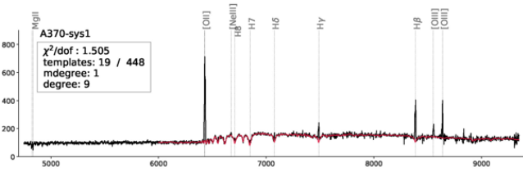
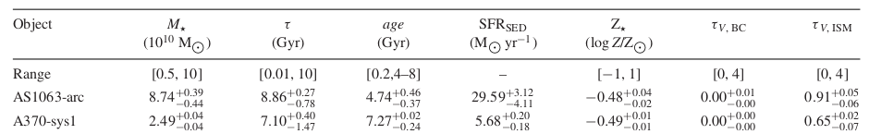
Demo: MUSE IFU
1arcmin² FOV,
480-930nm
Abell 370 galaxy cluster

Slide 29
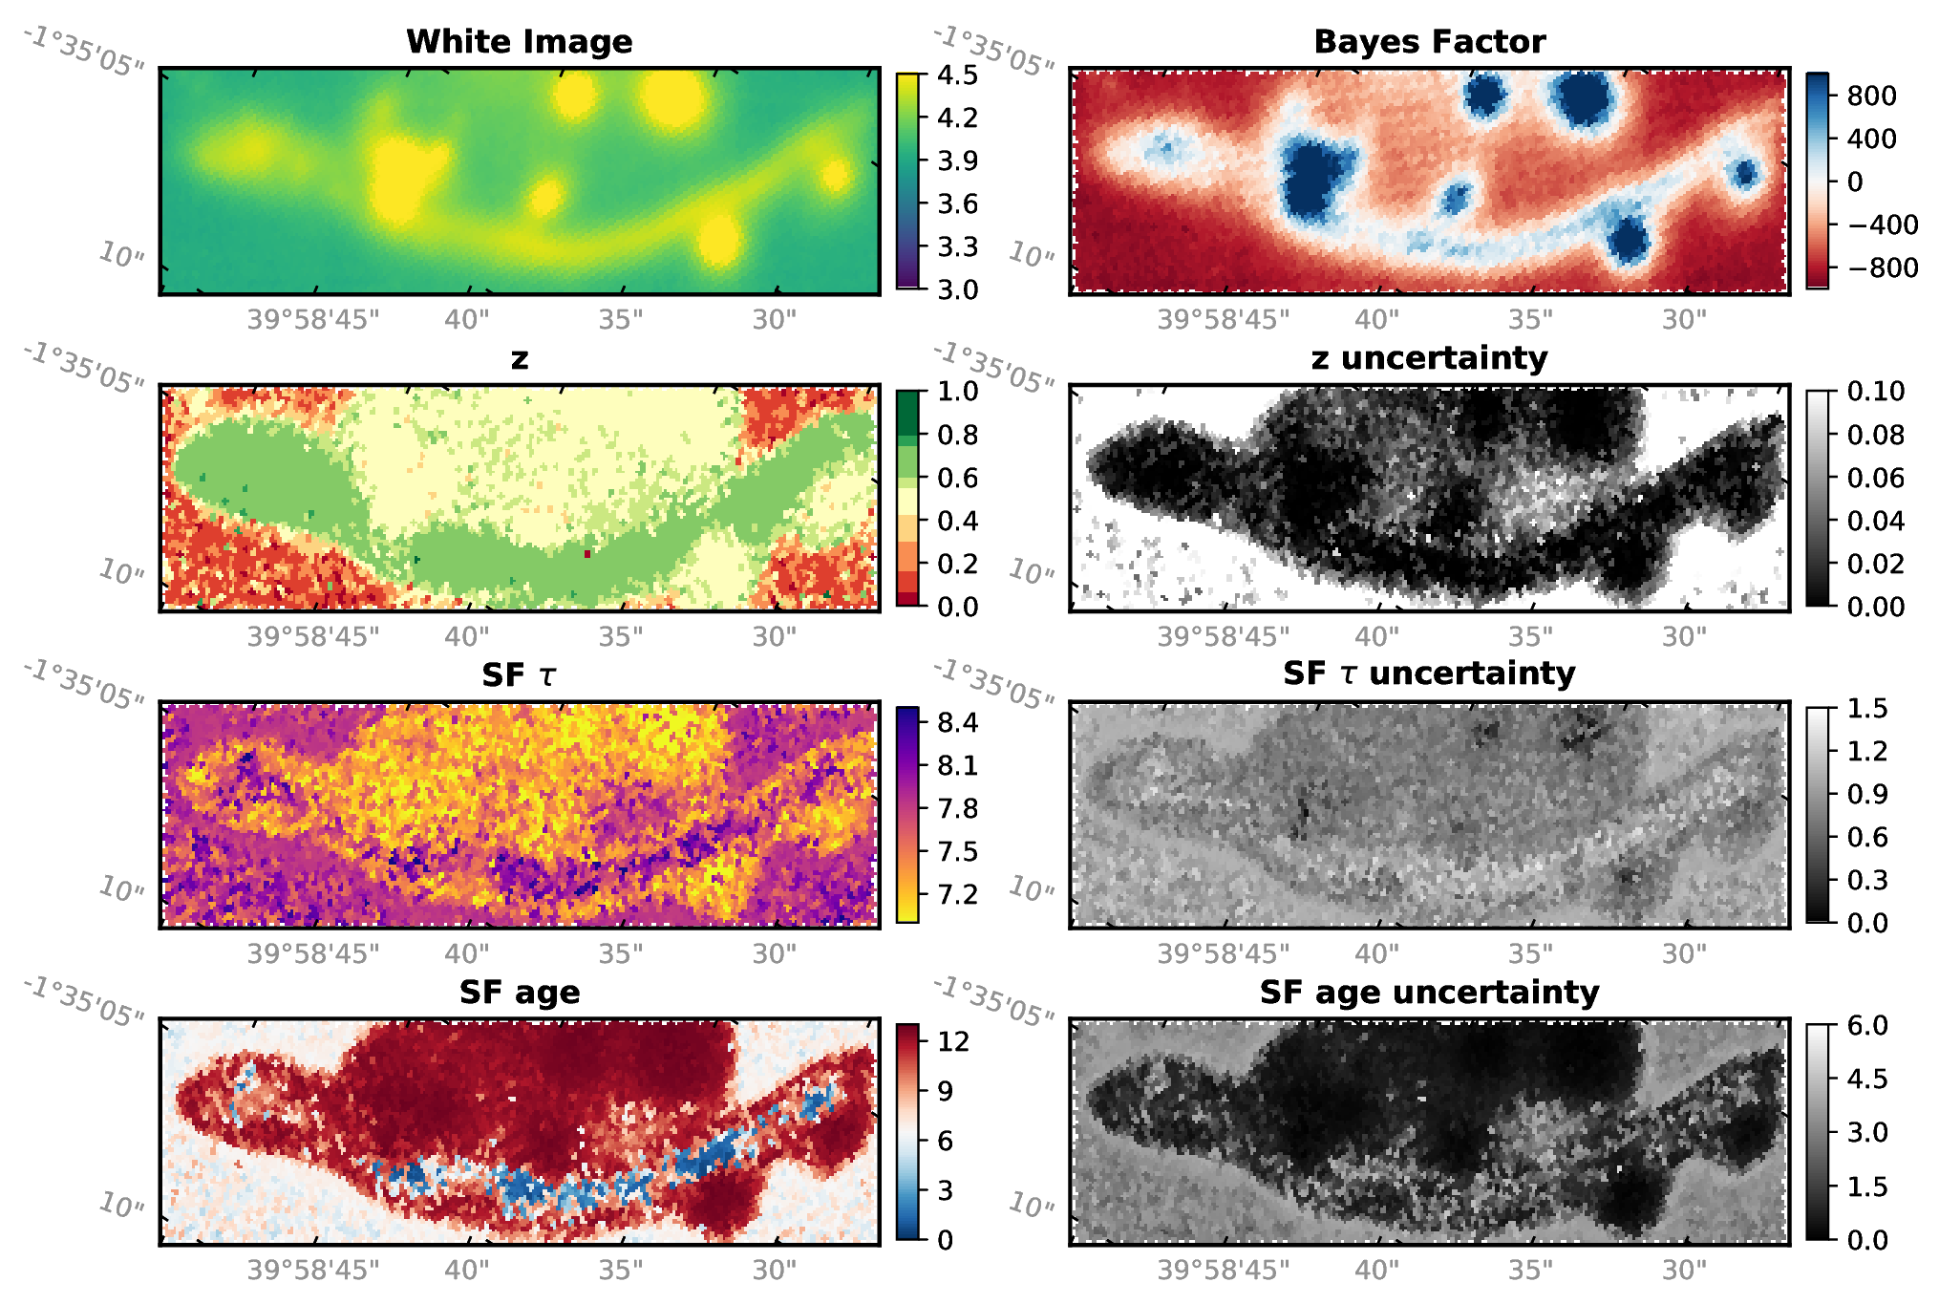
Buchner (2018): collaborative nested sampling

Slide 30
4223 fibers 140h 14.4e6 likelihood evaluations
100 fibers 14.9h 2.8e6 likelihood evaluations
speed-up: 4x
Buchner (2018): collaborative nested sampling

Slide 31
Limitations & Open problems
Multi-likelihood
M. slower than point bookkeeping
Complexity
  Python implementation @ https://github.com/JohannesBuchner/massivedatans/
Problem formulation
  Physical model uncertainties
How to do NS while accumulating data?
Model prediction
D1
D2
D3
D4
Buchner (2018): collaborative nested sampling

Slide 33
Common problems in astrophysics
Define a generative data model – likelihood + parameter space definition
Find parameter ranges
Distinguish models with Z
Robustness:
Test sensitivity to different priors
Cross-validation – leave some data out
Characterising a source
  Spectral lines, pulsation frequencies
  Orbital parameters
  Learn physical parameters
Comparing physical effects
  Include a mechanism or not. 0, 1 or 2 planets?
  Is the distribution a log-normal, a powerlaw or a broken powerlaw?

Slide 34
Common problems in astrophysics
Characterising a source
  Spectral lines, pulsation frequencies
  Orbital parameters
  Learn physical parameters
Comparing physical effects
  Include a mechanism or not. 0, 1 or 2 planets?
  Is the distribution a log-normal, a powerlaw or a broken powerlaw?
Characterising a population of sources
  Intrinsic distribution behind measurements
  Luminosity functions
  Population demographic behind drawn sample

Slide 35
Literature
In luminosity functions:
  Marshall+83, likely earlier
In astrostatistics:
  Loredo04 : Samples drawn from Poisson
  Kelly+08 : Samples drawn from Bernoulli
  Buchner+15: Side-to-side comparison, give same formula unless selection bias is applied.
In statistics/cross-fields:
  Hierarchical models, multi-level models

Slide 36
A common problem
Detected a set of objects
  Galaxies, stars, asteroids
Measured some property
  Luminosity, Mass, Obscuration, Metallicity
With uncertainty, upper limits, missing data
Limited sample size
What is the distribution of that property in the underlying population

Slide 37
Uncertainties
P(x)
Upper limit
Measurement error
“Degeneracy”
Multiple solutions
Multiple modes
x
Related to our measuring instrument and observing conditions
One of these values inside the posterior is the true one (LOGICAL XOR)

Slide 38
Intrinsic Scatter
f(x)
Spectral slope, Photon Index distribution
Mass, Luminosity distributions: Powerlaw-like, truncated
Beta distribution = Schechter function
x
Width of the distribution of the underlying population
Intrinsic to the astrophysical population
The population produced all of the objects
(LOGICAL AND)

Slide 39
Different “distributions”
Frequency distribution
  Population
Uncertainty, probability distribution
  Observation
social sciences, ML, non-parametric methods: Use point estimator, look at total distribution
Physics: Separate out measurement uncertainty
Political opinions
Ad-hoc behavior models

Slide 40
How to do it wrong
Generate N random points from measurements, treat them as pseudo-objects (weight 1/N)
Stack posteriors
Mixes uncertainty with intrinsic scatter
Can under-estimate or over-estimate
Also difficult: splitting sample (histograms, Vmax)
x

Slide 41
Parametric Methods
Assume a model for the underlying population
e.g. Gaussian distribution with intrinsic scatter
For a individual object, the likelihood to have x is
convolve measurement uncertainty with model
LOGICAL OR
Must be true for all objects --> LOGICAL AND

Slide 42
Example
Measurement gave
x1 = 4+-1
x2 = 5+-0.1
Generate 100 samples for each
100xN matrix of x

Slide 43
Example
Evaluate model
F(x)
100xN matrix of x
100xN matrix of F

Slide 44
Example
Sum probabilities
Multiply probabilities
Then try out other model parameters
100xN matrix of F
N
vector
L

Slide 45
Graphic explanation
P(x)
Measurement error
x
F(x)
Population distribution

Slide 46
Graphic explanation
P(x)
Measurement error
x
F(x)
Population distribution

Slide 47
Graphic explanation
P(x)
Measurement error
x
F(x)
Population distribution

Slide 48
Graphic explanation
P(x)
Measurement error
x
F(x)
Population distribution

Slide 49
Behaviour
Generate from 6+-2 with measurement errors

Slide 50
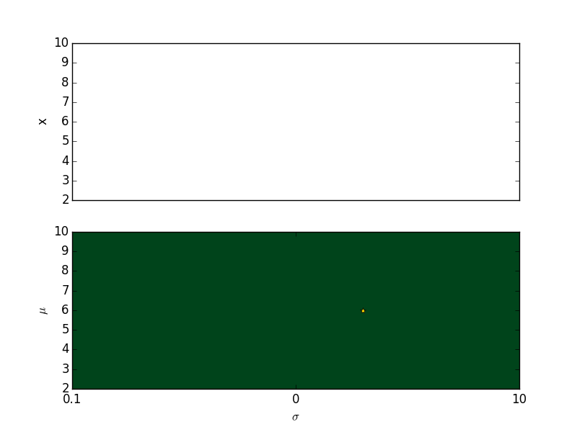
Behaviour

Slide 51
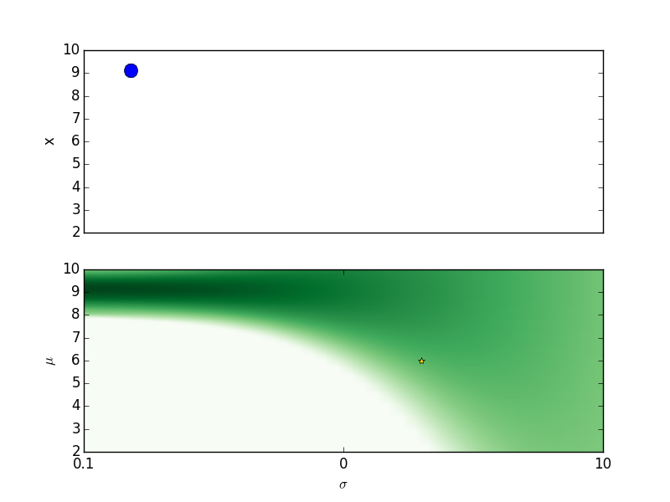
Behaviour

Slide 52
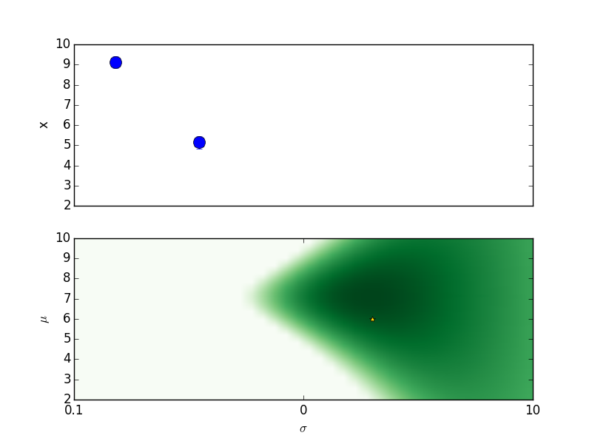
Behaviour

Slide 53
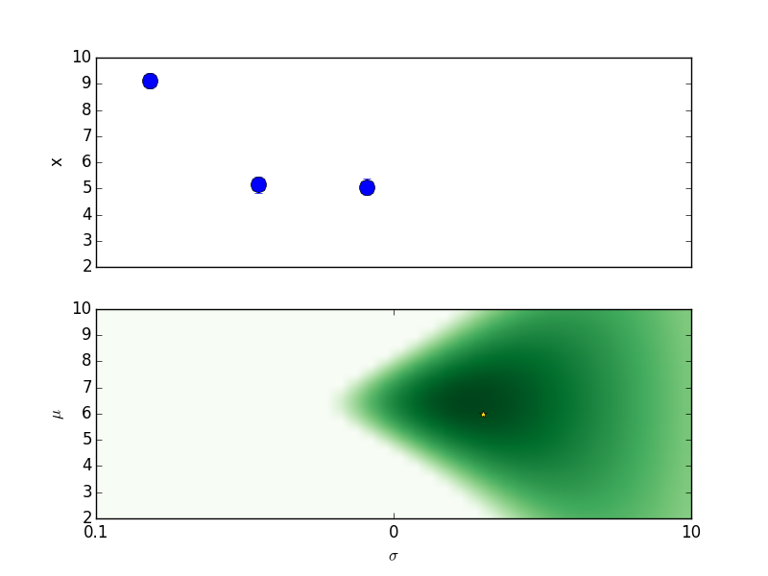
Behaviour

Slide 54
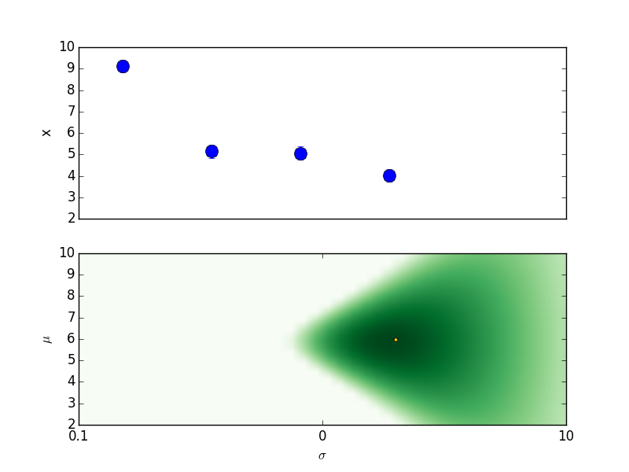
Behaviour

Slide 55
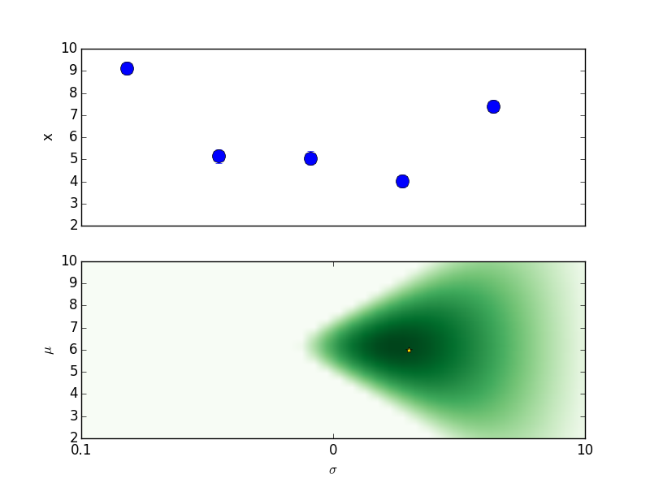
Behaviour

Slide 56
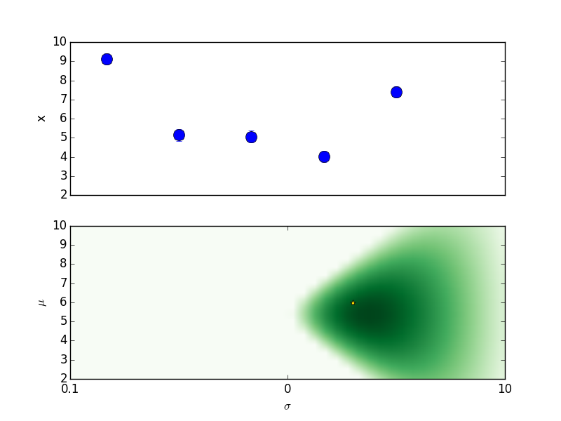
Behaviour

Slide 57
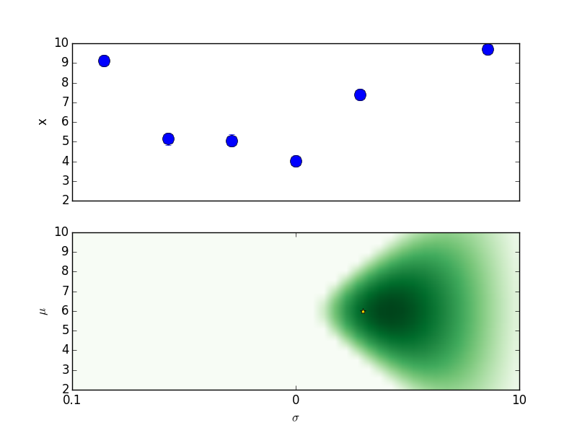
Behaviour

Slide 58
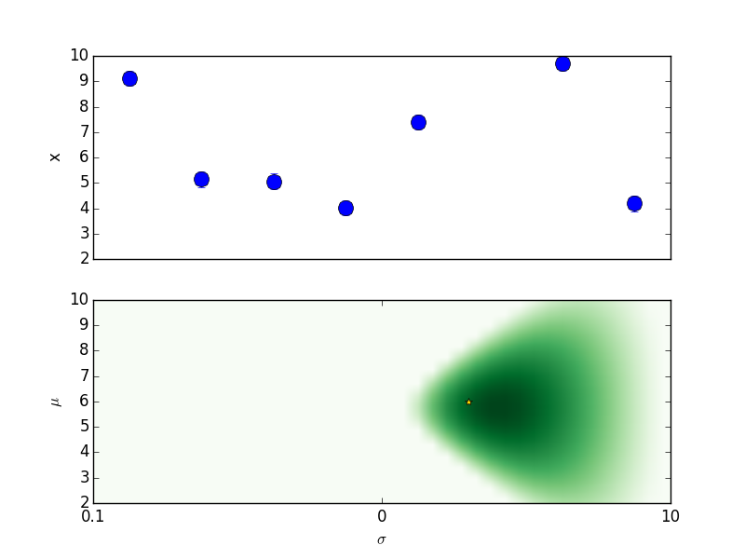
Behaviour

Slide 59
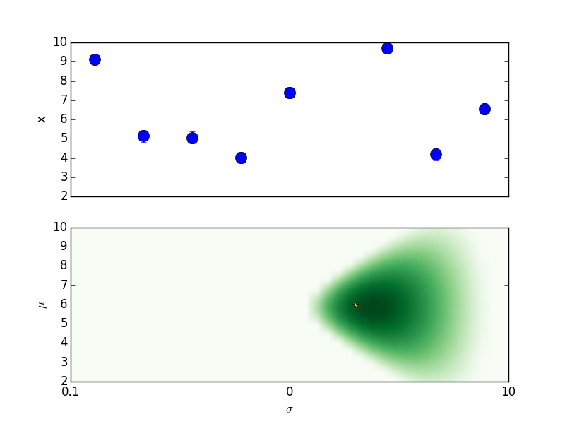
Behaviour

Slide 60
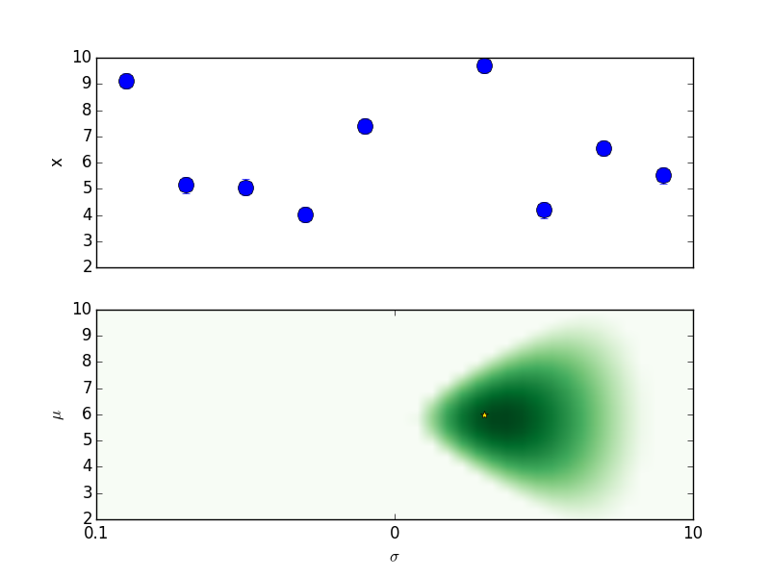
Behaviour

Slide 61

Behaviour

Slide 62

Behaviour

Slide 63
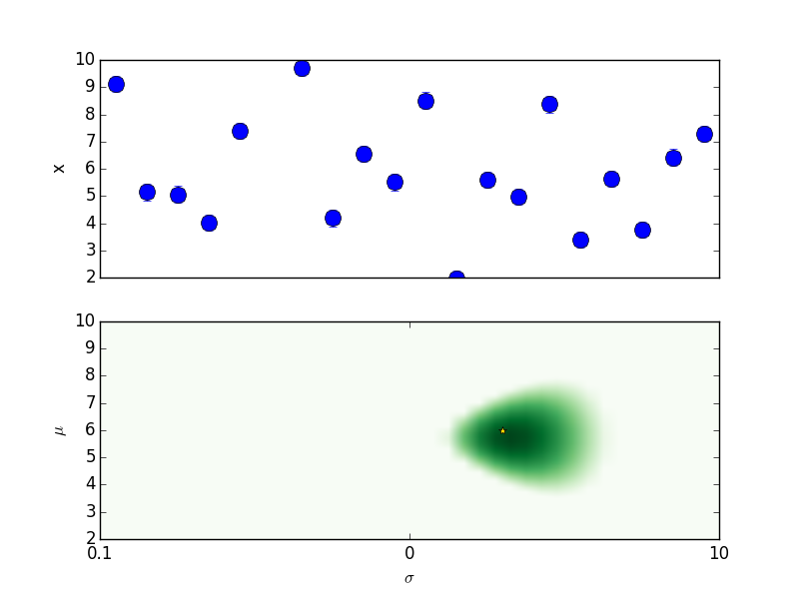
Behaviour

Slide 64
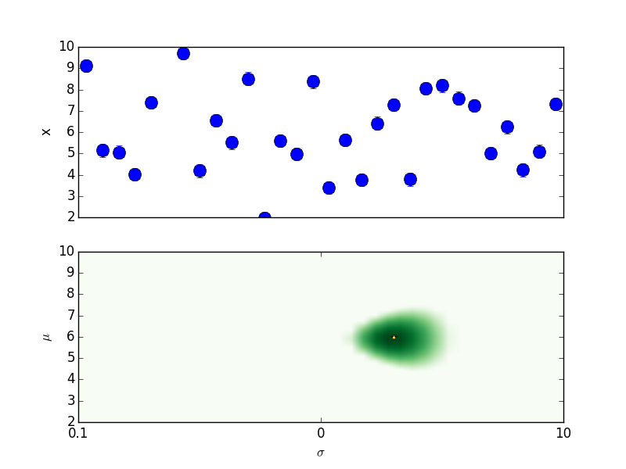
Behaviour

Slide 65
Behaviour

Slide 66
Behaviour

Slide 67
Behaviour

Slide 68

Behaviour

Slide 69

Behaviour

Slide 70
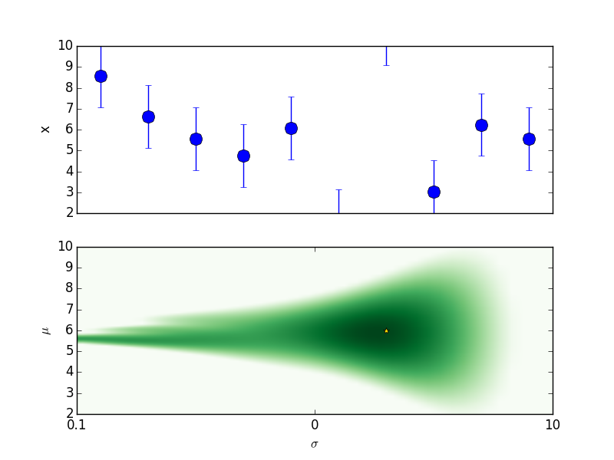
Behaviour

Slide 71
Behaviour

Slide 72
Behaviour

Slide 73
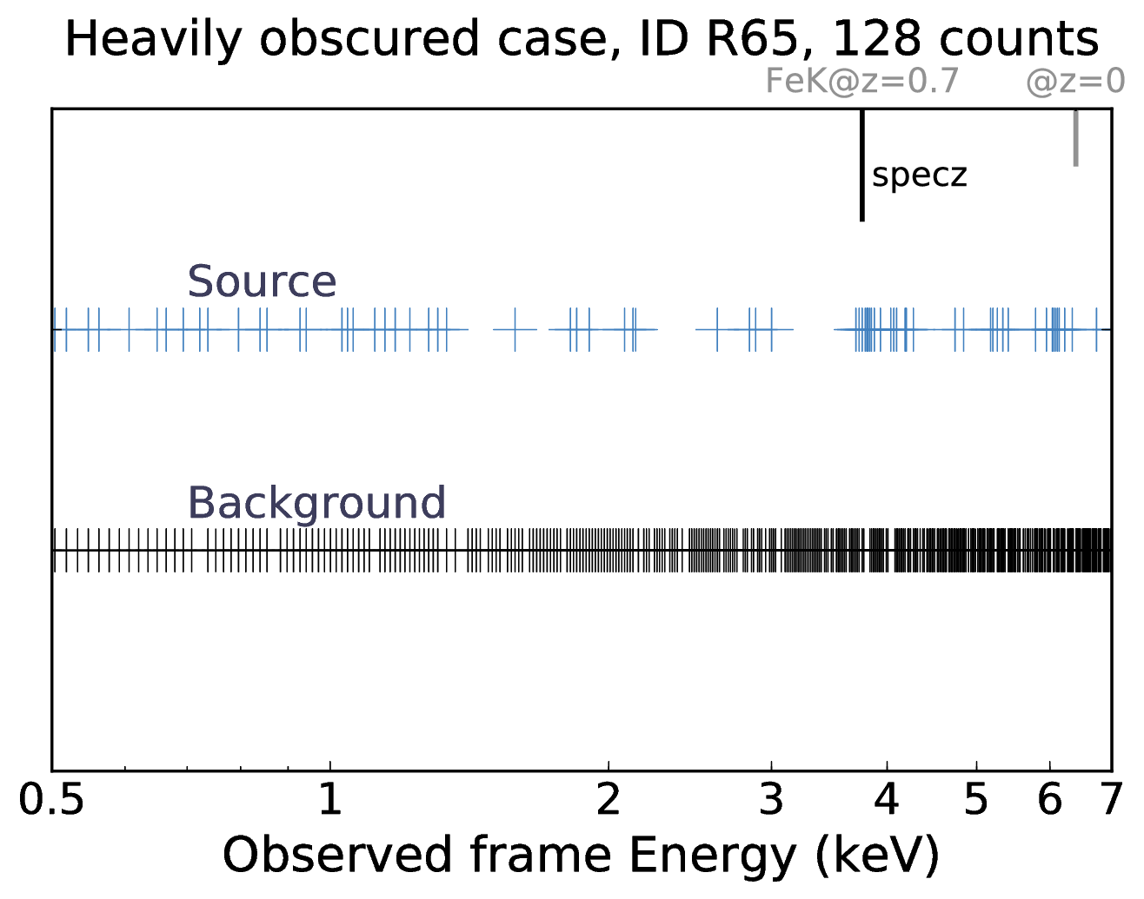
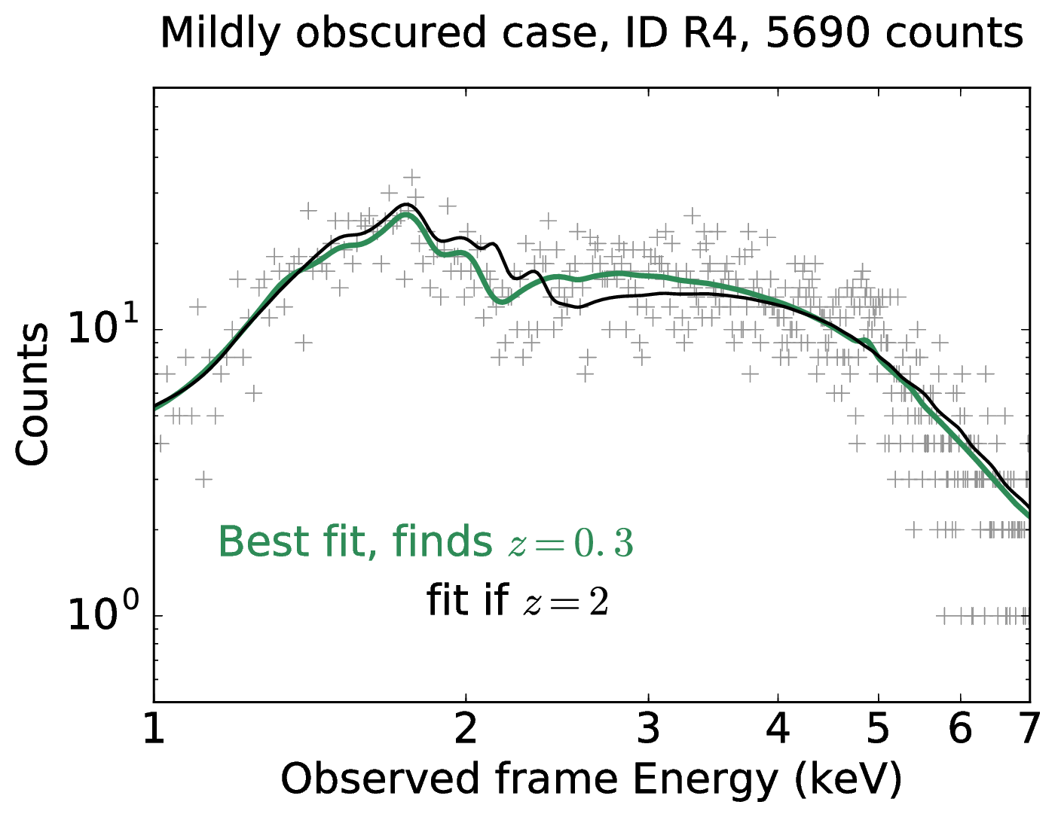
XZ
Research interests
X-ray Survey analysis
X-ray (low-resolution spectroscopic) Redshifts
(Simmonds, Buchner et al, 2018)
Geometry of obscurer
from X-ray spectra
Luminosity function
Heavily obscured AGN
SMBH occupation
f(M*,z)
(Simmonds, JB et al, accepted)
Obscured, CTK fraction
f(L,z)
Obscured, CTK fraction
by galaxy gas f(M*,z)
FLUORESCENT LINES
ABSORPTION EDGES
Spectral fitting
with low counts (BXA)
Multi-wavelength
Association NWAY
Cosmological Sims
Nested Sampling &
PyMultiNest
Hierarchical Bayesian
Models

Slide 74
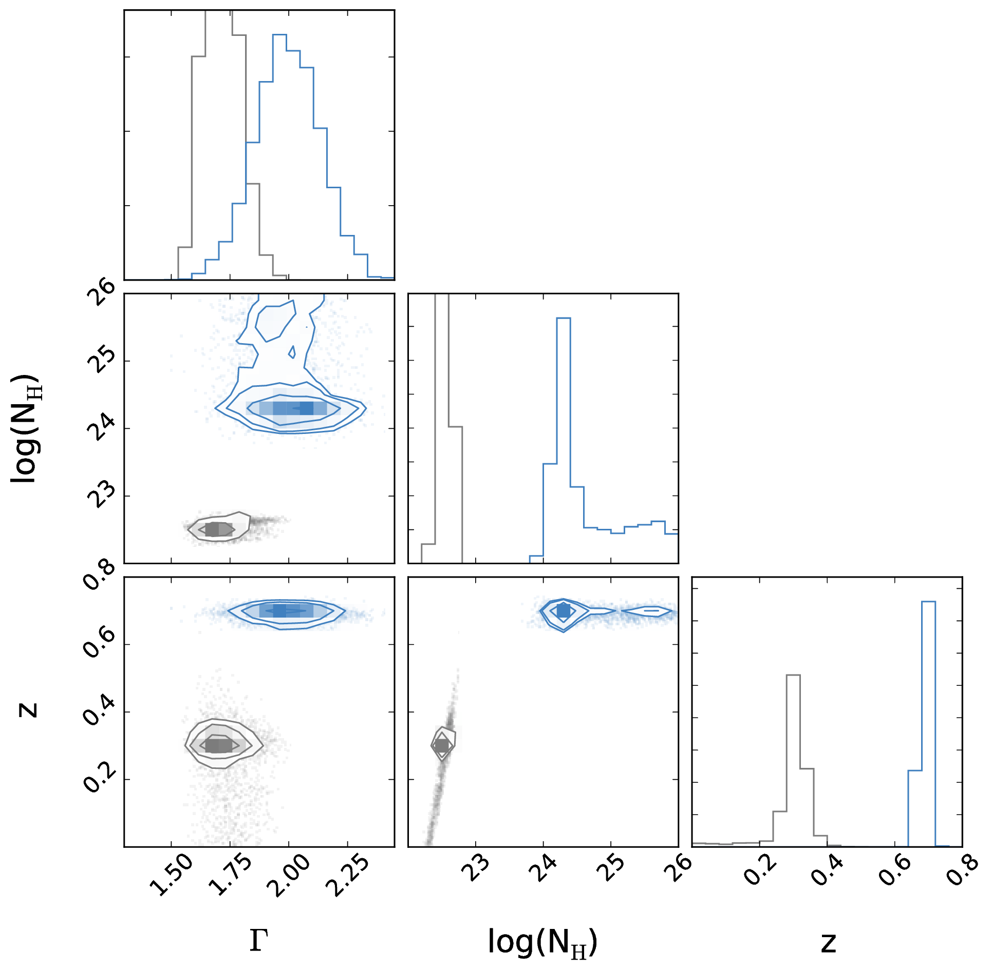
XZ
Research interests
BXA uses MultiNest
X-ray Survey analysis
(Simmonds, Buchner et al, 2018)
Explore
parameter space of complex models
Geometry of obscurer
from X-ray spectra
Luminosity function
Heavily obscured AGN
SMBH occupation
f(M*,z)
(Simmonds, JB et al, accepted)
Obscured, CTK fraction
f(L,z)
Obscured, CTK fraction
by galaxy gas f(M*,z)
FLUORESCENT LINES
ABSORPTION EDGES
Spectral fitting
with low counts (BXA)
Multi-wavelength
Association NWAY
Cosmological Sims
Nested Sampling &
PyMultiNest
Hierarchical Bayesian
Models
Redshift

Slide 75
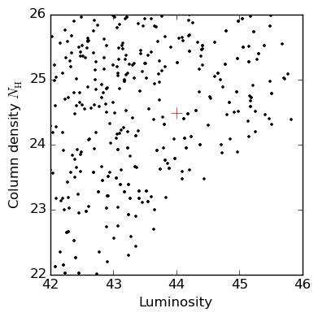
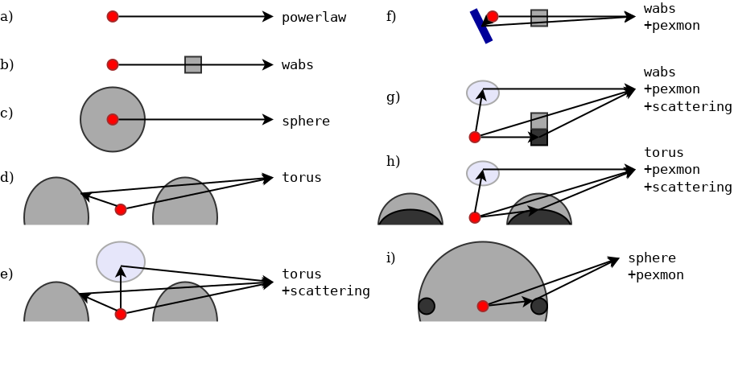
BXA
Research interests
X-ray Survey analysis
Derive probability distributions
on model parameters:
L_{X}, N_{H}, z
Compare models
Geometry of obscurer
from X-ray spectra
Luminosity function
Heavily obscured AGN
SMBH occupation
f(M*,z)
Obscured, CTK fraction
f(L,z)
Obscured, CTK fraction
by galaxy gas f(M*,z)
Spectral fitting
with low counts (BXA)
Multi-wavelength
Association NWAY
Cosmological Sims
Optional to extract more information:
Automatically fit empirical BKG models (Chandra, XMM/PN+MOS, NuSTAR, Swift, Suzaku, RXTE)
Nested Sampling &
PyMultiNest
Hierarchical Bayesian
Models

Slide 76
Geometries & X-rays
Research interests
X-ray Survey analysis
Geometry of obscurer
from X-ray spectra
Luminosity function
Heavily obscured AGN
SMBH occupation
f(M*,z)
Obscured, CTK fraction
f(L,z)
Obscured, CTK fraction
by galaxy gas f(M*,z)
Spectral fitting
with low counts (BXA)
Multi-wavelength
Association NWAY
Cosmological Sims
Buchner+14:
Geometry of torus from X-ray spectral fitting in CDFS
Nested Sampling &
PyMultiNest
Hierarchical Bayesian
Models

Slide 77
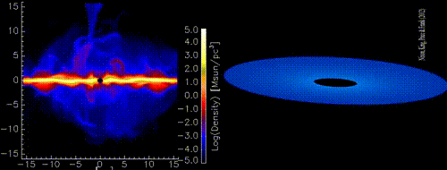

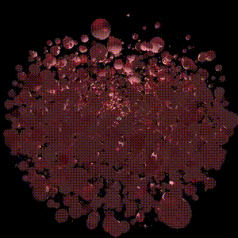
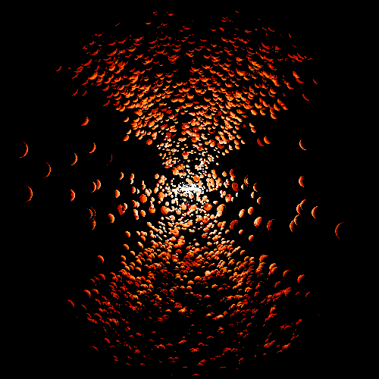
Geometries & X-rays
Research interests
X-ray Survey analysis
Geometry of obscurer
from X-ray spectra
Luminosity function
Heavily obscured AGN
SMBH occupation
f(M*,z)
Obscured, CTK fraction
f(L,z)
Obscured, CTK fraction
by galaxy gas f(M*,z)
http://github.com/JohannesBuchner/xars
Spectral fitting
with low counts (BXA)
Multi-wavelength
Association NWAY
Cosmological Sims
Nested Sampling &
PyMultiNest
Hierarchical Bayesian
Models

Slide 78
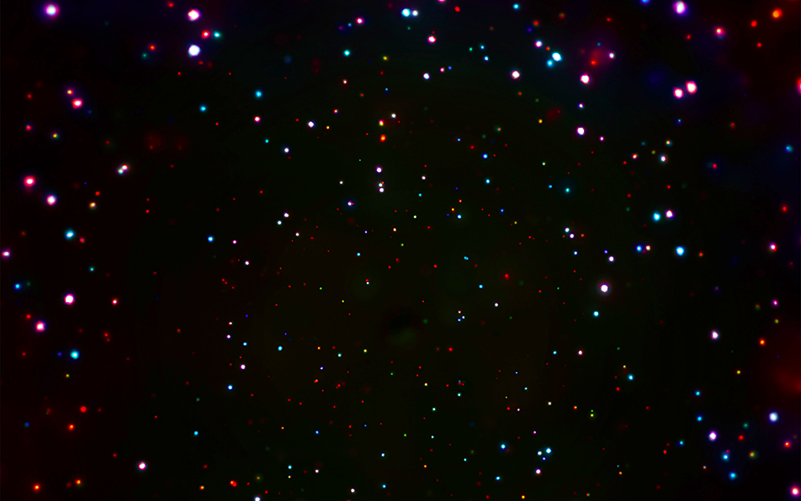


Research interests
X-ray Survey analysis
Geometry of obscurer
from X-ray spectra
Luminosity function
Heavily obscured AGN
SMBH occupation
f(M*,z)
Obscured, CTK fraction
f(L,z)
Obscured, CTK fraction
by galaxy gas f(M*,z)
Spectral fitting
with low counts (BXA)
Multi-wavelength
Association NWAY
Cosmological Sims
CDFS: Luo+17
COSMOS,
AEGIS-XD,
XMM-XXL
Buchner+15
Nested Sampling &
PyMultiNest
Hierarchical Bayesian
Models

Slide 79
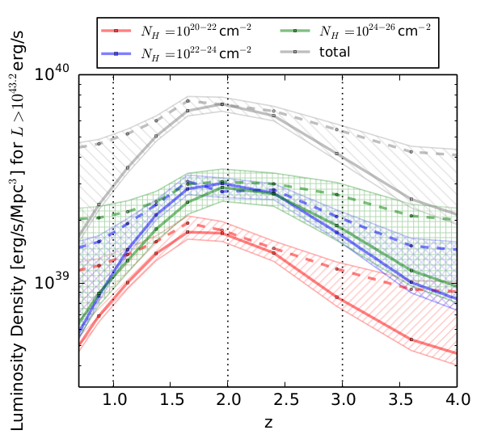
Research interests
X-ray Survey analysis
Geometry of obscurer
from X-ray spectra
Luminosity function
Heavily obscured AGN
SMBH occupation
f(M*,z)
Obscured, CTK fraction
f(L,z)
Obscured, CTK fraction
by galaxy gas f(M*,z)
Spectral fitting
with low counts (BXA)
Multi-wavelength
Association NWAY
Cosmological Sims
CDFS: Luo+17
COSMOS,
AEGIS-XD,
XMM-XXL
Buchner+15
Nested Sampling &
PyMultiNest
Hierarchical Bayesian
Models

Slide 80


Research interests
X-ray Survey analysis
Geometry of obscurer
from X-ray spectra
Luminosity function
Heavily obscured AGN
SMBH occupation
f(M*,z)
Obscured, CTK fraction
f(L,z)
Obscured, CTK fraction
by galaxy gas f(M*,z)
Horizon-AGN
Volonteri+16
EAGLE
Rosas-Guevara+16
Spectral fitting
with low counts (BXA)
Buchner+15
Cosmological Sims
Multi-wavelength
Association NWAY
Nested Sampling &
PyMultiNest
Hierarchical Bayesian
Models

Slide 81

Research interests
X-ray Survey analysis
Geometry of obscurer
from X-ray spectra
Luminosity function
Heavily obscured AGN
SMBH occupation
f(M*,z)
Obscured, CTK fraction
f(L,z)
Obscured, CTK fraction
by galaxy gas f(M*,z)
Obscuration by host-galaxy gas
(determined via
GRB obscuration)
Spectral fitting
with low counts (BXA)
Multi-wavelength
Association NWAY
Cosmological Sims
Nested Sampling &
PyMultiNest
Hierarchical Bayesian
Models
Buchner+15
Buchner+17a
Buchner+17b

Slide 82
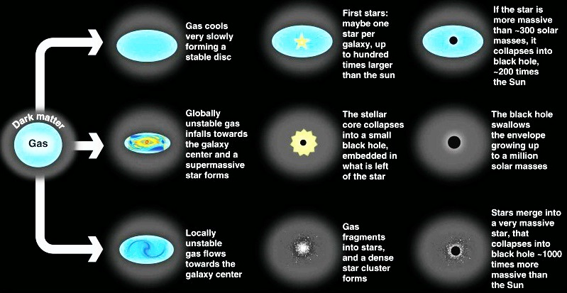
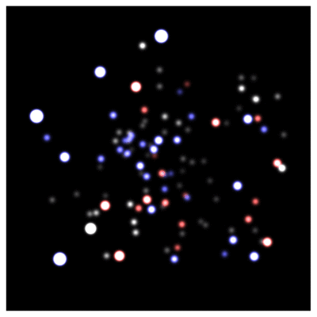
Research interests
X-ray Survey analysis
Geometry of obscurer
from X-ray spectra
Luminosity function
Heavily obscured AGN
SMBH occupation
f(M*,z)
Obscured, CTK fraction
f(L,z)
z=?
Obscured, CTK fraction
by galaxy gas f(M*,z)
z=0
Spectral fitting
with low counts (BXA)
Multi-wavelength
Association NWAY
Cosmological Sims
Nested Sampling &
PyMultiNest
Hierarchical Bayesian
Models
GC / IR group at MPE
Schödel+02, Eisenhauer+05, Gillessen+09
Volonteri 2012, Rees 1978

Slide 83
Research interests
X-ray Survey analysis
Geometry of obscurer
from X-ray spectra
Luminosity function
Heavily obscured AGN
SMBH occupation
f(M*,z)
Obscured, CTK fraction
f(L,z)
z=?
Obscured, CTK fraction
by galaxy gas f(M*,z)
z=0
Efficiency of seeding process?
How many SMBHs are there (at least)?
see Buchner et al. (2019)
Spectral fitting
with low counts (BXA)
Multi-wavelength
Association NWAY
Cosmological Sims
Nested Sampling &
PyMultiNest
Hierarchical Bayesian
Models
GC / IR group at MPE
Schödel+02, Eisenhauer+05, Gillessen+09
Volonteri 2012, Rees 1978

