Slide 1

Galaxy outflow channels
Johannes Buchner
http://astrost.at/istics

Slide 2
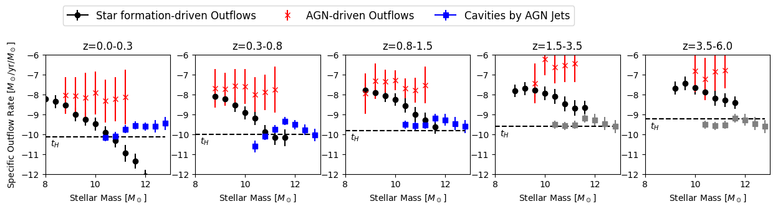
Idea
Compare importance of feedback channels
  Star-formation feedback
  Kinetic/heating/radio AGN mode
  Radiative/quasar AGN mode
For each:
  Estimate average outflow rate
  As a function of M*, z
  Completely data-driven

Slide 3
SFR-driven outflows
P(sSFR|M*)
Behroozi+19 compilation
Outflow relations
M(L_{AGN}=0,SFR,M*)
Fluetsch+18
Well-measured, small uncertatinties
Need to refit to get correlated uncertainties

Slide 4
AGN-driven outflows
Specific Accretion Rate Dist.
P(L_{X}|M*)
Aird+16, ?
Outflow relations
M(L_{AGN},SFR=0,M*)
Fluetsch+18
Aird+16 uncertain at bright end, need to include Georgakakis+17, renormalise
Need to refit to get correlated uncertainties

Slide 5
AGN jet power
Cavity power relation
P_{cav}=k L_{R}^{b}
O'Sullivan+11,
Cavagnolo+10,
Birzan+10
LF shape appears M* and z-indep
1.4GHz Radio LF
P(L_{R})
Sadler+02
Radio AGN frac.
P(L_{R}>L_{min}|M*,z)
Smolčić+09
Radio output
P(L_{R}|M*)
Total Cavity power
P_{cav}|M*
Need measurements at z>1.5
Need to find better LF measurements at z=0-5
Need to find newer measurements

Slide 6

AGN heating flow
Total Cavity power
P_{cav}|M*
Cooling Temperature
T~L
Giles+2018
Input from last slide
Clamped to
0.2-10keV range
Cooling flow
Using mean molecular mass = proton mass?

Slide 7
Outflows compared
Above Hubble time: effective, below: ineffective
This doesn‘t say which channel is impacting the galaxy
AGN-driven outflows are uncertain because of bright LF end of Aird+
Gray is extrapolated radio LF

Slide 8
Interpretation
Demonstrates that SN feedback is important at low-M, AGN feedback important at high-M.
We knew this comparing sims & obs. But this plot is independent of models! No assumptions about halos, dark matter, cosmic evolution.
Limitations: not probing the impact, only the outflow mechanism.

