Slide 1


Illuminating the clumpy torus with NuSTAR and eROSITA
Johannes Buchner
http://astrost.at/istics
Collaborators
Murray Brightman, Mislav Balokovic, Franz Bauer,
Mirko Krumpe, Liu Teng, Kirpal Nandra, Keiichi Wada, Robert Nikutta, et altera

Slide 2
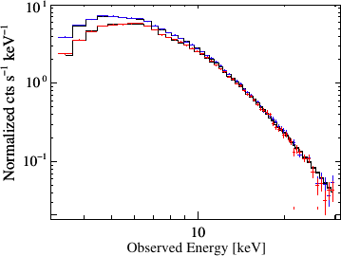
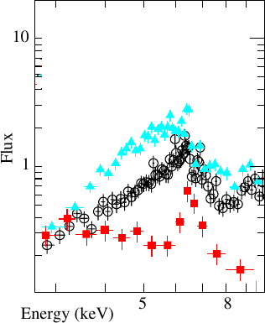
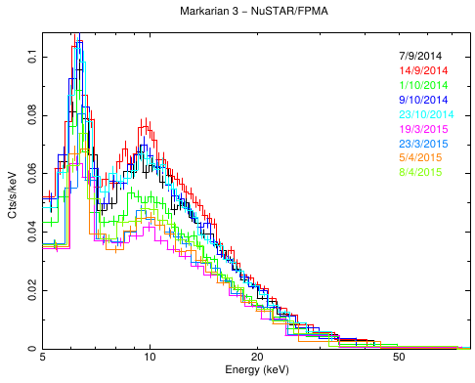
Column density changes
NGC 1365 Risaliti+05
Cen A Rivers+11
Mrk3 Guainazzi+16

Slide 3
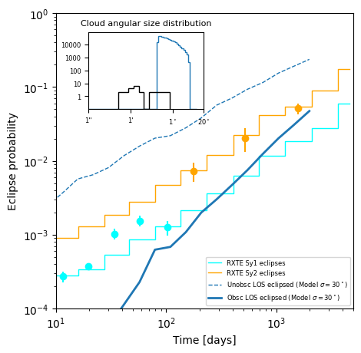
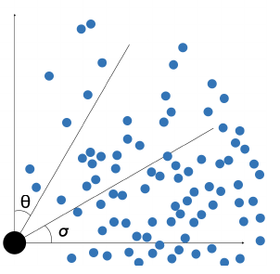
Simple Keplerian rotation model
Spheres
Orbits 11-1000y
Factor 20
Tanimoto+19

Slide 4
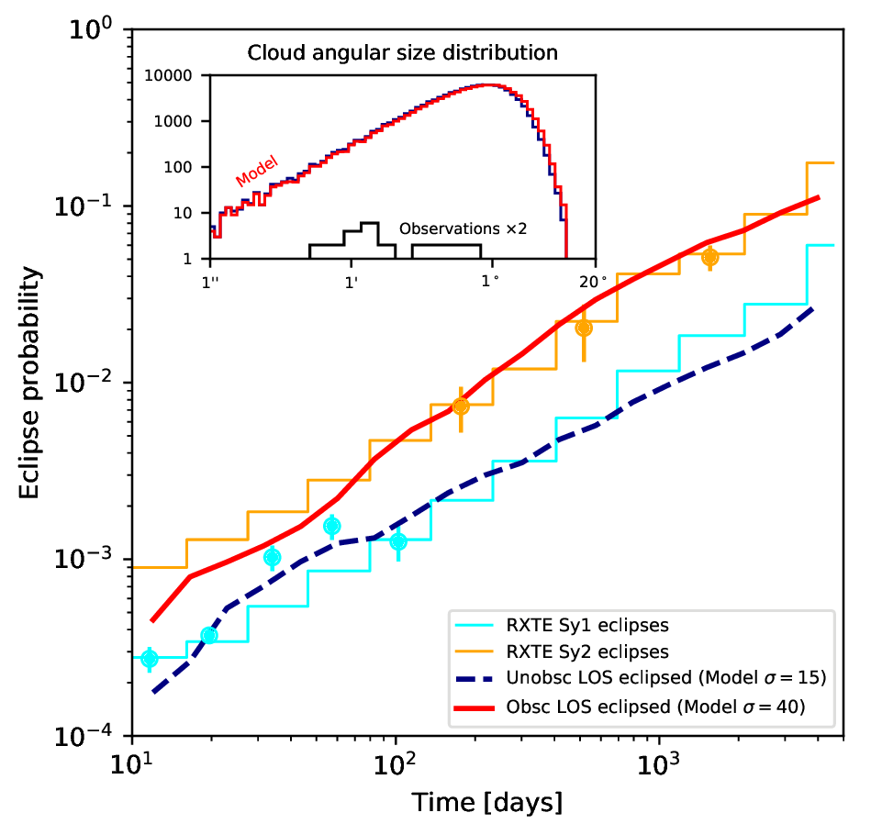
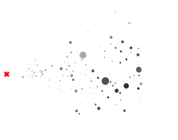
Matching Eclipse Frequencies
Spheres scale with distance
Wide size distribution
Factor 100
Buchner et al. (2019b)

Slide 6
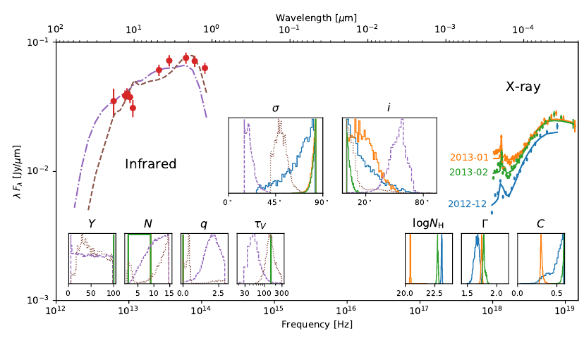
Multi-wavelength NGC 1365
Buchner et al. (2019b)

Slide 7

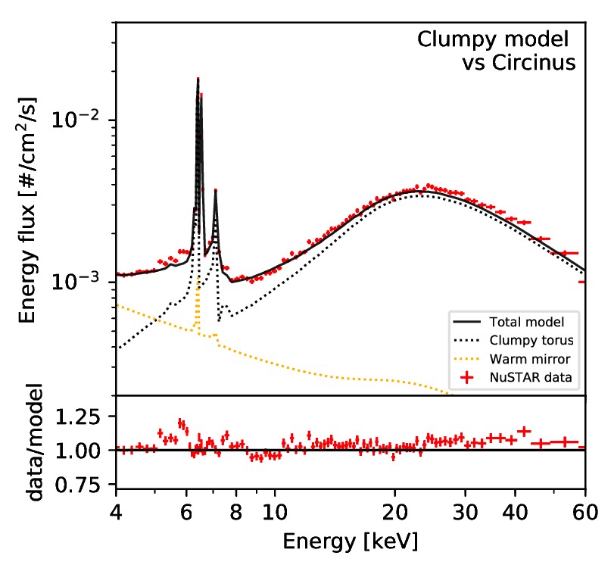
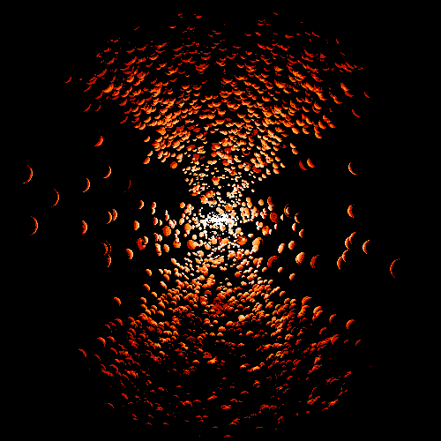
Outcomes
Wada 2012, Wada+2016
Pringle96,Maloney+96,Nixon+12
github.com/JohannesBuchner/xars
UXCLUMPY
CAT3D+WIND

Slide 8
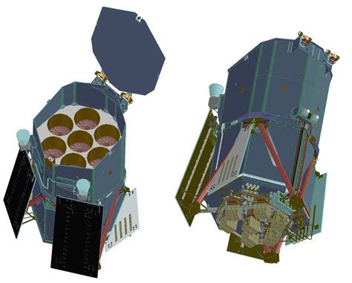
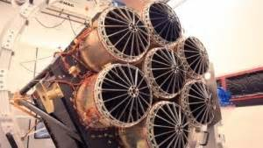
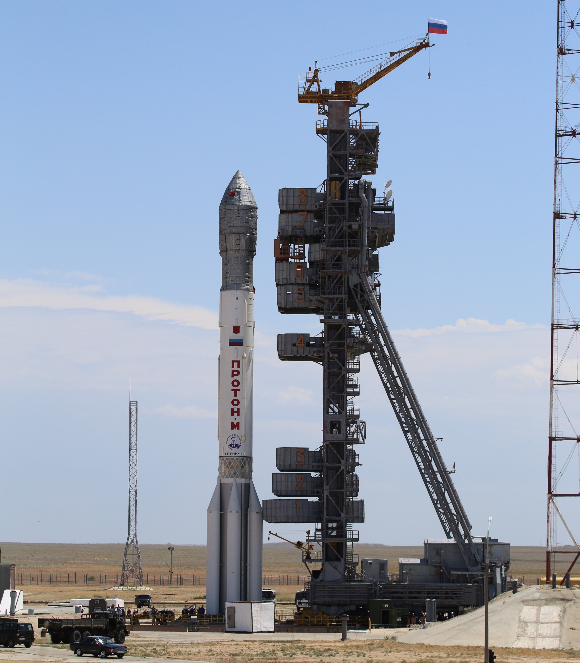

eROSITA
X-ray survey
  All-sky
  Deepest soft-band
  First hard-band
  every 6 months
  8 times
Science:
  Cosmology with clusters
  3 Million AGN expected
PSF: 15‘‘ on-axis
FOV: 0.8 deg²
soft/hard flux limit:
10^{-14/-13}erg/s/cm²
Launch: July 2019
Survey start: Dec 2019
@eROSITA_SRG on twitter
Conference 16-20 March 2020 Garching
Mapping the X-ray Sky with SRG: First Results from eROSITA and ART-XC

Slide 9


