Slide 1
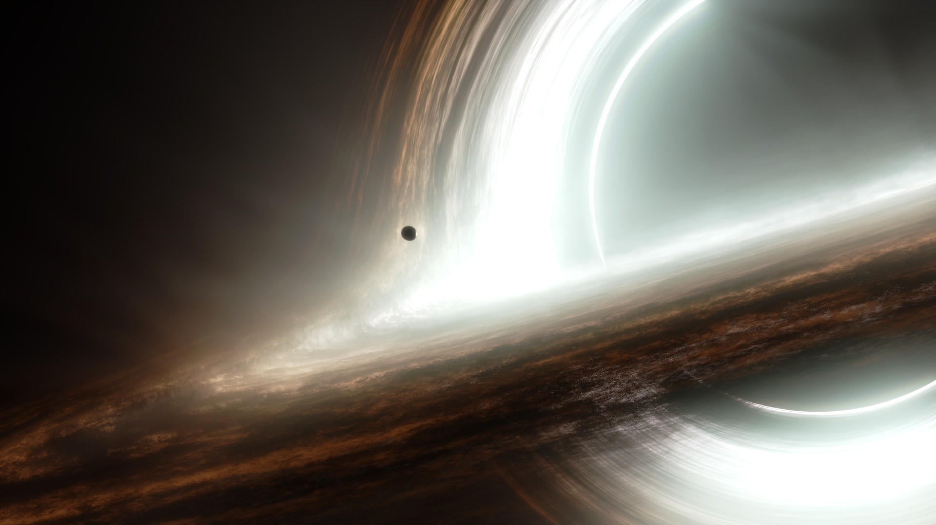

How many
Supermassive Black Holes are there?
Johannes Buchner
MPE, PUC
http://astrost.at/istics/
Collaborators (PUC & ETH): Ezequiel Treister, Franz Bauer,
Lia Sartori, Kevin Schawinski, Roberto Gonzalez, Nelson Padilla

Slide 2
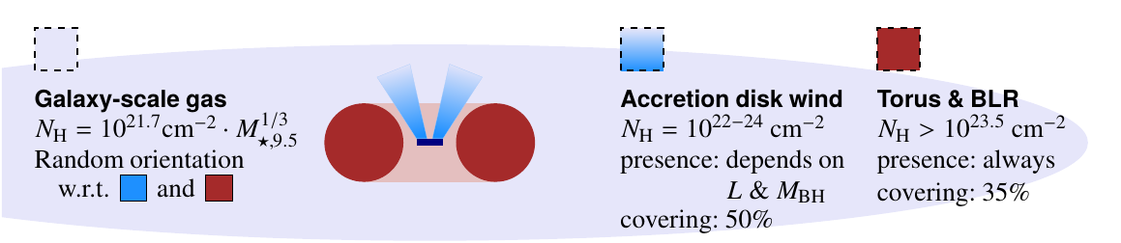
Accretion history of the Universe
Compton-thick fraction
Geometry of the nuclear obscurer
Galaxies as obscurers
Spectral fitting methodology (BXA)
Multi-catalog cross-matching (NWAY)
Buchner+15
Buchner+15
Buchner+14,+19
Buchner+17a,b
Buchner+14
Salvato, Buchner+17

Slide 3
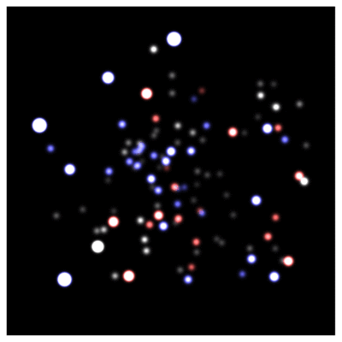
SMBH evidence: local Universe
Reconstruct orbits
Enclosed mass
4.31±0.38 10⁶M_{o}
Water masers, gas dynamics (HST), Reverberation mapping (spectroscopy)
10⁶⁻¹⁰ M_{o} in the centres of massive galaxies
GC / IR group at MPE
Schödel+02, Eisenhauer+05, Gillessen+09

Slide 4
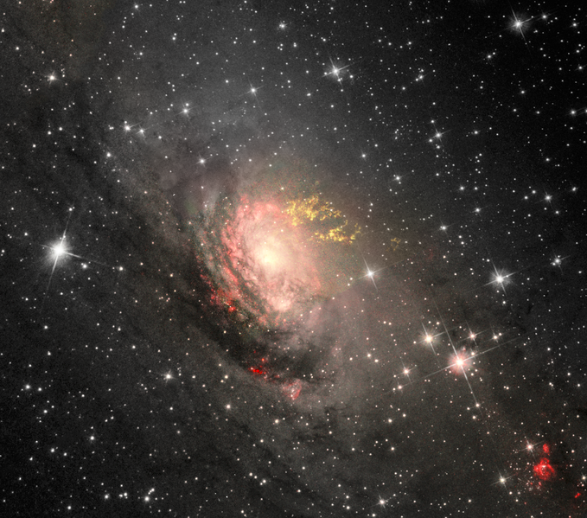
Growing SMBHs: AGN
Signatures of growing SMBH:
Hard UV ionisation field
Ionised line ratios (OIII)
Hard X-rays
Radio
Circinus CC Judy Schmidt

Slide 5
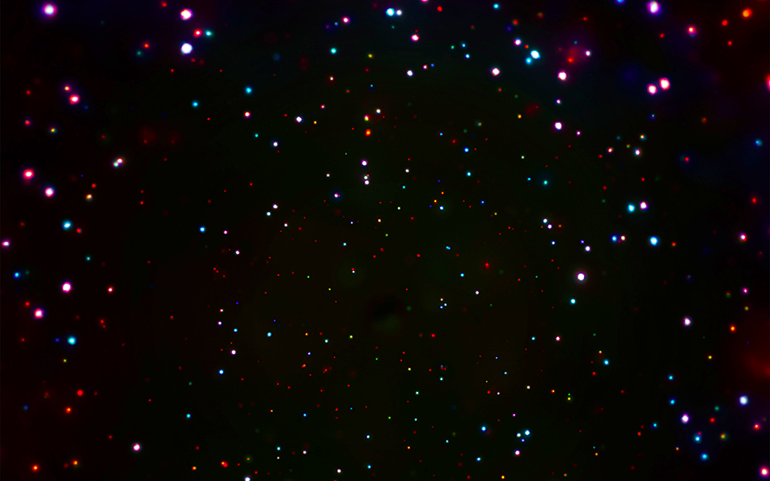
SMBH evidence z=0-4
CDFS: Luo+17

Slide 6
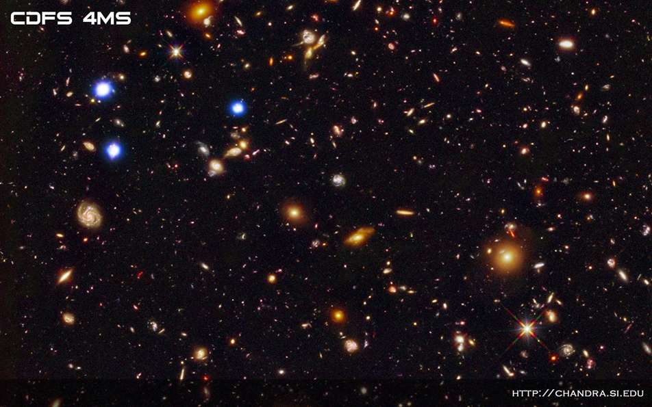
SMBH evidence z=0-4

Slide 7
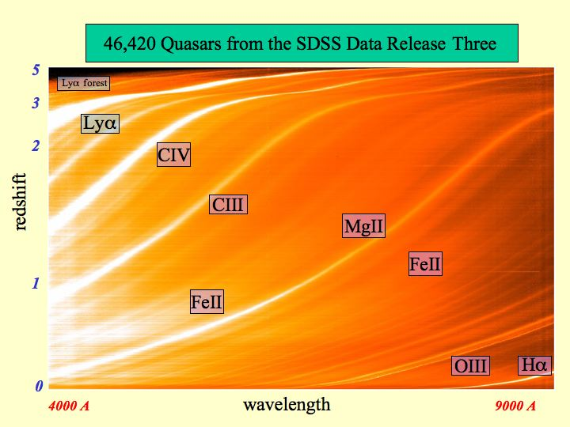
SMBH evidence z=6
Efficient z~6 detection with narrow filters around Lya
BHM measured with RM:
10⁶⁻¹⁰ M_{o}
X. Fan, SDSS

Slide 8
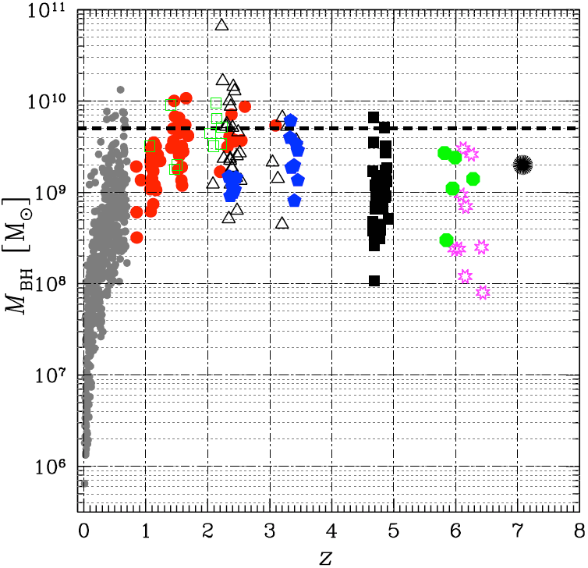
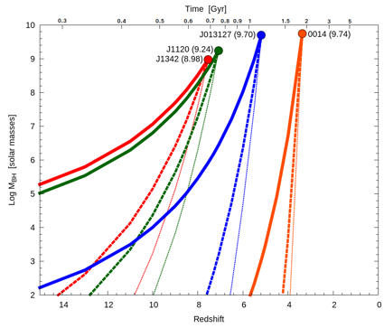
Timely growth
Eddington-rate limit relevant?
Gas supply available?
Black Hole Mass →
Time
Campitiello+18, Marziani & Sulentic (2012)

Slide 9
Timely growth
Eddington-rate limit relevant?
Gas supply available?
Black Hole Mass →
seeding mechanism?
growth over time?
co-evolution with galaxies?
Time
Campitiello+18, Marziani & Sulentic (2012)

Slide 10
Open questions
How did they get here? (seed mechanism)
Can we find unevolved seeds?
  In merger-free dwarf galaxies? Difficult!
    Sphere of influence 10⁵M_{o} at 10 Mpc ~ 0.01’’ (<HST)
    Hα widths ~ SN
    Low X-ray emission give selection biases
How do they evolve? (accretion, mergers)
Co-evolution with galaxies? (feedback)
Here: How many SMBH are minimally required by observations?

Slide 11
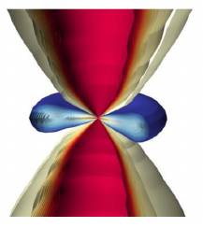
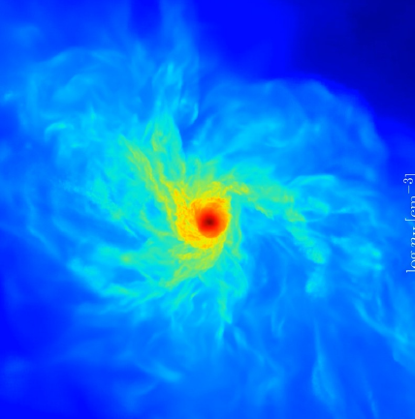
The origin of super-massive black holes
PopIII stars plus
  sustained super-Edd accretion
  metallicity, chemistry & feedback-dep.
  special halos?
Direct collapse:
  high-resolution,
  chemistry, feedback-dep. growth
  special halos?
Many assumptions, complex physics
EM predictions not unique
difficult to make progress
Cosmological sims: BH seeded in ~10¹⁰M_{o} halos
Light
Heavy
Pop-III
Becerra+15,
Kuiper&Hosokawa+19 Volonteri 2012, Rees 1978
How often does the process need to succeed?

Slide 12
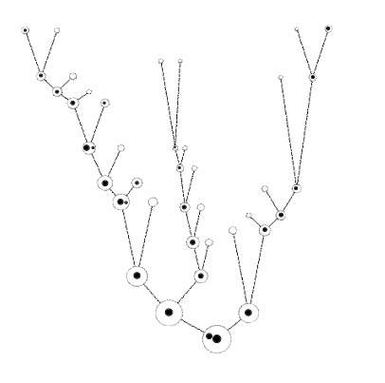
Ansatz
Halos are born and grow
At some threshold mass M_{c}: chance p for seeding success
Can approximate physical seeding mechanisms
many small halos merge
Time
Does not need assumptions of
- seed black hole mass
- accretion
- feedback
- galaxies
local galaxies host SMBHs
credit: M. Volonteri
see also Menou+01

Slide 13
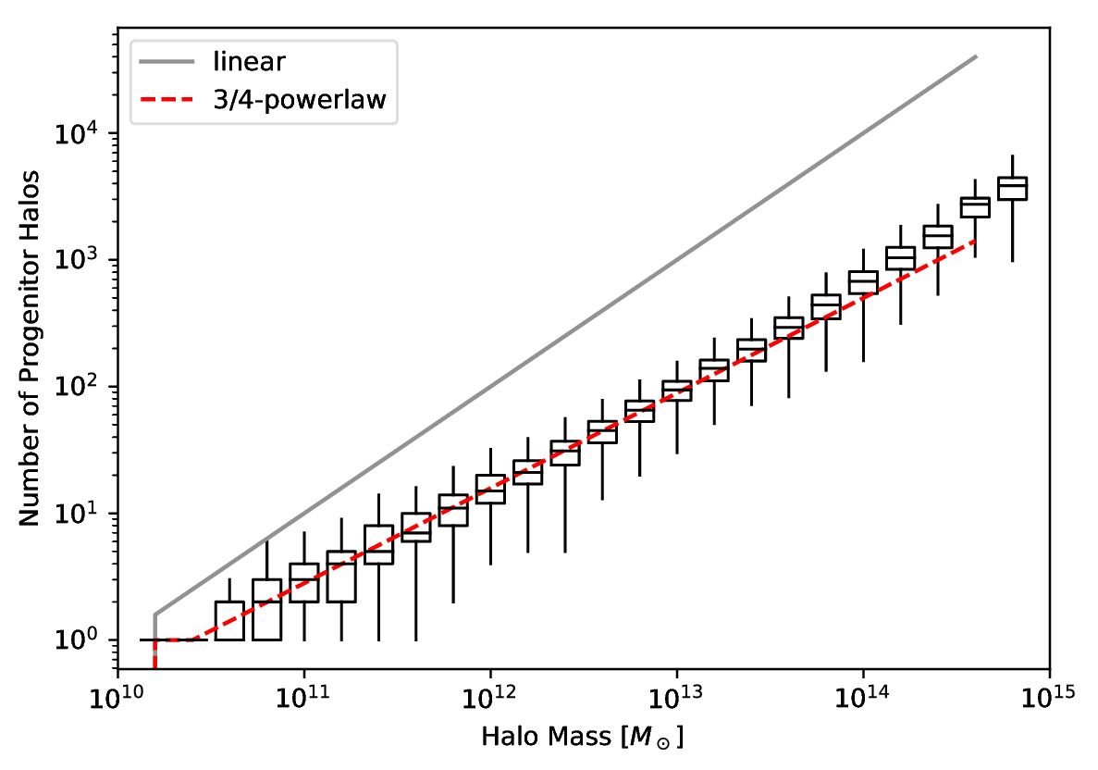
Building blocks
Count leaves of merger tree
z=0 halo building blocks
of size
SMDPL dark-matter simulation
Rockstar subhalos
Planck cosmology

Slide 14
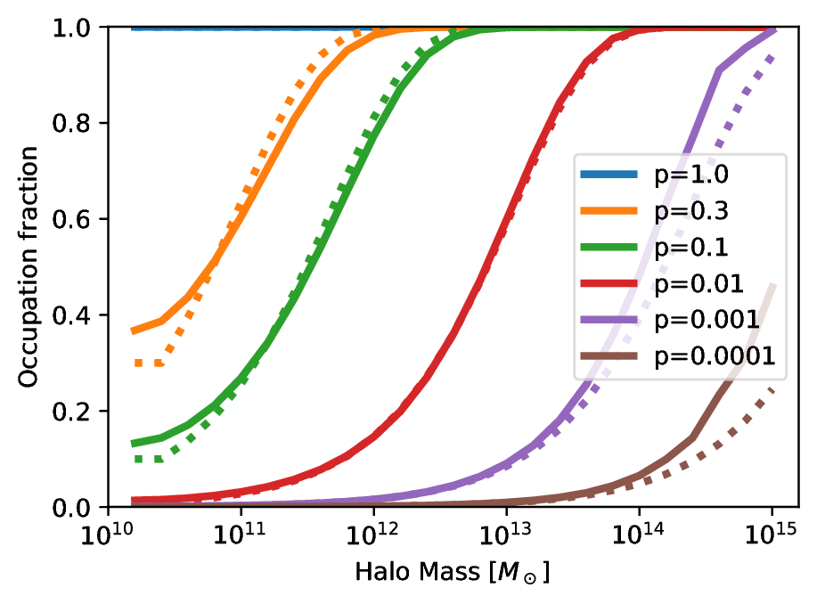
Occupation at z=0

Slide 15
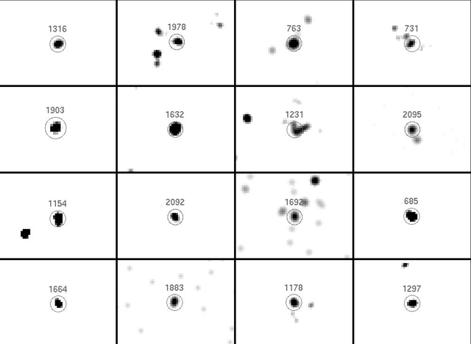
Occupation Observations
Gallo+10, Miller+15
AMUSE-Virgo

Slide 16
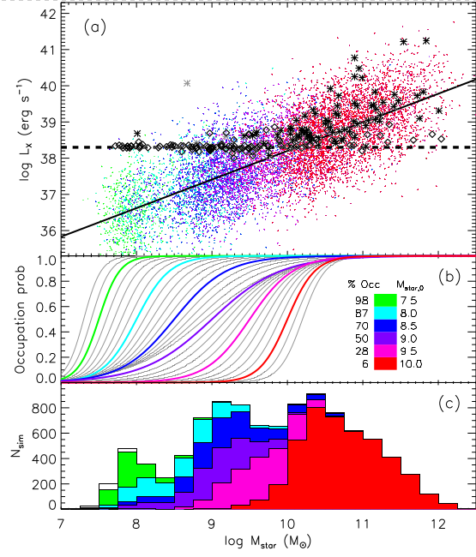
Occupation Observations
Gallo+10, Miller+15
AMUSE-Virgo

Slide 17
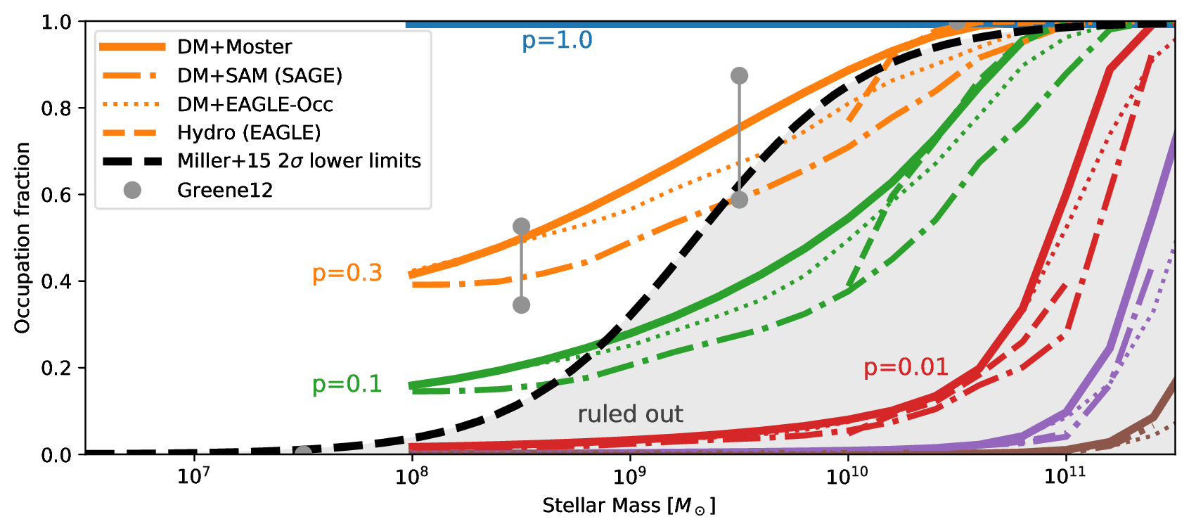
Occupation at z=0
Buchner et al. (in prep)

Slide 18
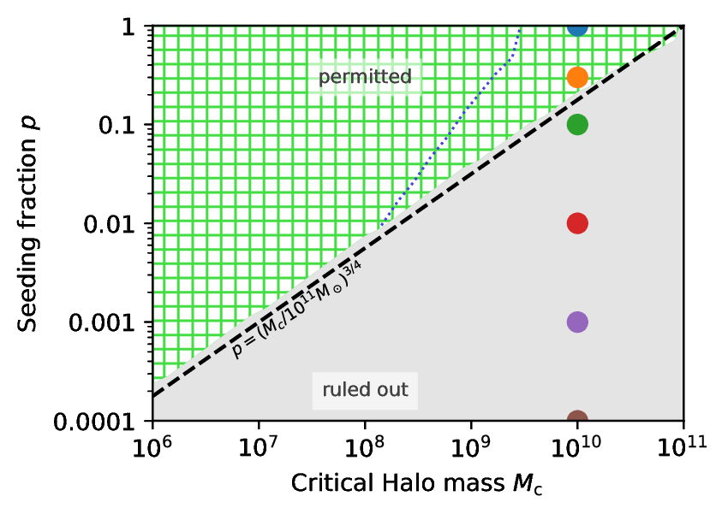
Required Seeding Efficiency
Buchner et al. (in prep)

Slide 19
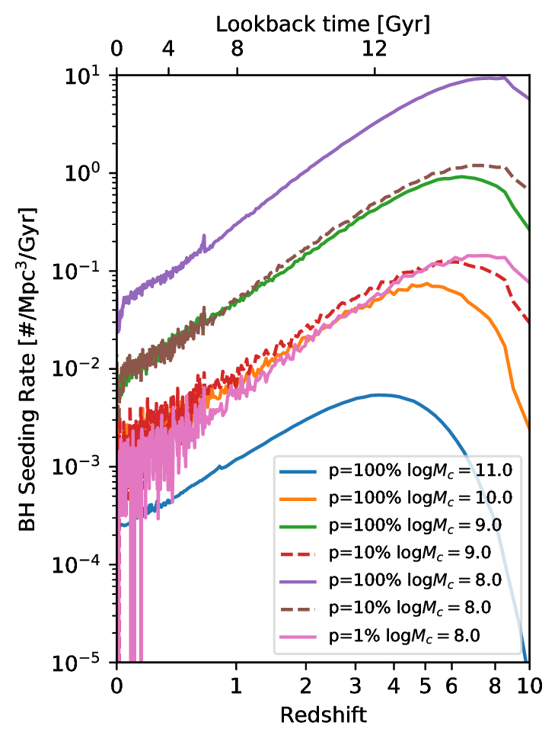
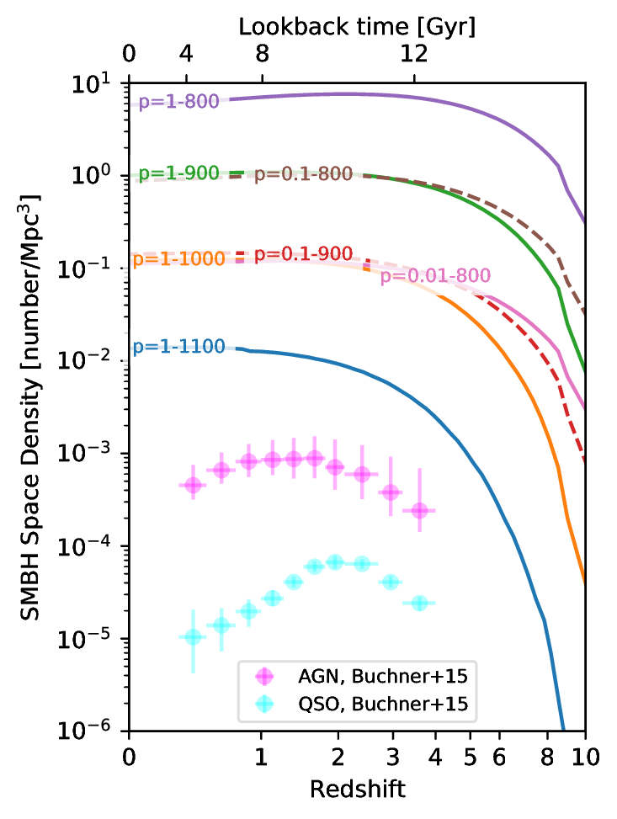
Population Evolution
BH births
Total number

Slide 20
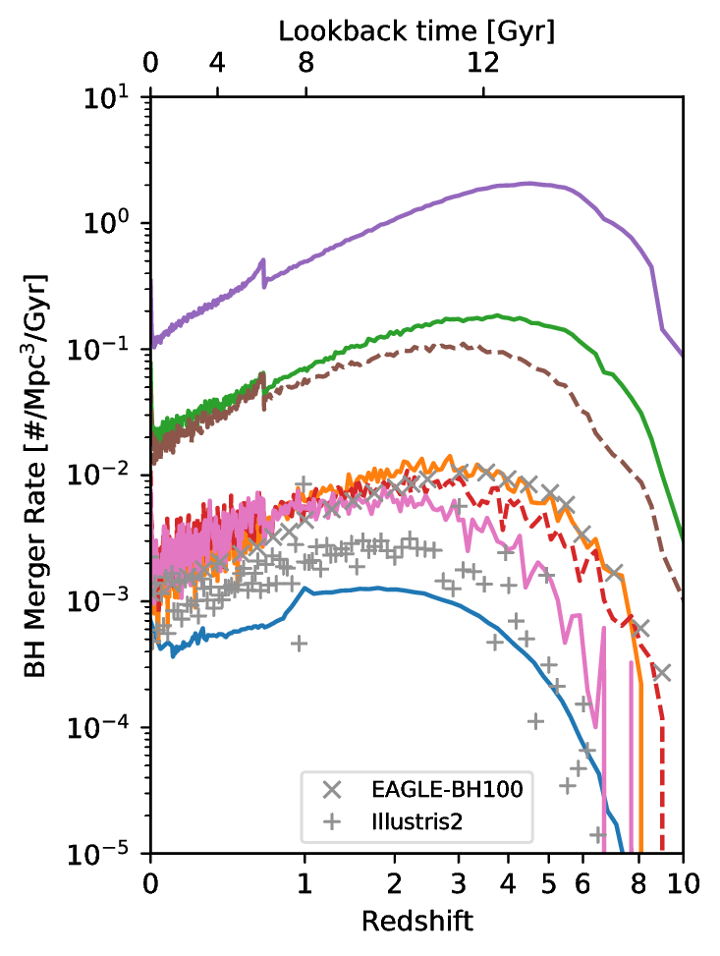
Population Evolution
BH births
BH host mergers

Slide 21
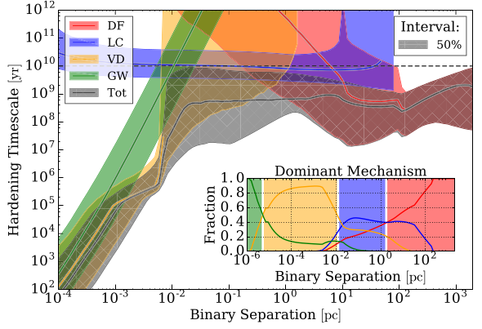
SMBH merger delays
Kelley+17
Dynamical friction, Light cone scattering, Viscous drag, Gravitational waves

Slide 22
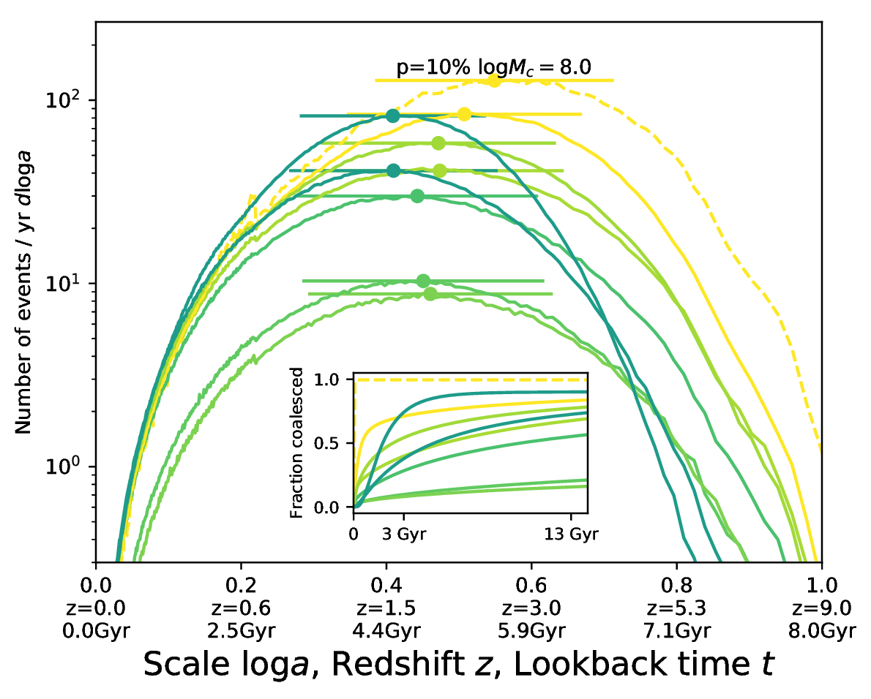
SMBH merger delays
Kelley+17

Slide 23
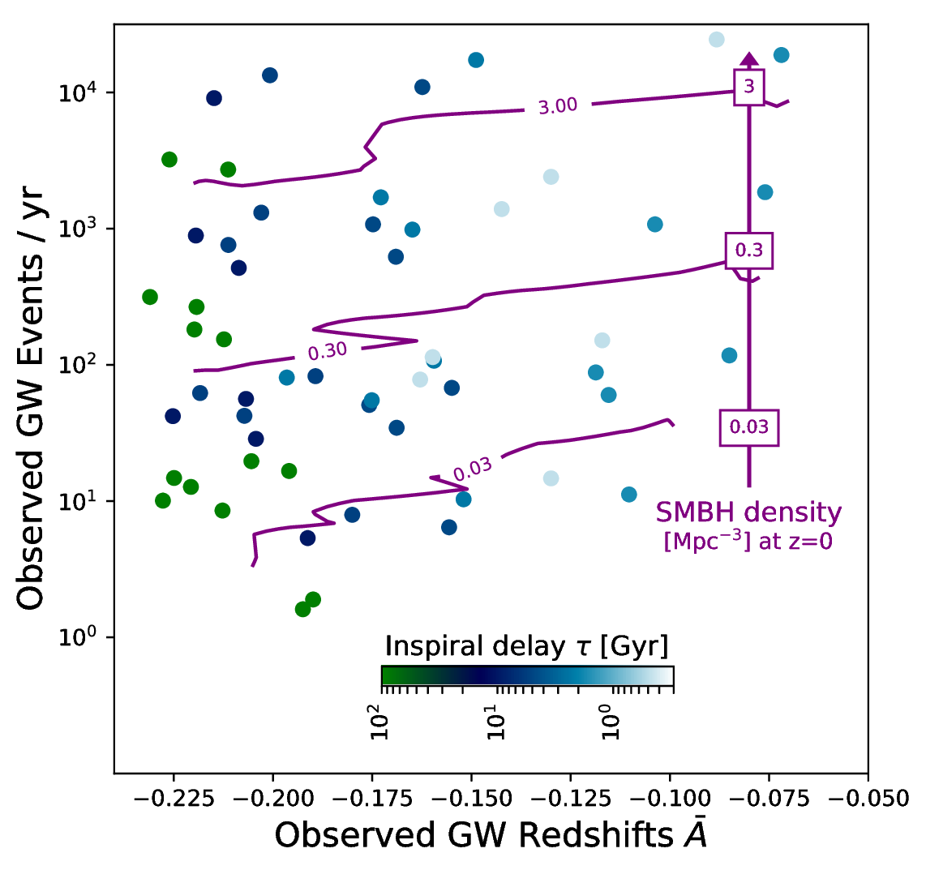
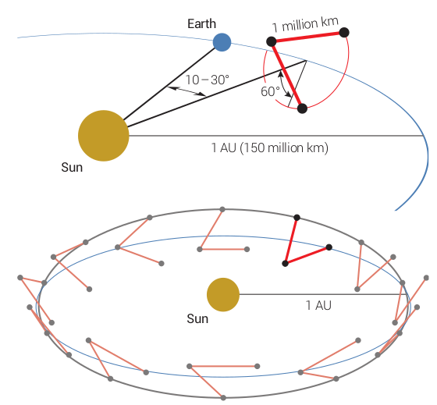
LISA GW Diagnostic Diagram
Buchner+19
10⁴⁻⁸ M_{o}
z=0-13
Virtually all SMBH mergers will be detected by LISA
(Salcido+16, EAGLE sim + waveshape modelling)
(talk by Sesana)
Combination of z mean and std

Slide 24
Summary: Model-independent seeding
Seeding efficiency
LISA will directly
  Detect >1 merger/year
  Measure the SMBH space density
  Measure the merger delay time
High-z Quasar host environments are diverse
see Buchner+19, ApJ (1901.04500)
For X-rays:
→ James Aird’s talk

Slide 25
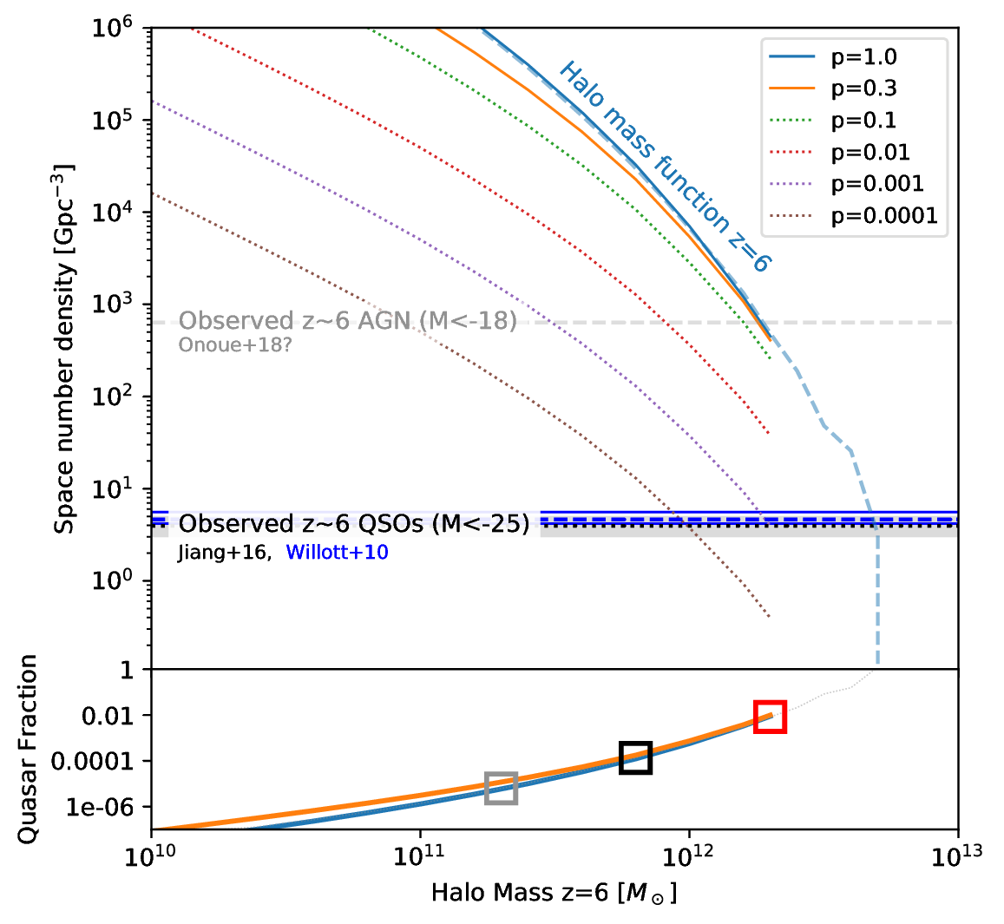
High-redshift quasars
z=6 QSO surveys (SDSS)
Earliest census of active SMBH population
There are more SMBHs
Live in massive halos?
Massive halos or duty cycle?

Slide 26
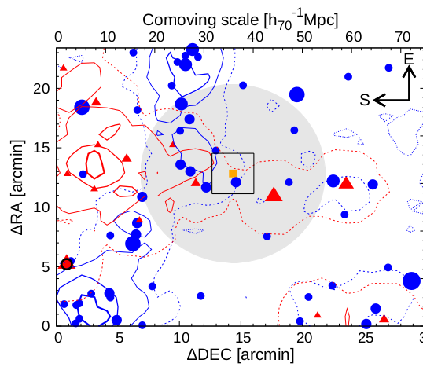
Overdensities near Quasars
LBG
Literature has conflicting results:
- Overdensities
- Equal
- Underdensities
compared to control fields
What is happening?
LAE
QSO
Ota+18

Slide 27
Overdensity predictions
QSO Hosts definition:
  Halo mass cut, e.g.:
  only >10^{12.3}M_{O}
Look at neighbourhood
Galaxies definition:
  LBG: Hatfield+17
  LAE: Kovač+07, Sobacchi&Mesinger+15
  selection as in observations (redshift window, magnitude)
Simply count galaxies within radial shells around quasar

Slide 28
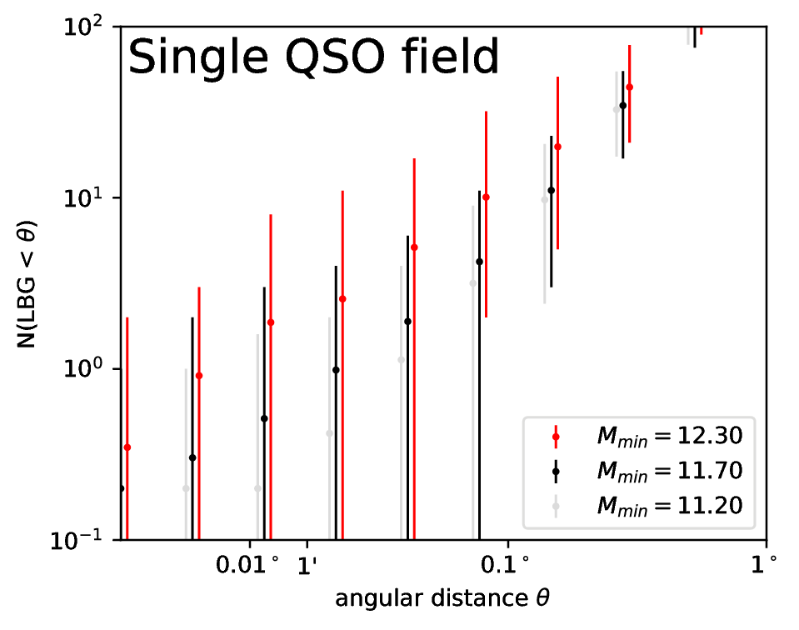
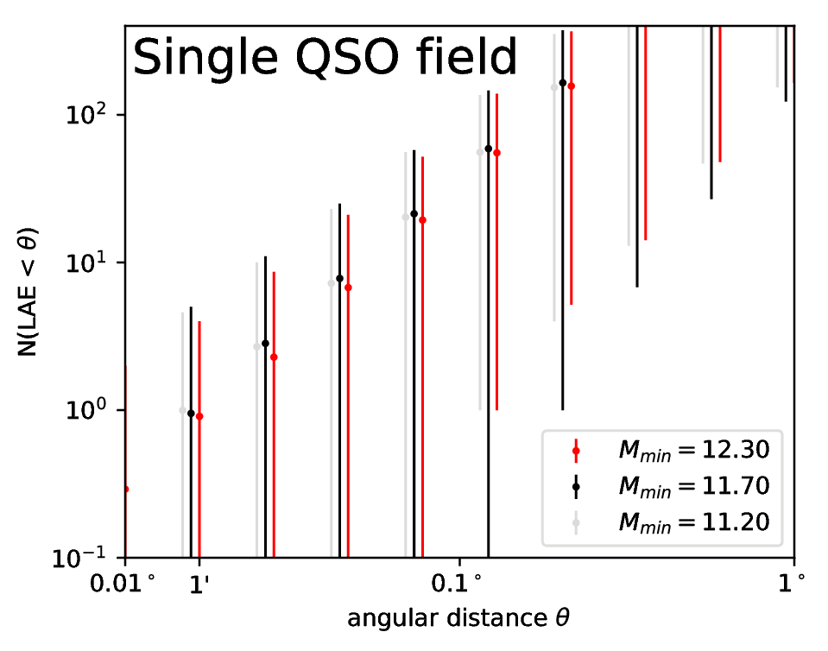
Understanding high-z quasars
LBG
LAE
Large diversity!
Large volume in z!
Large diversity!
Poisson noise!

Slide 29
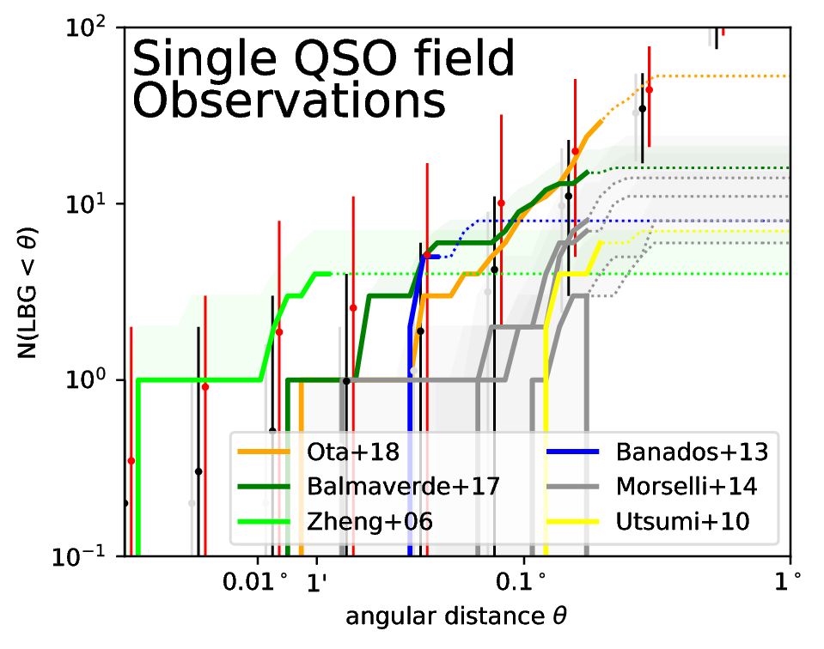
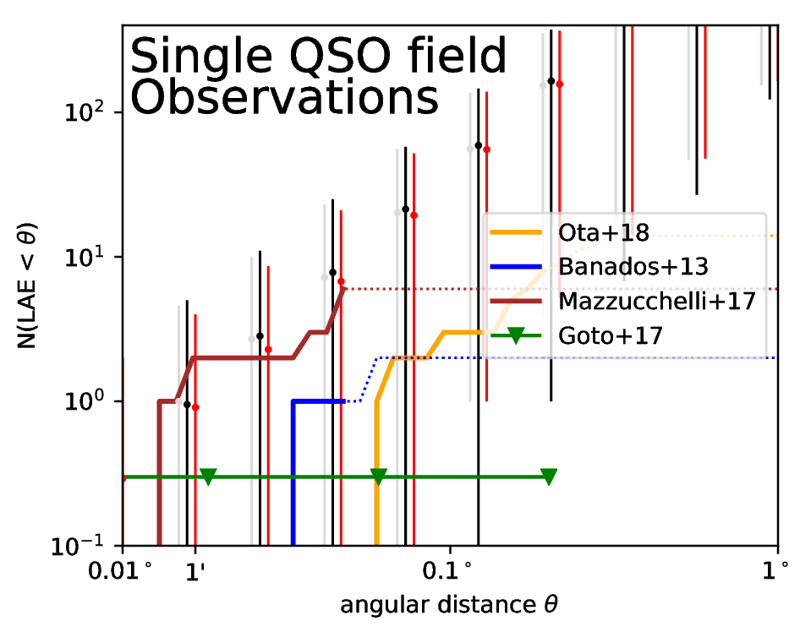
Understanding high-z quasars
LBG
LAE
Buchner et al. (in prep)

Slide 30
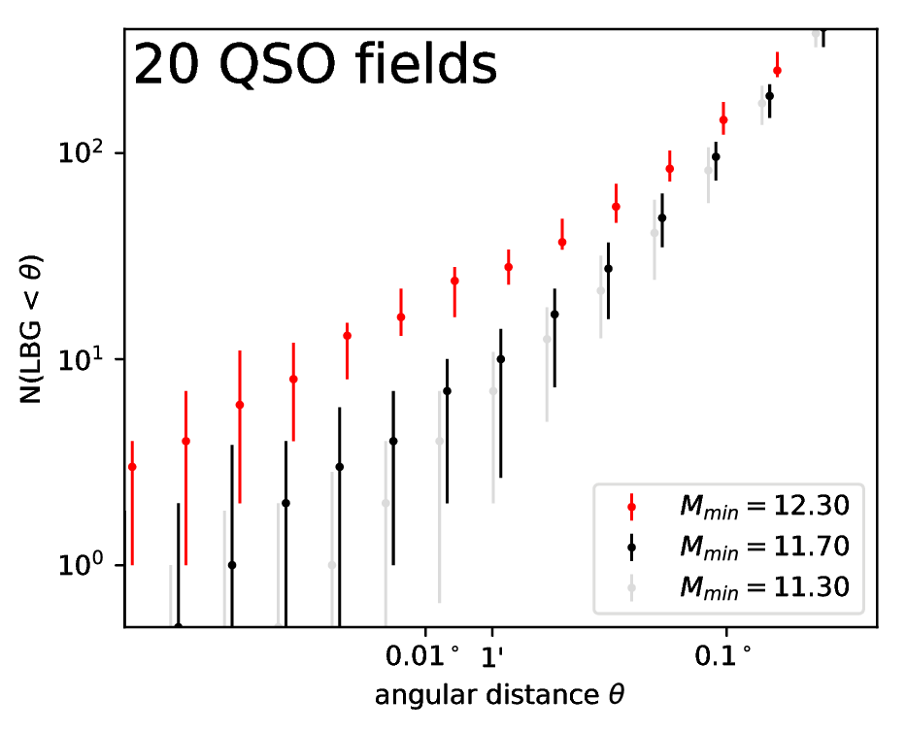
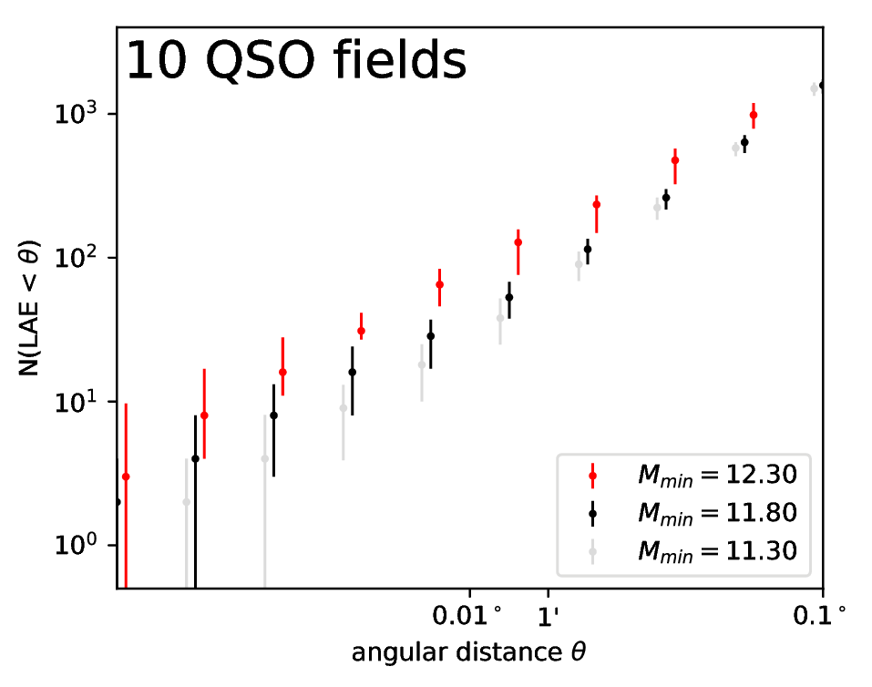
Understanding high-z quasars
LBG
LAE

