Slide 1

NWAY – the versatile cross-matching algorithm
+ application towards eROSITA
Johannes Buchner
http://astrost.at/istics/
Mara Salvato @MPE
Tamás Budavári
Tom Dwelly (MPE, SPIDERS)

Slide 2
NWAY multi-catalog association
Based on solid Bayesian statistics
Can process simultaneously N catalogs
Handles absent sources
Handles ambiguous cases
Gives probabilities for each possible association
Can ingest prior information
  magnitude, color (SED information), or other
Fast and automatic
Generic

Slide 3
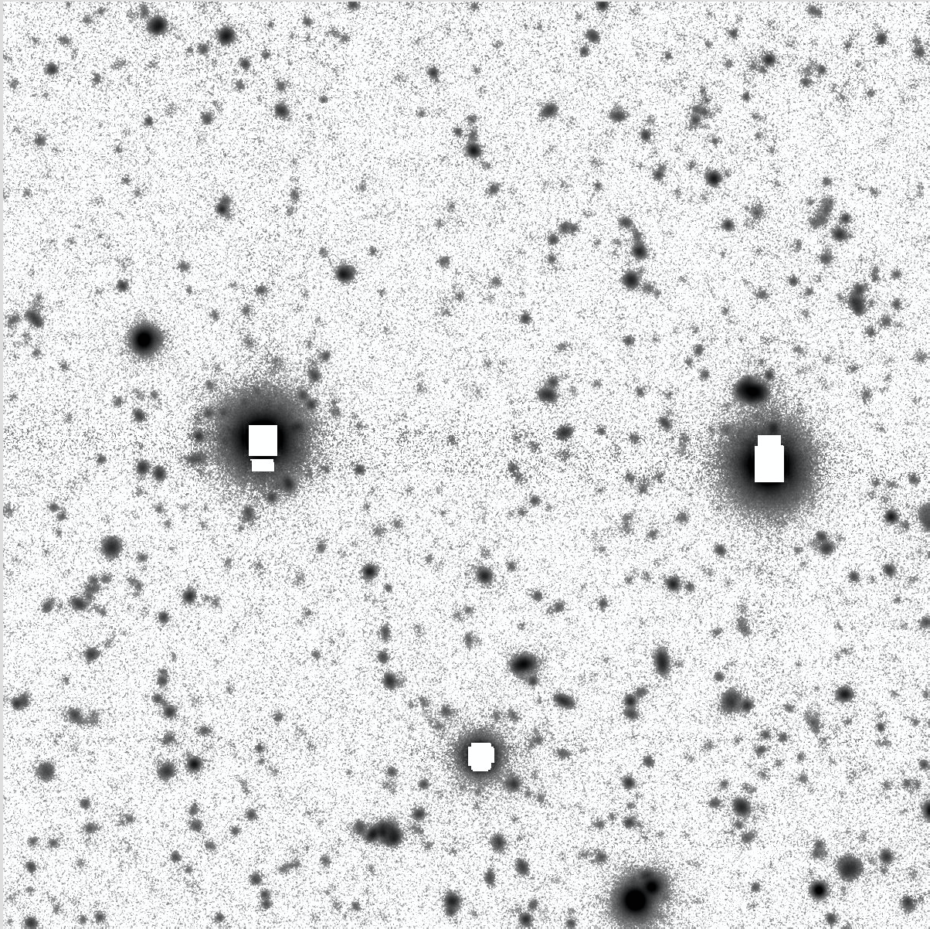
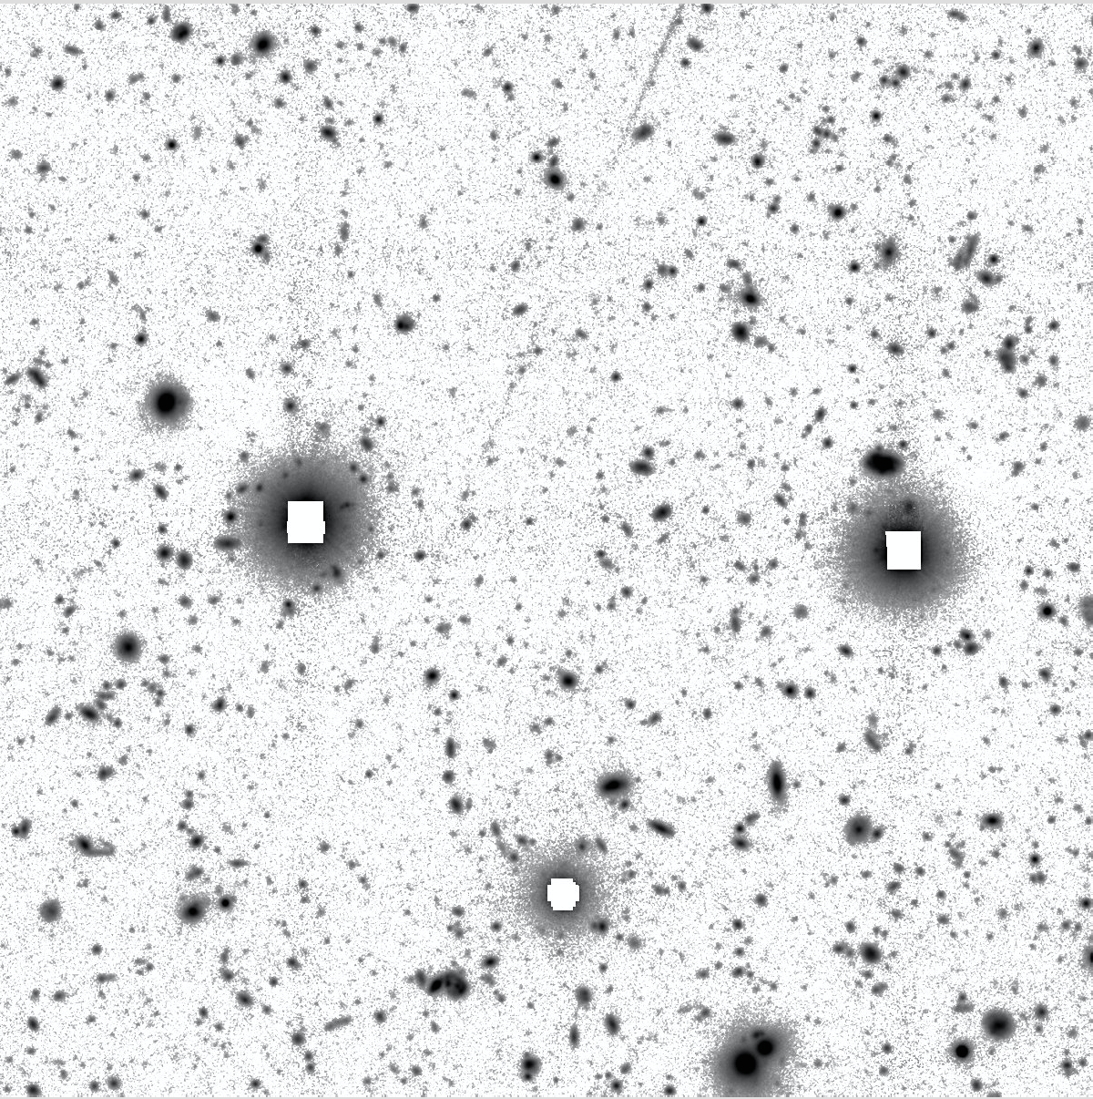
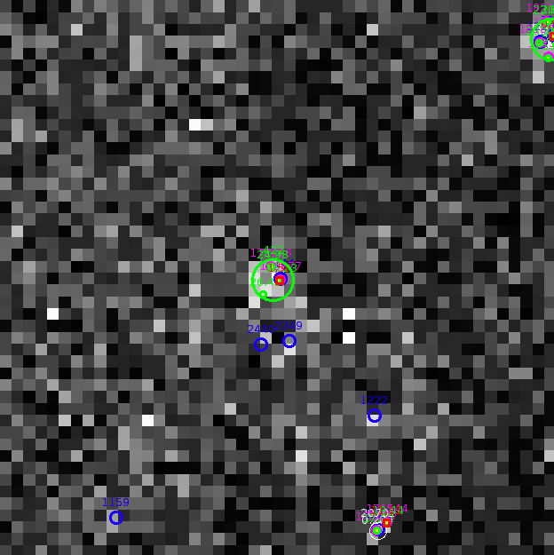
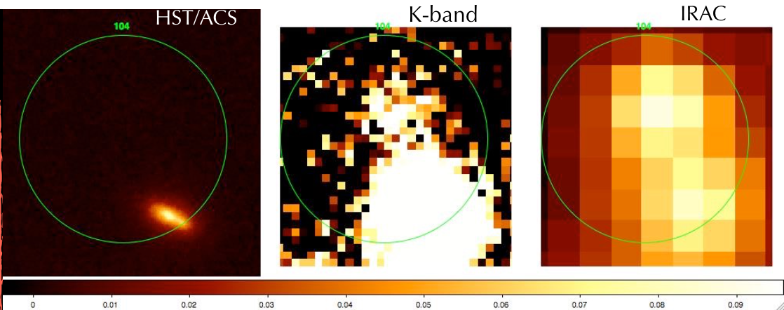
Matching in opt/NIR vs X
g band, 3’
z band, 3’
XMM, 3’

Slide 4
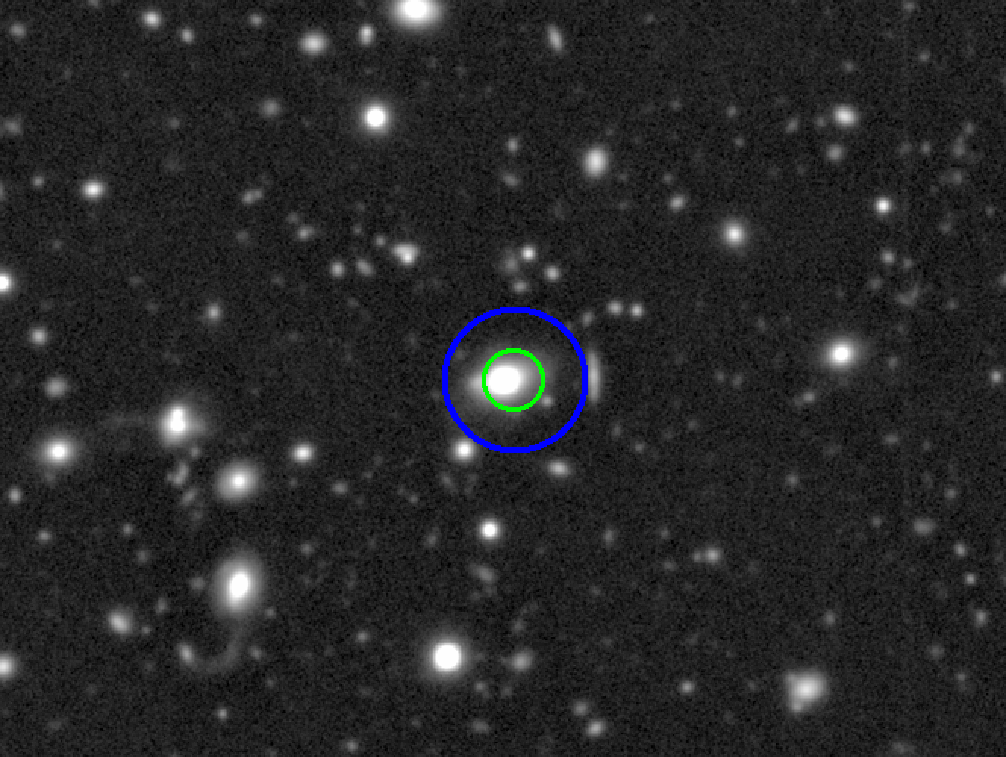
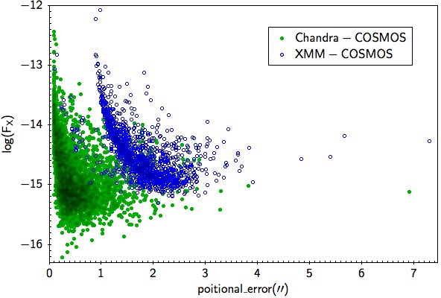


Association depends on SNR
Chandra
XMM
PSF depends on flux
# of sources depends
on image depth
real counterpart absent?

Slide 5
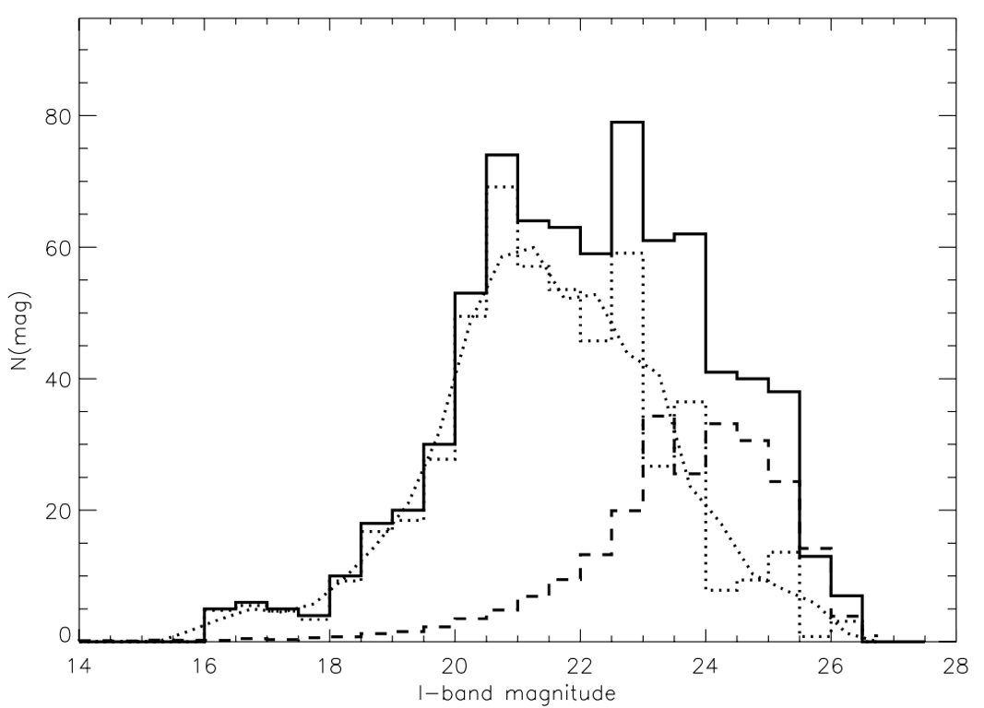
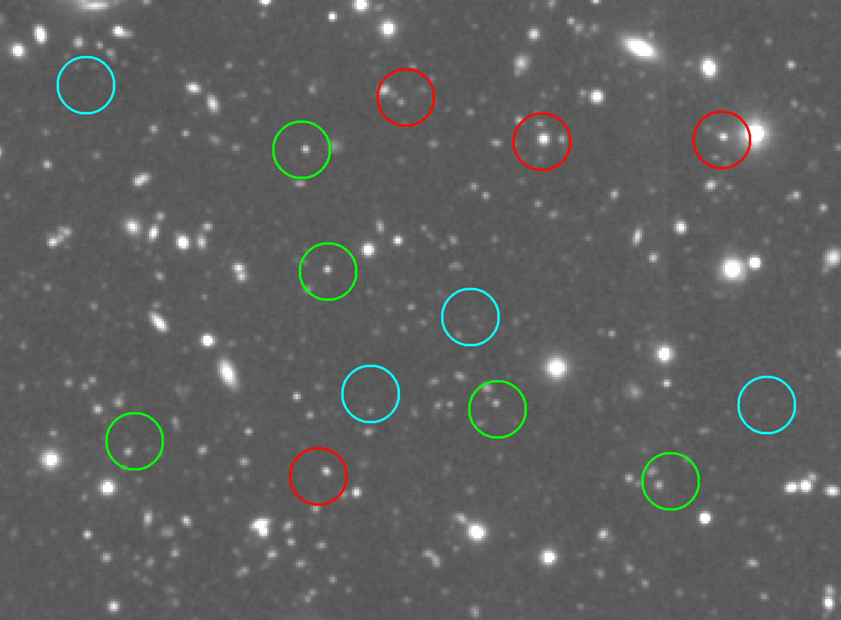
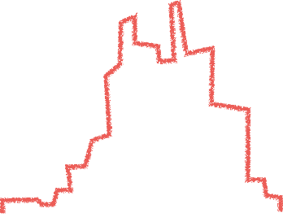
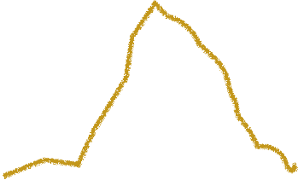

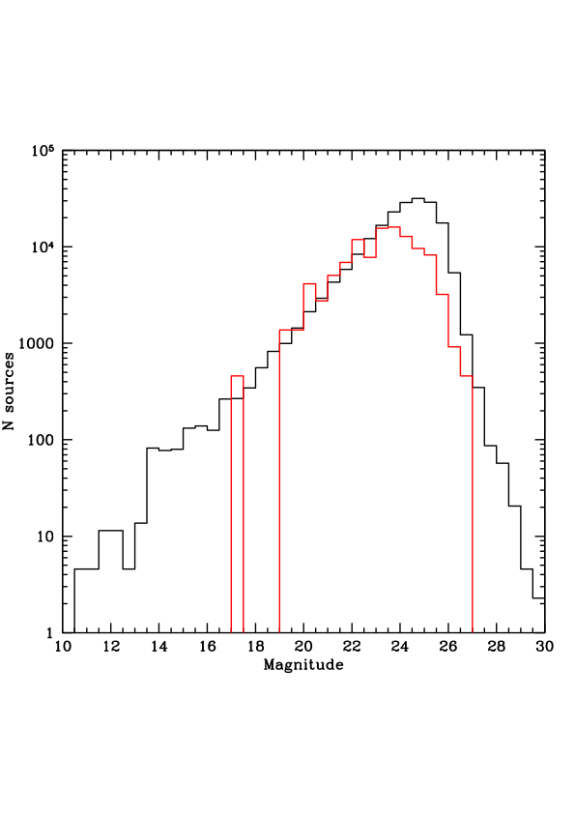
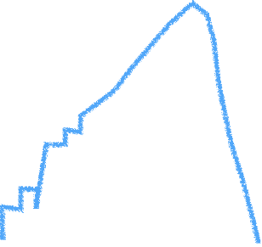

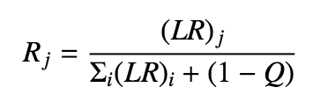
Likelihood Ratio Method
Naylor+13 for a review
near target
Brusa+07
random
subtraction
magnitude
LR=f(r) q(m) / n(m)
magnitude

Slide 6

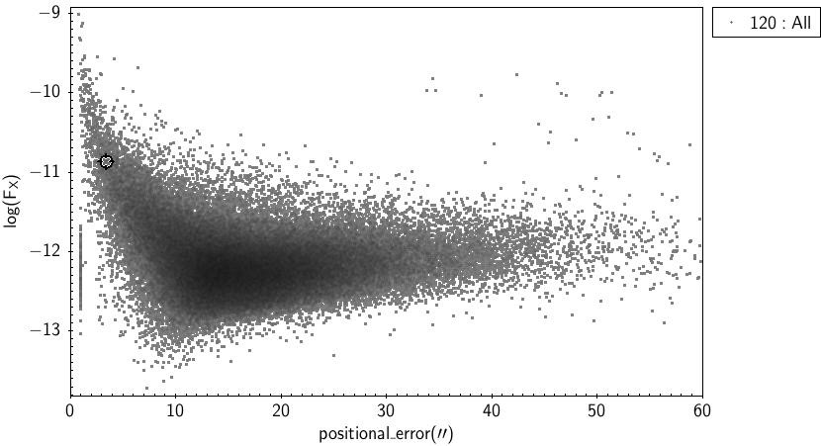
eROSITA Challenge
Chandra
XMM
ROSAT
eROSITA

Slide 7
Our method in a nutshell
Salvato, Buchner, Budavári et al. 2017
Hypothesis 1: chance alignment of unrelated srcs
Hypothesis 2: single source
depends on
counterpart sky number density ρ_{s}
and expected counterpart fraction η_{x}
Angular separation
Bayes
factor
Weighting term
(mag, colors,etc)
Positional uncertainties
The posterior probability for a match
between an X-ray source, i,
and a potential counterpart j

Slide 8

Combinatorics
Pineau+16

Slide 9

Test 1: XMM-COSMOS
ML: 1281 considered reliable, after careful visual inspection, two catalogue versions
Now with Chandra coverage (higher accuracy) we know 139 were mis-associated
NWAY: fast, automatic, with single band, self-learning magnitude distribution: 96% correct, including correcting 55 old wrong assignments
NWAY with
1+3.6um
catalogues:
98%
Fast!

Slide 10
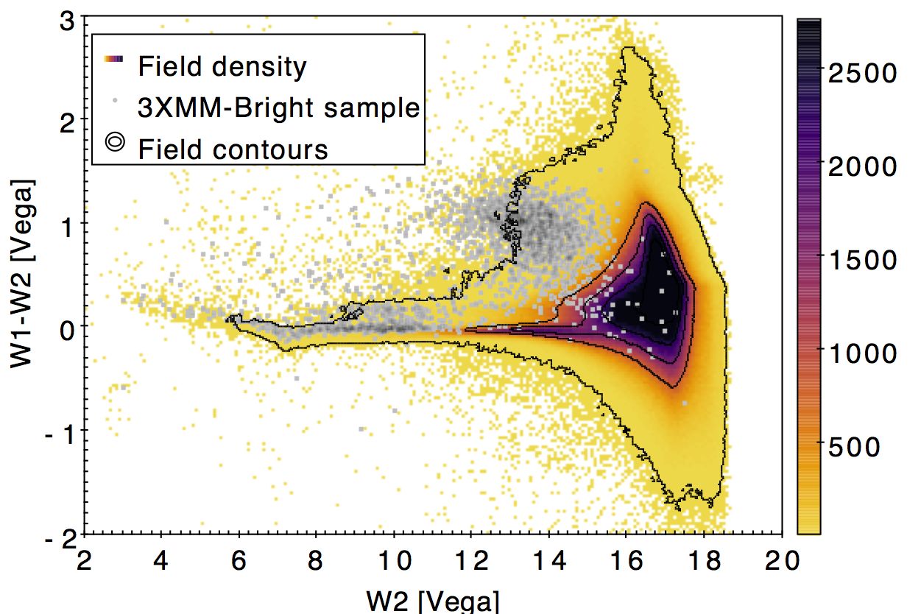
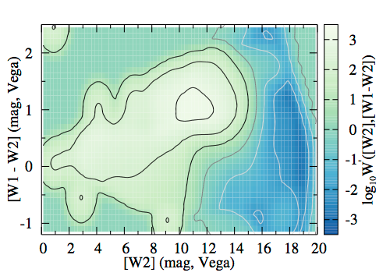
Test 2: ROSAT
Learn color prior from XMM counterparts at same depth
BOSS 10,000 deg² area: 4524 XMM sources.
With only ROSAT+SDSS: 96% recovered
Shifting ROSAT by 6’ gives false-association fraction: 4%

Slide 11
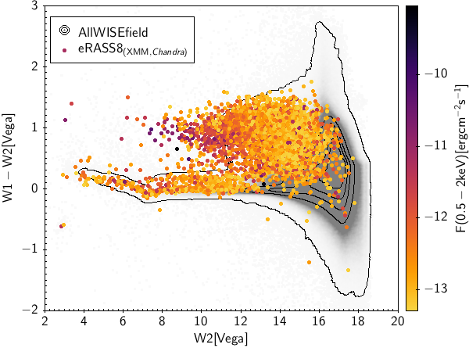
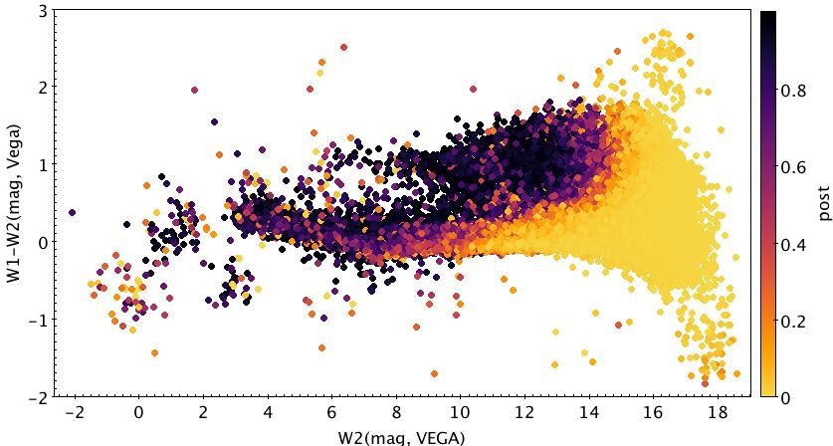
Open issues
XMM cut at ROSAT depth
XMM cut at eROSITA depth
For eROSITA need
better discriminators
Lack of all-sky survey
ROSAT distribution

Slide 12
Conclusions
Knowing correct counterpart for X-ray sources is crucial for galaxy-AGN co-evolution, BH physics and stellar evolution studies
NWAY is a better way!
‣ algorithm based on Bayesian statistics
‣ can process simultaneously N catalogues
‣ not limited to use of magnitude
‣ can ingest any kind of prior (ideally entire SED)

