Slide 1

NWAY – the versatile cross-matching algorithm
+ application towards eROSITA
Johannes Buchner (PUC)
astrost.at/istics
Mara Salvato (MPE)
Tamás Budavári
Tom Dwelly (MPE, SPIDERS)
Kirpal Nandra (MPE)

Slide 2
Outline
Aspects of the cross-matching problem
Limitations of the current method (LR)
Application, Goal
The NWAY method
Test case: COSMOS
Test case: eROSITA
Summary

Slide 3
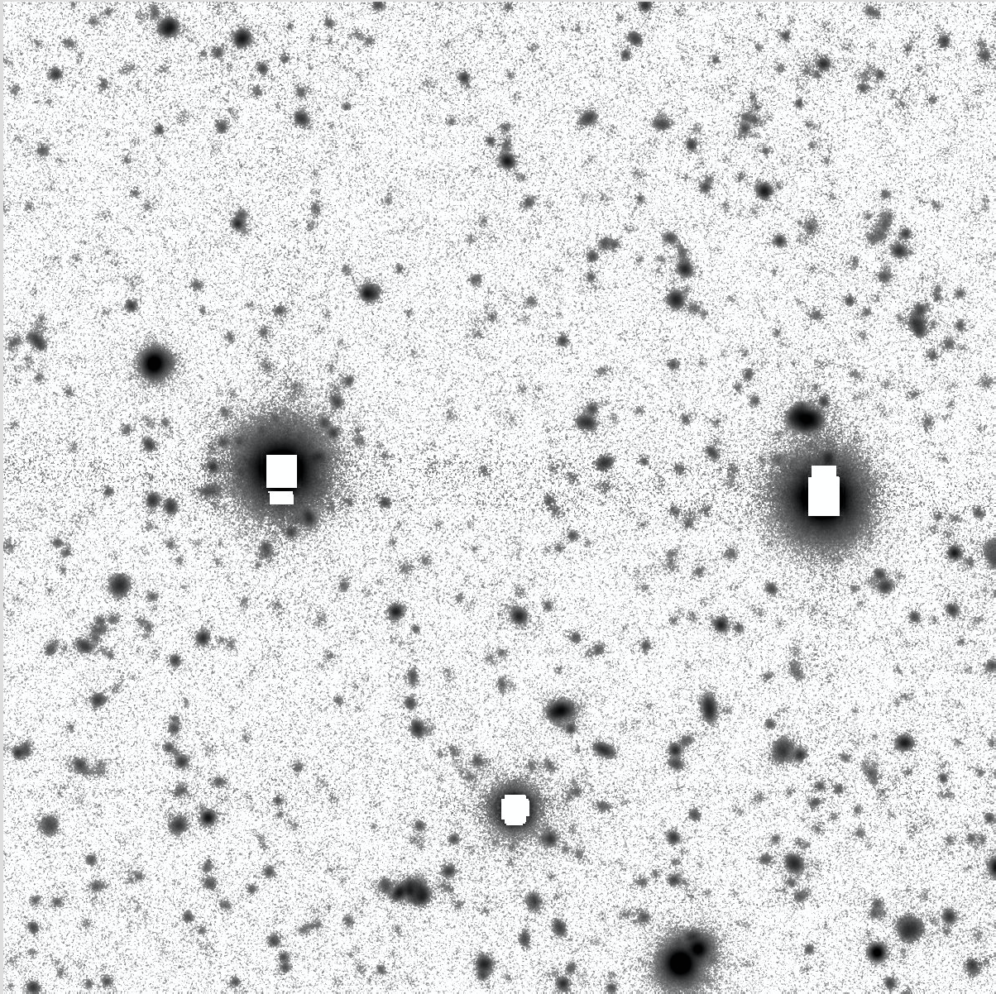
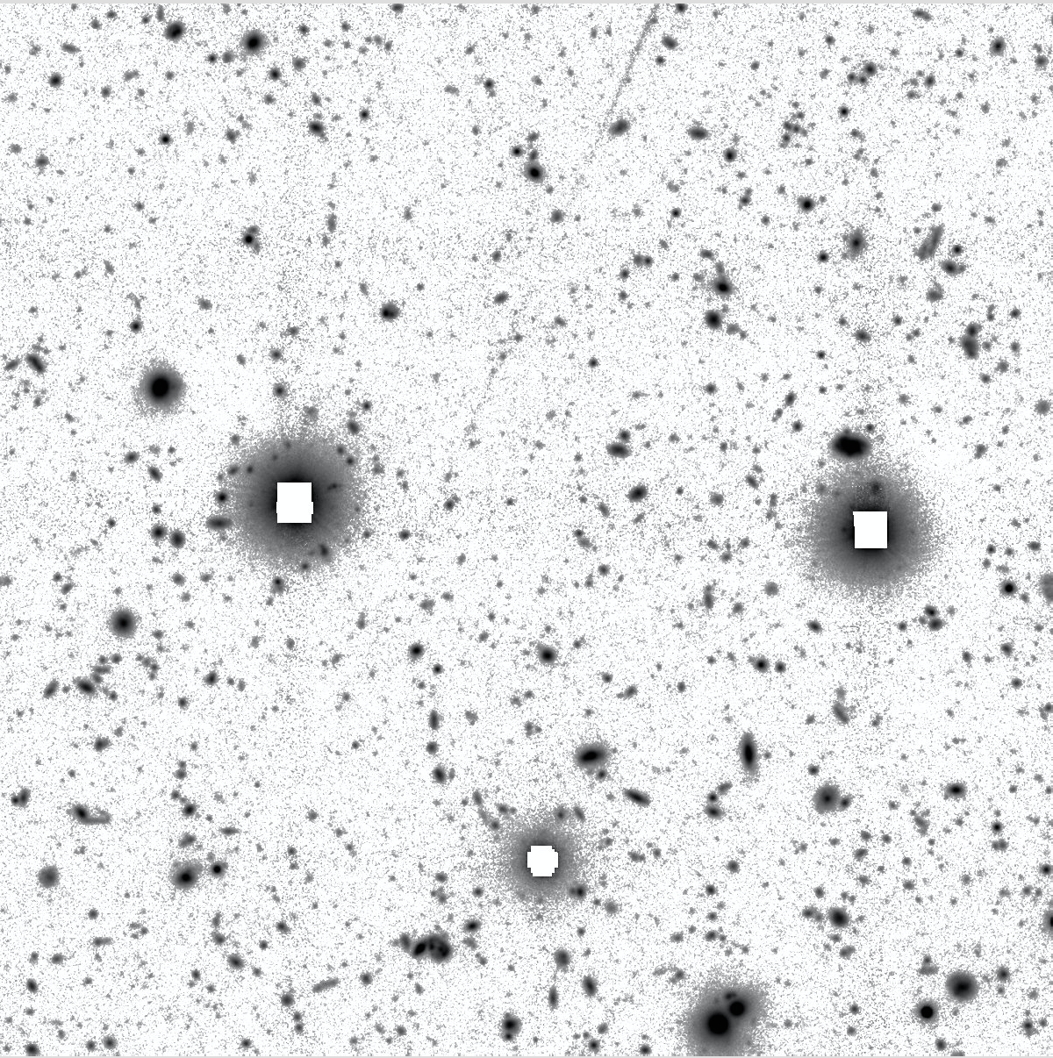
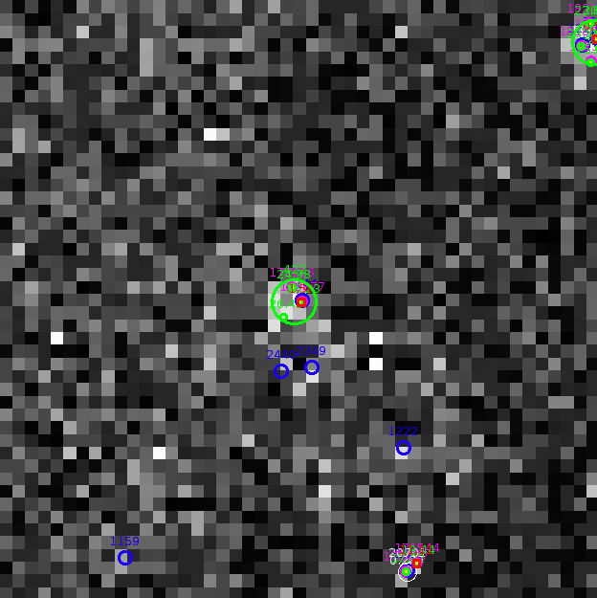
Matching in opt/NIR vs X
g band, 3’
z band, 3’
XMM, 3’

Slide 4
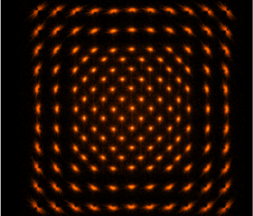
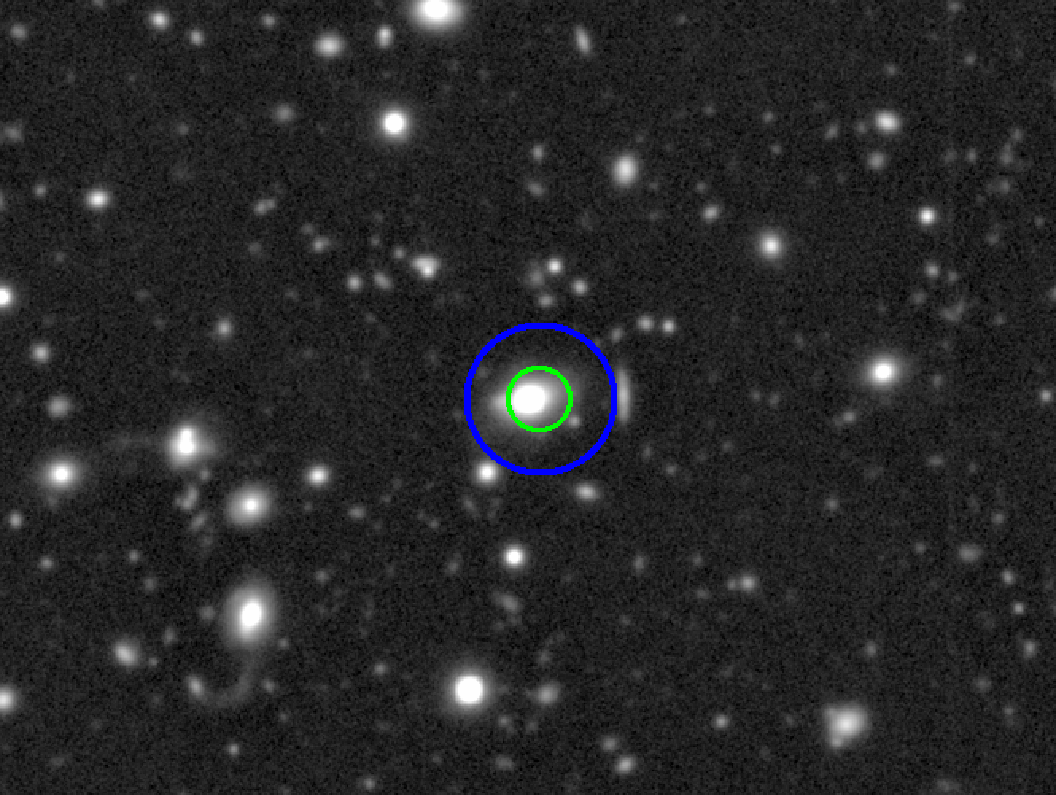
pos. error & centering
PSF depends on position and instrument
Chandra
XMM
Few sources per pointing, can make astrometry hard

Slide 5
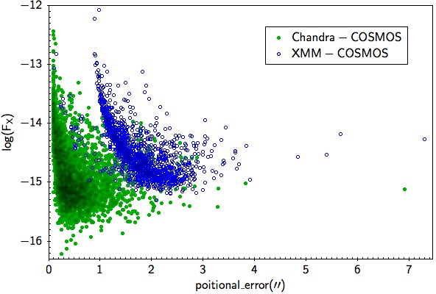


Association depends on SNR
Chandra
XMM
PSF depends on flux
# of sources depends
on image depth
real counterpart absent?

Slide 6
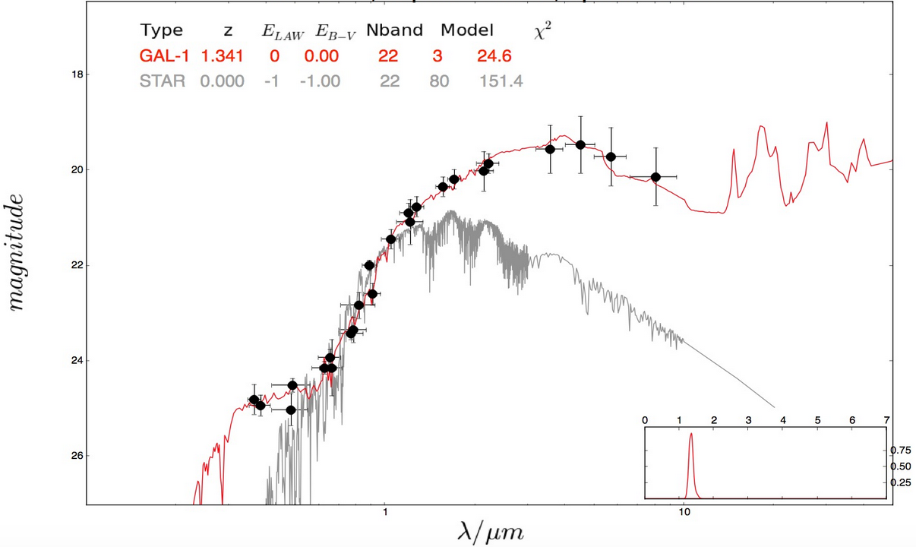
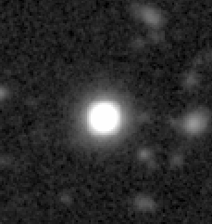
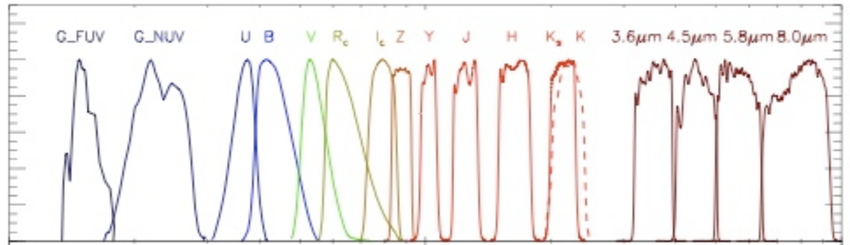
Photometry – object type
Photometry allows
multi-λ coverage
Can distinguish between object types
Magnitudes between filters are correlated

Slide 7
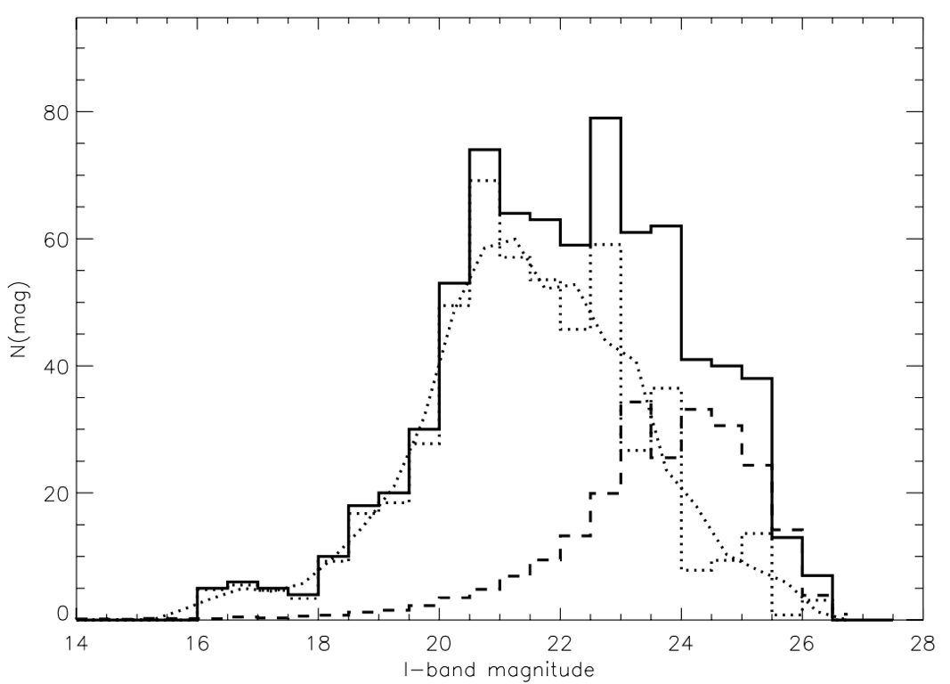
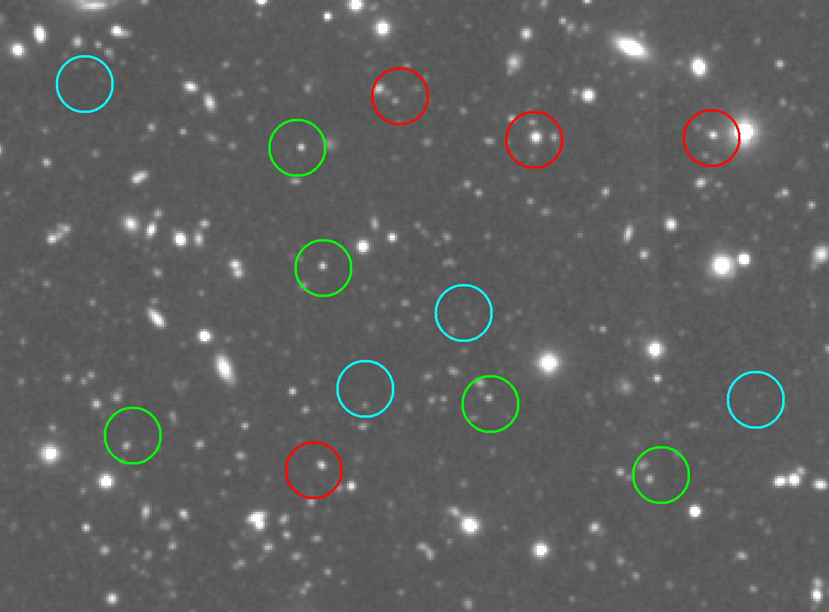
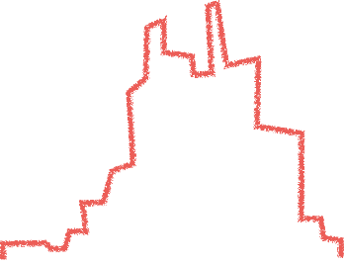
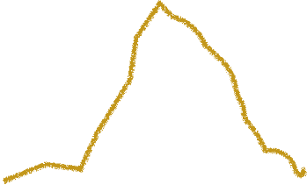

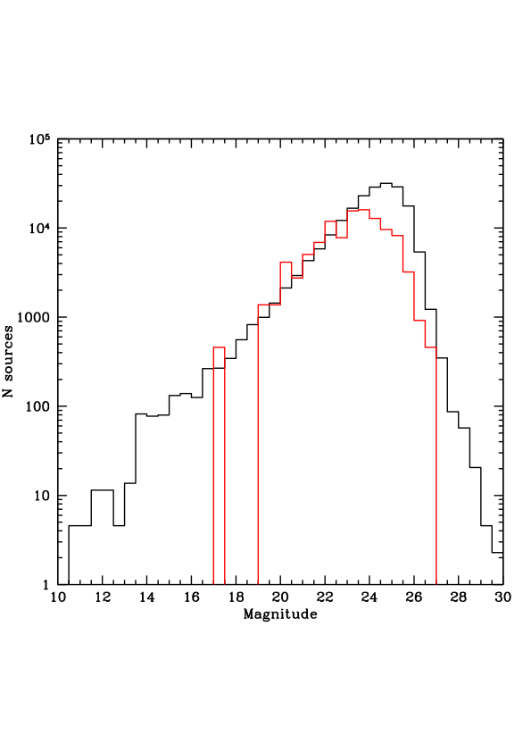
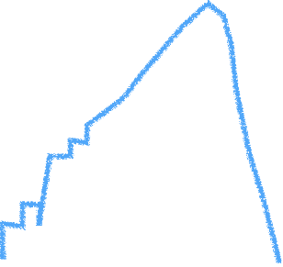

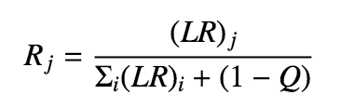
Likelihood Ratio Method
Naylor+13 for a review
near target
Brusa+07
random
subtraction
magnitude
LR=f(r) q(m) / n(m)
magnitude

Slide 8

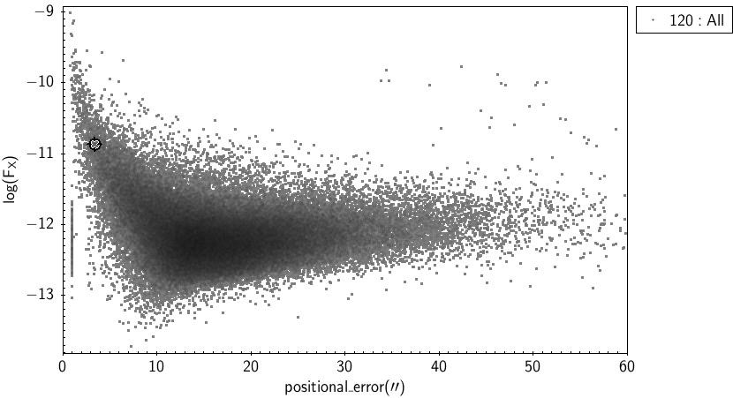
eROSITA Challenge
Chandra
XMM
ROSAT
eROSITA

Slide 9
Our method in a nutshell
Salvato, Buchner, Budavári et al. 2017
Hypothesis 1: chance alignment of unrelated srcs
Hypothesis 2: single source
depends on
counterpart sky number density ρ_{s}
and expected counterpart fraction η_{x}
Angular separation
Bayes
factor
Weighting term
(mag, colors,etc)
Positional uncertainties
The posterior probability for a match
between an X-ray source, i,
and a potential counterpart j

Slide 10
NWAY multi-catalog association
Based on solid Bayesian statistics
Can process simultaneously N catalogs
Handles absent sources
Handles ambiguous cases
Gives probabilities for each possible association
Can ingest prior information
  magnitude, color (SED information), or other
Fast and automatic

Slide 11
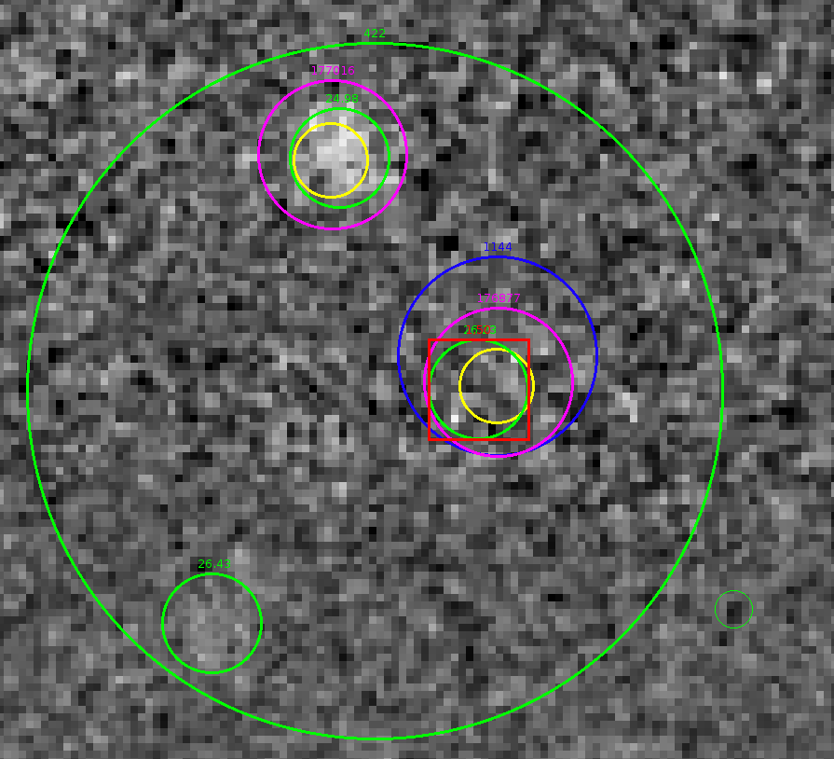
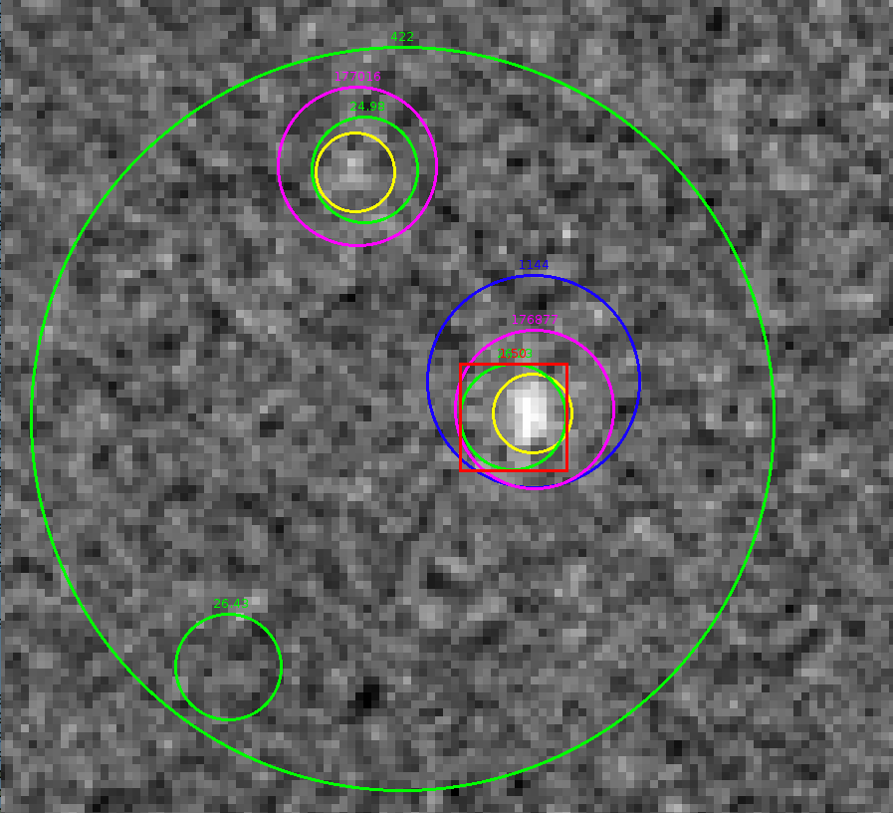
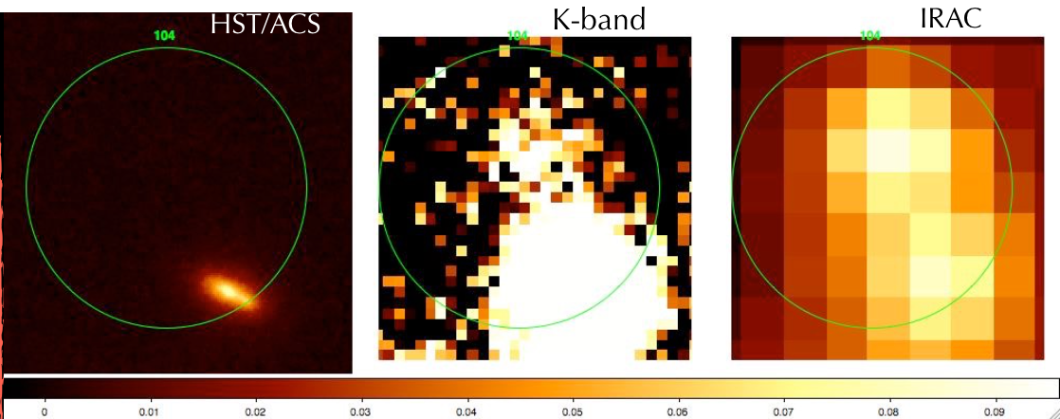
One band is not enough
z band
K band
ML approach:
Procedure repeated
over many catalogs at
different wavelength:
difficult to quantify
the “global” threshold
26mag
21mag(?)
23mag

Slide 12
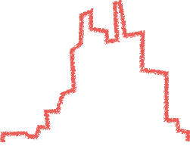
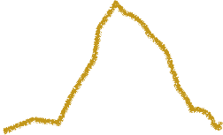

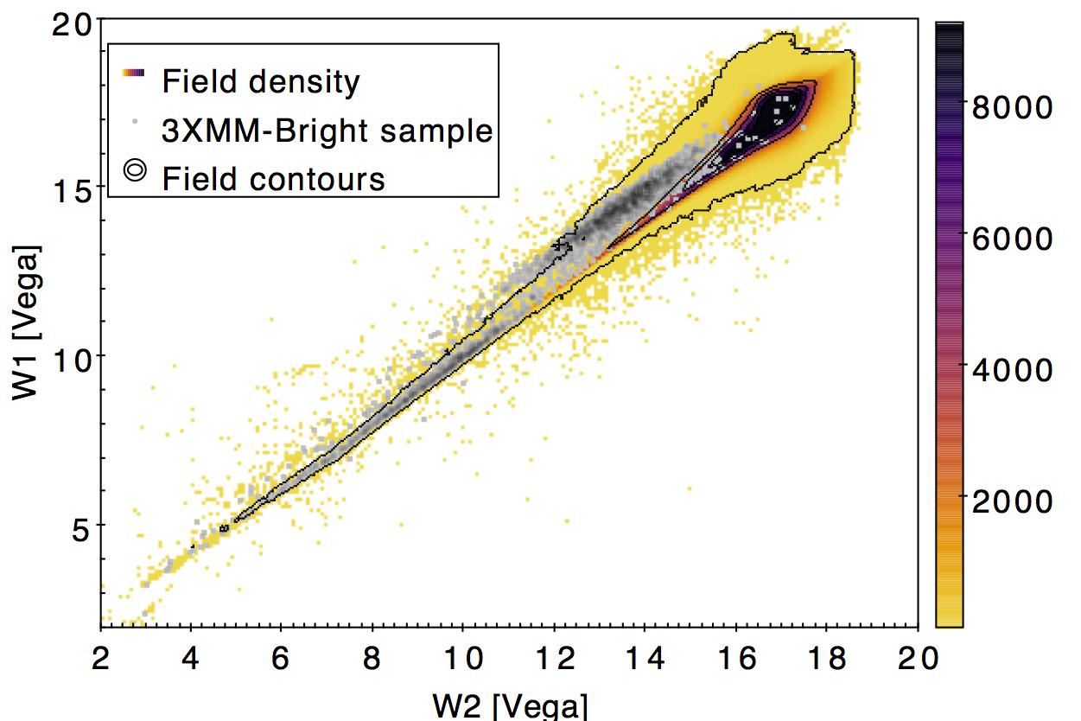
Multiple bands
AND
(i.e. Simultaneously)
magnitude A
magnitude B
OR
even better:
magnitude A
magnitude B

Slide 13

Combinatorics
Pineau+16

Slide 14

Test 1: XMM-COSMOS
ML: 1281 considered reliable, after careful visual inspection
Now with Chandra coverage (higher accuracy) we know 139 were mis-associated
NWAY: fast, automatic, with single band, self-learning magnitude distribution: additional 49/139 sources right
NWAY with
1+3.6um
catalogues:
got 86/139
sources right
Fast!

Slide 15
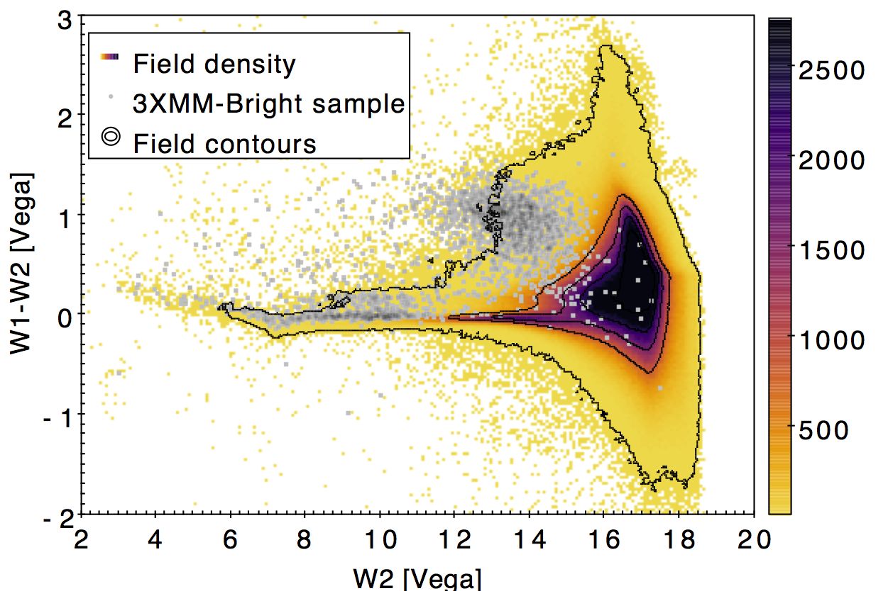
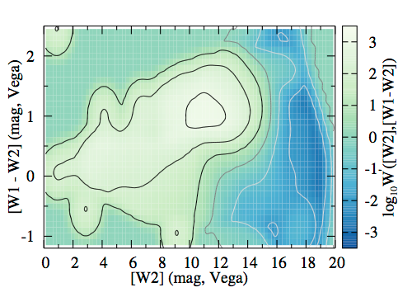
Test 2: ROSAT
Learn color prior from XMM counterparts at same depth
BOSS 10,000 deg² area: 4524 XMM sources.
With only ROSAT+SDSS: 96% recovered

Slide 16
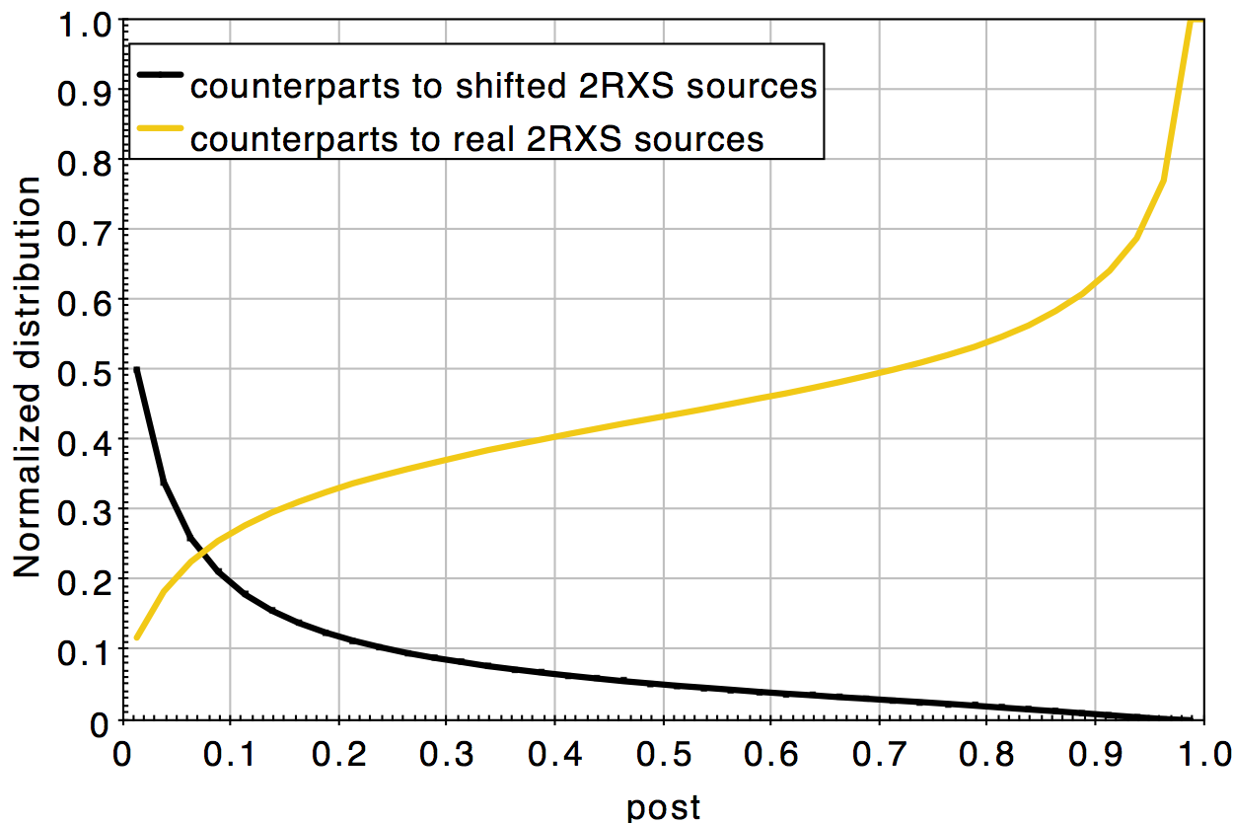
Test 2: ROSAT
With only ROSAT+SDSS: 96% recovered
95% have high probability
Shifting ROSAT by 6’ gives false-association fraction: 4% – consistent

Slide 17
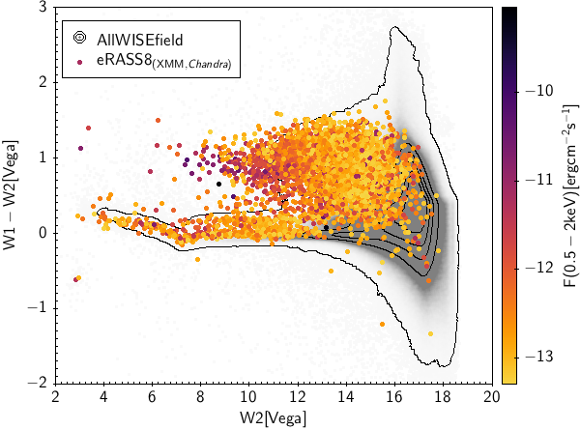
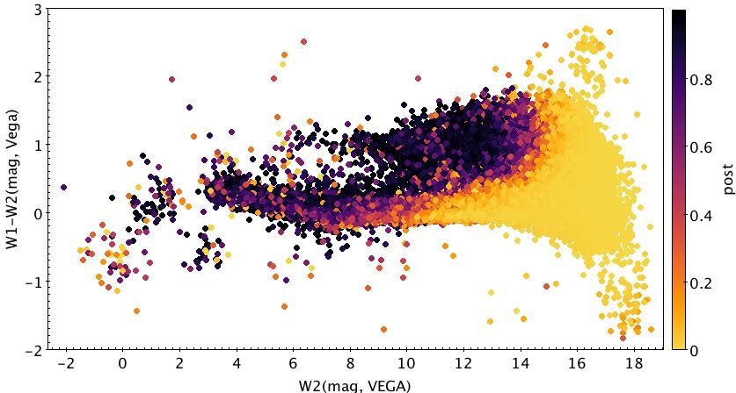
Open issues
XMM cut at ROSAT depth
XMM cut at eROSITA depth
For eROSITA need
better discriminators
Lack of all-sky survey
ROSAT distribution

Slide 18
Open issues II
Taking into account multiple X-ray sources: stars, AGN, star-forming galaxies, central ellipticals in clusters
Blending of these within eROSITA PSF
But: want to discover high-z AGN (non-QSO), high-z obscured AGN
how to define a model for unknowns?
  Self-learning capabilities of NWAY

Slide 19
Conclusions
Knowing correct counterpart for X-ray sources is crucial for galaxy-AGN co-evolution, BH physics and stellar evolution studies
NWAY is a better way!
‣ algorithm based on Bayesian statistics
‣ can process simultaneously N catalogues
‣ not limited to use of magnitude
‣ can ingest any kind of prior (ideally entire SED)

Slide 20
Web: http://example.org twitter: @example identi.ca: @example mail: name@example.org
Questions?

