Slide 1
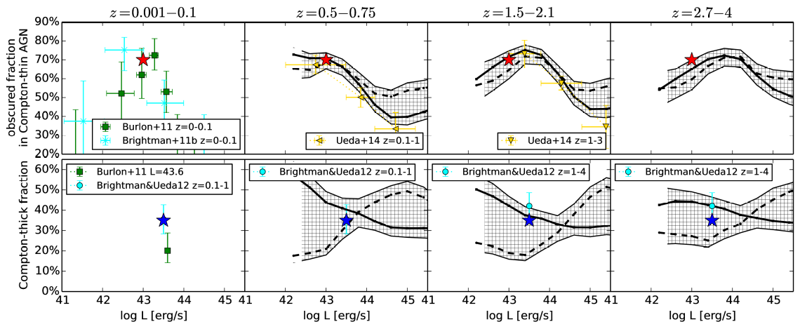
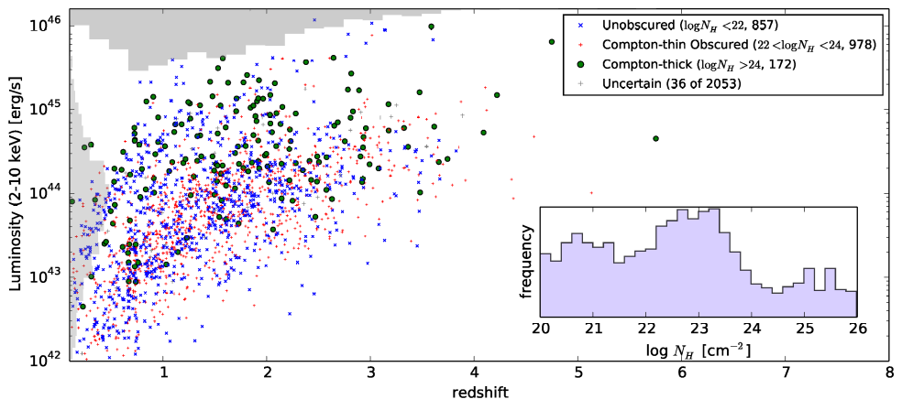
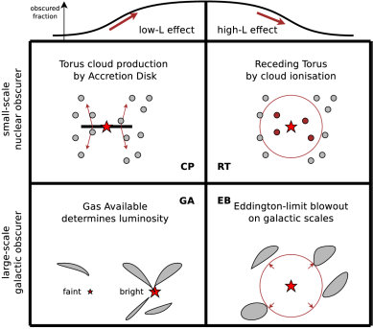
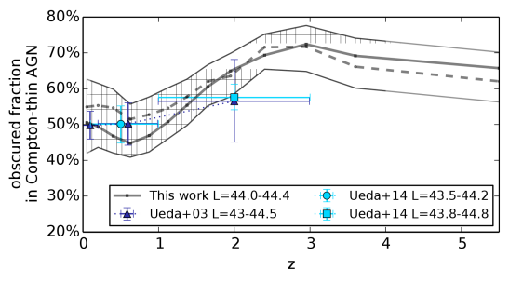
Obscuration-dependent evolution of Active Galactic Nuclei
Johannes Buchner, Antonis Georgakakis, Kirpal Nandra, Murray Brightman, Marie-Luise Menzel, Zhu Liu, Li-Ting Hsu, Mara Salvato, Cyprian Rangel, James Aird, Andrea Merloni and Nicholas Ross
~2000 AGN
  CDFS
  AEGIS-XD
  C-COSMOS
  XMM-XXL
Luminosity function
  Intrinsic 2-10keV
  Propagation of redshift uncertainties
  Non-parametric, recover smooth density field
Fraction of
  Obscured: 76⁺⁴₋₅%
  Compton-thick: 36⁺⁸₋₈%

