Slide 1


Practical Bayesian Inference with PyMultiNest
Johannes Buchner
Max Planck Institute for extraterrestrial Physics
http://astrost.at/istics/

Slide 2
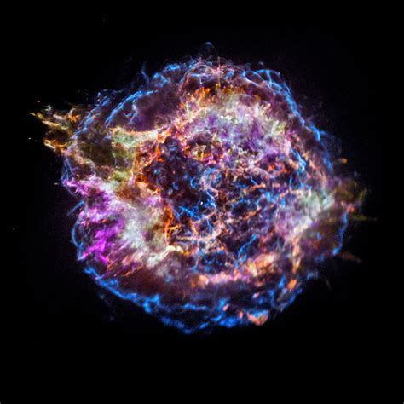
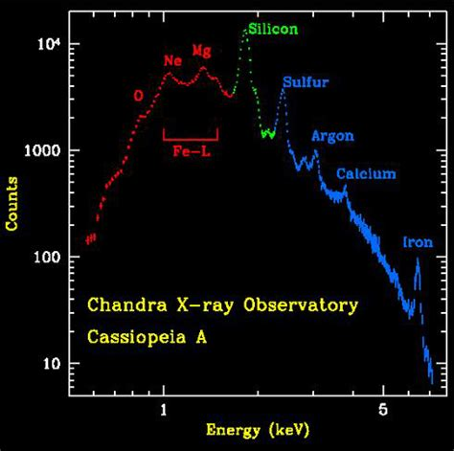
Astronomy & Astrophysics
Understanding individual objects
Physical model
Poisson data
... 10²⁰eV
In wavelength or energy →
In time →
In space →
In multiple →
Light & beyond

Slide 3
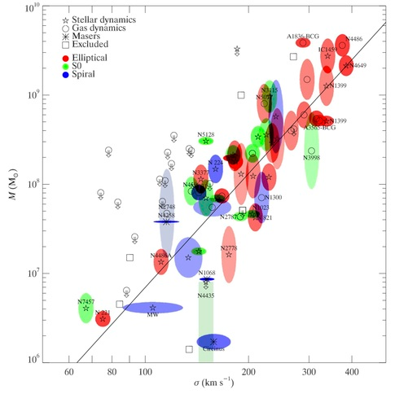
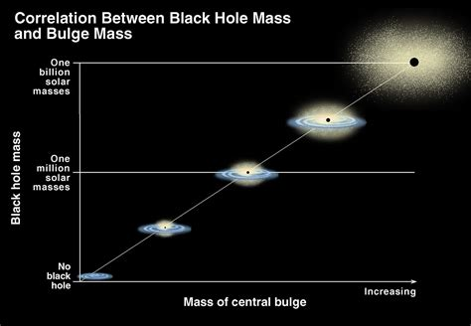
Astronomy & Astrophysics
Understanding samples
Blac Hole Mass
Empirical models, correlations
Physical interpretation
reproduction with galaxy simulations
Velocity dispersion of stars

Slide 4


Astronomy & Astrophysics
Understanding underlying populations
Censorship (but understood)
heavily heterogeneous uncertainties (but understood)
Hierarchical Bayesian Model with censorship (1983)
(N+1)*nested sampling + importance sampling
N * nested sampling + Stan

Slide 5
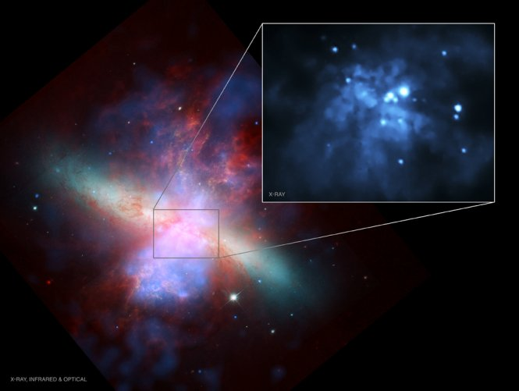
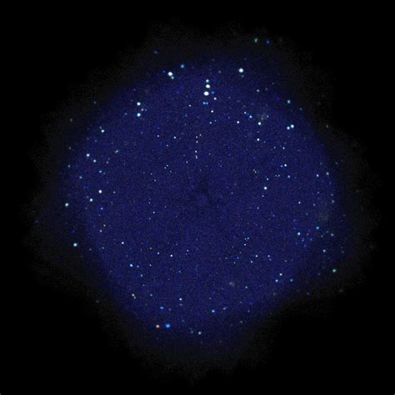
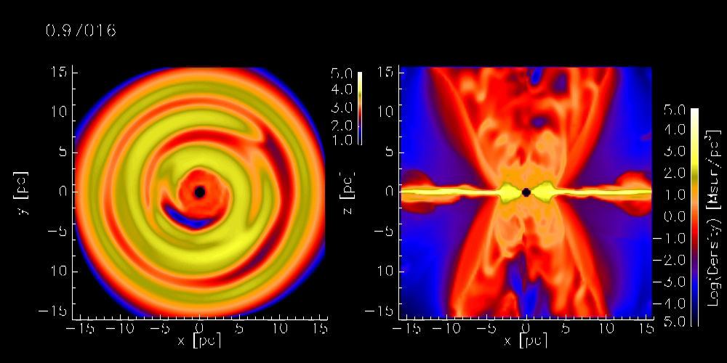
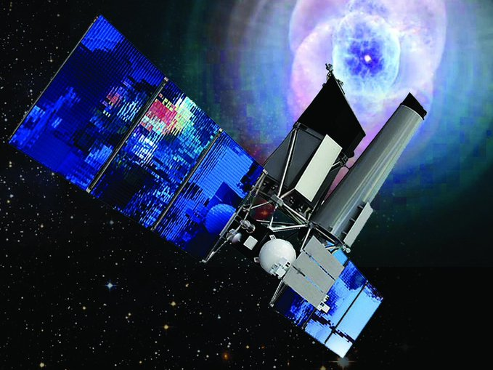
Galaxy clusters for Dark Energy
3 million Active Galactic Nuclei
Johannes Buchner
http://astrost.at/istics/
Max Planck Institute for Extraterrestrial Physics
Garching, Munich
@eROSITA_SRG

Slide 6
Agenda
Choice of tools
Setting up problems, running
Use of posterior samples
Workflow
  Visualisation
  Comparison of model comparison methods (BF vs IC vs prediction-based)
How to break things

Slide 7
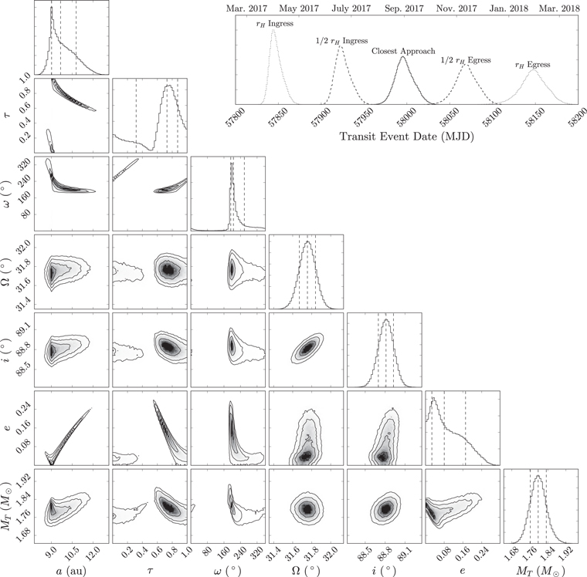
Inference requirements
Forward modeling with Bayesian inference pretty popular
Physical models can be complex & expensive Monte Carlo simulations
“degenerate” parameter constraints
multiple solutions
Sometimes little data
Often 2-15d ^{(or 1e6d)}
Competing physical effects

Slide 8
Bayesian tools
Parameter estimation
Nested sampling (MultiNest)
HMCMC with multiple chains – Stan
→ posterior samples
Model comparison
Nested sampling (MultiNest)
open research problem. NS+some MCMC variant. More research needed
→ lnZ
low-d:
(~20d)
high-d:
To handle multiple maxima, low state of information, peculiar posterior shapes, numerical likelihoods
(& have a life beyond convergence criteria)
GP: george, celerite
https://arxiv.org/abs/1703.09710
Other tools: emcee, PolyChord

Slide 9
PyMultiNest in practice
Inputs
  Dimensionality of problem
  Number of live points
  Efficiency parameter
  Prior transformation function
  Likelihood function
Outputs
  Posterior samples
  ln(Z) with uncertainties
In Python
Easy to load data
complex calculations, legacy code
visualize results
automate
(~400-1000)
30%
(like in MCMC)
https://github.com/JohannesBuchner/PyMultiNest/

Slide 10
Specifying priors
Transform uniform cube to physical parameters
1
10
def my_prior_transform(cube):
# cube is a d-dimensional array
params = cube.copy()
# from 0 to 10
params[0] = cube[0] * 10
return params
0
0

Slide 11
Specifying priors
Transform uniform cube to physical parameters
1
10
def my_prior_transform(cube):
# cube is a d-dimensional array
params = cube.copy()
# from -10 to +10
params[0] = cube[0] * 20 - 10
return params
0
-10

Slide 12
Specifying priors
Transform uniform cube to physical parameters
1
10
def my_prior_transform(cube):
# cube is a d-dimensional array
params = cube.copy()
# from -10 to +10
params[0] = cube[0] * 20 – 10
# from 1 to 10¹⁰
params[1] = 10**(cube[1] * 10)
# via inverse CDF
params[2] = rv.ppf(cube[2])
return params
# Gaussian prior 5+-1
rv = scipy.stats.norm(5, 1)
0
0
1
0
1
0

Slide 13
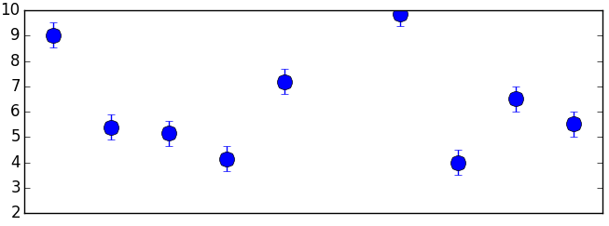
Specifying likelihoods
Gaussian example
mydata = numpy.loadtxt(“mydata.txt”)
x, y, yerr = mydata.transpose()
def my_likelihood(params):
# params is a d-dimensional array
# already transformed
a, b, c, d = params
# compute model prediction:
m = (a + numpy.sin(x * c)) * d
# compute gaussian likelihood
return (((m – y)/yerr)**2).sum()
y +- yerr
x

Slide 14
Specifying likelihoods
Gaussian example
mydata = numpy.loadtxt(“mydata.txt”)
x, y, yerr = mydata.transpose()
def my_likelihood(params):
# params is a d-dimensional array
# already transformed
a, b, c, d = params
# compute model prediction:
m = (a + numpy.sin(x * c)) * d
# compute gaussian likelihood
return (((m – y)/yerr)**2).sum()
result = solve(
LogLikelihood=my_likelihood,
Prior=my_prior_transform,
n_dims=4,
outputfiles_basename=’mysine_’)
y +- yerr
x
Arbitrarily complex model calculation →
Arbitrarily complex data uncertainties →

Slide 15
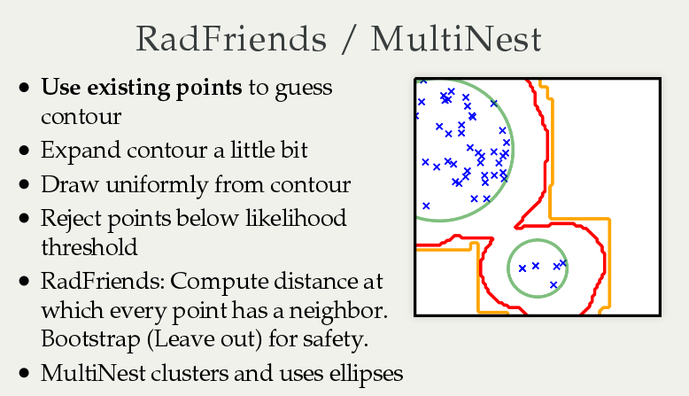
MultiNest: Feroz, Hobson & Bridges (2009)
PyMultiNest: Buchner et al. (2014)
RadFriends: Buchner (2014)

Slide 16
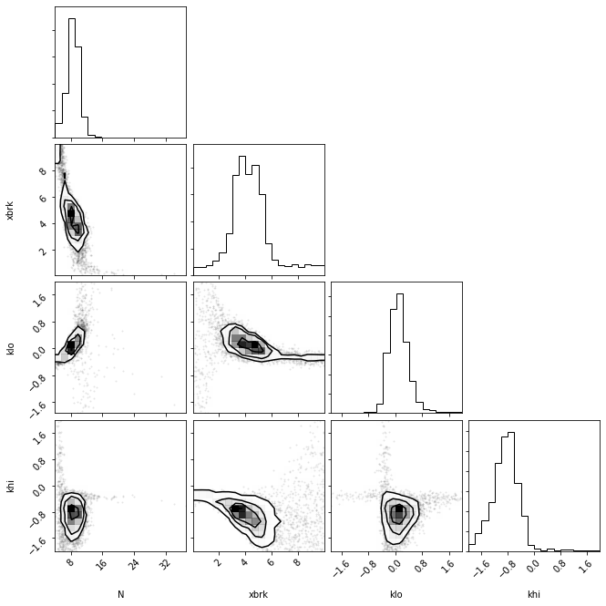
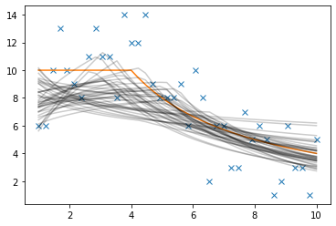
Example

Slide 17
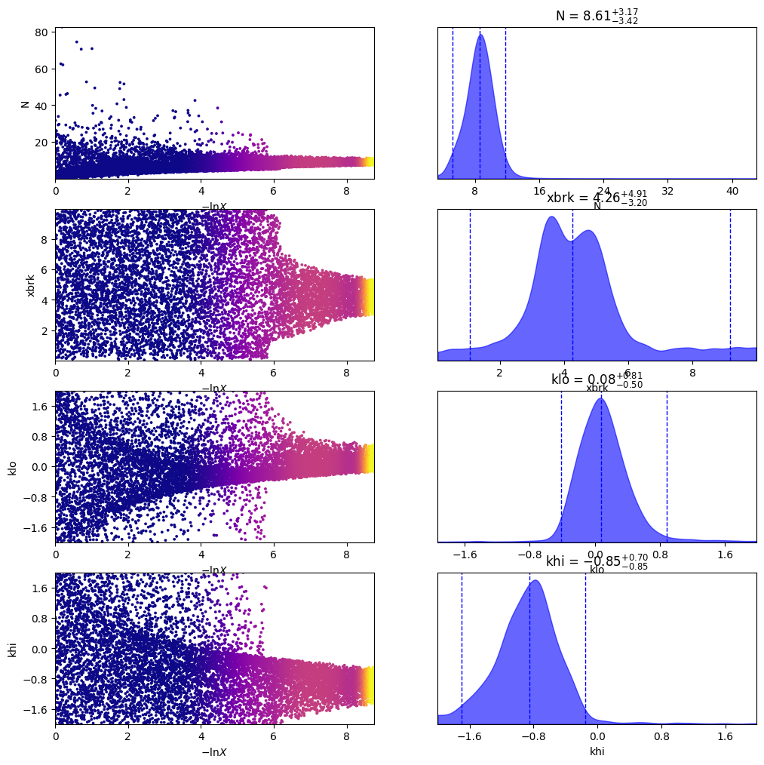
Important files
<prefix>post_equal_weights.dat
<prefix>stats.dat
multinest_marginals*.py <prefix>
Higson+19

Slide 18
Model comparison
Empirical models
  Information content
Component presence
  Regions of practical equivalence
Physical effects
  Bayes factors
  Priors often well-justified
https://arxiv.org/abs/1506.02273
Betancourt (2015)
(exoplanets)
Monte Carlo simulations
(parametric bootstrap)
Vary priors
Zwicky’s morphological analysis + Bayesian inference

Slide 19
Workflows
Best model
Parameters go to extremes
empirical
model
modification
Parameters go to extremes
Visualisations
Thinking
BMC
(physics)
Model set
New
physical
model
Add to model
comparison set
AIC
Best
empirical
model
Visualisations (PPC)
model
modification
(economics/political science)
LOO CV/WAIC

Slide 20
Stan
data {
int<lower=0> N;
real[N] x;
real[N] y;
real[N] y_err;
}
parameters {
real a;
real b;
real c;
real d;
}
model {
for (i in 1:N) {
real m;
m <- a*sin(x[i]*b + c) + d;
y[i] ~ normal(m, y_err[i]);
}
}
http://mc-stan.org
Excellent manual

Slide 21
Strengths
In general robust & reliable
MPI capable
Can resume
$ pip install mpi4py
$ mpiexec -np 4 python myprog.py

Slide 22
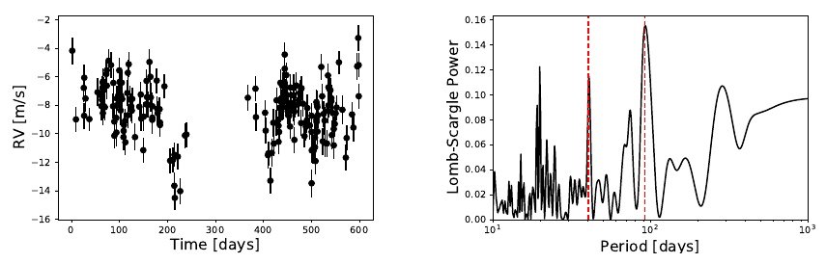
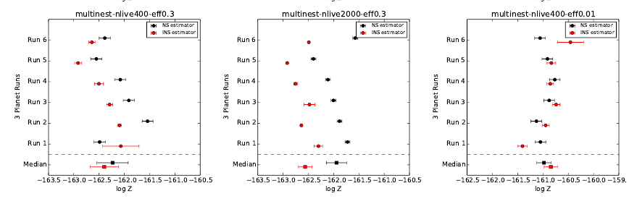
Failure modes
estimators INS!=NS
  Multiple runs
  → lnZ scatter
  Check with other techniques (RadFriends, VB+IS)

Slide 23
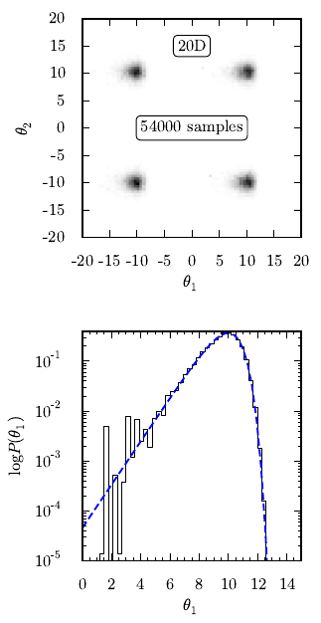
Creating difficulties
When ellipsoids approximation is poor
Multi-modal
Posterior is heavy-tailed/asymmetric

Slide 24
Future
http://astrost.at/istics/
http://github.com/JohannesBuchner
Failure modes & tuning of step-based methods
region reconstruction +
step-based methods
Rigorous extensions to dynamic nested sampling
Analysis of many similar datasets
Review of nested sampling extensions
slice sampling, NUTS
Stay tuned!
(UltraNest3)

