Slide 1




The column density distribution of galaxies at z=0.5-3 from GRBs and implications for obscured AGN
Johannes Buchner
MPE, PUC
Kaffeerunde, 2015
With Steve Schulze & Franz Bauer

Slide 2
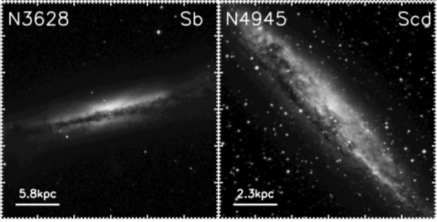
Motivation
20-40% Compton-thick AGN
75% AGN are obscured (X-ray N_{H} > 10²²cm⁻²)
Importance of galaxy-scale obscuration?
Goal: z=0.5-3 upper limit
Fraction obscured
Maiolino&Rieke95, Matt00, Goulding&Alexander09
1e42
Accretion Luminosity [erg/s]
1e46

Slide 3
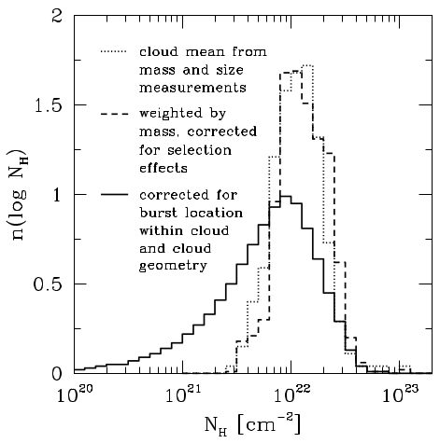
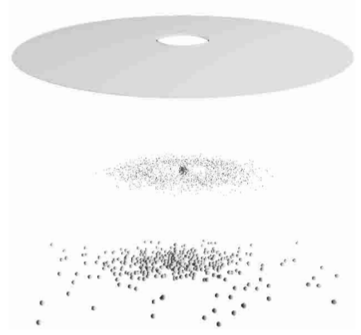
GRBs as probes
Death of massive stars
Show obscuration in their afterglow spectrum
Consistent with GMC origin
Milky Way model
Richard&Price02, Vergani+04, Campana+06

Slide 4
Aims
Gamma ray detection unbiased
Estimate column density distribution (CDD) of GRBs from their X-ray afterglows
GRB environment central CDD (upper limit)
GRB host galaxies central CDD (upper limit)
Low-luminosity AGN host galaxies
  Obscured fraction from galaxy-scale gas
  Compton-thick fraction from galaxy-scale gas
    Is Galaxy-scale obscuration important?

Slide 5
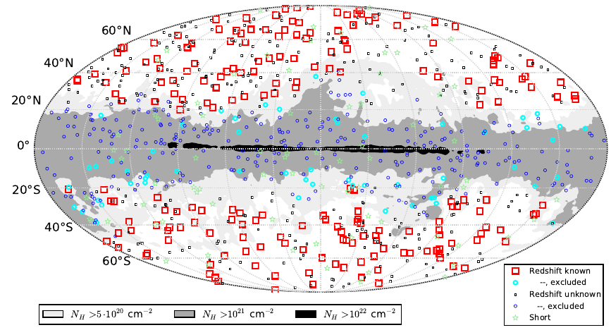
Data: long GRB afterglows
X-ray lightcurve
Swift
  Long GRBs
  Outside galactic plane
  Select afterglow intervals
X-ray spectrum:
  powerlaw
  Galactic abs.
  Absorption
-3
10000-100000s
100-1000s
-0.5
-1.3
time
-2

Slide 6
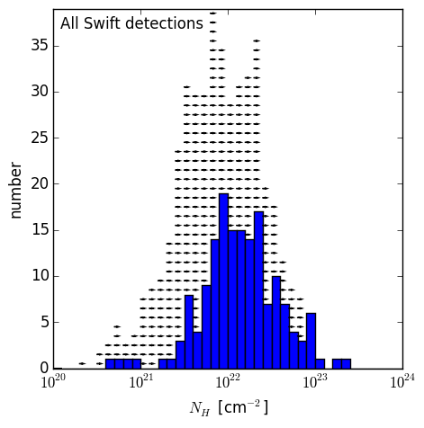
Results: Column density analysis
Complete sample:
  10^{20.5} – 10^{23.2} cm⁻²
  No Compton-thick

Slide 7
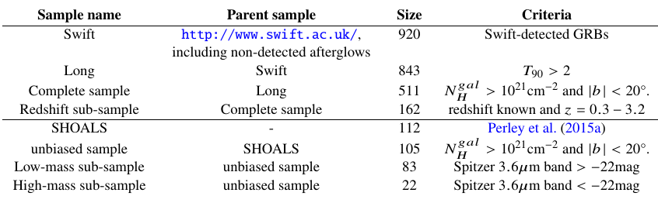
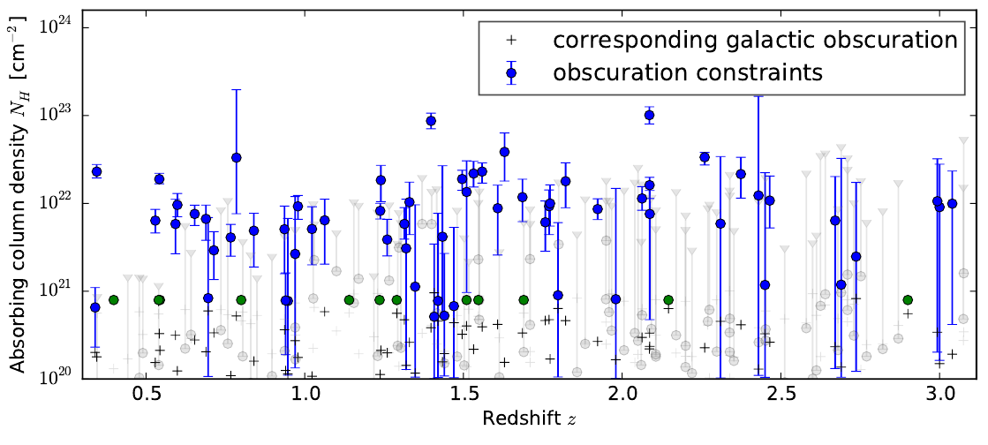
Data: long GRB afterglows
10^{20.5} – 10²³cm⁻²
No Compton-thick GRBs

Slide 8
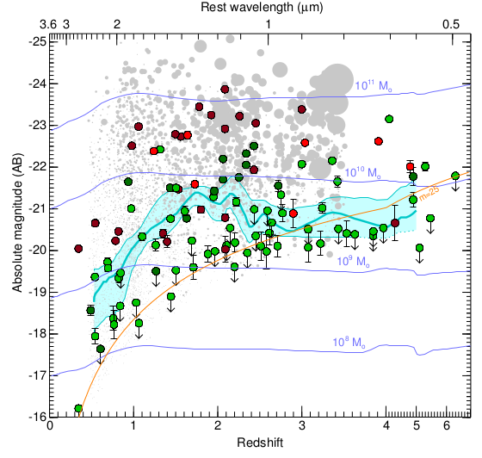

SHOALS Sample: Host mass
obscured
Perley+15

Slide 9
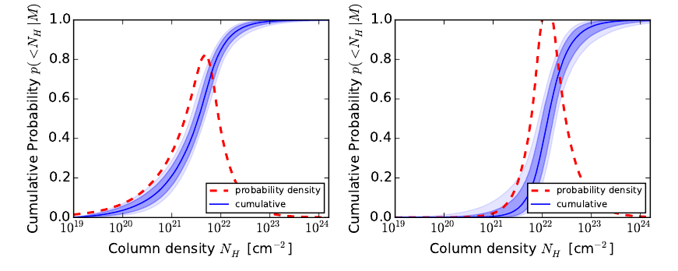
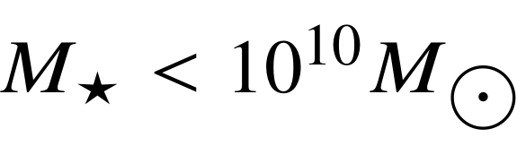
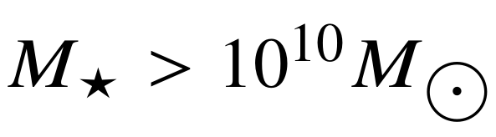
SHOALS Sample: Host Mass
Low mass
High mass

Slide 10
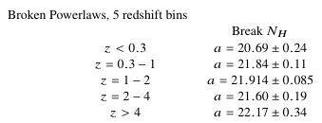
Redshift Evolution
Complete sample: No evolution at z > 0.5
22
Break N_{H}
20
21
23

Slide 11

Redshift Incompleteness Bias
Unbiased samples
(only observability criteria: time, sky location, γ-ray flux)
All Swift
detections, including w/o redshifts, afterglows
Only those with redshift determined
Redshift incompleteness
avoids high-mass galaxies
(see e.g. Schulze+15, Campana+12)

Slide 12
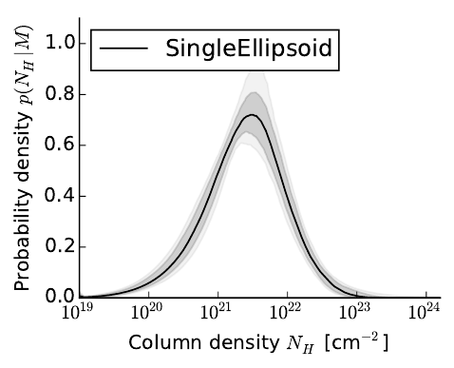
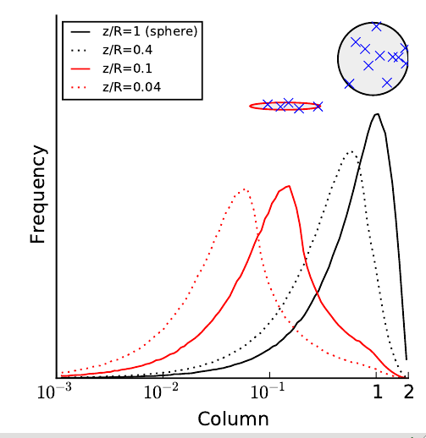
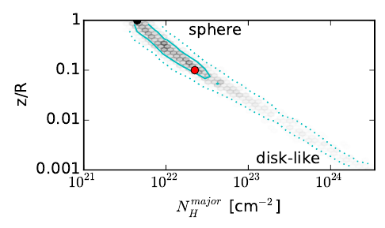
Ellipsoids
Obscuring gas – GRB
Similar to MW cloud analysis, σ=

Slide 13
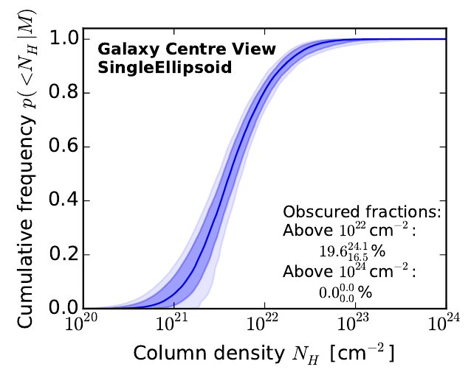
GRB conclusions
Consistent with random placement in clouds
No Compton-thick GRBs

Slide 14
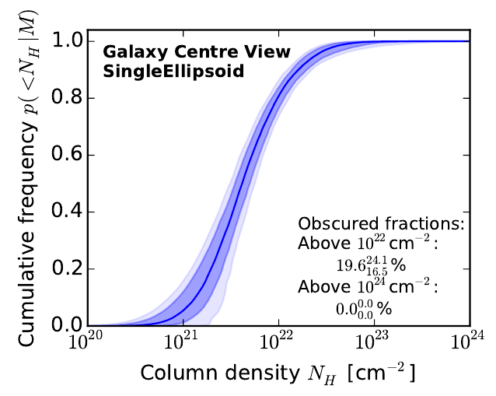
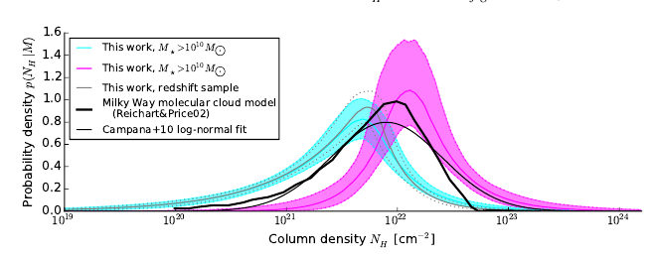
GRB host galaxies
Consistent with random placement in clouds
No Compton-thick GRBs
<

Slide 15
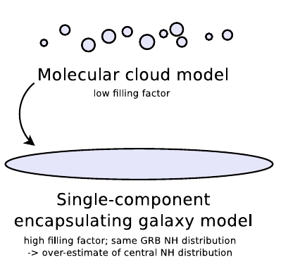
Gas in GRB host galaxies
Argument 1: Wrapping
Argument 2: Packing
Local Analogies:
  MW: 2° NH~22
  LMC: max NH=21.5
~16%
~2%
0%
~20%

Slide 16
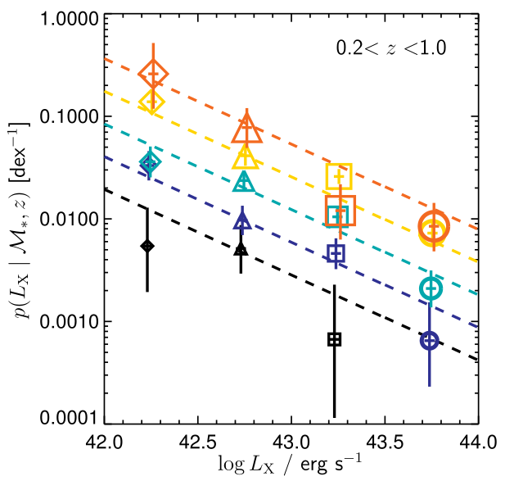
Connection with AGN
M~1e9 galaxies: <20% obscured fraction
“Eddington ratio” L_{X}/M*
If M / L = const
  low-M = low-L
Reality: powerlaw dist.
  Faint: low-M & high-M
  Bright: high-M
High-mass:
bright & faint
M=1e12
Low-mass:
only faint
M=1e9
Aird+12

Slide 17
Argument by contradiction
Bright: high-M
Faint: low-M & high-M
Low-M: 20% f(obsc)
H₀: Galaxy-scale gas is obscurer
Either:
  high-M have more obscuration
  high-M have less obscuration
Drop of 35% can not be explained → reject H₀
Fraction obscured
20%
From low-M
No low-M
1e42
Accretion Luminosity [erg/s]

Slide 18
What about Compton-thick AGN?
Fraction 20-40%, L-indep (AGN)
Galaxy-scale gas: 0% (GRB)
Must be nuclear (“torus” or CMZ)
Compton-thin sky obscured by host galaxy
  Random orientations:
    Compton-thin obscured fraction AGN – gal obscuration
  Poles aligned:
    Gal obscuration lower
  Torus pole always points to disk
    Gal obscuration higher

Slide 19
Conclusions
GRBs have obscuration 10²⁰-10²³ cm⁻²
GRBs live in Compton-thin environments, consistent with GMC-like clouds
GRBs in high-M hosts have more obscuration
No evolution around cosmic SF peak
AGN obscuration:
  CT – nuclear
  Variable obscuration – nuclear or feedback
  Host contribution: <20%

