Slide 1
Separating the nuclear and galaxy-scale obscuration in AGN
Johannes Buchner
PUC
Collaborators: @PUC: Steve Schulze, Franz Bauer
NASA GSFC

Slide 2
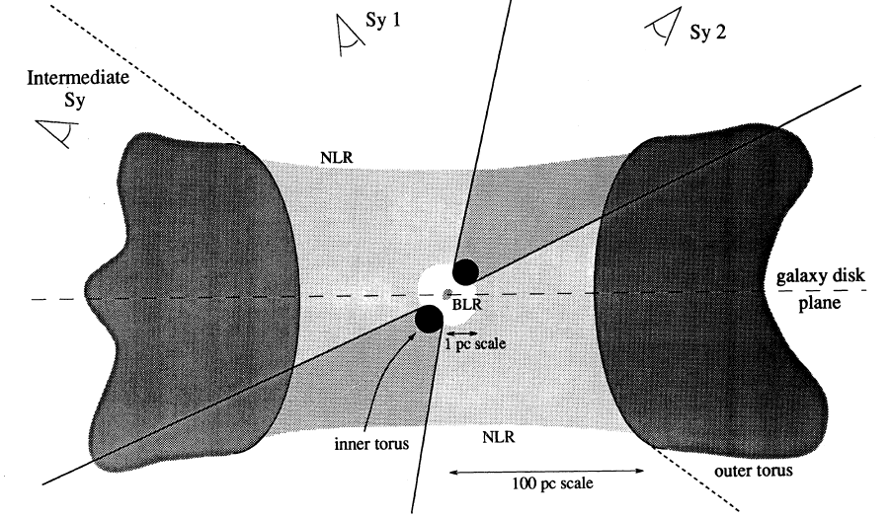
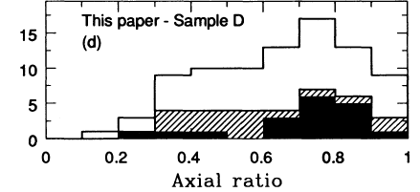
Host galaxy obscuration
Maiolino&Rieke 1995: “Sy1 are mostly found in face-on galaxies, intermediate type are mostly found in edge-on hosts.”
Sy2+Sy1
Sy 1-1.5
Edge-on
Face-on

Slide 3
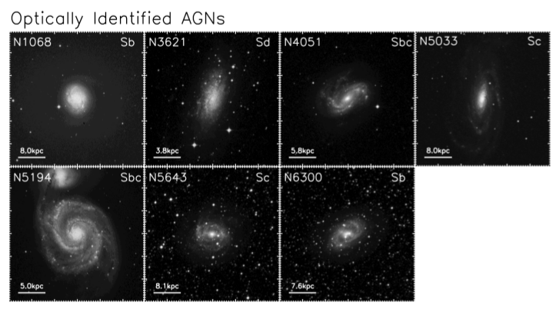
Spitzer identification of AGN
Volume-limited
Goulding & Alexander 2009

Slide 4
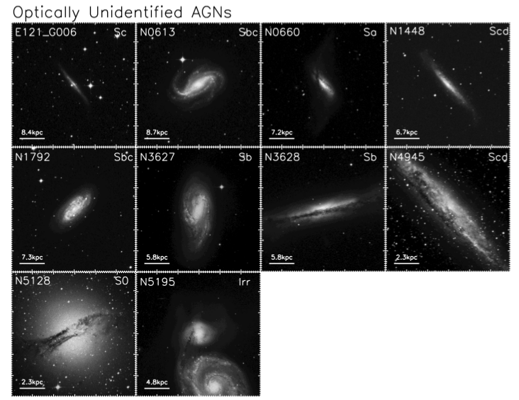
Spitzer ID of AGN
Volume-limited
Goulding & Alexander 2009

Slide 5
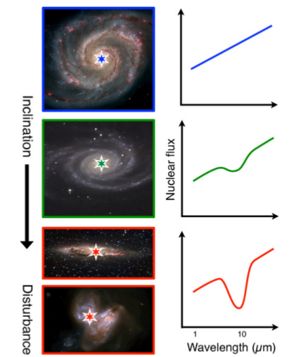
Local Compton-thick sample
Goulding+2012

Slide 6
Column density N_{H}
N_{H} … number of H atoms along line-of-sight
N_{H} = few atoms / cm³ x few kpc = 10²²/cm²
Compton-thick: ~ 10²⁴ cm² – Circinus, NGC1068
  Nuclear regions with high density
  Mergers – major accretion events for SMBH
Fe, O
  absorb everything except hard X-ray, re-radiate thermally in IR
  Measure N_{H} from X-ray spectrum assuming local abundances

Slide 7
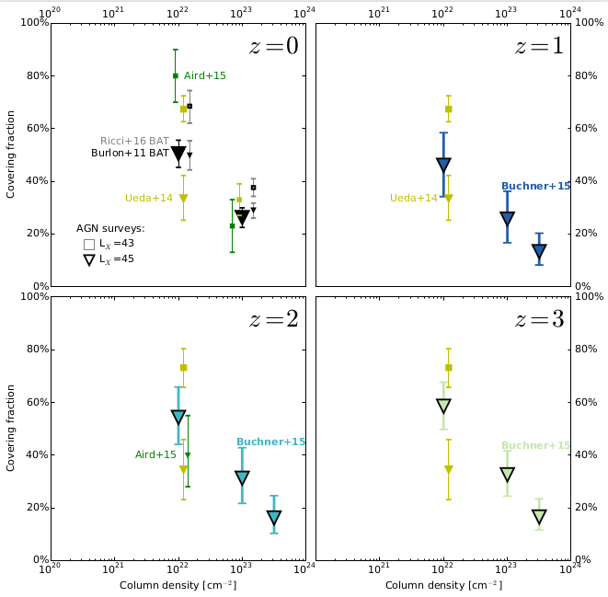
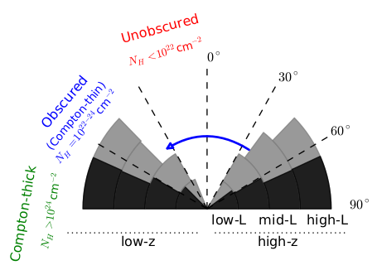
Covering fraction
Column density NH

Slide 8
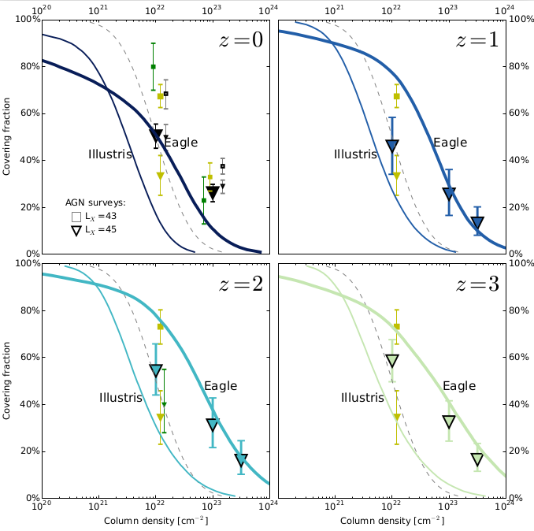

Slide 9
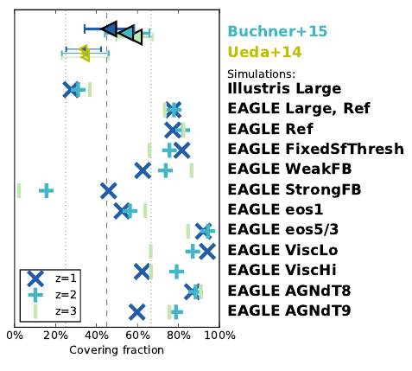
SMF
Star formation rate
Galaxy size distribution
CO masses
H surface densities
Cluster X-ray gas

Slide 10
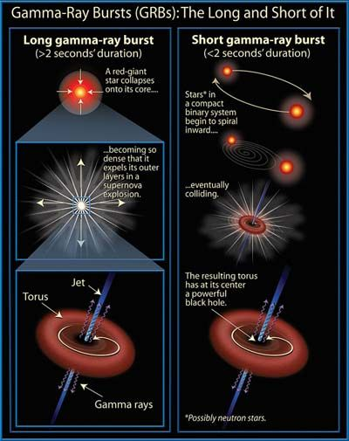
Observational constraints
Beacons inside galaxy
Z=1-3
Detected through any obscuration
Long (>2s) Gamma Ray Bursts:
  Collapse of massive stars - SN
  Accretion disk, torus, jet
  Jet produce γ-ray
    Detected at z=0-10
    Detected through any obscuration
  X-ray, Opt, … Radio afterglow

Slide 11
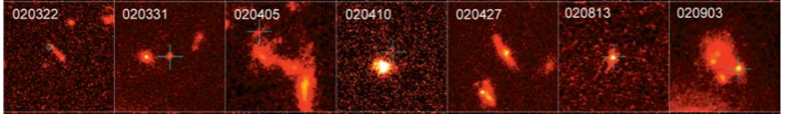
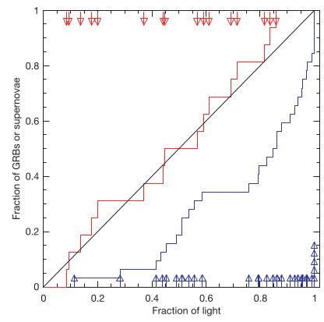
HST, blue or ultraviolet rest-frame images of GRB host galaxies
Fruchter+06
Nature
Massive O/B stars
Die early
In star-forming regions, molecular clouds
Need low metallicity gas
SN: proportional
to blue light
GRB:
concentrated at bluest regions

Slide 12
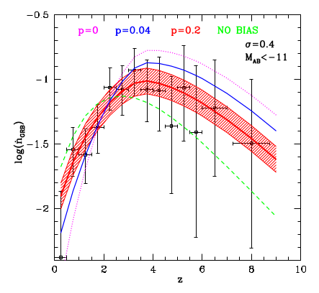
Obstacles
Is the obscuration of GRBs local or the galaxy?
Metallicity cut-off → Stellar mass distribution
Actively star-forming, AGN not necessarily
Cosmic SFR
GRB: metallicity cut on host galaxy stars

Slide 13
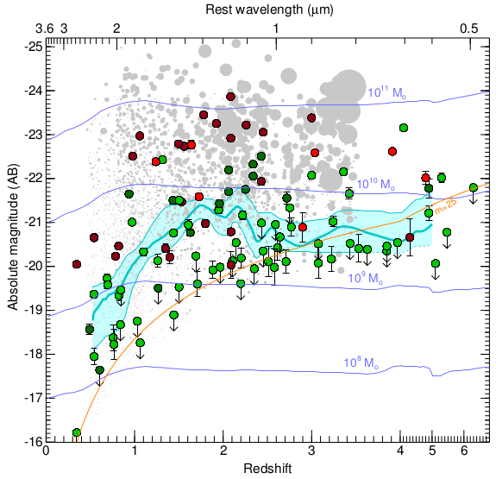

Stellar Mass
Perley+16
Redshift

Slide 14
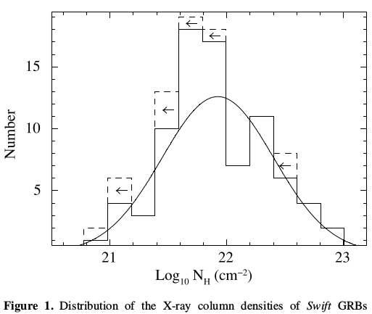
GRB column densities
Swift: ~900 GRBs
Long >2s GRB
X-ray afterglow
Flares removed
No Compton-thick GRBs
Campana+10

Slide 15

Host Mass – Obscuration
SHOALS
  Perley+15
  Deep follow-up
  ~90% redshift complete
  Spitzer masses
“Galaxy gas as obscurer: I.”
Buchner, Schulze & Bauer (submitted)

Slide 16




Host Mass – Obscuration
SHOALS
  Perley+15
  Deep follow-up
  ~90% redshift complete
“Galaxy gas as obscurer: I.”
Buchner, Schulze & Bauer (submitted)

Slide 17

Expected Scatter
~0.5 dex from geometry
“Galaxy gas as obscurer: I.”
Buchner, Schulze & Bauer (submitted)

Slide 18

Local Galaxies
1% densest column from HI maps
Gas metallicity-corrected
“Galaxy gas as obscurer: I.”
Buchner, Schulze & Bauer (submitted)

Slide 19
From GRBs to AGN
New Relation from GRBs
AGN fraction
Aird+12, Bongiorno+12
Stellar Mass Function
Ilbert+13, Muzzin+13
Marginalisation
Buchner et al (in prep)

Slide 20

Predictions for AGN
Slight overprediction:
  GRB-SF?
  Ellipticals?
Buchner et al (in prep)

Slide 21
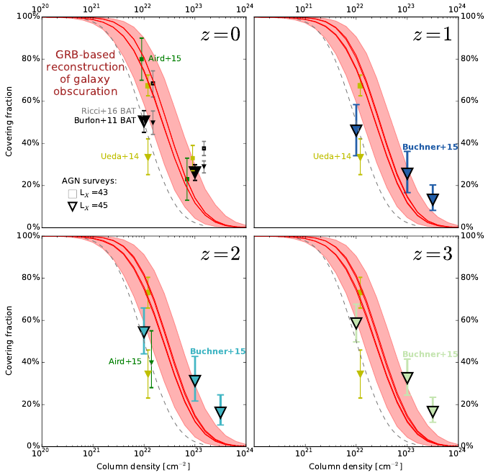

Slide 23
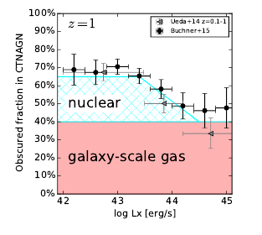

Implications for the Torus
nuclear
galactic
Definitely nuclear
Buchner et al (in prep)

Slide 24
Contents
GRB show mass-dependent obscuration
  Predicted by simulations
  Metallicity-effects
Host galaxy obscuration for AGN population
  Caveats: SF distribution, metallicity, host mass
  Galaxy gas+dust can explain much of the AGN obscuration at N_{H} = 10²² – 10²³ cm⁻²
  Consistent with simulations
Nuclear obscurer model for Torus modellers & simulations
  Covering factors is dependent on
    Black hole mass
    Accretion rate (X-ray luminosity)
    Host galaxy mass
Consistent with Swift/BAT survey
Consistent with IR covering fractions

Slide 25
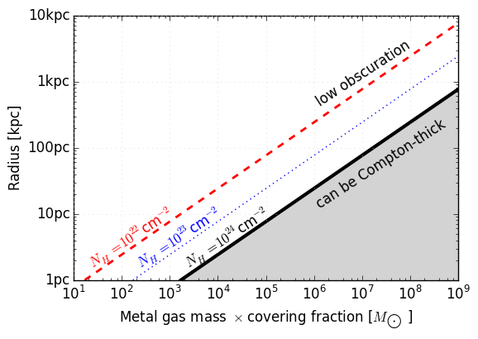
Mass required by CT obscurers
Modulo covering fraction
M_{Z} = 1% of stellar mass

