Slide 1

The nuclear and galaxy-scale obscuration in AGN, separated
Johannes Buchner
CONICYT fellow
Collaborators: @PUC: Steve Schulze, Franz Bauer
Previously: @MPE HEG: A. Georgakakis, K. Nandra,
M. Salvato, L-T. Hsu, M-L. Menzel, Z. Liu

Slide 2
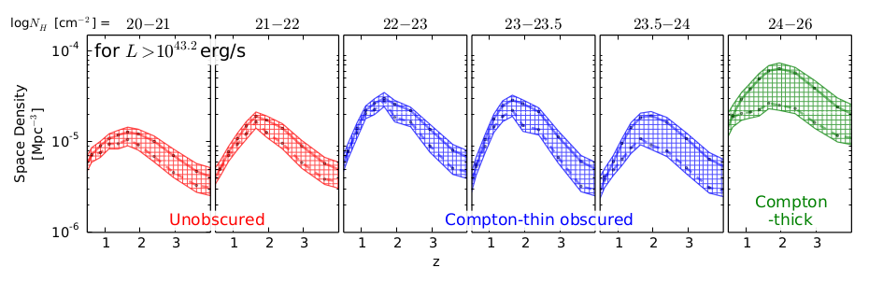
Luminosity function of AGN
Buchner et al. 15 (MPE HEG)
Large survey of X-ray AGN
Including Compton-thick AGN
Advances for realistic uncertainties

Slide 3
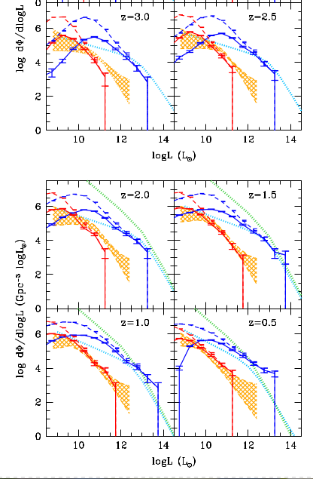
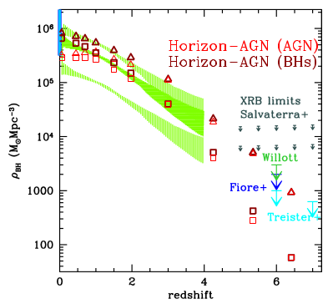
Horizon-AGN
Volonteri+16
Buchner+15

Slide 4
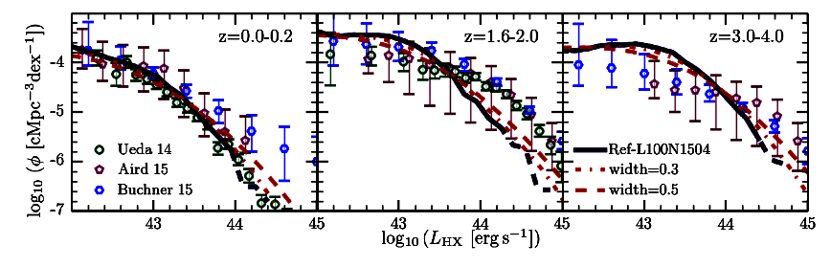
Luminosity function of AGN
Buchner+15
EAGLE
Rosas-Guevara+16

Slide 5
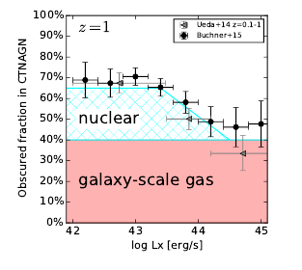

Host Galaxy Obscuration
nuclear
galactic
Definitely nuclear
“Galaxy gas as obscurer: II. Separating the galaxy-scale and nuclear obscurers of Active Galactic Nuclei“
Buchner, Schulze & Bauer (submitted)

Slide 6
Column density N_{H}
N_{H} … number of H atoms along line-of-sight
N_{H} = few atoms / cm³ x few kpc = 10²²/cm²
Compton-thick: ~ 10²⁴ cm² – Circinus, NGC1068
  Nuclear regions with high density
  Mergers – major accretion events for SMBH
Fe, O
  absorb everything except hard X-ray, re-radiate thermally in IR
  Measure N_{H} from X-ray spectrum assuming local abundances

Slide 7
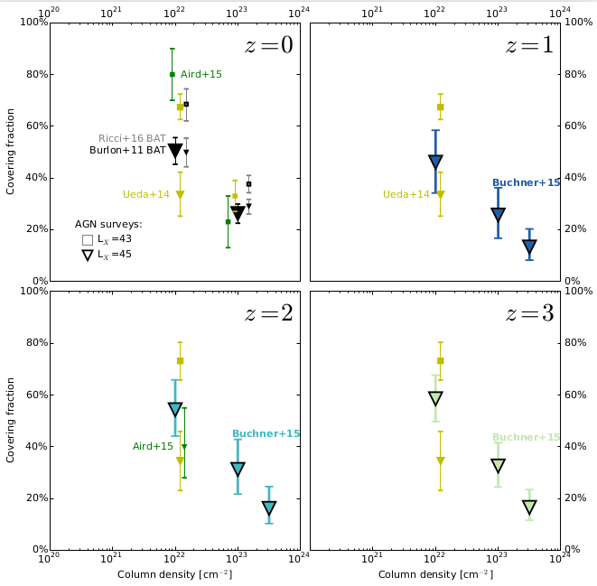
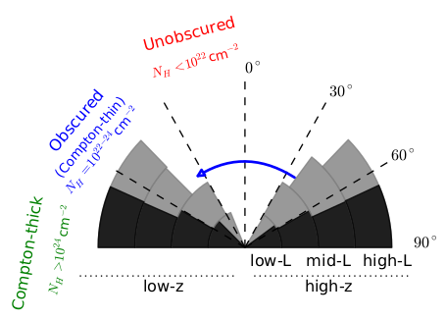
Covering fraction
Column density NH

Slide 8
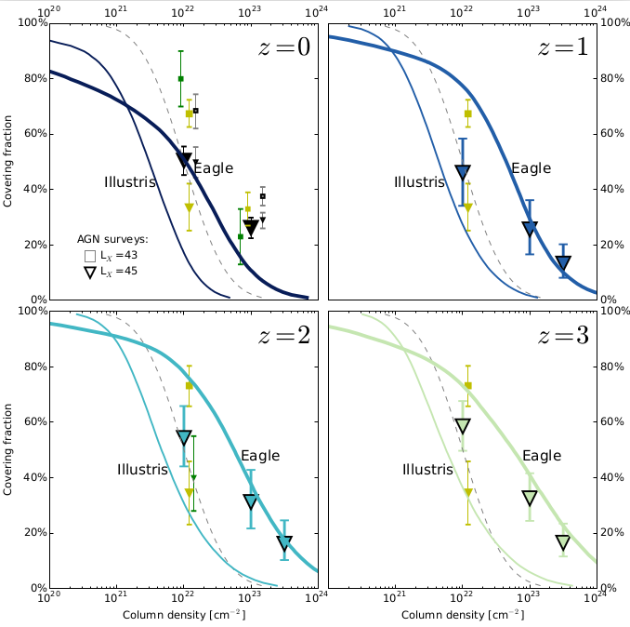

Slide 9
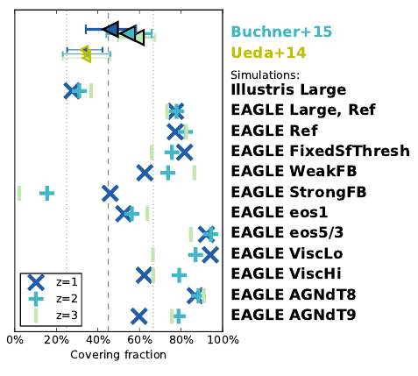
SMF
Star formation rate
Galaxy size distribution
CO masses
H surface densities
Cluster X-ray gas

Slide 10
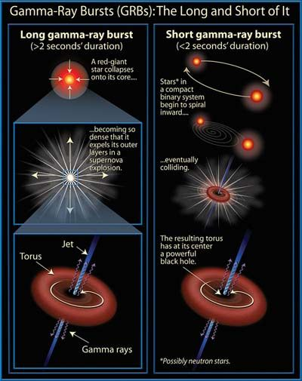
Observational constraints
Beacons inside galaxy
Z=1-3
Detected through any obscuration
Long (>2s) Gamma Ray Bursts:
  Collapse of massive stars - SN
  Accretion disk, torus, jet
  Jet produce γ-ray
    Detected at z=0-10
    Detected through any obscuration
  X-ray, Opt, … Radio afterglow

Slide 11
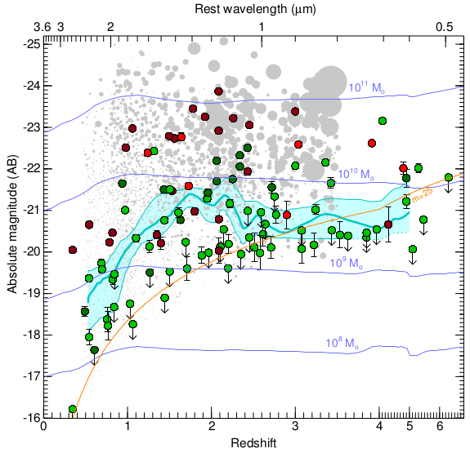

Stellar Mass
Perley+16
Redshift

Slide 12

Host Mass – Obscuration
SHOALS
  Perley+15
  Deep follow-up
  ~90% redshift complete
  Spitzer masses
“Galaxy gas as obscurer: I.”
Buchner, Schulze & Bauer (submitted)

Slide 13





Host Mass – Obscuration
SHOALS
  Perley+15
  Deep follow-up
  ~90% redshift complete
Hosts?
  Actively star-forming, AGN not necessarily
  Metallicity bias
“Galaxy gas as obscurer: I.”
Buchner, Schulze & Bauer (submitted)

Slide 14

Expected Scatter
~0.5 dex from geometry
“Galaxy gas as obscurer: I.”
Buchner, Schulze & Bauer (submitted)

Slide 15

Local Galaxies
1% densest column from HI maps
Gas metallicity-corrected
“Galaxy gas as obscurer: I.”
Buchner, Schulze & Bauer (submitted)

Slide 16
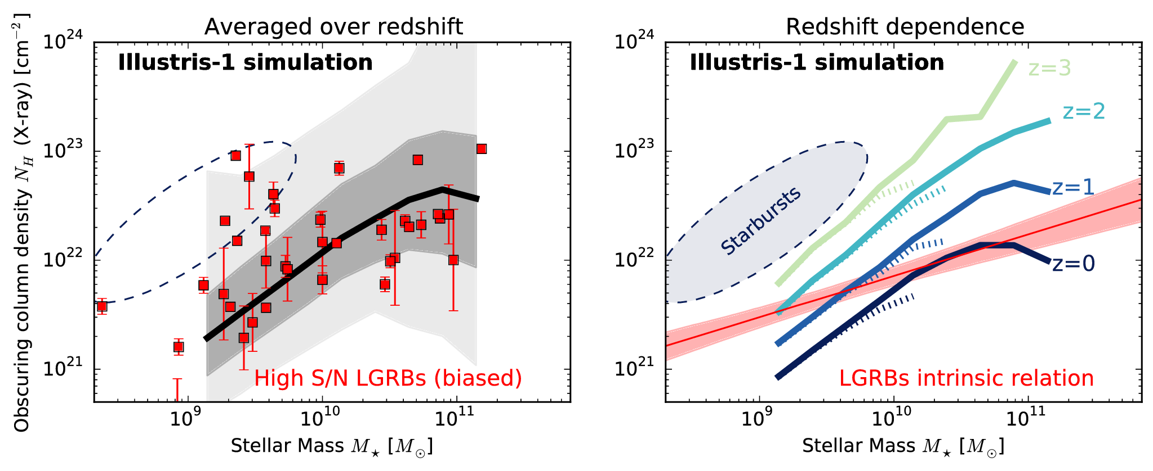
Predictions by simulations

Slide 17
From GRBs to AGN
New Relation from GRBs
AGN fraction
Aird+12, Bongiorno+12
Stellar Mass Function
Ilbert+13, Muzzin+13
Marginalisation
Buchner & Bauer (submitted)

Slide 18

Predictions for AGN
Slight overprediction:
  GRB-SF?
  Ellipticals?
Buchner & Bauer (submitted)

Slide 19
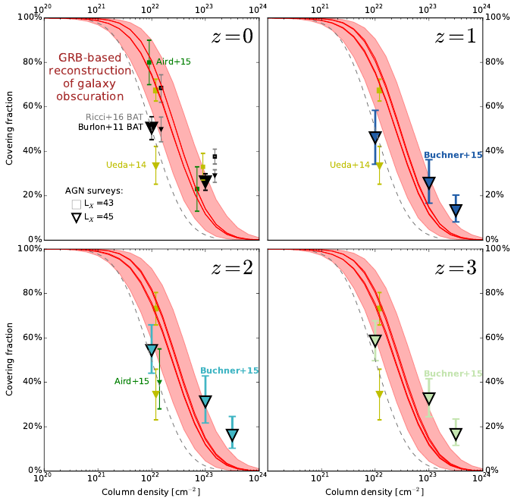

Slide 20
Implications for the Torus
nuclear
galactic
Definitely nuclear
“Galaxy gas as obscurer: II. Separating the galaxy-scale and nuclear obscurers of Active Galactic Nuclei“
Buchner, Schulze & Bauer (submitted)

Slide 21
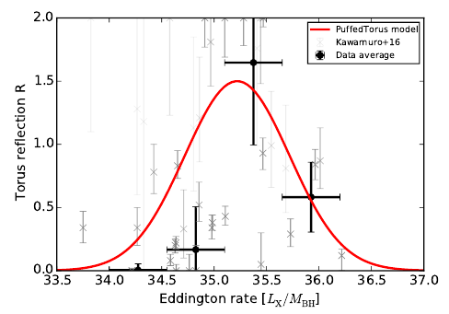
Nuclear and Host obscurer
Models predicting obscured fractions
Host obscuration:
  M*
“radiation-lifted torus”
  M_{BH}
  LX (from )
“Galaxy gas as obscurer: II. Separating the galaxy-scale and nuclear obscurers of Active Galactic Nuclei“
Buchner & Bauer (submitted)
Covering fraction

Slide 22
Contents
GRB show mass-dependent obscuration
  Predicted by simulations, different slope
Host galaxy obscuration for AGN population
  Caveats: SF distribution, metallicity, host mass
  Galaxy gas+dust can explain some mild AGN obscurations
  Consistent with (some) simulations, feedback-dependent
Nuclear obscurer model for Torus modellers & simulations
  Covering factors is dependent on
    Black hole mass
    Accretion rate (X-ray luminosity)
    Host galaxy mass
github.com/JohannesBuchner/LightRayRider
Consistent with Swift/BAT survey
Consistent with IR covering fractions

Slide 23
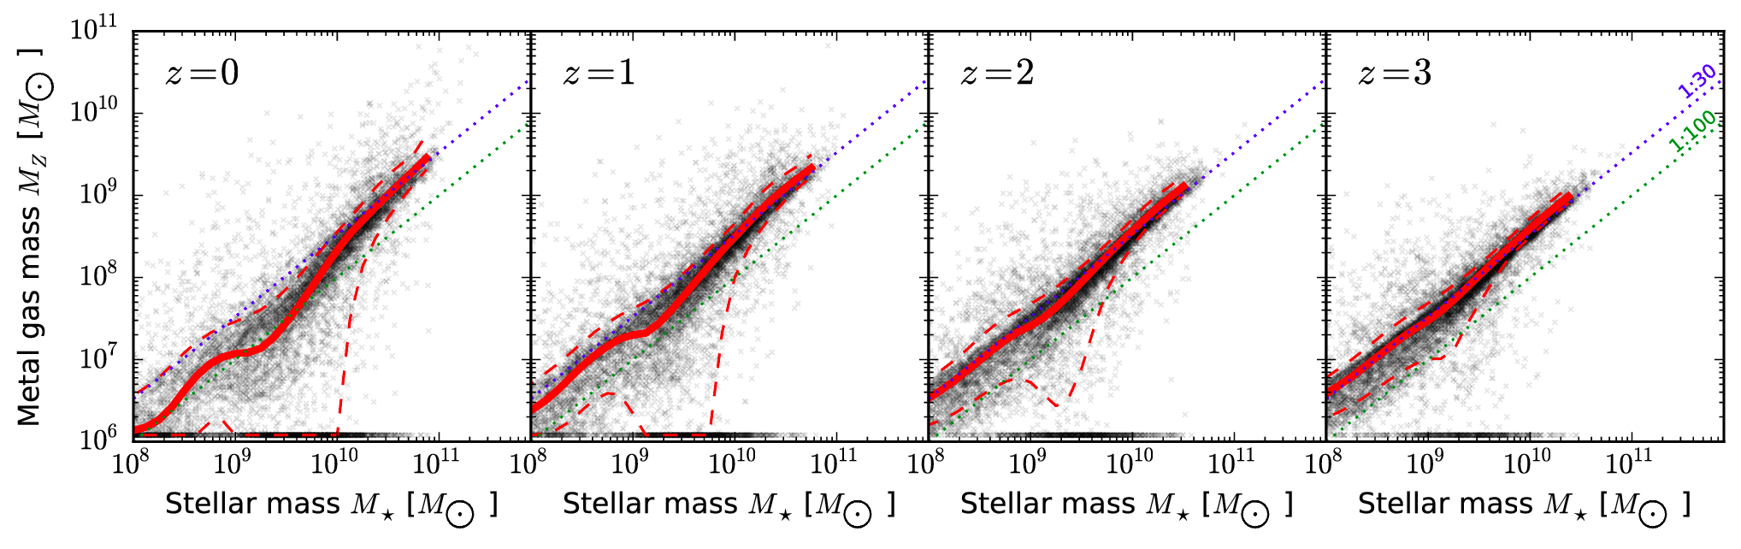
Metal Gas Mass
1:30 – 1:100
from IMF, metal yield, feedback strength

