Slide 1
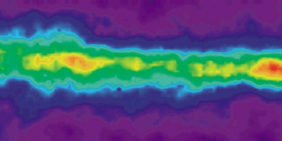
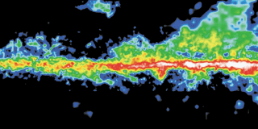
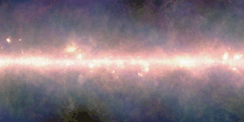
Separating the nuclear and galaxy-scale obscuration in AGN
Milky Way plane:
Atomic HI
Molecular Hydrogen
Infrared (dust)
Johannes Buchner
PUC
Collaborators: @PUC: Steve Schulze, Franz Bauer
@MPE: A. Georgakakis, K. Nandra, M. Brightman, ML. Menzel, Z. Liu, L-T. Hsu, M. Salvato, C. Rangel, J. Aird, A. Merloni
NASA GSFC

Slide 2
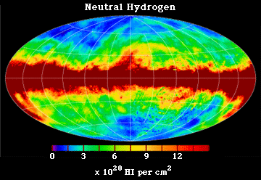
Galaxies from Gas & Dust
Gas collapse
SF & accretion
Emission
Absorption
most activity
at z=0.5-3
e.g. AGN, SF
Neutral Hydrogen map
of the Milky Way
Dickie-Lockman (1990)
MW: 1% > 1e22
LMC, SMC: <1e22

Slide 3
AGN: Accretion onto SMBH
Accretion Disk
“Torus” Obscurer
Galactic Center gas
Star forming regions
e.g. in spiral arms
UV, Opt, X-ray, ...
<0.1pc
10pc
1 kpc
10 kpc
Nuclear obscuration
Galaxy-scale obscuration
How is it stable and extended?
Density? Substructure?
Feeding of AGN?
First constraint:
- Column density
- Covering fraction

Slide 4
Column density N_{H}
N_{H} … number of H atoms along line-of-sight
N_{H} = few atoms / cm³ x few kpc = 10²²/cm²
Compton-thick: ~ 10²⁴ cm² – Circinus, NGC1068
  Nuclear regions with high density
  Mergers – major accretion events for SMBH
Fe, O, He, H
  absorb everything except hard X-ray, re-radiate thermally in IR
  Measure N_{H} assuming local abundances from X-ray spectrum

Slide 5
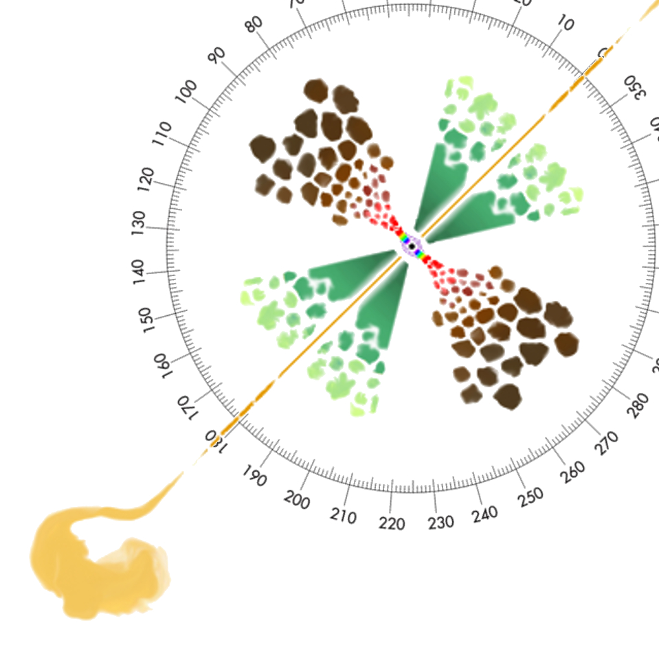
Covering fraction
Unobscured sky
assuming random views
% of obscured AGN =
% of obscured sky =
covering fraction
Obscured sky: Nuclear? Galaxy?
Matt2000
Compton-thick sky
Torus, Nuclear
(?) Goulding&Alexander+09
Marin+16

Slide 6
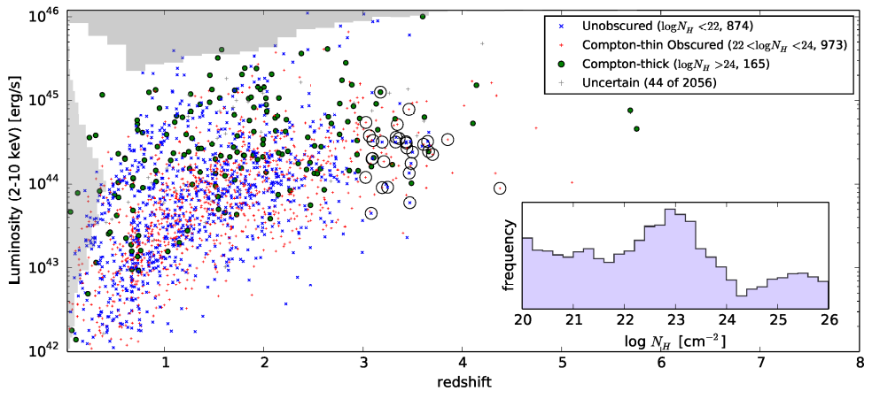
Luminosity Function
AGN surveys:
  Detection + Selection bias
  Association + Redshift
  Spectral analysis -> L, z, NH
Intrinsic number density
  φ(L,z,NH) Luminosity function
  Accretion history
  Obscured fractions
Buchner+15
INTRINSIC LUMINOSITY 2-10keV
CDFS
AEGIS-XD
C-COSMOS
XMM-XXL
REDSHIFT

Slide 7
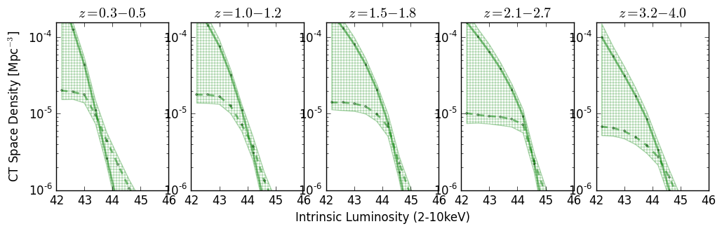
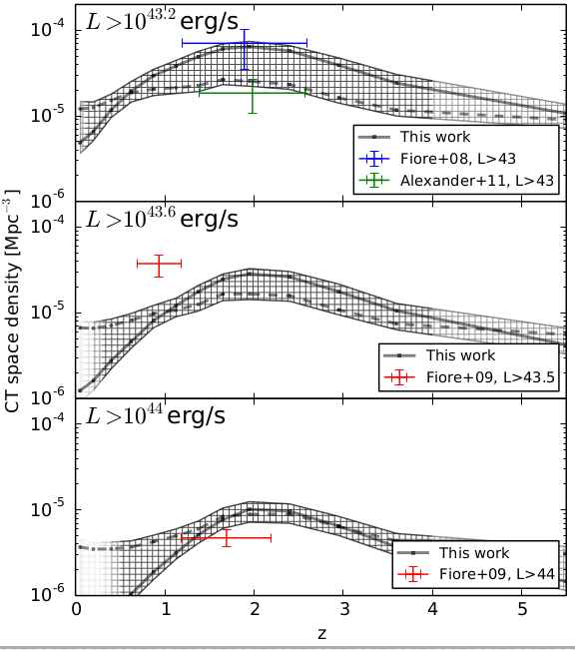
Compton-thick Luminosity Function
Reconstruction of a smooth density field
  Results insensitive to chosen
  smoothing length
    0.5 mag between bins
  Consistent with IR studies
  Consistent with Cthin LF of
  Ueda+14, Aird+10
Buchner+15

Slide 8
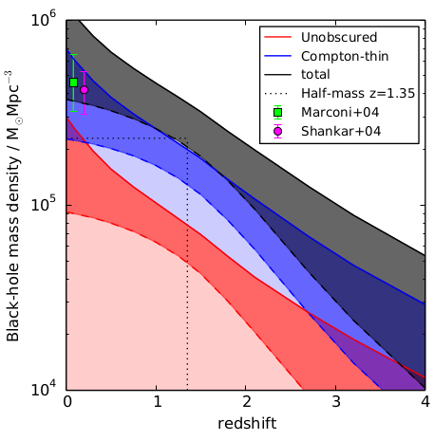
Black Hole Mass Accretion
ε=10%
Bol. Corr.:
Marconi+04
in prep., see also Merloni15

Slide 9
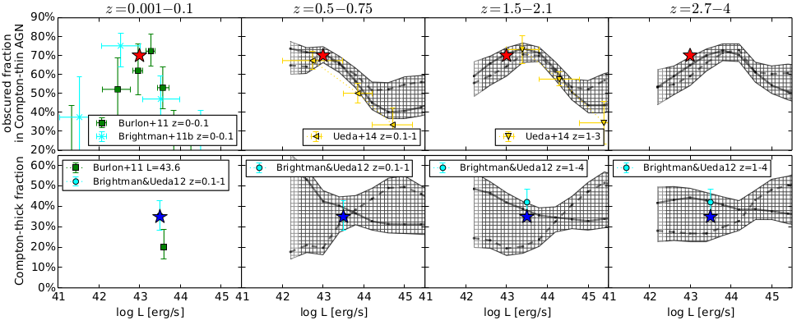
Fraction of Obscured AGN
38⁺⁸₋₇%
Buchner+15

Slide 10

Fraction of Obscured AGN
Nuclear?
Galactic?
Can not be answered from a single central point source
Buchner+15

Slide 11
GRBs x-raying Galaxies
Long (>2s) Gamma Ray Bursts:
  Collapse of massive stars
  Produce γ-ray
    Detected through any obscuration
    Detected at z=0-10
  X-ray, Opt, … Radio
  Follow blue light, general SF
    But: avoid high-Z galaxies
    SF, low-mass galaxies
Idea:
  X-ray tomography
  Can we reconstruct the galaxy from LOS densities

Slide 12

Expected Shape
Scatter:
  ~0.5 dex Geometry
  and Galaxy diversity
    Mass
    Gas content
    Clumpiness
    ...

Slide 13
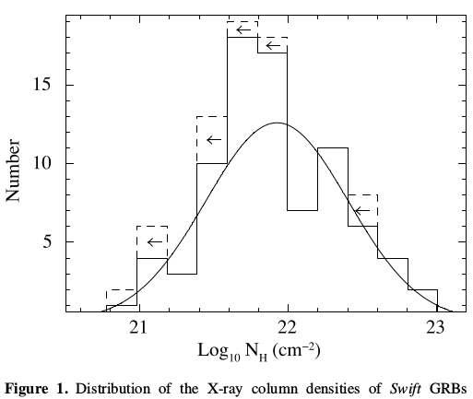
GRB column densities
Swift: ~900 GRBs
Long >2s GRB
X-ray afterglow
Flares removed
No Compton-thick GRBs
Campana+10

Slide 14

Host Mass – Obscuration
SHOALS
  Perley+15
  Deep follow-up
  ~90% redshift complete
  Spitzer masses
“Galaxy gas as obscurer: I.”
Buchner, Schulze & Bauer (submitted)

Slide 15





Host Mass – Obscuration
SHOALS
  Perley+15
  Deep follow-up
  ~90% redshift complete
“Galaxy gas as obscurer: I.”
Buchner, Schulze & Bauer (submitted)

Slide 16
Caveats
Geometric effects from different POV
  but <x1.5 for ellipsoidal geometries
Relation from actively star-forming galaxies
  AGN have typical/lower SFR, also red&dead ell.
Metallicity lower in GRB than AGN hosts
  but overlap
AGN feedback may alter galaxies
  outflows, radiation pressure
Massive AGN host galaxies with N_{H}<10²² cm⁻² exist
  e.g. BCG; – ionisation; rare

Slide 17
From GRBs to AGN
New Relation from GRBs
AGN fraction
Aird+12, Bongiorno+12
Stellar Mass Function
Ilbert+13, Muzzin+13
Marginalisation
Buchner et al (in prep)

Slide 18
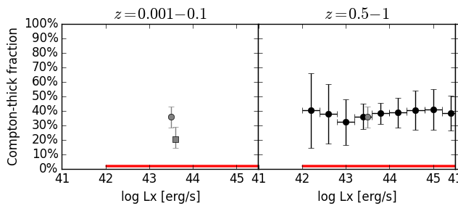
Predictions for
Compton-thick AGN
GRB-based model:
  No Compton-thick AGN expected from galaxy gas
  Compton-thick obscurer is nuclear
Buchner et al (in prep)

Slide 19

Predictions for AGN
Slight overprediction:
  GRB-SF?
  Ellipticals?
Buchner et al (in prep)

Slide 20
Fraction of Obscured AGN
Nuclear: Disappears for luminous AGN: feedback on nucleus?
Galactic
Nuclear.
Galactic
Buchner et al (in prep)

Slide 21
Fraction of Obscured AGN
Nuclear
Disappears for luminous AGN
Galactic
Nuclear.
Galactic
Galactic
Buchner et al (in prep)

Slide 22
Conclusions
GRB show mass-dependent obscuration
Relation can predict LOS distribution for individual galaxies
For AGN population:
  Caveats: SF distribution, metallicity
  Galaxy gas+dust can explain much of the AGN obscuration at N_{H} = 10²² – 10²³ cm⁻²
For Torus models:
  Covering factors is … (see Buchner et al. in prep)
  Diminished in luminous AGN

Slide 23
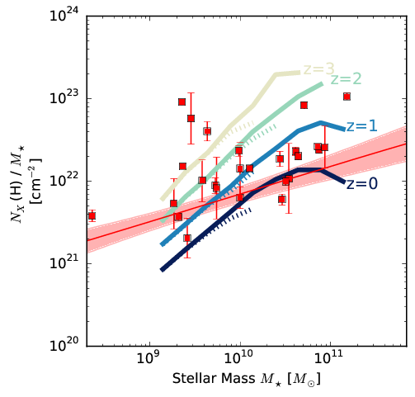
Cosmological simulations: GRB
Match SMF
Predict gas mass in galaxies
  Morphology
  Colors
  Sizes
Illustris

Slide 24
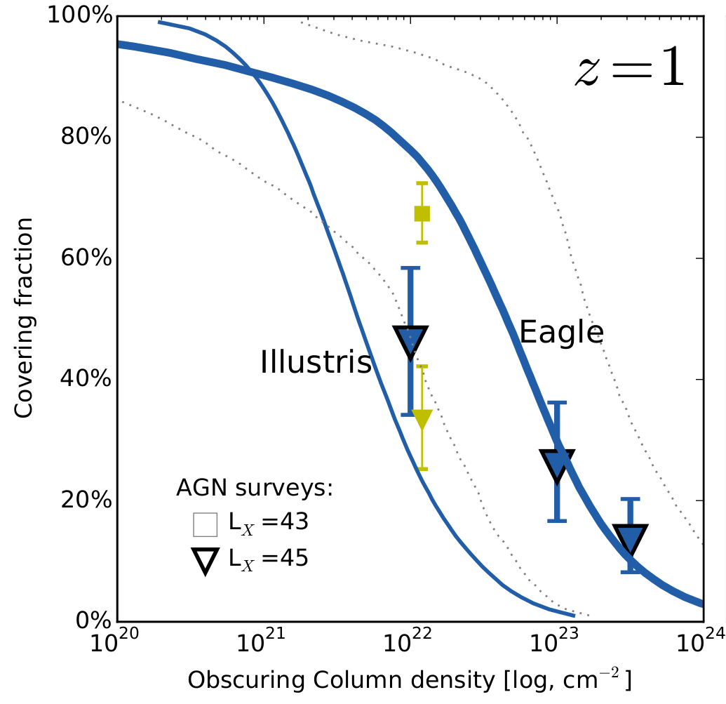
Cosmological simulations: AGN
In agreement depending on assumed feedback

Slide 25
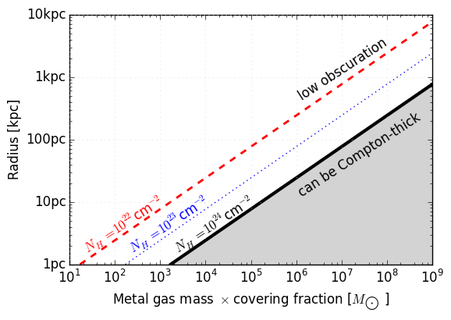
Mass required by CT obscurers
Modulo covering fraction
M_{Z} = 1% of stellar mass

Slide 26

Local Galaxies

