Slide 1
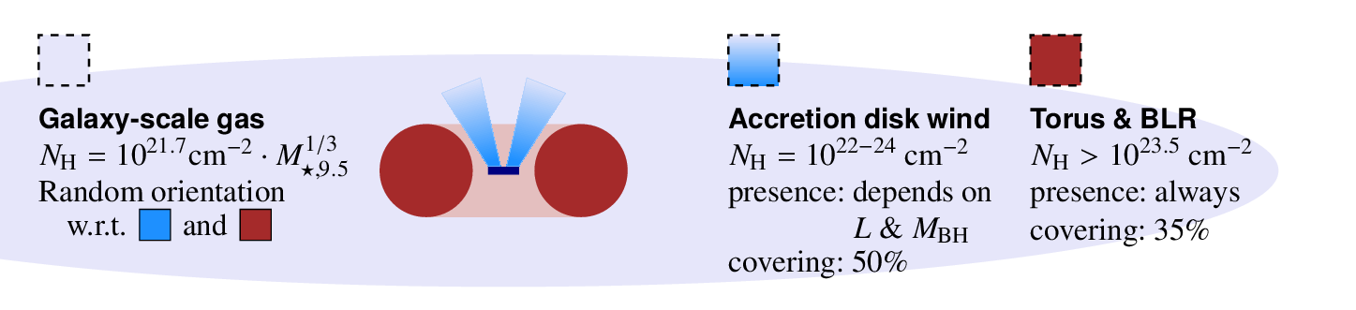

A high-energy view of the galaxy-scale metal gas at z=0.5-3
Johannes Buchner
FONDECYT fellow
astrost.at/istics
Collaborators: @PUC: Steve Schulze, Franz Bauer
Previously: @MPE HEG: A. Georgakakis, K. Nandra,
M. Salvato, L-T. Hsu, J. Aird, M-L. Menzel, Z. Liu

Slide 2
About me: Johannes Buchner
Astrophysics interests
  AGN; SMBH growth; X-ray surveys
  Obscurer of AGN; galaxy-scale obscuration
  Obscuration of Gamma-ray burst afterglows
  Simulations: X-ray illumination; cosmological simulations
Astrostatistics interests
  PyMultinest, nested sampling algorithms
  Improving X-ray spectral analysis (BXA)
    invited talk HEAD meeting August 2017, astrostatistics for X-rays
  Consulting for papers, Astrostatistics group
  astrost.at/istics
Buchner15
Buchner16a
Buchner17a
Buchner17b + in prep
Buchner14
Buchner+14

Slide 3
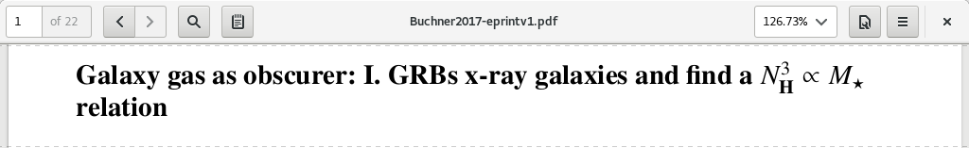
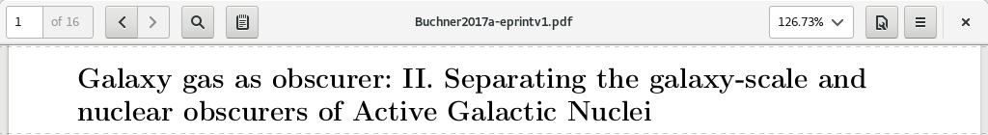
Topic today:
Buchner, Schulze & Bauer (2017)
Buchner & Bauer (2017)

Slide 4
The obscurer
Accretion Disk
“Torus” Obscurer
Galactic Center gas
Star forming regions
e.g. in spiral arms
UV, Opt, X-ray, ...
<0.1pc
10pc
1 kpc
10 kpc
Nuclear obscuration
Galaxy-scale obscuration
Separation?

Slide 5
Column density N_{H}
N_{H} … number of H atoms along line-of-sight
N_{H} = few atoms / cm³ x few kpc = 10²²/cm²
Compton-thick: ~ 10²⁴ cm²
O, Fe, He
  absorb soft X-rays via photo-electric effect
  Measure N_{H} assuming local abundances from X-ray spectrum

Slide 6
GRBs x-raying Galaxies
Long (>2s) Gamma Ray Bursts:
  Collapse of massive stars
  Produce γ-ray
    Detected through any obscuration
    Detected at z=0-10
  X-ray, Opt, … Radio
  Follow blue light, general SF
    But: avoid high-Z galaxies
    SF, low-mass galaxies
Idea:
  X-ray tomography
  Can we reconstruct the galaxy from LOS densities

Slide 7
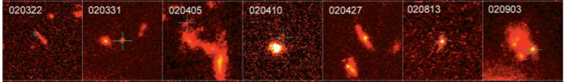
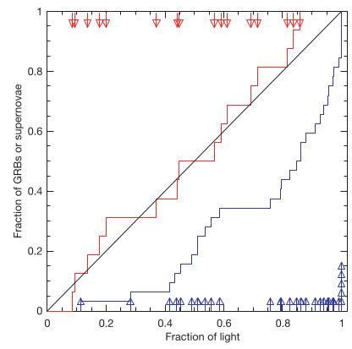
HST, blue or ultraviolet rest-frame images of GRB host galaxies
Massive O/B stars
Die early
In star-forming regions, molecular clouds
Need low metallicity gas
Follow blue light, general SF
But: avoid high-Z galaxies
SF, low-mass galaxies
Fruchter+06
SN: proportional
to blue light
GRB:
concentrated at bluest regions

Slide 8
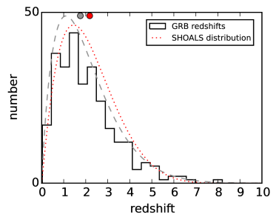
LGRB surveys
Swift: >900 sample of LGRBs, good positioning
Limited follow-up = redshift bias
Solutions:
  Include sources without redshift in analysis
  Use highly complete, unbiased samples
    SHOALS: defines criteria that do not depend on properties of the host galaxy

Slide 9
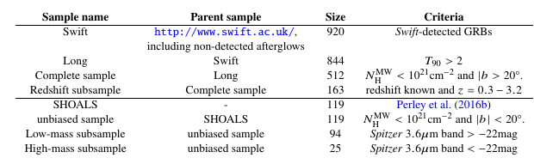
Data
Entire swift.ac.uk archive
Exclude flares & prompt emission
  Automated + visual inspection
Samples

Slide 10
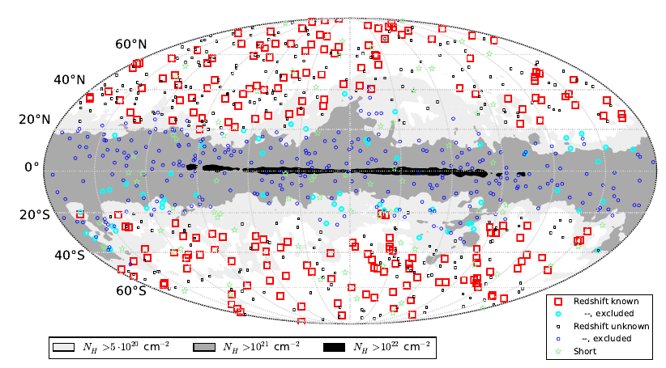

Slide 11
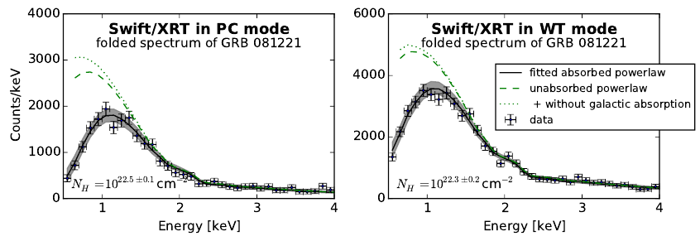
X-ray spectroscopy
Obscurer model:
  Intrinsic powerlaw
  Absorber (photo-electric absorption,
  Compton scattering)
Normalisation

Slide 12
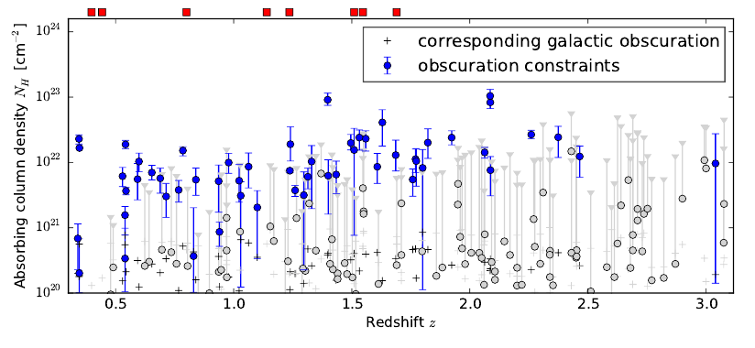
Column density distribution

Slide 13

N_{H} distribution: Primer
~0.5 dex from geometry

Slide 14
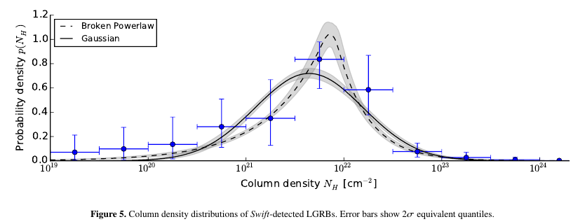
N_{H} distribution: observed
Model comparison (AIC):
broken powerlaw is better

Slide 15
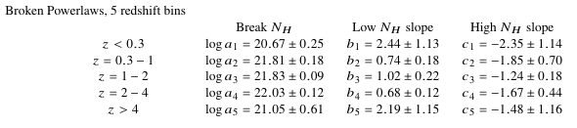
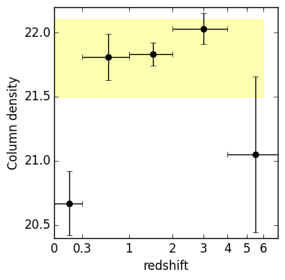
Redshift evolution
Not monotonic
Consistent within factor 2
KS test not valid
Splitting sample not valid

Slide 16

Host Mass – Obscuration
SHOALS
  Perley+15
  Deep follow-up
  ~90% redshift complete
  Spitzer masses
“Galaxy gas as obscurer: I.”
Buchner, Schulze & Bauer (submitted)

Slide 17
Expected Scatter
~0.5 dex from geometry
“Galaxy gas as obscurer: I.”
Buchner, Schulze & Bauer (submitted)

Slide 18

Local Galaxies
1% densest column from HI maps
Gas metallicity-corrected
“Galaxy gas as obscurer: I.”
Buchner, Schulze & Bauer (submitted)

Slide 19
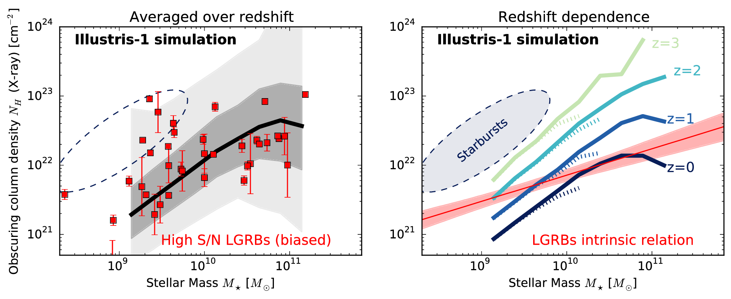
Predictions by simulations
“Galaxy gas as obscurer: I.”
Buchner, Schulze & Bauer (submitted)

Slide 20





Host Mass – Obscuration
SHOALS
  Perley+15
  Deep follow-up
  ~90% redshift complete
Hosts?
  Actively star-forming, AGN not necessarily
  Metallicity bias
N_{H} – M* relation
Obscurer is host galaxy
Understand normalisation
Understand slope
Understand scatter
“Galaxy gas as obscurer: I.”
Buchner, Schulze & Bauer (submitted)

Slide 21
Caveats
Stellar mass
Redshift evolution
SFR
  Lower in AGN
Metallicity
  Overlapping
  Stellar metallicity vs. gas metallicity
Vantage point

Slide 22
From GRBs to AGN
New Relation from GRBs
AGN fraction
Aird+12, Bongiorno+12
Stellar Mass Function
Ilbert+13, Muzzin+13
Marginalisation
“Galaxy gas as obscurer: II.”
Buchner & Bauer (2017)

Slide 23

Predictions for AGN
No CT AGN
Substantial % C-thin obscured
Slight overprediction:
  GRB-SF?
  Ellipticals?
“Galaxy gas as obscurer: II.”
Buchner & Bauer (2017)

Slide 24
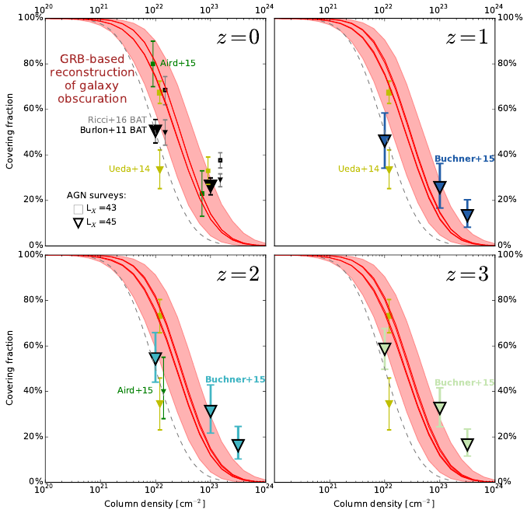

Slide 25
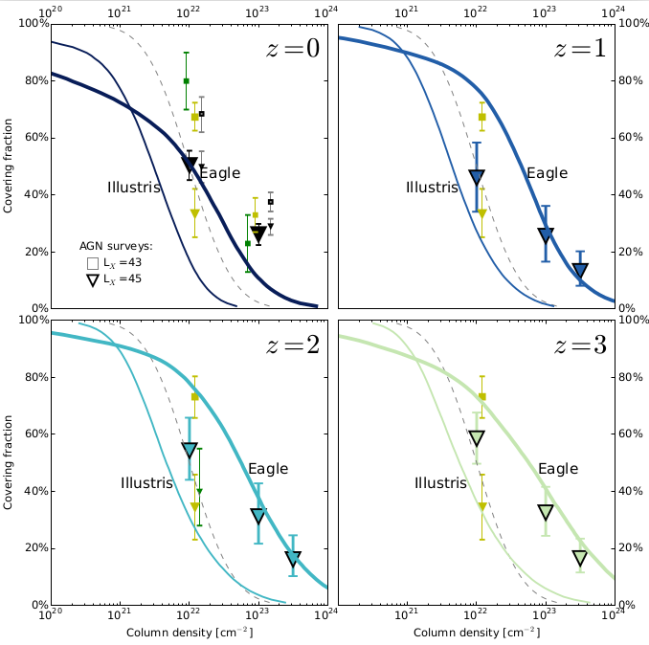

Slide 26
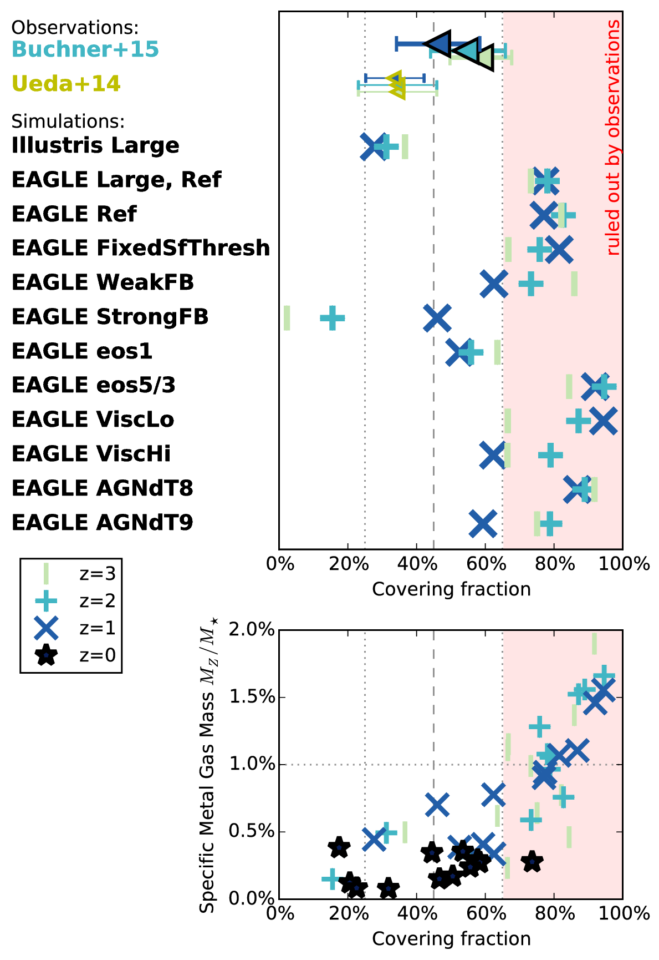
Successfully (to a degree) reproducing:
SMF
Star formation history
Galaxy size distribution
CO masses
H surface densities
Cluster X-ray gas
Fractal substructure of ISM
As an aside –
z=0.5 formation of solar system

Slide 27
Obscurers of AGN
“Galaxy gas as obscurer: II.”
Buchner & Bauer (2017)

Slide 28
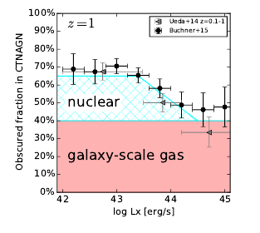

Implications for the Torus
nuclear
galactic
Definitely nuclear
“Galaxy gas as obscurer: II.”
Buchner & Bauer (2017)

Slide 29
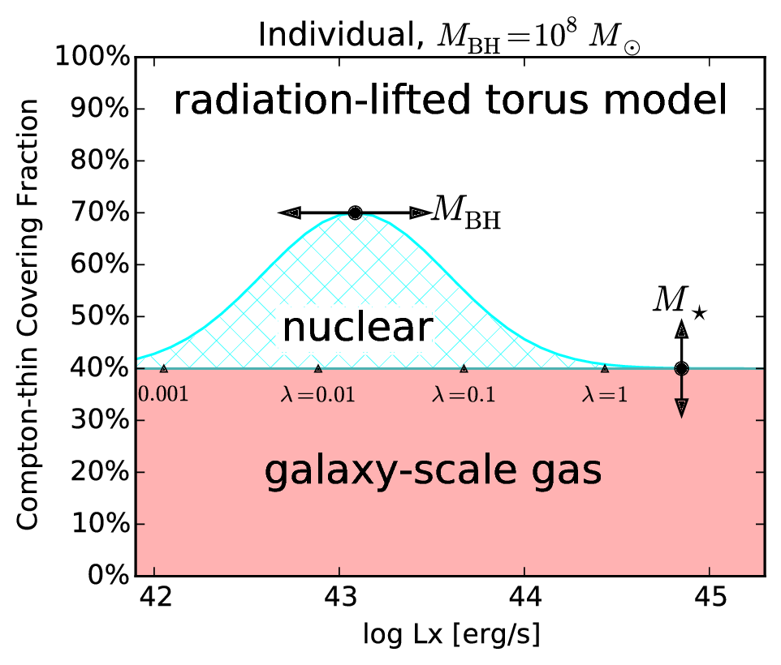
“Radiation-lifted torus”
Predict covering factor
f(L_{X}, M_{BH})
  Redshift evolution Buchner+15
  L_{X}/(M_{BH}^{2/3}) rad. pressure Elitzur+15, Wada15
  Opt./SDSS Oh+15
replace receding torus
  Unphysical for X-rays
“Galaxy gas as obscurer: II.”
Buchner & Bauer (2017)

Slide 30
Summary
GRB show mass-dependent obscuration
  Predicted by simulations
  Metallicity-effects
Host galaxy obscuration for AGN population
  Caveats: SF distribution
  Galaxy-scale obscuration important at N_{H} = 10²² – 10²³ cm⁻²
  Fractions consistent with simulations
Nuclear obscurer model for Torus modellers & simulations
  Covering factors is dependent on
    Black hole mass
    Accretion rate (X-ray luminosity)
    Host galaxy mass

Slide 31
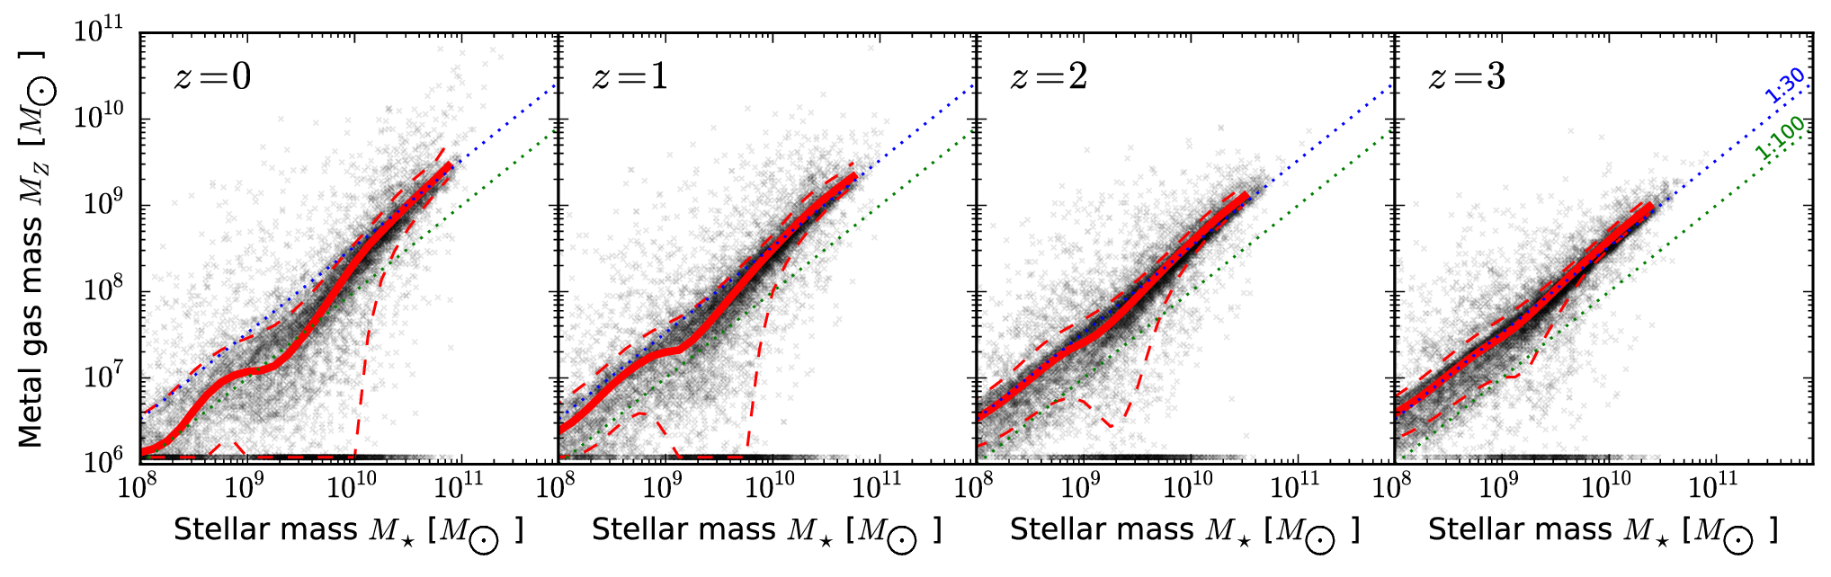
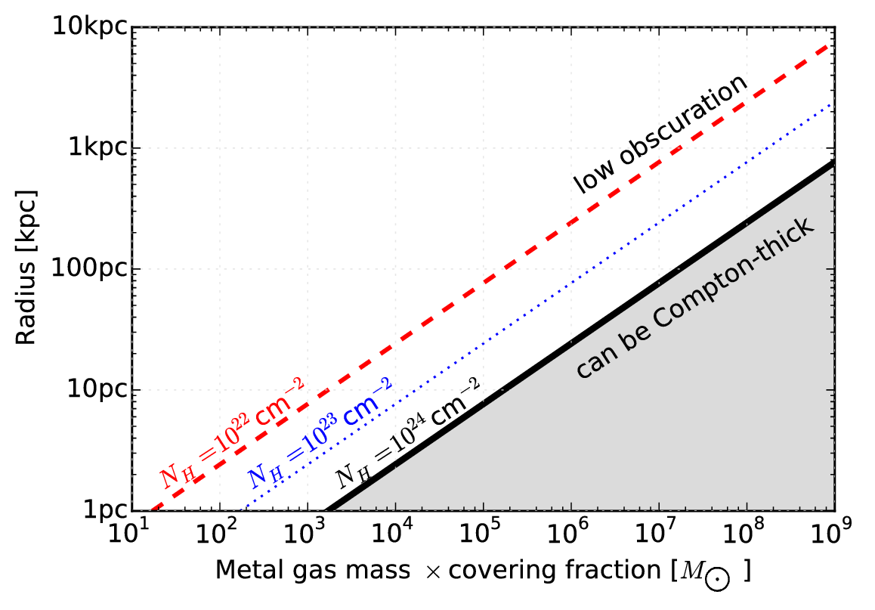
Metal gas
in galaxies

