Slide 1

Substructure of the AGN torus
Johannes Buchner
FONDECYT fellow
http://astrost.at/istics/

Slide 2
What is the “Torus”?
Nuclear obscurer
substantial covering (30-80%)
few pc scale – VLBI, ALMA
Non-spherical – polarisation
  –> donut?
polar dust emissions – high-res IR
  –> wind/outflow?
Eclipses, Si feature
  –> clumpy?

Slide 3
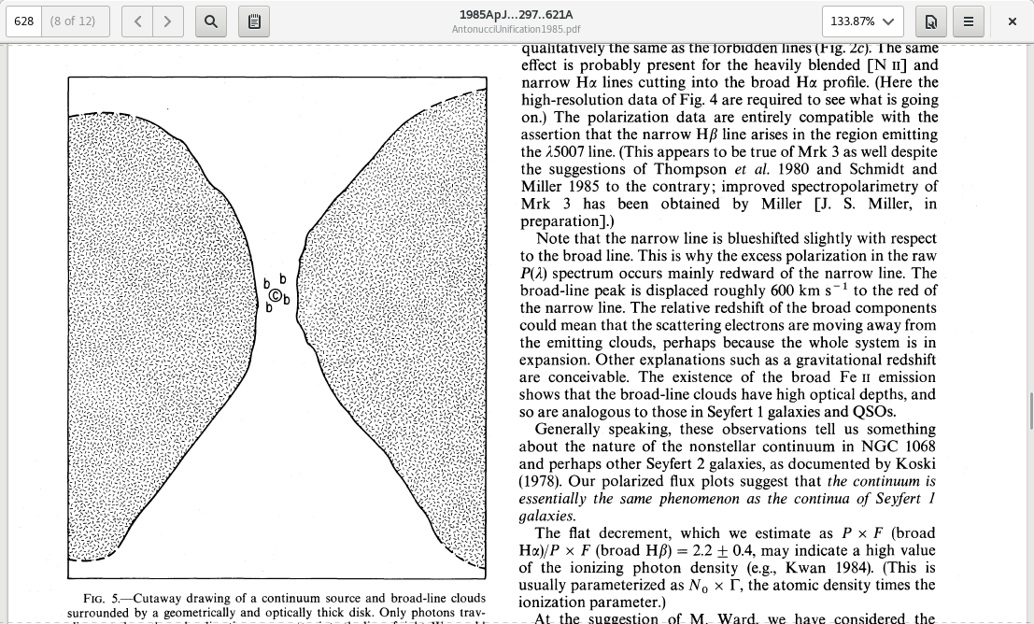
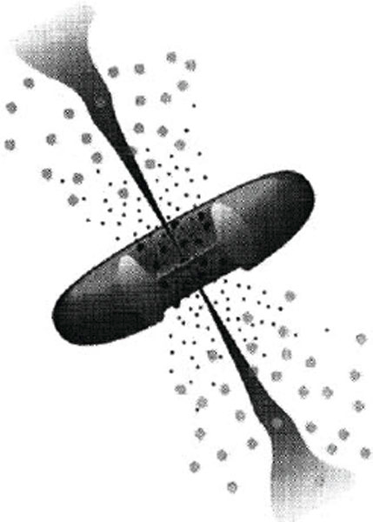
Old picture
Antonucci&Miller85
An actual torus/donut
  Evidence: non-spherical
  from polarisation direction
  high polarisation of
  broad lines
Urry&Padovani95

Slide 4
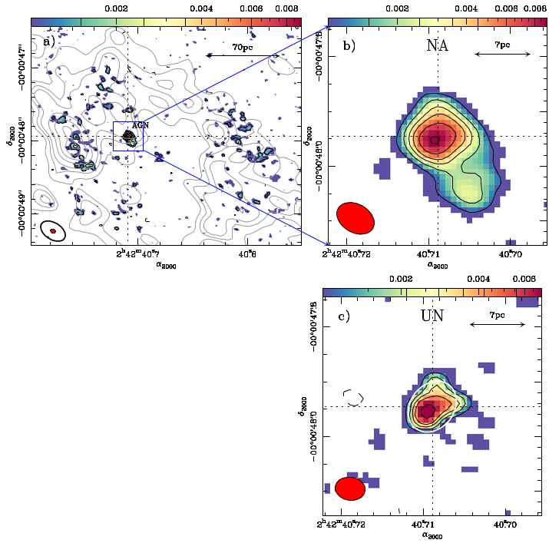
Best picture
ALMA 694 GHz (432 μm)
NGC1068
Garcı́a-Burillo et al. (2016)

Slide 5
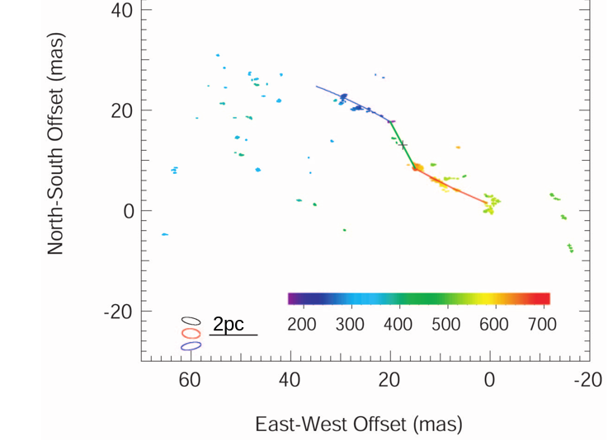
Warped maser disks
VLBI 1.3 cm
H₂O maser clumps
Keplerian warped disk
Greenhill+03

Slide 6
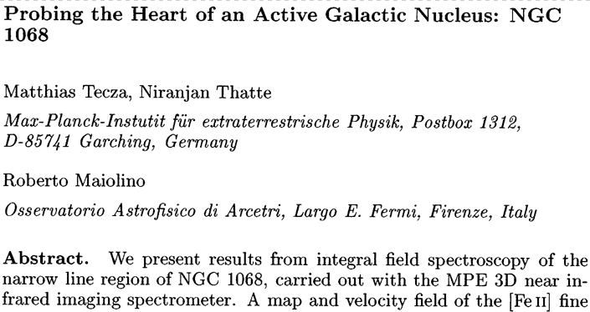
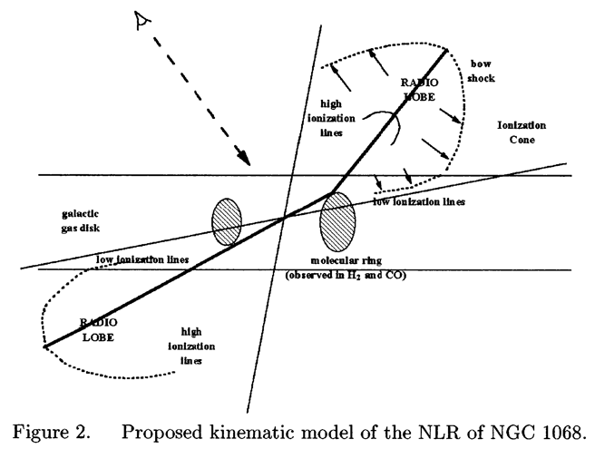
Larger structures

Slide 7
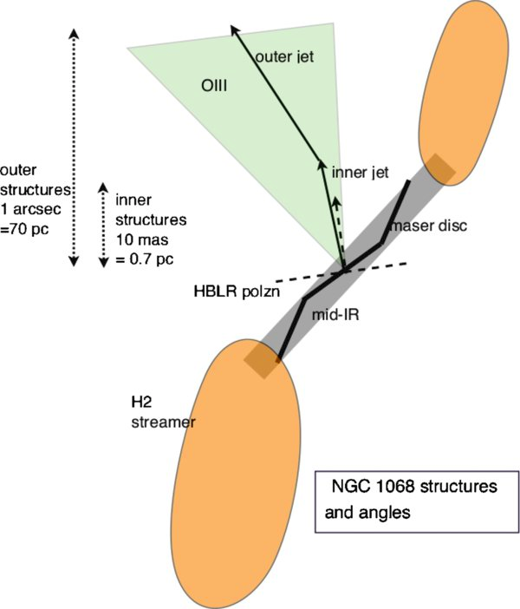
Warped disks
Warped, tilted, twisted disks
  Evidence: maser disks
  Evidence: misalignments
  on larger scales
Lawrence & Elvis (2010)

Slide 8
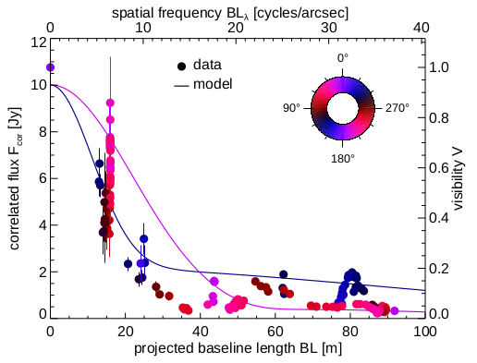
Polar dust
Tristram+13
IR interferometry
MIDI, Circinus, 8+13µm

Slide 9
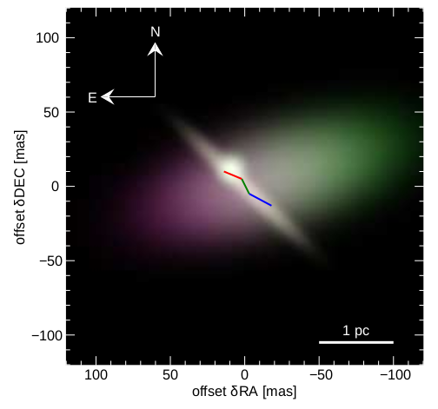
Polar dust
Tristram+13
Model with 3 Gaussians
1 perpendicular!
80% emission from that component

Slide 10
Progress in modeling
Self-consistent physical models
    Radiation pressure + hydrodynamics = hard
Constrained empirical models
    1) Obscurer needs to obscure enough
      covering fractions & column densities
      Unification assumption (or 1 variable)
    2) Substructure
    clumpy, but how

Slide 11
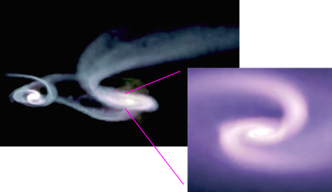
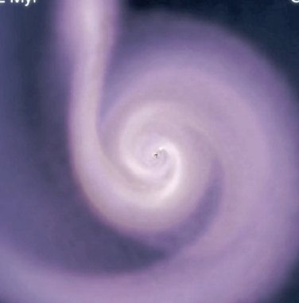
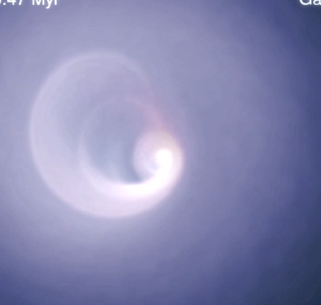
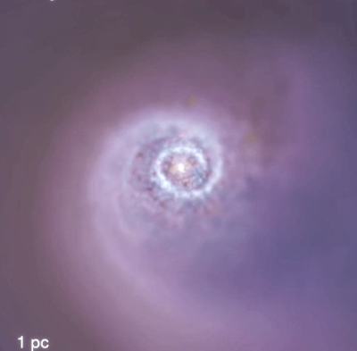
Hopkins+12
Torus is just torqued accretion flow from larger scales
Tilting & warping

Slide 12
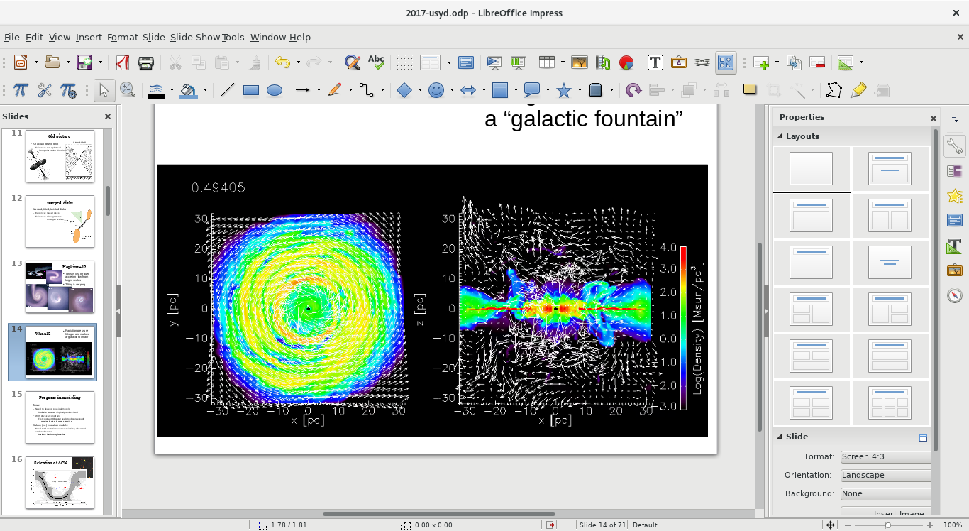
Wada12
Radiation pressure lifts gas and makes a “galactic fountain”

Slide 13
Wada12
Radiation pressure lifts gas and makes a “galactic fountain”

Slide 14
Progress in modeling
Self-consistent physical models
    Radiation pressure + hydrodynamics = hard
Constrained empirical models
    1) Obscurer needs to obscure enough
      covering fractions & column densities
      Unification assumption (or 1 variable)
    2) Substructure
    clumpy, but how

Slide 15
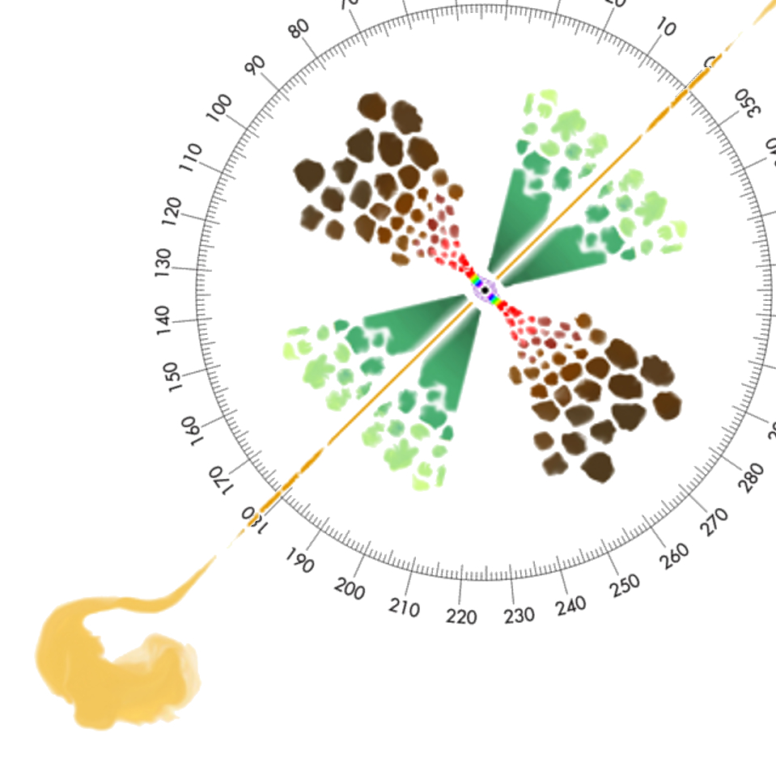
Covering fraction
Unobscured sky
assuming random views
% of obscured AGN =
% of obscured sky =
covering fraction
need selection function
+L, z, N_{H} range coverage
Obscured sky
Compton-thick sky
Marin+16
Buchner+15: 1/3 CTK, ¾ obscured

Slide 16
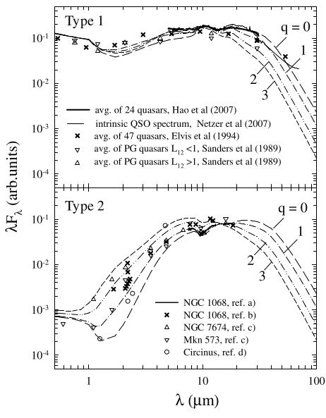
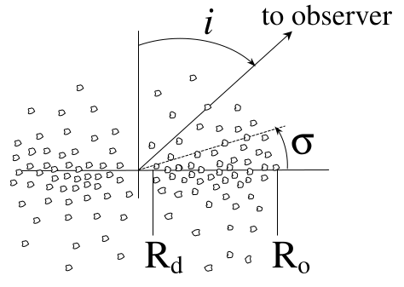
Substructure: infrared SED
Si feature 10µm
Nenkova+ CLUMPY formalism

Slide 17
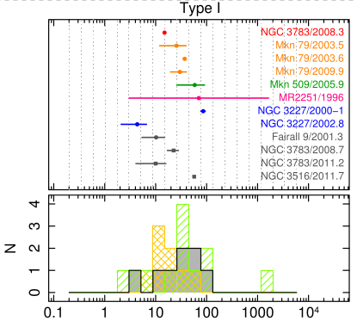
Substructure: Eclipse events
Duration
Markowitz+14, RXTE archive
Days

Slide 18
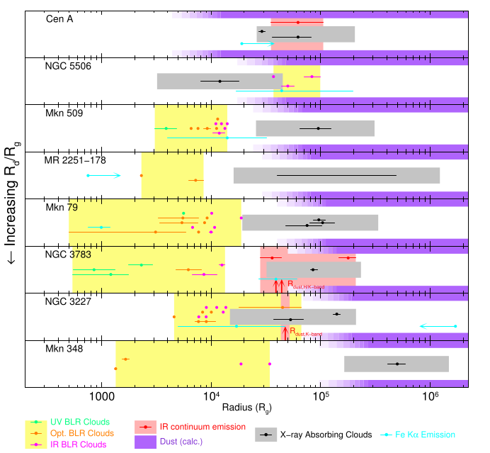
Substructure: Eclipse events
Duration
Location
Markowitz+14

Slide 19
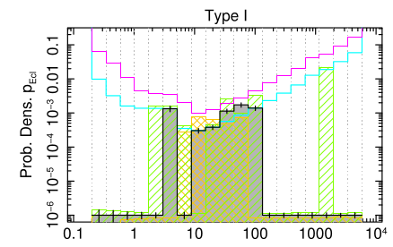
Substructure: Eclipse events
Duration
Location
Frequency
Days
Markowitz+14, RXTE archive

Slide 20
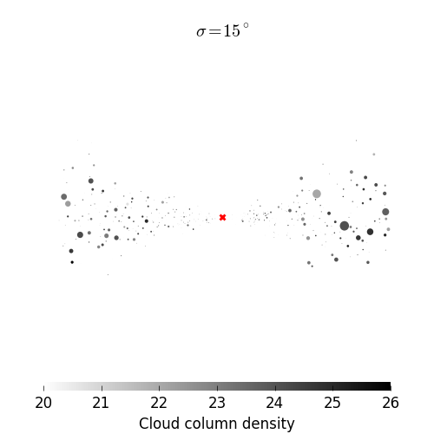
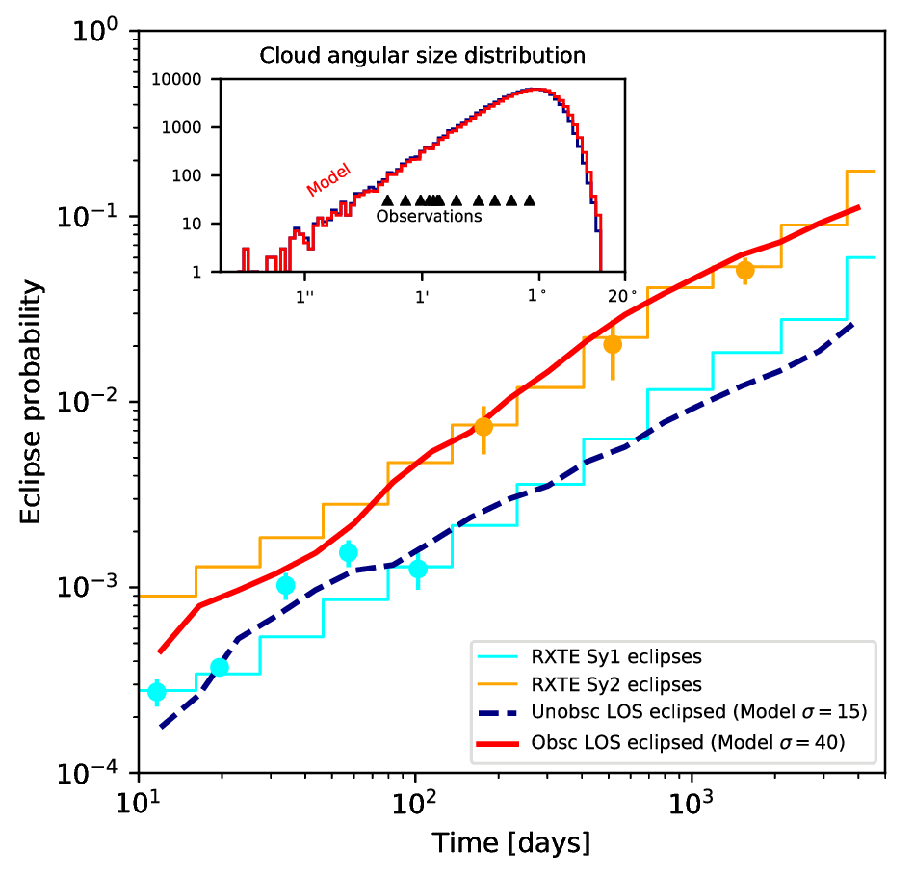
Substructure: Eclipse events
Assumptions:
Keplerian circular orbits
Vary covering factor
inner-most cloud period: 1 day
–> outer-most cloud period: 8 years
–> inner-most cloud orbital radius of 42 au M₇^{1/3}
Buchner+ (in prep)

Slide 21
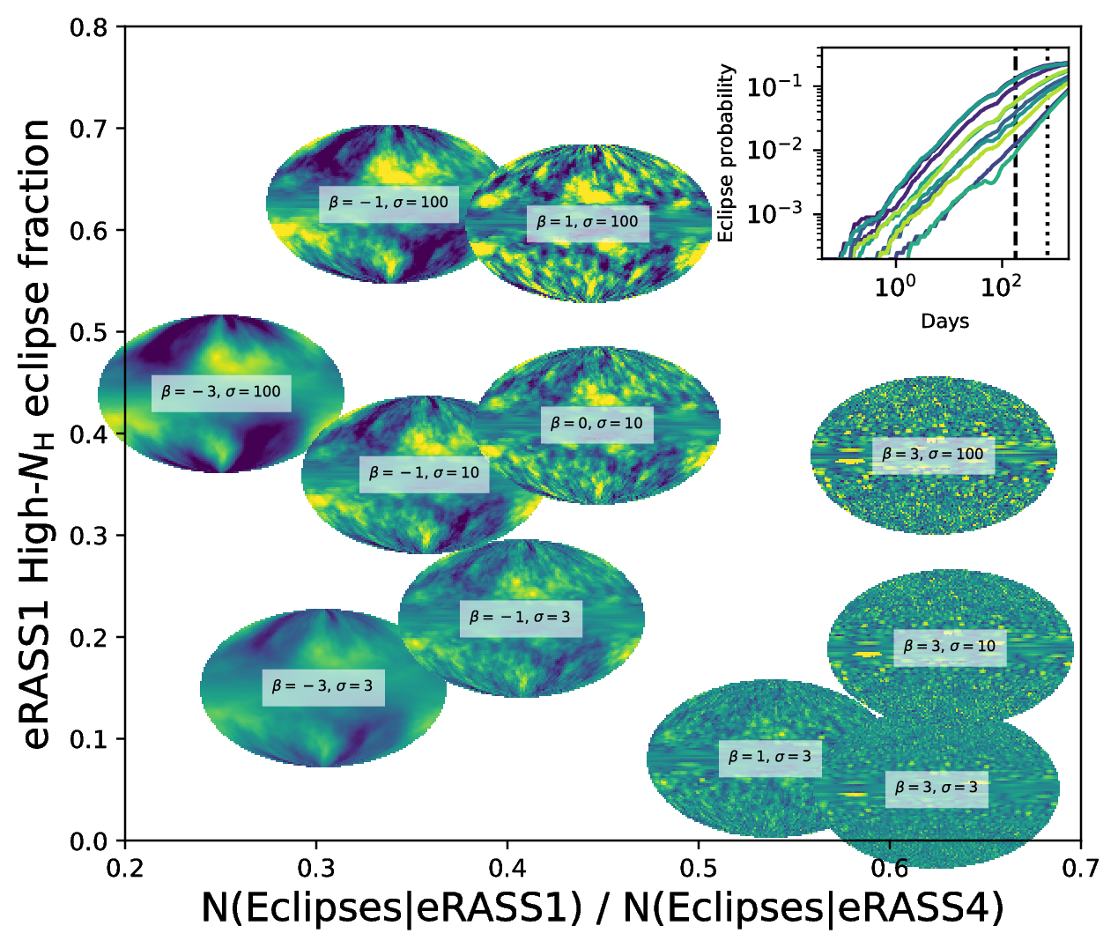

Slide 22
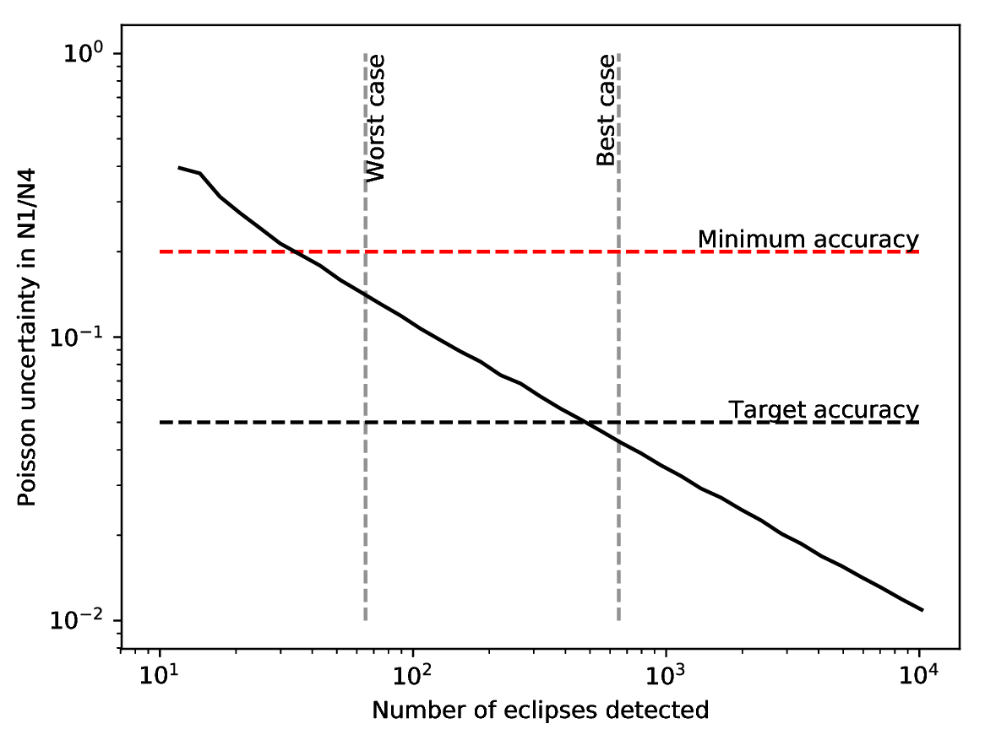
Eclipse events with eROSITA
Predictions:
340,000 extragalactic AGN in 6m catalogue
13,000 2-10keV detected
1-10% eclipses expected after 6 months, 50% sky

Slide 23
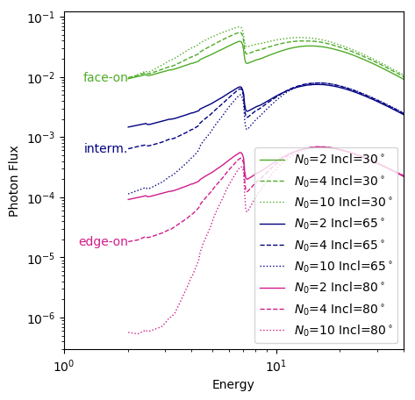

X-ray reprocessing by clouds
Liu&Li14 clumpy model

Slide 24
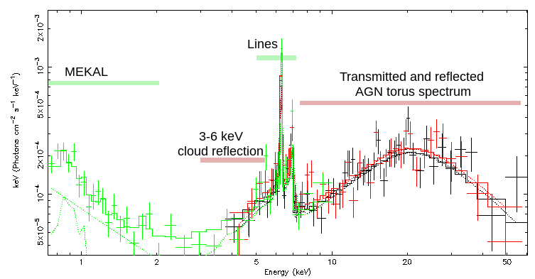
NGC 424
#rosettastone
NuSTAR 40ks
XMM 4ks

Slide 25
Torus Substructure
Torus substructure
Reflection spectroscopy 3-6 keV slope
Eclipse events with eROSITA

