Slide 1

Exploring Torus geometries with
NuSTAR Compton humps
Johannes Buchner
FONDECYT fellow
http://astrost.at/istics/
Collaborators:
M. Brightman, M. Baloković,
F.E. Bauer, K. Nandra,
K. Wada, R. Nikutta

Slide 2
Goals
Test geometries
  Toroids
  Clumpy
  Warped disks
  Hydro-radiative sims
  …
Constraints:
Spectral diversity
Unification
Eclipse events
+ ultimately: IR+X

Slide 3
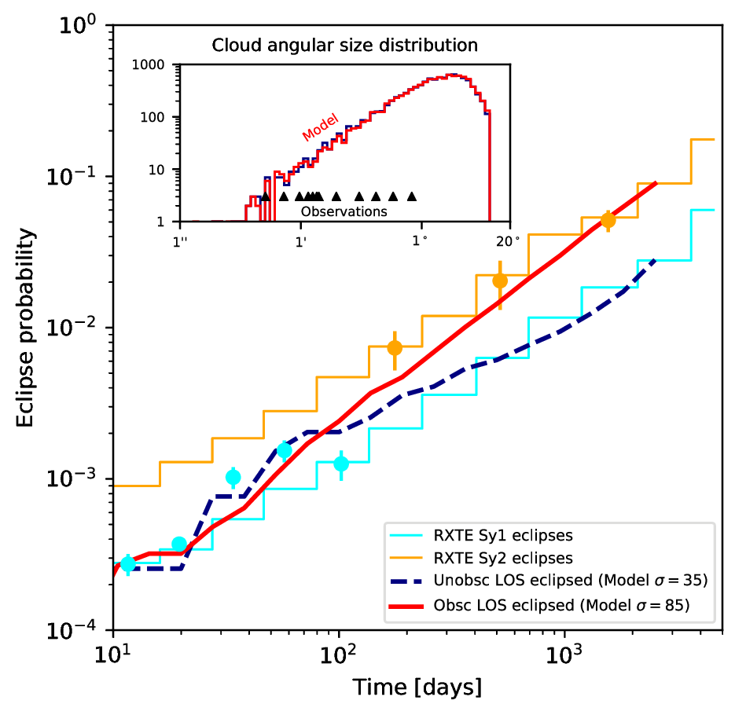
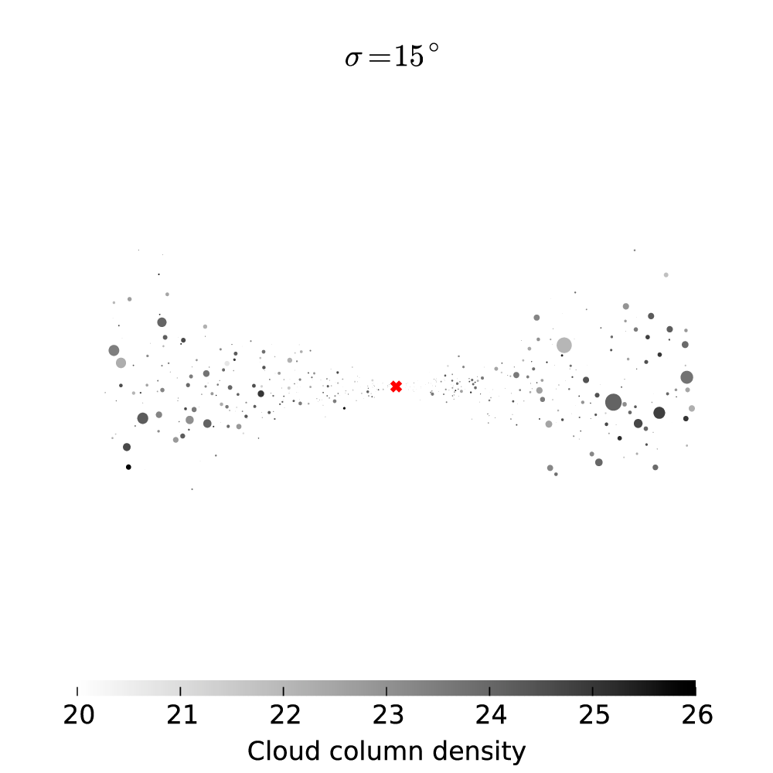
UXCLUMPY
Buchner et al. (submitted)
Eclipse events
Unification
(Markowitz+14, Nikutta in prep.)

Slide 4
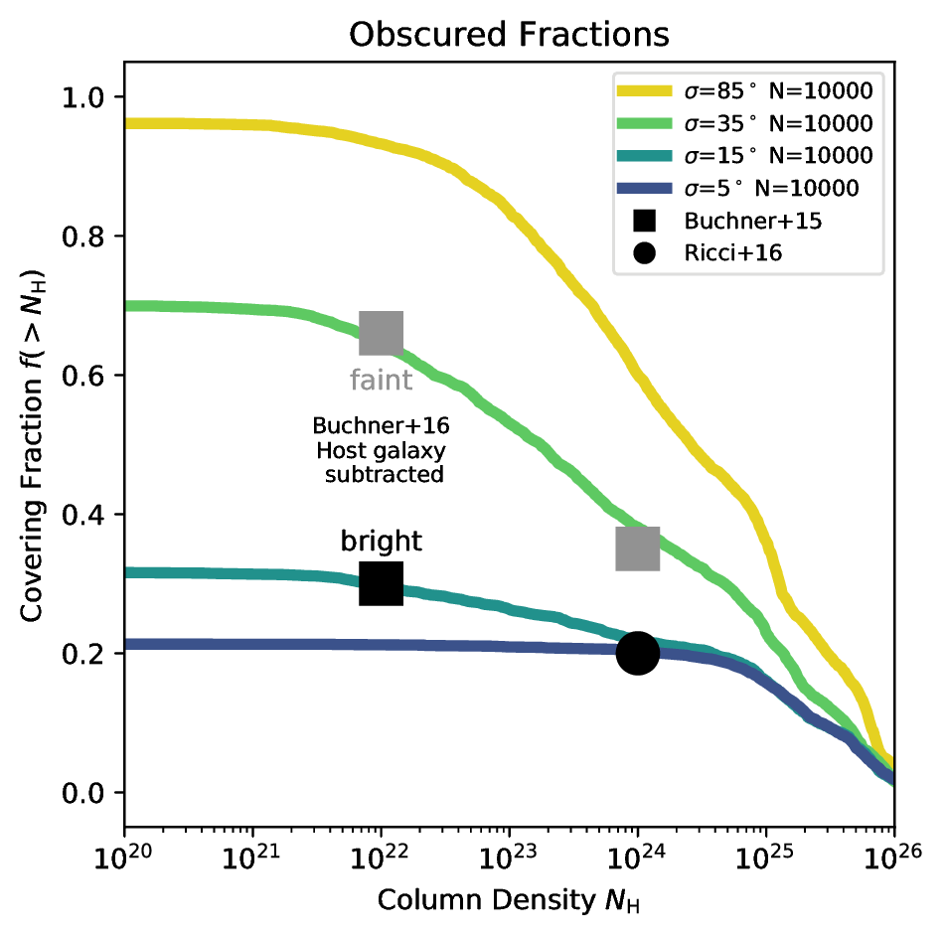
UXCLUMPY
Buchner et al. (submitted)
Eclipse events
Unification

Slide 5
XARS
X-ray Absorption Re-emission Scattering
Ray-tracing code for X-rays
Open source, Python
Arbitrary geometries:
  Torus, Sphere,
  Millions of spheres
  Grids (like from hydrodynamic simulations)
http://github.com/JohannesBuchner/xars

Slide 6
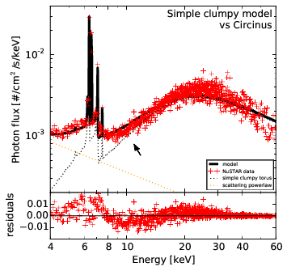
The problem

Slide 7
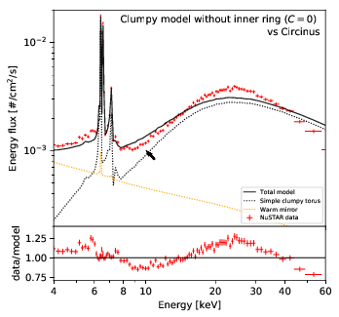
The problem
(nuclear contamination already modelled out)

Slide 8
Circinus
Has a weird shape,
explained with complex models
Physics is simple at >8keV
Geometry models don’t fit
so there is constraining power here!
Search for geometries matching the data
Simplify problem: 3 flux measurements

Slide 9
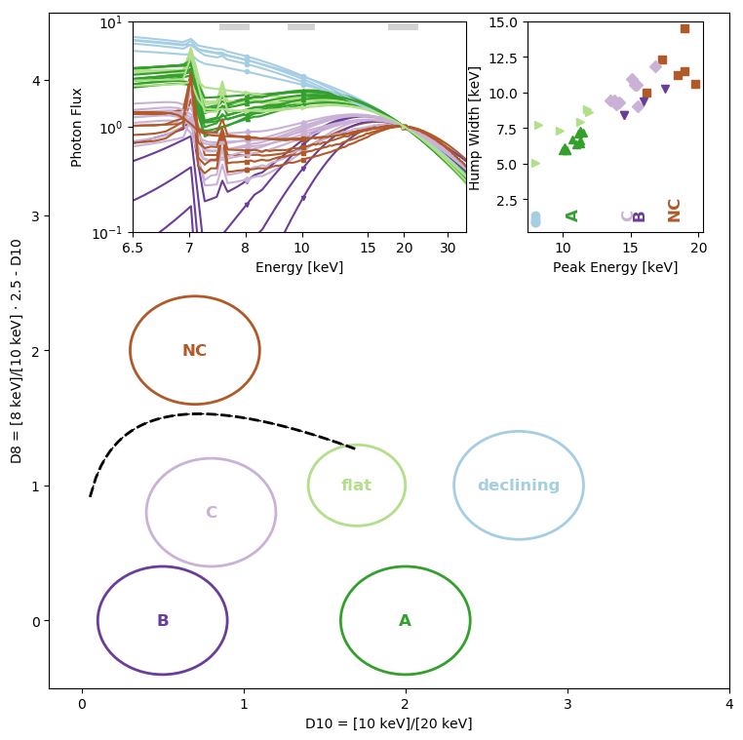
X-ray color-color diagram
Shape of the Compton hump
High-energy
Plane where
models and
observations
can meet
8/10
keV
10/20 keV

Slide 10
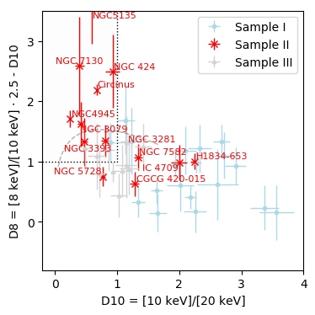
NuSTAR Observations
Below X-MIR correlation
Some interesting sources
Compton-thick candidates from previous studies
(Swift/BAT sample, Balokovic et al., in prep.)

Slide 11
What is the point?
Can we find a model geometry for each?
Can a single geometry explain most? (Unification)
Any model space not used by nature?
Quick way to check new models
Model-independent characterisation of sources
3pts!

Slide 12
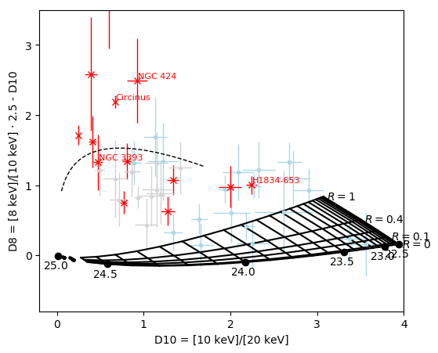
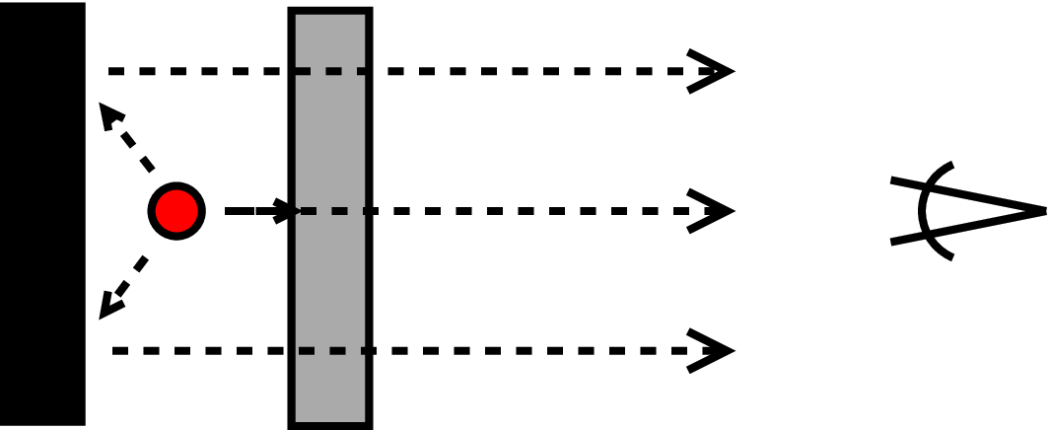
Absorbed system
Lessons learned:
No 4pi obscured sources?

Slide 13
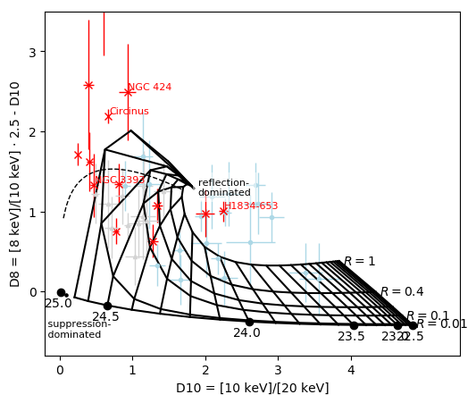
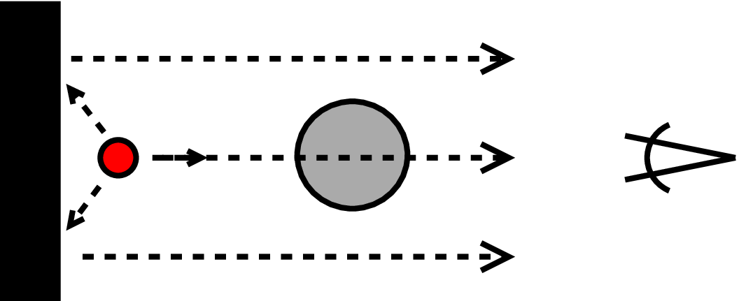
Unobstructed view to cold mirror
Lessons learned:
Reflection dominated sources
Fair overlap

Slide 14
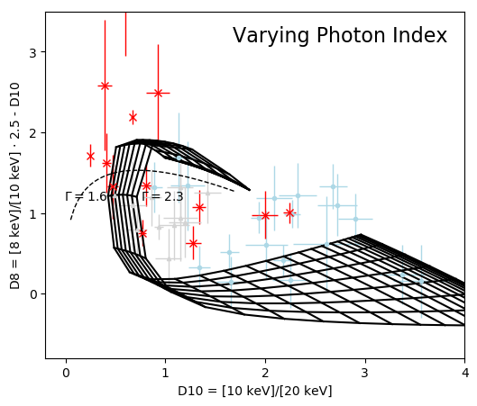
Impact of Photon Index
Lessons learned:
Small impact

Slide 15
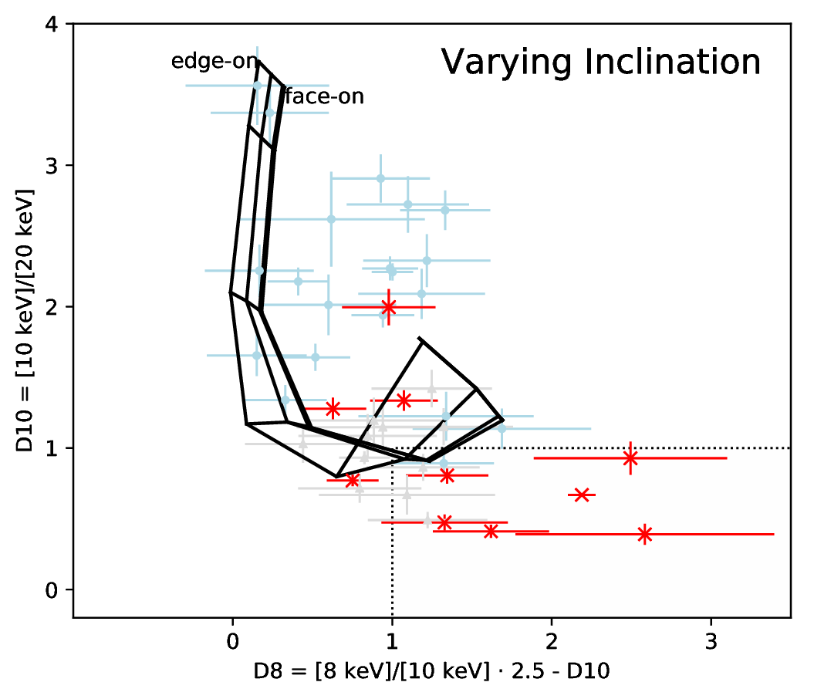
Impact of Inclination
Lessons learned:
Small impact

Slide 16
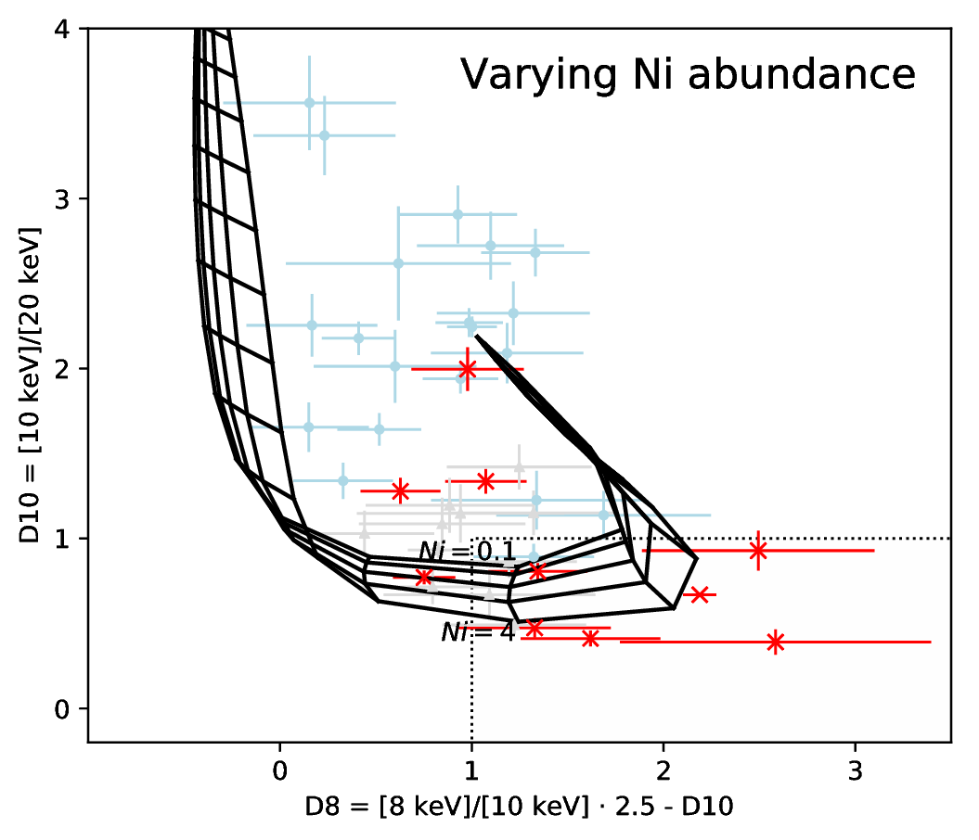
Impact of Ni/Fe ratio
Lessons learned:
Small impact

Slide 17
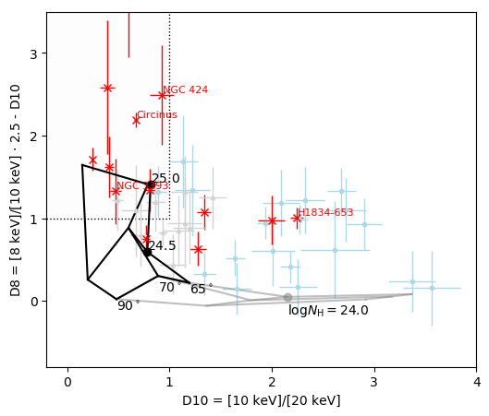
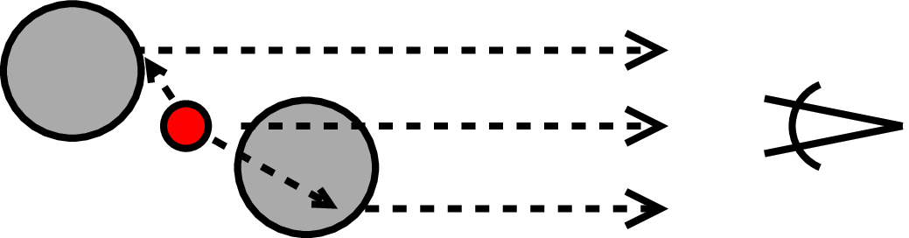
Smooth torus
Murphy & Yaqoob (2009)

Slide 18
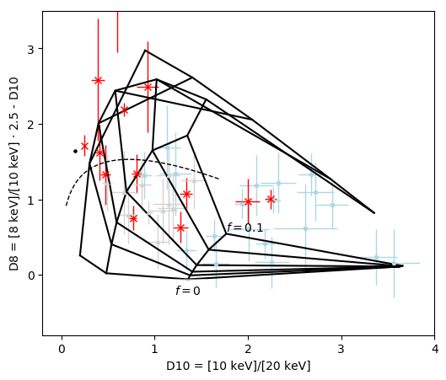
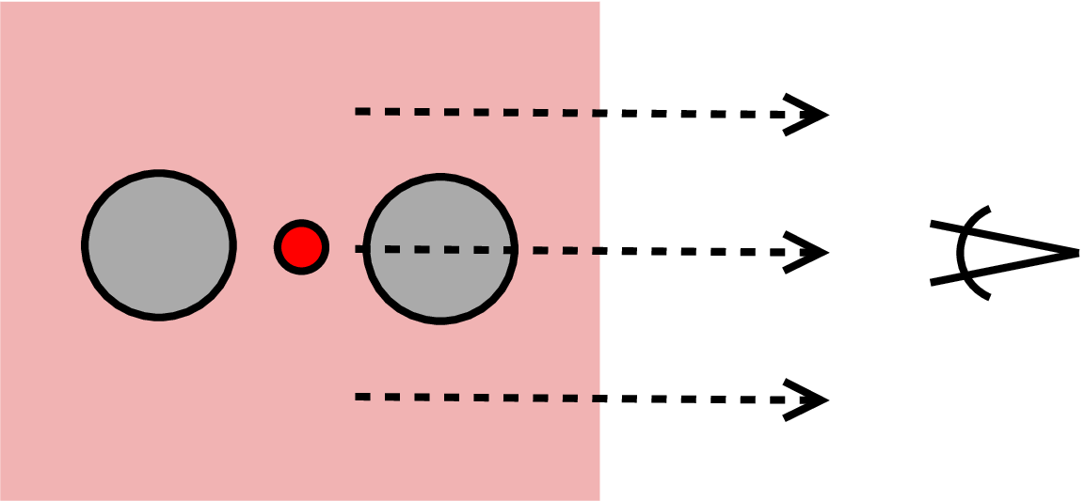
Smooth torus + warm mirror

Slide 19
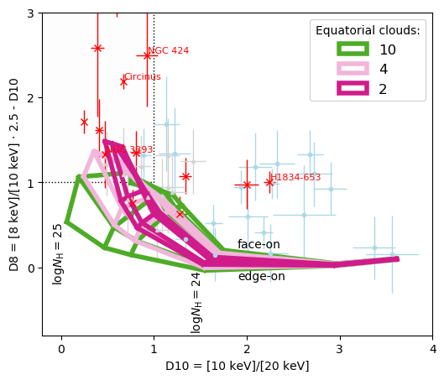
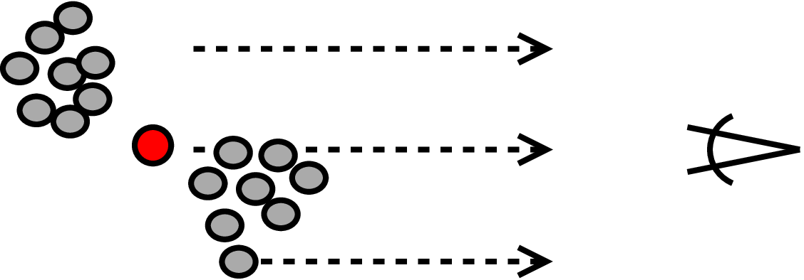
Clumpy torus
Liu&Li (2014)
Lessons learned:
Low number of clouds preferred
logN_{H}>25 reflectors needed (!)

Slide 20
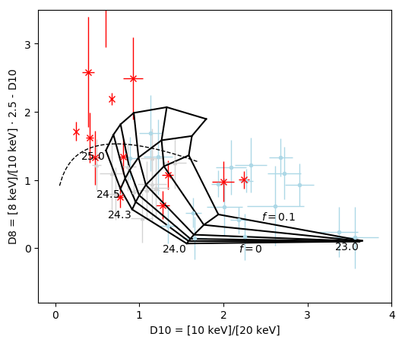
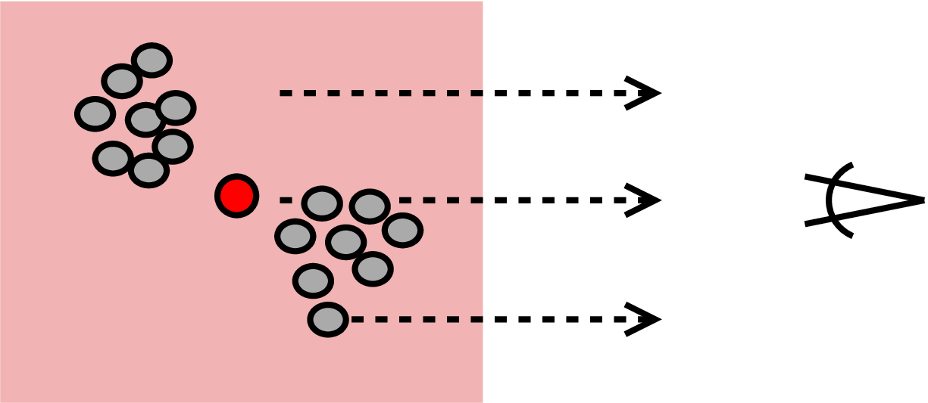
Clumpy torus
Liu&Li (2014)
Lessons learned:
Low number of clouds preferred
logN_{H}>25 reflectors needed (!)

Slide 21
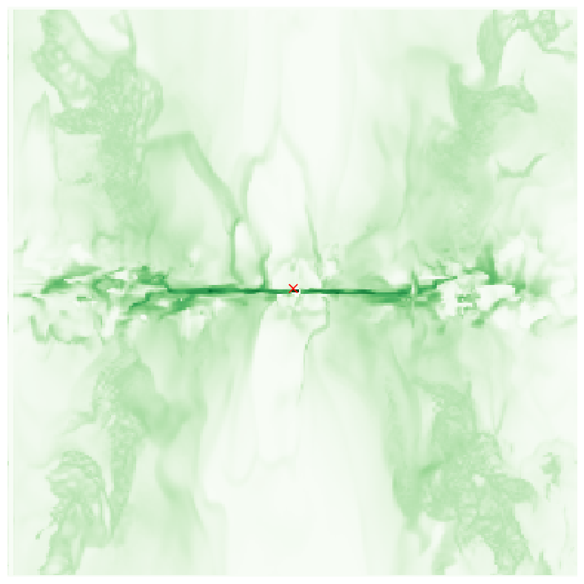
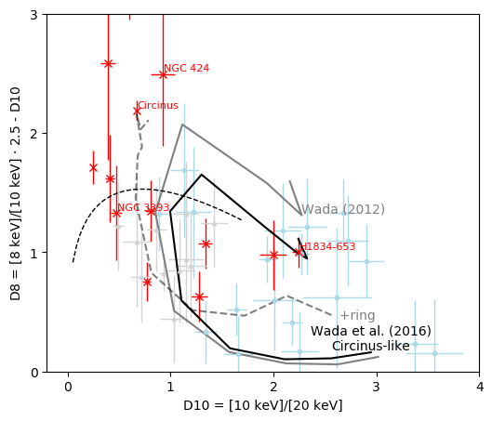
Radiative fountain
Wada12, Wada+15
Lessons learned:
Physically motivated
Polar Compton-thin gas contaminates

Slide 22
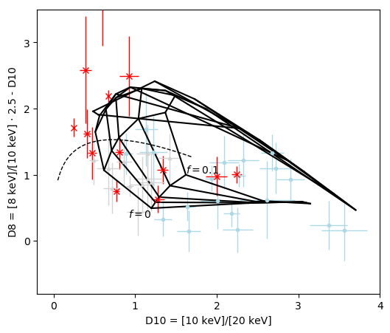
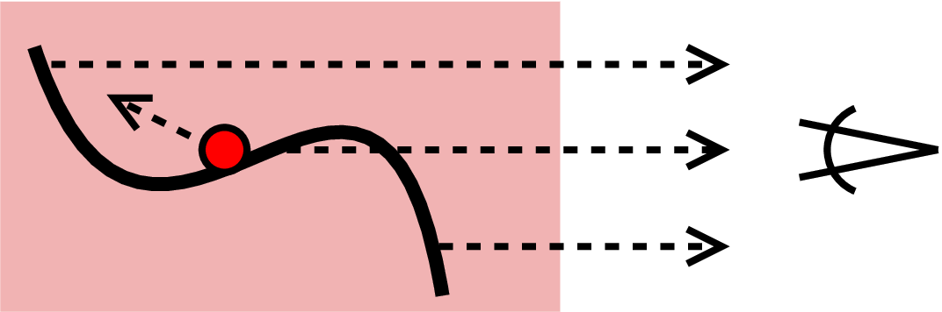
Warped disk + warm mirror
Lessons learned:
Reproduces left outline
Physically motivated
Best spectral fit to Circinus

Slide 23
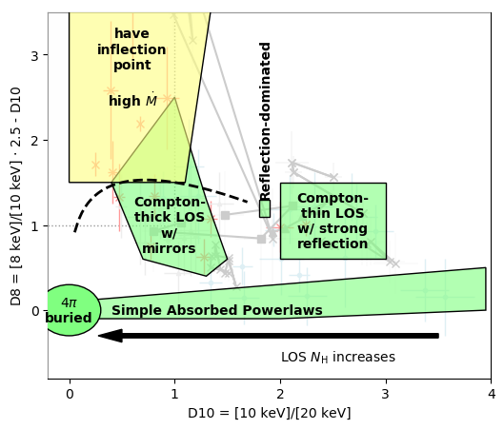
Properties of the diagram
Hard X-ray
color-color diagram
Observations:
  Mission-independent
  Model-independent
  classification
Geometries:
  Quick check if covers observations
  Need more models at top left

Slide 24
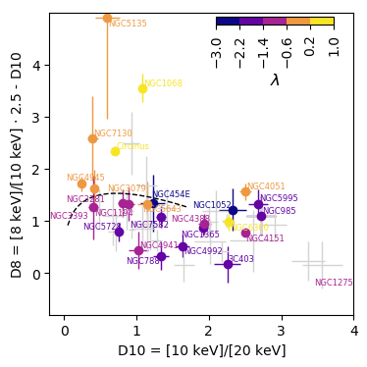
Eddington rate
Rapid accretors
<-> inflection point
Something happens at
Side-note: changing-look sources
BHM: Gao+15, Koss+15, Bian&Gu07, Beckmann+09 | Lbol: VLT/VLTI 12µm Asmus+15

Slide 25
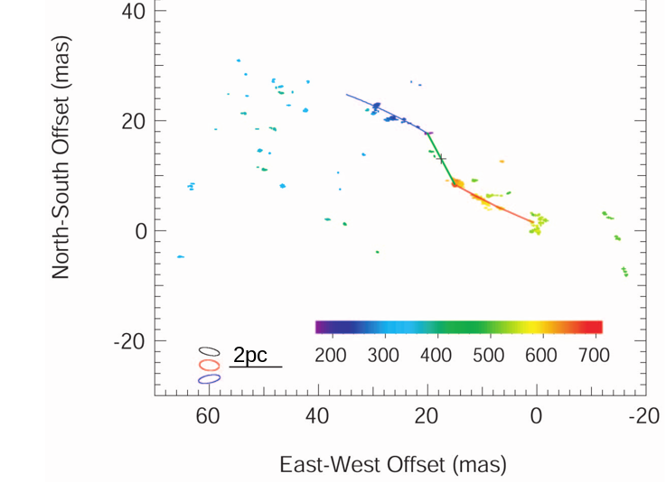
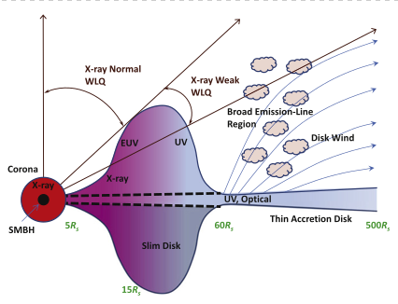
Interpretation
Seeing a reflector
  logN_{H}>25
  With large area
  Unobscured to our LOS
  When accretion is rapid
Geometries:
  Warped disk?
  Puffed-up/Slim disk?
  Shielding gas?
Warped water maser disk
Greenhill+03
Wu+11, Luo+15

Slide 26
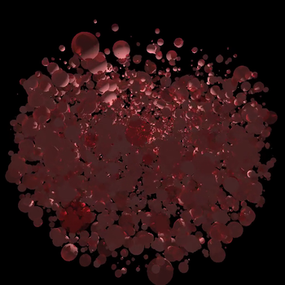
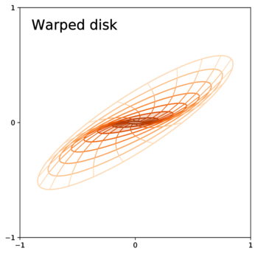
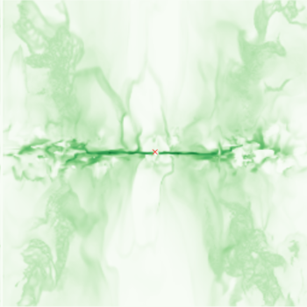

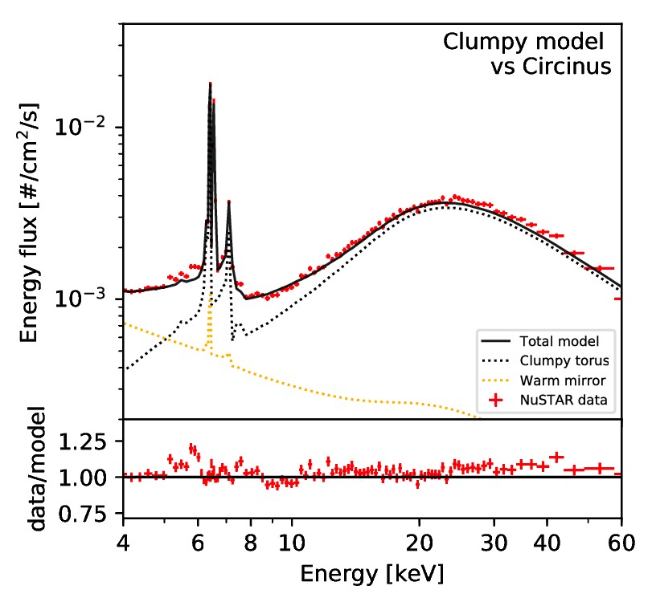
Outcomes
UXCLUMPY
Radiative fountain

Slide 27
UXCLUMPY
Eclipse events
Unification
CLUMPY-
compatible
http://github.com/JohannesBuchner/xars/

Slide 28
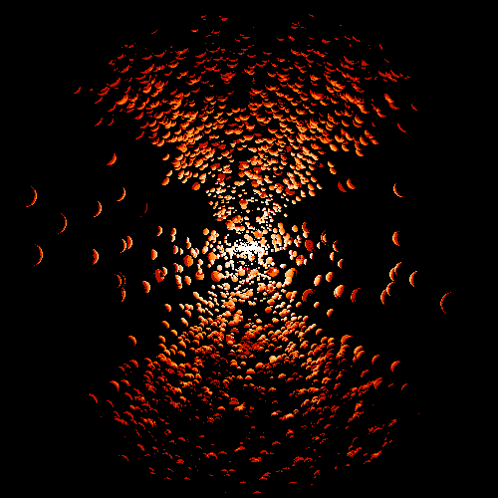
Outcomes
Wada 2012, Wada+2016
Pringle96,Maloney+96,Nixon+12
http://github.com/JohannesBuchner/xars
UXCLUMPY
CAT3D+WIND

Slide 29
Radiative Fountain model
http://github.com/JohannesBuchner/xars/

Slide 30
Torus ideas: (4) warps & tilts
http://github.com/JohannesBuchner/xars/

Slide 31
Torus ideas: (2) clumpy torus

Slide 32
The need for new models
Eclipse events
Unification
Physical origin
Good X-ray fits
UXCLUMPY
Radiative fountain
Warped disk
Visualise disagreements
Pringle96,Maloney+96,Nixon+12
Wada 2012, Wada+2016

Slide 33
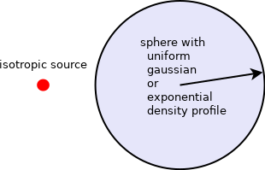
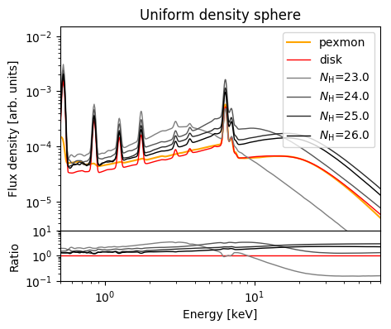
Compton Hump Primer
N_{H}
Compton-hump contains imprints of geometry and density of reflector
Also: Nandra&George (1994)

Slide 34
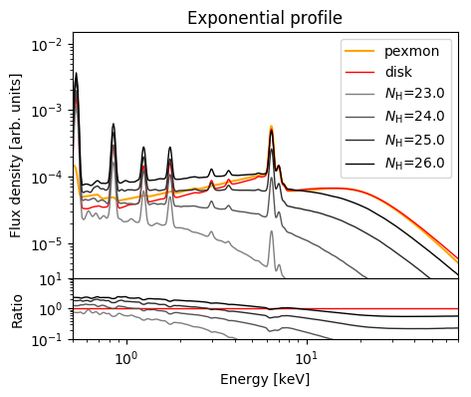
Compton Hump Primer

Slide 35
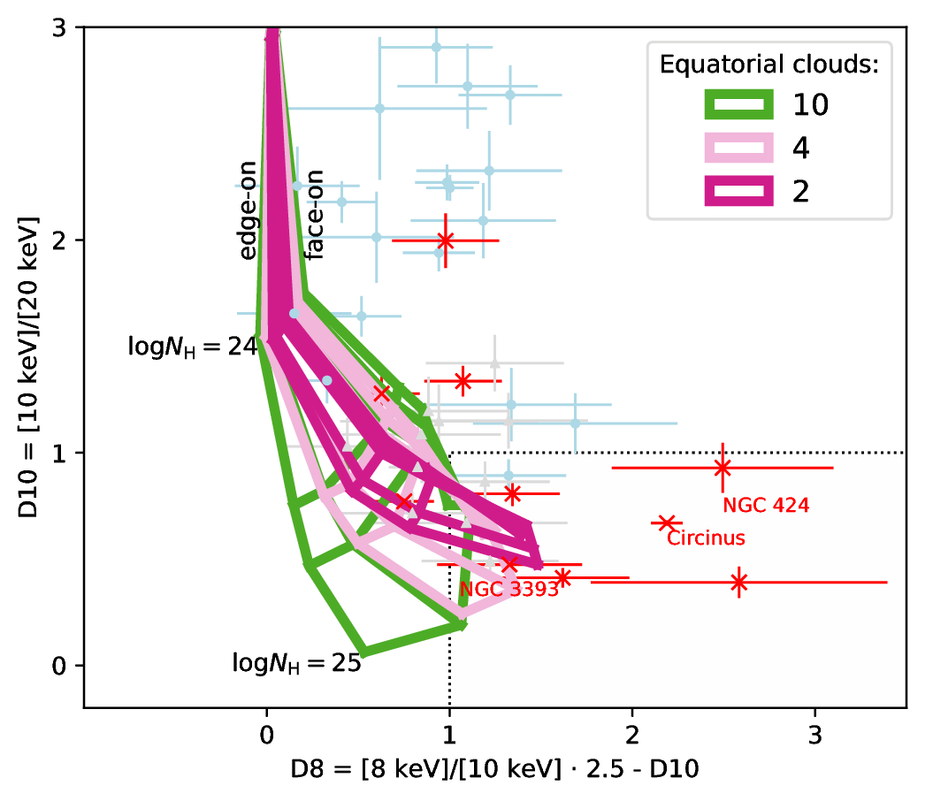
Directions for future models
In CTK sources, last scattering surface can be constrained:
  Large-covering
  Non-clumpy
  logN_{H}>25 (!)
  low-N_{H} reflectors absent
Physically motivated models:
  Radiative fountain
  Warped disk – good fits

Slide 36
Things to look forward to in 2018
XARS
  X-ray Absorption Re-emission Scattering
  Python, open-source
  Arbitrary user-defined geometries
  Uniform Spheres (100000)
  Arbitrary uniform density grid
New models:
  Radiative fountain model
  Warped disk
  UXCLUMPY

Slide 38
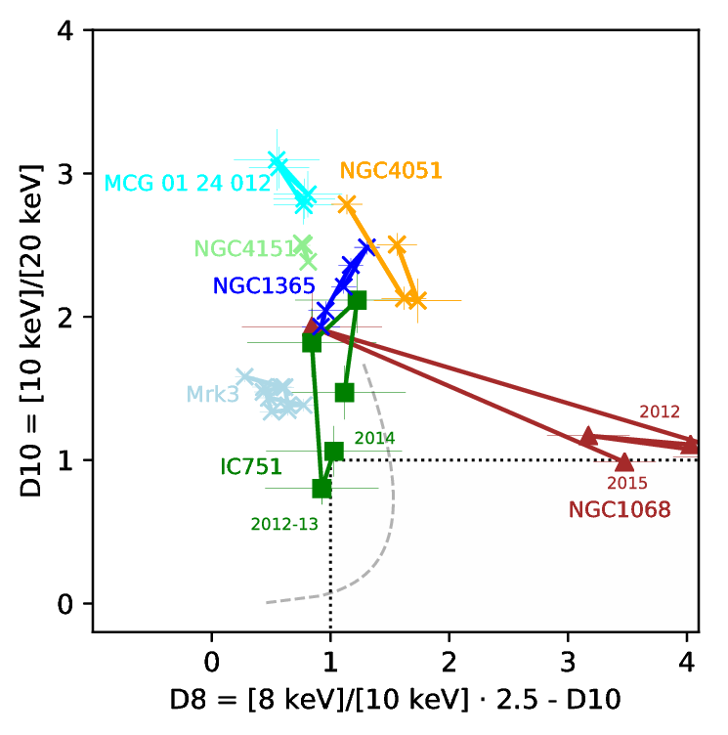
Changing Look sources
Models should reproduce these without grave changes in the geometry
NGC1068!

Slide 39
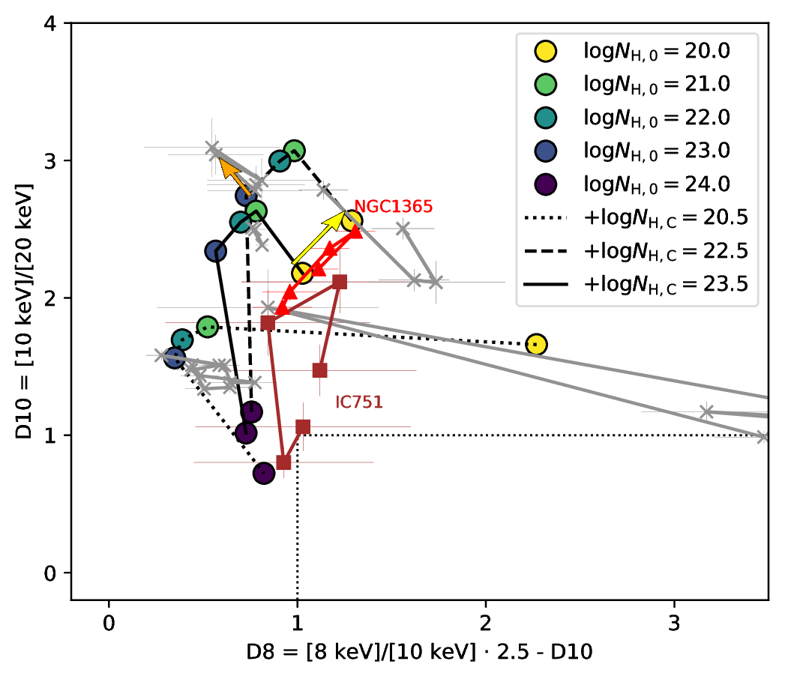
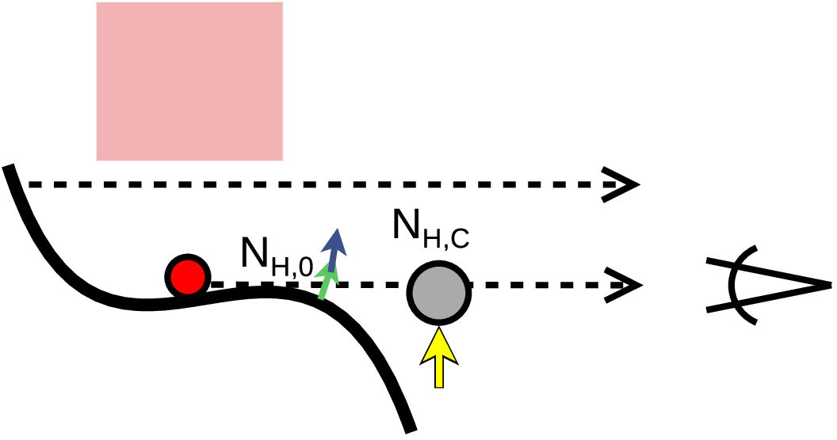
Changing looks at models

Slide 40
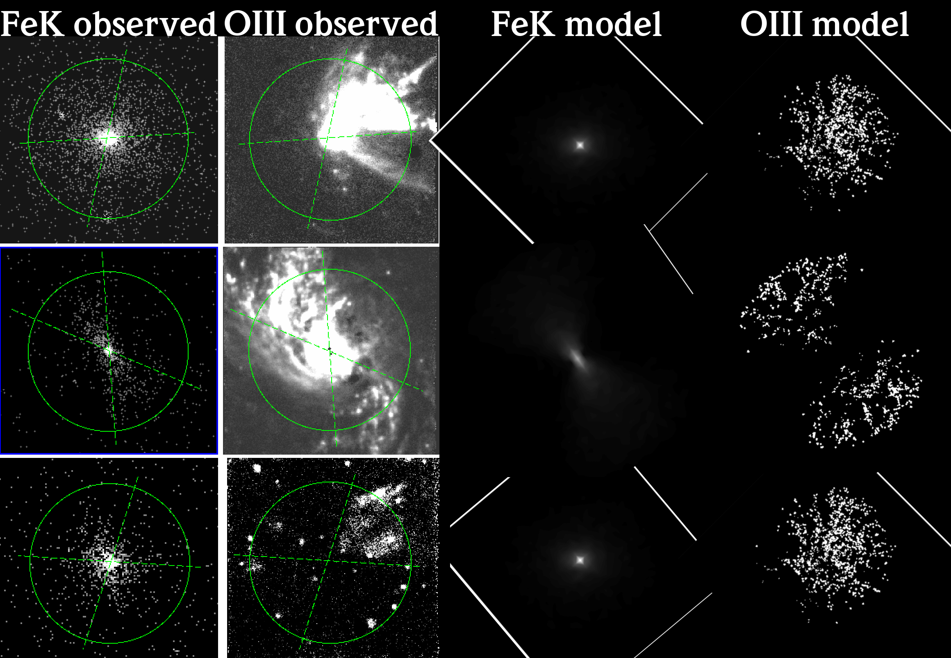
The need for new models
Eclipse events
Unification
UXCLUMPY

