Slide 1


The hidden
SMBH population over cosmic time
Collaborators:
Franz Bauer, Ezequiel Treister,
Mara Salvato, Kirpal Nandra,
Antonis Georgakakis, Murray Brightman, Mislav Balokovic,
Keiichi Wada, Robert Nikutta,
Lia Sartori, et altera
Johannes Buchner
http://astrost.at/istics

Slide 2
Research interests
X-ray Survey analysis
Geometry of obscurer
from X-ray spectra
Luminosity function of
Heavily obscured AGN
SMBH occupation
f(M*,z)
Obscured, CTK fraction
f(L,z)
Obscured, CTK fraction
by galaxy gas f(M*,z)
Spectral fitting
with low counts (BXA)
Multi-wavelength
Association NWAY
Cosmological Sims
Nested Sampling &
PyMultiNest
Hierarchical Bayesian
Models

Slide 3
Research interests
X-ray Survey analysis
Geometry of obscurer
from X-ray spectra
Luminosity function of
Heavily obscured AGN
SMBH occupation
f(M*,z)
Obscured, CTK fraction
f(L,z)
Obscured, CTK fraction
by galaxy gas f(M*,z)
Spectral fitting
with low counts (BXA)
Multi-wavelength
Association NWAY
Cosmological Sims
Nested Sampling &
PyMultiNest
Hierarchical Bayesian
Models

Slide 4
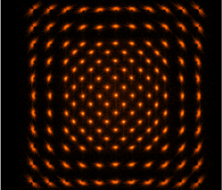

Research interests
X-ray Survey analysis
Chandra
XMM
ROSAT
eROSITA
Geometry of obscurer
from X-ray spectra
Luminosity function
Heavily obscured AGN
SMBH occupation
f(M*,z)
Obscured, CTK fraction
f(L,z)
Obscured, CTK fraction
by galaxy gas f(M*,z)
X-ray PSF can be large
in deep images: Multiple possible counterparts
Spectral fitting
with low counts (BXA)
Multi-wavelength
Association NWAY
Cosmological Sims
Nested Sampling &
PyMultiNest
Hierarchical Bayesian
Models

Slide 5


Research interests
X-ray Survey analysis
Geometry of obscurer
from X-ray spectra
Luminosity function
Heavily obscured AGN
SMBH occupation
f(M*,z)
Obscured, CTK fraction
f(L,z)
Obscured, CTK fraction
by galaxy gas f(M*,z)
Presence or absence of counterpart in catalog
Depends on imaging depth
Spectral fitting
with low counts (BXA)
Multi-wavelength
Association NWAY
Cosmological Sims
Nested Sampling &
PyMultiNest
Hierarchical Bayesian
Models

Slide 6
Our method in a nutshell: NWAY
Research interests
X-ray Survey analysis
Salvato, Buchner, Budavári et al. 2017
H1: chance alignment of unrelated srcs
H2: single source
depends on
counterpart sky number density ρ_{s}
and expected counterpart fraction η_{x}
Geometry of obscurer
from X-ray spectra
Luminosity function
Heavily obscured AGN
SMBH occupation
f(M*,z)
Bayes
factor
Angular separation
Obscured, CTK fraction
f(L,z)
Obscured, CTK fraction
by galaxy gas f(M*,z)
posterior probability for
match between X-ray source i
& a potential counterpart j
Weighting term
(mag, colors,etc)
Positional uncertainties
Spectral fitting
with low counts (BXA)
Multi-wavelength
Association NWAY
Cosmological Sims
Nested Sampling &
PyMultiNest
Hierarchical Bayesian
Models

Slide 7

Research interests
X-ray Survey analysis
Pineau+16
Geometry of obscurer
from X-ray spectra
Luminosity function
Heavily obscured AGN
SMBH occupation
f(M*,z)
Obscured, CTK fraction
f(L,z)
Obscured, CTK fraction
by galaxy gas f(M*,z)
Explore combinatorics
Find relative probabilities of matches
Spectral fitting
with low counts (BXA)
Multi-wavelength
Association NWAY
Cosmological Sims
Nested Sampling &
PyMultiNest
Hierarchical Bayesian
Models

Slide 8

Test 1: XMM-COSMOS
Research interests
Fast!
X-ray Survey analysis
ML: 1281 considered reliable, after careful visual inspection
Now with Chandra coverage:
NWAY: automatic, with single band, self-learning magnitude distribution:
NWAY with 1+3.6um catalogues
1281 total
139 were mis-associated
additional
49/139 sources right
Geometry of obscurer
from X-ray spectra
Luminosity function
Heavily obscured AGN
SMBH occupation
f(M*,z)
got 86/139 sources right
Obscured, CTK fraction
f(L,z)
Obscured, CTK fraction
by galaxy gas f(M*,z)
eROSITA: All-Sky priors
Spectral fitting
with low counts (BXA)
Multi-wavelength
Association NWAY
Cosmological Sims
Nested Sampling &
PyMultiNest
Hierarchical Bayesian
Models

Slide 9
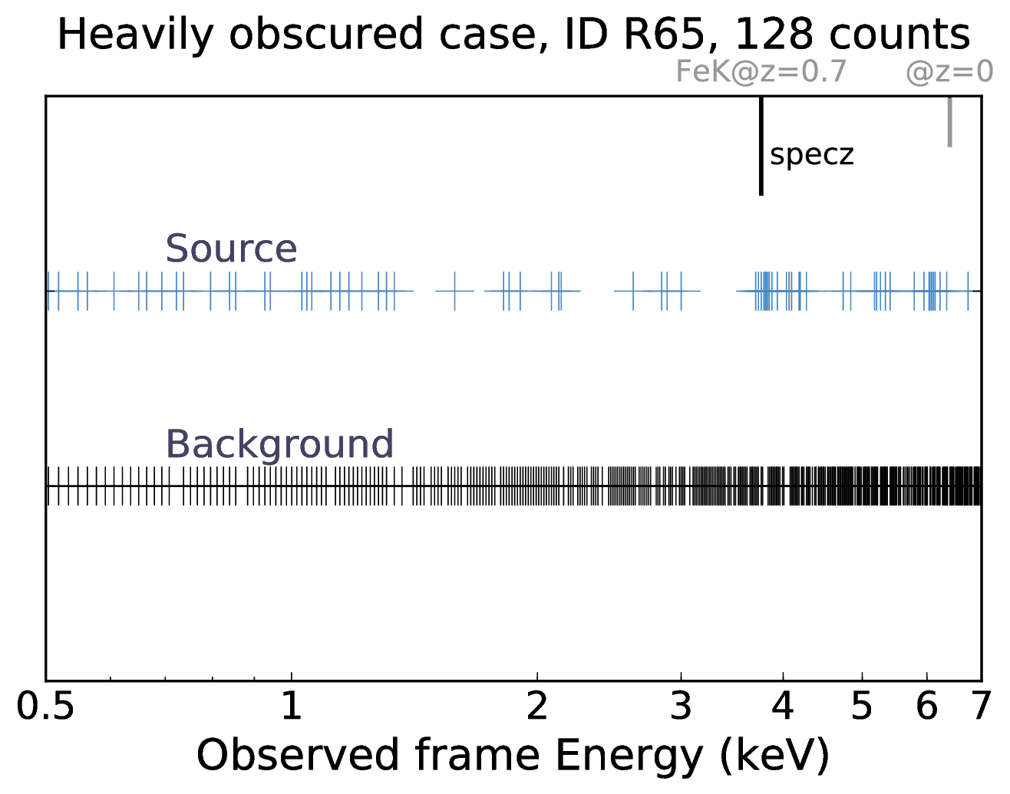
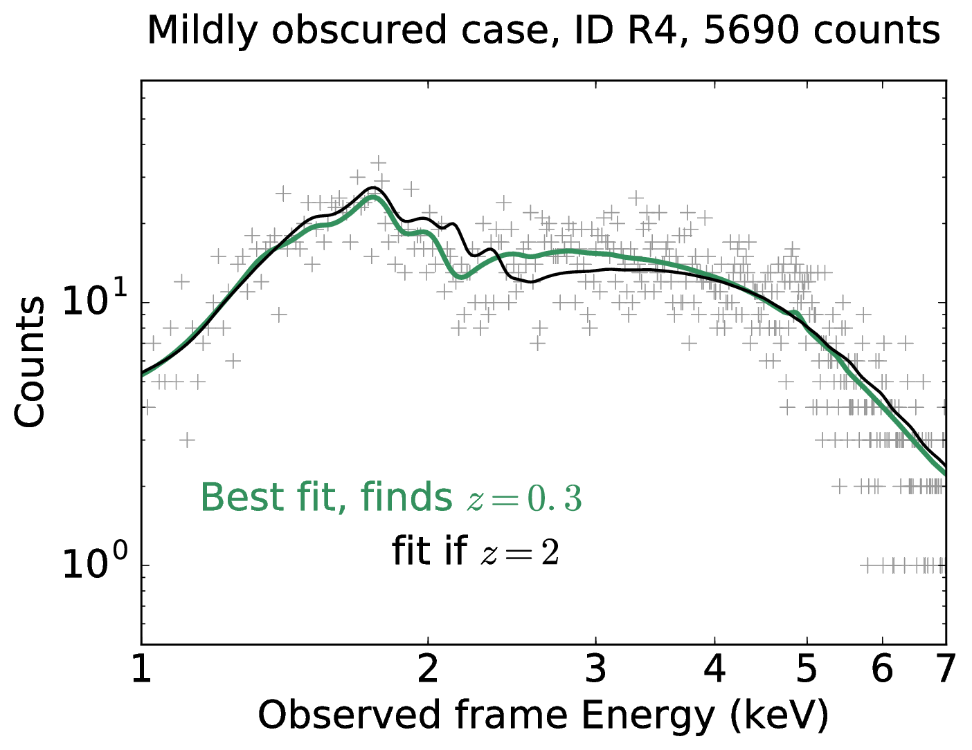
XZ
Research interests
X-ray Survey analysis
X-ray (low-resolution spectroscopic) Redshifts
(Simmonds, Buchner et al, 2018)
Geometry of obscurer
from X-ray spectra
Luminosity function
Heavily obscured AGN
SMBH occupation
f(M*,z)
(Simmonds, JB et al, accepted)
Obscured, CTK fraction
f(L,z)
Obscured, CTK fraction
by galaxy gas f(M*,z)
FLUORESCENT LINES
ABSORPTION EDGES
Spectral fitting
with low counts (BXA)
Multi-wavelength
Association NWAY
Cosmological Sims
Nested Sampling &
PyMultiNest
Hierarchical Bayesian
Models

Slide 10
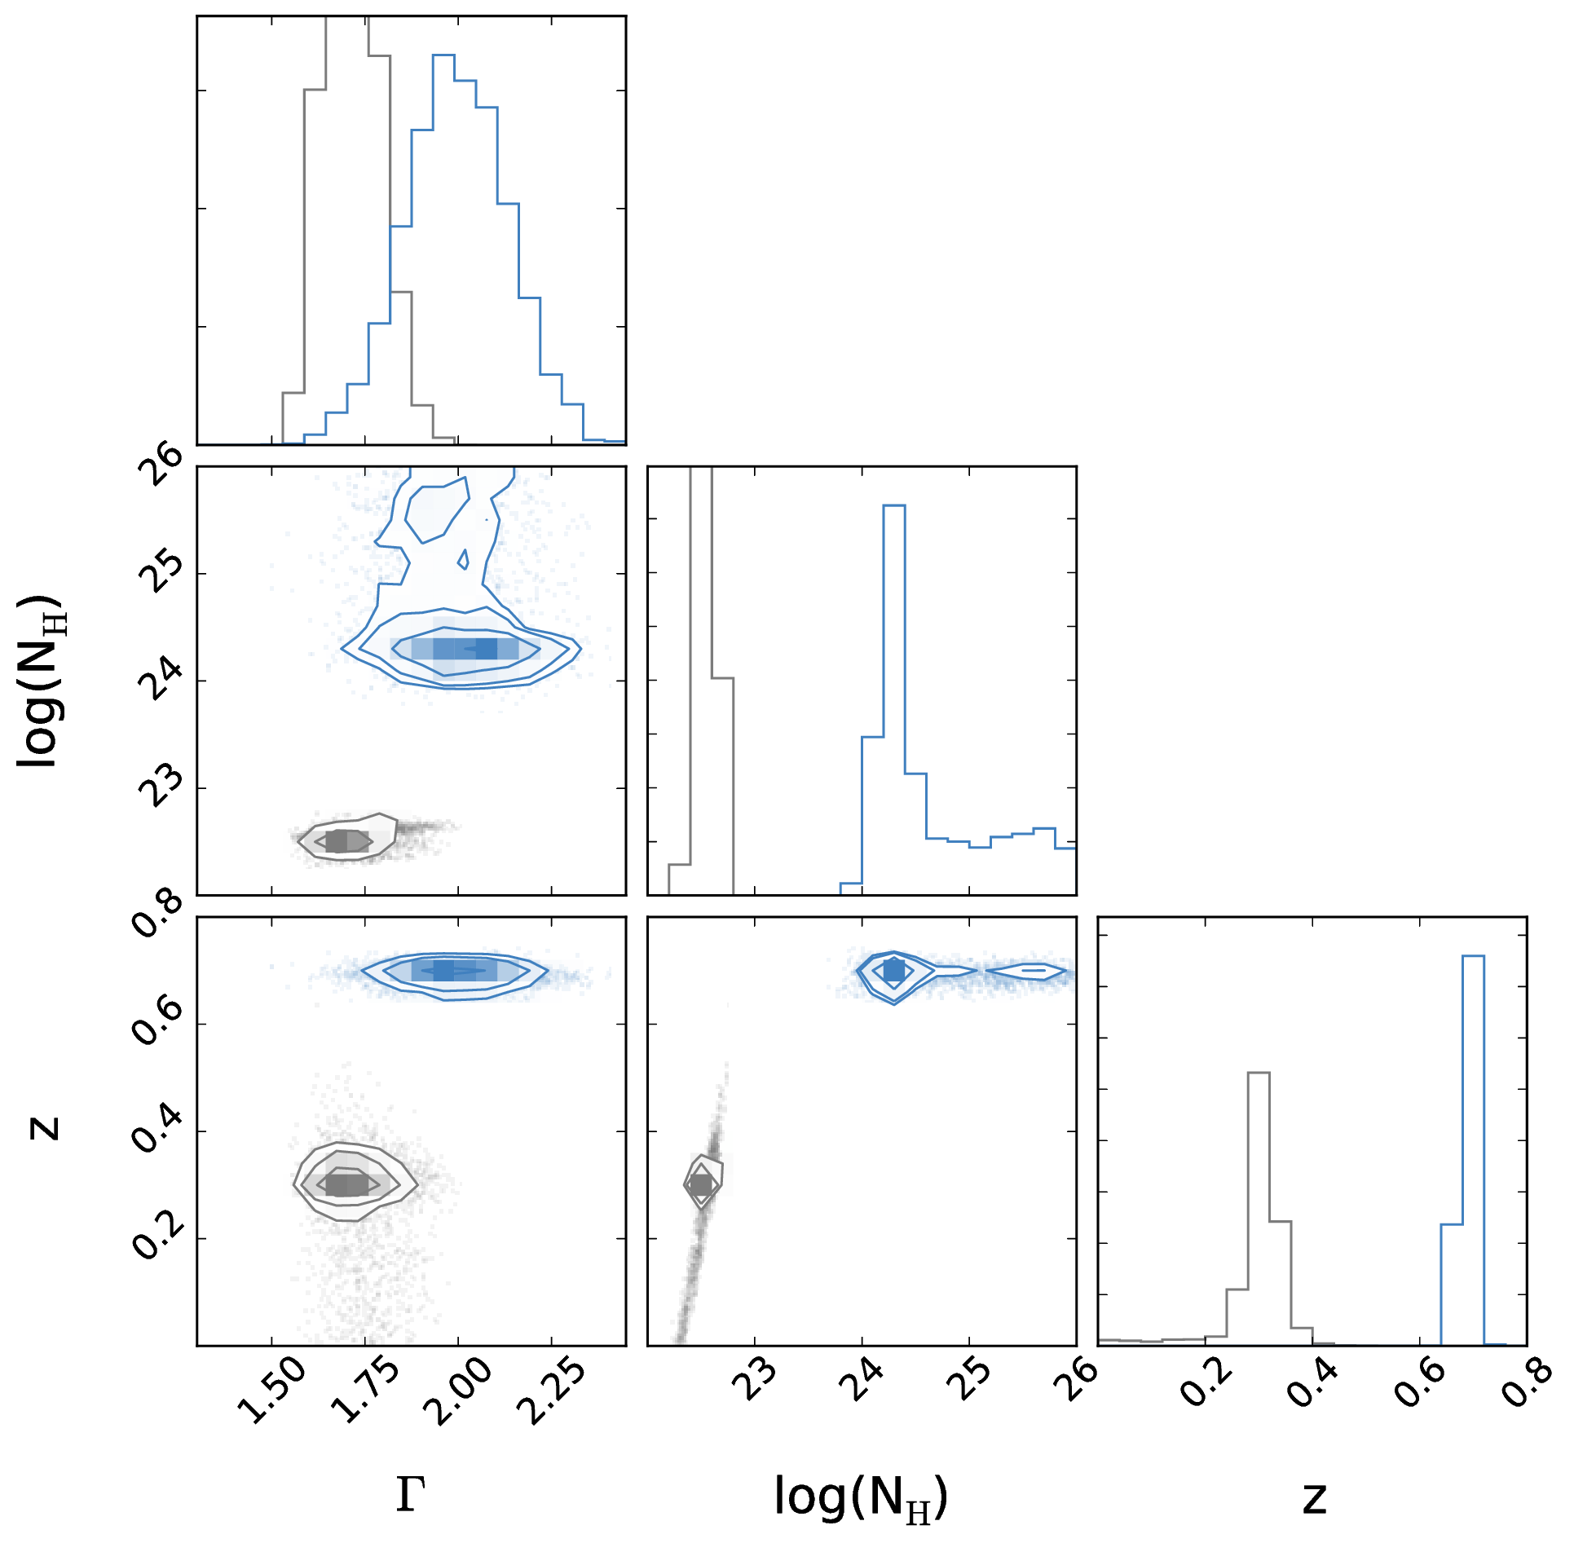
XZ
Research interests
BXA uses MultiNest
X-ray Survey analysis
(Simmonds, Buchner et al, 2018)
Explore
parameter space of complex models
Geometry of obscurer
from X-ray spectra
Luminosity function
Heavily obscured AGN
SMBH occupation
f(M*,z)
(Simmonds, JB et al, accepted)
Obscured, CTK fraction
f(L,z)
Obscured, CTK fraction
by galaxy gas f(M*,z)
FLUORESCENT LINES
ABSORPTION EDGES
Spectral fitting
with low counts (BXA)
Multi-wavelength
Association NWAY
Cosmological Sims
Nested Sampling &
PyMultiNest
Hierarchical Bayesian
Models
Redshift

Slide 11
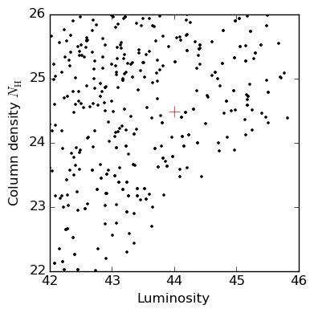
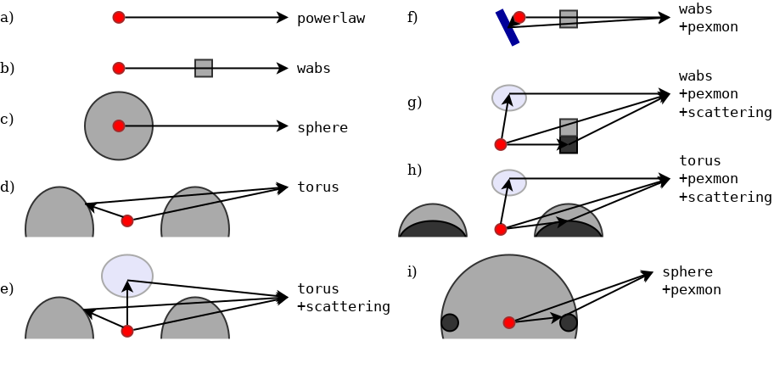
BXA
Research interests
X-ray Survey analysis
Derive probability distributions
on model parameters:
L_{X}, N_{H}, z
Compare models
Geometry of obscurer
from X-ray spectra
Luminosity function
Heavily obscured AGN
SMBH occupation
f(M*,z)
Obscured, CTK fraction
f(L,z)
Obscured, CTK fraction
by galaxy gas f(M*,z)
Spectral fitting
with low counts (BXA)
Multi-wavelength
Association NWAY
Cosmological Sims
Optional to extract more information:
Automatically fit empirical BKG models (Chandra, XMM/PN+MOS, NuSTAR, Swift, Suzaku, RXTE)
Nested Sampling &
PyMultiNest
Hierarchical Bayesian
Models

Slide 12
Geometries & X-rays
Research interests
X-ray Survey analysis
Geometry of obscurer
from X-ray spectra
Luminosity function
Heavily obscured AGN
SMBH occupation
f(M*,z)
Obscured, CTK fraction
f(L,z)
Obscured, CTK fraction
by galaxy gas f(M*,z)
Spectral fitting
with low counts (BXA)
Multi-wavelength
Association NWAY
Cosmological Sims
Buchner+14:
Geometry of torus from X-ray spectral fitting in CDFS
Nested Sampling &
PyMultiNest
Hierarchical Bayesian
Models

Slide 13
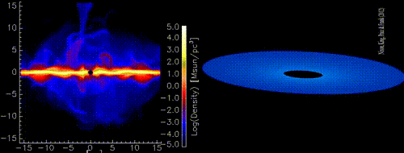

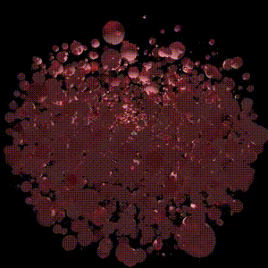
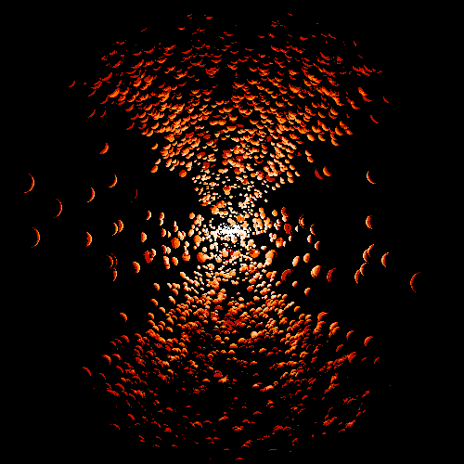
Geometries & X-rays
Research interests
X-ray Survey analysis
Geometry of obscurer
from X-ray spectra
Luminosity function
Heavily obscured AGN
SMBH occupation
f(M*,z)
Obscured, CTK fraction
f(L,z)
Obscured, CTK fraction
by galaxy gas f(M*,z)
http://github.com/JohannesBuchner/xars
Spectral fitting
with low counts (BXA)
Multi-wavelength
Association NWAY
Cosmological Sims
Nested Sampling &
PyMultiNest
Hierarchical Bayesian
Models

Slide 14
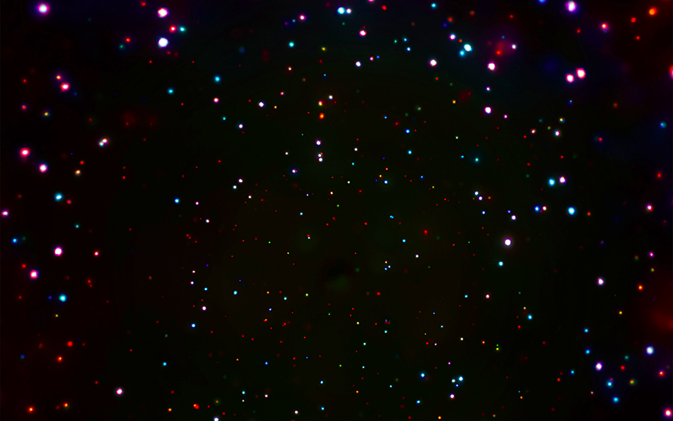


Research interests
X-ray Survey analysis
Geometry of obscurer
from X-ray spectra
Luminosity function
Heavily obscured AGN
SMBH occupation
f(M*,z)
Obscured, CTK fraction
f(L,z)
Obscured, CTK fraction
by galaxy gas f(M*,z)
Spectral fitting
with low counts (BXA)
Multi-wavelength
Association NWAY
Cosmological Sims
CDFS: Luo+17
COSMOS,
AEGIS-XD,
XMM-XXL
Buchner+15
Nested Sampling &
PyMultiNest
Hierarchical Bayesian
Models

Slide 15
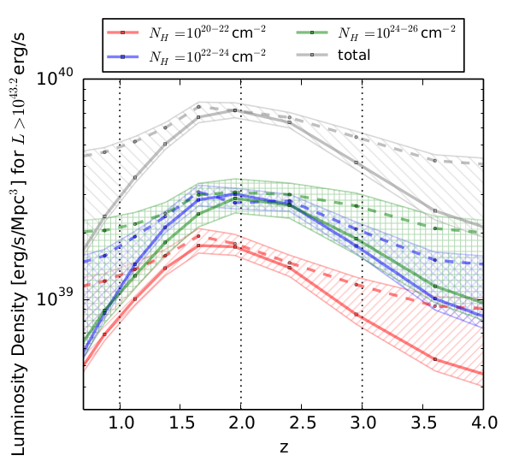
Research interests
X-ray Survey analysis
Geometry of obscurer
from X-ray spectra
Luminosity function
Heavily obscured AGN
SMBH occupation
f(M*,z)
Obscured, CTK fraction
f(L,z)
Obscured, CTK fraction
by galaxy gas f(M*,z)
Spectral fitting
with low counts (BXA)
Multi-wavelength
Association NWAY
Cosmological Sims
CDFS: Luo+17
COSMOS,
AEGIS-XD,
XMM-XXL
Buchner+15
Nested Sampling &
PyMultiNest
Hierarchical Bayesian
Models

Slide 16


Research interests
X-ray Survey analysis
Geometry of obscurer
from X-ray spectra
Luminosity function
Heavily obscured AGN
SMBH occupation
f(M*,z)
Obscured, CTK fraction
f(L,z)
Obscured, CTK fraction
by galaxy gas f(M*,z)
Horizon-AGN
Volonteri+16
EAGLE
Rosas-Guevara+16
Spectral fitting
with low counts (BXA)
Buchner+15
Cosmological Sims
Multi-wavelength
Association NWAY
Nested Sampling &
PyMultiNest
Hierarchical Bayesian
Models

Slide 17

Research interests
X-ray Survey analysis
Geometry of obscurer
from X-ray spectra
Luminosity function
Heavily obscured AGN
SMBH occupation
f(M*,z)
Obscured, CTK fraction
f(L,z)
Obscured, CTK fraction
by galaxy gas f(M*,z)
Obscuration by host-galaxy gas
(determined via
GRB obscuration)
Spectral fitting
with low counts (BXA)
Multi-wavelength
Association NWAY
Cosmological Sims
Nested Sampling &
PyMultiNest
Hierarchical Bayesian
Models
Buchner+15
Buchner+17a
Buchner+17b

Slide 18
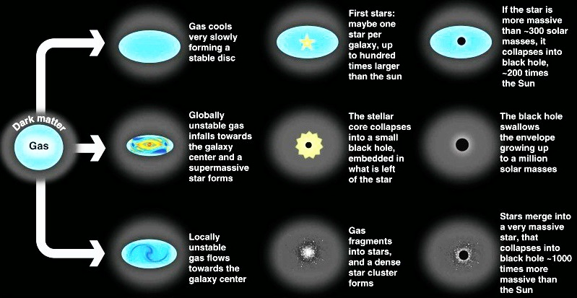
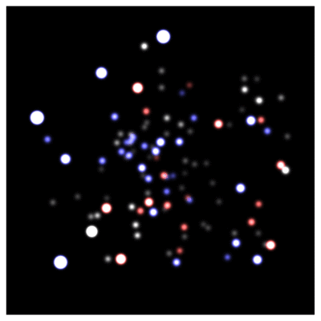
Research interests
X-ray Survey analysis
Geometry of obscurer
from X-ray spectra
Luminosity function
Heavily obscured AGN
SMBH occupation
f(M*,z)
Obscured, CTK fraction
f(L,z)
z=?
Obscured, CTK fraction
by galaxy gas f(M*,z)
z=0
Spectral fitting
with low counts (BXA)
Multi-wavelength
Association NWAY
Cosmological Sims
Nested Sampling &
PyMultiNest
Hierarchical Bayesian
Models
GC / IR group at MPE
Schödel+02, Eisenhauer+05, Gillessen+09
Volonteri 2012, Rees 1978

Slide 19
Research interests
X-ray Survey analysis
Geometry of obscurer
from X-ray spectra
Luminosity function
Heavily obscured AGN
SMBH occupation
f(M*,z)
Obscured, CTK fraction
f(L,z)
z=?
Obscured, CTK fraction
by galaxy gas f(M*,z)
z=0
Efficiency of seeding process?
How many SMBHs are there (at least)?
Spectral fitting
with low counts (BXA)
Multi-wavelength
Association NWAY
Cosmological Sims
Nested Sampling &
PyMultiNest
Hierarchical Bayesian
Models
GC / IR group at MPE
Schödel+02, Eisenhauer+05, Gillessen+09
Volonteri 2012, Rees 1978

Slide 20
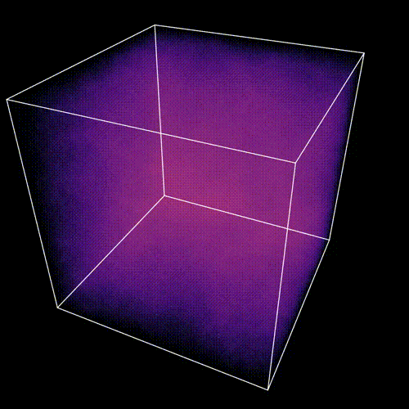
LCDM: Hierarchical collapse
EAGLE simulation

Slide 21
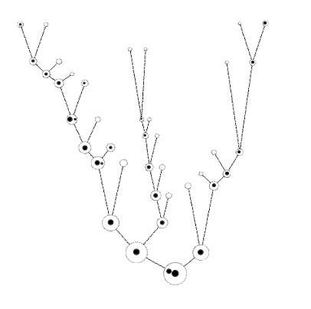
Motivation
Local galaxies host SMBHs
Built from many small halos
How does the seeding process need to behave?
Insights independent of specific seeding model
credit: M. Volonteri

Slide 22
Assumptions
Halos are born and grow
At some threshold mass M_{c}: chance p for seeding success
Can approximate physical seeding mechanisms
Does not need assumptions of
- seed black hole mass
- accretion
- feedback
see also Menou+01

Slide 23
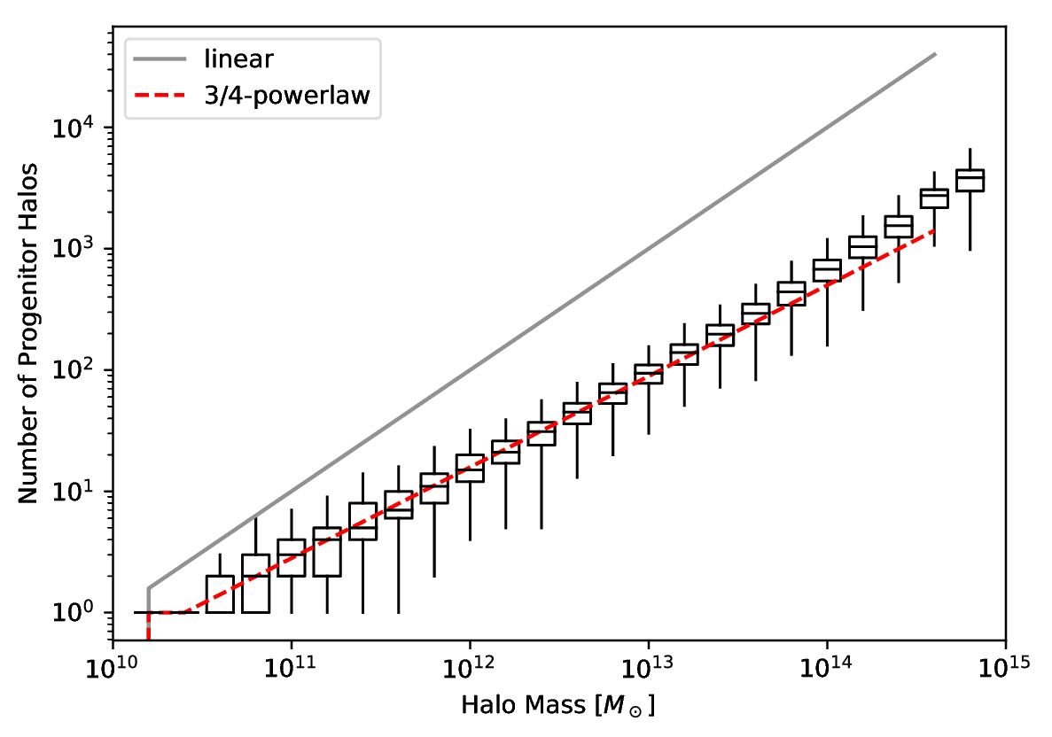
Building blocks
Count leaves of merger tree
z=0 halo building blocks
of size
SMDPL dark-matter simulation
Rockstar subhalos
Planck cosmology

Slide 24
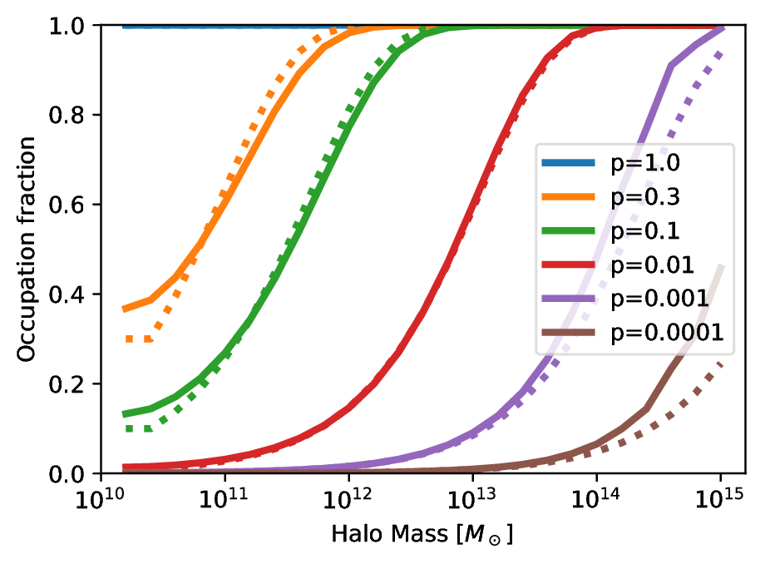
Occupation at z=0

Slide 25
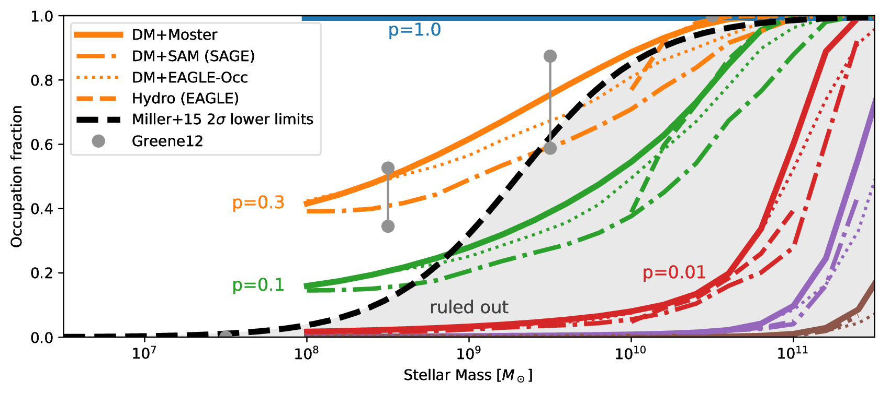
Required Seeding Efficiency
Buchner et al. (2019)

Slide 26
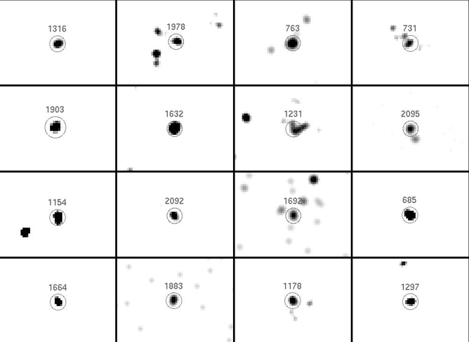
Occupation Observations
Gallo+10, Miller+15
AMUSE-Virgo

Slide 27
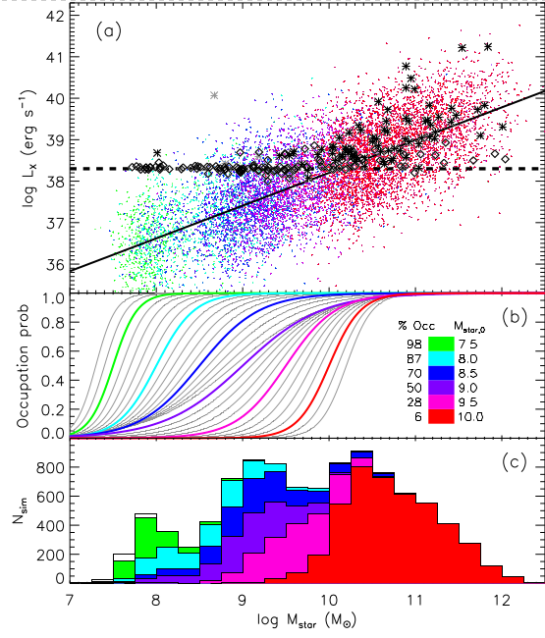
Occupation Observations
Gallo+10, Miller+15
AMUSE-Virgo

Slide 28
Required Seeding Efficiency
Buchner et al. (2019)

Slide 29
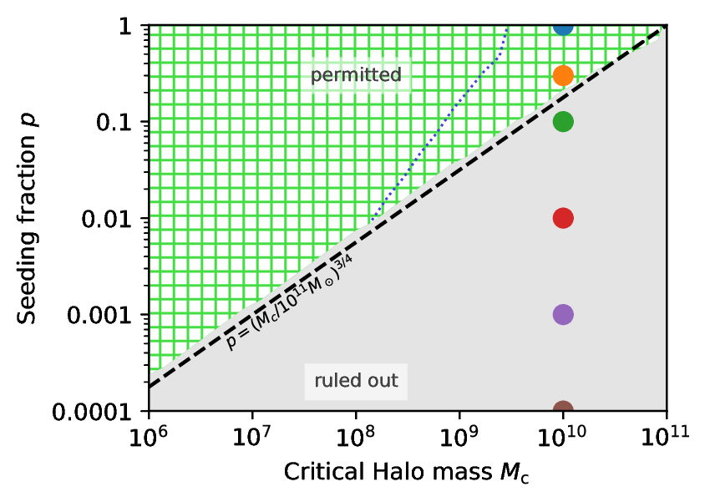
Required Seeding Efficiency
Buchner et al. (2019)

Slide 30
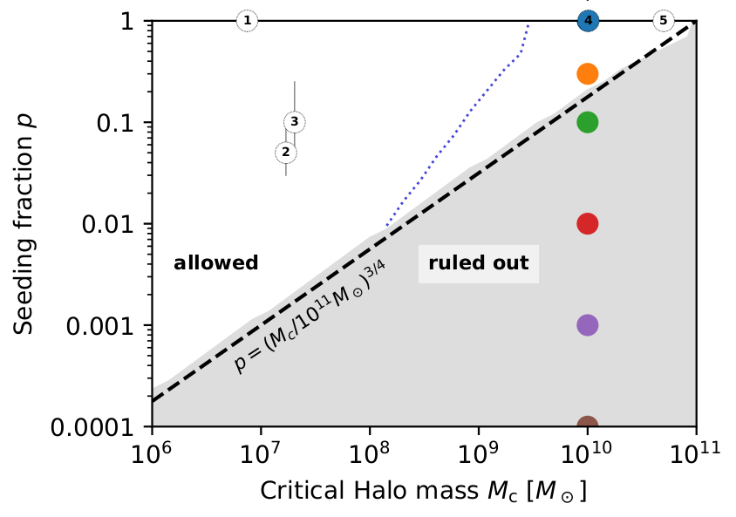
Required Seeding Efficiency
Buchner et al. (2019)

Slide 31
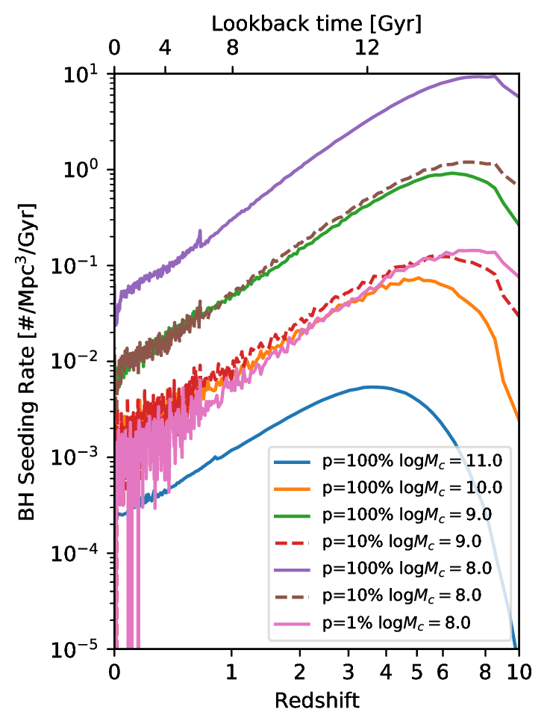
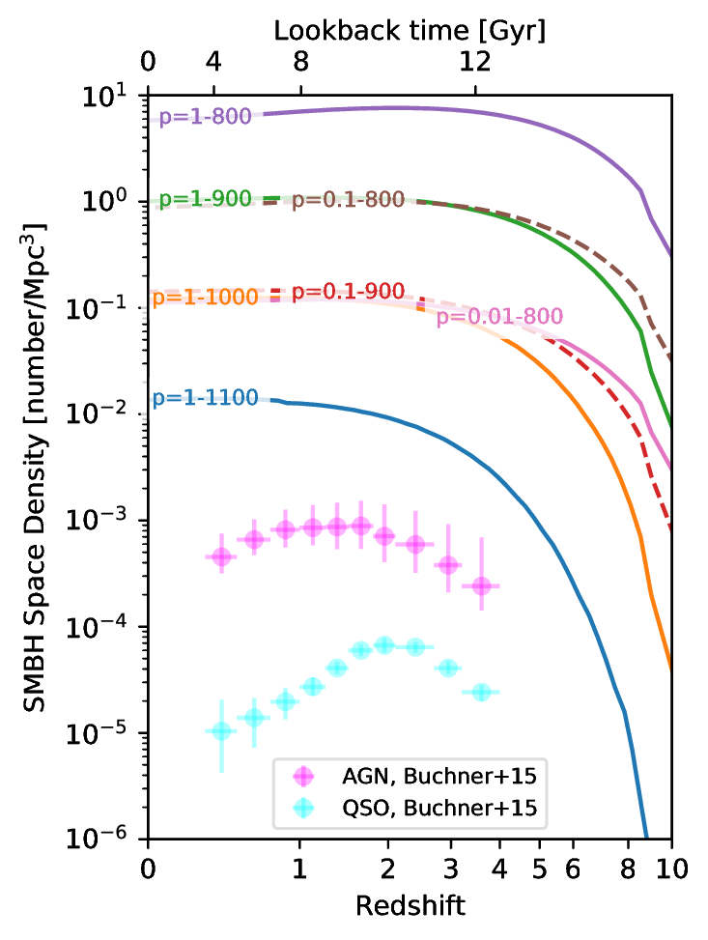
Population Evolution
BH births
Total number

Slide 32
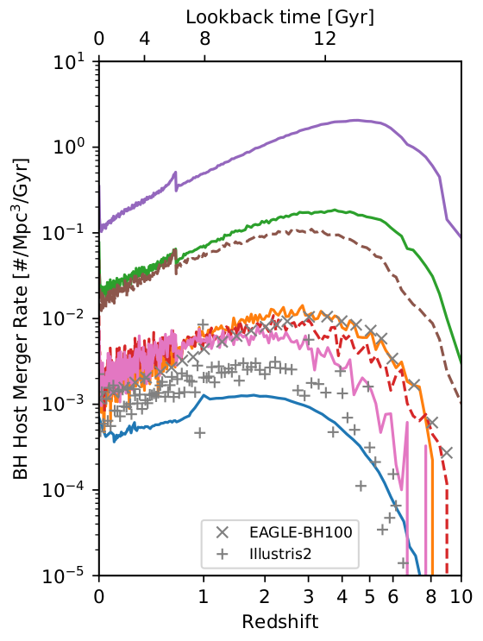
Population Evolution
BH births
BH host mergers

Slide 33
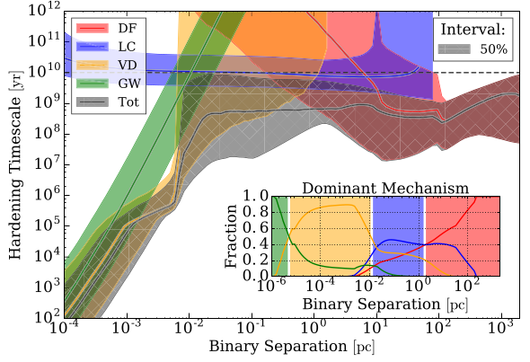
SMBH merger delays
Kelley+17
Dynamical friction, Light cone scattering, Viscous drag, Gravitational waves

Slide 34
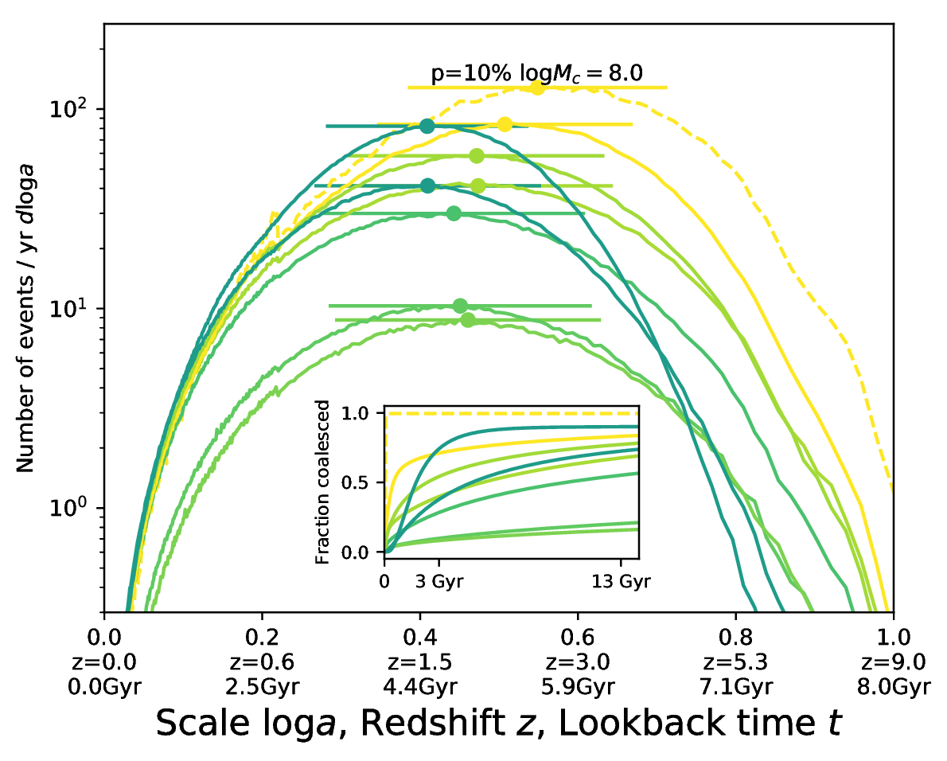
SMBH merger delays
Kelley+17

Slide 35
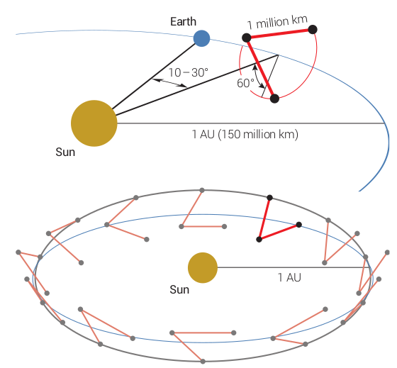
Gravitational Waves with LISA
Interferometry with 2 arms
10⁴⁻⁸ M_{o}
z=0-13
Distance -> z
Signal duration -> Doppler shift localisation

Slide 36
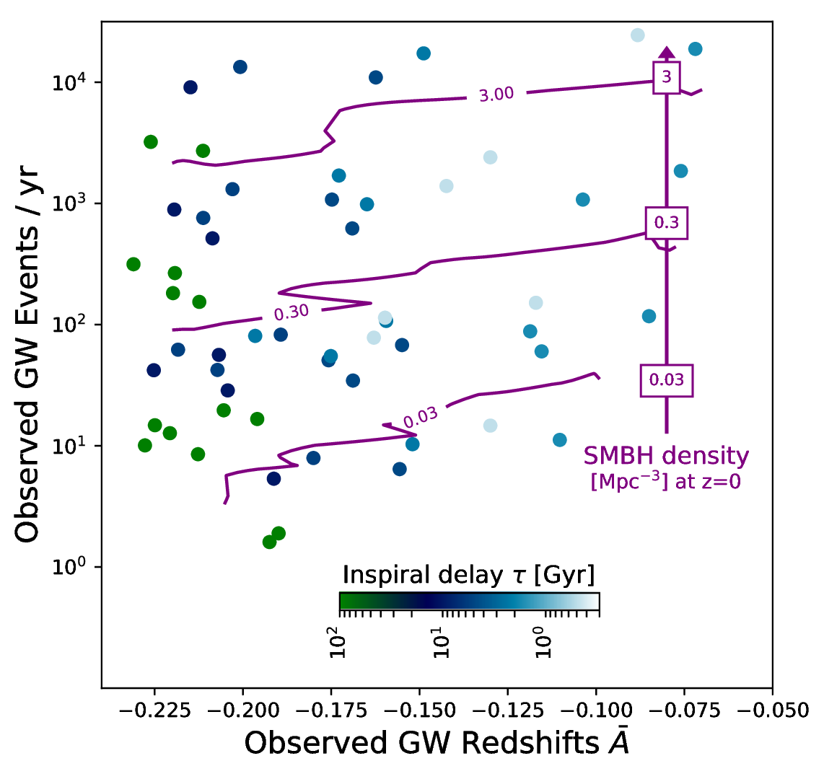
LISA Gravitational Wave Events
Buchner et al. (2019)
All SMBH mergers will be detected
(Salcido+16, EAGLE sim + waveshape modelling)
Combination of z mean and std

Slide 37
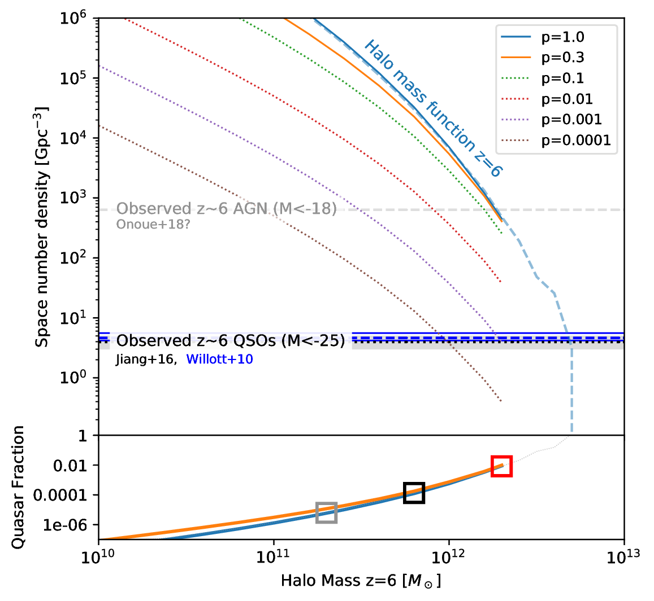
High-redshift quasars
z=6 QSO surveys (SDSS)
Earliest census of active SMBH population
There are more SMBHs
Live in massive halos?
Massive halos or duty cycle?
Buchner et al. (2019)

Slide 38
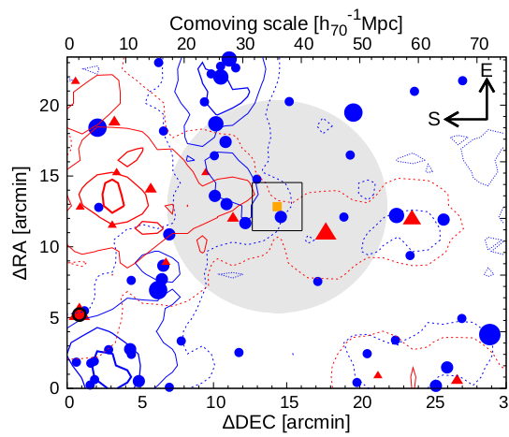
Overdensities near Quasars
LBG
Literature has conflicting reports:
Overdensities
Equal
Underdensities
… compared to control fields
What is happening?
LAE
QSO
Ota+18

Slide 39
Overdensity predictions
QSO Hosts definition:
  Halo mass cut, e.g.:
  only >10^{12.3}M_{O}
Look at neighbourhood
Galaxies definition:
  LBG: Hatfield+17
  LAE: Kovač+07, Sobacchi&Mesinger+15
  selection as in observations (redshift window, magnitude)
Simply count galaxies within radial shells around quasar

Slide 40
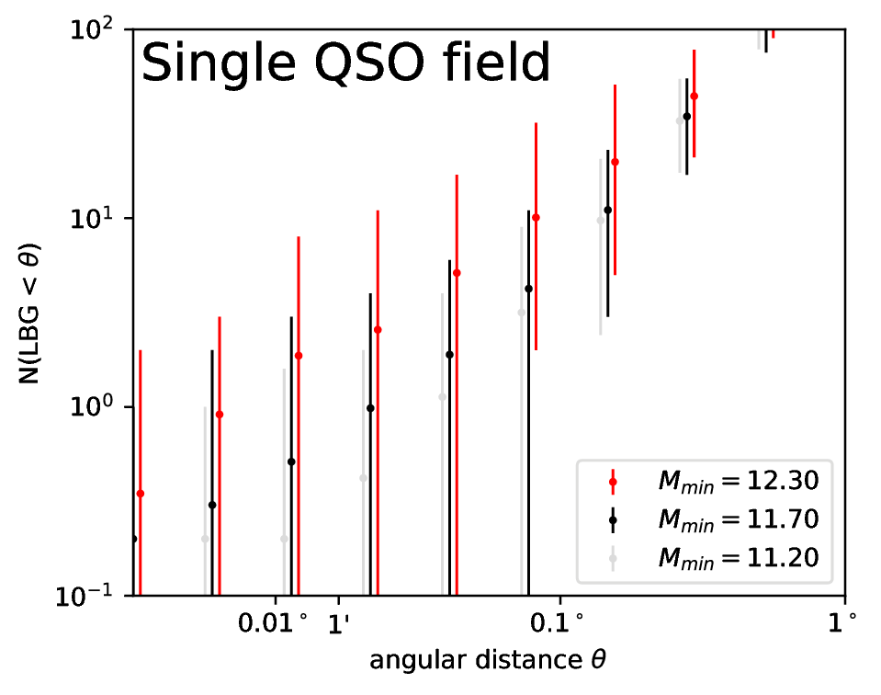
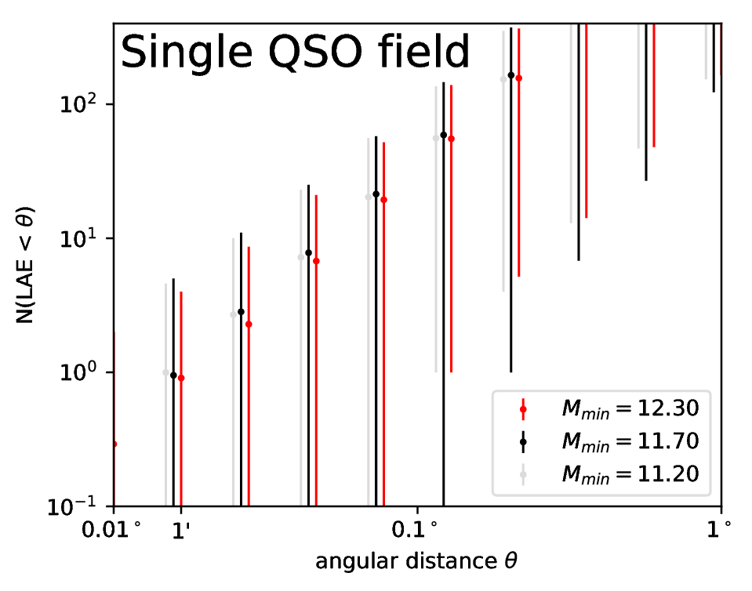
Understanding high-z quasars
LBG
LAE
Large diversity!
Large volume in z!
Large diversity!
Poisson noise!

Slide 41
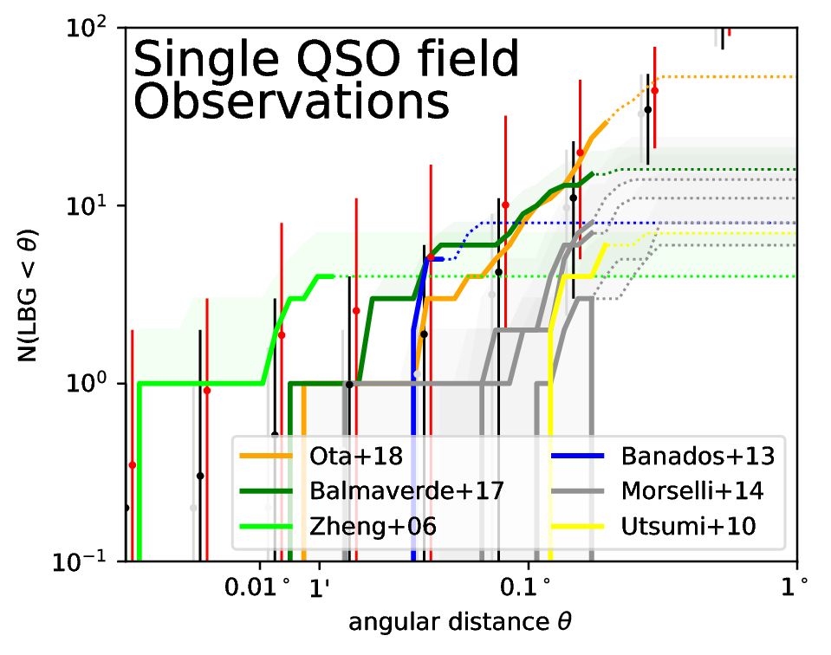
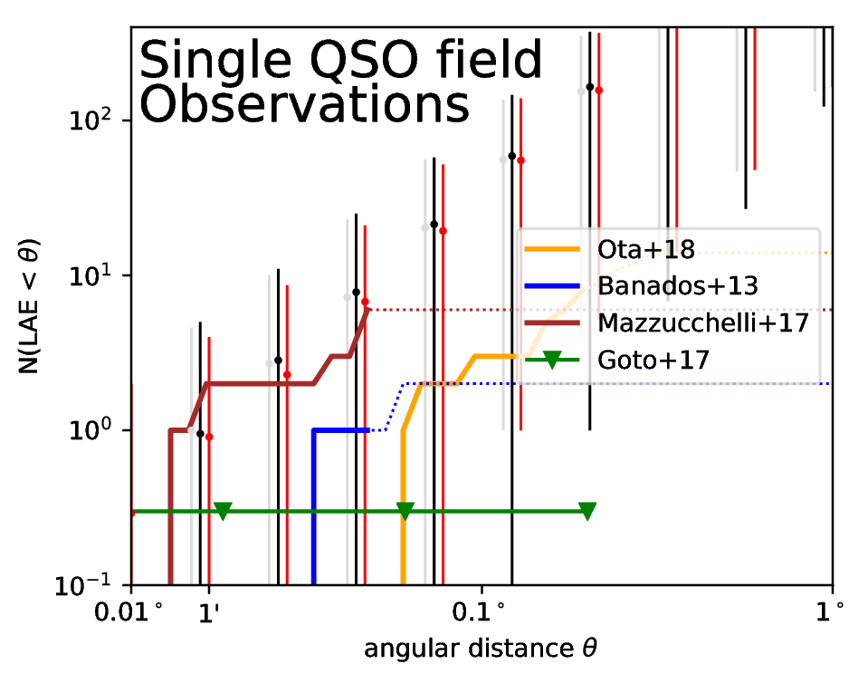
Understanding high-z quasars
LBG
LAE
Buchner et al. (in prep)

Slide 42
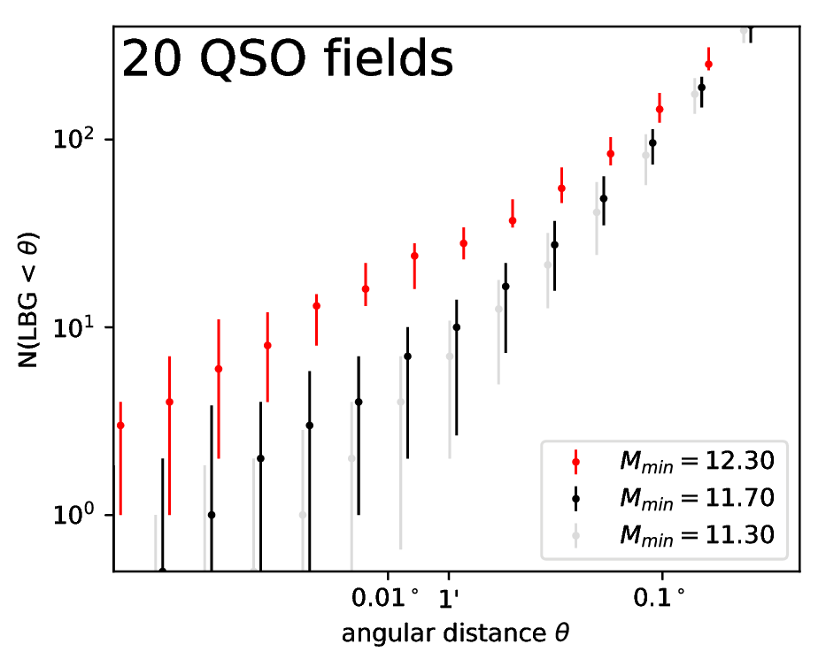
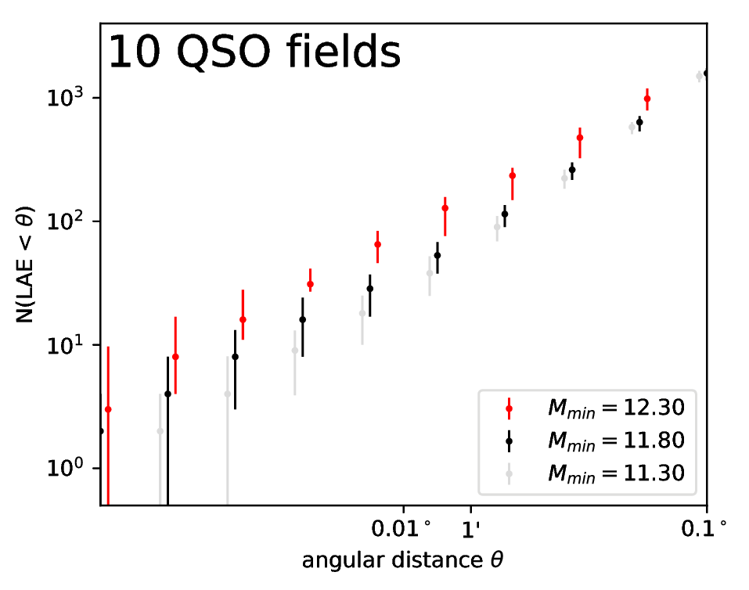
Understanding high-z quasars
LBG
LAE

Slide 43
Model-independent seeding
Seeding efficiency
LISA will directly
  Detect >1 merger/year
  Measure the SMBH space density
  Measure the merger delay time
High-z Quasar host environments are diverse
  Observe many(ten) fields
see Buchner et al. (2019) arxiv:1901.04500

Slide 44
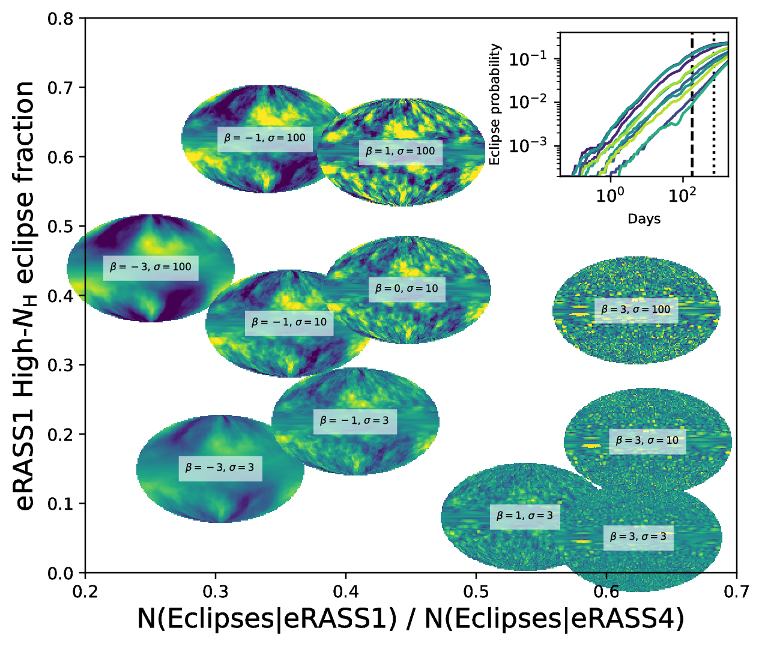

Slide 45
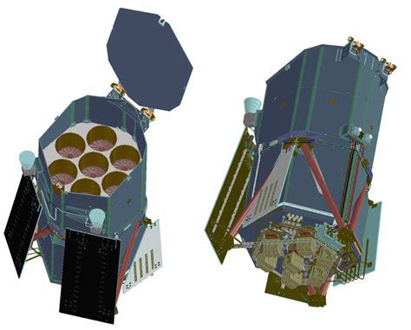
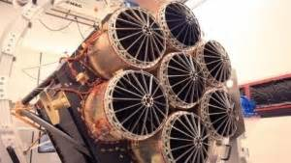
eROSITA
Deepest all-sky X-ray survey
  0.2-2keV primarily
  But also 2-10keV
Science:
  Primary: Cosmology with clusters
  3 Million AGN expected!
Survey strategy:
  L2
  Stripes with overlaps
  Entire sky every 6 months, 8 times
Data:
  Time-domain
  X-ray spectra
  New parameter space!
Merloni+12
Built by MPE
Launch: April 2019!
PSF: 15‘‘ on-axis
FOV: 0.8 deg²
soft flux: 1e-14 erg/s/cm²
hard flux: 1e-13 erg/s/cm²

Slide 46
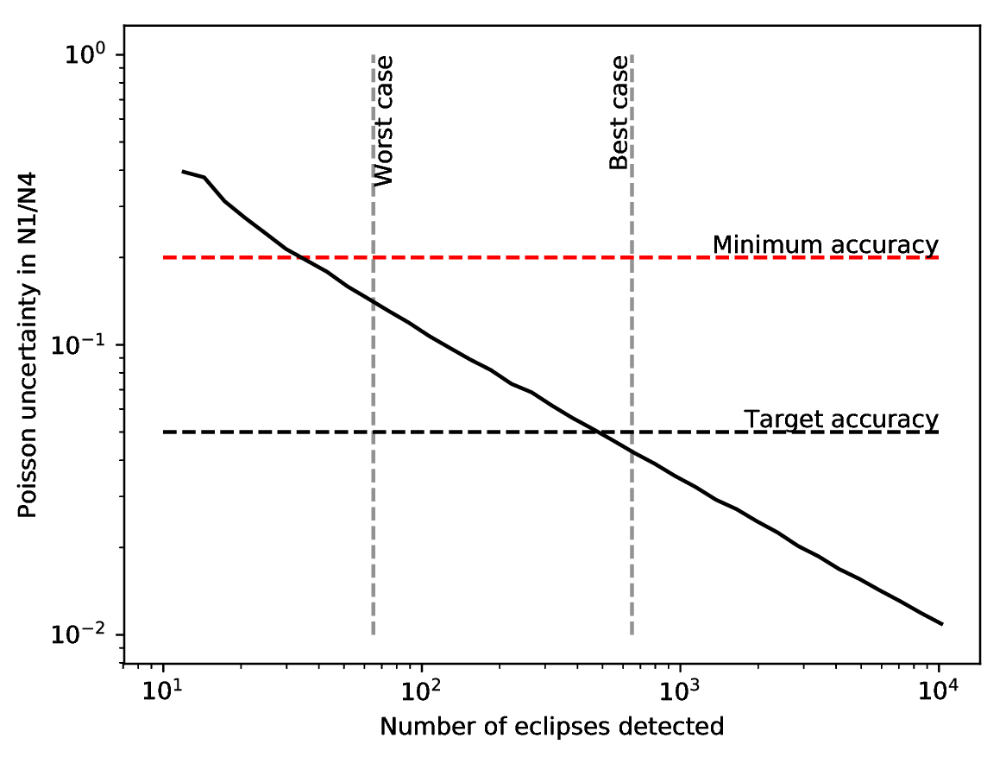
Eclipse events with eROSITA
Predictions:
340,000 extragalactic AGN in 6m catalogue
13,000 2-10keV detected
1-10% eclipses expected after 6 months, 50% sky
120-1200 eclipses

