Slide 1


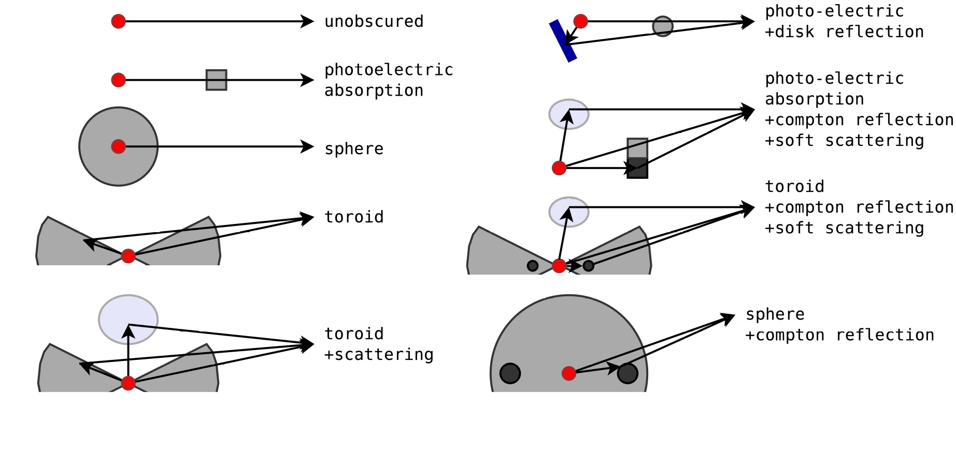
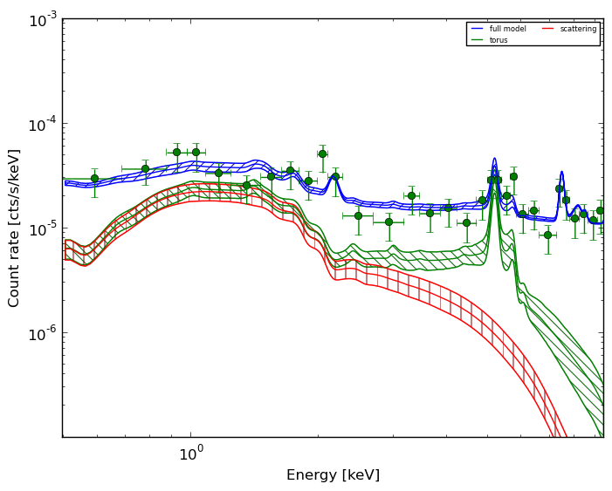
Bayesian spectral characterisation of
X-ray selected AGN in the CDF-S
Active Galactic Nuclei (AGN) show obscuration due to cold, neutral material in the line of sight. With a Bayesian analysis method, X-ray selected AGN in the Chandra Deep Field South (CDF-S) were analysed using a range of X-ray models. Using Bayesian model selection, we find that the obscurer has to have a large covering geometry with strong Compton reflection.
AGN are thought to intrinsically emit a Comptonized spectrum in X-rays which can be approximated by a powerlaw. The variety of observed spectra is attributed largely to viewing angles (unification scheme). Interaction processes such as photoelectric absorption, Fe fluorescence and Compton-scattering determine the spectral shape in dependence of the obscurer geometry and density.
Using a Bayesian approach, we analyse X-ray spectra of 413 X-ray detected AGN in the CDF-S. This method allows us to
(1) extract the most information from typically low signal-to-noise spectra of z~1 AGN, which represent the majority of black hole growth in the Universe.
(2) compare various non-nested models using Bayesian model selection (see Figure 1, left column) corresponding to different geometries.
The sphere or torus geometry
with a scattering component (see Figure 2) rule out all
other geometries with very strong evidence (Bayes factor > 30). We find:
Obscured AGN require a model based on multiple photon interactions.
The obscurer extends outside the line of sight with a large covering fraction.
Thomson scattering is important in ~10% of sources, making an unobscured opening physically necessary
Figure 1. Various geometries considered. The left first four cases represent zero, small, medium and large covering fractions respectively. Additional components, such as Thomson-scattering off ionized clouds (soft scattering) and reflection are considered (see text).
Ongoing research deals with the problem that the reflection hump and Fe-line is pronounced to various degrees. Introducing additional reflection (see Figure 1, right column) is very strongly preferred by model selection, however there are sources which show a weaker Fe-line than the torus model predicts, potentially indicative of a different geometry, ionization state or metallicity.
Figure 2. Most observed spectra, like the strongly obscured one shown here, can be described by a powerlaw source embedded in a torus of constant density (“torus”, green area) and a “scattering” powerlaw (red area). The model with background (blue) is in agreement with the observed counts (green points).
Johannes Buchner, Antonis Georgakakis, Andrea Merloni, Kirpal Nandra
Notes:
- Make clear what the new things are in your work, e.g. using Bayesian model selection instead of delta-chisq, delta-C, F-test etc. and that you're looking at spectra of objects typical of the majority of BH growth in the Universe (e.g. not local object, which have been studied in great detail before). I would somehow mention also that your aim is to get the maximum possible information out of rather low signal-to-noise ratio spectra in the low count limit.
- In the figure, the geometry illustrated for the torus is not the same as Murray's geometry, which is a pher with a cone cut out.
- Abstract: I don't think I agree with any of the first sentence! For example delete" molecular" and its not at all clear whether or not this material is associated with subsequent accretion.

