Slide 1
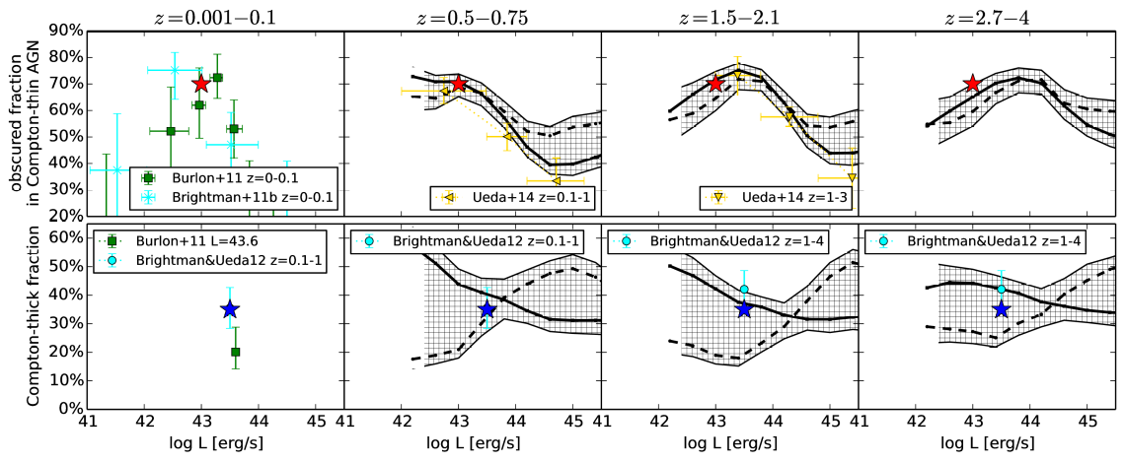
Robust and complete Demographics of Active Galactic Nuclei
Johannes Buchner (MPE)
Antonis Georgakakis, Kirpal Nandra, Murray Brightman, Marie-Luise Menzel, Zhu Liu, Li-Ting Hsu, Mara Salvato, Cyprian Rangel, James Aird, Andrea Merloni and Nicholas Ross
http://arxiv.org/abs/1501.02805
Fraction of Obscured
AGN: 77⁺⁴₋₅%
N_{H}>10²²cm⁻²
L_{X}>10⁴² erg/s
Averaged over cosmic time
Fraction of Compton-thick
AGN: 38⁺⁸₋₇%
Data: ~2000 2-10keV detected AGN: CDFS, AEGIS-XD, C-COSMOS, XMM-XXL (20deg²)
Full Bayesian spectral analysis Buchner+14
Non-parametric luminosity-function & N_{H} distribution Buchner+15

