Slide 1
Association
Method of Budavári+08:
  prob of chance alignment vs
  prob of same source
  based on distance
Combined with magnitudes/colors:
  prob for target sources vs
  prob for all sources
Similar to LR method, but better
3way/N-way code
  Arbitrary number of input catalogues

Slide 2
photo-z + association
X-ray / Optical / IR
Models (?)
Systematics in p(z)

Slide 3
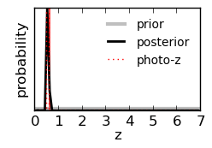
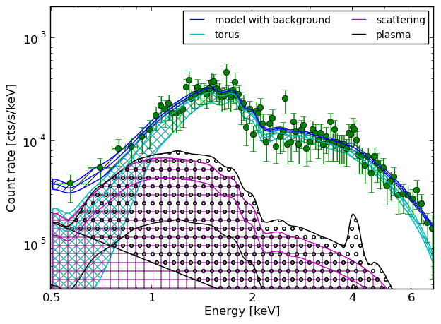

Slide 4
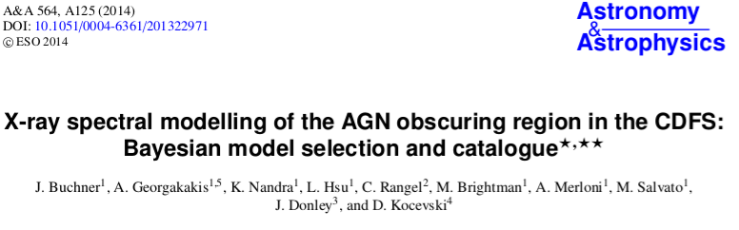
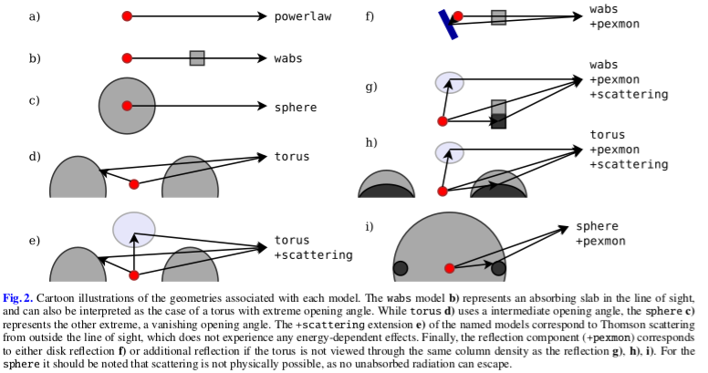
Model comparison
Generalized (and more efficient) model comparison
Automated parameter estimation
Buchner et al. 2014
arxiv:1402.0004

Slide 5
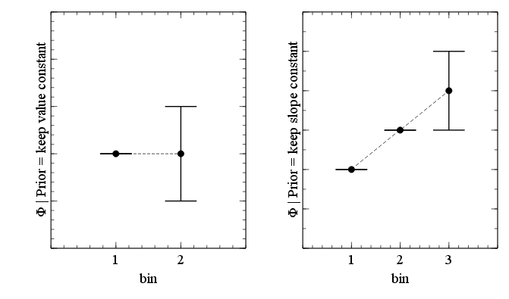
Discover changes
Assume parameter is the same
Let the data convince you otherwise
Applications:
  Change in obscuration
  Variability?
  Here: LF

Slide 6
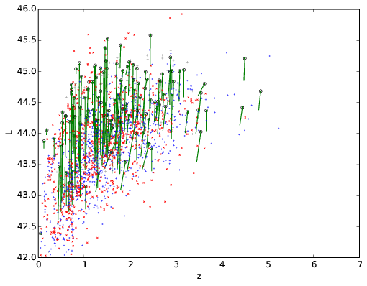
2-10keV LF of AGN (incl obscured)
CDFS
  326 detected
  293 (276) AGN
EGS
  547 detected
  541 (536) AGN
COSMOS
  1016 detected
  996 (973) AGN
XMM-XXL
  206 (142) detected, AGN

Slide 7
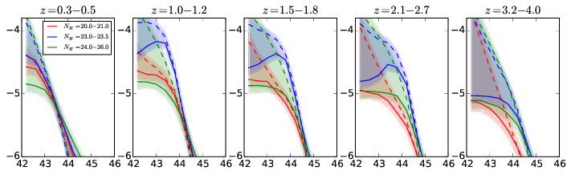
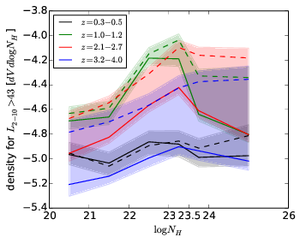

Slide 8
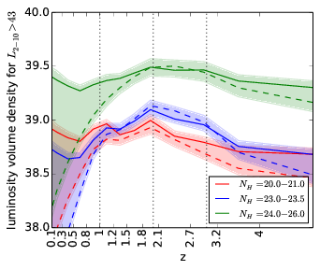

Slide 9
