Slide 1




Implications of
X-ray population studies:
Torus geometry and SMBH accretion history
Johannes Buchner
MPE, PUC
MPE IR group, 2015
with A. Georgakakis, K. Nandra, M. Brightman, ML. Menzel, Z. Liu,
LT. Hsu, M. Salvato, C. Rangel, J. Aird, A. Merloni

Slide 2
Motivation
Hidden Accretion over Cosmic Time
  Local BH mass density
Accretion Luminosity – Obscuring Gas
  Feedback, Feeding or Unrelated
Frequency of the AGN phenomenon
  Duty Cycle
Method
  Estimate comoving number density (LF)

Slide 3
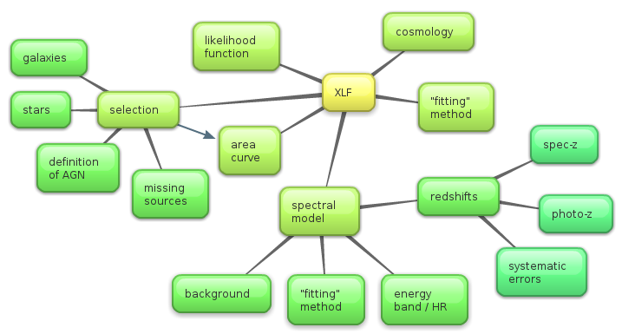
Population Studies

Slide 4
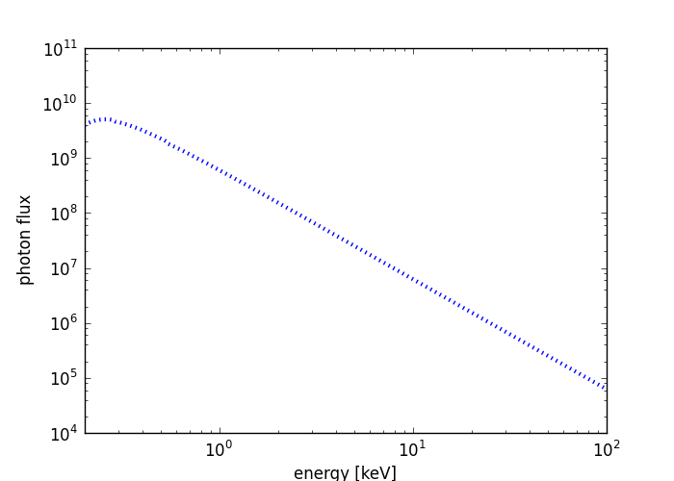
Detection: X-ray 2-10 keV
Compton-thick obscuration absorbs most
0.5-8keV photons
Independent of
host galaxies
Efficient
Redshift
  6-30 keV @ z=2
High sensitivity & angular resolution of Chandra/XMM
Brightman&Nandra11
Notes:
Why choose X-rays / Chandra

Slide 5
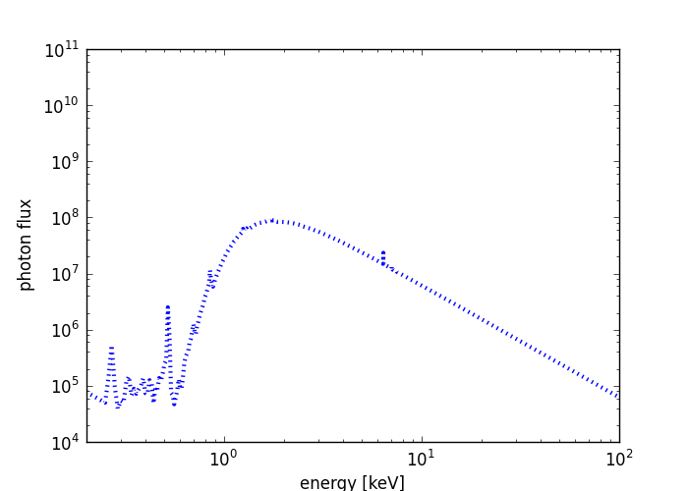
Detection: X-ray 2-10 keV
Compton-thick obscuration absorbs most
0.5-8keV photons
Independent of
host galaxies
Efficient
Redshift
  6-30 keV @ z=2
High sensitivity & angular resolution of Chandra/XMM
Brightman&Nandra11
Notes:
Why choose X-rays / Chandra

Slide 6
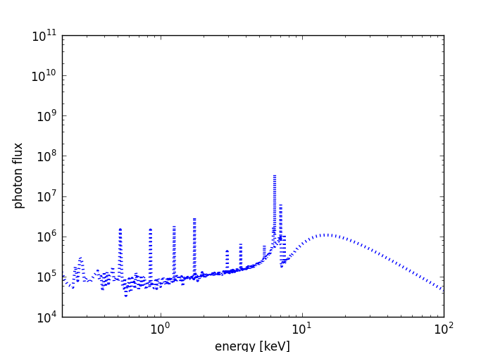
Detection: X-ray 2-10 keV
Compton-thick obscuration absorbs most
0.5-8keV photons
Independent of
host galaxies
Efficient
Redshift
  6-30 keV @ z=2
High sensitivity & angular resolution of Chandra/XMM
Brightman&Nandra11
Notes:
Why choose X-rays / Chandra

Slide 7


Data
2-10 keV detection
Wedding-cake
~2000 objects
>100 CT (Brightman+14)

Slide 8

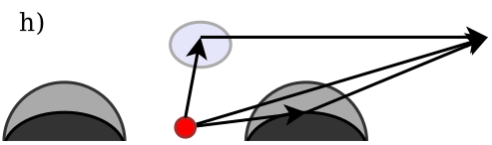
Spectral Analysis
For each source obtain
  Intrinsic luminosities (L, 2-10keV, erg/s)
  Column densities (N_{H}, cm⁻²)
    Obscured (N_{H}>10²² cm⁻²)
    Compton-thick (N_{H}>10²⁴ cm⁻²)
Appropriate modeling (Buchner+14)
  Intrinsic powerlaw
  Torus (Brightman&Nandra11)
  + Compton reflection (pexmon)
  + Soft powerlaw
  Like local AGN (e.g. Bauer+14)
redshift
Buchner+15: probable CT in green
Brightman+14
(catalogues online: mpe/XraySurveys)
obs

Slide 9
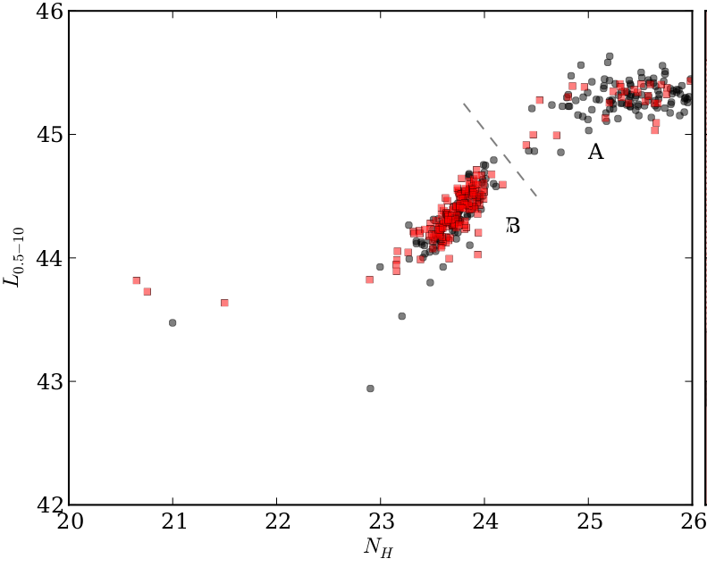
Consistent Bayesian Analysis
Advanced matching to opt/IR (Hsu+14, M. Brusa)
Deep multi-wavelength coverage
  High redshift completeness
  Precise & accurate photo-z (M. Salvato, Hsu+14)
Include sources without counterparts consistently
Uncertainty in photometric redshift, multiple solutions
Systematic errors of photometric redshift
Full spectral analysis of unbinned spectrum
  Uncertainty clouds in L, z, NH
Propagated into luminosity function analysis
  Recover a smooth field ϕ(L, z, NH) / d...
  Non-parametric, model-independent
Luminosity
Column density NH
Buchner+14
Robust Results – Realistic Uncertainties

Slide 10


Compton-thick Luminosity Function
Reconstruction of a smooth field
  Results insensitive to chosen
  smoothing length
    0.5 mag between bins
  Consistent Cthin total LF with
  Ueda+14, Aird+10
Buchner+15

Slide 11
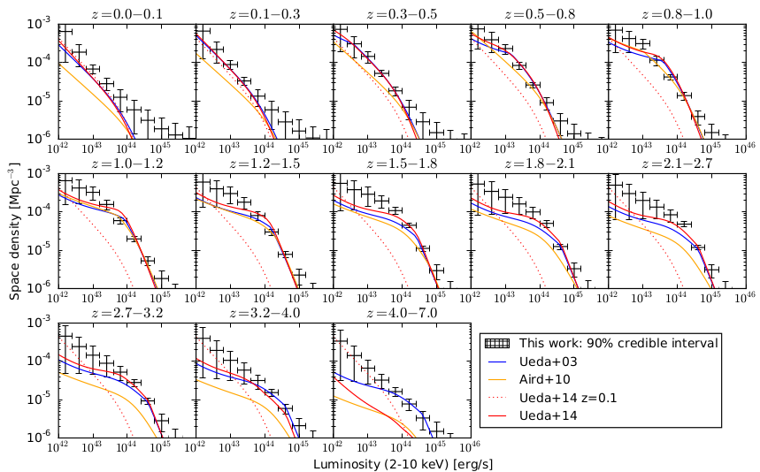
Compton-thin Luminosity functions

Slide 12
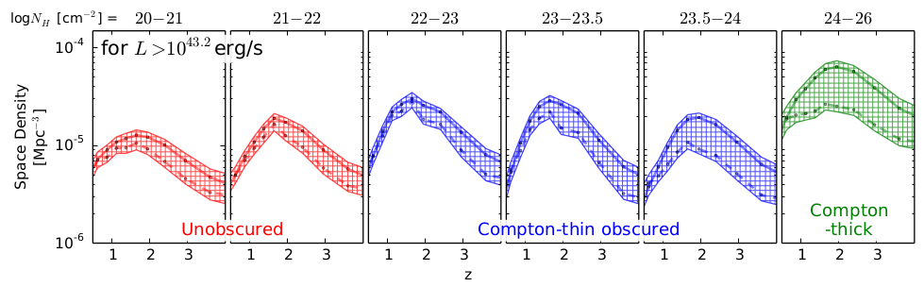
Compton-thick Luminosity Function
redshift
Reconstruction of a smooth field
  Results insensitive to chosen
  smoothing length
    0.5 mag between bins
  Consistent Cthin total LF with
  Ueda+14, Aird+10
Buchner+15

Slide 13

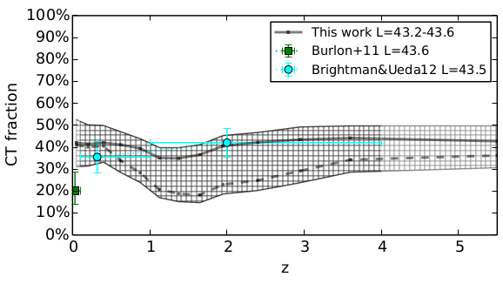
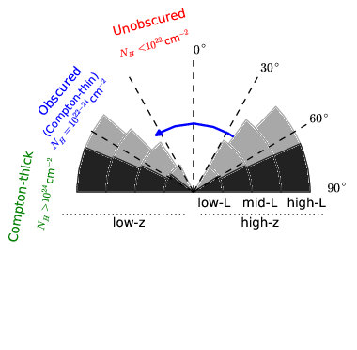
Obscuration – Luminosity – Redshift
Buchner+15

Slide 14


Slide 15
Pretty video for patient listeners
Wada12, Wada15

Slide 16
Obscured fractions
38 ⁺⁸₋₇%
Compton-thick fraction:
Obscured fraction:
Complex luminosity-obscuration-redshift dependence
  Implications for torus models – side-effect of Mass downsizing?
  (see talk of A. Schulze; M. Hirschmann; simulations of N. Fanidakis)
77 ⁺⁴₋₅%

Slide 17

Black Hole Mass Accretion
ε=10%
Bol. Corr.:
Marconi+04
not Hopkins+07!
in prep., see also Merloni15

Slide 18
Conclusions
38 ⁺⁸₋₇%
Compton-thick fraction:
Obscured fraction:
Luminosity function is a bending powerlaw at all z, NH
Complex luminosity-obscuration-redshift dependence
  Implications for torus models – side-effect of Mass downsizing?
  (Schulze+15; Hirschmann+14; Fanidakis+12)
Found Compton-thick population appears sufficient
  For local SMBH density
  For CXRB (Ueda+14) … IRB …
77 ⁺⁴₋₅%

Slide 19
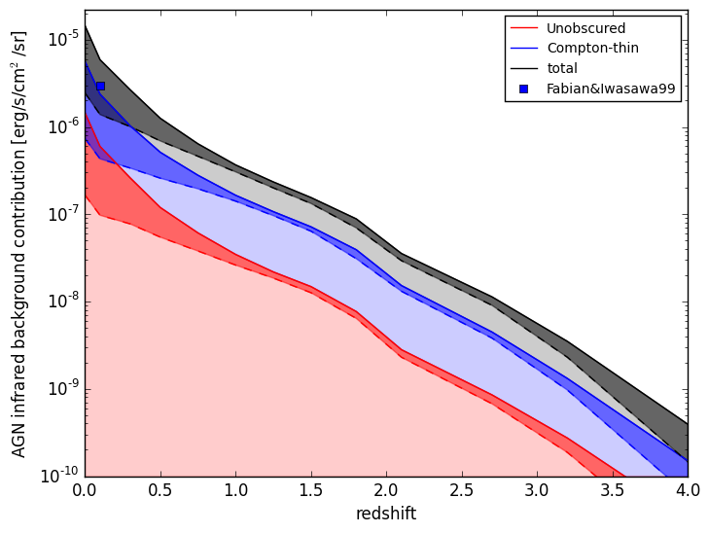
Absorbed luminosity

Slide 20
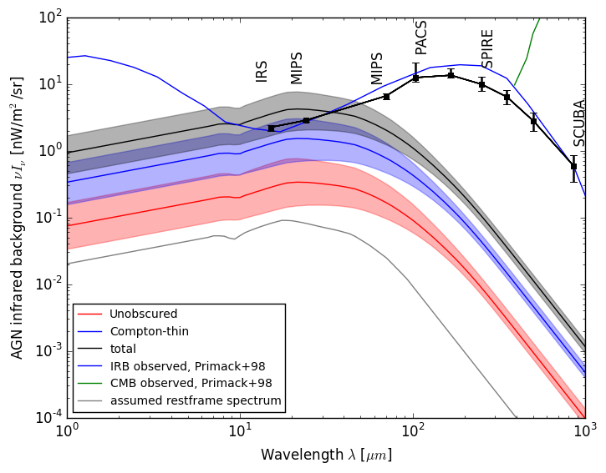
Re-emitted in IRB
Mullaney+12
average IR AGN
spectrum L~44

Slide 21
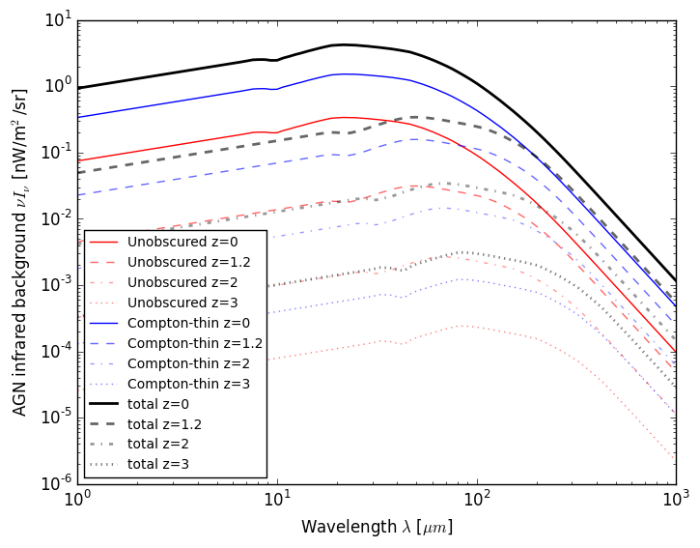
Re-emitted in IRB
Mullaney+12
average IR AGN
spectrum L~44

Slide 22
Backup slides

