Slide 1
A population study of obscuration in Active Galactic Nuclei
Buchner Johannes
2015
in press, ApJ – astro-ph today
Antonis Georgakakis, Kirpal Nandra, Murray Brightman,
Marie-Luise Menzel, Zhu Liu, Li-Ting Hsu, Mara Salvato,
Cyprian Rangel, James Aird, Andrea Merloni and Nicholas Ross

Slide 2
Motivation
Science question
Fraction of CT AGN? XRB?
Obscured Growth times?
Fraction of CT AGN?
Fraction of Obscured AGN?

Slide 3
Data
 | size | 2-10keV detections | Have counter-part | Have spec. redshift
CDFS | 464'² | 326 | 97% | 57%
AEGIS-XD | 1010'² | 574 | 97% | 40%
C-COSMOS | 0.9°² | 1016 | 100% | 48%
XMM-XXL | 20°² | 206 | 100% | 84%
total |  | 2122 | 98% | 51%

Slide 4
Data
 | size | 2-10keV detections | Have counter-part | Have spec. redshift
CDFS | 464'² | 326 | 97% | 57%
AEGIS-XD | 1010'² | 574 | 97% | 40%
C-COSMOS | 0.9°² | 1016 | 100% | 48%
XMM-XXL | 20°² | 206 | 100% | 84%
total |  | 2122 | 98% | 51%
Detection, Spectral extraction:
Cyprian Rangel, Murray Brightman, Zhu Liu
Association & redshifts:
Li-Ting Hsu, Mara Salvato,
Marie-Luise Menzel, James Aird
CDFS Hsu+2014
AEGIS-XD Nandra+(accepted)
COSMOS Salvato+11, Civano+12
XMM-XXL Menzel+(in prep.)

Slide 5
Differences to previous works
(Deeper data)
Incorporate objects without secure counter-parts
Incorporate uncertainty from photometric redshift, including (some of the) systematic
Detailed spectral analysis (BXA) with physical obscurer model to get L, NH
  Torus (Brightman&Nandra 2011)
  soft scattering component (powerlaw)
  Additional reflection (pexmon, Nandra+07)

Slide 6
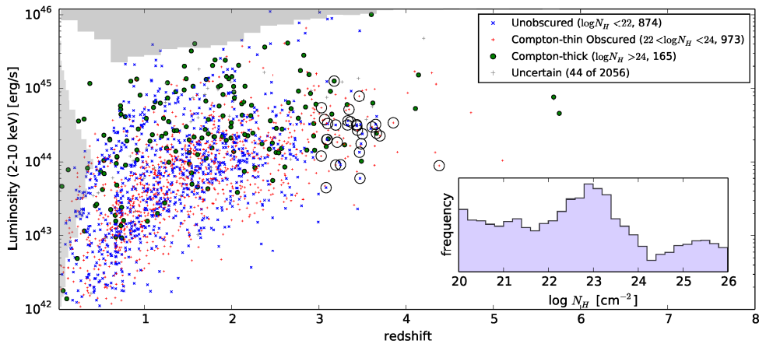
Data

Slide 7
Methodology
Reconstruct space density
  At each Lx, z, NH
  “fit 3-dimensional histogram”
z
L

Slide 8
With a twist
Neighbors should have similar value
  Smoothness prior
  similar value
z
L

Slide 9
With a twist
Neighbors should have similar value
  Smoothness prior
  similar value or similar slope
z
z
L
L

Slide 10
With a twist
Neighbors should have similar value
  Smoothness prior
  similar value or similar slope
z
z
L
L

Slide 11
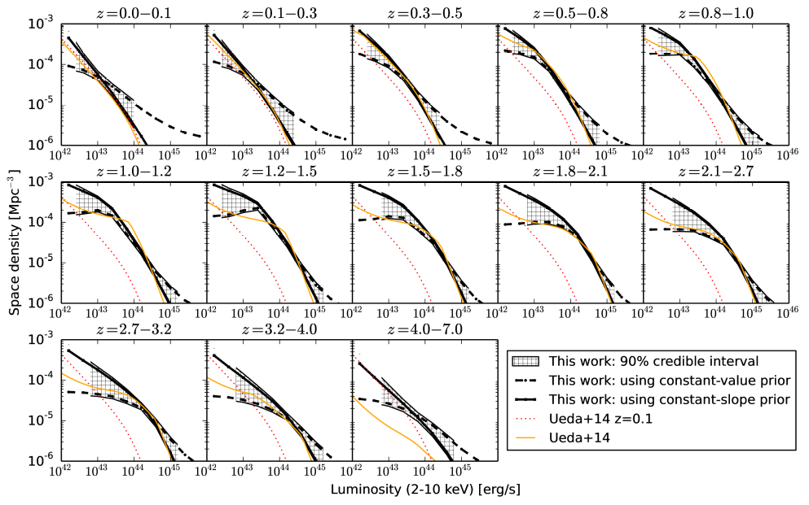
Recovering a smooth field
Space density [Mpc⁻³/dlogL]
Luminosity
(2-10keV ) [erg/s]

Slide 12
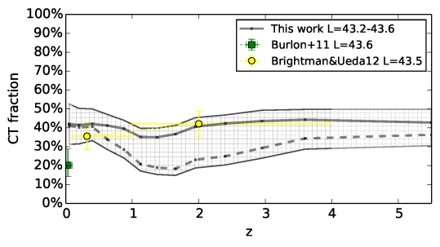
Compton-thick fraction

Slide 13
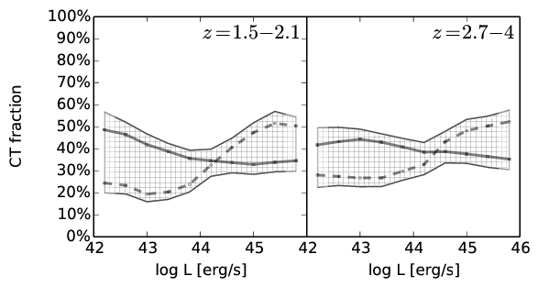
Compton-thick fraction

Slide 14
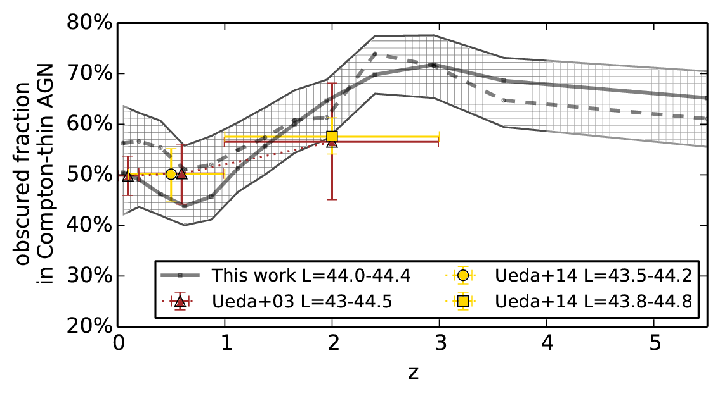
Obscured fraction evolution

Slide 15
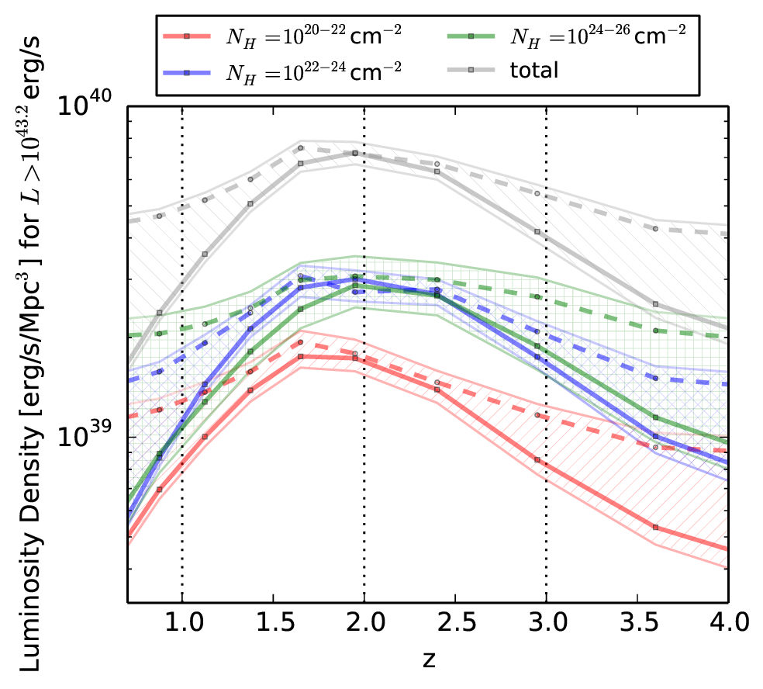
Obscured fraction evolution

Slide 16
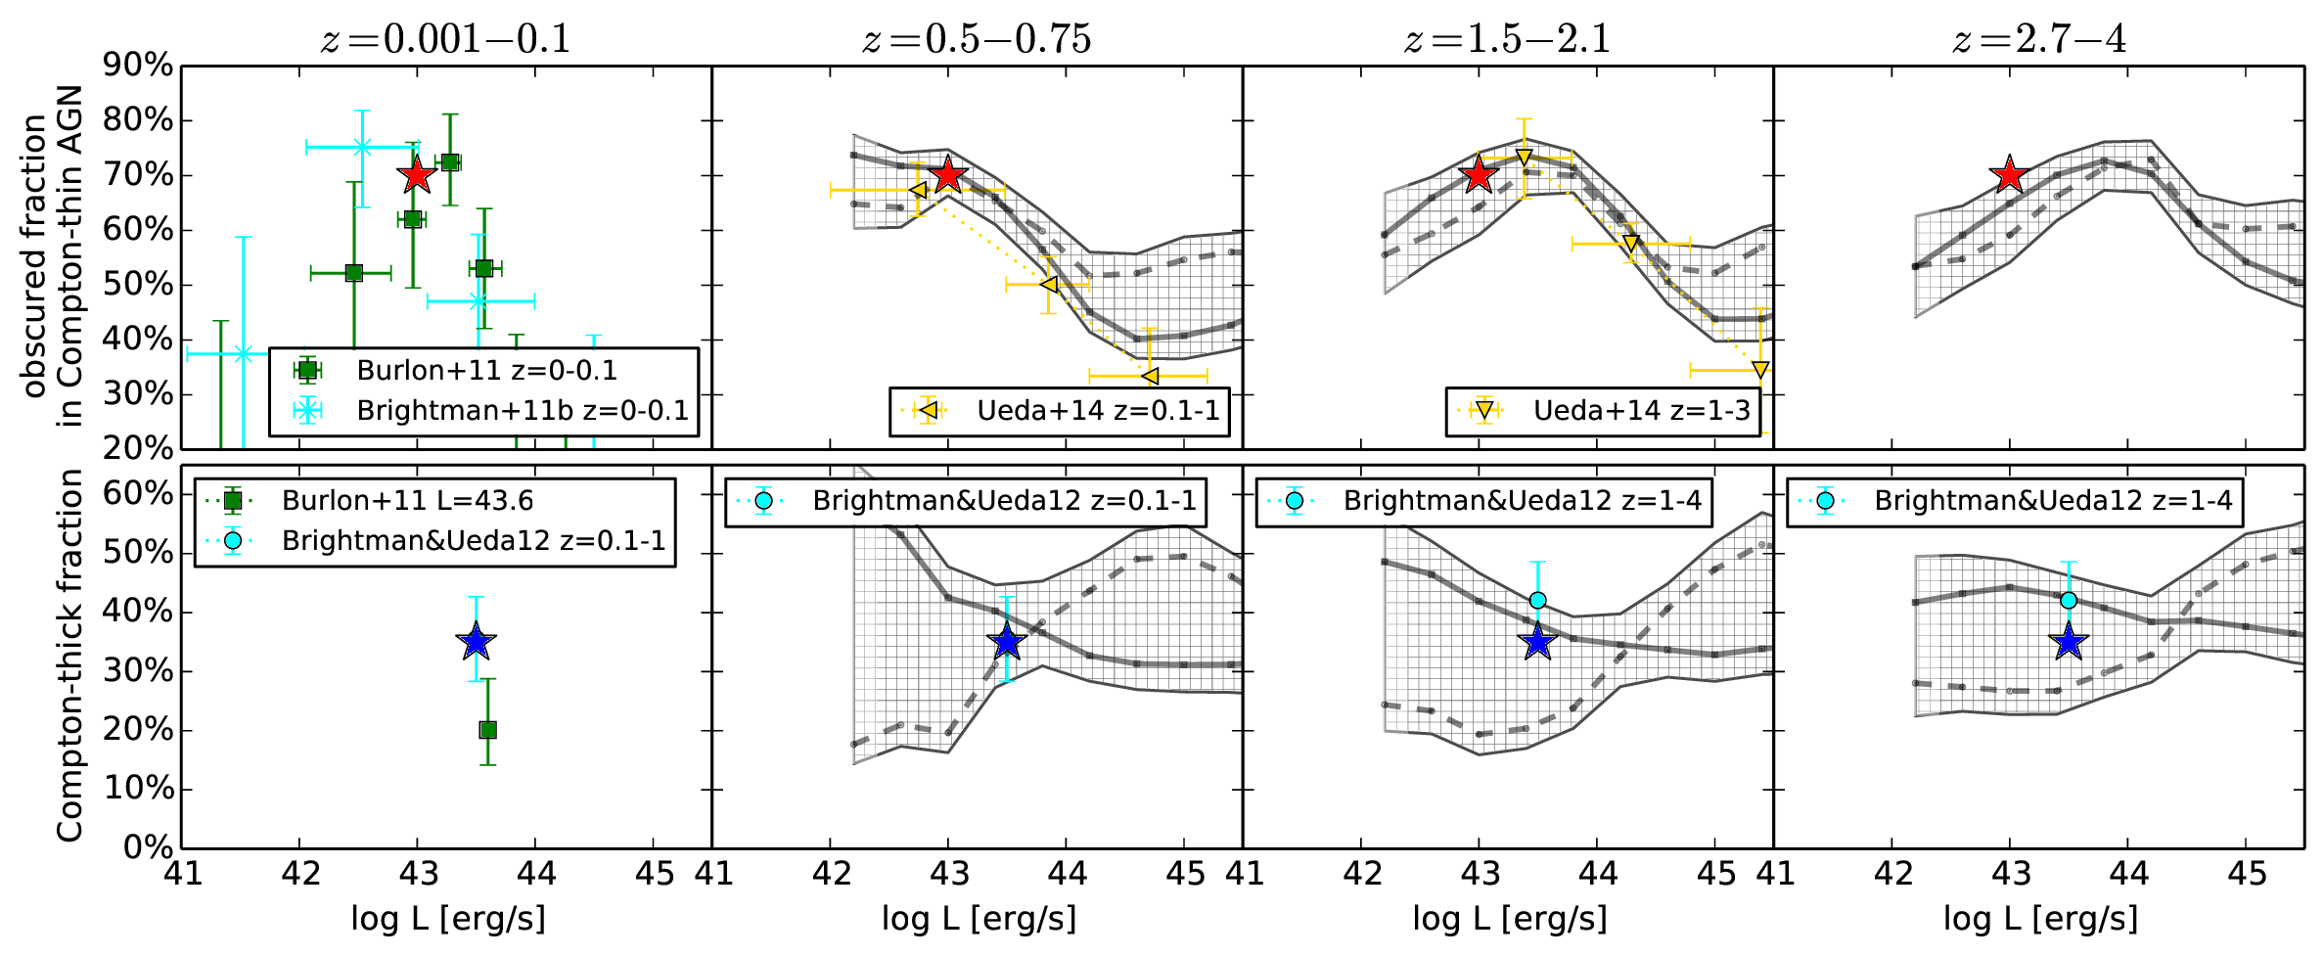
Obscured fraction – Luminosity

Slide 17
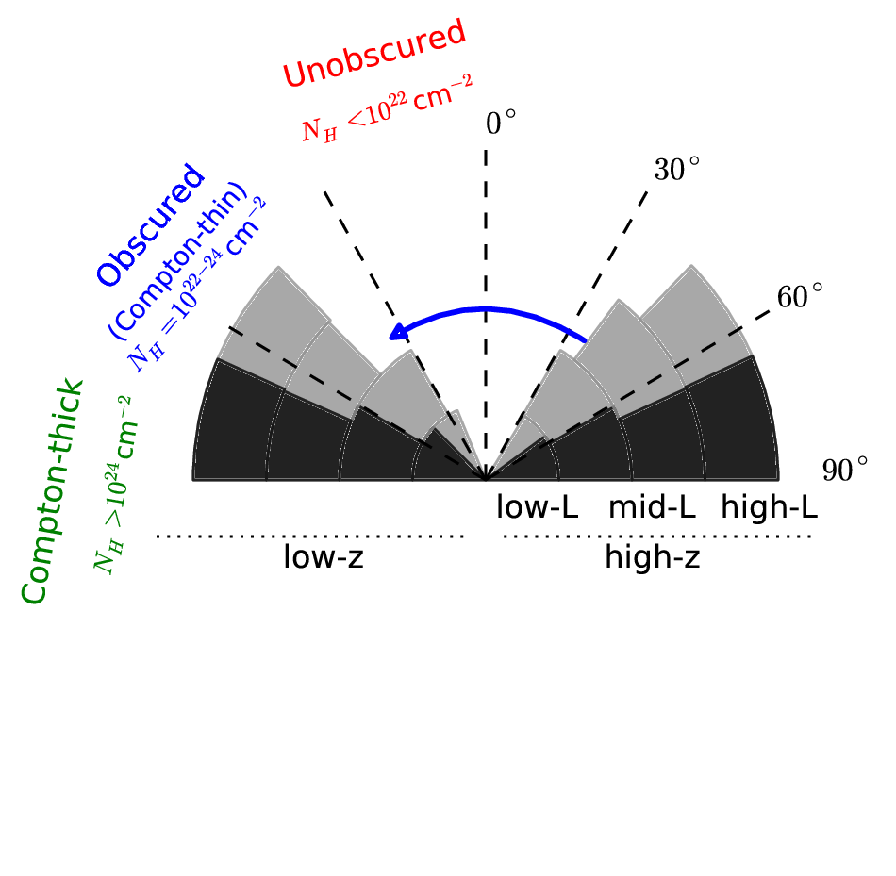
Interpretation

Slide 18
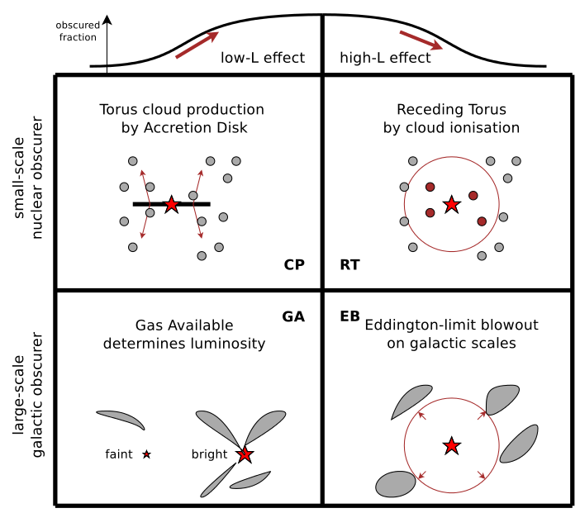
Interpretation

Slide 19
Summary
Fraction of obscured AGN: 75%­±8%
Fraction of CT AGN: 37%±7%
Fundamental physics(?)
  Torus creation process may be luminosity-dependent
    cloud production, (Elitzur & Shlosman 2006)
  Scale (BHM) of the system evolves, anti-hierarchical growth
  Changes critical luminosity where torus “reacts”
Luminosity-dependence evolution
  Take-away: Select obscured AGN – intrinsically fainter
  Select at different redshifts – different systems

Slide 20
Future work
Alternatives to LDDE (Ueda+14) LF
  Parameterisation of obscuration & its evolution
  Tighter constraints by more knowledge (broken powerlaws)
Sołtan argument integration
  Does the luminosity output match the local black hole mass density?
XRB predictions
  Including additional reflection
Integrate the local BHMF backwards
  BHMF at higher redshifts
  Eddington rate distribution at higher redshifts

