Slide 1
Separating the nuclear and galaxy-scale obscuration in AGN
Keywords: AGN, GRB, Gas in galaxies
Johannes Buchner
PUC
Collaborators: @PUC: Steve Schulze, Franz Bauer

Slide 2
Johannes Buchner

Slide 3

GRBs x-ray host galaxies
Unbiased sample (SHOALS)
92% redshift complete
Spitzer masses
NH~M^{1/3}
redshift-indep.
“Galaxy gas as obscurer: I. “
Buchner, Schulze & Bauer (submitted)

Slide 4
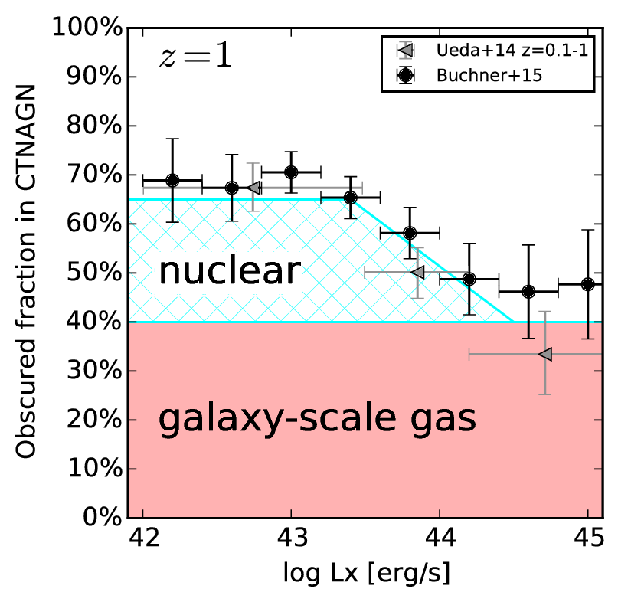
Host obscuration of AGN
Re-weight by AGN mass distribution
Host obscured fraction:
  ~40% Compton-thin
  0% Compton-thick
New Torus model
  fcov(LX, z, MBH)
“Galaxy gas as obscurer: II. Separating the galaxy-scale and nuclear obscurers of Active Galactic Nuclei“
Buchner, Schulze & Bauer (submitted)

