Slide 1




Johannes Buchner
MPE, PUC
with A. Georgakakis, K. Nandra, M. Brightman, ML. Menzel, Z. Liu,
LT. Hsu, M. Salvato, C. Rangel, J. Aird, A. Merloni

Slide 2
Methodological improvements
Boyle+93: First with Poisson Likelihood
Ueda+03: First for intrinsic LF
La Franca+05: First with CT
Brusa+07: Improved association of optical counterparts
Salvato+09: Drastic photo-z improvements for AGN
Aird+10: First including AGN w/o counterparts consistently, modern statistical methods
Ueda+14: Data update with Ueda+03 methods
Buchner+15: New non-parametric, model-independent approach ==> robust
  consistent probabilistic treatment of all uncertainties
  includes photo-z uncertainties, including systematic uncertainties
  improved associations from Salvato+ in prep.
  focus on evolution of obscuration (+CT) at z=0.5-3
Aird+15: Semi-parametric polynomial LF evolutions
Fotopoulou+16: Shape confirmed using ultra-hard XLF (30keV at z=2)

Slide 3
Commonly found results: LF
1. Shape is approximately a bending powerlaw
  Evolves in both density and luminosity
  No agreement that shape evolves
2. Downsizing
  Density maximum of bright AGN at high-z
  Density maximum of faint AGN at lower redshifts

Slide 4
Commonly found results: Obscuration
3. Obscured AGN are the vast majority
  78±5% averaged over cosmic time (Buchner+15)
  Obscured fraction decreases with L
                in LDDE formulations:
4. Obscuration evolves somehow with redshift
  The fraction of obscured AGN increases
  Buchner+15: Because luminosity-dependent shape of (3) is at higher L at high-z
5. Compton-thick fraction is 10-50%
  38±8% average over cosmic time (Buchner+15)
  Agreement with local SMBH density and CXRB can be found (Ueda+14)

Slide 5
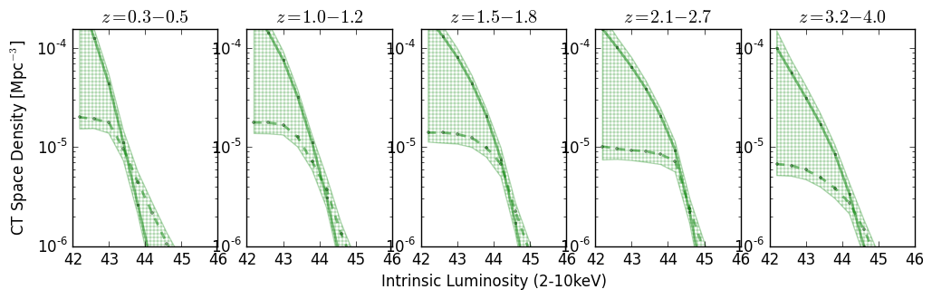
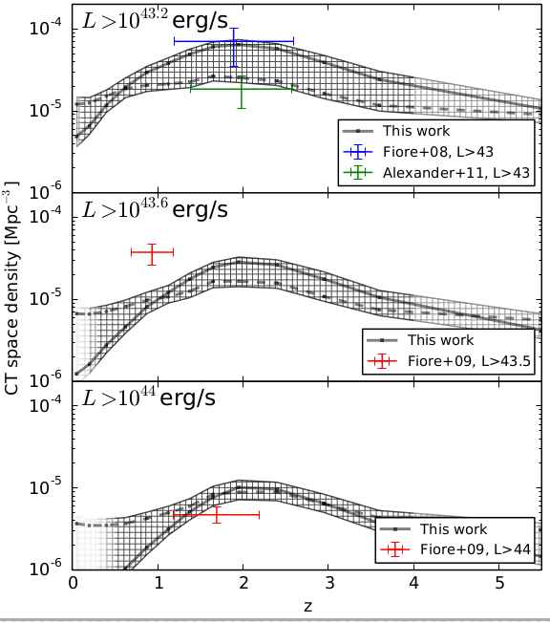
Compton-thick Luminosity Function
Reconstruction of a smooth density field
  Results insensitive to chosen
  smoothing length
    0.5 mag between bins
  Consistent with IR studies
  Consistent with Cthin LF of
  Ueda+14, Aird+10
Buchner+15

Slide 6
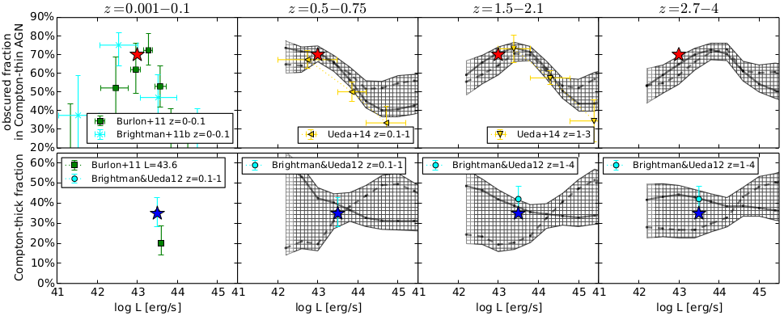

Obscuration – Luminosity – Redshift
L-obscured fraction evolves:
  Characteristic L changes
  Not simply obscuration increases with z
Buchner+15

Slide 7
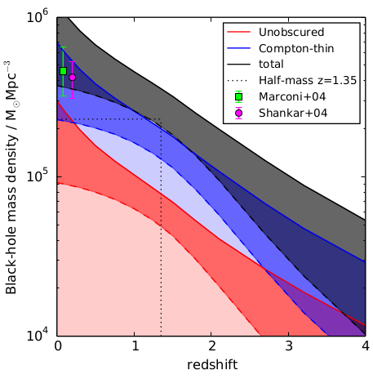
Black Hole Mass Accretion
ε=10%
Bol. Corr.:
Marconi+04
in prep., see also Merloni15

