Slide 1
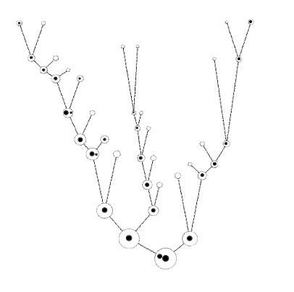
Black hole seeding
Local galaxies host SMBHs
Built from many small halos
How does the seeding process need to behave?
Buchner, Treister, Bauer, Sartori et al. (submitted)
credit: M. Volonteri

Slide 2
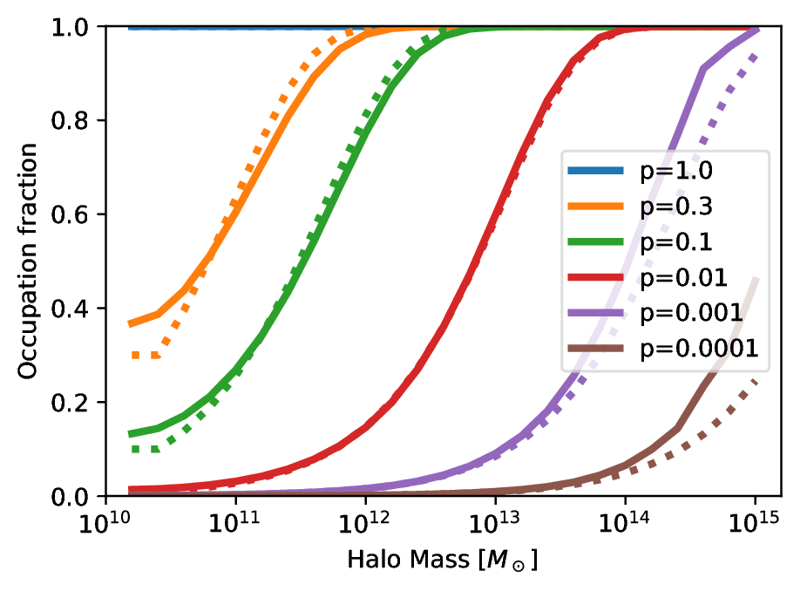
SMBH Occupation at z=0
Buchner, Treister, Bauer, Sartori et al. (submitted)

Slide 3
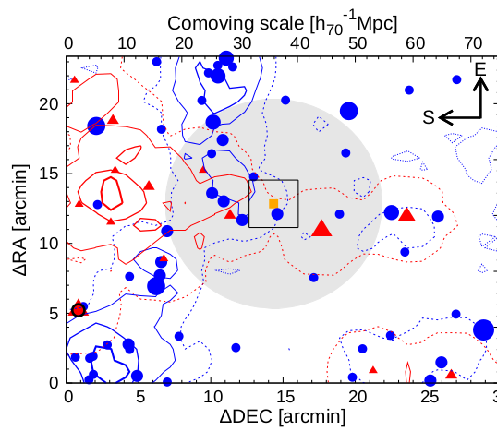
Overdensities near Quasars
LBG
Literature has conflicting results:
- Overdensities
- Equal
- Underdensities
compared to control fields
What is happening?
LAE
QSO
Ota+18

