Slide 1
AGN Torus models: X-rays & IR
Exploring possible geometries
Torus & Cones
Clumpy distribution
Warped maser disk
Hydro-radiative
dynamic models
Carolina Andonie, Claudio Ricci,
Johannes Buchner, Franz Bauer
Buchner et al (in prep)

Slide 2
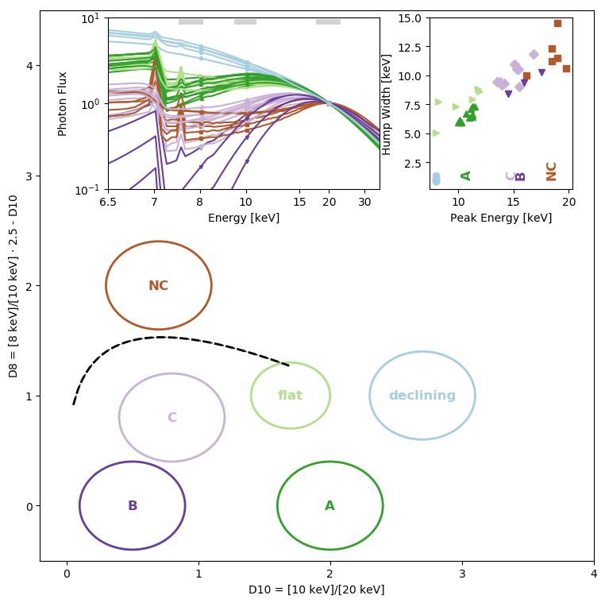
X-ray color-color diagram
Shape of the Compton hump
High-energy
Plane where
models and
observations
can meet
8/10keV
Buchner et al (in prep)
10/20
keV

