Slide 1

X-ray survey’s spectral analysis
Johannes Buchner
FONDECYT fellow
http://astrost.at/istics/

Slide 2
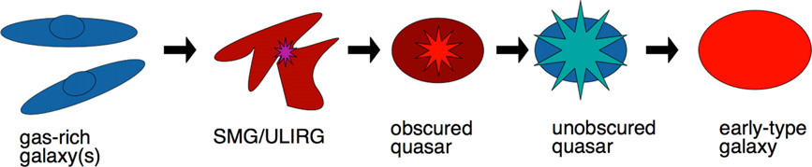
Hidden accretion
Triggering of black hole growth
Co-evolution, galaxy-BH interactions, mergers
  matter feeding can be matter obscuring
Alexander&Hickox12

Slide 3
Characterisation of AGN
inflow rate
inflow obscuration
inflow time
Accretion luminosity
intrinsic (abs.-corr.)
LOS column density
Redshift

Slide 4
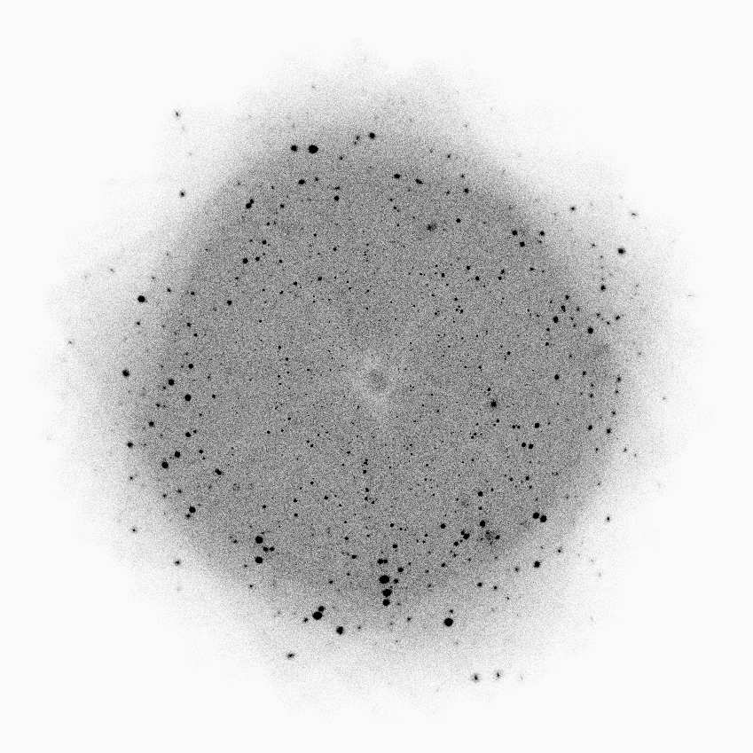

Improving methods
Powerlaw distributions, flux limited
  –> most sources have few counts
Missions and follow-up are costly
  –> how to extract most information?

Slide 5
Improving methods
Source detection
Multi-λ association NWAY
Redshift estimation spec-z, photo-z, XZ
X-ray spectral analysis
  Parameter constraints BXA
  of complex models
  with few counts
  Better spectral models UXCLUMPY, warps
See posters
FS-294
FS-359
https://github.com/JohannesBuchner

Slide 6
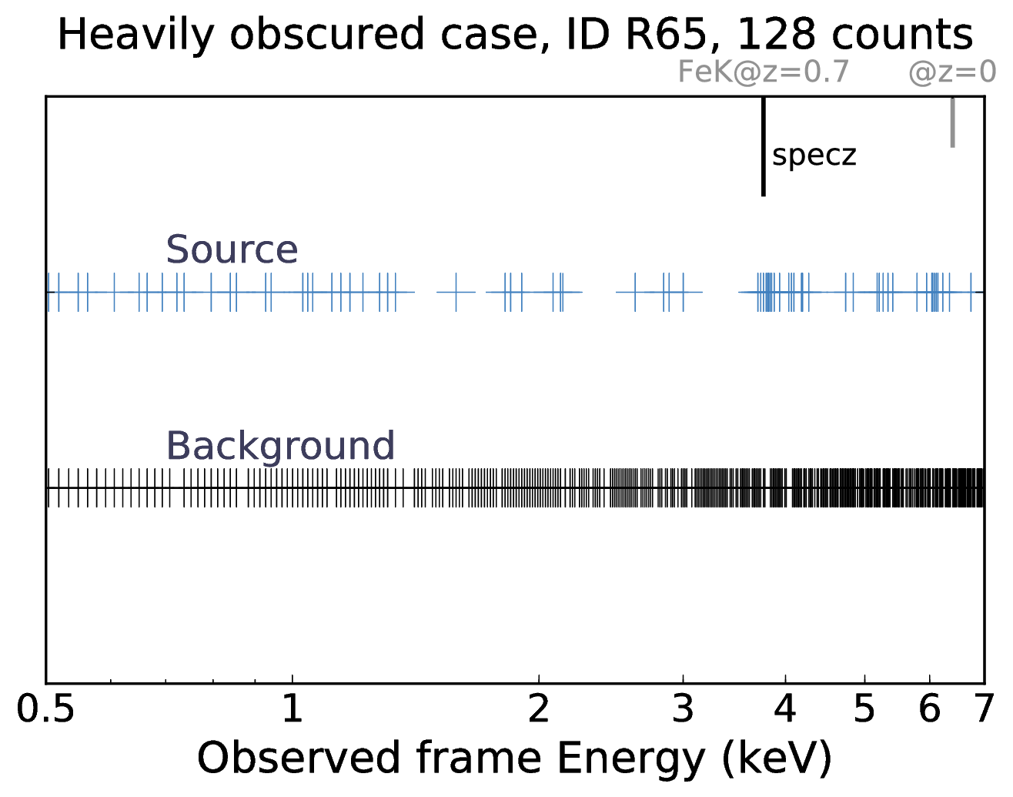
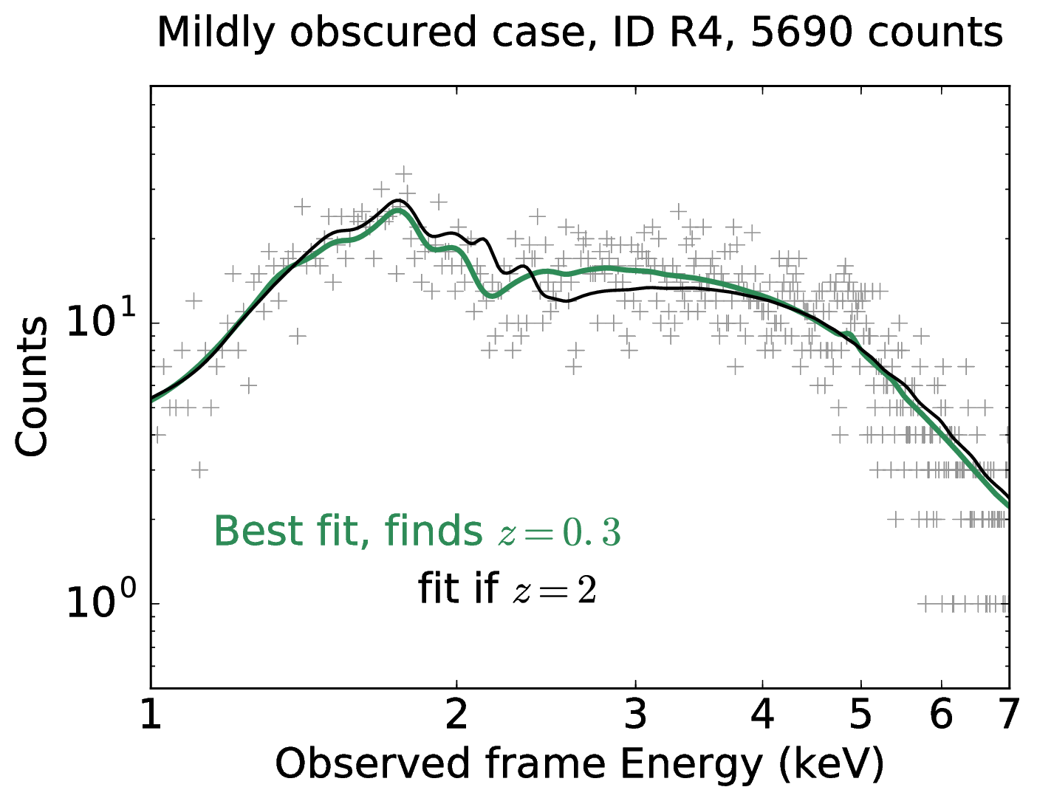
XZ
(Simmonds, JB et al, accepted)
FLUORESCENT LINES
ABSORPTION EDGES

Slide 7
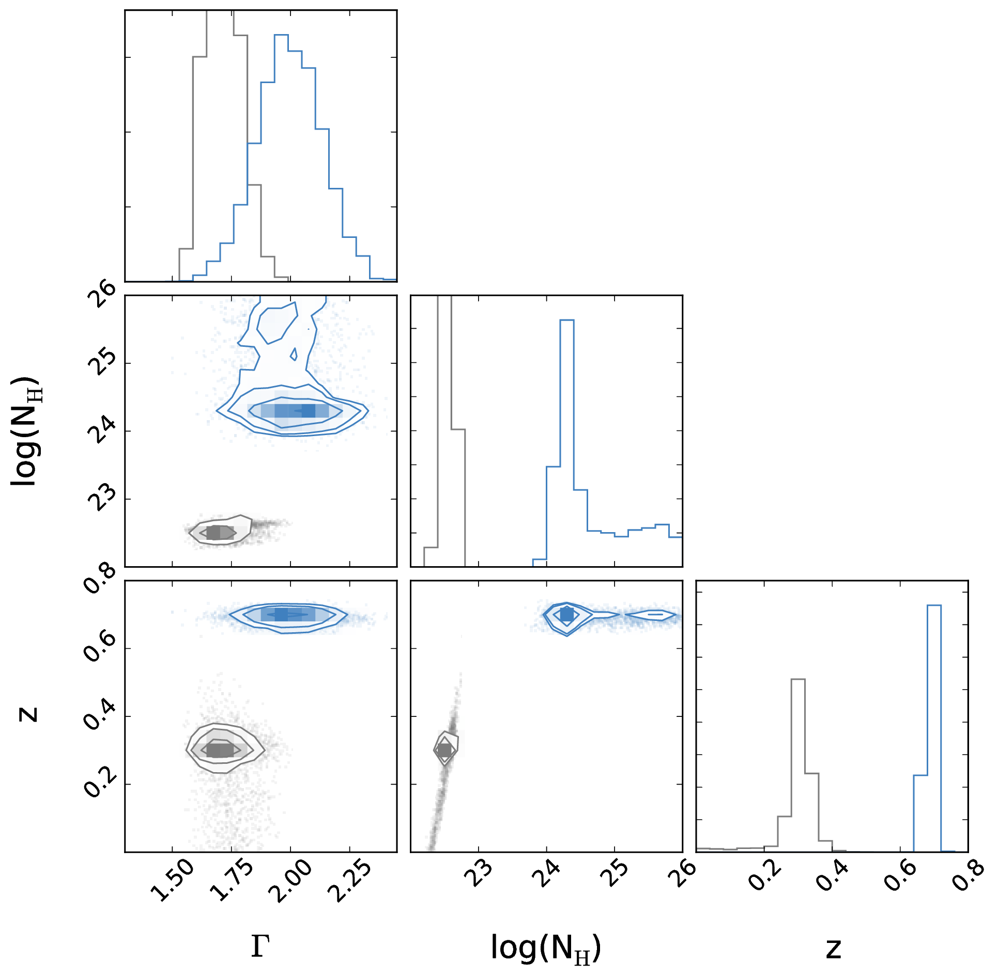
XZ
(Simmonds, JB et al, accepted)
FLUORESCENT LINES
ABSORPTION EDGES

Slide 8
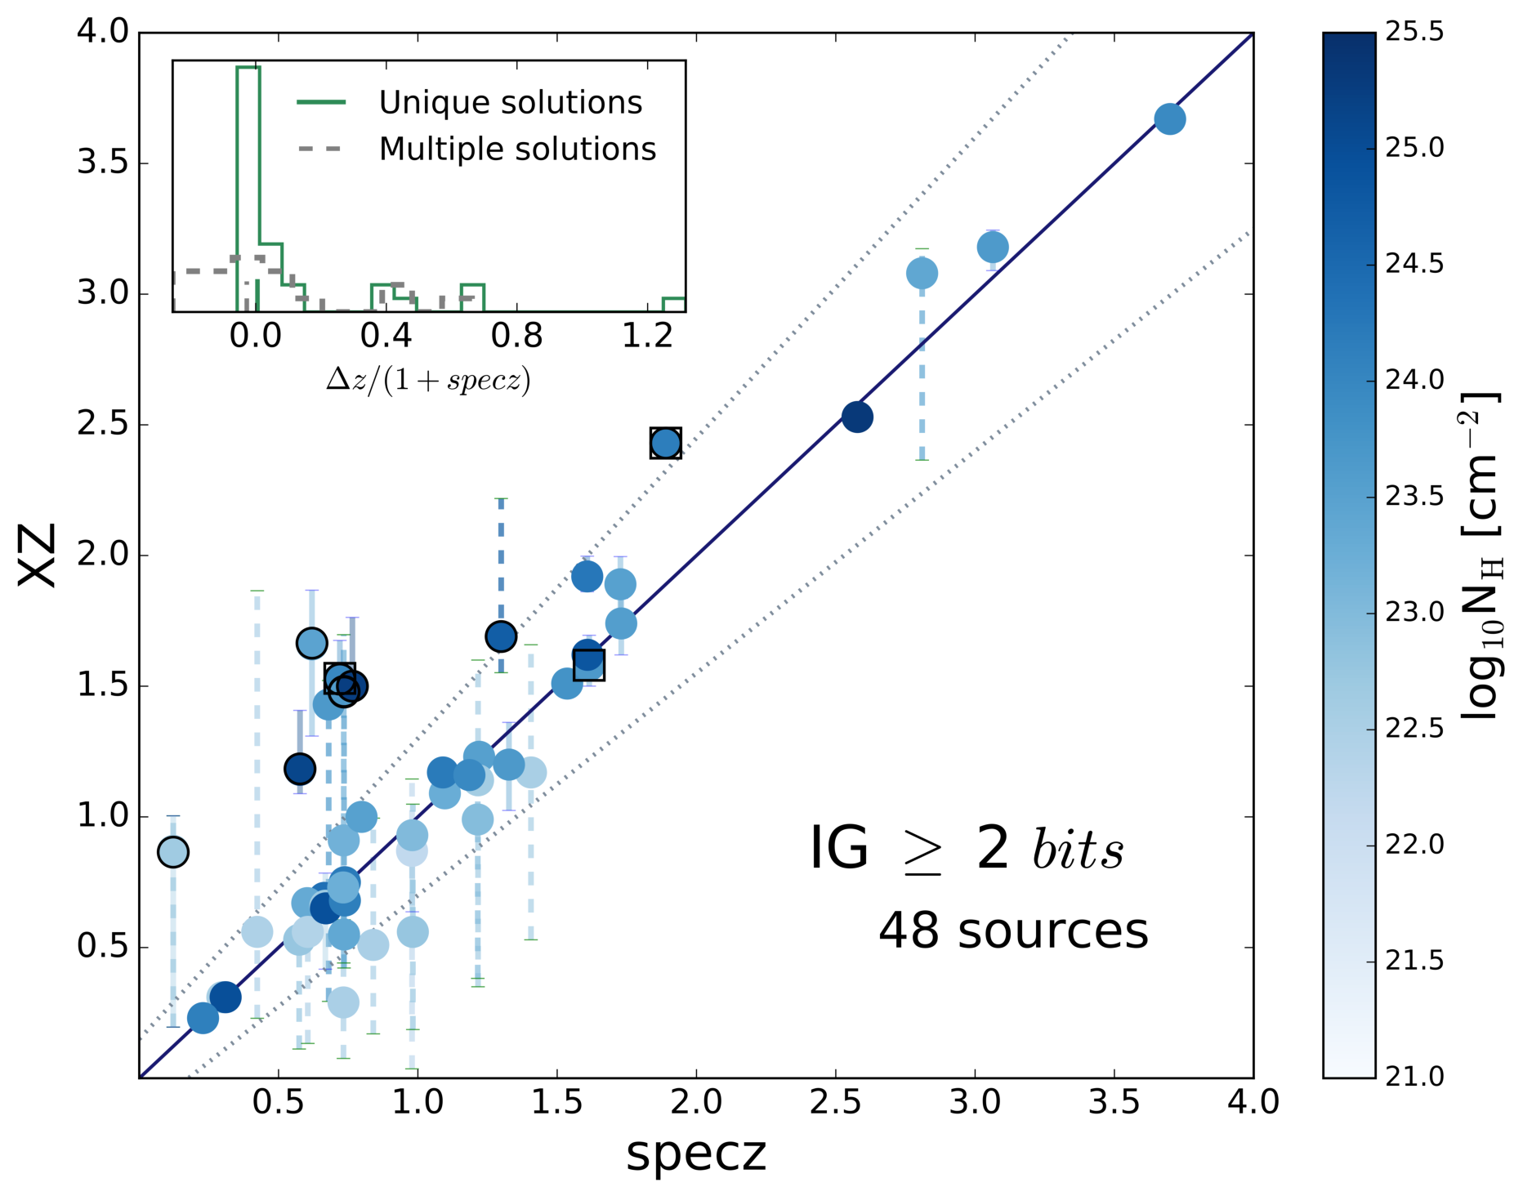
XZ
(Simmonds, JB et al, accepted)
92% agreement
spec-z vs XZ

Slide 9
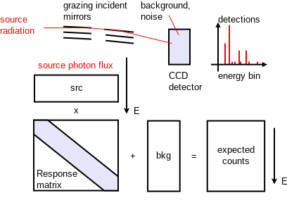
X-ray spectral analysis
cstat =
Poisson likelihood
Poisson
Flux variability
Spectral variability

Slide 10
Background handling
Photon counts
Source
subtract
wstat
dedicated model
automatically fitted empirical models
Background,
scaled
Energy
XMM, Chandra, Swift,
NuSTAR, Suzaku, RXTE

Slide 11
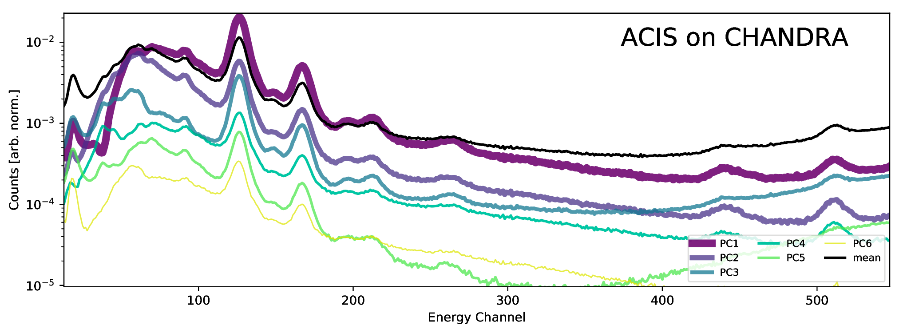
Automatic background model
PCA features learnt from archive
components fitted to background spectrum
–> Simmonds+18

Slide 12
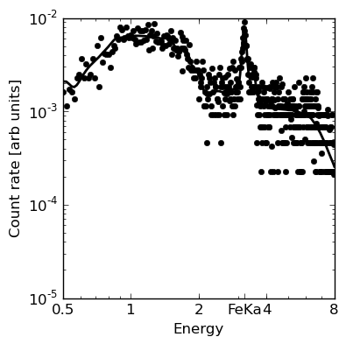
L, N_{H} from X-ray spectrum
Scattered Powerlaw component
CTK flat spectrum + FeK line

Slide 13
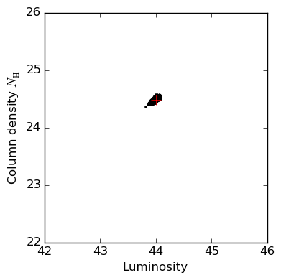
L, N_{H} from X-ray spectrum
Spectrum
Probability cloud

Slide 14
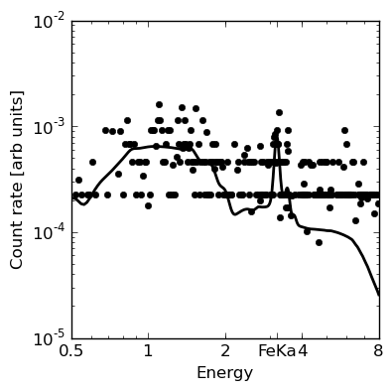
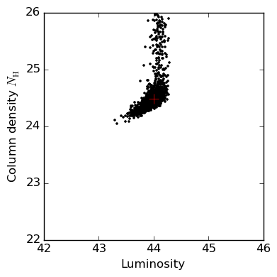
L, N_{H} from X-ray spectrum
Spectrum
Probability cloud

Slide 15
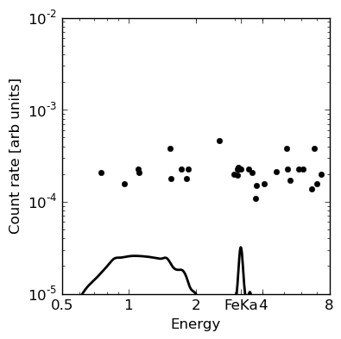
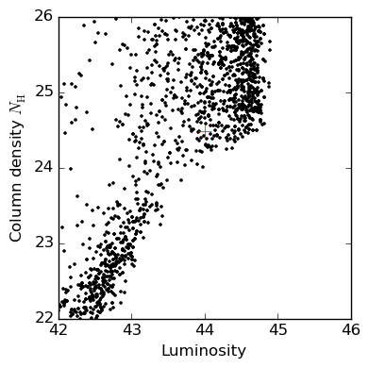
L, N_{H} from X-ray spectrum
Spectrum
Probability cloud

Slide 16
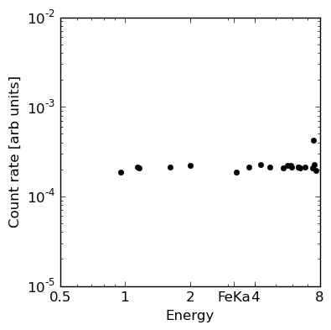
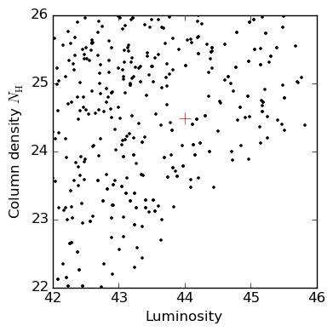
L, N_{H} from X-ray spectrum
Spectrum
Probability cloud

Slide 17
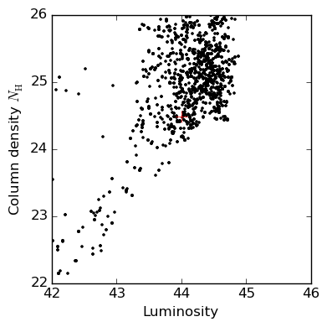
L, N_{H} from X-ray spectrum
MCMC (emcee/GW)
Nested Sampling (BXA/Multinest)
Simple fitting:
One minimum
MCMC:
One minimum
convergence tests
can be fooled

Slide 18

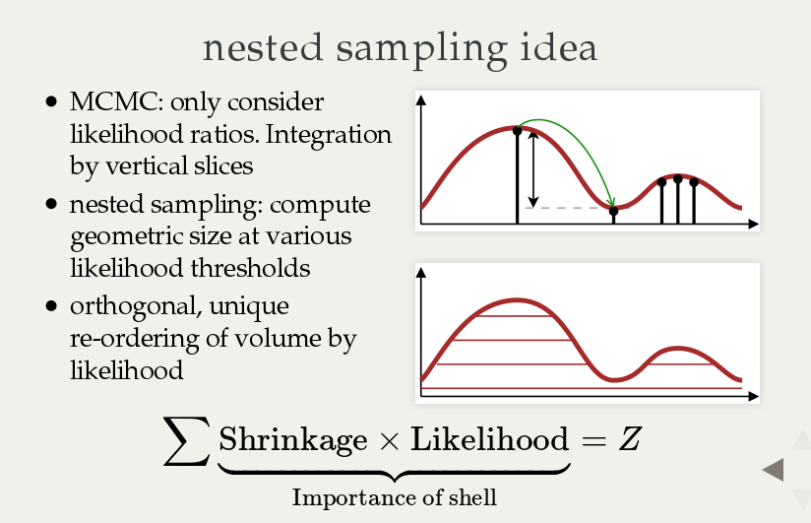

Slide 19
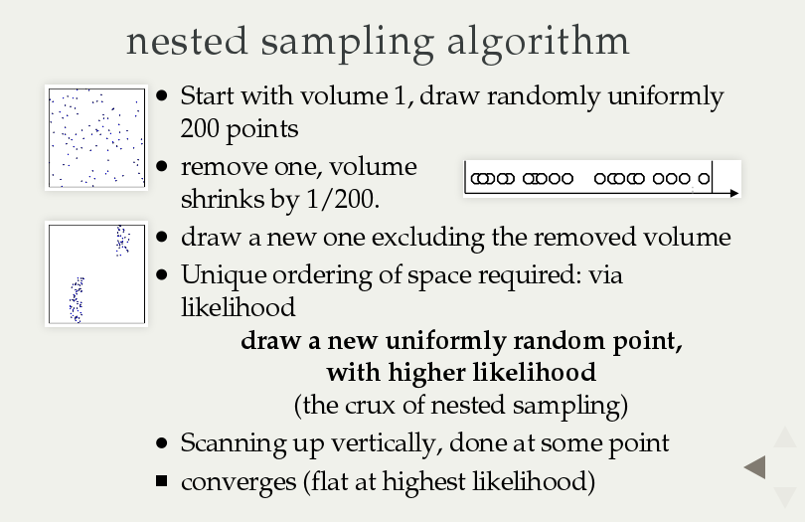

Slide 20
X-ray spectral analysis
Parameter
estimation
Minimizer,
stepping,
local covariance
Stuck in local optima,
non-gaussian optima,
many parameters
MCMC or
nested sampling
–> Buchner+14
Combining
multiple
observations
Stacking
the data
Average may not be meaningful
Redshift blur
Hierarchical model
–> Buchner+17a
Goodness
of fit
chi² test
Invalid if at parameter border, model non-linear or not in the high-data regime
(i.e., never valid)
Visualize!
Monte Carlo simulations
Model comparison
Model
comparison
Likelihood
ratio, F-test
Invalid if at parameter border, model non-linear or not in the high-data regime
(i.e., never valid)
Bayesian evidence or likelihood ratio,
calibrate with Monte Carlo simulations
–> Buchner+14

Slide 21
BXA
Do not need to abandon xspec/sherpa – plugin
Specify working parameter space and model
Run once, be done!
  No stepping, no convergence worries
  No wondering about other solutions
Output
  PDF of each parameter
  Model comparison
https://github.com/JohannesBuchner/BXA
new: docker container

Slide 22
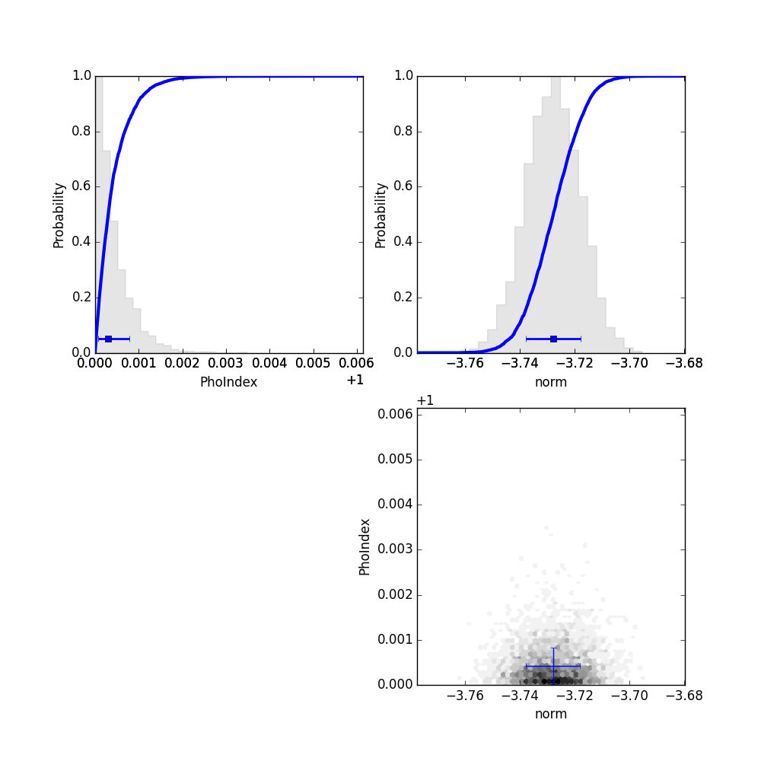
Parameter probability distributions
That was parameter estimation
– now for model comparison!
Parameter correlations

Slide 23
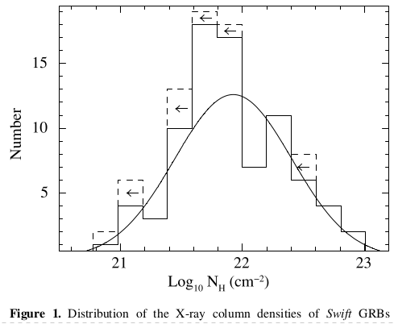
Intrinsic Distribution
Estimators vary in uncertainties + upper limits
Histogram of best-fits misleading
Use a Simple Hierarchical model
e.g., see Buchner+17a

Slide 24
Model comparison
see Buchner+14
Z = p(D|M) =
    “marginal likelihood”, “evidence” …
    average likelihood over parameter space
Z1/Z2:
  Probability for model M1 compared to M2
Example:
  M1: wabs*pl – photo-el absorbed powerlaw
  M2: table{sphere}: includes Compton scattering
M1:
M2:
Z1/Z2 was 10
CDFS source 179

Slide 25
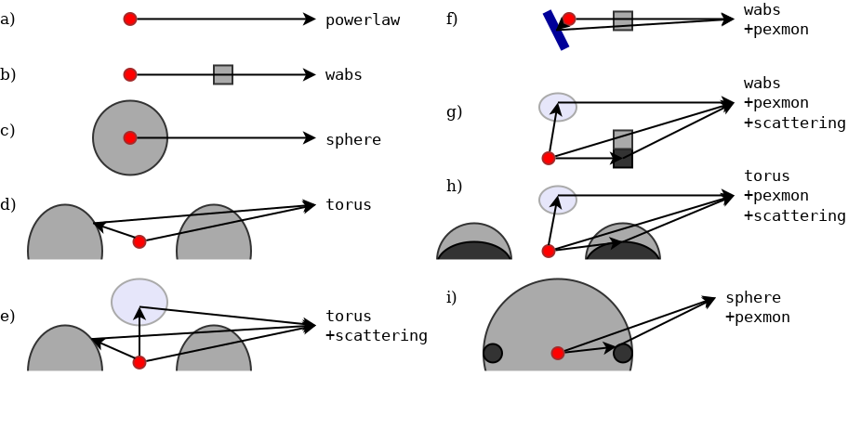
Comparison of several models
Z_{i} = p(M_{i}|D)
see Buchner+14
Model i
%

Slide 26
Example applications
Comparison between obscurer geometries (Buchner+14)
Identifying relativistic broad lines:
  Narrow line model vs.
  Relativistic broad line models
  –> Baronchelli+, accepted source R190
Threshold for decisions? False selection rates?
  Simulated data –> Bayes factors decision threshold
  –> frequentist properties

Slide 27
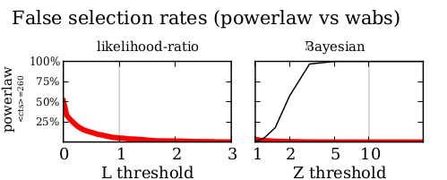
False selection rates
As with any other estimator!
  Simulate many times without effect
  measure false decisions
  Calibrate threshold
Feasible with BXA

Slide 28
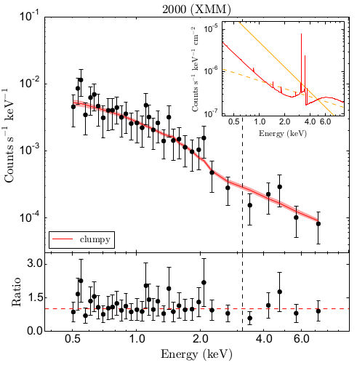
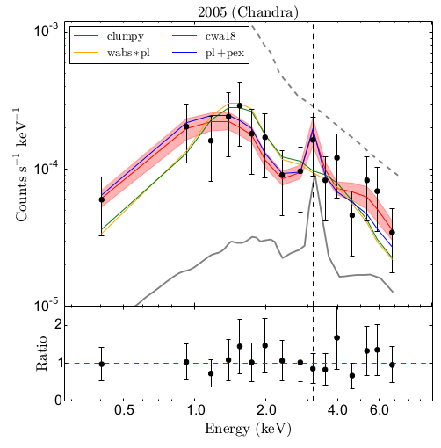
A type-1 with Compton-thick eclipse

Slide 29
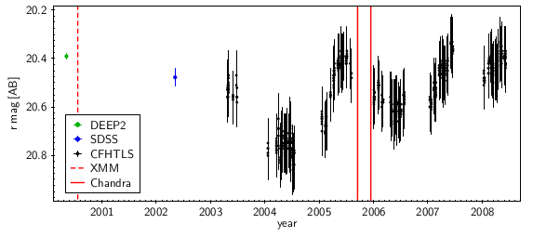
A type-1 with Compton-thick eclipse

Slide 30
Population inference
Example: Photon index, N_{H} distribution of population of LGRBs, AGN
sample statistics
(selection effects – see Buchner+15, A1)
Keep uncertainties, Upper limits
Don’t:
  Plot histogram of means
  Stack posteriors

Slide 31
Hierarchical Bayesian inference
Assume flexible population model
  Examples: Gaussian, Gaussian mixture, beta distribution
Fold in posterior samples for object i
Likelihood for population parameters - MCMC
Importance sampling from posteriors
  need flat priors, see Buchner+17a for details
Product over objects
Mean over samples

Slide 32
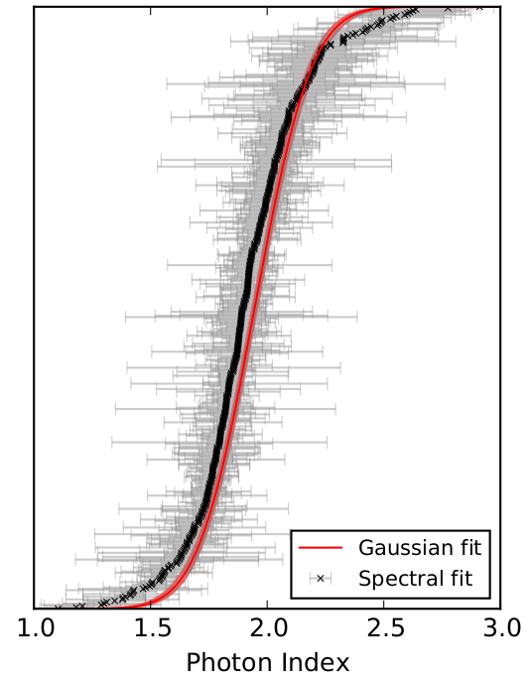
Population inference
Keeps uncertainties
  Fold in redshift uncertainties
  (unlike X-ray stacking!)
Population uncertainties
  Include limited sample size
  Model can be 1d,2d,3d,…
Special case of
luminosity function
analysis (Loredo2004)

Slide 33
X-ray survey’s spectral analysis
NWAY
Auto-bkg
BXA
spectral models
UXCLUMPY, warps
better associations
+ use color information
extract more information
reliably explore parameter space
+ model comparison
physically motivated, reproduce eclipses
Posters
FS-294
FS-359
https://github.com/JohannesBuchner
Buchner+14, Salvato+17,
Buchner+17a, Simmonds+18

